Slide 1
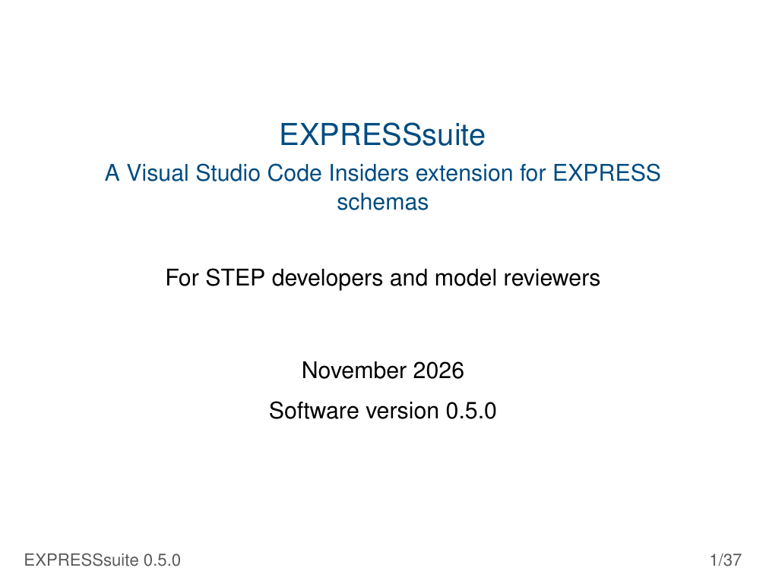
Notes:
EXPRESSsuite
A Visual Studio Code Insiders extension for EXPRESS
schemas
For STEP developers and model reviewers
November 2026
Software version 0.5.0
EXPRESSsuite 0.5.0 1/37

Slide 2
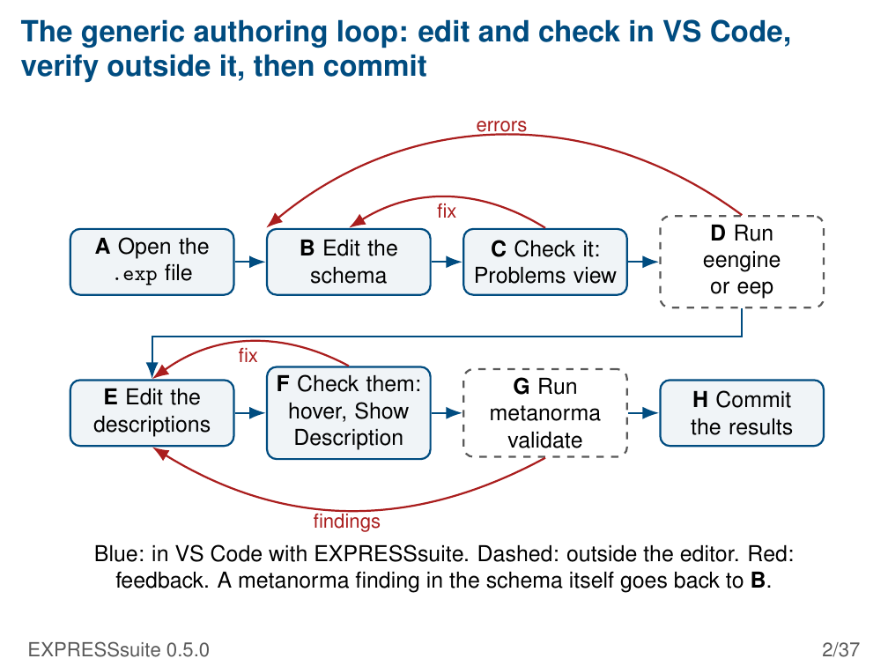
Notes:
The generic authoring loop: edit and check in VS Code,
verify outside it, then commit
errors
fix
D Run
A Open the B Edit the C Check it:
eengine
.exp file schema Problems view
or eep
fix
F Check them: G Run
E Edit the H Commit
hover, Show metanorma
descriptions the results
Description validate
findings
Blue: in VS Code with EXPRESSsuite. Dashed: outside the editor. Red:
feedback. A metanorma finding in the schema itself goes back to B.
EXPRESSsuite 0.5.0 2/37

Slide 3
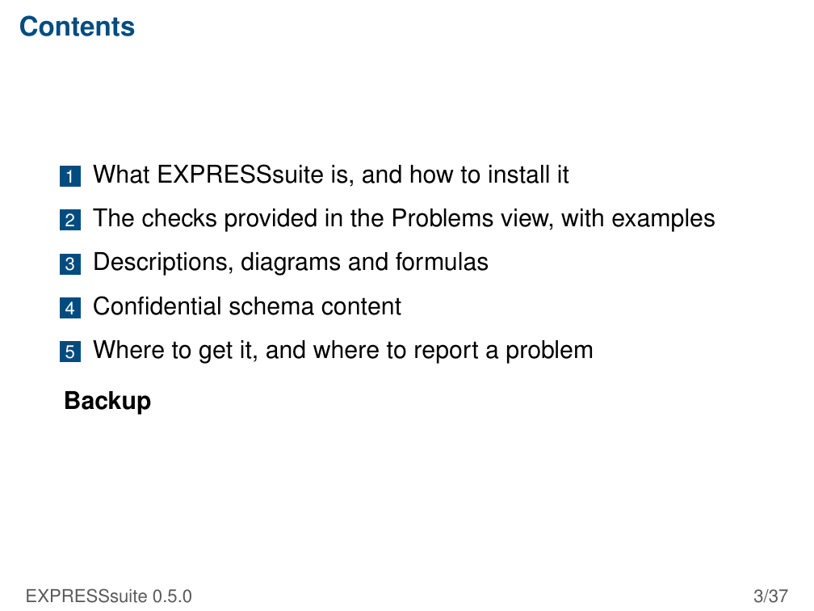
Notes:
Contents
1 What EXPRESSsuite is, and how to install it
2 The checks provided in the Problems view, with examples
3 Descriptions, diagrams and formulas
4 Confidential schema content
5 Where to get it, and where to report a problem
Backup
EXPRESSsuite 0.5.0 3/37

Slide 4
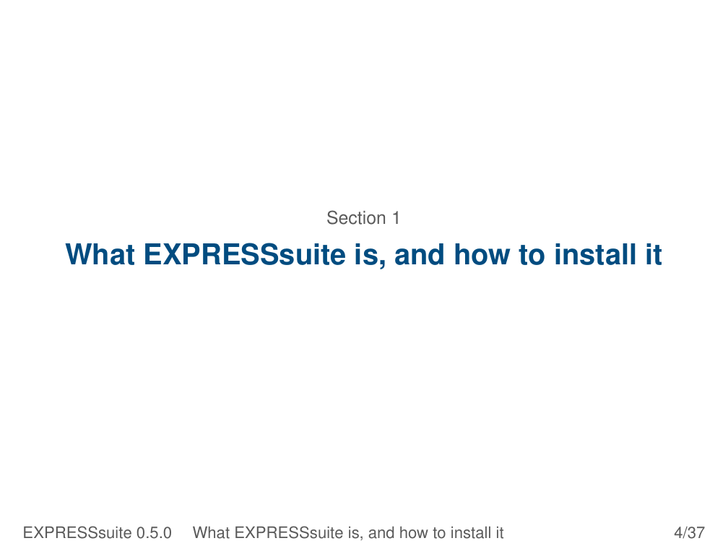
Notes:
Section 1
What EXPRESSsuite is, and how to install it
EXPRESSsuite 0.5.0 What EXPRESSsuite is, and how to install it 4/37

Slide 5
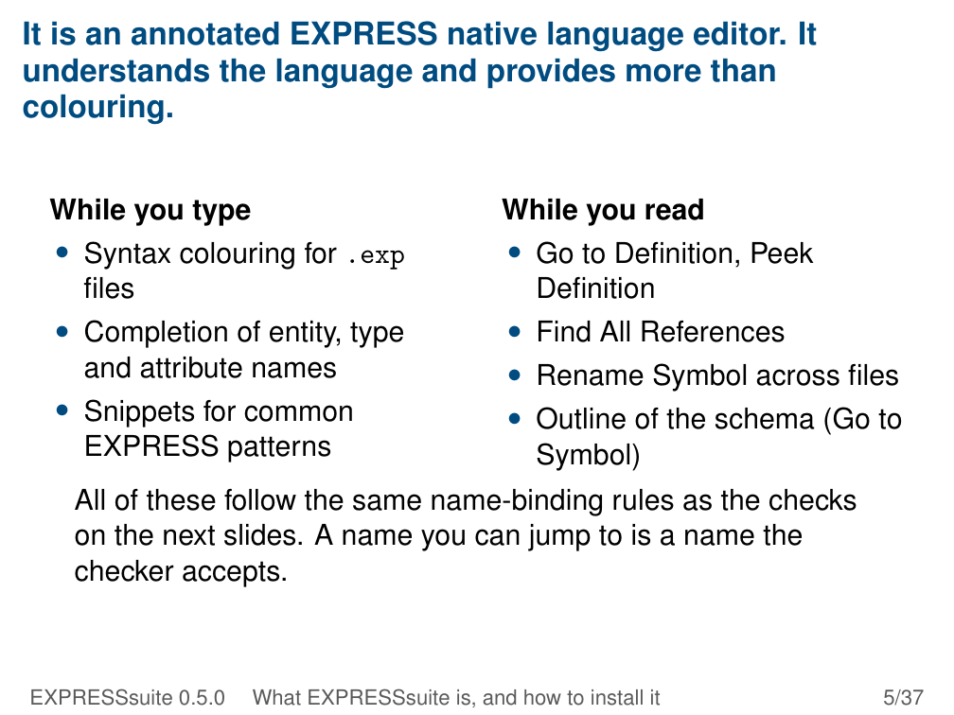
Notes:
It is an annotated EXPRESS native language editor. It
understands the language and provides more than
colouring.
While you type While you read
• Syntax colouring for .exp • Go to Definition, Peek
files Definition
• Completion of entity, type • Find All References
and attribute names • Rename Symbol across files
• Snippets for common • Outline of the schema (Go to
EXPRESS patterns Symbol)
All of these follow the same name-binding rules as the checks
on the next slides. A name you can jump to is a name the
checker accepts.
EXPRESSsuite 0.5.0 What EXPRESSsuite is, and how to install it 5/37

Slide 6
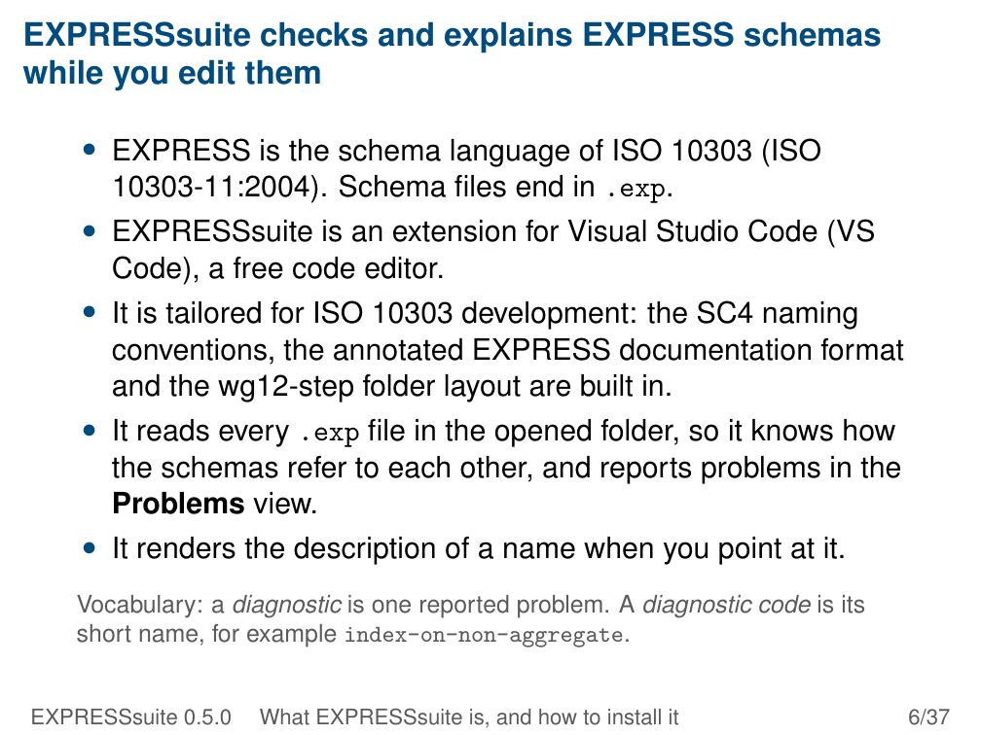
Notes:
EXPRESSsuite checks and explains EXPRESS schemas
while you edit them
• EXPRESS is the schema language of ISO 10303 (ISO
10303-11:2004). Schema files end in .exp.
• EXPRESSsuite is an extension for Visual Studio Code (VS
Code), a free code editor.
• It is tailored for ISO 10303 development: the SC4 naming
conventions, the annotated EXPRESS documentation format
and the wg12-step folder layout are built in.
• It reads every .exp file in the opened folder, so it knows how
the schemas refer to each other, and reports problems in the
Problems view.
• It renders the description of a name when you point at it.
Vocabulary: a diagnostic is one reported problem. A diagnostic code is its
short name, for example index-on-non-aggregate.
EXPRESSsuite 0.5.0 What EXPRESSsuite is, and how to install it 6/37

Slide 7
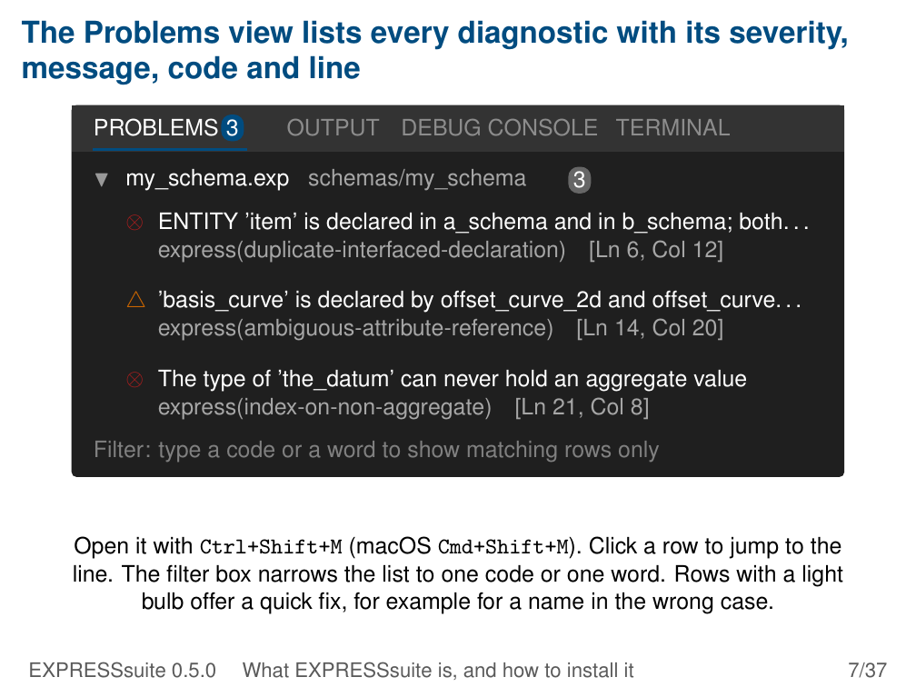
Notes:
The Problems view lists every diagnostic with its severity,
message, code and line
PROBLEMS 3 OUTPUT DEBUG CONSOLE TERMINAL
▼ my_schema.exp schemas/my_schema 3
⊗ ENTITY ’item’ is declared in a_schema and in b_schema; both. . .
express(duplicate-interfaced-declaration) [Ln 6, Col 12]
△ ’basis_curve’ is declared by offset_curve_2d and offset_curve. . .
express(ambiguous-attribute-reference) [Ln 14, Col 20]
⊗ The type of ’the_datum’ can never hold an aggregate value
express(index-on-non-aggregate) [Ln 21, Col 8]
Filter: type a code or a word to show matching rows only
Open it with Ctrl+Shift+M (macOS Cmd+Shift+M). Click a row to jump to the
line. The filter box narrows the list to one code or one word. Rows with a light
bulb offer a quick fix, for example for a name in the wrong case.
EXPRESSsuite 0.5.0 What EXPRESSsuite is, and how to install it 7/37

Slide 8
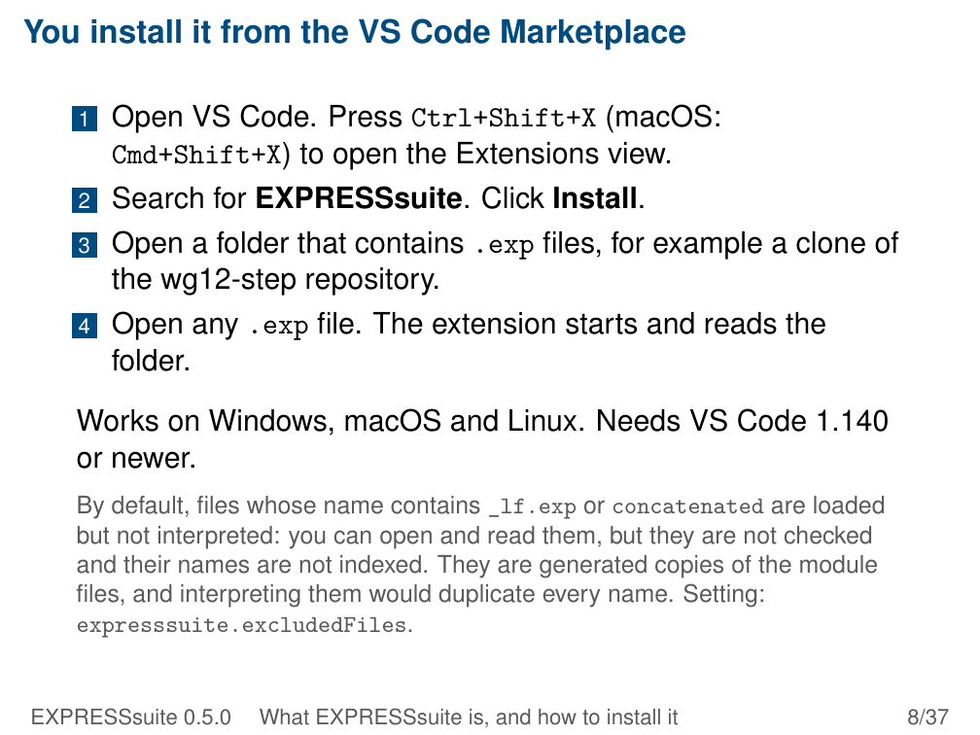
Notes:
You install it from the VS Code Marketplace
1 Open VS Code. Press Ctrl+Shift+X (macOS:
Cmd+Shift+X) to open the Extensions view.
2 Search for EXPRESSsuite. Click Install.
3 Open a folder that contains .exp files, for example a clone of
the wg12-step repository.
4 Open any .exp file. The extension starts and reads the
folder.
Works on Windows, macOS and Linux. Needs VS Code 1.140
or newer.
By default, files whose name contains _lf.exp or concatenated are loaded
but not interpreted: you can open and read them, but they are not checked
and their names are not indexed. They are generated copies of the module
files, and interpreting them would duplicate every name. Setting:
expresssuite.excludedFiles.
EXPRESSsuite 0.5.0 What EXPRESSsuite is, and how to install it 8/37

Slide 9
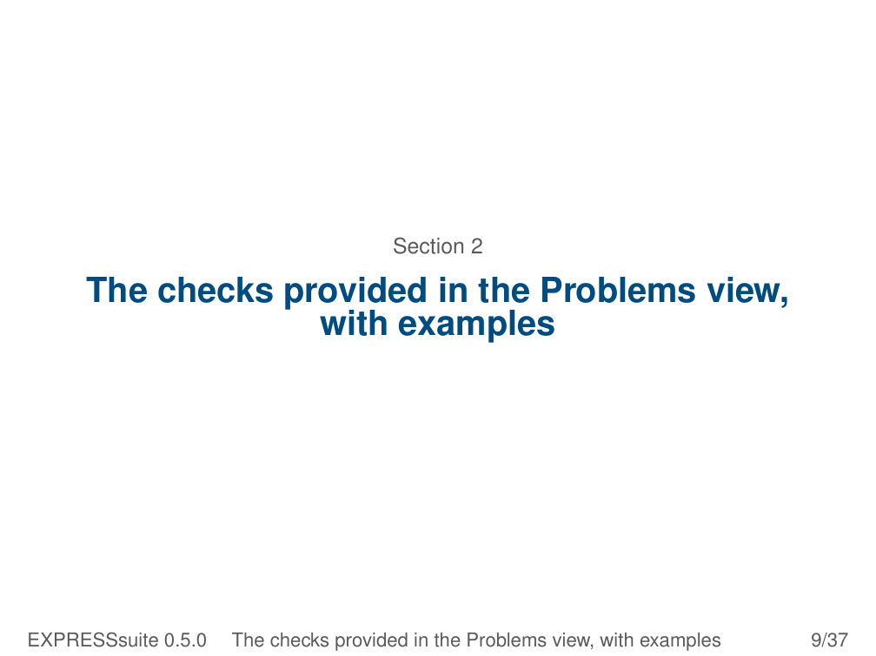
Notes:
Section 2
The checks provided in the Problems view,
with examples
EXPRESSsuite 0.5.0 The checks provided in the Problems view, with examples 9/37

Slide 10
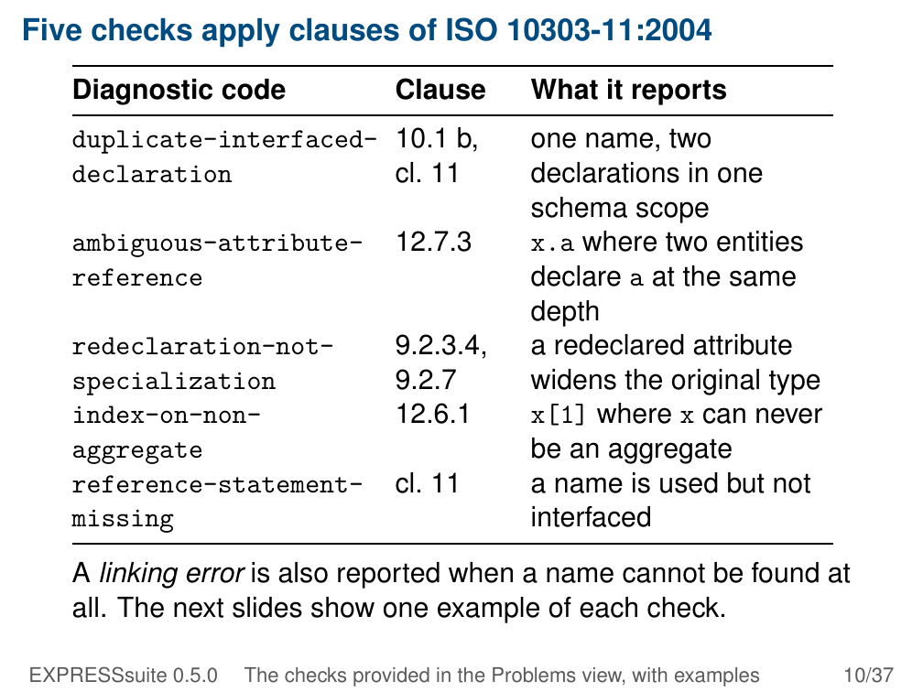
Notes:
Five checks apply clauses of ISO 10303-11:2004
Diagnostic code Clause What it reports
duplicate-interfaced- 10.1 b, one name, two
declaration cl. 11 declarations in one
schema scope
ambiguous-attribute- 12.7.3 x.a where two entities
reference declare a at the same
depth
redeclaration-not- 9.2.3.4, a redeclared attribute
specialization 9.2.7 widens the original type
index-on-non- 12.6.1 x[1] where x can never
aggregate be an aggregate
reference-statement- cl. 11 a name is used but not
missing interfaced
A linking error is also reported when a name cannot be found at
all. The next slides show one example of each check.
EXPRESSsuite 0.5.0 The checks provided in the Problems view, with examples 10/37

Slide 11
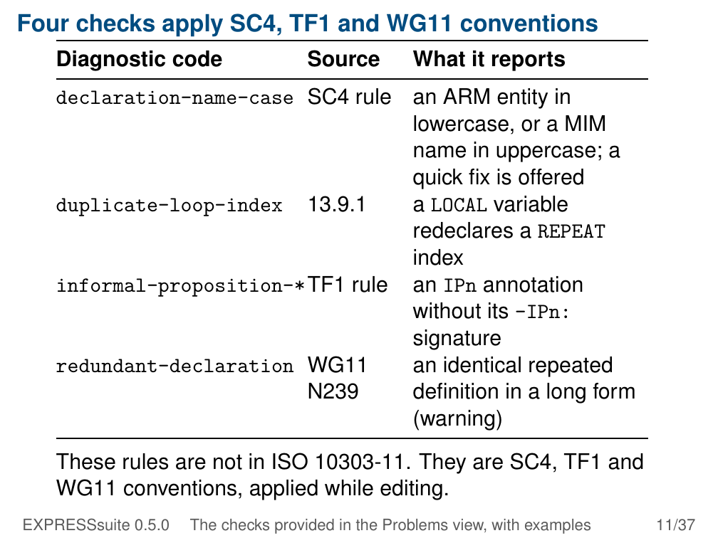
Notes:
Four checks apply SC4, TF1 and WG11 conventions
Diagnostic code Source What it reports
declaration-name-case SC4 rule an ARM entity in
lowercase, or a MIM
name in uppercase; a
quick fix is offered
duplicate-loop-index 13.9.1 a LOCAL variable
redeclares a REPEAT
index
informal-proposition-*TF1 rule an IPn annotation
without its –IPn:
signature
redundant-declaration WG11 an identical repeated
N239 definition in a long form
(warning)
These rules are not in ISO 10303-11. They are SC4, TF1 and
WG11 conventions, applied while editing.
EXPRESSsuite 0.5.0 The checks provided in the Problems view, with examples 11/37

Slide 12
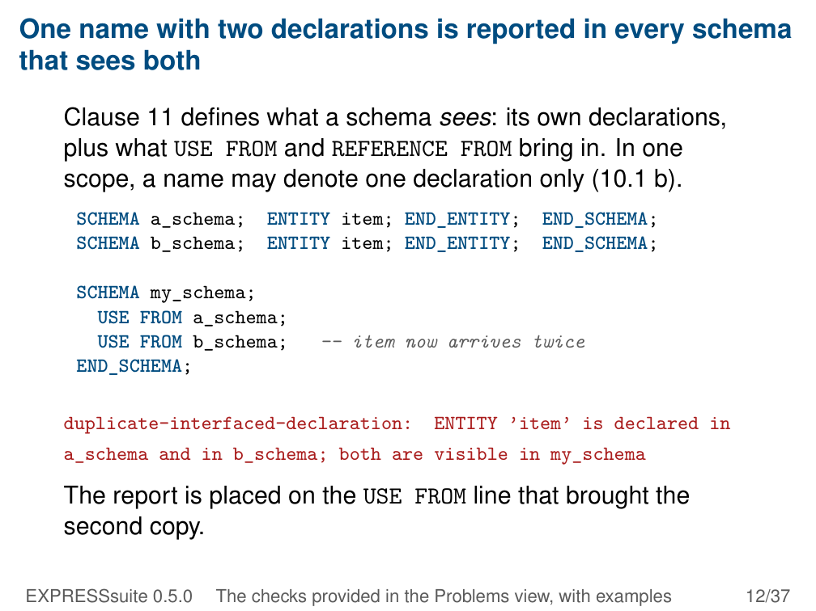
Notes:
One name with two declarations is reported in every schema
that sees both
Clause 11 defines what a schema sees: its own declarations,
plus what USE FROM and REFERENCE FROM bring in. In one
scope, a name may denote one declaration only (10.1 b).
SCHEMA a_schema; ENTITY item; END_ENTITY; END_SCHEMA;
SCHEMA b_schema; ENTITY item; END_ENTITY; END_SCHEMA;
SCHEMA my_schema;
USE FROM a_schema;
USE FROM b_schema; -- item now arrives twice
END_SCHEMA;
duplicate-interfaced-declaration: ENTITY ’item’ is declared in
a_schema and in b_schema; both are visible in my_schema
The report is placed on the USE FROM line that brought the
second copy.
EXPRESSsuite 0.5.0 The checks provided in the Problems view, with examples 12/37

Slide 13
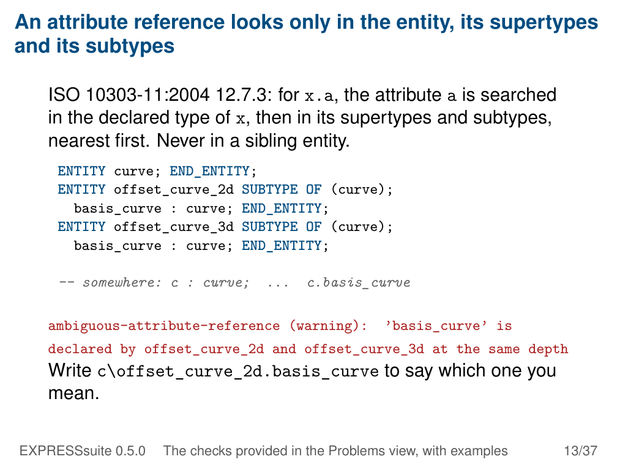
Notes:
An attribute reference looks only in the entity, its supertypes
and its subtypes
ISO 10303-11:2004 12.7.3: for x.a, the attribute a is searched
in the declared type of x, then in its supertypes and subtypes,
nearest first. Never in a sibling entity.
ENTITY curve; END_ENTITY;
ENTITY offset_curve_2d SUBTYPE OF (curve);
basis_curve : curve; END_ENTITY;
ENTITY offset_curve_3d SUBTYPE OF (curve);
basis_curve : curve; END_ENTITY;
-- somewhere: c : curve; ... c.basis_curve
ambiguous-attribute-reference (warning): ’basis_curve’ is
declared by offset_curve_2d and offset_curve_3d at the same depth
Write c\offset_curve_2d.basis_curve to say which one you
mean.
EXPRESSsuite 0.5.0 The checks provided in the Problems view, with examples 13/37

Slide 14
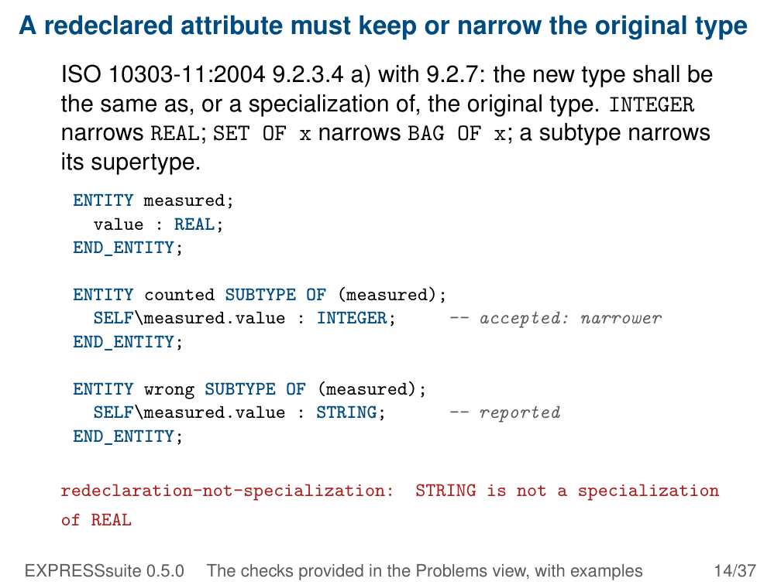
Notes:
A redeclared attribute must keep or narrow the original type
ISO 10303-11:2004 9.2.3.4 a) with 9.2.7: the new type shall be
the same as, or a specialization of, the original type. INTEGER
narrows REAL; SET OF x narrows BAG OF x; a subtype narrows
its supertype.
ENTITY measured;
value : REAL;
END_ENTITY;
ENTITY counted SUBTYPE OF (measured);
SELF\measured.value : INTEGER; -- accepted: narrower
END_ENTITY;
ENTITY wrong SUBTYPE OF (measured);
SELF\measured.value : STRING; -- reported
END_ENTITY;
redeclaration-not-specialization: STRING is not a specialization
of REAL
EXPRESSsuite 0.5.0 The checks provided in the Problems view, with examples 14/37

Slide 15
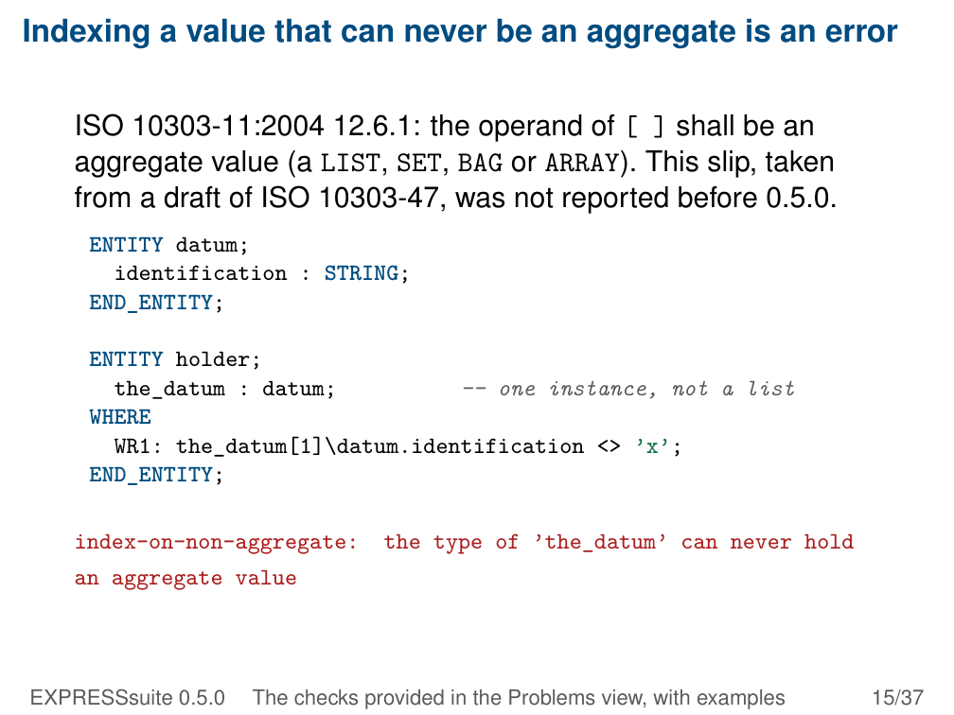
Notes:
Indexing a value that can never be an aggregate is an error
ISO 10303-11:2004 12.6.1: the operand of [ ] shall be an
aggregate value (a LIST, SET, BAG or ARRAY). This slip, taken
from a draft of ISO 10303-47, was not reported before 0.5.0.
ENTITY datum;
identification : STRING;
END_ENTITY;
ENTITY holder;
the_datum : datum; -- one instance, not a list
WHERE
WR1: the_datum[1]\datum.identification <> ’x’;
END_ENTITY;
index-on-non-aggregate: the type of ’the_datum’ can never hold
an aggregate value
EXPRESSsuite 0.5.0 The checks provided in the Problems view, with examples 15/37

Slide 16
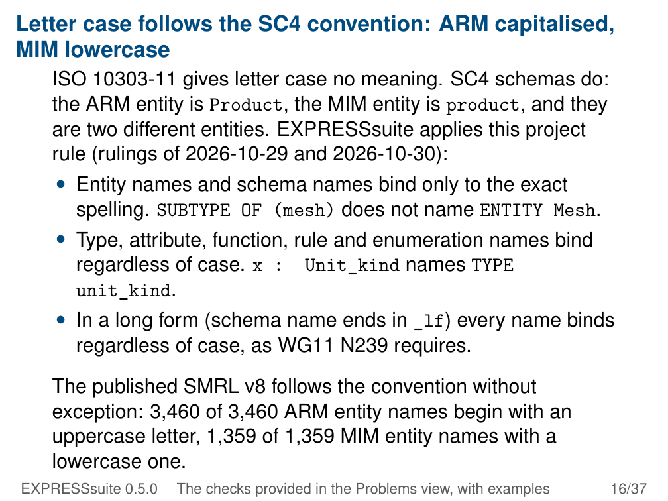
Notes:
Letter case follows the SC4 convention: ARM capitalised,
MIM lowercase
ISO 10303-11 gives letter case no meaning. SC4 schemas do:
the ARM entity is Product, the MIM entity is product, and they
are two different entities. EXPRESSsuite applies this project
rule (rulings of 2026-10-29 and 2026-10-30):
• Entity names and schema names bind only to the exact
spelling. SUBTYPE OF (mesh) does not name ENTITY Mesh.
• Type, attribute, function, rule and enumeration names bind
regardless of case. x : Unit_kind names TYPE
unit_kind.
• In a long form (schema name ends in _lf) every name binds
regardless of case, as WG11 N239 requires.
The published SMRL v8 follows the convention without
exception: 3,460 of 3,460 ARM entity names begin with an
uppercase letter, 1,359 of 1,359 MIM entity names with a
lowercase one.
EXPRESSsuite 0.5.0 The checks provided in the Problems view, with examples 16/37

Slide 17
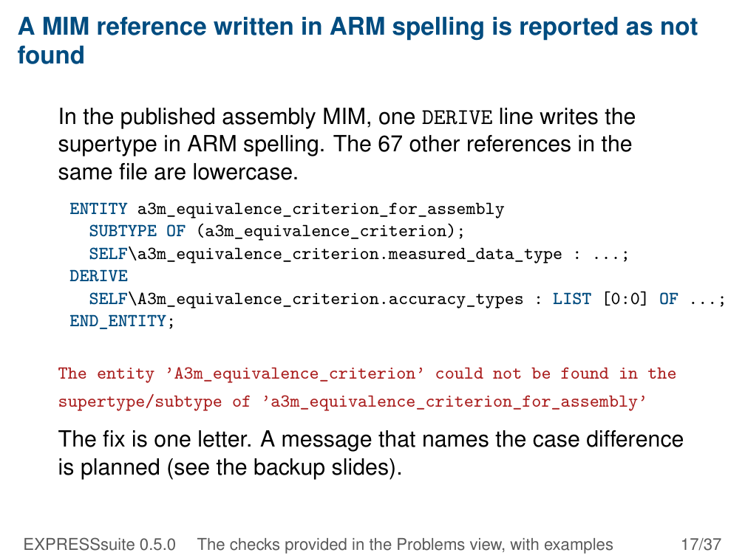
Notes:
A MIM reference written in ARM spelling is reported as not
found
In the published assembly MIM, one DERIVE line writes the
supertype in ARM spelling. The 67 other references in the
same file are lowercase.
ENTITY a3m_equivalence_criterion_for_assembly
SUBTYPE OF (a3m_equivalence_criterion);
SELF\a3m_equivalence_criterion.measured_data_type : ...;
DERIVE
SELF\A3m_equivalence_criterion.accuracy_types : LIST [0:0] OF ...;
END_ENTITY;
The entity ’A3m_equivalence_criterion’ could not be found in the
supertype/subtype of ’a3m_equivalence_criterion_for_assembly’
The fix is one letter. A message that names the case difference
is planned (see the backup slides).
EXPRESSsuite 0.5.0 The checks provided in the Problems view, with examples 17/37

Slide 18
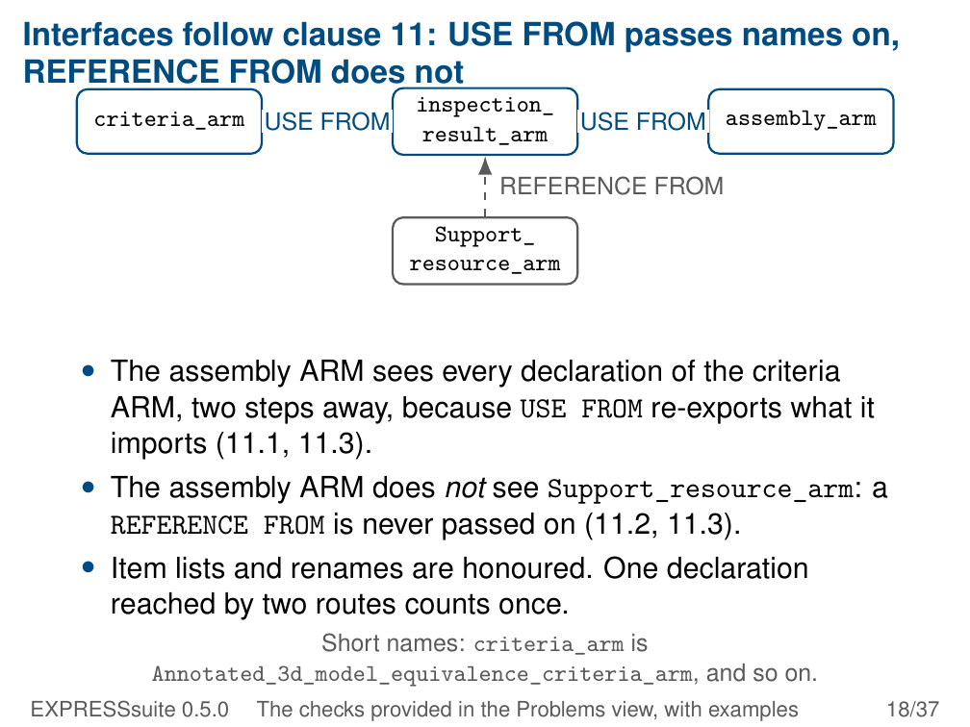
Notes:
Interfaces follow clause 11: USE FROM passes names on,
REFERENCE FROM does not
inspection_
criteria_arm USE FROM
result_arm USE FROM assembly_arm
REFERENCE FROM
Support_
resource_arm
• The assembly ARM sees every declaration of the criteria
ARM, two steps away, because USE FROM re-exports what it
imports (11.1, 11.3).
• The assembly ARM does not see Support_resource_arm: a
REFERENCE FROM is never passed on (11.2, 11.3).
• Item lists and renames are honoured. One declaration
reached by two routes counts once.
Short names: criteria_arm is
Annotated_3d_model_equivalence_criteria_arm, and so on.
EXPRESSsuite 0.5.0 The checks provided in the Problems view, with examples 18/37

Slide 19
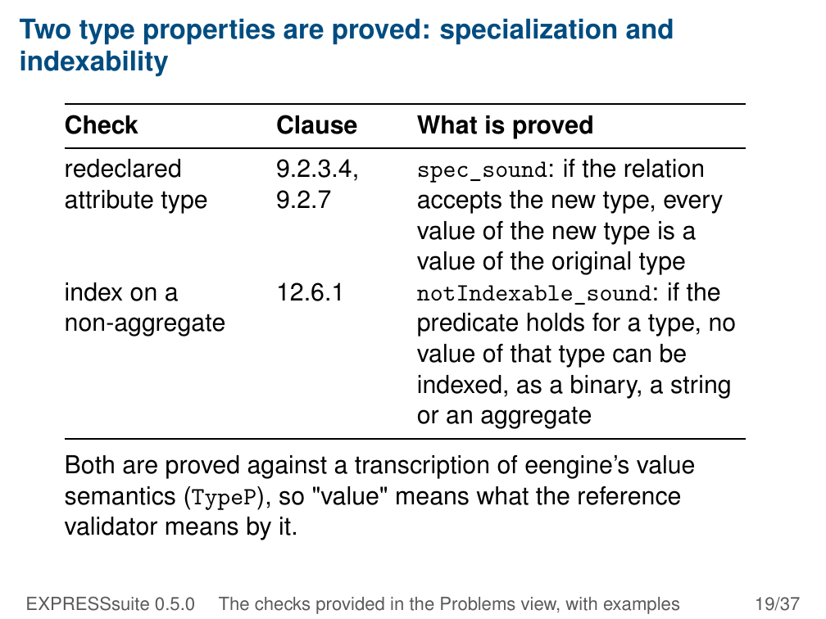
Notes:
Two type properties are proved: specialization and
indexability
Check Clause What is proved
redeclared 9.2.3.4, spec_sound: if the relation
attribute type 9.2.7 accepts the new type, every
value of the new type is a
value of the original type
index on a 12.6.1 notIndexable_sound: if the
non-aggregate predicate holds for a type, no
value of that type can be
indexed, as a binary, a string
or an aggregate
Both are proved against a transcription of eengine’s value
semantics (TypeP), so "value" means what the reference
validator means by it.
EXPRESSsuite 0.5.0 The checks provided in the Problems view, with examples 19/37

Slide 20
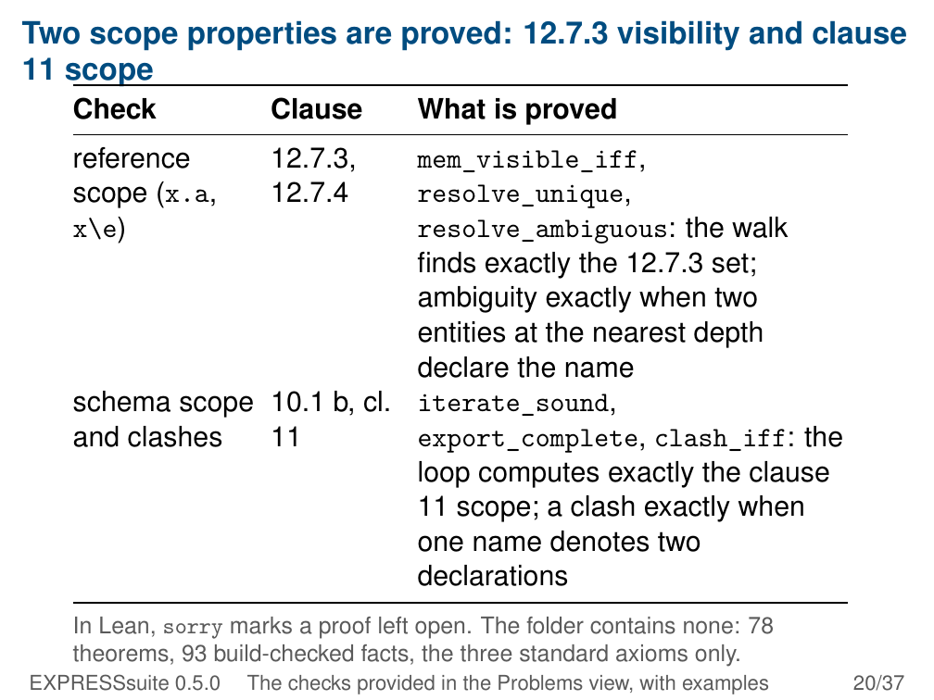
Notes:
Two scope properties are proved: 12.7.3 visibility and clause
11 scope
Check Clause What is proved
reference 12.7.3,
mem_visible_iff,
scope (x.a, 12.7.4resolve_unique,
x\e) resolve_ambiguous: the walk
finds exactly the 12.7.3 set;
ambiguity exactly when two
entities at the nearest depth
declare the name
schema scope 10.1 b, cl. iterate_sound,
and clashes 11 export_complete, clash_iff: the
loop computes exactly the clause
11 scope; a clash exactly when
one name denotes two
declarations
In Lean, sorry marks a proof left open. The folder contains none: 78
theorems, 93 build-checked facts, the three standard axioms only.
EXPRESSsuite 0.5.0 The checks provided in the Problems view, with examples 20/37

Slide 21
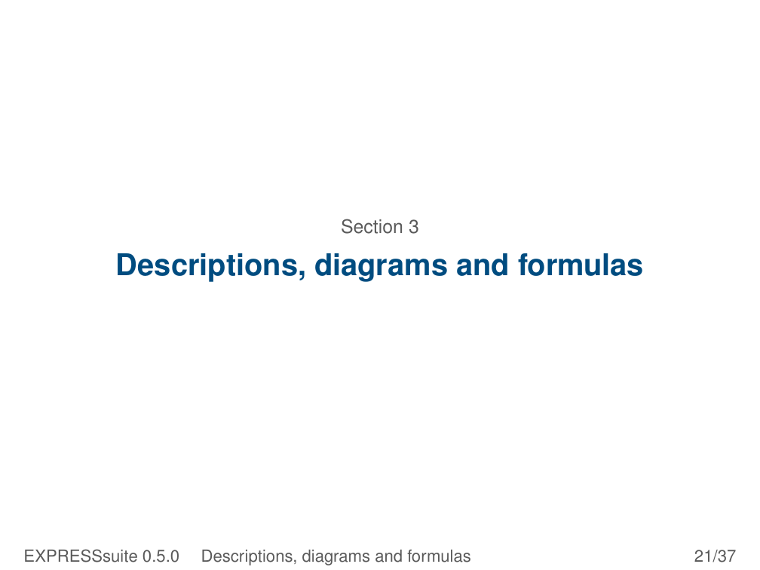
Notes:
Section 3
Descriptions, diagrams and formulas
EXPRESSsuite 0.5.0 Descriptions, diagrams and formulas 21/37

Slide 22
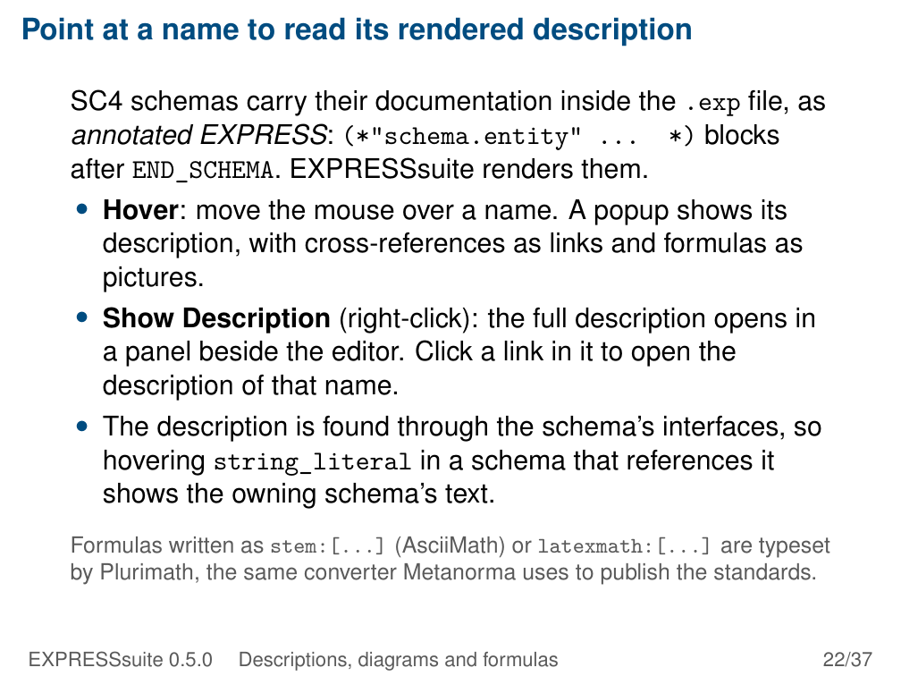
Notes:
Point at a name to read its rendered description
SC4 schemas carry their documentation inside the .exp file, as
annotated EXPRESS: (*"schema.entity" ... *) blocks
after END_SCHEMA. EXPRESSsuite renders them.
• Hover: move the mouse over a name. A popup shows its
description, with cross-references as links and formulas as
pictures.
• Show Description (right-click): the full description opens in
a panel beside the editor. Click a link in it to open the
description of that name.
• The description is found through the schema’s interfaces, so
hovering string_literal in a schema that references it
shows the owning schema’s text.
Formulas written as stem:[...] (AsciiMath) or latexmath:[...] are typeset
by Plurimath, the same converter Metanorma uses to publish the standards.
EXPRESSsuite 0.5.0 Descriptions, diagrams and formulas 22/37

Slide 23
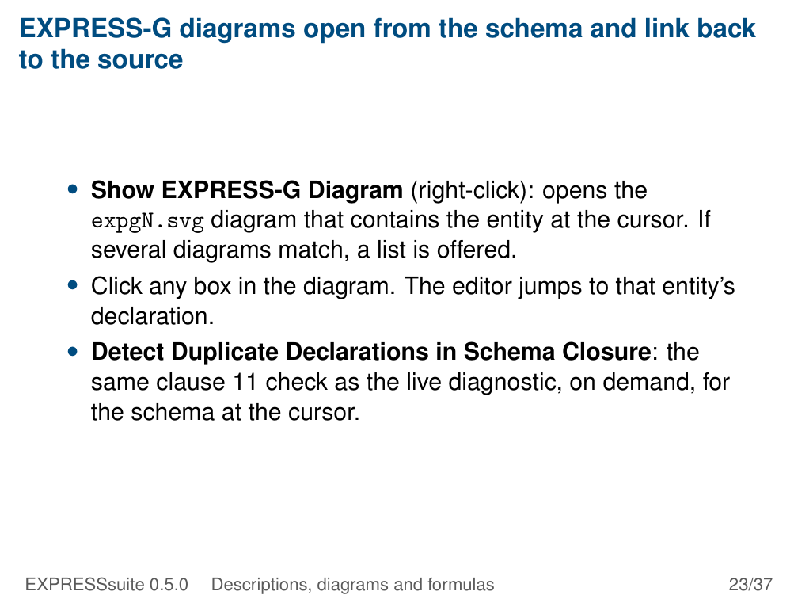
Notes:
EXPRESS-G diagrams open from the schema and link back
to the source
• Show EXPRESS-G Diagram (right-click): opens the
expgN.svg diagram that contains the entity at the cursor. If
several diagrams match, a list is offered.
• Click any box in the diagram. The editor jumps to that entity’s
declaration.
• Detect Duplicate Declarations in Schema Closure: the
same clause 11 check as the live diagnostic, on demand, for
the schema at the cursor.
EXPRESSsuite 0.5.0 Descriptions, diagrams and formulas 23/37

Slide 24
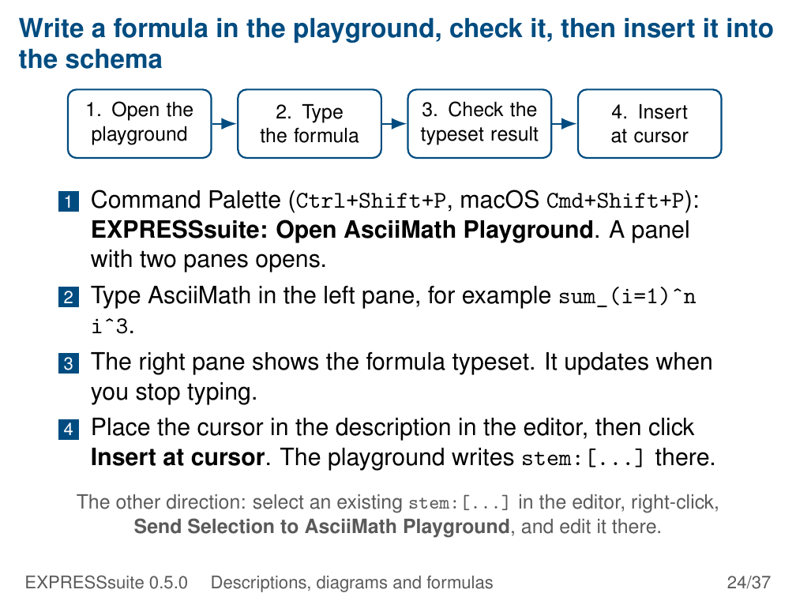
Notes:
Write a formula in the playground, check it, then insert it into
the schema
1. Open the 2. Type 3. Check the 4. Insert
playground the formula typeset result at cursor
1 Command Palette (Ctrl+Shift+P, macOS Cmd+Shift+P):
EXPRESSsuite: Open AsciiMath Playground. A panel
with two panes opens.
2 Type AsciiMath in the left pane, for example sum_(i=1)ˆn
iˆ3.
3 The right pane shows the formula typeset. It updates when
you stop typing.
4 Place the cursor in the description in the editor, then click
Insert at cursor. The playground writes stem:[...] there.
The other direction: select an existing stem:[...] in the editor, right-click,
Send Selection to AsciiMath Playground, and edit it there.
EXPRESSsuite 0.5.0 Descriptions, diagrams and formulas 24/37

Slide 25
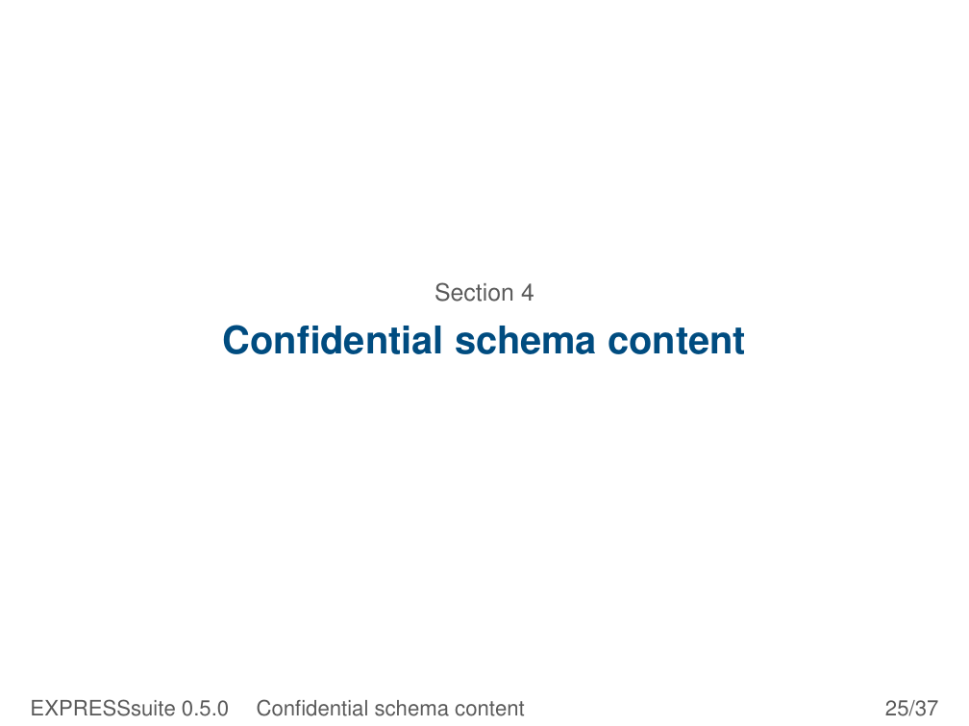
Notes:
Section 4
Confidential schema content
EXPRESSsuite 0.5.0 Confidential schema content 25/37

Slide 26
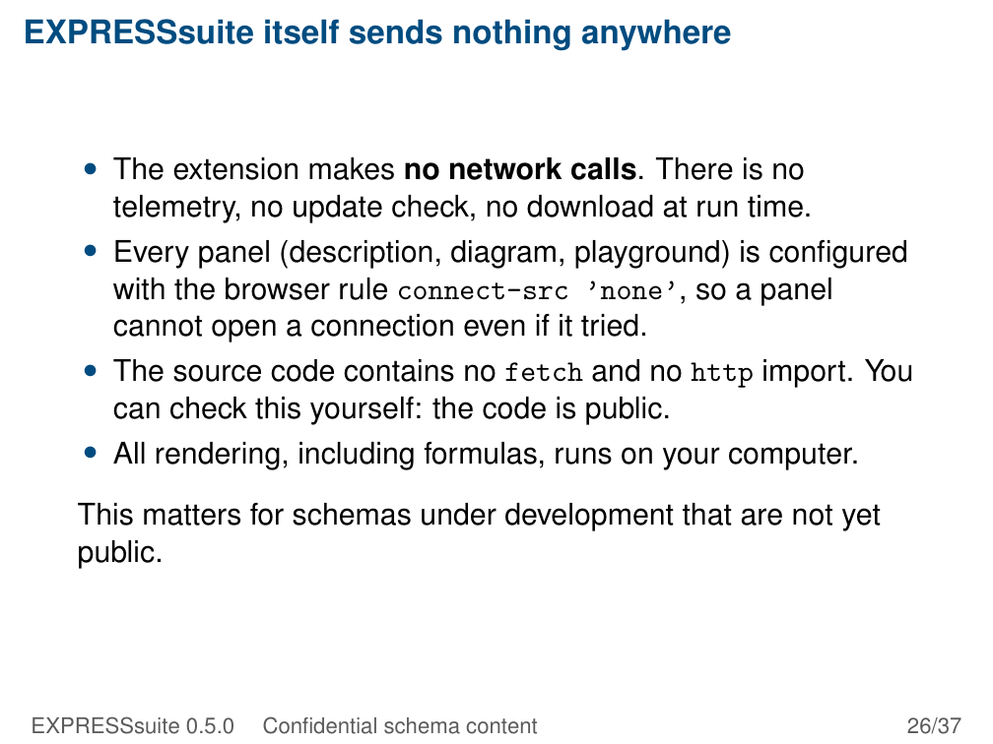
Notes:
EXPRESSsuite itself sends nothing anywhere
• The extension makes no network calls. There is no
telemetry, no update check, no download at run time.
• Every panel (description, diagram, playground) is configured
with the browser rule connect-src ’none’, so a panel
cannot open a connection even if it tried.
• The source code contains no fetch and no http import. You
can check this yourself: the code is public.
• All rendering, including formulas, runs on your computer.
This matters for schemas under development that are not yet
public.
EXPRESSsuite 0.5.0 Confidential schema content 26/37

Slide 27
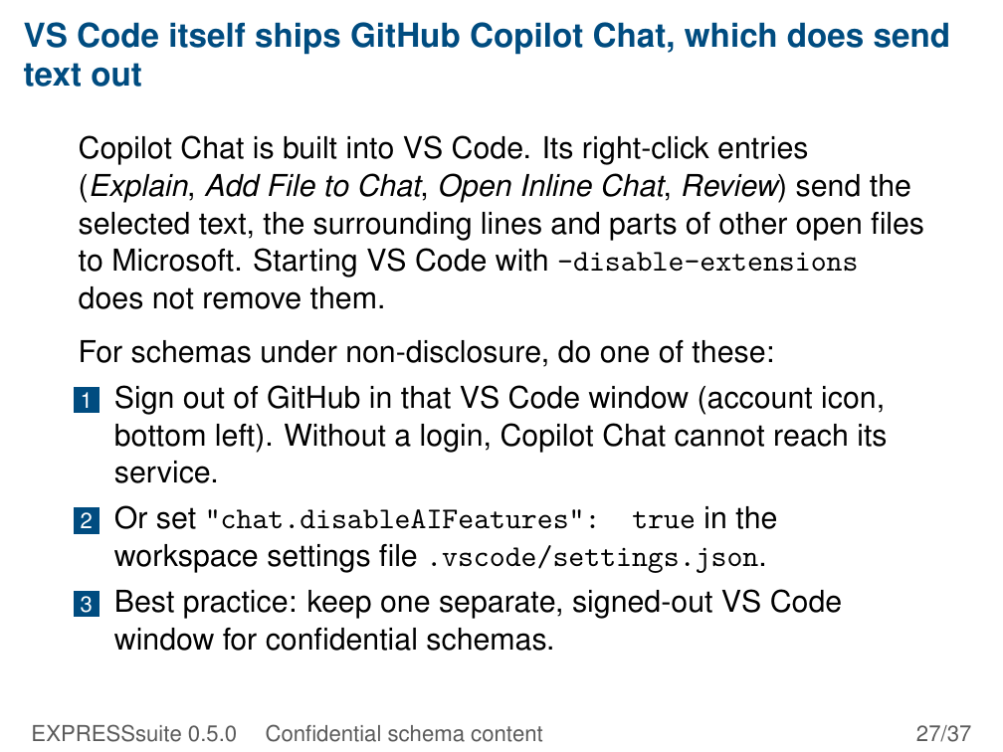
Notes:
VS Code itself ships GitHub Copilot Chat, which does send
text out
Copilot Chat is built into VS Code. Its right-click entries
(Explain, Add File to Chat, Open Inline Chat, Review) send the
selected text, the surrounding lines and parts of other open files
to Microsoft. Starting VS Code with –disable-extensions
does not remove them.
For schemas under non-disclosure, do one of these:
1 Sign out of GitHub in that VS Code window (account icon,
bottom left). Without a login, Copilot Chat cannot reach its
service.
2 Or set "chat.disableAIFeatures": true in the
workspace settings file .vscode/settings.json.
3 Best practice: keep one separate, signed-out VS Code
window for confidential schemas.
EXPRESSsuite 0.5.0 Confidential schema content 27/37

Slide 28
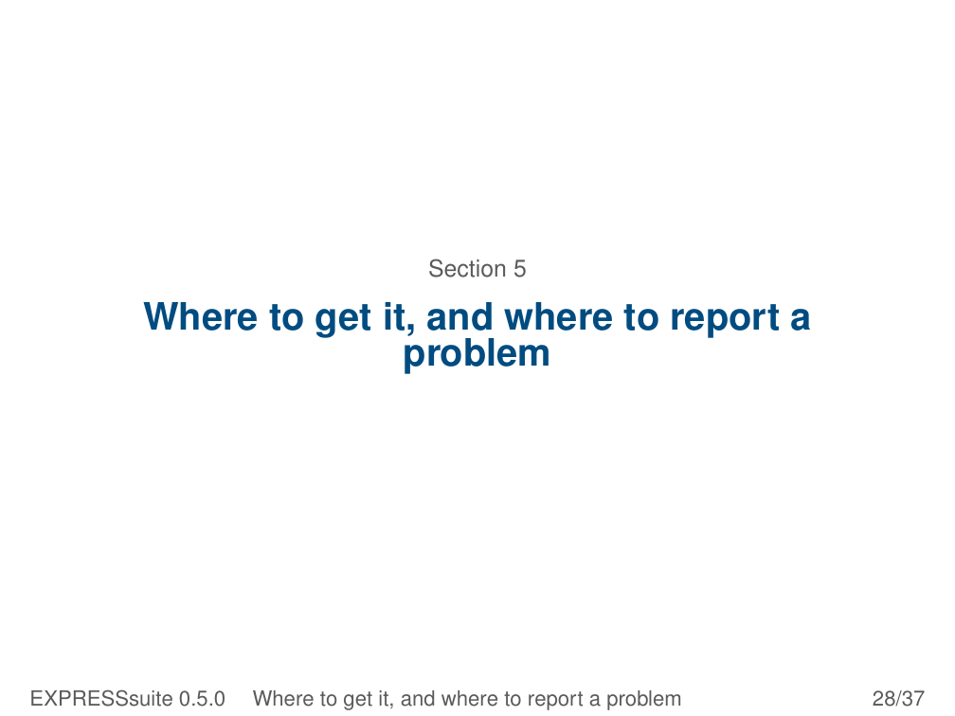
Notes:
Section 5
Where to get it, and where to report a
problem
EXPRESSsuite 0.5.0 Where to get it, and where to report a problem 28/37

Slide 29
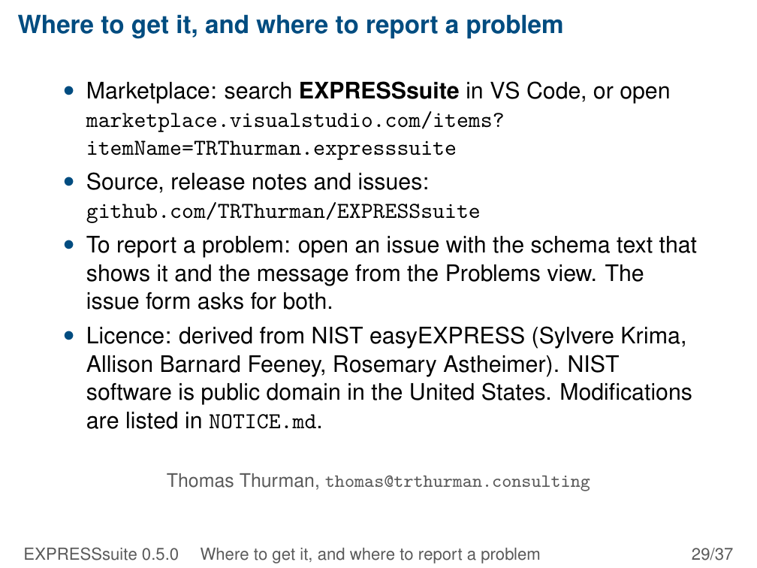
Notes:
Where to get it, and where to report a problem
• Marketplace: search EXPRESSsuite in VS Code, or open
marketplace.visualstudio.com/items?
itemName=TRThurman.expresssuite
• Source, release notes and issues:
github.com/TRThurman/EXPRESSsuite
• To report a problem: open an issue with the schema text that
shows it and the message from the Problems view. The
issue form asks for both.
• Licence: derived from NIST easyEXPRESS (Sylvere Krima,
Allison Barnard Feeney, Rosemary Astheimer). NIST
software is public domain in the United States. Modifications
are listed in NOTICE.md.
Thomas Thurman, thomas@trthurman.consulting
EXPRESSsuite 0.5.0 Where to get it, and where to report a problem 29/37

Slide 30
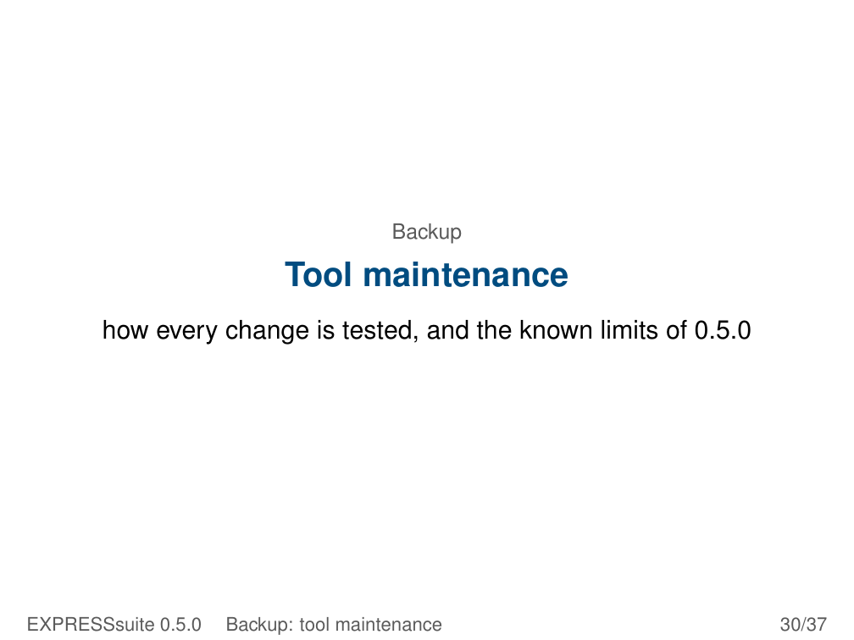
Notes:
Backup
Tool maintenance
how every change is tested, and the known limits of 0.5.0
EXPRESSsuite 0.5.0 Backup: tool maintenance 30/37

Slide 31
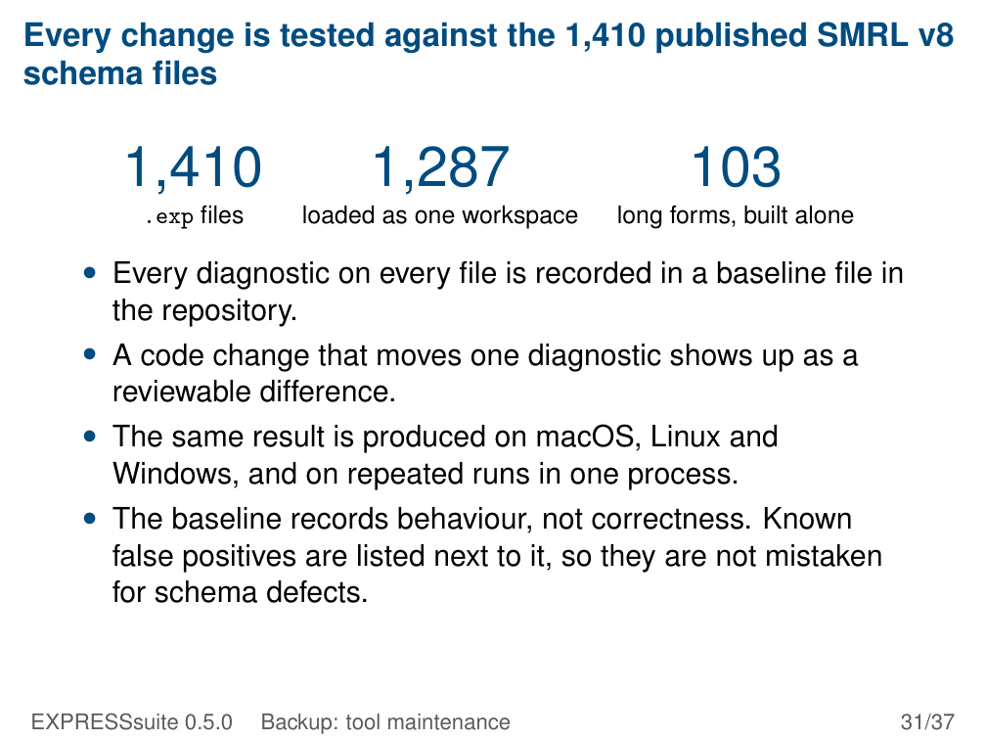
Notes:
Every change is tested against the 1,410 published SMRL v8
schema files
1,410 1,287 103
.exp files loaded as one workspace long forms, built alone
• Every diagnostic on every file is recorded in a baseline file in
the repository.
• A code change that moves one diagnostic shows up as a
reviewable difference.
• The same result is produced on macOS, Linux and
Windows, and on repeated runs in one process.
• The baseline records behaviour, not correctness. Known
false positives are listed next to it, so they are not mistaken
for schema defects.
EXPRESSsuite 0.5.0 Backup: tool maintenance 31/37

Slide 32
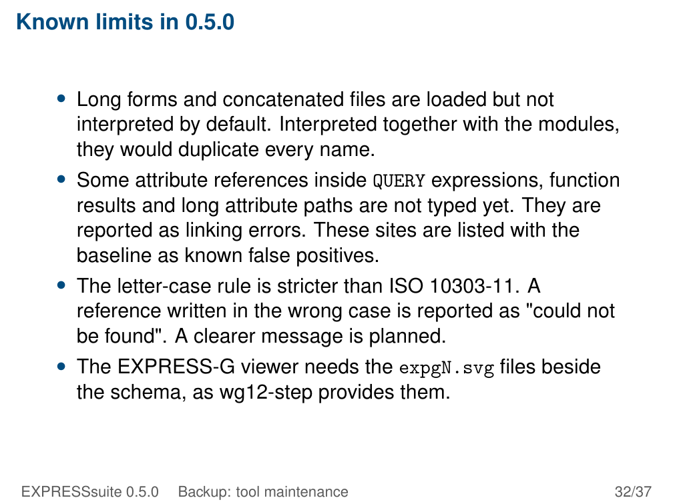
Notes:
Known limits in 0.5.0
• Long forms and concatenated files are loaded but not
interpreted by default. Interpreted together with the modules,
they would duplicate every name.
• Some attribute references inside QUERY expressions, function
results and long attribute paths are not typed yet. They are
reported as linking errors. These sites are listed with the
baseline as known false positives.
• The letter-case rule is stricter than ISO 10303-11. A
reference written in the wrong case is reported as "could not
be found". A clearer message is planned.
• The EXPRESS-G viewer needs the expgN.svg files beside
the schema, as wg12-step provides them.
EXPRESSsuite 0.5.0 Backup: tool maintenance 32/37

Slide 33
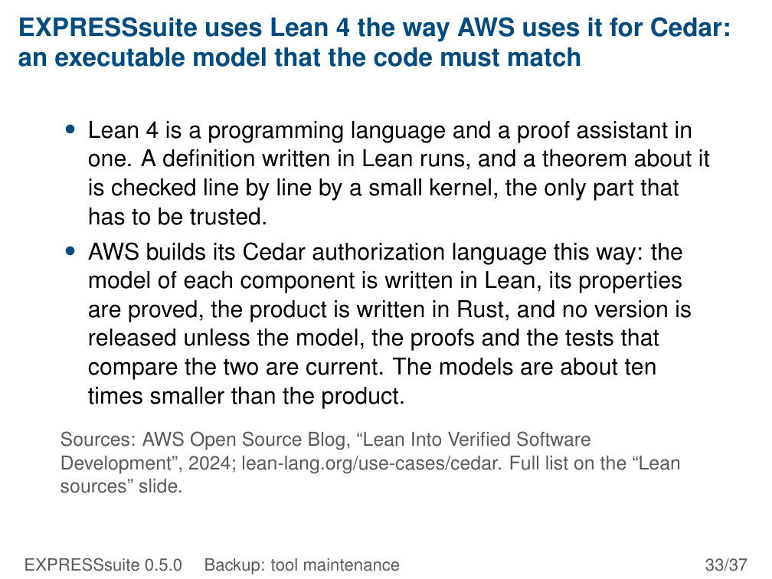
Notes:
EXPRESSsuite uses Lean 4 the way AWS uses it for Cedar:
an executable model that the code must match
• Lean 4 is a programming language and a proof assistant in
one. A definition written in Lean runs, and a theorem about it
is checked line by line by a small kernel, the only part that
has to be trusted.
• AWS builds its Cedar authorization language this way: the
model of each component is written in Lean, its properties
are proved, the product is written in Rust, and no version is
released unless the model, the proofs and the tests that
compare the two are current. The models are about ten
times smaller than the product.
Sources: AWS Open Source Blog, “Lean Into Verified Software
Development”, 2024; lean-lang.org/use-cases/cedar. Full list on the “Lean
sources” slide.
EXPRESSsuite 0.5.0 Backup: tool maintenance 33/37

Slide 34
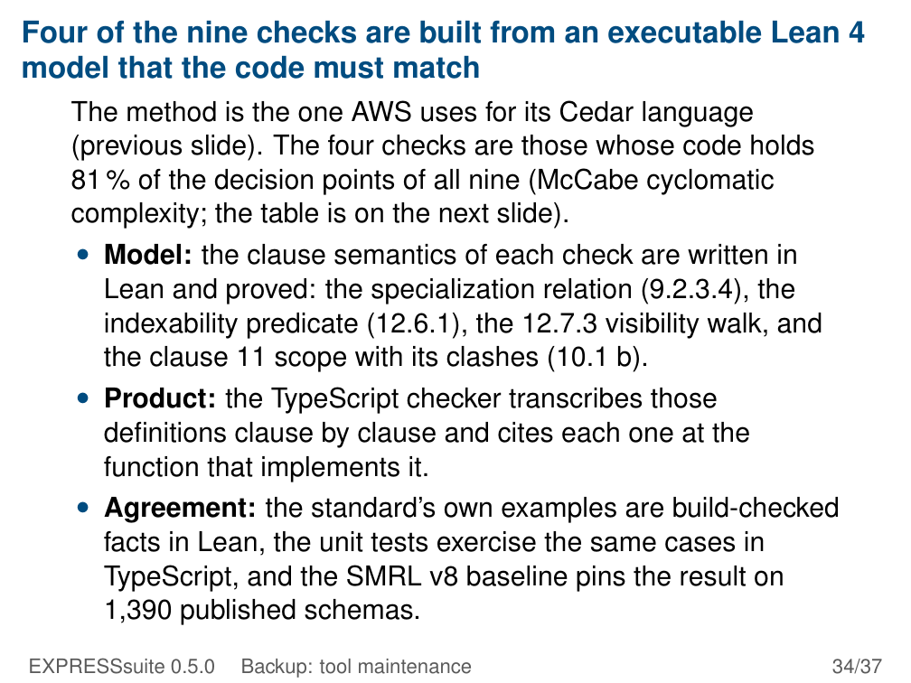
Notes:
Four of the nine checks are built from an executable Lean 4
model that the code must match
The method is the one AWS uses for its Cedar language
(previous slide). The four checks are those whose code holds
81 % of the decision points of all nine (McCabe cyclomatic
complexity; the table is on the next slide).
• Model: the clause semantics of each check are written in
Lean and proved: the specialization relation (9.2.3.4), the
indexability predicate (12.6.1), the 12.7.3 visibility walk, and
the clause 11 scope with its clashes (10.1 b).
• Product: the TypeScript checker transcribes those
definitions clause by clause and cites each one at the
function that implements it.
• Agreement: the standard’s own examples are build-checked
facts in Lean, the unit tests exercise the same cases in
TypeScript, and the SMRL v8 baseline pins the result on
1,390 published schemas.
EXPRESSsuite 0.5.0 Backup: tool maintenance 34/37

Slide 35
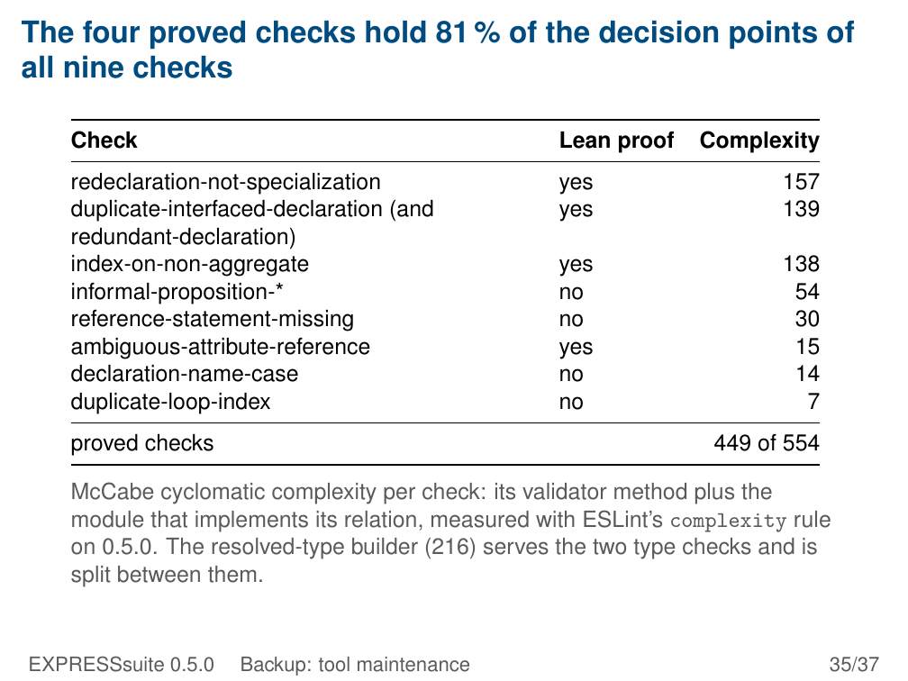
Notes:
The four proved checks hold 81 % of the decision points of
all nine checks
Check Lean proof Complexity
redeclaration-not-specialization yes 157
duplicate-interfaced-declaration (and yes 139
redundant-declaration)
index-on-non-aggregate yes 138
informal-proposition-* no 54
reference-statement-missing no 30
ambiguous-attribute-reference yes 15
declaration-name-case no 14
duplicate-loop-index no 7
proved checks 449 of 554
McCabe cyclomatic complexity per check: its validator method plus the
module that implements its relation, measured with ESLint’s complexity rule
on 0.5.0. The resolved-type builder (216) serves the two type checks and is
split between them.
EXPRESSsuite 0.5.0 Backup: tool maintenance 35/37

Slide 36
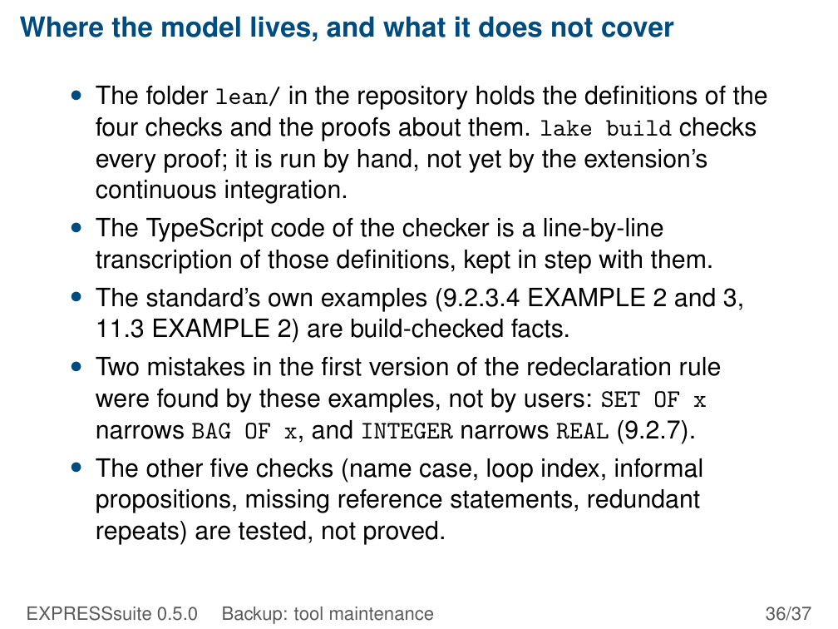
Notes:
Where the model lives, and what it does not cover
• The folder lean/ in the repository holds the definitions of the
four checks and the proofs about them. lake build checks
every proof; it is run by hand, not yet by the extension’s
continuous integration.
• The TypeScript code of the checker is a line-by-line
transcription of those definitions, kept in step with them.
• The standard’s own examples (9.2.3.4 EXAMPLE 2 and 3,
11.3 EXAMPLE 2) are build-checked facts.
• Two mistakes in the first version of the redeclaration rule
were found by these examples, not by users: SET OF x
narrows BAG OF x, and INTEGER narrows REAL (9.2.7).
• The other five checks (name case, loop index, informal
propositions, missing reference statements, redundant
repeats) are tested, not proved.
EXPRESSsuite 0.5.0 Backup: tool maintenance 36/37

Slide 37
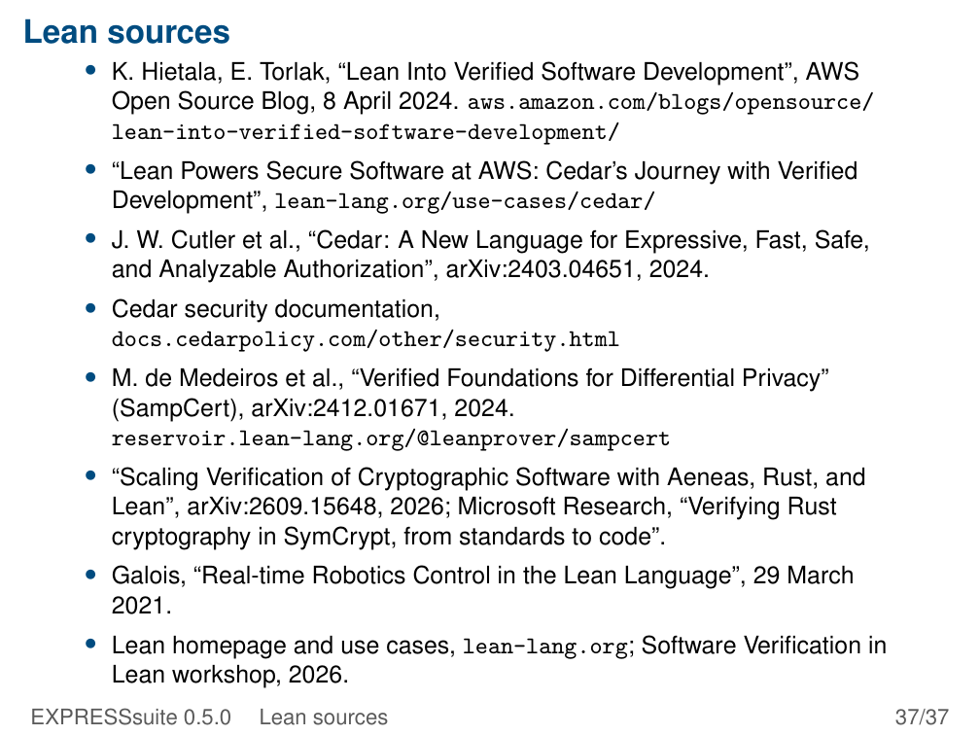
Notes:
Lean sources
• K. Hietala, E. Torlak, “Lean Into Verified Software Development”, AWS
Open Source Blog, 8 April 2024. aws.amazon.com/blogs/opensource/
lean-into-verified-software-development/
• “Lean Powers Secure Software at AWS: Cedar’s Journey with Verified
Development”, lean-lang.org/use-cases/cedar/
• J. W. Cutler et al., “Cedar: A New Language for Expressive, Fast, Safe,
and Analyzable Authorization”, arXiv:2403.04651, 2024.
• Cedar security documentation,
docs.cedarpolicy.com/other/security.html
• M. de Medeiros et al., “Verified Foundations for Differential Privacy”
(SampCert), arXiv:2412.01671, 2024.
reservoir.lean-lang.org/@leanprover/sampcert
• “Scaling Verification of Cryptographic Software with Aeneas, Rust, and
Lean”, arXiv:2609.15648, 2026; Microsoft Research, “Verifying Rust
cryptography in SymCrypt, from standards to code”.
• Galois, “Real-time Robotics Control in the Lean Language”, 29 March
2021.
• Lean homepage and use cases, lean-lang.org; Software Verification in
Lean workshop, 2026.
EXPRESSsuite 0.5.0 Lean sources 37/37

