Slide 1
WEBGL CAPABILITY
WebGL turns the browser into a deployable 3D visualization runtime.
Browser
JavaScript API
WebGL
The research arc moves from accessible 3D campus tours to optimized city-scale rendering to real-time 2D/3D situation platforms.
GPU pipeline
interactive 3D page
03
02
36
SOURCE PAPERS
LIVE PROJECTS
FPS CASE
campus, geographic, situation display
city roaming and situation display labs
reported city-roaming average frame rate
Sources: user DOCX; WebGL papers supplied in workspace
01

Slide 2
SOURCE MAP
The papers form a maturity model: access, scale, then operational integration.
2015 campus system
2017 geographic scenes
2024 situation platform
Three.js/WebGL made a 3D campus information system viewable in a browser, with ground/free modes, clickable building info, and usability testing.
The city-scale paper adds glTF organization, prediction-based prefetching, view-frustum culling, occlusion/back-face logic, and Cesium rendering.
The platform wraps WebGL in SOA layers, data services, 2D/3D linkage, model and map management, measurement tools, and deployment options.
Takeaway
WebGL capability is not one feature. It expands as the system adds asset pipelines, streaming strategy, culling, real-time data, and workflow modules.
Sources: user DOCX; WebGL papers supplied in workspace
02

Slide 3
RUNTIME SHIFT
WebGL removes plugin friction without giving up the GPU.
HTML5 canvas
JavaScript
WebGL API
GPU rasterization
Open browser standard
Page integration
Hardware acceleration
No proprietary runtime is required for compatible browsers.
3D content can sit with normal web UI, data, controls, and overlays.
Rendering work moves to the graphics pipeline instead of DOM-only drawing.
Sources: user DOCX; WebGL papers supplied in workspace
03

Slide 4
CAPABILITY LADDER
The capability ladder moves from navigation to optimization to decision support.
01
Virtual place
Campus tour: user moves through buildings and retrieves object information in-browser.
02
Large-scene engine
City roaming: scene delivery, cache queues, prefetching, view-frustum culling, and GPU rendering work together.
03
Operational platform
Situation display: WebGL is embedded in service layers, map services, live data, model libraries, and measurement workflows.
The same browser-native graphics standard supports all three, but each step adds architecture around the canvas.
Sources: user DOCX; WebGL papers supplied in workspace
04

Slide 5
ARCHITECTURE
Architecture changes as the WebGL workload gets heavier.
Campus prototype
Geographic city scene
2D/3D situation platform
Browser client
WebGL + Three.js renders models and UI.
Client/server
Server stores glTF scene files; client renders with Cesium/WebGL.
SOA layers
Infrastructure, storage, service, and application interaction.
Data model
Local JSON/object metadata for building info.
Scheduling
Trajectory prediction builds a pre-download queue.
Services
Scenario, model, map, measurement, plotting, and basic support.
Optimization
Accessible interaction; limited large-scene strategy.
Visibility
Frustum and occlusion/back-face culling reduce draw work.
Deployment
Standard server, portable server, and standalone modes.
Sources: user DOCX; WebGL papers supplied in workspace
05

Slide 6
RENDERING PIPELINE
Performance comes from the whole pipeline, not WebGL alone.
3D authoring
Web asset format
Network scheduling
Visibility filter
GPU render
Blender / 3ds Max / source models
glTF-style JSON, binary buffers, images, shaders
tile queues and trajectory-based prefetching
frustum, depth, back-face and occlusion logic
WebGL draws the visible working set
The geographic paper combines glTF, prefetching, view-frustum culling, occlusion/back-face visibility, and Cesium/WebGL. The demo mirrors that stack with generated city tiles and live working-set counters.
Sources: user DOCX; WebGL papers supplied in workspace
06

Slide 7
SCALE EVIDENCE
The New York case proves the problem is data movement plus draw cost.
765
354k
550k
36
<1s
MODELS
POLYGONS
VERTICES
FPS
AVG RESPONSE
city model count in experiment
reported 354,249 polygons
reported 549,702 vertices
average browsing frame rate
average platform response time
Storage reduction after conversion
Before conversion: 35.6 MB
After glTF conversion: 27.7 MB
The important point is not the exact file format alone. The paper reduces payload size, predicts what the user will need next, then renders only the useful subset.
Source: 3D Geographic Scenes Visualization Based on WebGL
07

Slide 8
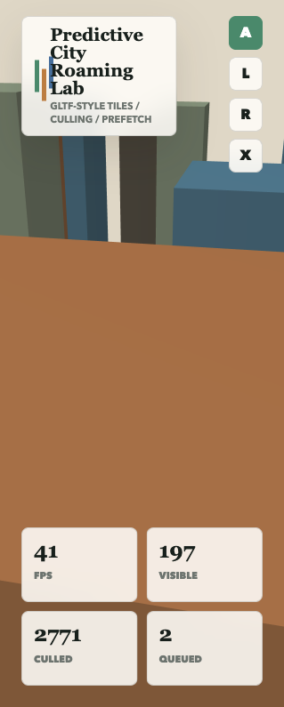
PROJECT 1
The city demo makes invisible optimization visible.
Working set
Prefetch queue
The HUD reports visible objects, culled objects, FPS, and queued tile requests while the camera moves.
The cache panel predicts near-future tiles from the camera heading and marks queued, loaded, and current regions.
GPU path
Seminar path
The renderer uses WebGL shaders, depth testing, and back-face culling so the browser canvas behaves like a 3D runtime.
Open webgl-showcase/city-roaming/index.html during the rendering-pipeline section.
Project file: webgl-showcase/city-roaming/index.html
08

Slide 9
SITUATION PLATFORM
In the situation paper, WebGL is the view layer of a service platform.
Application interaction
Web UI, 2D/3D situation display, Cesium 3D, data service interface
Service layer
scenario building, model management, map management, measurement, plotting, basic support
Data storage
entity models, geographic environment, schemes, users, configuration, logs, cache
Infrastructure
standard server, portable server, standalone deployment, browser clients
This is the architectural jump: the browser canvas is no longer a demo surface. It becomes one module inside a maintainable, data-driven decision-support system.
Source: Design of a 2D and 3D Situation Display Platform Based on WebGL and Modern Web Technology Stack
09

Slide 10
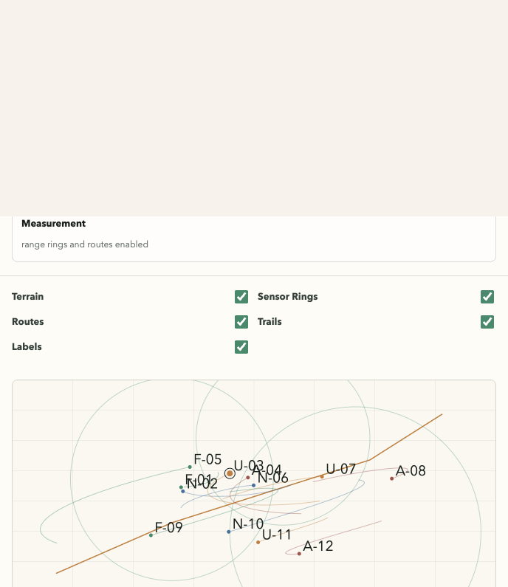
PROJECT 2
The situation demo turns WebGL into a live operational surface.
3D terrain
2D linked map
A WebGL terrain surface renders the current operational environment and moving entities.
A synchronized map view shows tracks, labels, routes, sensor rings, and selected entity range.
Layer controls
Replay/data bus
The interface exposes map-style toggles for terrain, sensors, routes, trails, and labels.
A simulated live stream drives packet, latency, mission time, and entity-state readouts.
Project file: webgl-showcase/situation-display/index.html
10

Slide 11
LIMITS
The remaining research problems are engineering problems, not just graphics problems.
Asset pipeline
Prediction accuracy
Mobile performance
Model conversion can lose fidelity; formats must preserve materials, scale, metadata, and loading performance.
Prefetching helps only when the next viewpoint is predicted well enough to avoid wasted bandwidth.
Thermals, memory ceilings, and GPU differences make browser 3D uneven across devices.
Multi-user state
Security/deployment
UX density
Collaborative 3D requires synchronization, authority, conflict handling, and replayable events.
Operational WebGL systems need access control, logs, offline mode, and service reliability.
3D views must avoid becoming visually impressive but operationally hard to scan.
Sources: user DOCX; WebGL papers supplied in workspace
11

Slide 12
ROADMAP
Turn the showcase into a progressive WebGL research prototype.
Now
Next
Then
Finally
Static WebGL labs
Real asset pipeline
Live services
Collaborative GIS
Dependency-free demos show rendering, culling, prefetch, 2D/3D linkage, layers, and replay.
Add glTF/3D Tiles loading, model metadata, texture budgets, and progressive LOD.
Connect WebSocket data streams, cache storage, scenario files, and service health telemetry.
Add multi-user state, measurement workflows, annotations, and exportable analysis sessions.
Closing thesis
WebGL is most compelling when the browser is treated as a full visualization system: render engine, UI surface, data client, and analysis workspace.
Sources: user DOCX; WebGL papers supplied in workspace
12

