Slide 1

Parallel Game Tree Search
Jason Chalom - 711985
Liron Mizrahi – 708810

Slide 2
Background Knowledge

Slide 3
Game Trees
Background
A game tree is a directed graph where each node indicates a gamestate and each edge indicates an action.
A game tree is complete if it contains all possible actions from each possible state.
Game trees can be incredibly large for simple games.
Game trees are highly parallelisable as each subtree can be seen as disjoint trees and so can be searched individually.
Free PowerPoint Templates

Slide 4
The Game of 2048
Background
2048 is a single-player simple, deterministic block sliding puzzle game.
The rules are as follows:
The game is played on a square grid, i.e. 4x4 or 8x8 grid.
Every turn the player will choose a direction for the blocks to move, either up, down, left or right.
Tiles will slide as far as possible until stopped by the edge of the grid or another block.
If 2 tiles have the same number while colliding then they will combine into a single block and the new value will be the sum of their values.
After each action, a new tile will appear on the grid with a value of 2.
The game is won when a tile with value of 2048 appears on the board.
Free PowerPoint Templates

Slide 5
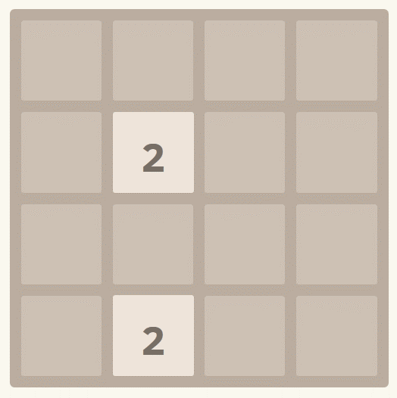
Example of a 2048 Game
Background
Free PowerPoint Templates

Slide 6
Technology Used

Slide 7
Technology
The game was implemented using C++.
The tree search was implemented in C++ and parallelised using Nvidia Cuda and Open MPI.
HTML and CSS were used for the demo.
Free PowerPoint Templates

Slide 8
Strategies Used

Slide 9
Serial Approach
Strategies
We used a user controlled stack in order to build the tree.
From the root node, all possible children are pushed to the stack.
Then for each node at the top of the stack:
Each child is checked to see if its a dead state or if it is a solution state
A dead state is one where there are no possible moves left.
If not dead state or solution state then it is pushed to the top of the stack
If a solution is found then store it for later processing.
However, since the game tree is so big for 2048, the tree is limited by the number of nodes.
Free PowerPoint Templates

Slide 10
MPI Approach
Strategies
The MPI approach is very similar to the serial approach.
The root process creates a small subtree until the number of leaves is equal to number of processes used.
Each process is sent its initial state
Each process then creates a serial search from the initial state.
Then each process sends back its local optimal solution depth to the root process.
The root process compares them and chooses the minimum.
Free PowerPoint Templates

Slide 11
CUDA Approach
Strategies
The CUDA approach starts in a similar manner to the MPI approach.
The host generates a small subtree and stores each initial state to be used in the first column of a matrix.
Each row in this matrix is a subtree to be explored by a thread.
For each entry in its row, each thread creates the nodes children and places them in the row of the matrix.
For this approach to work, we must assume the tree is complete and symmetric.
Free PowerPoint Templates

Slide 12
Results

Slide 13
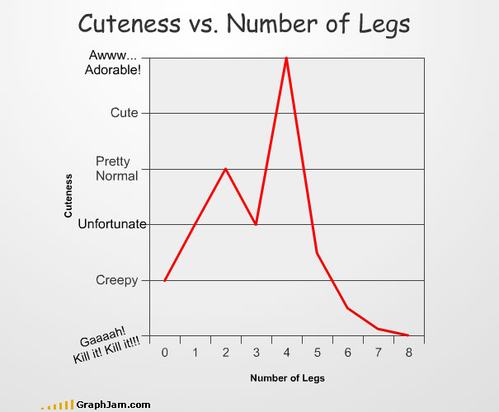
Results
Free PowerPoint Templates

Slide 14
Problems Encountered

Slide 15
Problems
Inplace DFS and Recursive DFS
Enforcing terminating conditions for tree generation.
Using strings instead of ints.
Underestimated game tree size
Trying to code in such a way that code can be re-used for all 3 approaches.
Most code had to be re-done for CUDA.
The CUDA implementation was very challenging.
Indexing
Class function used pointers
Random number generation
Creating initial subtrees for MPI and CUDA.
Co-ordinating processes with MPI
Free PowerPoint Templates

Slide 16
Conclusions

Slide 17
Conclusions
MPI is a simple way to gain a massive speed performance over the serial approach.
However, while CUDA may be a lot more complex to implement and may be slow, the limits of the tree size can greatly be expanded.
Free PowerPoint Templates

Slide 18
Works Cited
Sager, J. (2015, October 1). Free PowerPoint Template. Retrieved 2016, from http://sage-fox.com/
En.wikipedia.org. 2048 (video game). [online] Available at: https://en.wikipedia.org/wiki/2048_(video_game) [Accessed 17 May 2017].
NVIDIA Developer. CUDA Zone. [online] Available at: https://developer.nvidia.com/cuda-zone [Accessed 17 May 2017].
Open-mpi.org. Open MPI: Open Source High Performance Computing. [online] Available at: https://www.open-mpi.org/ [Accessed 17 May 2017].
Softonic. 2048 Game. [image] Available at: https://features.en.softonic.com/how-to-win-at-2048 [Accessed 17 May 2017].
Free PowerPoint Templates

Slide 19
Image Tips
Image Removal & Modifications:
Background Images:
Many of our slides have background images, which you may want to replace or remove to fit your needs. To modify, right click the slide (in the left preview panel) and choose “format background” from the dropdown menu. A “format background” screen will open to the right of the slide. To replace image, choose “file” from the insert section to browse your computer, or “online” to search the internet.
Smaller Images in Content:
Simply right click the image and choose the “change picture” option, and it will give you options to browse your computer or search online.
Color Transparency Screen:
Many slides have colored screen with varying transparency levels to give color to the slide and allow text on slide to be seen better. This is usually placed at the back of the slide, just in front of the background image. To modify color or change transparency, right click in the slide somewhere that does not have text or objects. Then choose ‘format shape” from the dropdown box. You will now see a color selector box and transparency options to the right. Make changes to get the desired results you are looking for. If you want to just remove this screen, choose “cut” from the dropdown menu when you right click it.
Image Usage Rights:
Most of our images are licensed through Shutterstock, for use within our PowerPoint Templates only. You are free to modify and transfer photos between our templates, but use outside our templates could constitute a copyright violation. By providing these PowerPoint Templates to you, we are not transferring any of our licensing of images to be used outside these templates.
Free PowerPoint Templates

