Slide 1
Online Proctoring
In Search of an Ethical Balance
Between Integrity and Privacy
Timothy Rezendes - DTSC690 - April 2022
Notes:
Hello, my name is Timothy Rezendes, and this is
"Online Proctoring: In Search of an Ethical Balance Between Integrity and Privacy"
presented for DTSC 690: Ethical and Philosophical Issues in Data Science in the 2022 Spring 2 term.
With recent explosion of online distance learning due to the COVID-19 pandemic, institutions of higher education have found themselves with an increased need to find ways to ensure the integrity of online learning assessments.
Many have turned to various forms of online proctoring to meet this need, but that solution has raised a variety of concerns among students, professors, and other interested parties.
With this presentation, I sought to learn if a balance could be struck between this institutional concern and the privacy and related rights of their students .

Slide 2
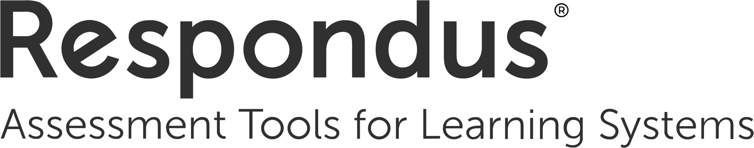

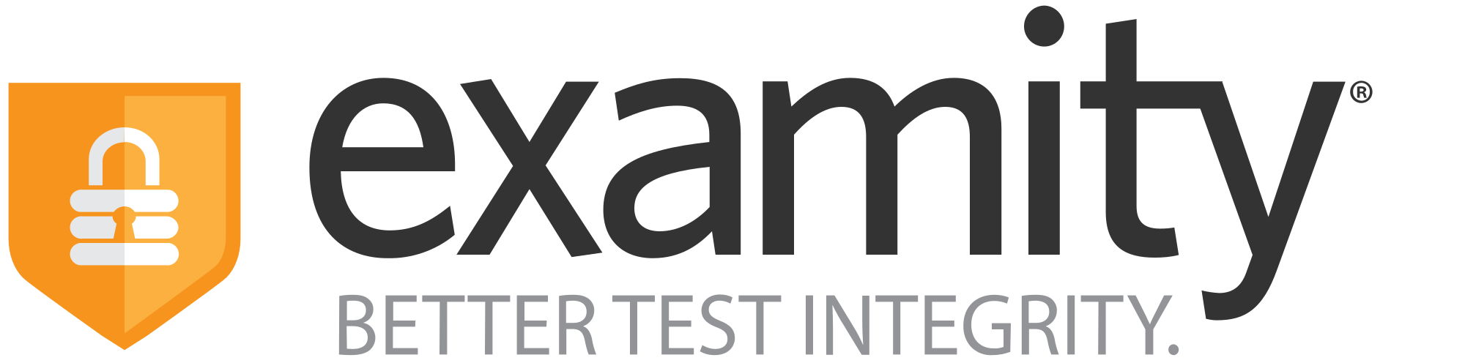

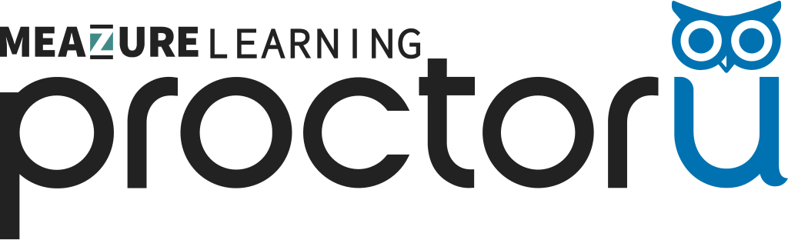
Online Protoring
Many Forms, Many Companies
Lockdown browsers
Automated webcam monitoring
Eye tracking
Live proctor monitoring
Screen sharing
Network traffic analysis
(Balash, 2021)
Notes:
"Online proctoring" can mean many things and goes by different names — "remote proctoring", "electronic invigilation", among others.
It consists of software that uses either AI, human monitors (either in real time, or after the fact), or some combination thereof to:
•Restrict and/or monitor a student's use of their computer
•Monitor a student's behavior via their webcam, including:
-hand, eye, and head tracking
-monitoring video and/or audio for restricted materials and/or other people in the room
•Otherwise watch and/or record aspects of a student's environment — both physical and digital
For the purposes of this presentation, "online proctoring" refers to any software that must be used by students in order to participate in some aspect of an online remote learning class and uses one or more of the above techniques.
Although some classes have opted for first party proctoring, i.e. by the professor over Zoom, the vast proliferation of online proctoring is via third party commercial vendors, including P, P, R, E, E, Proctortrack, Honorlock, and others.

Slide 3
Distance Learning is not New
Correspondence courses are as old as a reliable postal system, dating back to at least the early 18th century.
The world's first all-remote university, Open University in the UK enrolled its first sutdents in 1971 and taught via various media including books, audio and video tape, television and radio programs, and computer software.
(Harting & Erthal, 2005)
Notes:
When we discuss distance learning in 2022, we are almost always referring to classes offered via the internet, whether they are classes like this one, offered via a traditional "brick & mortar" university, classes offered by universities that operate almost or entirely online, like the University of Phoenix or the Open University, or MOOCs—Massively Open Online Courses—offered by providers like Coursera.
But distance learning is not new. In fact, it is likely as sold as a reliable postal service. Harting & Erthal (2005) show examples of correspondence courses via mail as far back as 1728.
Even modern remote learning predates the internet as we know it. When the Open University opened in the UK, its all-remote programs were offered via books, tapes, and even television and radio broadcasts (Harting & Erthal, 2005).
As distance learning has become a more and more a part of the everyday educational landscape, however, there are some competing concerns that have put it on the path to …

Slide 4
An
Ethical
Collision

Slide 5
An Ethical Collision
Academic Integrity vs. Student Privacy
Maintaining academic integrity in post-secondary institutions gives value to the degrees it confers, which value, in turn, benefits the institution's students (Holden et al., 2021).
Even early proponents of online distance learning recognized the possibility for increased academic dishonesty during online exams (Savenye, 2004).
Online proctoring software collects personal data on students and may require access to computer functions that allow it to monitor students' physical surroundings and their computer activity (Kelley & Oliver, 2020).
Online proctoring exacerbates students' anxiety leading to reduced exam performance (Woldeab & Brothen, 2019).
Notes:
(trans 1)
There is value in maintaining academic integrity — both as a moral good unto itself, and insofar as it underpins the worth of the credentials bestowed by an institution.
(trans 2)
As such, institutions have a vested interest in verifiably maintaining that integrity among their students and faculty.
Even champions of online learning in its earliest days, like the United States Distance Learning Association, recognized that taking classes out of the classroom and onto the internet opened up an increased possibility for academic dishonesty (Savenye, 2004).
While the institution's need to protect its standing is important, it must also consider the needs of its constituents, needs which may be compromised by online proctoring
(trans 3)
:: SLIDE

Slide 6
The Rise of Distance Learning

Slide 7
A Steady Increase
Although distance learning has been around for centuries, online learning is less than 40 years old.
The first online courses were offered in the late 1980s.
Online learning expanded in the 1990s and 2000s.
The 2010s saw steady growth in both the number of courses offered online and the number of students enrolled in them.
(Kenton, 2015) (U.S. Department of Education, 2012–2020)
Notes:
(trans 1)
Distance learning may be centuries old, but modern online education had its advent with the University of Phoenix's online program in 1989 (Kenton, 2015).
(trans 2)
Online offerings grew throughout the 90s and 2000s commensurate with the expansion of the internet and world wide web into all aspects of people's lives.
The 2010s :: SLIDE
Aside:
This presentation focuses on institutions of higher learning—colleges and universities, and primarily in the US—but as the pandemic has brought distance learning even into primary schools, the issues discussed here are largely relevant across the educational landscape.

Slide 8
(U.S. Department of Education, 2012–2020)
Notes:
This chart, using data from the
US Department of Education's National Center for Education Statistics,
Integrated Postsecondary Education Data System [IPEDS] Survey,
shows the number of United States Institutions of Higher Education that offer at least some courses entirely online.
The data here were collected from 2012–2020. 2020 is the most recent data available, and changes to the survey over time mean that earlier years are not as easily comparable.
From 2012–2019, a steady year over year increase in the number of institutions offering online programming is clearly evident.
2020 shows a noticeable (though not massive) increase in year over year growth, undoubtedly due to changes necessitated by the COVID-19 pandemic.

Slide 9
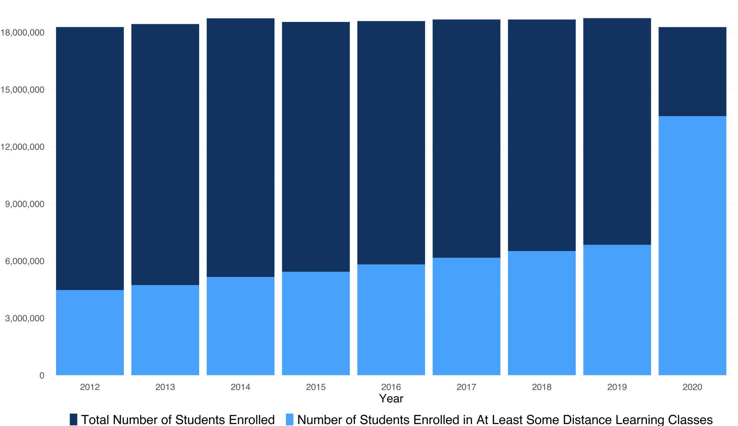
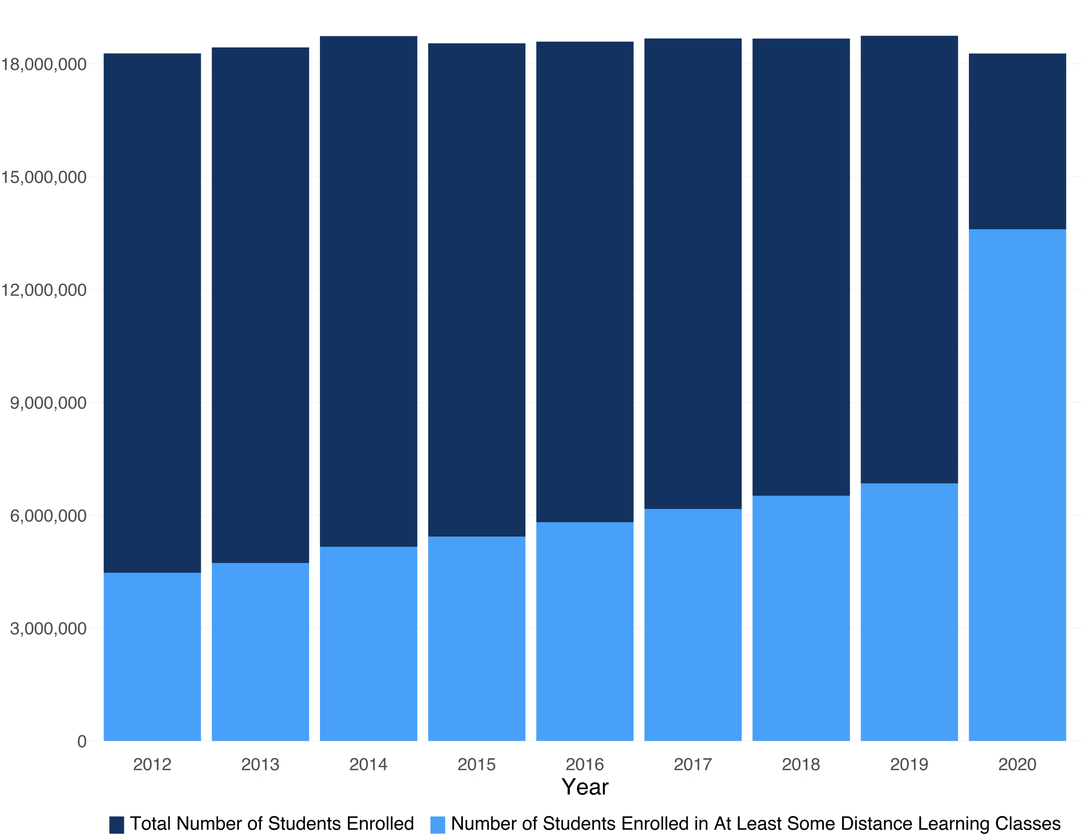
(U.S. Department of Education, 2012–2020)
Notes:
Comparing the number of students enrolled in higher education to the number of those enrolled in at least some distance learning shows a similar trend to the previous data.
While the total number of students enrolled stayed relatively consistent, the percentage enrolled in distance learning increased slowly but steadily from 2012–2019.
This chart departs from the previous one, however, in 2020. The pandemic precipitated unprecedented year over year growth in the number of students participating in distance learning.

Slide 10
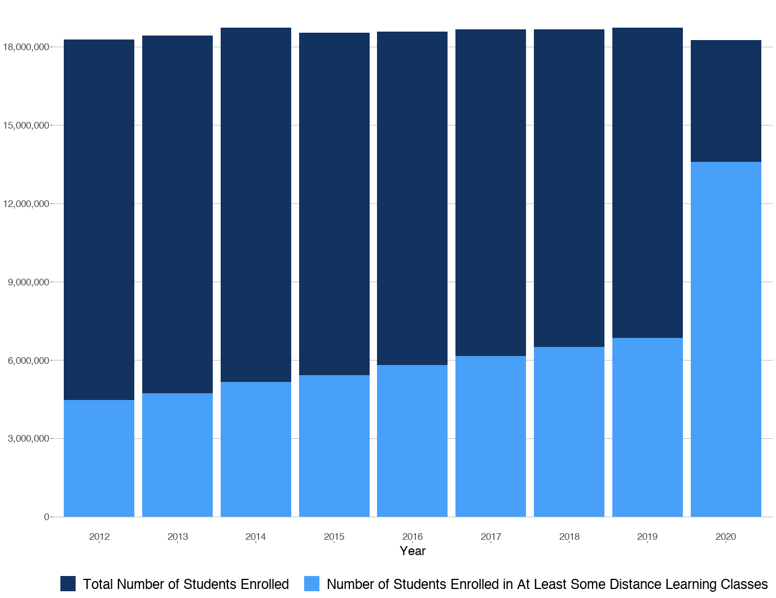
With the rise in online
education came the rise in
online proctoring. Online
proctoring companies
proliferated during the first
decade and a half of the
21st century.
ExamSoft • 1998
Respondus • 2000
ProctorU • 2008
Examity • 2013
Proctorio • 2013
Proctortrack • 2013
Honorlock • 2015
(About Examsoft, 2022)
(Respondus, 2020)
(Anderson, 2014)
(Examity, 2022)
(Proctorio, 2022)
(Craft.co, 2022)
(Hemlepp, 2018)
Notes:
SLIDE
(trans1)
Online proctoring is not new, but 2020's sudden surge in online learners meant that the companies that had grown up over the last 20 years saw enormous overnight growth and were thrust into the spotlight as millions more people were now required to use them.
These companies are all privately held, and their growth metrics are not readily available, but estimates suggest that some of them have seen increases in business of more than 500% (Caplan-Bricker, 2021).

Slide 12
Why Proctor?

Slide 13
“
Understanding the fundamental values of academic
integrity that are held within a community
—and behaving in accordance with them—
instills a shared framework for professional work, making explicit the value of the mastery of knowledge, skills, and abilities” (Holden et al., 2021).

Slide 14
Academic Integrity
As Defined by the International Center for Academic Integrity
(ICAI, 2021)
Honesty
Trust
“
Understanding the fundamental values of academic
integrity that are held within a community
—and behaving in accordance with them—
instills a shared framework for professional work, making explicit the value of the mastery of knowledge, skills, and abilities” (Holden et al., 2021).
Fairness
Courage
Respect
Responsibility
Notes:
Institutions of Higher Education have a responsibility to fairly educate their students and a responsibility to society to ensure that the credentials they issue meaningfully represent the education that students receive.
Those responsibilities can best be met when the institution maintains a culture of academic integrity.
In their paper, "Academic integrity in online assessment: A research review.", Holden et al. (2021) summarize this idea thusly:
:: SLIDE
The International Center for Academic Integrity identifies six values as fundamental to academic integrity:
(trans 1, etc)
:: SLIDE (2021).

Slide 15
The Evidence for Proctoring
There is evidence to show that online proctoring of remote exams reduces academic dishonesty.
(Alessio et al., 2017)
Notes:
There is evidence to support the claim that online proctoring deters cheating in online academic assessments.
A studio by Alession et al. (2017) compared assessment results across three groups of students:
•Those who took their exams online without any form of proctoring.
•Those that took their exams online using software that both locked out computer functionality and recorded the student and their surroundings via they webcam
•Those that took their exams online using software that locked out computer functionality not related to the exam, but did not monitor their behavior in any way
The study found no meaningful difference between the results of students in the two groups that were not monitored via video, but found that the group that was monitored had a lower average test score than the other groups and used a significantly smaller percentage of the time allotted to take the test.
The study conclusion posits that the differences in both metrics can be attributed to unmonitored students taking time to look up answers in restricted materials during the exam.

Slide 16
The Evidence for Proctoring
There is evidence to show that online proctoring of remote exams reduces academic dishonesty.
But wait…
(Alessio et al., 2017)
Notes:
:: SLIDE ::

Slide 17
Not All of the Evidence Agrees
There are conflicting studies on the prevalence of cheating in online classes.
Showed Similar
Cheating
Online and In-person
Showed Lower
Cheating Online
Showed Higher Cheating Online
Khan and
Balasubramanian
(2012)
King and
Case (2014)
Watson and
Sottile (2010)
Ladyschewsky*
(2015)
Grijalva et al.
(2006)
Stuber-McEwen*
et al. (2009)
Lanier (2006)*
Varble (2014)
(*as cited in Holden et al., 2021)
Notes:
In their research review, Holden et al. (2021) find that,
(trans 1)
while there are multiple studies that find that students have a higher proclivity for cheating in online classes than in-person,
(trans 2)
those studies are as likely as not to be contradicted by studies that show similar or even lower incidences of cheating in online versus in-person instruction.

Slide 18
The Problems with Proctoring
Notes:
Which brings us to… ::SLIDE::

Slide 19
Fairness & Trust
Online Proctoring Undermines the Very Values it Seeks to Uphold
At its heart, academic integrity is about maintaining trust in the academic institution.
The students’ trust that they will get the education they paid for.
The public’s trust that a degree from the institution is a valid measure of the bearer’s academic attainment.
Trust is only maintained if the learning environment is fair.
If some students are unfairly advantaged over others, those at a disadvantage have fewer opportunities to learn.
In an unfair institution of higher education, all degrees are not representative of the same level of intellectual achievement and so the value of every degree is diminished.
(Coghlan et al., 2021)
Notes:
While the use of online proctoring as an effective tool to combat academic dishonesty may be supported, its detractors raise serious concerns about its use.
(trans 1)
The use of online proctoring, may even undermine the very values it seeks to uphold.
(trans 2)
:: SLIDE ::

Slide 20
Fairness & Trust
Online Proctoring Undermines the Very Values it Seeks to Uphold
Online proctoring may help provide a level playing field by deterring cheating.
It may also algorithmically discriminate against students of color, neurodiverse students, and non cisgender students.
BUT
(Coghlan et al., 2021)
(Swauger, 2020a, 2020b)
Notes:
(trans 1)
While institutions that employ online proctoring may do so as a means to level the academic playing field by deterring cheating, its use can introduce unfairness in other ways.
:: SLIDE (top)::
(trans 2)
::SLIDE (bottom)::
Reports over the last two years have repeatedly documented complaints from students of color who are not recognized as present by online proctoring facial detection algorithms, transgender students who are forced to out themselves to strangers because of ID verification rules, and neurodiverse and disabled students whose innocuous movements are flagged as suspicious by proctoring algorithms (Caplan-Bricker, 2021; Harwell, 2020; Swauger, 2020a, 2020b)

Slide 21
Fairness & Trust
Online Proctoring Undermines the Very Values it Seeks to Uphold
Maintaining the integrity and validity of exams helps to ensure people’s trust in the institution.
Utilizing software and systems that surveil students and compromise their autonomy breaks trust and discredits the idea of the institution as a moral and ethical leader.
BUT
(Coghlan et al., 2021)
Notes:
(trans 1)
Fairness in the institution is a necessary foundation for trust in the institution, but trust goes beyond the idea of students trusting the institution to provide a valuable education and the wider trust in the institution to ready students to be participants in society.
(trans 2)
Students must also trust that the institution will not endanger their health or security.
And, as Coghlan et al. (2021) put it in their paper on the
Ethics of Online Exam Supervision Technologies,
if, as many universities do, institutions (quote) "claim to be major contributors to the democratic social good…through the education of ethically responsible leaders and global citizens" (endnote),
the ethically dubious nature of online proctoring poses a serious challenge to that claim.
(trans 3)

Slide 22
Fairness & Trust
Online Proctoring Undermines the Very Values it Seeks to Uphold

Slide 23
Allowing proctors or professors to see a student’s entire bedroom or other workspace.
Requiring
students to override system-level security controls meant to prevent third party software from compromising their computer.
In addition to concerns over bias and discrimination, online proctoring raises serious questions about privacy and security.
Webcam monitoring of spaces that are shared with people who did not consent to be recorded.
Requiring the recording of biometric data.
(Cahn et al., 2020)
(Harwell, 2020)
(Chin, 2020)
Notes:
Aside from the questions of bias, discrimination, and unfairness introduced by online proctoring, privacy, security, and digital rights advocates like the Electronic Frontier Foundation have decried the use of such technology as invasive surveillance that puts at risk both students' personal privacy and electronic security (Kelley & Oliver, 2020).
(trans 1, etc…)
::SLIDE::

Slide 24
Increased Anxiety Leads to Poorer Exam Performance
Student fears about online proctoring raise anxiety and lower test scores
Studies show that online proctoring of exams can lead to increased test anxiety, particularly in those students already prone to anxiety.
Increased test anxiety leads to lower test scores.
(Woldeab & Brothen, 2019) (Cahn et al., 2020) (Conijn et al., 2022)
Notes:
For many students, the sum of all of these concerns over online proctoring is an understandable increase in test related anxiety.
(trans 1)
In yet another way that online proctoring introduces unfairness where it is meant to eliminate it, this increase is particularly pronounced in students who already have a tendency to high anxiety, as is the attendant decrease in exam performance (Woldeab & Brothen, 2019).
(trans out)

Slide 25
Can a Balance be Found?

Slide 26
Some of The Problems can be Mitigated
Some are Intrinsic to the Technology
Artificial Intelligence and Computer Vision can be improved through more training on better and more inclusive datasets.
Software can be written to be less sensitive to problems like spotty internet connections.
More affordances can be made for students who struggle with the technical or algorithmic components of online proctoring.
Notes:
:: SLIDE ::

Slide 27
Some of The Problems can be Mitigated
Some are Intrinsic to the Technology
Artificial Intelligence and Computer Vision can be improved through more training on better and more inclusive datasets.
Software can be written to be less sensitive to problems like spotty internet connections.
More affordances can be made for students who struggle with the technical or algorithmic components of online proctoring.
Online proctoring is employed to surveil students. It impinges upon privacy and autonomy by design.
Modern operating systems routinely incorporate new and better security features that are intended to secure computers against control by a third party. Online proctoring software override such protections in order to fulfill its function.
When an institution that students trust requires them to install security-compromising software, it undermines infosec best practices and could instill bad habits that have negative repercussions in the future.
(Cahn et al., 2020)
Notes:
(auto)
Online proctoring is employed to surveil students. It impinges upon privacy and autonomy by design.
(trans 1)
Modern operating systems routinely incorporate new and better security features that are intended to secure computers against control by a third party. Online proctoring software override such protections in order to fulfill its function.
(trans 2)
When an institution that students trust requires them to install security-compromising software, it undermines infosec best practices and could instill bad habits that have negative repercussions in the future.
(trans out)

Slide 28
Further Research & Careful Consideration
Although online learning had been growing steadily for years, the massive jump in online learners precipitated by the COVID-19 pandemic lead to a commensurate increase in the use of online proctoring. Many papers on the subject have been written in the intervening two years, but many of them recognize the need for more research in the area.
(Coghlan et al., 2021)
(Conijn et al., 2022)
(Holden et al., 2021)
(Parsons, 2020)
(Woldeab & Brothen, 2019, 2021)
Notes:
:: SLIDE ::
(trans out *x2*)

Slide 29
Further Research & Careful Consideration
After an ethical assessment of online proctoring tools and related technologies, Coghlan et al. (2021) conclude that, while it is imperative that institutions ensure academic integrity, online proctoring comes with a host of ethically suspect side effects that must be carefully weighed against their benefit.
Notes:
:: SLIDE ::
The paper suggests that institutions that consider using online proctoring take a rigorous ethically inquisitive approach to making decision, ensuring that online proctoring is used only when it is determined that there do not exist feasible alternative assessments and the costs of using the technology are acceptably outweighed by the costs of not using it.
(trans out)

Slide 30
Hard to Trust
Online proctoring companies do little to reassure the skeptical
A 2020 ProctorU data breach exposed personal data of half a million students
Proctorio has made legal threats and filed lawsuits against multiple critics
Three leading companies were called upon by the United States Senate to account for concerns over discrimination and data security.
(Errick, 2021)
(Kelley, 2021)
(Feathers, 2021)
(Richard Blumenthal U.S. Senator for Connecticut, 2020)
Notes:
Online proctoring companies are largely privately held for-profit corporations that sign lucrative contracts with institutions. They ask students, faculty, and administrators alike to trust them with enormous amounts of sensitive data.
Many of these companies, however, do little to engender that trust.
(trans 1, etc …)
(trans out)

Slide 31
A Solution with Too Many Tradeoffs
For institutions of higher learning, maintaining academic integrity is essential, but the rights of their students must take precedence.
Online proctoring may solve one problem, but it creates many others.
It is a “solution” that should be used only when necessary and with care taken to mitigate its many potential harms.
(Coghlan et al., 2021)
Notes:
In preparing this presentation, I sought to learn if the concerns over the use of online proctoring were balanced by the role it filled in supporting the legitimate need to ensure the institution's academic integrity.
In the end, the scales tip in the favor of rejecting it. There is evidence supporting the use of online proctoring to deter academic dishonesty, but it is hardly overwhelming.
For a "solution" that comes with such a high price
in both literal dollars spent on its implementation and in the potential metaphorical cost to students' privacy,
security,
and wellbeing
and the institution's reputation
the bar for entry should be high, and I do not believe that the current state of the art clears it.
Thank you for watching. References follow.
(trans out)

Slide 33
References

Slide 34
About. Examity. (2022, March 10). Retrieved April 9, 2022, from https://www.examity.com/about/
About. Respondus. (2020). Retrieved April 8, 2022, from https://web.respondus.com/about/
Alessio, H., Malay, N., Maurer, K., Bailer, A., & Rubin, B. (2017). Examining the effect of proctoring on online test scores. Online Learning, 21(1). http://dx.doi.org/10.24059/olj.v21i1.885
Anderson, J. (2014, August 22). ProctorU Online Test Proctoring Company, founded in Hoover, makes inc. 500 list of fastest-growing private businesses. al. Retrieved April 8, 2022, from https://www.al.com/business/2014/08/proctoru_online_test_proctorin.html
Balash, D. G., Kim, D., Shaibekova, D., Fainchtein, R. A., Sherr, M., & Aviv, A. J. (2021). Examining the Examiners: Students’ Privacy and Security Perceptions of Online Proctoring Services. https://doi.org/10.48550/ARXIV.2106.05917
Cahn, A.F., Magee, C., Manis, E., Akyol, N., (2020, November 11). Snooping where we sleep: the invasiveness and bias of remote proctoring services. Surveillance Technology Oversight Project. retrieved April 9, 2022 from https://www.stopspying.org/s/Snooping-Where-We-Sleep-Final.pdf
Caplan-Bricker, N. (2021, May 27). Is online test-monitoring here to stay? The New Yorker. Retrieved April 10, 2022, from https://www.newyorker.com/tech/annals-of-technology/is-online-test-monitoring-here-to-stay

Slide 35
Chin, M. (2020, April 29). Exam anxiety: how remote test-proctoring is creeping students out. The Verge. Retrieved April 9, 2022, from https://www.theverge.com/2020/4/29/21232777/examity-remote-test-proctoring-online-class-education
Coghlan, S., Miller, T., & Paterson, J. (2021). Good proctor or “big brother”? Ethics of online exam supervision technologies. Philosophy & Technology, 34(4), 1581–1606. https://doi.org/10.1007/s13347-021-00476-1
Conijn, R., Kleingeld, A., Matzat, U., & Snijders, C. (2022). The fear of big brother: The potential negative side‐effects of proctored exams. Journal of Computer Assisted Learning, 1–14. https://doi.org/10.1111/jcal.12651
Errick, K. (2021, March 15). Students sue online exam proctoring service ProctorU for biometrics violations following data breach - tech. Law Street Media. Retrieved April 10, 2022, from https://lawstreetmedia.com/news/tech/students-sue-online-exam-proctoring-service-proctoru-for-biometrics-violations-following-data-breach/
Feathers, T. (2021, April 29). Proctorio is doubling down on lawsuits against its critics. VICE. Retrieved April 10, 2022, from https://www.vice.com/en/article/88nae5/proctorio-is-doubling-down-on-lawsuits-against-its-critics
Grijalva, T.C., Nowell, C. & Kerkvliet, J. (2006). Academic honesty and online courses. Coll. Stud. J.. 40. https://www.researchgate.net/publication/228771121_Academic_honesty_and_online_courses

Slide 36
Harting, K., & Erthal, M. J. (2005). History of distance learning. Information Technology, Learning, and Performance Journal, 23(1), 35-44. https://www.proquest.com/scholarly-journals/history-distance-learning/docview/219815808/se-2?accountid=45483
Harwell, D. (2020, November 13). Cheating-detection companies made millions during the pandemic. now students are fighting back. The Washington Post. Retrieved April 4, 2022, from https://www.washingtonpost.com/technology/2020/11/12/test-monitoring-student-revolt/
Hemlepp, M. (2018, September). Michael Hemlepp - CEO at Honorlock - LinkedIn. Michael Hemlepp | LinkedIn. Retrieved April 9, 2022, from https://www.linkedin.com/in/michaelhemlepp
History. Proctorio. (2022). Retrieved April 8, 2022, from https://proctorio.com/about/history
Holden, O. L., Norris, M. E., & Kuhlmeier, V. A. (2021). Academic integrity in online assessment: A research review. Frontiers in Education, 6. https://doi.org/10.3389/feduc.2021.639814
International Center for Academic Integrity [ICAI]. (2021). The Fundamental Values of Academic Integrity. (3rd ed.). www.academicintegrity.org/the-fundamental-values-of-academic-integrity

Slide 37
Kelley, J. (2021, June 25). A long overdue reckoning for online proctoring companies may finally be here. Electronic Frontier Foundation. Retrieved April 10, 2022, from https://www.eff.org/deeplinks/2021/06/long-overdue-reckoning-online-proctoring-companies-may-finally-be-here
Kelley, J., & Oliver, L. (2020, September 19). Proctoring apps subject students to unnecessary surveillance. Electronic Frontier Foundation. Retrieved April 7, 2022, from https://www.eff.org/deeplinks/2020/08/proctoring-apps-subject-students-unnecessary-surveillance
Kenton, H. (2015). Distance Education and the Evolution of Online Learning in the United States. Curriculum and Teaching Dialogue, 17(1 & 2), 21–34. Retrieved April 7, 2022, from https://digitalcommons.du.edu/law_facpub/24/
Khan, Z. R., & Balasubramanian, S. (2012). Students Go Click, Flick and Cheat e-Cheating, Technologies, and More. Journal of Academic and Business Ethics, 1–26. Retrieved April 9, 2022, from http://www.aabri.com/manuscripts/121192.pdf
King, D. L., & Case, C. J. (2014). E-cheating: Incidence and trends among college students. Issues In Information Systems, 15(I), 20–27. https://doi.org/10.48009/1_iis_2014_20-27
Parsons, T. D. (2020). Ethics and educational technologies. Educational Technology Research and Development, 69(1), 335–338. https://doi.org/10.1007/s11423-020-09846-6

Slide 38
Richard Blumenthal U.S. Senator for Connecticut. (2020, December 3). Blumenthal Leads Call for Virtual Exam Software Companies to Improve Equity, Accessibility & Privacy for Students Amid Troubling Reports [Press Release] https://www.blumenthal.senate.gov/newsroom/press/release/blumenthal-leads-call-for-virtual-exam-software-companies-to-improve-equity-accessibility-and-privacy-for-students-amid-troubling-reports
Savenye, W. C. (2004). Alternatives for Assessing Learning in Web-Based Courses. Distance Learning. Retrieved April 6, 2022, from https://www.usdla.org/wp-content/uploads/2015/09/Vol.-1-No.-1.pdf
Swauger, S. (2020a, April 2). Our bodies encoded: Algorithmic test proctoring in Higher Education. Hybrid Pedagogy. Retrieved April 9, 2022, from https://hybridpedagogy.org/our-bodies-encoded-algorithmic-test-proctoring-in-higher-education/
Swauger, S. (2020b, September 9). Software that monitors students during tests perpetuates inequality and violates their privacy. MIT Technology Review. Retrieved April 9, 2022, from https://www.technologyreview.com/2020/08/07/1006132/software-algorithms-proctoring-online-tests-ai-ethics/
U.S. Department of Education, National Center for Education Statistics, Integrated Postsecondary Education Data System (IPEDS), (2012–2020), Fall Enrollment/Distance education status and level of student, Institutional Characteristics/Institutional Characteristics. Retrieved from https://nces.ed.gov/ipeds/use-the-data on April 3, 2022.
Varble, D., (2014) Reducing cheating opportunities in online test. Atlantic Marketing Journal: 3(3), 131–149. https://digitalcommons.kennesaw.edu/amj/vol3/iss3/9

Slide 39
Watson, G., & Sottile, J. (2010). Cheating in the digital age: do students cheat more in online courses?. Online Journal of Distance Learning Administration 13(1). https://www.westga.edu/~distance/ojdla/spring131/watson131.html
Woldeab, D., & Brothen, T. (2019). 21st Century assessment: Online proctoring, test anxiety, and student performance. International Journal of E-Learning & Distance Education / Revue Internationale Du E-Learning Et La Formation à Distance, 34(1). Retrieved from http://www.ijede.ca/index.php/jde/article/view/1106
Woldeab, D., & Brothen, T. (2021). Video Surveillance of Online Exam Proctoring: Exam Anxiety and Student Performance . International Journal of E-Learning & Distance Education / Revue Internationale Du E-Learning Et La Formation à Distance, 36(1). Retrieved from http://www.ijede.ca/index.php/jde/article/view/1204

Slide 40

Timothy Rezendes
DTSC 690
Dr. Gregory Longo
Spring II 2022
Online Proctoring: In Search of an Ethical Balance Between Integrity and Privacy © 2022 by Timothy Rezendes is licensed under CC BY-NC-SA 4.0. To view a copy of this license, visit http://creativecommons.org/licenses/by-nc-sa/4.0/

