Slide 1
NYU FRE7121 · ETF MARKET MICROSTRUCTURE
Market Making &
Statistical Arbitrage
An XLK minute-level study with explicit bid/ask execution accounting,
z-score parameter heatmaps, and walk-forward selection discipline.
8
3 mo.
219K
tech-name universe
minute-level data (Jan–Mar 2026)
audited trade-log rows
Progress review · Spring 2026

Slide 2
EXECUTIVE SUMMARY
Three findings that drive the rest of this deck
01
02
03
Pair trading fails OOS
Execution model > parameters
XLK-only timing survives
Validation can pick z-score rules with positive net P&L on Feb data, but every pair turns red in March under consistent bid/ask boundary cost accounting. Range: -225 to -641 bps.
XLK-ORCL midpoint shows +3,228 bps. Same trades under correct bid/ask audit: -225 bps. The conclusion flips entirely on the fill model — not on the z-score threshold.
Using the basket premium as a fair-value signal but trading only the XLK leg avoids paying multi-leg hedge costs. March OOS net: +638 bps after explicit bid/ask fills.
Bottom line: an honest negative result is the contribution. The framework now shows when a strategy is real and when it's an accounting artifact.
FRE7121 — XLK Statistical Arbitrage
1 / 15

Slide 3
SETUP
Universe, data, and four nested experiments
EXPERIMENT STACK
THE UNIVERSE
XLK + 8 tech constituents
A
Sparse Basket Replication
ETF-vs-basket residual mean-reversion (legacy)
AAPL · MSFT · NVDA · AVGO
ORCL · CRM · AMD · CSCO
B
Pair Trading on 8 Names
Per-name hedge β, z-score on residual spread
MINUTE-LEVEL DATA
WRDS TAQ quote + trade panel
23,790 valid minutes per symbol
bid, ask, bid size, ask size — full NBBO
Jan / Feb / Mar 2026 — clean three-way split
C
Z-Score Heatmap & Risk
10×6 entry/exit grid, max-holding, stop-z
D
XLK-Only Timing Extension
Use basket premium as signal, trade ETF only
FRE7121 — XLK Statistical Arbitrage
2 / 15

Slide 4
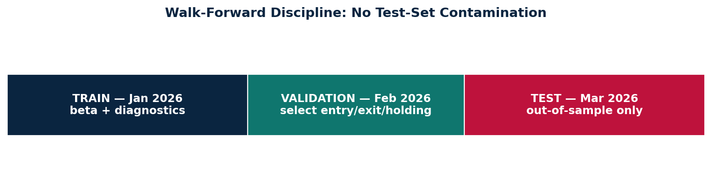
METHODOLOGY
Pair construction and walk-forward discipline
PAIR CONSTRUCTION
WALK-FORWARD SPLIT
r_XLK,t = β · r_stock,t + ε_t
spread_t = Σ ε_t (cumulative residual)
z_t = rolling z-score(spread_t)
z > +entry_z → short XLK, long β·stock
z < −entry_z → long XLK, short β·stock
WHY THIS DISCIPLINE MATTERS
January estimates β and diagnostics — NEVER touches z-score search.
February selects entry / exit / max-holding from a 6,840-cell grid.
March is held out — strategy parameters cannot leak into it.
selection_audit.csv tags every row as final-claim or diagnostic-only.
EXIT RULES
z crosses the exit band
max-holding minutes elapsed (30/60/120/240)
end-of-day flat
z-score stop-loss diagnostic at 3.5 / 4.0 / 4.5 / 5.0
FRE7121 — XLK Statistical Arbitrage
3 / 15

Slide 5
UPDATES SINCE LAST REVIEW
What changed,
and why the conclusion is sharper now.
Professor's last guidance focused on five items — all five are now implemented and audited end-to-end:
✓ high-frequency pair trading
✓ z-score heatmaps
✓ smaller thresholds than 3.5
✓ stop / risk controls
✓ explicit transaction-cost diagnostics
FRE7121 — XLK Statistical Arbitrage
4 / 15

Slide 6
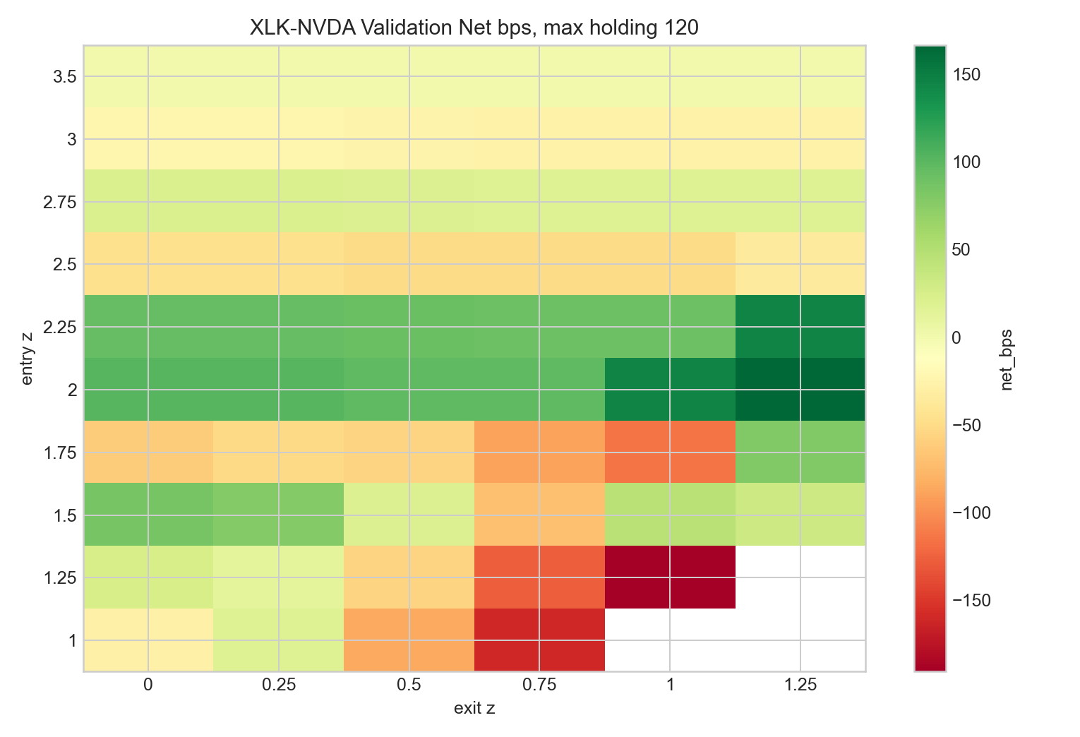
UPDATE 01 — PAIR TRADING + PARAMETER HEATMAP
Replacing the single z=3.5 rule with a full 10×6 grid
WHAT WAS WRONG
The old rule used entry_z = 3.5 only. That produced very few trades and made every result a 1–2 lucky-window outcome.
WHAT'S NEW
entry_z ∈ {1.0 … 3.5}, 10 levels
exit_z ∈ {0.0 … 1.25}, 6 levels
constraint: exit_z < entry_z
max-holding ∈ {30,60,120,240, none}
8 pairs × 5 max-holding × 60 z combos
= 6,840 audited cells, ~219K trades
XLK-NVDA validation surface — green islands cluster near (entry≈2.0, exit≈1.0). The selection picks the local maxima here.
FRE7121 — XLK Statistical Arbitrage
5 / 15

Slide 7
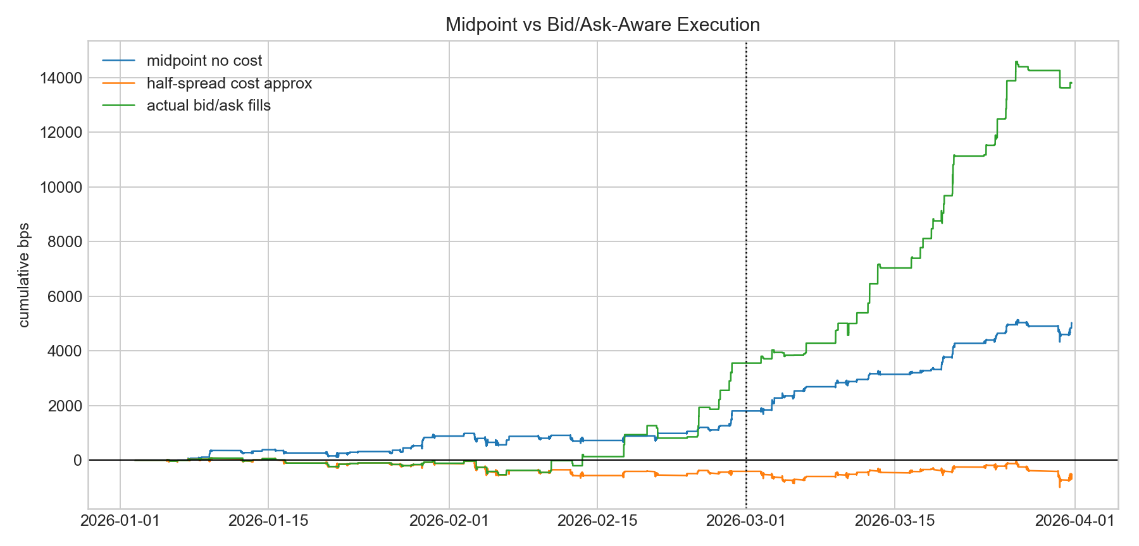
UPDATE 02 — EXPLICIT BID/ASK EXECUTION
From midpoint backtest to NBBO-aware fills
THREE EXECUTION MODELS
Midpoint, no cost
Generates +3,228 bps test net. Looks tradeable. It isn't.
Half-spread approx
Penalises every entry/exit by 0.5×spread. Goes negative.
Bid/ask boundary fills
Buy at ask, sell at bid, on the actual NBBO snapshot at entry/exit/position-change. The honest number.
XLK-ORCL trade timestamps, three execution models, same trades.
Same trades. Same data. The fill model is the entire story.
FRE7121 — XLK Statistical Arbitrage
6 / 15

Slide 8
UPDATE 03 — AUDIT TRAIL AT SCALE
Every claim now has a row that says: selected without seeing March
6,840
219,137
8
1
parameter cells evaluated
trade-log rows logged
pair leaderboards rebuilt
selection_audit.csv (truth)
EVERY GRID CELL NOW RECORDS
gross / cost / net bps
win rate
average holding minutes
max drawdown bps
trade count + turnover
Sharpe-style t-stat
max-holding setting
z-score stop diagnostic
execution model tag
entry & exit timestamps
direction (long/short)
exit reason (z-cross / max-hold / EOD)
FRE7121 — XLK Statistical Arbitrage
7 / 15

Slide 9
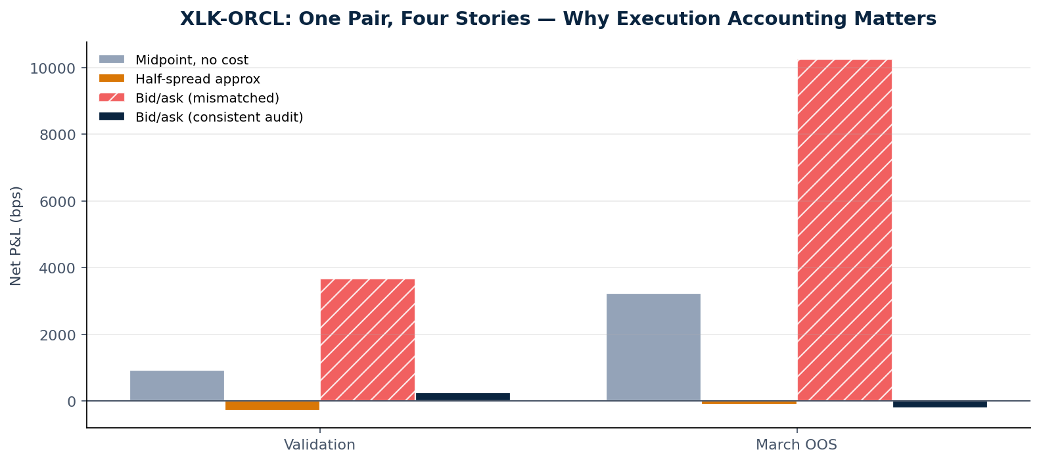
HONEST FINDING 01
XLK-ORCL: why the original +10,249 bps result was not real
BEFORE — METHOD_UPDATE.md
+10,249
bps March test (mismatched accounting)
AFTER — CONSISTENT BID/ASK AUDIT
−225
bps March test (gross +510, cost 735)
Root cause: the prior bid/ask version paired midpoint-window gross P&L with one-sided fill cost, double-counting half the spread. The corrected audit measures gross P&L on the same fill timestamps it charges costs at.
FRE7121 — XLK Statistical Arbitrage
8 / 15

Slide 10
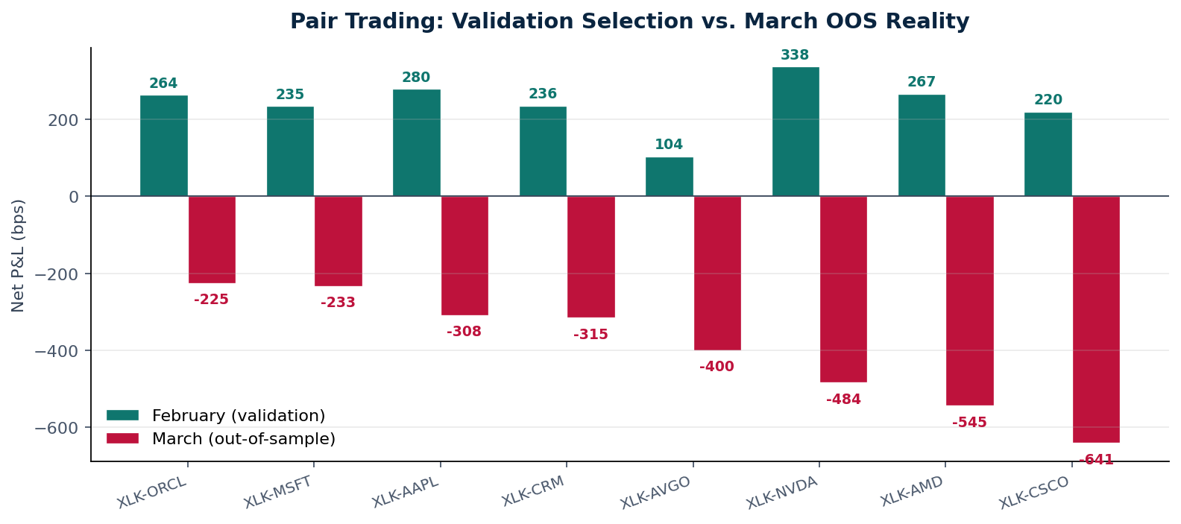
HONEST FINDING 02
All 8 pairs go red OOS — selection bias was doing the work
DIAGNOSIS
Validation alpha was selection bias.
Feb selects from 6,840 cells → some look great even by chance.
March doesn't replay February's quote / spread environment.
Spreads on single names (CRM 138bps, AVGO 92bps) eat any midpoint edge.
More trades ≠ more alpha — CSCO has the most trades and the worst loss.
Reading the chart: green = February validation net bps; red = March OOS. The flip is universal across every pair after consistent execution accounting.
FRE7121 — XLK Statistical Arbitrage
9 / 15

Slide 11
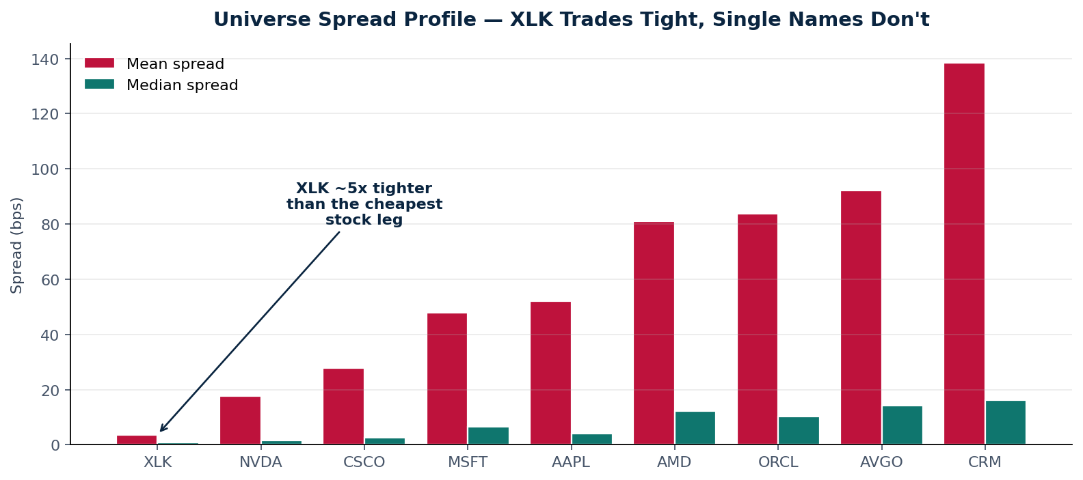
WHY THE PAIR TRADES LOSE MONEY
The cost arithmetic of a 5-bps ETF leg + 50-bps stock leg
THE COST ARITHMETIC
Round-trip on a 2-leg pair
XLK leg: ~ 4 bps × 2 = 8 bps
Stock leg: ~50 bps × 2 = 100 bps
Round-trip cost ≈ 108 bps
—
Mean residual move ≈ 50–80 bps.
Edge < cost on most trades.
This is not a parameter problem. It's a microstructure problem.
XLK quotes are tight because liquidity providers can hedge the basket. Single-name spreads are 5–40× wider — and the strategy must pay both.
FRE7121 — XLK Statistical Arbitrage
10 / 15

Slide 12
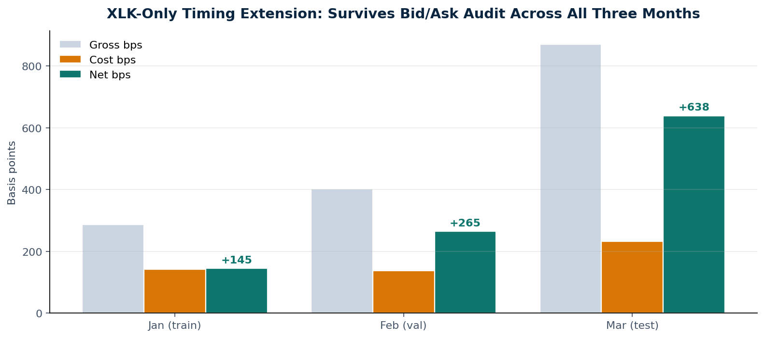
WHAT SURVIVED THE AUDIT
XLK-only timing: trade only the cheap leg, basket as signal
THE INSIGHT
Don't pay spread you don't need.
Build the basket-vs-XLK premium from quotes only — never trade the names.
Trade only the XLK leg when premium is extreme.
Round-trip cost collapses from ~108 bps to ~8 bps.
Net March OOS: +638 bps — replicates Jan/Feb sign.
Caveat: this is a small-universe directional ETF strategy, not a market-neutral arbitrage. It still owes us robustness checks on quote depth, queue position, and selection of the basket weights.
FRE7121 — XLK Statistical Arbitrage
11 / 15

Slide 13
NEXT STEPS — PART 1
Scale the universe; tighten the microstructure model
DATA
UNIVERSE
Top-20 / 6-month panel
Liquidity & spread filter
Move from 8 names × 3 months to top-20 by liquidity × 6 months. The framework already accepts it — only the universe list, the date split, and the parquet path change.
Drop names with median spread > 10 bps from pair candidates. Keep the wide-spread names only inside the timing-extension basket signal.
QUOTES
EXECUTION
Beyond top-of-book
Realistic fills
Add quote depth (bid_size, ask_size) and a micro-price (Stoikov 2018) instead of midpoint as the gross-P&L reference. Spread-weighted residuals should narrow the noise.
Add latency, partial-fill probability proportional to top-of-book size, and a borrow-cost model on the short leg. This will likely move the ETF-only strategy down too.
FRE7121 — XLK Statistical Arbitrage
12 / 15

Slide 14
NEXT STEPS — PART 2
From threshold rules to optimal market-making models
MODEL
MODEL
Avellaneda–Stoikov optimal MM
Dynamic hedge β (Kalman)
Replace fixed z-bands with reservation-price quoting. Inventory penalty γ and intensity κ make spread-capture endogenous to inventory risk. Becomes a market-making strategy, not just a stat-arb one.
Time-varying β instead of a January point estimate. Lets the cointegration relationship breathe across regimes — would have helped catch the Feb→Mar shift.
MODEL
RISK
OU / Avellaneda–Lee scoring
Portfolio-level VaR + drawdown stop
Score each pair by its Ornstein–Uhlenbeck mean-reversion speed and signal-to-noise. Trade only pairs with statistically meaningful s-score, replacing the leaderboard heuristic.
Right now each pair has its own stop. Add an aggregate inventory and DD constraint across pairs to prevent correlated losses on rebalancing days.
FRE7121 — XLK Statistical Arbitrage
13 / 15

Slide 15
LITERATURE THAT WILL DRIVE THE NEXT ITERATION
Six papers, mapped to specific changes in the project
PAIR SELECTION
OPTIMAL MM
FAIR-VALUE
Avellaneda & Lee (2010)
Avellaneda & Stoikov (2008)
Stoikov (2018)
Statistical arbitrage in the U.S. equities market
High-frequency trading in a limit-order book
The Micro-Price: a high-frequency estimator of future prices
Drop-in replacement for the leaderboard: compute the s-score on residuals, rank by it, retire pairs whose OU half-life > horizon.
Inventory-aware quoting framework. Replaces fixed z-bands with reservation-price spread that reacts to current position and time-to-close.
Use micro-price (size-weighted) instead of midpoint as the gross-P&L reference. Should reduce the apparent midpoint–bidask gap that misled the original ORCL number.
SURVEY
EXECUTION
IMPACT
Krauss (2017)
Cartea, Jaimungal & Penalva (2015)
Almgren & Chriss (2001)
Statistical arbitrage pairs trading strategies — review and outlook
Algorithmic and High-Frequency Trading
Optimal execution of portfolio transactions
Survey of 5 pair-trading methodologies. Useful for justifying the cointegration choice and for adding a copula-based variant as a robustness check.
Standard reference for execution costs, optimal liquidation, and stochastic optimal control. Use Chapters 7–10 to formalise the cost model and the inventory-stopping rule.
If the next phase trades larger size, slice every entry/exit using AC and add temporary + permanent impact terms to the cost model.
FRE7121 — XLK Statistical Arbitrage
14 / 15

Slide 16
CLOSING
The deliverable was a strategy.
The contribution is a framework that knows when one is real.
Walk-forward selection discipline — Jan / Feb / Mar with audit tags.
Bid/ask boundary execution model — same fills used for cost and gross.
Negative pair result that survives the audit — a defensible empirical claim.
Positive XLK-only timing extension that survives the audit — a real next-phase candidate.
Thank you · Questions welcome

