Slide 1



Liceria & Co.
In India, millions of digital users—especially students, gig workers, and rural earners—actively transact through UPI yet remain ineligible for formal credit due to a lack of traditional credit history. Banks and NBFCs struggle to evaluate such users’ repayment capability, resulting in credit exclusion or unreliable micro-lending based on incomplete data.

Slide 2
Objective
Add a little bit of body text

Slide 3
Proposed Solution

Slide 4
Target Market and customer segments

Slide 5
Unique value proposition
  Other apps use smartphone data, telco info etc which may not be available for a majority of the people. Our product uses UPI + AePS transaction data which is widely available.
  Explainable AI shows how each factor affects TrustScore & Resilience.
  Financial inclusion & literacy - helping users qualify and improve over time.

Slide 6
Business model canvas

Slide 7
Market Analysis
  India’s fintech sector is witnessing explosive growth — UPI processes over ₹20 lakh crore in transactions every month
  Yet, nearly 300 million Indians remain credit-invisible, unable to access formal loans due to a lack of credit history, despite active UPI use.
  The digital lending market in India is projected to surpass ₹29 lakh crore by 2028, growing at a 25% annual rate.

Slide 8
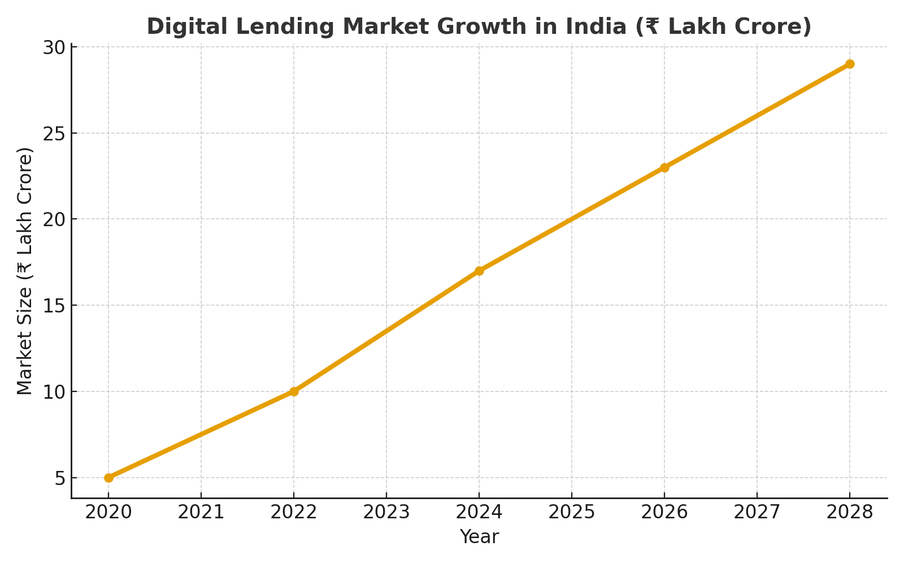

Slide 9
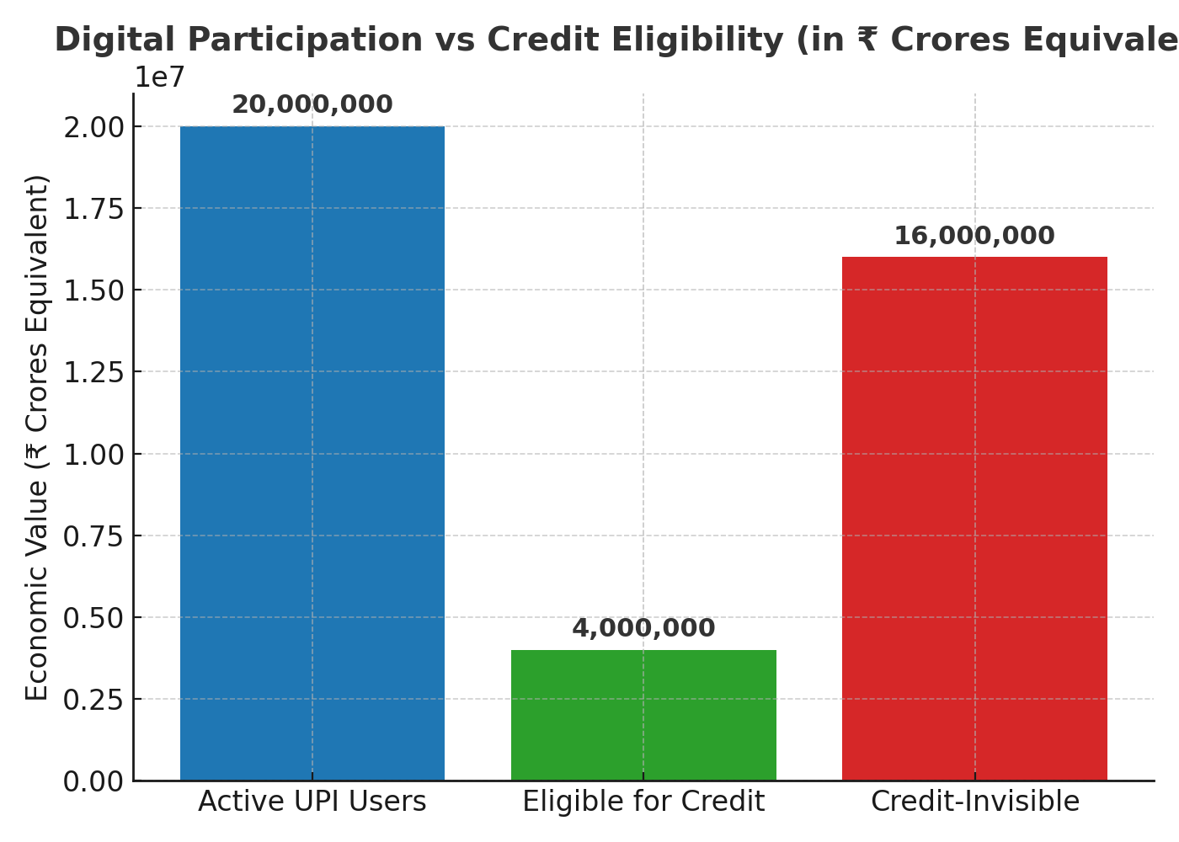

Slide 10
Proposed Solution
  Transforms UPI transaction data into financial credibility using AI models that classify expenses into needs, wants, and savings.
  Generates dual financial metrics —
    TrustScore: Measures financial discipline.
    Financial Resilience Meter: Evaluates income stability and credit-handling capacity.
  Provides personalized insights & smart recommendations to help users improve financial habits and boost loan eligibility.
  Integrates with RBI’s Account Aggregator Framework ensuring consent-based, secure, and privacy-compliant data use.
  Bridges the gap between users and financial institutions by enabling data-backed, fair, and inclusive lending decision

Slide 11
Competitive Analysis
  CreditVidya - Uses alternative data to help banks assess customers, more tailored towards urban customers who have digital footprint.
  LenddoEFL - Uses social and psychometric data
  Perfios / Anumati (Account Aggregator, a potential infra partner) - Provides APIs for banks to access financial data with user consent.
How our product overcomes these challenges:
  Our platform uses UPI + AEPS data, which even rural users already generate + visual charts.
  Most of the time, competitors use a black-box algorithm which doesnt allow for user feedback.
  It’s an AI-driven scoring + insight platform that any bank or MFI can use.
  The platform could integrate AA data and add AI-based behavioral analytics and TrustScore insights.

Slide 12
Financial projection (is it same as cost analysis?? - only include if applicable)

Slide 13
Proposed Solution
  Partner institutions (banks, NBFCs, fintechs) purchase data-analysis credits in bulk to access the dashboard’s AI-driven TrustScore and Financial Resilience evaluations.
  Each credit allows them to analyze one user’s financial behavior or verify digital creditworthiness.
  Bulk purchases ensure scalability and recurring revenue as financial institutions onboard more users.
  Flexible pricing tiers based on volume of credits and feature access (e.g., API integration, dashboard analytics, risk reports).

Slide 14
Target Market
  Over 65% of India’s population resides in rural and semi-urban regions, where formal credit access remains under 10% despite growing digital adoption.
  Rapid smartphone penetration and widespread UPI usage have created a massive untapped base with digital transaction footprints but no credit history.
  These regions are witnessing a surge in government-backed digitization drives and financial inclusion schemes, yet traditional credit scoring systems fail to represent these users accurately.

Slide 15
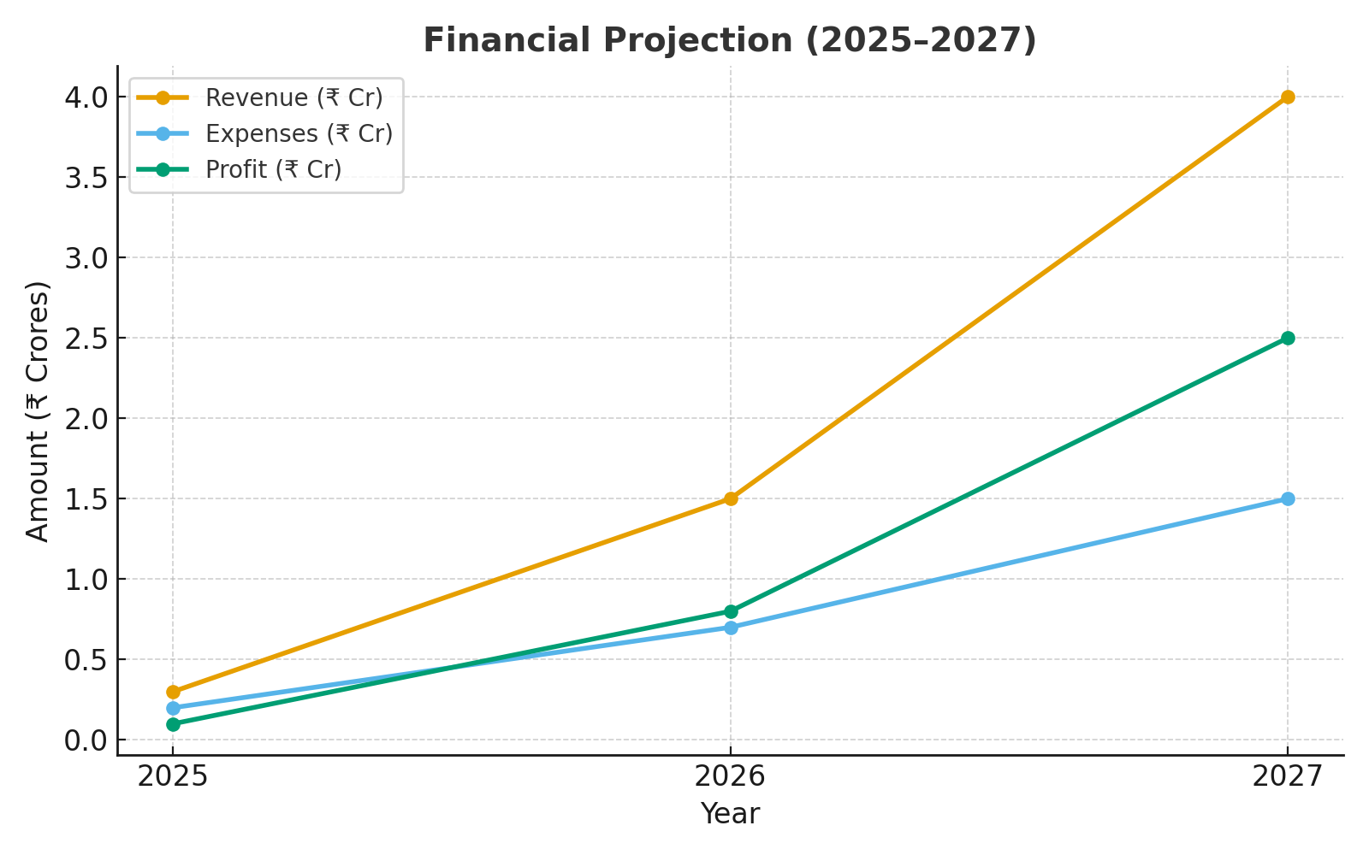

Slide 16
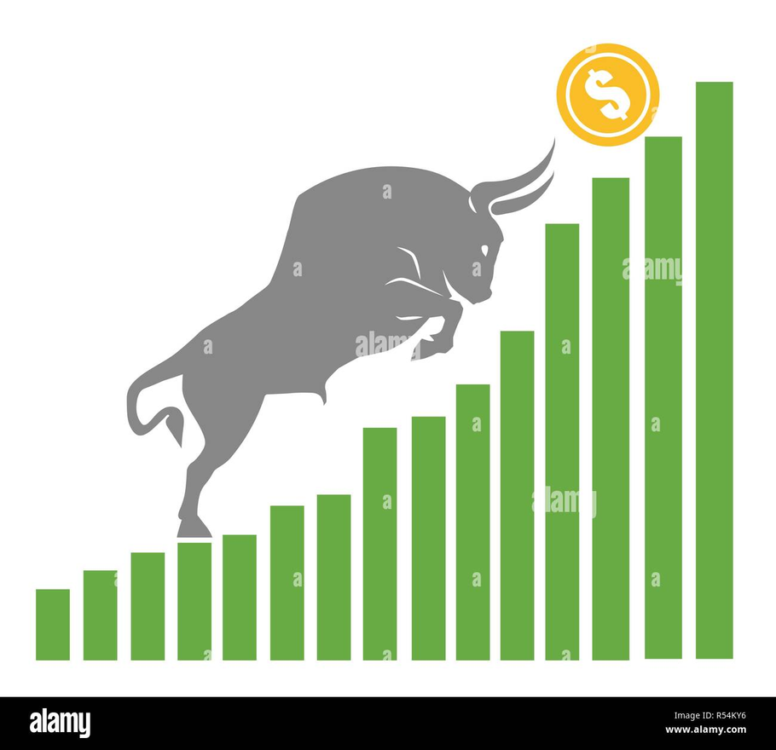
Go to Market Stratergy
1. Strategic Partnerships (B2B2C model)
2. Government & CSR Integration
3. UPI Ecosystem Leverage

Slide 17
Final Financial Projection
Assumptions
  You sell to MFIs, rural banks, and cooperatives.
  Each year’s growth is mainly in the number of partner institutions, while reports per institution stay roughly constant (≈1000 each).
  Price per report: ₹30
  Cost per report: ₹15

Slide 18
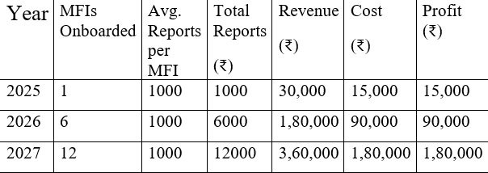
Yearly Breakdown

Slide 19
How we used comet
  Used Comet Browser to gather research materials and references efficiently.
  Accessed real-time data and documentation for project development.
  Utilized it for collaborative web browsing and sharing research findings.
  Helped in testing and previewing our web-based project components.

