Slide 1
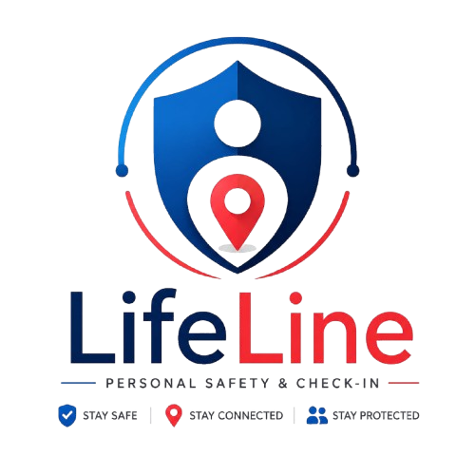
LifeLine
Safety in one tap.
Personal Safety & Check-In
Group 39 · Phoenix Cohort · TS Academy PM Capstone · May 2026
Anthony Osakwe · Faith · Bolanle · Nosa · Favour
Notes:
Welcome. We are Group 39 from TS Academy's Phoenix Cohort. The product we built is called LifeLine — a personal safety and check-in web app for Nigerian campus students. We will walk you through the problem, our user, the solution, and the road ahead.

Slide 2
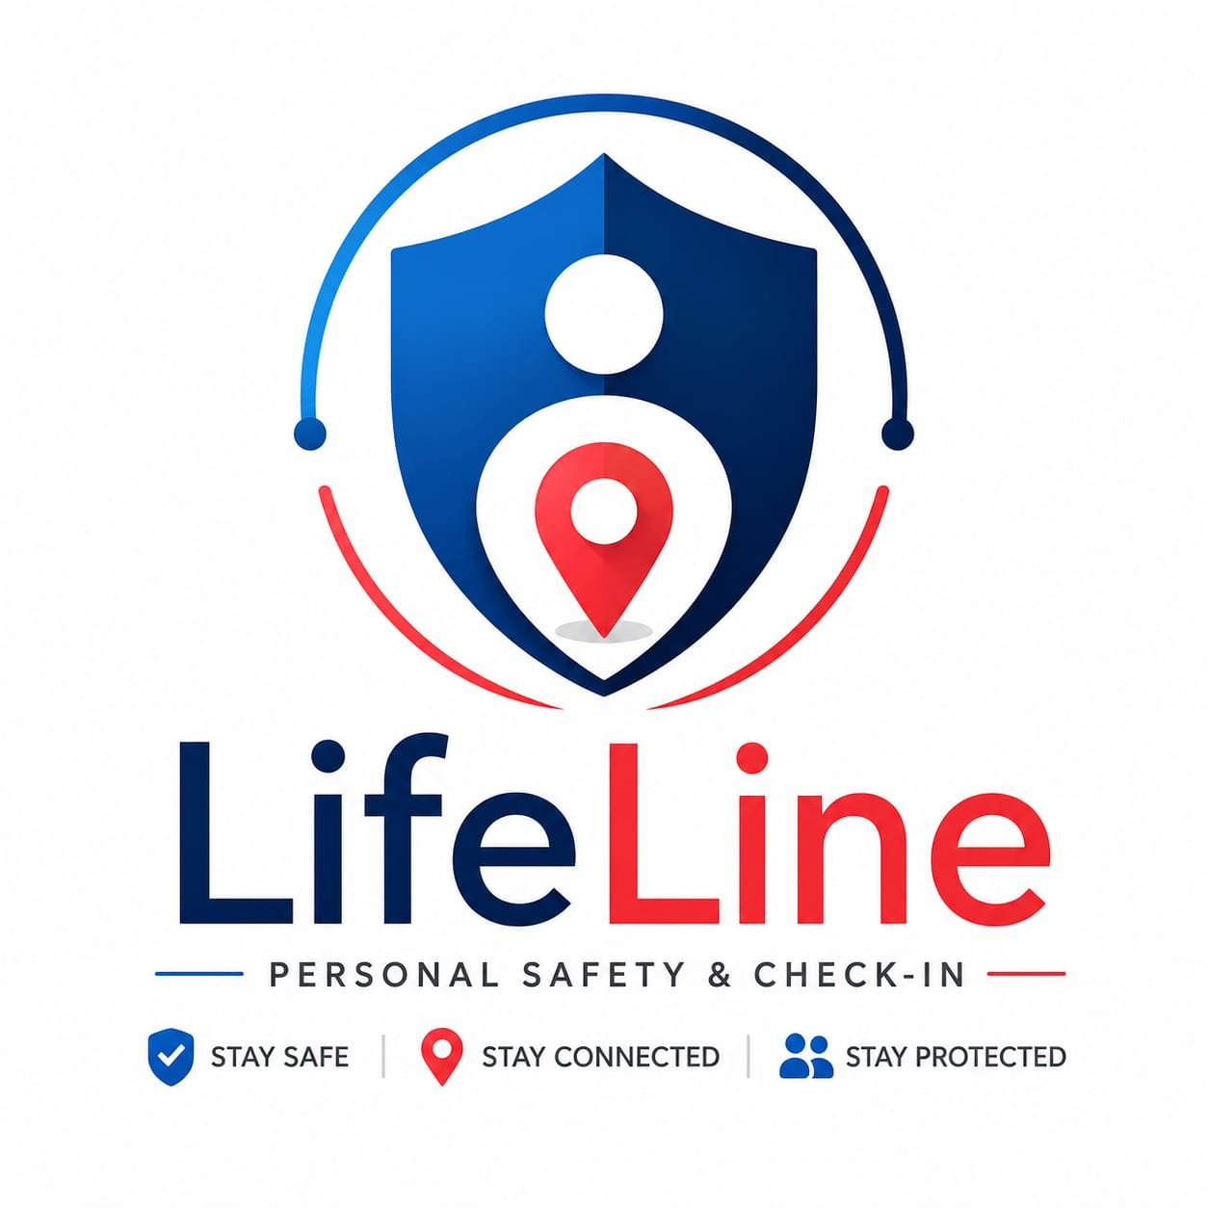
THE PROBLEM
Where harm happens
79%
of campus women feel unsafe
walking alone after 7pm
“Whenever I’m entering Bolt at night, I always send my live location to at least two people. Even after that, I still feel anxious till I reach home.”
69%
have experienced or
witnessed a safety incident
Amaka O., 22 — University student, Lagos
Discovery interview #1
61%
rely on manual workarounds:
share location, fake phone calls
6 real interviews confirmed:
The gap between “text a friend” and “call the police” is where harm happens.
Notes:
Our discovery research consistently surfaced one core pain: there is a dangerous gap between informal check-ins (WhatsApp, phone calls) and the emergency services. 79% of the 52 survey respondents reported feeling unsafe on campus after 7pm. All 6 interviewees had already invented manual safety systems for themselves — sharing live locations, pretending to be on calls, texting repeatedly. The product's job is to formalise and automate what they already do.

Slide 3
DISCOVERY INSIGHT
The reframe that shaped everything
BEFORE
AFTER
Emergency-first thinking
Prevention-first design
We started building an SOS panic button as the
primary feature. The assumption was:
users need emergency help in a crisis.
Users don’t expect emergencies. They want a
routine “I arrived safely” signal — automatic,
low-friction, every journey.
➡
Discovery
revealed
“We were solving for the rare moment,
not the daily need.”
“Safe Arrival is the daily habit.
SOS is the safety net.”
Notes:
This is the single insight that changed our product. We originally designed the SOS panic button as the hero feature. After 6 interviews, the pattern was clear: users don't actually fear emergencies every day — they fear the anxiety of routine journeys with no structured check-in. The Safe Arrival flow is used daily. The SOS is the safety net that must be flawless when it fires. This reframe is reflected in our North Star metric, our UI hierarchy, and our GTM messaging.

Slide 4
THE USER
Ada Umeh
20 years old · 300-level Biochemistry · University of Nigeria, Nsukka
DAILY ROUTINE
CURRENT WORKAROUND
TOP FRUSTRATION
Library until 9pm
Manual, fragmented
The walk after 8pm
Lectures end at 6pm. She stays late in the library, then walks back to her hostel through dimly-lit campus paths.
Calls her boyfriend on the walk. Has campus security numbers saved but has never tested if they pick up.
She rushes. Watches every shadow. Doesn’t enjoy late library sessions because the walk home is always anxious.
“Why she’d use LifeLine:”
A configured Safe Arrival trip handles the “let mum know I’m home” routine automatically. The SOS gives her real recourse if something feels off on the walk.
Notes:
Ada is our primary persona. She is not a fictional construct — she represents the composite of 6 real users we interviewed, all of whom shared the same core pattern: they move alone at night on campus, they have invented manual safety systems, and they are anxious not because emergencies happen daily, but because they have no reliable check-in mechanism. Ada's decision to stay in the library late is directly affected by the anxiety of the walk home — that is the opportunity LifeLine addresses.

Slide 5
THE SOLUTION
Safety in one tap.
SAFE ARRIVAL FLOW — daily habit
SOS FLOW — safety net
✓ Pick destination + ETA (15 / 30 / 60 min)
⚠ Hold red SOS button 3 seconds (SVG ring fills)
✓ Select trusted contacts to watch
⚠ Haptic feedback: [200ms, 100ms, 200ms] vibration
✓ Live OpenStreetMap tracking + countdown timer
⚠ 2:45 escalation countdown begins
✓ Tap “I’ve arrived safely” → confetti + contacts notified
⚠ Live GPS streams to trusted contacts
✓ ETA expires without tap → contacts auto-alerted
⚠ “I’m safe — cancel” override any time before 2:45
✓ Zero manual texting required once configured
⚠ Timer expires → contacts see location on red-tinted map
North Star: ≥ 90% of journeys end in safe-arrival confirmation
Shake-to-SOS hint · Pocket-bump safe: 3-second hold prevents false alarms
Notes:
LifeLine delivers exactly two core flows. Safe Arrival is the daily-habit flow — it handles the routine 'let mum know I'm home' automatically. SOS is the safety net — it rarely fires, but when it does it must be flawless: 3-second deliberate hold to prevent accidental triggers, a 2:45 cancellation window, and automatic escalation if the user cannot respond. Demo OTP code for today is 8484.

Slide 6
LIVE DEMO
What you will see in the next 90 seconds
1
Onboarding
2
Safe Arrival
3
Live Tracking
4
SOS Flow
5
Failure Paths
OTP screen
Demo code:
8484
Set destination
+ ETA
Share contacts
OSM map
Countdown
timer
3-sec hold
2:45 timer
Cancel override
Wrong OTP
GPS denied
ETA overdue
Demo URL:
http://tsa-phoenix-safetytech-39.github.io/lifeline/lifelineapp · Works on any phone · Nigerian 3G tested · No install required
Notes:
Open the app on your phone or laptop: tsa-phoenix-safetytech-39.github.io/lifeline/lifelineapp. Walk through: (1) OTP screen — enter 8484. (2) Add a trusted contact. (3) Start a Safe Arrival trip — pick destination, set 30-min ETA, share with contacts. (4) Show the live map and countdown. (5) Tap 'I've arrived safely' — watch the confetti. (6) Return to home screen, hold the SOS button for 3 seconds — show the escalation timer and cancel. If network is slow: the app is a single file with Leaflet embedded — it works offline. OSM tiles are the only network dependency and degrade gracefully to grey.

Slide 7
ARCHITECTURE & TECH
Built for Nigerian networks, not California ones.
Frontend
Vanilla HTML + CSS + JavaScript. No framework. No build step.
Why self-hosted libraries?
Map
Leaflet 1.9.4 — embedded inline (~147KB). Zero CDN dependency.
jsDelivr, unpkg, and Cloudflare CDNs are unreliable on MTN 3G in Nigeria. Embedding Leaflet directly in the same file means the app loads completely from one HTTP request — no external dependencies that can fail.
Map tiles
OpenStreetMap (free, no API key). Fails gracefully to grey.
Location
Browser navigator.geolocation (GPS)
Haptics
navigator.vibrate — [200ms, 100ms, 200ms] on SOS activation
Known limitations (honest):
Deployment
GitHub Pages — single file, ~210KB total
• Map tiles still need internet (fail gracefully to grey)
Backend (V2)
Supabase (Postgres + Auth + Realtime)
• No persistence — refresh resets state (V2 fixes via Supabase)
• Tested on iPhone 13 mini + Tecno Camon 19 only
SMS (V2)
Termii / Africa's Talking
Notes:
The defining technical decision was to embed Leaflet (the map library) directly into the HTML file rather than loading it from a CDN. This was not laziness — it was an explicit network-resilience design choice after discovering that CDNs are frequently blocked or throttled on MTN 3G in Nigeria. The result: the app loads from a single 210KB file with no external dependencies at load time. Known limitations are honest — no backend persistence in MVP (planned for V2 via Supabase), and tiles still require network (they degrade gracefully).

Slide 8
METRICS & SUCCESS
How we know LifeLine is working.
NORTH STAR
METRIC
ACTIVATION RATE
DAILY HABIT
EMERGENCY EFFECTIVENESS
70%
3×/wk
80%
90%
New users who complete onboarding + add ≥1 contact
Safe-arrival sessions per active user per week
SOS alerts where contact responds within 2 minutes
% of journeys ending in
successful safe-arrival confirmation
V2+ NSM: Safety Interactions per Active User per week
Guard metric: False-positive rate < 15% · Alert delivery < 5s (V2) · Dashboard mocked in Metrics Plan v2 §6
Notes:
The North Star is the single clearest measure of whether LifeLine fulfils its core promise: does Ada get home and does the app register it? We deliberately chose this over vanity metrics like downloads or DAU because it cannot be gamed. The three supporting metrics diagnose WHY the North Star moves: activation rate (are users configured?), daily habit frequency (are they using it?), and emergency effectiveness (does it work when it matters?). A full mocked dashboard is documented in our Metrics & Tracking Plan v2, Section 6.

Slide 9
GTM & ROADMAP
From UNN pilot to nationwide platform.
ACQUISITION
ROADMAP
PRIMARY
SECONDARY 1
SECONDARY 2
MVP
May 2026
(shipped)
Campus Ambassador
Built-in Referral
Social Content
Single-file web app
12 screens, 3 flows
GitHub Pages
50 ambassadors at UNN. Each acquires 30–50 users. Target: 1,500–2,500 organic users.
Adding a trusted contact sends them an invite. Each user brings 3–5 contacts naturally.
TikTok/Instagram POV safety scenarios. 3–5 posts/week. Low cost, high campus reach.
V2
Y1 Q1
Supabase backend
Real SMS via Termii
Persistent accounts
V3
Y1 Q2–Q3
Offline PWA
Voice SOS
UNN + UNILAG closed beta
Pilot plan:
V4
Y1 Q4
Wks 1–4: 300–500 UNN students (soft launch) → Wks 5–12: #ArriveSafeChallenge public campaign. Success gate: 2,000–5,000 users, ≥40% Day-30 retention.
Public launch
Expanded personas
Paid B2B tier
V5
Year 2
Public API
Risk maps
Wearables
Notes:
Our GTM starts hyper-local: UNN, where Ada lives. We start small because it lets us close the feedback loop quickly — we know the campus, we have contacts there, and the tight-knit hostel community is high on referral behaviour. The built-in referral loop is the product's best marketing: every trusted contact Ada adds receives an invitation to download LifeLine. The roadmap is honest about what's in the MVP and what's coming. V2 is the critical milestone — real backend, real SMS, persistent accounts. Full GTM Mini-Plan is a separate 2-page deliverable.

Slide 10
THE TEAM
Group 39 · Phoenix Cohort · TS Academy
PM
RS
DS
BL
GT
Product Management
Research & Discovery
Design
Build
GTM & Comms
PM lead, PRD, metrics, roadmap
6 interviews, 52-person survey, insights
Journey map, wireframes, Figma prototype
HTML MVP, GitHub Pages, no-CDN resilience
GTM plan, pitch deck, demo-day delivery
What we learned building LifeLine:
Thank you.
✓ Discovery reshapes products — our SOS-first design became prevention-first after interview #2.
✓ Network constraints are a product requirement, not a deployment problem.
Questions & feedback welcome.
✓ Honest scope beats aspirational scope — every judge can tell.
Safety in one tap.
Notes:
We are five squads who built a real, working safety app from scratch in under four weeks. PM designed the product logic and metrics. Research validated the problem with real users. Design built the flows and Figma prototype. Build shipped a working HTML app. GTM built the strategy and this deck. Three things we would tell the next cohort: let discovery lead, not confirm; treat network constraints as part of your MVP spec; and be honest about what you built vs what you plan to build — judges respect that more than polished fiction. We are ready for questions. The demo URL is live.

