Slide 1
CIND119
Project
Dataset: Credit Card

Slide 2
Attributes , Types and Features
Attribute | Creditability | Account Balance | Duration of Credit (month) | Payment Status of Previous Credit: | Purpose of the loan | Credit Amount value showing the credit amount | Value Savings/Stocks: | Length of current employment: | Instalment percent | 10. Sex & Marital Status:
Type | Nominal | Nominal | Numerical | Nominal | Nominal | Numerical | Nominal |  | Numerical | Nominal
Features | 1: Good | 1:<0DM |  | 0: no credits taken | 0: New car |  | 1 : < 100DM | unemployed, |  | (1: male :divorced/separated
 | 2:Bad | 2:0<=,,,<200 DM |  | 1: All credits at this bank paid back duly | 1: Used car |  | 2: 100<= ... < 500 DM | 2: < 1 year, |  | 2: female : divorced/separated/married,
 |  | 3: >200DM |  | 2: existing credits paid back duly till now | 2.Furniture/Equipment |  | 3 : 500<= ... < 1000 DM | 3: 1<=...<4 years, |  | 3 : male: single,
 |  | 4: No Checking account |  | 3: delay in paying off in the past | 3: Radio/Television |  | 4 : =>1000 DM | 4: 4<=...<7 years, |  | 4: male :married/widowed,
 |  |  |  | 4: critical account. | 4: Domestic Appliances |  | 5: unknown/ no savings | 5:>=7years). |  | 5 : female : single)
 |  |  |  |  | 5: Repairs
 |  |  |  |  | 6: Education
 |  |  |  |  | 7:Vacation
 |  |  |  |  | 8: Retraining
 |  |  |  |  | 9: Business
Guarantors | Duration in Current address | Most valuable available asset: | Age (years): | Concurrent Credits: | Type of apartment | No of Credits at this Bank | Occupation: | No of dependents | Telephone | Foreign Worker
Nominal | Nominal | Nominal | Numerical | Nominal | Nominal | Numerical | Nominal | Numerical | Nominal | Nominal
1 : none, | 1: <= 1 | 1 : real estate |  | ( 1 : bank, | 1 : rent, |  | 1 : unemployed/ unskilled - non-resident, |  | 1:Yes | 1:Yes
2 : co-applicant, | 1<...<=2 years | 2 : savings agreement/ life insurance, |  | 2 : stores, | 2 : own, |  | 2 : unskilled - resident, |  | 2:No | 2:No
3 : Guarantor | 2<...<=3 years | 3 : car or other, |  | 3 : none ) | 3 : for free) |  | 3 : skilled employee / official
 | 3:>4years | 4 : unknown / no property) |  |  |  |  | 4 : management/ self-employed/highly qualified employee/ officer)

Slide 3
Summary of the Type
Numeric : Duration of Credit Credit Amount
Instalment percent No. of credits at this bank
Age No. of dependents
Nominal: Creditability Concurrent credits
Account Balance Type of apartment
Payment status of previous credit Occupation
Purpose of the loan Telephone
Value savings / stock Foreign Worker
Length of current employment
Sex and Marital status
Guarantors
Duration in current address
Most Valuable available asset

Slide 4
Min, Max, Mean & Standard Deviation
Attribute | Min | Max | Mean | Std. Dev.
Duration of Credit | 4 | 72 | 20.903 | 12.059
Credit Amount | 250 | 18424 | 3271.25 | 2822.75
Instalment percent | 1 | 4 | 2.973 | 1.119
No. of credits at this bank | 1 | 4 | 1.407 | 0.578
Age | 19 | 75 | 35.542 | 11.353
No. of Dependents | 1 | 2 | 1.155 | 0.362

Slide 5
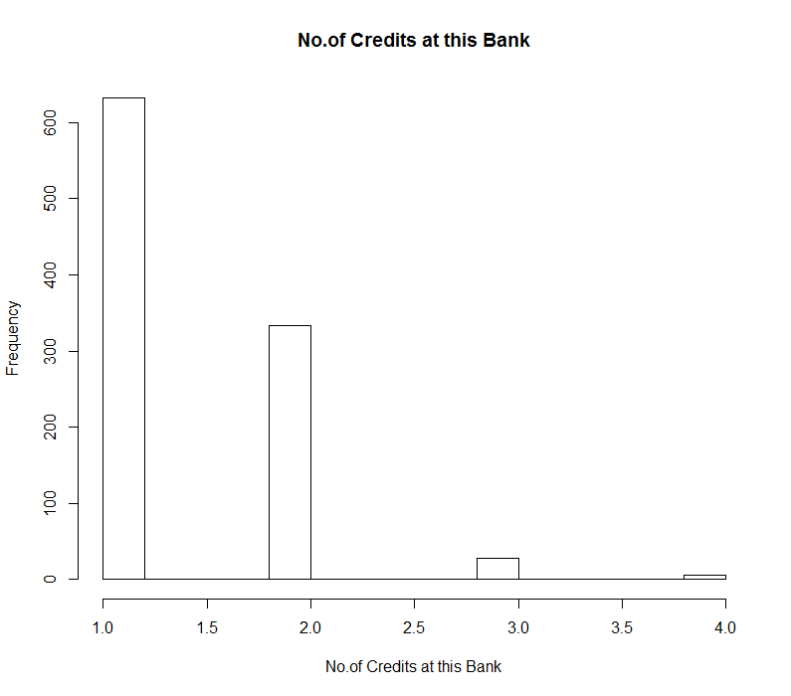
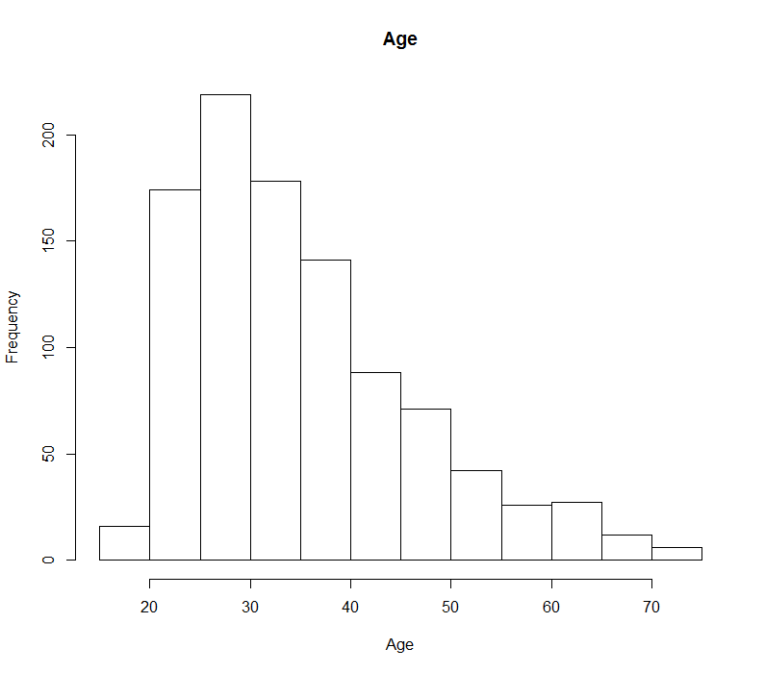
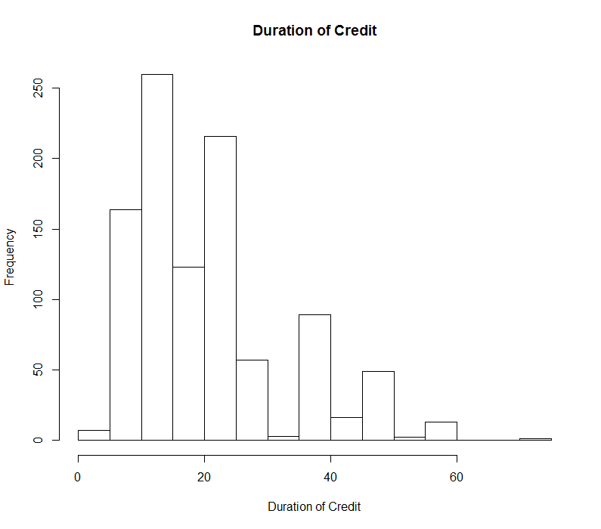
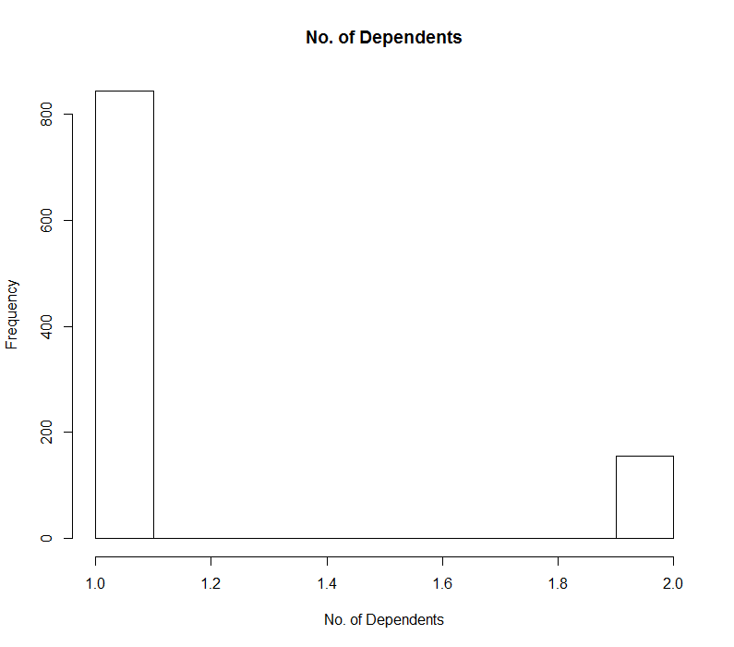
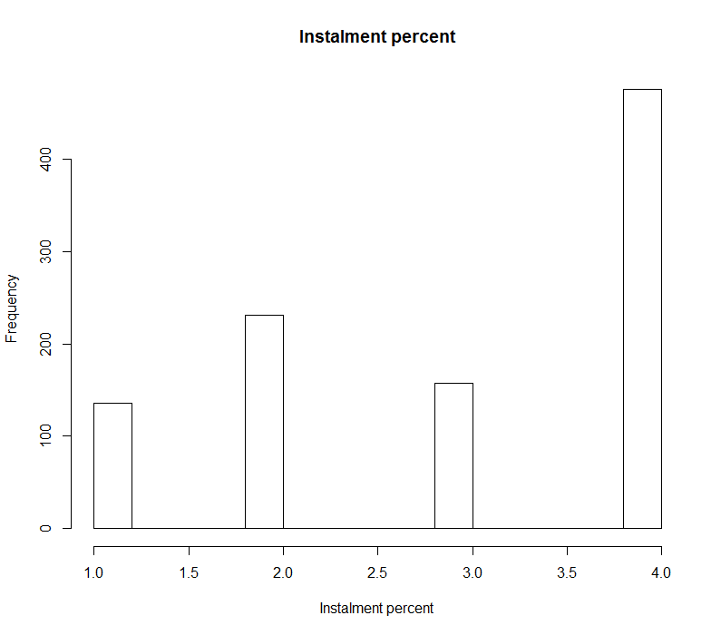
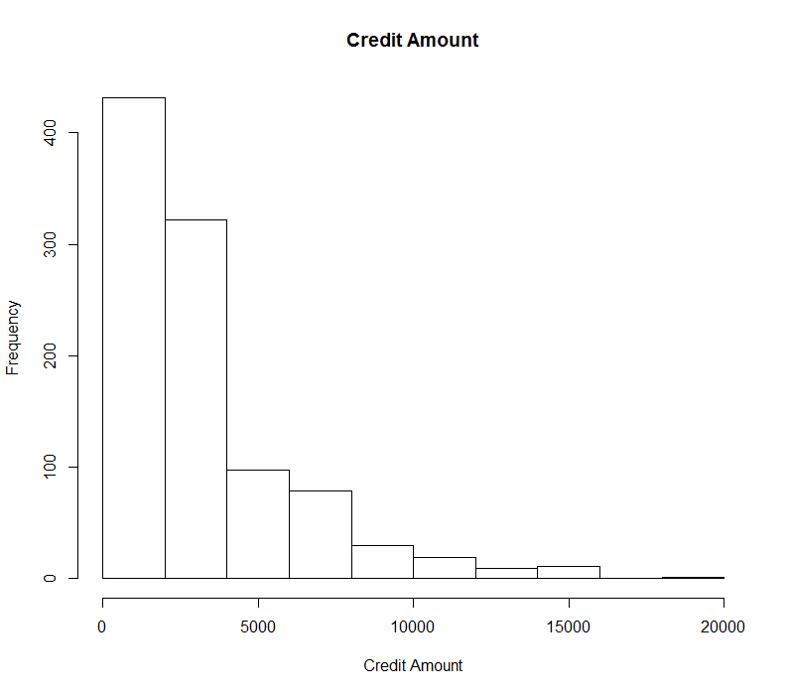

Slide 6
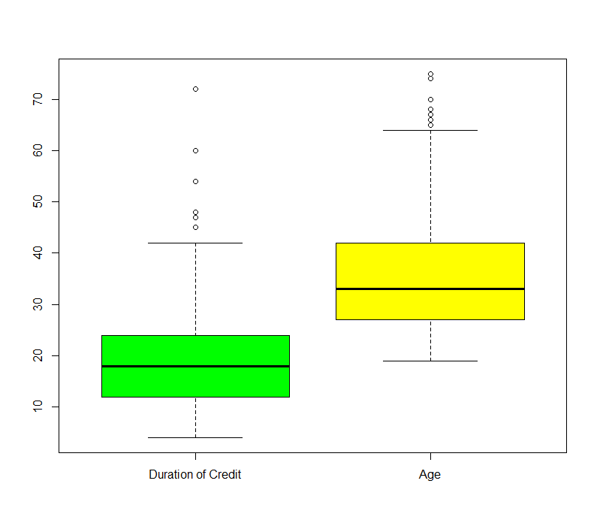
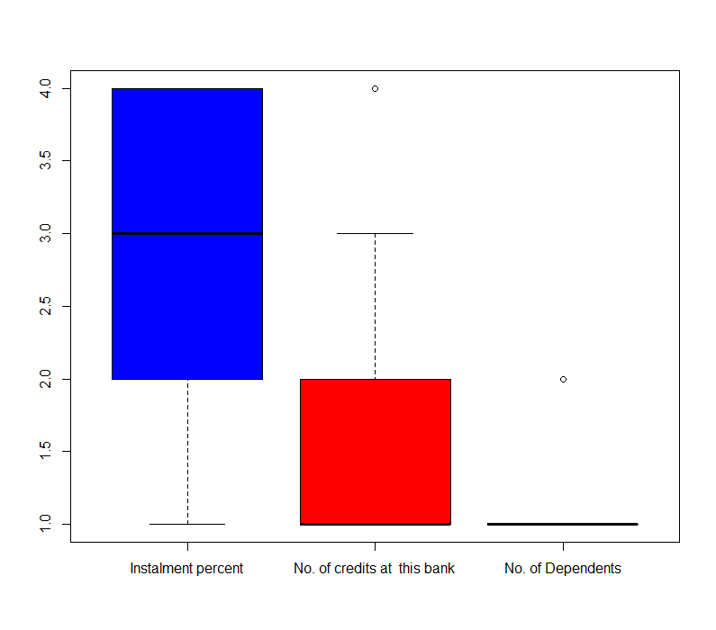
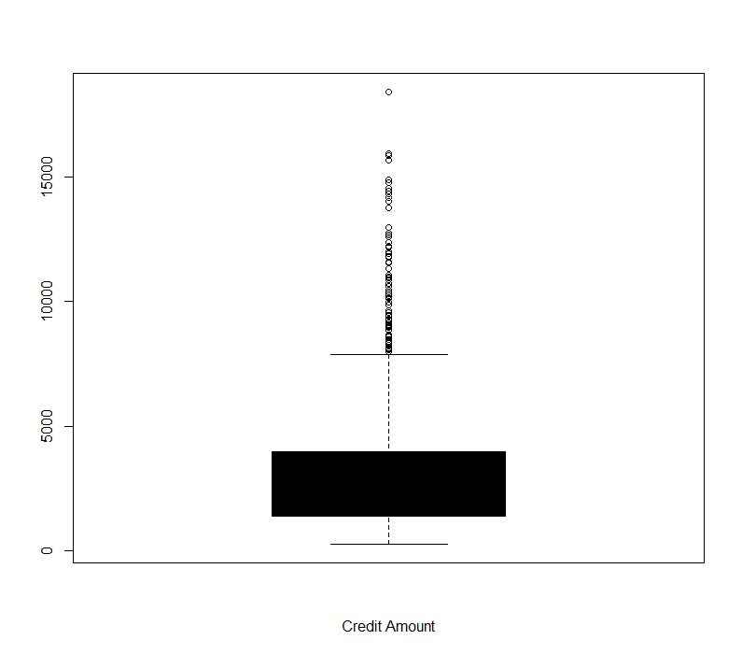
Attribute | Outliers
Duration of Credit | >42
Credit Amount | >7500
Instalment percent
No. of credits at this bank | >=3
Age | >50
No. of Dependents | 2

Slide 7
Instances left
data_sub2<-subset(data,data$Age..years.<50&No.of.Credits.at.this.Bank<3&data$Duration.of.Credit..month.<42&data$Credit.Amount<7500)
Left with 741 instances
Exported the file out of R and that is the file tried to use for classification but realised that there is not much difference in the accuracy.

Slide 8
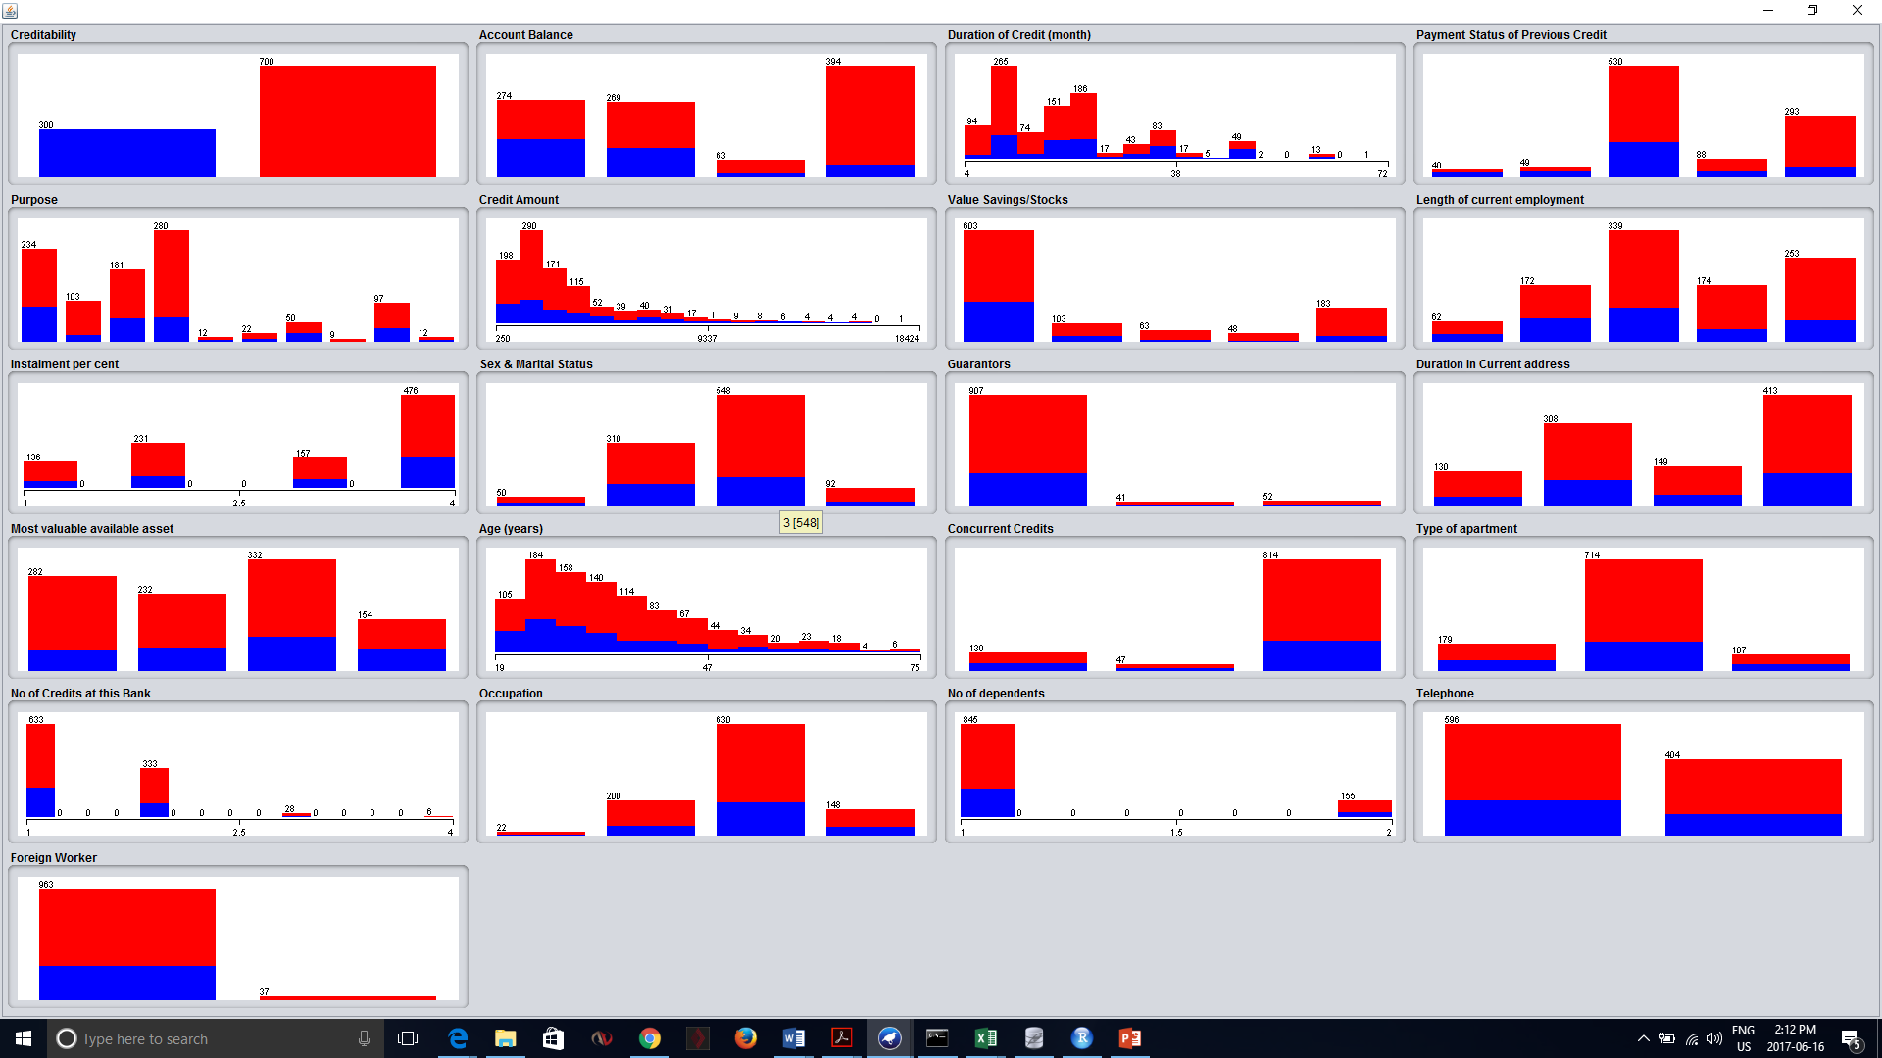

Slide 9
Ranked attributes: Based on Info Gain Attribute Eval
0.094739 2 Account Balance 0.001337 18 Occupation
0.043618 4 Payment Status of Previous Credit 0.000964 20 Telephone
0.0329 3 Duration of Credit (month) 0.000543 12 Duration in Current address
0.028115 7 Value Savings/Stocks 0 19 No of dependents
0.024894 5 Purpose 0 9 Instalment per cent
0.018333 6 Credit Amount 0 17 No of Credits at this Bank
0.016985 13 Most valuable available asset
0.013102 8 Length of current employment
0.013077 16 Type of apartment
0.011278 14 Age (years)
0.008875 15 Concurrent Credits
0.006811 10 Sex & Marital Status
0.005823 21 Foreign Worker
0.004797 11 Guarantors

Slide 10
Predictive Modeling (Classification)

Slide 11
Models used
1. Naïve Bayes
2. J48
3. Random Forest

Slide 12
Tests | 1000 fold | 10 fold | Confidence Factor | Correctly Classified Instances (%) | True Positive | False Positive | Precision | Recall
Naive Bayes |  | * | Not applicable | 75 | 0.867 | 0.532 | 0.795 | 0.867
 | * |  | Not applicable | 75.7 | 0.87 | 0.507 | 0.8 | 0.87
J48 |  | * | 0.25 | 71.9 | 0.841 | 0.507 | 0.776 | 0.841
 | * |  | 0.25 | 70.8 | 0.817 | 0.547 | 0.777 | 0.817
 |  | * | 0.2 | 72.2 | 0.844 | 0.563 | 0.778 | 0.844
RandomForest |  | * | Not applicable | 75 | 0.901 | 0.603 | 0.777 | 0.901
 | * |  | Not applicable | 75.3 | 0.897 | 0.583 | 0.782 | 0.897

Slide 13
Post-predictive Analysis

Slide 14
Clustering

Slide 15
Final cluster centroids:
Cluster#
Attribute Full Data 0 1
(700.0) (484.0) (216.0)
====================================================================
Account Balance 4 4 4
Duration of Credit (month) 12 24 12
Payment Status of Previous Credit 2 2 4
Purpose 3 3 2
Credit Amount 1258 701 1169
Value Savings/Stocks 1 1 1
Length of current employment 3 3 5
Sex & Marital Status 3 3 3
Guarantors 1 1 1
Most valuable available asset 3 3 2
Age (years) 27 26 36
Concurrent Credits 3 3 3
Type of apartment 2 2 2
Foreign Worker 1 1 1
Time taken to build model (full training data) : 0.02 seconds
=== Model and evaluation on training set ===
Clustered Instances
0 484 ( 69%)
1 216 ( 31%)

Slide 16
Association Rules

Slide 17
Best rules found:
1. Type of apartment=2 528 ==> Foreign Worker=1 504 <conf:(0.95)> lift:(1) lev:(0) [0] conv:(1)
2. Value Savings/Stocks=1 386 ==> Foreign Worker=1 368 <conf:(0.95)> lift:(1) lev:(0) [0] conv:(0.96)
3. Concurrent Credits=3 590 ==> Foreign Worker=1 561 <conf:(0.95)> lift:(1) lev:(-0) [-1] conv:(0.93)
4. Concurrent Credits=3 Type of apartment=2 444 ==> Foreign Worker=1 422 <conf:(0.95)> lift:(1) lev:(-0) [-1] conv:(0.91)
5. Sex & Marital Status=3 402 ==> Foreign Worker=1 377 <conf:(0.94)> lift:(0.98) lev:(-0.01) [-6] conv:(0.73)
6. Foreign Worker=1 667 ==> Concurrent Credits=3 561 <conf:(0.84)> lift:(1) lev:(-0) [-1] conv:(0.98)
7. Type of apartment=2 528 ==> Concurrent Credits=3 444 <conf:(0.84)> lift:(1) lev:(-0) [-1] conv:(0.98)
8. Type of apartment=2 Foreign Worker=1 504 ==> Concurrent Credits=3 422 <conf:(0.84)> lift:(0.99) lev:(-0) [-2] conv:(0.95)
9. Type of apartment=2 528 ==> Concurrent Credits=3 Foreign Worker=1 422 <conf:(0.8)> lift:(1) lev:(-0) [-1] conv:(0.98)
10. Foreign Worker=1 667 ==> Type of apartment=2 504 <conf:(0.76)> lift:(1) lev:(0) [0] conv:(1)
11. Concurrent Credits=3 590 ==> Type of apartment=2 444 <conf:(0.75)> lift:(1) lev:(-0) [-1] conv:(0.99)
12. Concurrent Credits=3 Foreign Worker=1 561 ==> Type of apartment=2 422 <conf:(0.75)> lift:(1) lev:(-0) [-1] conv:(0.98)
13. Concurrent Credits=3 590 ==> Type of apartment=2 Foreign Worker=1 422 <conf:(0.72)> lift:(0.99) lev:(-0) [-2] conv:(0.98)

Slide 18
Best Characterstics of a Creditable customer
Concurrent Credit 3
Type of Apartment 2
Length of Employment 3,5
Concurrent Credits: Installment plans ( 1 : bank, 2 : stores, 3 : none )
Type of apartment: Type of housing ( 1 : rent, 2 : own, 3 : for free)
Length of current employment: Qualitative attribute showing length of employment (1 :
unemployed, 2: < 1 year, 3: 1<=...<4 years, 4: 4<=...<7 years, 5:>=7years).

