Slide 1

PORTFOLIO PROJECT
Banking Risk Analytics
An end-to-end data analytics portfolio project using MySQL, Python, Pandas, and Power BI.
Business-facing analysis · descriptive risk intelligence

Slide 2
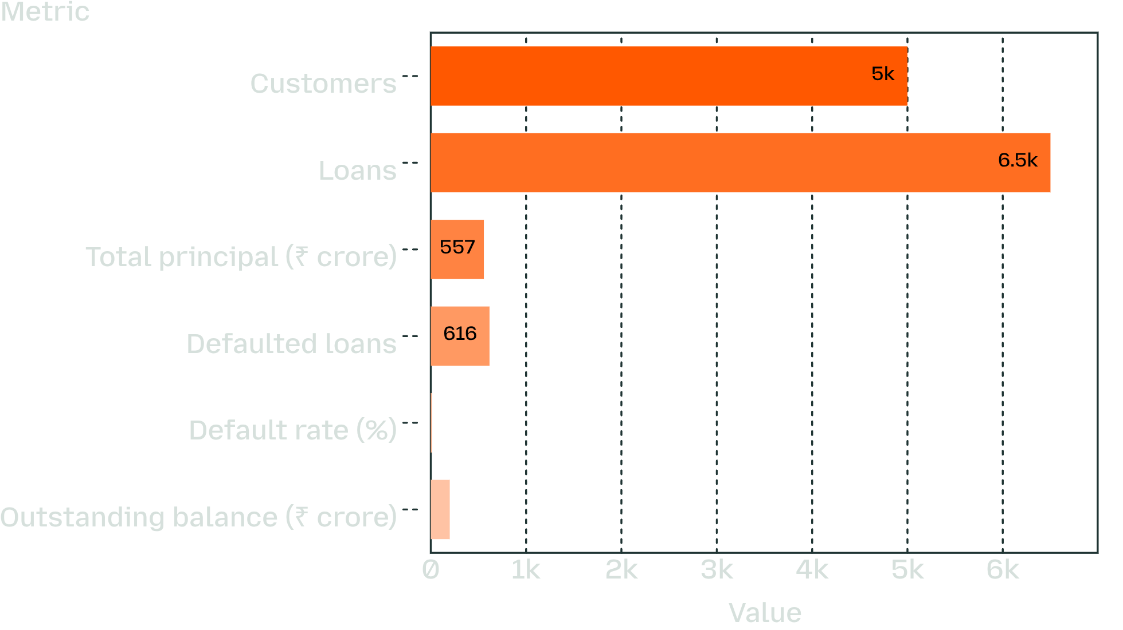
PORTFOLIO SNAPSHOT
A ₹556.62 crore loan portfolio carries a 9.48% default incidence
Portfolio KPI snapshot
5,000 customers and 6,500 loans analyzed
616 loans flagged Defaulted; ₹51.91 crore of original principal associated with those loans
₹198.65 crore total outstanding balance
2 / 10

Slide 3

ANALYTICAL FRAME
The analysis connected four business views into one risk story
The project is descriptive analytics, not a predictive credit model.
Customer Segmentation
Portfolio Composition
Risk Exposure
Transaction Reliability
3 / 10

Slide 4
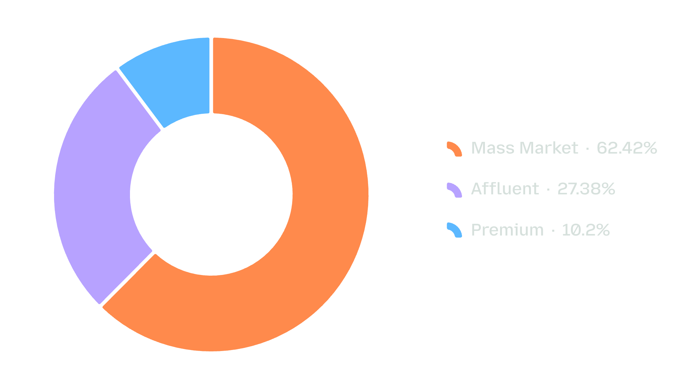
CUSTOMER BASE
Mass Market customers make up 62.42% of the base
Average credit score across the 5,000 original customers: 734.12
Customer segment mix
4 / 10

Slide 5
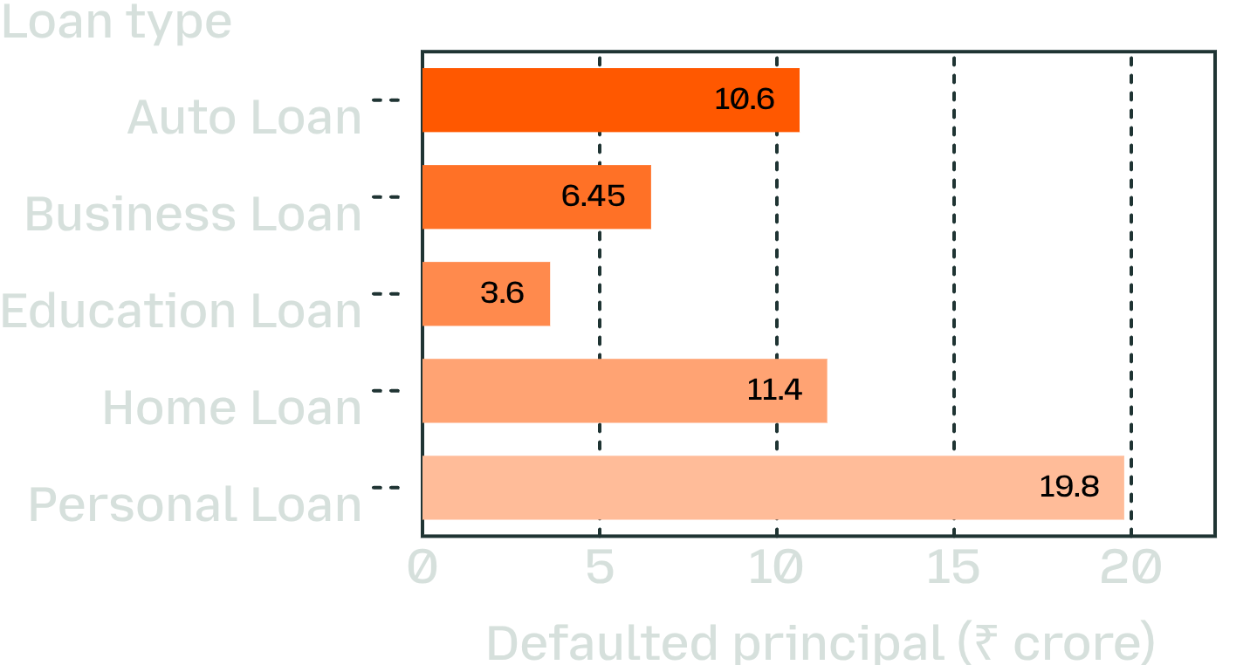
PRODUCT EXPOSURE
Personal Loans create the largest absolute defaulted principal
Defaulted principal (₹ crore) by loan product
Personal Loan: ₹19.80 crore defaulted principal, 220 defaulted loans, 9.22% default rate.
Home Loan: ₹11.42 crore, 141 defaults, 10.01% rate.
Auto Loan: ₹10.64 crore, 128 defaults, 9.88% rate.
Education Loan has the highest observed product default rate at 10.20%, but the smallest product volume in the table.
5 / 10

Slide 6
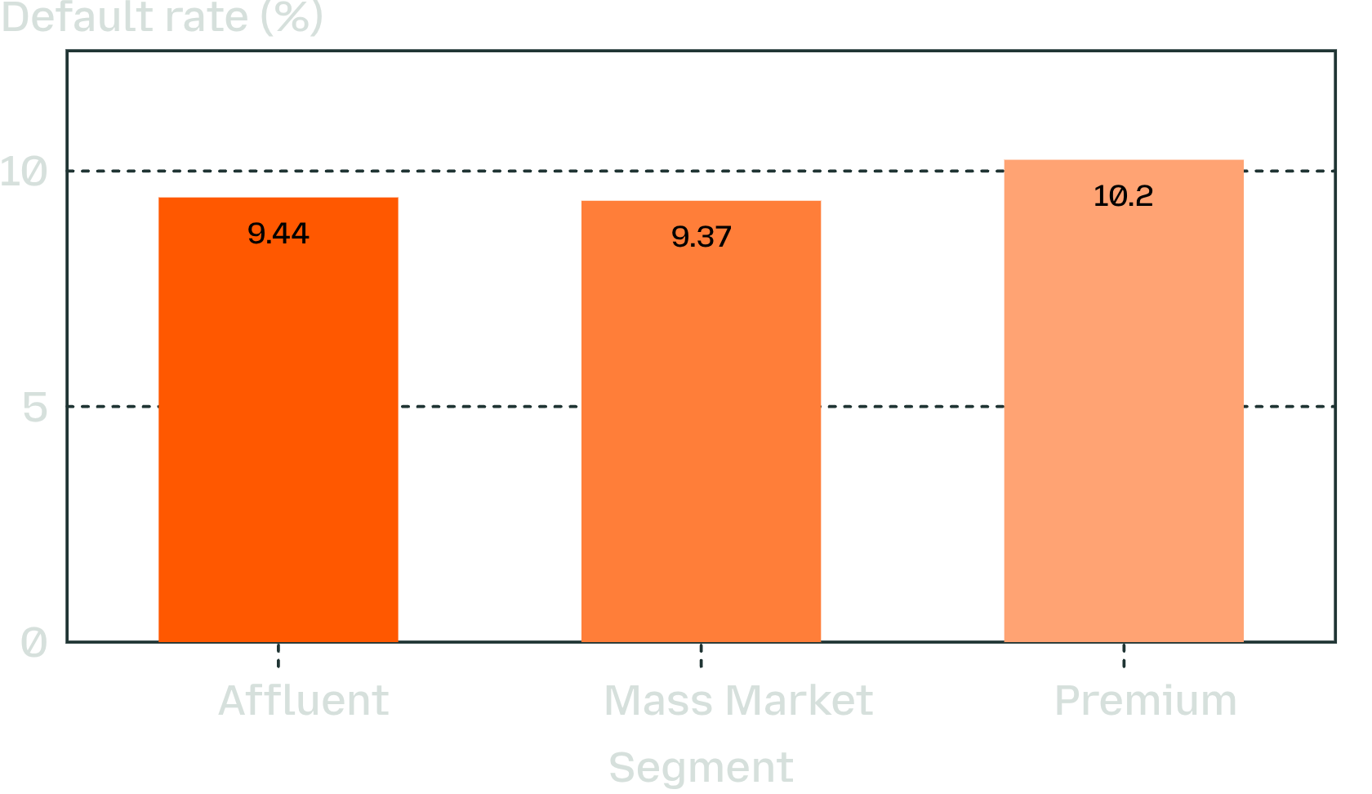
SEGMENT RISK
Premium has the highest segment default rate, but Mass Market drives volume
Loan-level default rate after customer matching
Segment | Loans | Defaults | Default rate
Premium | 635 | 65 | 10.24%
Affluent | 1,747 | 165 | 9.44%
Mass Market | 4,118 | 386 | 9.37%
Rates are loan-level after customer matching, not the percentage of unique customers who defaulted.
6 / 10

Slide 7
VALIDATION CHECK
Risk bands need validation before they become lending thresholds
Source risk band check · Default rate (%)
Risk band | Loan count | Default rate (%)
High | 1240 | 7.66
Low | 1680 | 10.77
Medium | 1952 | 9.12
Very High | 612 | 8.17
Very Low | 1016 | 11.02
The source risk labels do not show a clean increasing default pattern in this dataset. The observed ordering is not monotonic, so labels should be treated as descriptive until calibrated against actual outcomes.
SQL ranking by summed outstanding balance can prioritize exposure review, but it is not a probability-of-default model.
7 / 10

Slide 8
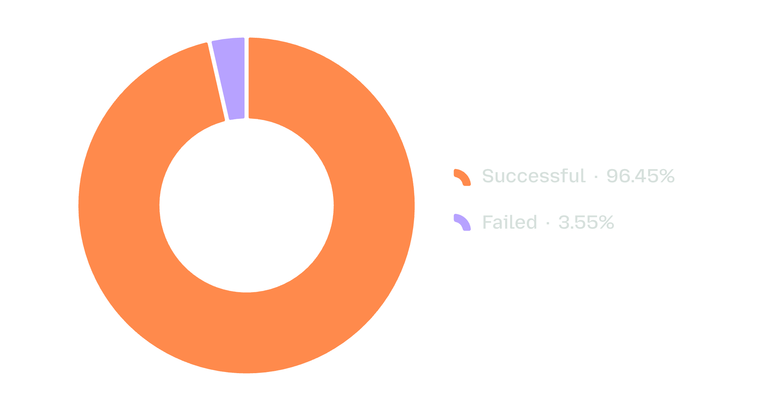
OPERATIONS
Transaction operations show a measurable reliability gap
Transaction success and failure
30,000 consolidated transaction records analyzed.
Mobile App had highest observed channel volume: 9,581 transactions; approximately ₹7.89 crore in displayed value.
3.55% failed share
Failure rates should be compared by channel and city using a consistent denominator.
8 / 10

Slide 9

END-TO-END WORKFLOW
The workflow demonstrates an end-to-end analytics skill set
01
02
03
SQL
Python
Power BI
Joins, conditional aggregations, CTEs, ranking, date functions, and customer prioritization
Data inspection, missing-value analysis, feature aggregation, merges, descriptive statistics, and visual exploration
KPI reporting, risk distributions, transaction trends, and interactive dashboard navigation
Position the project as a business-facing analytics workflow, not only a collection of charts.
A workflow that turns raw records into business-facing analysis.
9 / 10

Slide 10




CREDIBILITY CHECK
Data quality decisions are part of the risk analysis
Loan-derived features showed 27.96% missingness because many customers had no matched loans
The notebook filled medians and then dropped rows, leaving 4,988 records; the consolidated CSV retained 5,000 rows with no nulls
For no-loan customers, zero exposure is usually more meaningful than a median-filled amount.
Branch borrower counts should use distinct customers, and percentages must state their denominator.
Missingness Identified
Median Imputation
Row Drop to 4,988
Consolidated CSV: 5,000
10 / 10

