Slide 1
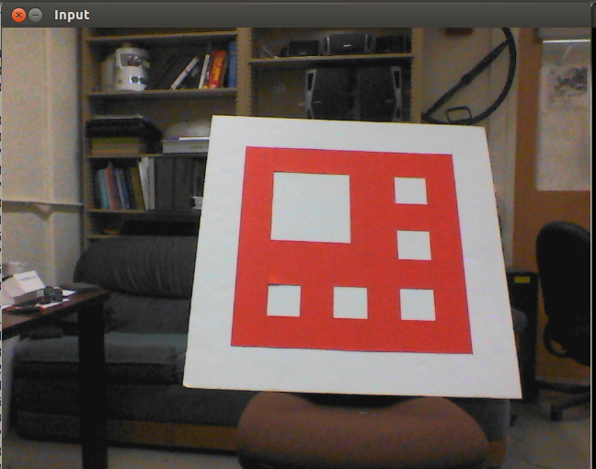
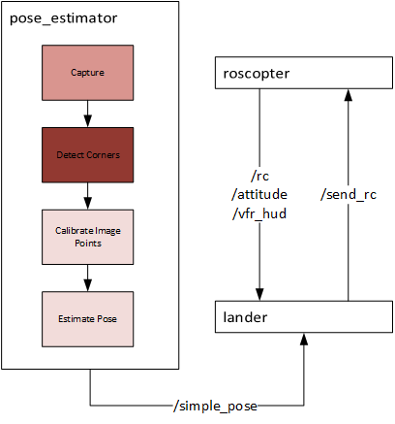
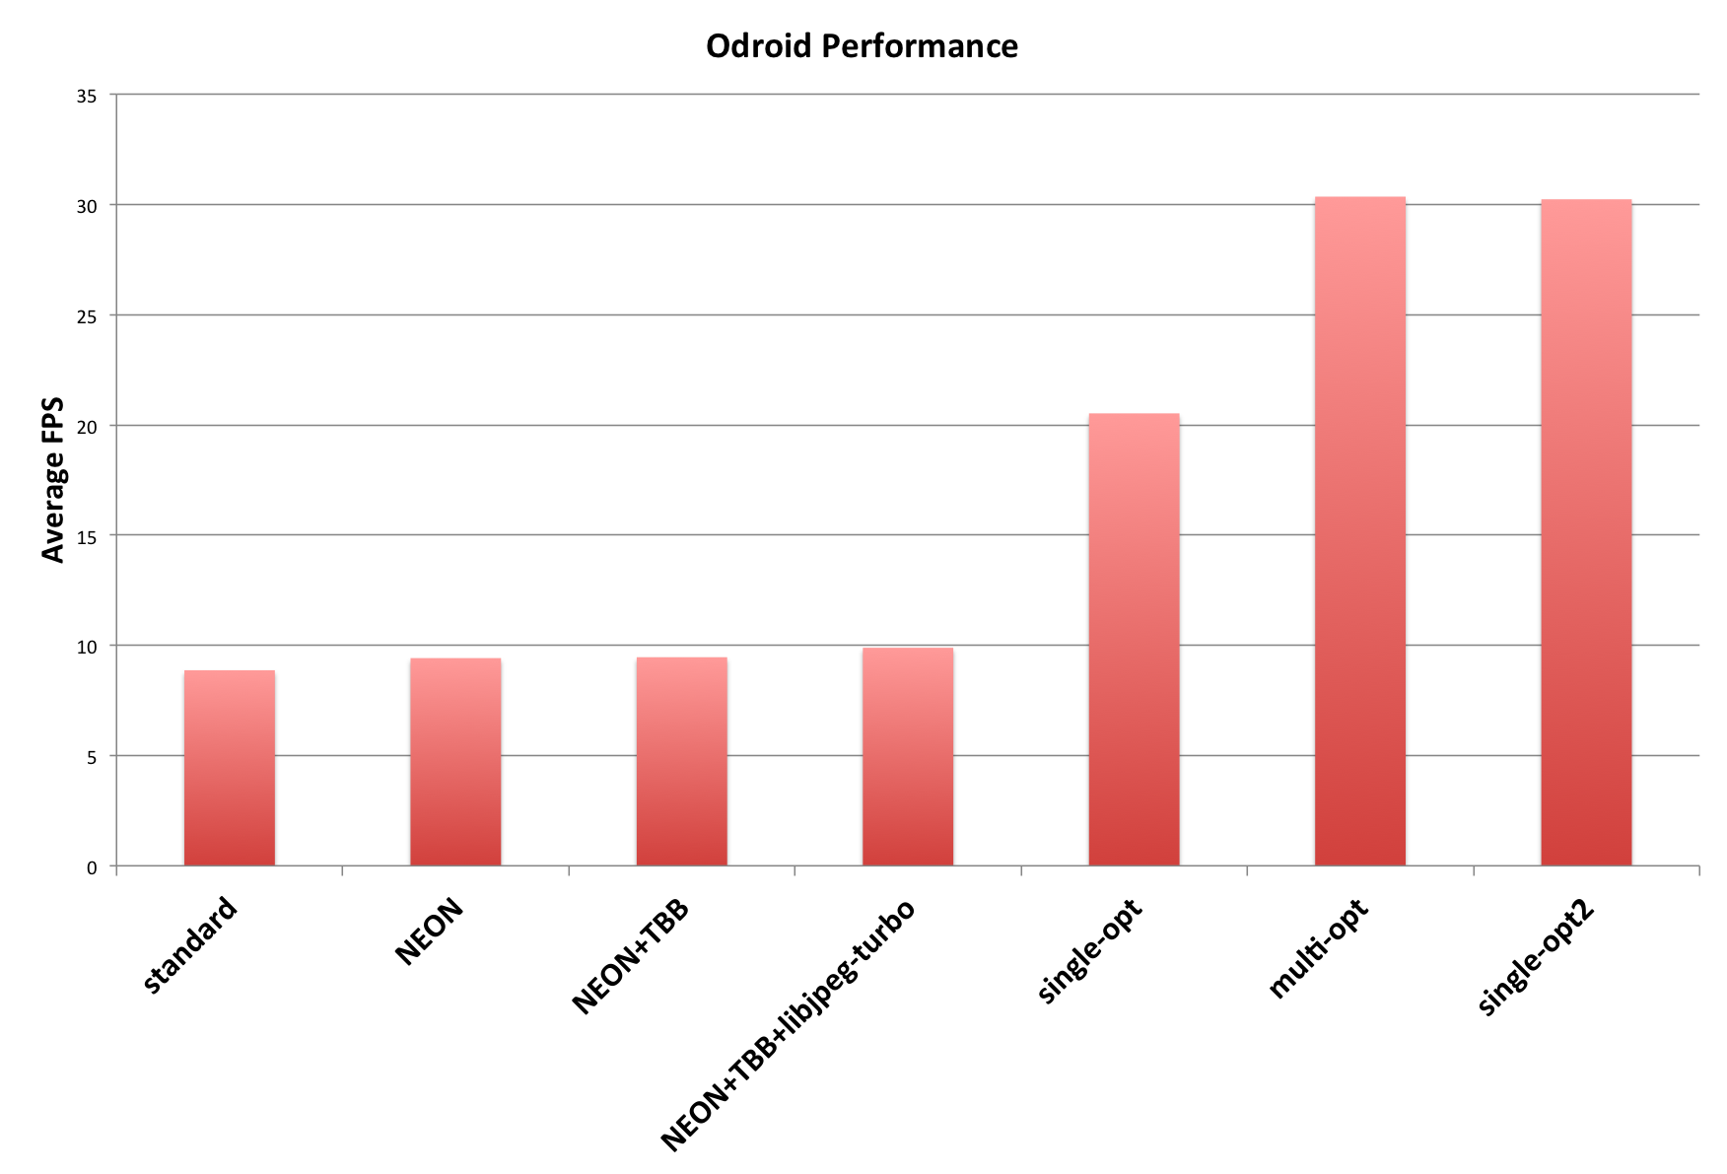

Parallelised Pose Estimation for Automated Landing
Used a known landing pad pattern to very accurately localise an UAV by estimating pose using computer vision techniques.
For pose to be used in control loop, need at least 10 FPS
Naïve implementation of algorithm operated at 8 FPS, we used the following techniques to take it to 30 FPS:
  Compiler SIMD Optimisations
  Library Performance Tuning (TBB and libjpeg-turbo)
  Removing redundant calls while maintaining correctness
  Using multi-threading to implement pipelining
Team members: Nahush Bhanage, Hoang Nguyen, Sunil Shah
Source code: http://www.github.com/ssk2/drones-267

