Slide 1
Objective
Goal: Implement Role-Based Access Control (RBAC) for SQL Server data.
Benefits:
- Stronger security
- Compliance alignment
- Least-privilege enforcement
- Easier audits and reviews

Slide 2
Current Progress
- Role inventory started (Analysts, Researchers, Admins, Auditors)
- Draft mapping of roles → data permissions
- Pilot role definition written (Analyst RO)
- Initial SQL implementation script prepared

Slide 3
Approach
1. Inventory roles by business owner & data sensitivity
2. Map to SQL Server roles & permissions
3. Document definitions (scope, approval, review)
4. Align with HR/IT (AD groups)
5. Pilot rollout → audit & review process

Slide 4
Next Steps
- Validate role inventory with stakeholders
- Implement pilot roles in Dev/Test
- Finalize documentation & request/approval workflow
- Plan quarterly access reviews & audit setup

Slide 5
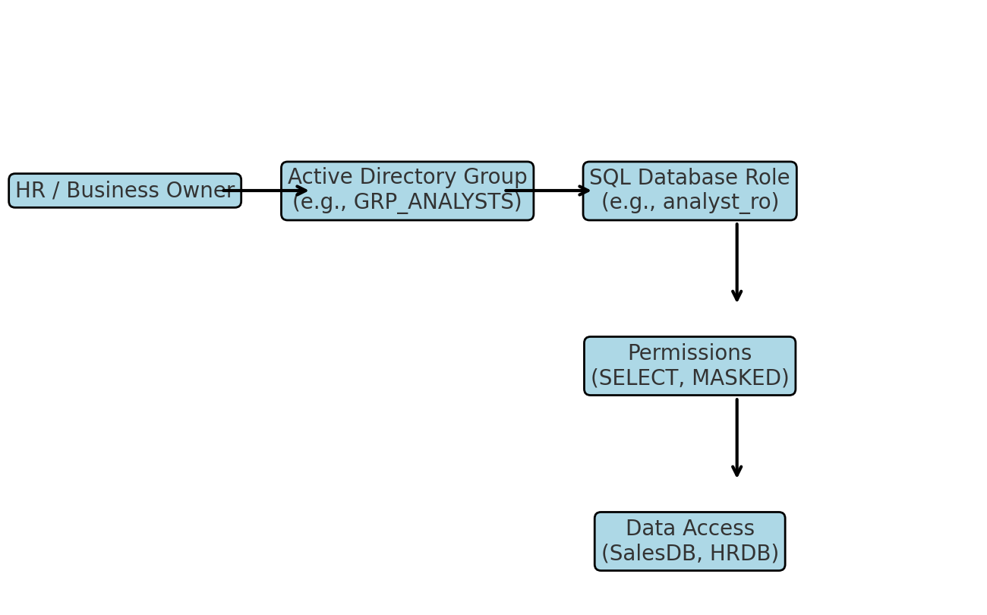
RBAC Flow Diagram

