Slide 1
Row-Level Security (RLS)
Implementation Steps

Slide 2
Row-Level Security (RLS) – Summary Infographic
🔎 Define Filtering Logic → Users see only their department/org 🗂️ Centralized Mapping Table → Map users to orgs/depts 📜 Define Security Policy → Document rules ⚙️ Implement RLS Mechanism → Auto rules during queries ✅ Test Scenarios → Validate roles see correct rows 🔒 Govern Changes → Control process for modifications

Slide 3
We apply RLS :
🔒 Data Confidentiality & Privacy .User only see their patient data (Doctor only see patient record)
📜 Meets compliance & audit needs(RLS provides a database-enforced mechanism that satisfies auditors better than app-level filters
⚙️ Reduced Application Complexity (Developers write one query for everyone, and database automatically apply the right filter)
🛡️ Adds an extra security layer (defense in depth) (RLS at the database layer still protects the data even if the application has a bug or misconfiguration
📊 Centralized Security (With RLS,The database itself enforces access, no matter which application or tool is used.

Slide 4
🔎 1. Define Filtering Logic
Users can only see records from their department or organization.
📌 Example: A Finance user only sees Finance data.
Notes:
Today I’ll walk you through the steps to implement Row-Level Security (RLS). This ensures users only see the data they’re authorized to access.”

Slide 5
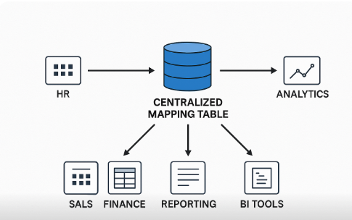
🗂️ 2. Create Centralized Mapping Table
Maintain a mapping of 👤 users → departments/organizations.
This becomes the reference for filtering.
Notes:
Step one is defining the filtering logic. We start by deciding what each user or role should be allowed to see. For example, Finance only sees Finance records, HR only sees HR records. This is the foundation of RLS.”

Slide 6
📜 3. Define Security Policy Logic
Document the filtering rules.
Ensure consistency and clarity for auditors & developers.
Notes:
Next, we create a centralized mapping table that links users to their departments or organizations. This table becomes our source of truth for enforcing the filters.”

Slide 7
⚙️ 4. Implement RLS Mechanism
Configure rules so they apply automatically during query execution.
💻 Example: SQL Server RLS functions, Oracle VPD policies, etc.
Notes:
We then document the security policy logic. This means writing clear rules on how access should be enforced, so both developers and auditors know what’s in place.”

Slide 8
✅ 5. Test Scenarios
Validate that each role sees only the correct rows.
Confirm that unauthorized data is never exposed.
Notes:
The fourth step is implementing the actual mechanism. This could be SQL Server RLS functions, Oracle VPD policies, or similar tools. The goal is to ensure filtering happens automatically at query time.”

Slide 9
🔒 6. Govern Changes
Use a change control process for modifying filtering logic.
Prevents accidental or malicious bypass of security rules.
Notes:
“Finally, we set up governance. Any changes to filtering logic should go through change control. This prevents accidental or malicious alterations that could expose sensitive data.”

Slide 10
✅ Quick Visual Summary
Database Security Methods Comparison
Method | Granularity | Example Control | Best For
Table-Level | Whole table | Allow/Deny access to Employees | Broad role-based access
Column-Level (Masking) | Column | Hide Salary column | Sensitive attributes only
App-Layer Filtering | Rows (app enforced) | App adds WHERE Region='West' | Apps without DB RLS support, but riskier
Row-Level Security | Rows (DB enforced) | Finance sees only Finance rows | Fine-grained, automatic, compliance-heavy DBs

Slide 11
Note
Row-Level Security = Invisible WHERE clause that the database adds for you, based on who’s querying.
Step 1 – Create a Filter Function
CREATE FUNCTION fn_securitypredicate(@Region AS nvarchar(50)) RETURNS TABLE WITH
SCHEMABINDING
AS
RETURN SELECT 1 AS fn_result
WHERE @Region = USER_NAME(); -- Example check by user
Step 2 – Apply Security Policy
CREATE SECURITY POLICY SalesFilter
ADD FILTER PREDICATE fn_securitypredicate(Region)
ON
dbo.Sales WITH (STATE = ON);
Now:
Alice’s queries → only rows with Region = West
Bob’s queries → only rows with Region = East
They don’t need special queries; the filter is automatic.

Slide 12
✅ In Summary
We apply RLS because it:
🔒 Protects sensitive data (privacy)
📜 Meets compliance & audit needs
⚙️ Simplifies application code
🛡️ Adds an extra security layer (defense in depth)
📊 Ensures centralized, consistent, fine-grained access

