Slide 1
EDM – TERA: Auditing & Logging (POC)

Slide 2
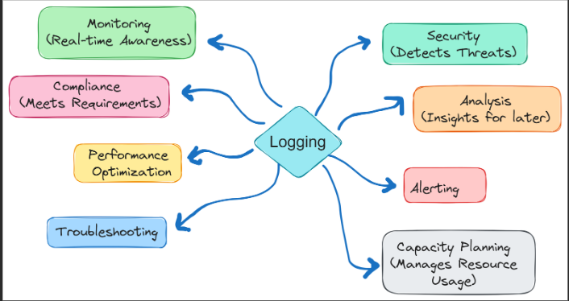
Objectives
Demonstrate active auditing & logging for the TERA SQL database
Provide visibility: who accessed what, when, from where, and outcome
Show readiness for HIPAA-aligned traceability on PHI/PII
Outline alerting, retention, and next‑step productionization
Notes:
Goal today: prove active SQL auditing on TERA/Database. Provide visibility on who accessed what, when, from where, and outcome—for SELECTs, DML, EXEC, and permission/DDL changes.
Why it matters:
1.Security (detects suspicious reads/writes),
2. Compliance/HIPAA (traceability on PHI/PII),
3. Troubleshooting & Performance (spot noisy/failed queries)
4. Monitoring: This help real time Awareness

Slide 3
Scope of POC
Environment: TERA SQL database (non‑production)
Schemas/Tables: targeted PHI/PII domains (EDM/Provider/Employee)
Actions captured: SELECT/INSERT/UPDATE/DELETE, failed logins, permission denials
Notes:
The Demo will be running on TERA non-production SQL database. No prod impact.
We target PHI/PII-relevant schemas —so we focus on the tables that matter for HIPAA traceability.
We log SELECT, INSERT, UPDATE, DELETE, EXEC, plus failed logins and permission denials, so we can see who tried what, when, and whether it succeeded or not

Slide 4
Architecture Overview (High‑Level)
Application & ETL → TERA SQL Database
SQL Server Audit (Server + Database Specs) → File target on secured share
Extended Events → runtime errors & deadlocks
Notes:
Application and ETL interact with the TERA SQL database—that’s where day-to-day reads, writes, and stored-proc calls happen.
We’ve enabled SQL Server Audit at both the server and database levels.
Those specs write to a file target on a secured share, giving us reviewable logs for who did what and when.
In parallel, we use Extended Events to capture runtime errors and deadlocks. so
Together, Audit provides security and compliance traceability, while Extended Events adds operational visibility.

Slide 5
Technical Workflow
1) Activity occurs (user/ETL query )
2) Audit spec intercepts action; XE captures errors/deadlocks
3) Events written to secure audit files with timestamps
4) Admins query audit files; alerts trigger on rules (e.g., failed logins spikes)
5) Periodic review & archive per retention policy
Notes:
Here’s the technical workflow end-to-end.
Step 1: A user or ETL runs a query or proc.
Step 2: Our Database/Server Audit Specs intercept the action; in parallel, Extended Events pick up runtime errors and deadlocks.
Step 3:We save each event—who did what, when, and whether it succeeded or failed—into secure, time-stamped audit files.
Step 4: Admins query those files for investigations and automated alerts—like spikes in failed logins or unauthorized SELECTs.
Step 5: We perform periodic review and archive per our retention policy, to keep evidence and ready for HIPAA audits.

Slide 6
Loggable Elements Catalog (TERA)
Authentication & Session
Successful/failed logins; lockouts
Login source (client host, app name), session_id
Impersonation/EXECUTE AS usage
Authorization & Security Changes
GRANT/DENY/REVOKE on objects/schemas
Role membership changes; ALTER ROLE/USER
ALTER ANY LOGIN/USER; IMPERSONATE permissions
Data Access to Sensitive Objects
SELECTs on PHI/PII tables/views (column sensitivity)
DML on PHI tables: INSERT/UPDATE/DELETE
Bulk operations: BULK INSERT, bcp, OPENROWSET/OPENDATASOURCE
Schema & Config Changes (DDL)
CREATE/ALTER/DROP TABLE/VIEW/PROC/FUNCTION/TRIGGER
Database options: containment, TRUSTWORTHY, CLR, xp_cmdshell
Linked server/endpoint changes; credentials/proxies
Operational Risk Signals
Permission denials (succeeded = 0) on sensitive objects
Audit disabled/altered, spec turned OFF
Unusually large result sets/SELECT INTO into temp tables (exfil patterns)
Long‑running queries; high‑severity errors; deadlocks
Data Protection Policies
RLS predicate/SECURITY POLICY changes
Dynamic/static masking policy changes
Always On/Failover events impacting audit continuity
Lifecycle & Governance
Backup/restore operations and access to backups
SQL Agent job create/alter/execute (ETL paths)
Audit file access/read attempts outside approved group
Notes:
Opening (15 s)
“This slide outlines the full catalog of what we can log across the TERA environment. Each category represents a different layer of visibility — from user authentication to schema changes, data protection, and governance lifecycle.”
Authentication & Session “
We capture every login event — both successful and failed
Authorization & Security Changes (15 s)
Every GRANT, DENY, REVOKE, or role membership update is captured.
Data access to sensitive objects:
Avery Select on PHI/PII tables and views, plus INSERT/UPDATE/DELETE and bulk operations are track
Schema & Config Changes + Operational Signals “
Table creating, altering, or dropping objects are fully logged.
Configuration changes like enabling CLR or xp_cmdshell, or linking servers, are also audited. On the operational side, we capture risk signals: failed permissions ,audit changes, large data extractions, and high-severity errors or deadlocks.”
Data Protection Policies & Lifecycle Governance
“We audit all RLS predicate or security-policy changes and any dynamic/static data-masking updates. “Together, these seven categories form our complete audit baseline for TERA — giving us both compliance traceability and operational visibility.

Slide 7
Alerting & Thresholds (Examples)
≥5 failed logins for a principal in 10 minutes → High
Any permission denial on PHI tables/views → Critical
Audit/Spec turned OFF or altered → Critical, page on‑call
DDL on sensitive schemas outside change window → High
Deadlock rate > N per hour on critical workloads → Medium
Notes:
We can integrate an alert and thresholds
≥5 failed logins in 10 minutes → Severity High
Any denial on PHI/PII → Severity Critical
Audit turned OFF or altered → Severity Critical, Alert the on-call team immediately. (threat to traceability).
DDL on sensitive schemas outside change window → Severity High (unauthorized change risk).

Slide 8
Demo:
I’ll run actions as reporter, analyst, and ETL, then open the audit view filtered to business schemas to show the exact events.

