Slide 1
Computing Equilibrium Measures
with Power Law Kernels
Timon S. Gutleb
Imperial College London
2020 CMS Winter Meeting
Spectral Methods and Singular Integral Equations

Slide 2
Equilibrium measure problems
We¹ apply a sparse spectral method to equilibrium measure problems, which is to minimize the expression:
In particular, for attraction-repulsion power law kernels
¹Gutleb, T. S., Carrillo, J. A., & Olver, S. (2020).
Computing Equilibrium Measures with Power Law Kernels.
arXiv:2011.00045.

Slide 3
Equilibrium measure problems
We¹ apply a sparse spectral method to equilibrium measure problems, which is to minimize the expression:
In particular, for attraction-repulsion power law kernels
Via an Euler-Lagrange formulation this can be reduced to

Slide 4


A primer on sparse spectral methods
A set of polynomials is orthogonal w.r.t. a weight if
We can then expand sufficiently well-behaved functions

Slide 5
A primer on sparse spectral methods
Multiplication operators can be defined using recurrence relations of the orthogonal polynomial basis of choice.
And similarly for basis shift, differentiation, and many other operators.
For details, see e.g.:
Olver, S., Slevinsky, R.M., & Townsend, A. (2020).
Fast algorithms using orthogonal polynomials.
Acta Numerica.

Slide 6


Action of power law integral on ultraspherical polynomials
We focus on a single power law integral initially, noting that
The integrals on the RHS are Riemann-Liouville fractional integrals.
We prove that

Slide 7


A recurrence for Riemann-Liouville fractional integrals
Beginning with the left-handed fractional integral
The first term can be rewritten and expanded as follows using the semi-group properties of R-L fractional integrals:

Slide 8
Starting the recurrence
An analogous result for the other Riemann-Liouville operator leads to
The following result allow us to get this started:

Slide 9
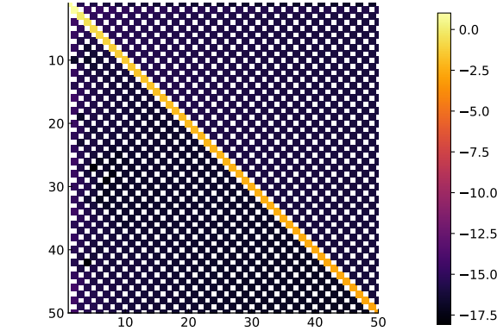
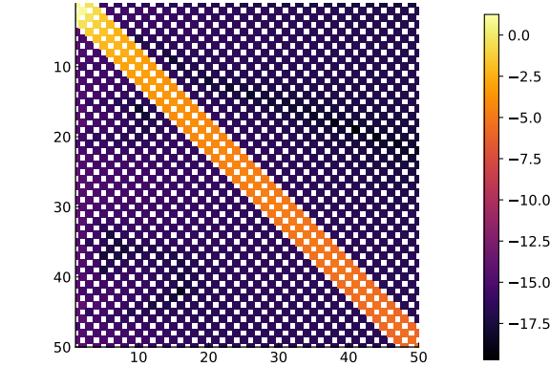
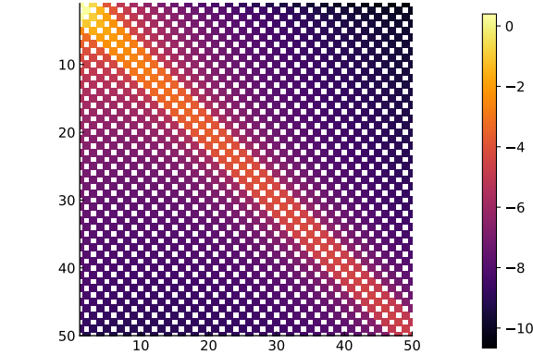
Structure of the power law integral operator

Slide 10
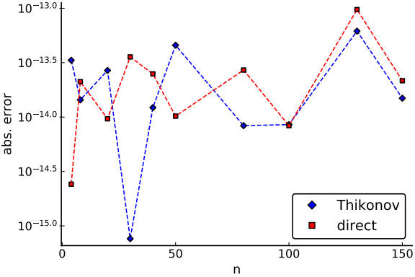
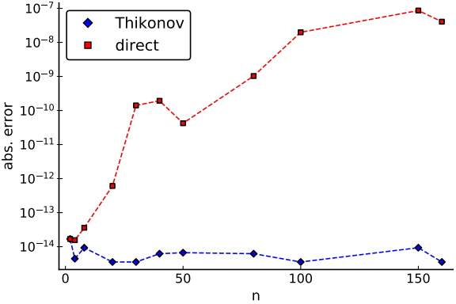
Convergence and stability
Remember we wish to minimize the expression

Slide 11
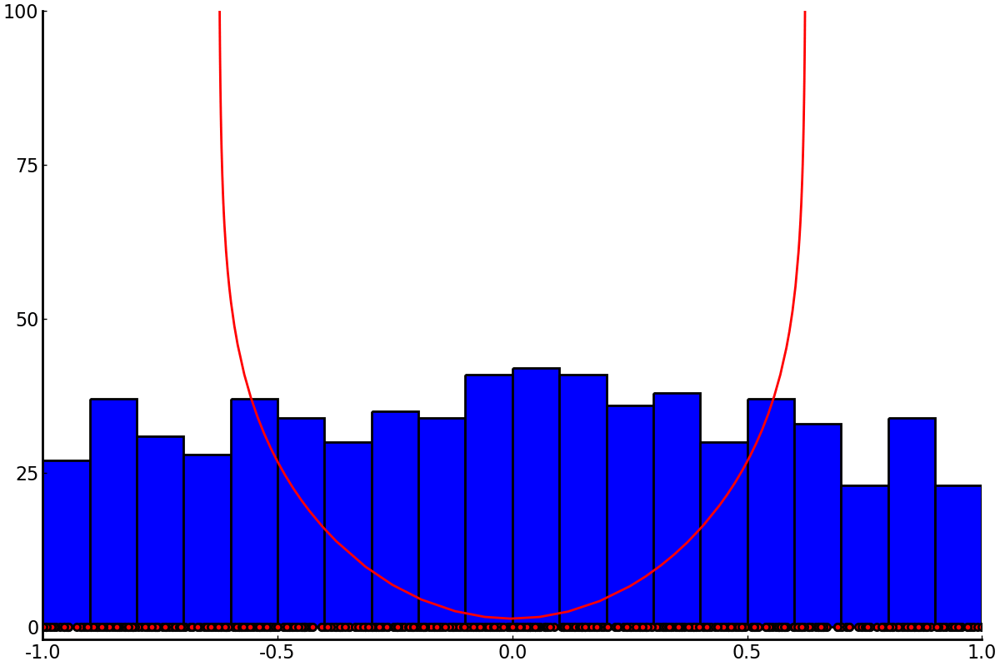
Comparison with discrete particle simulations

Slide 12
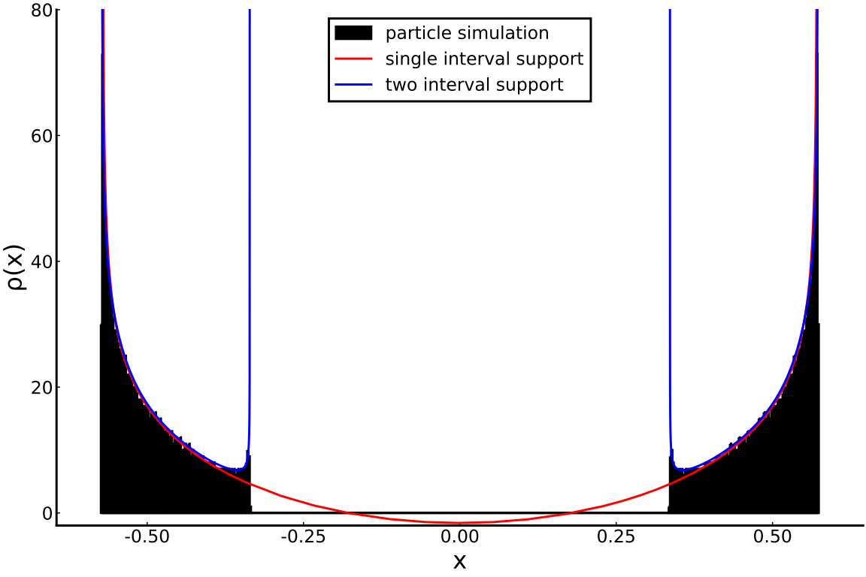
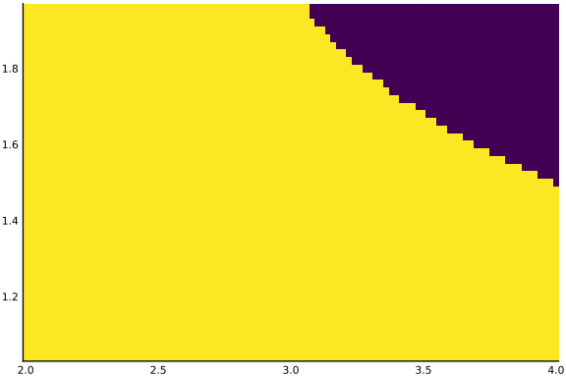
Gap formation for high repulsion

Slide 13
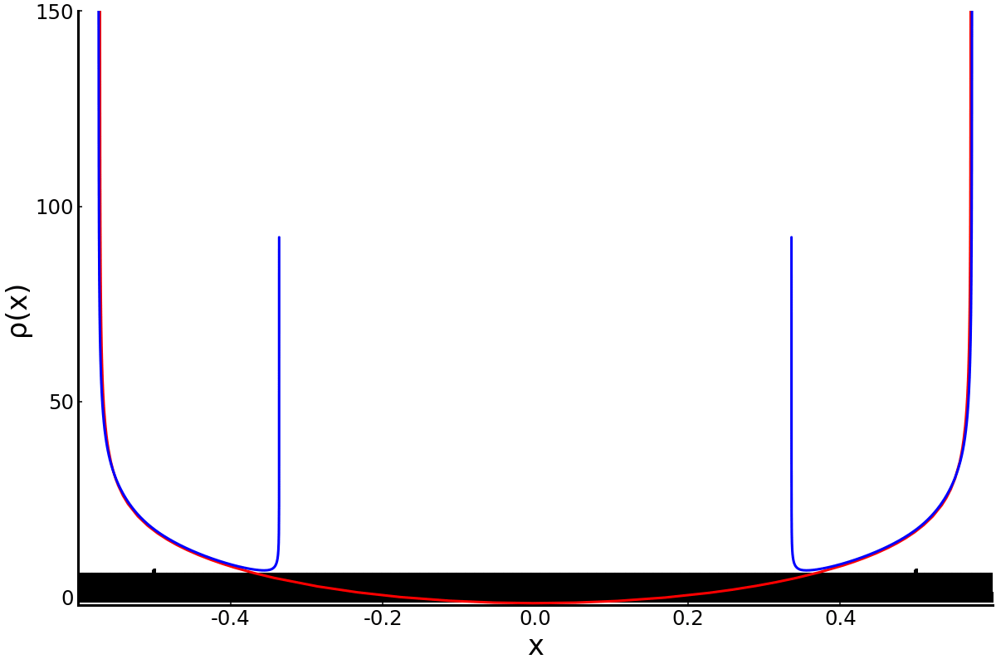
Gap formation for high repulsion

Slide 14
Studying the transition
During the talk, this slide contained the video file which can be found online at:
https://doi.org/10.6084/m9.figshare.13095821.v3
As it would needlessly increase the size of these slides, this media file is not embedded here.

Slide 15
Future work
Higher dimensions? Work in progress.
Connection to fractional calculus
via fractional Laplacians .

