Slide 1
Sparse spectral methods for equilibrium measures
Supported by EPSRC grant EP/T022132/1
SIAM CSE23
Amsterdam, 2023
Timon Salar Gutleb
Oxford Centre for Nonlinear PDE
Mathematical Institute, University of Oxford
In collaboration with:
José A. Carrillo
Sheehan Olver

Slide 2
Talk structure
Banded spectral methods
Computing power law equilibrium measures
Numerical experiments

Slide 3


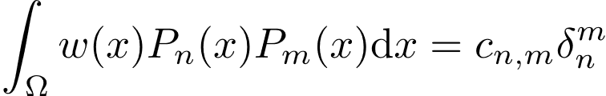
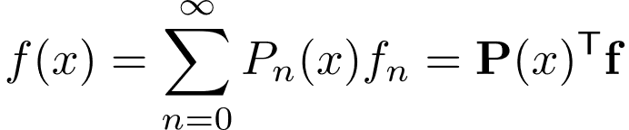
A primer on sparse spectral methods
1. Banded spectral methods
A set of polynomials is orthogonal w.r.t. a weight if
We can then expand sufficiently well-behaved functions

Slide 4
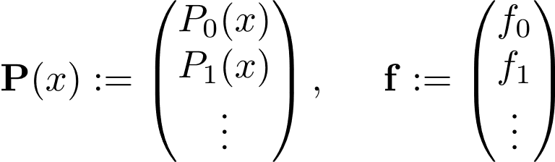
A primer on sparse spectral methods
1. Banded spectral methods
A set of polynomials is orthogonal w.r.t. a weight if
We can then expand sufficiently well-behaved functions

Slide 5

Banded sparse operators via orth. polynomials
1. Banded spectral methods
Multiplication operators can be defined using recurrence relations of the orthogonal polynomial basis of choice:
And similarly for integration, differentiation and other operators.
Olver, S., Slevinsky, R.M., & Townsend, A. (2020). Fast algorithms using orthogonal polynomials. Acta Numerica.

Slide 6
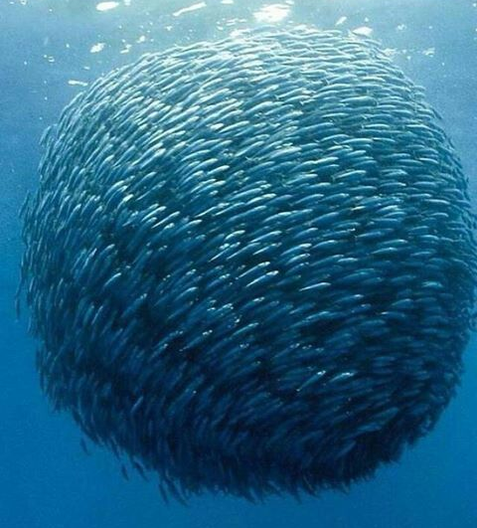
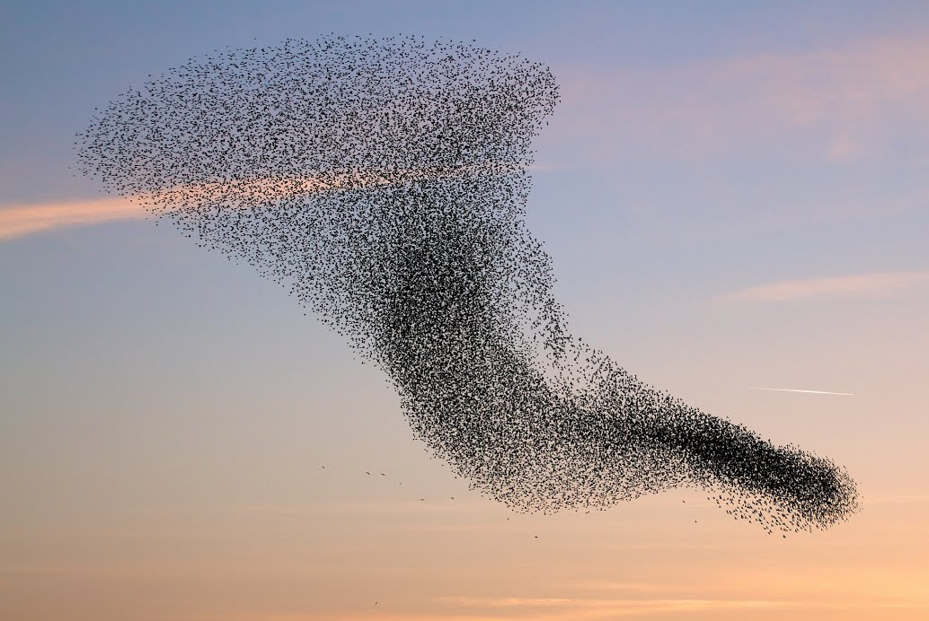
Motivating power law equilibrium measures (I)
2. Computing power law equilibrium measures

Slide 7
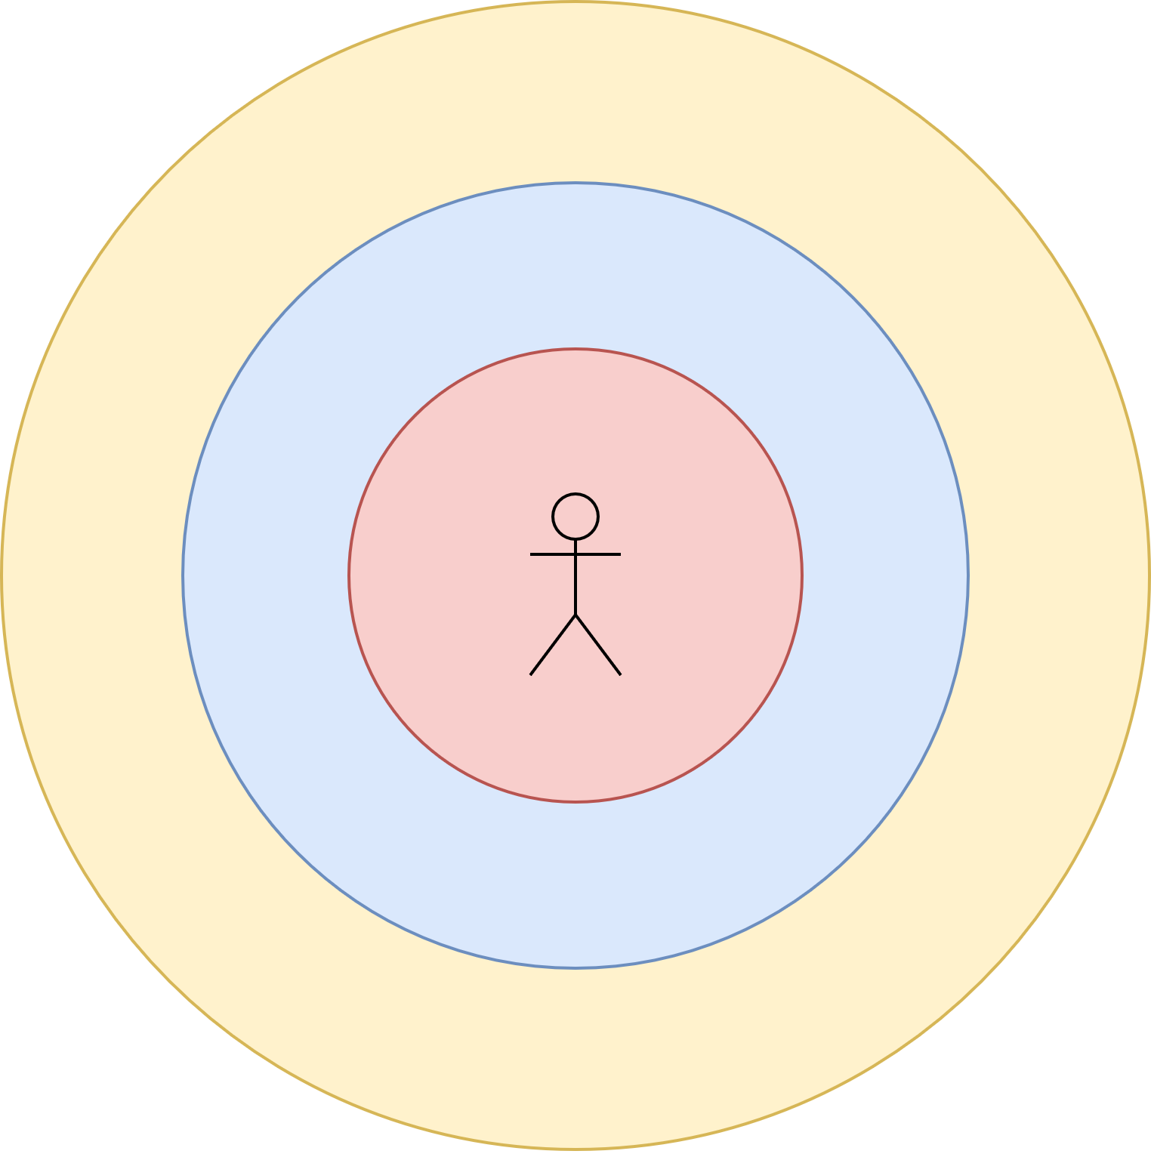
Motivating power law equilibrium measures (I)
2. Computing power law equilibrium measures
repulsion
alignment
attraction

Slide 8
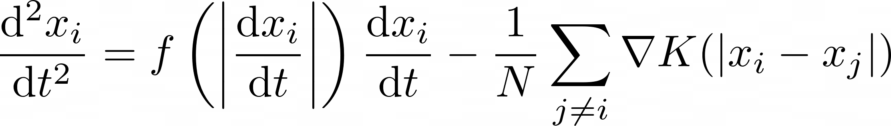
Motivating power law equilibrium measures (II)
2. Computing power law equilibrium measures
Discrete -particle dynamics described by Newtonian dynamics:

Slide 9
Motivating power law equilibrium measures (II)
2. Computing power law equilibrium measures
Discrete -particle dynamics described by Newtonian dynamics:
particle acceleration

Slide 10
Motivating power law equilibrium measures (II)
2. Computing power law equilibrium measures
Discrete -particle dynamics described by Newtonian dynamics:
self-propulsion and friction forces
particle acceleration

Slide 11
Motivating power law equilibrium measures (II)
2. Computing power law equilibrium measures
Discrete -particle dynamics described by Newtonian dynamics:
self-propulsion and friction forces
particle acceleration
pair-wise interaction potential

Slide 12
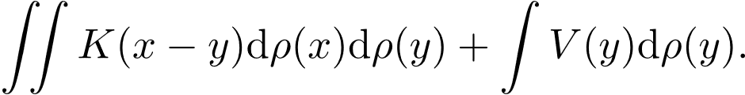
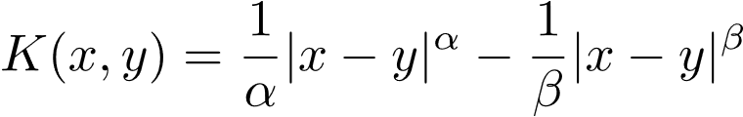
Motivating power law equilibrium measures (II)
2. Computing power law equilibrium measures
The equilibrium states of the continuous problem minimize
We consider attractive-repulsive power law kernels of the form
An Euler-Lagrange approach shows we can instead minimize

Slide 13
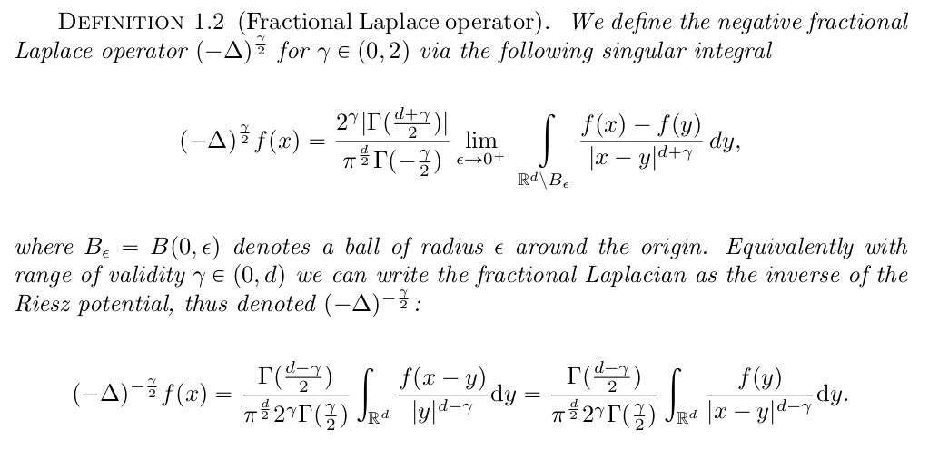
Connection to fractional calculus
2. Computing power law equilibrium measures
Kwaśnicki, M. Ten equivalent definitions of the fractional Laplace operator. Fractional Calc. and Appl. Analysis, 2017.

Slide 14
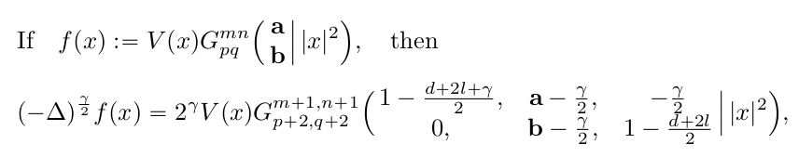
Motivating the use of spectral methods
2. Computing power law equilibrium measures
Dyda, B., Kuznetsov, A. & Kwaśnicki, M. Fractional Laplace Operator and Meijer G-function. Constr. Approx. 2017.

Slide 15
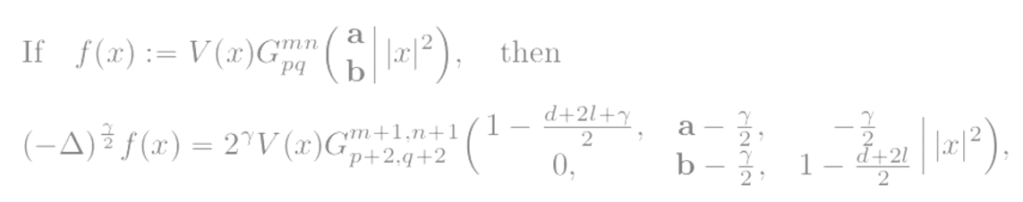
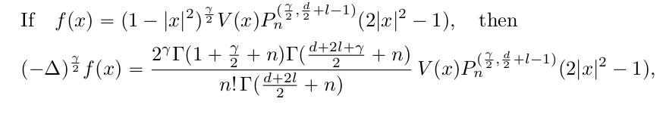
Motivating the use of spectral methods
2. Computing power law equilibrium measures
Dyda, B., Kuznetsov, A. & Kwaśnicki, M. Fractional Laplace Operator and Meijer G-function. Constr. Approx. 2017.

Slide 16
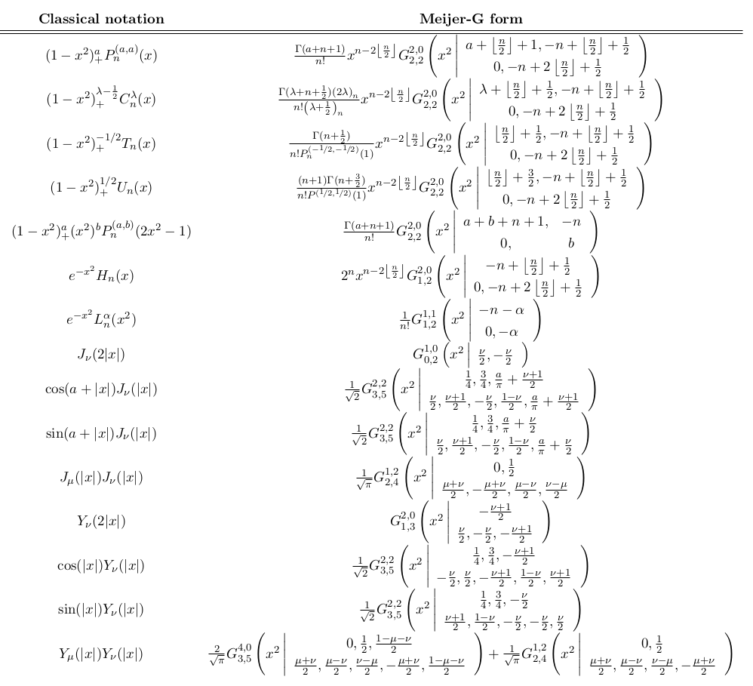

Slide 17
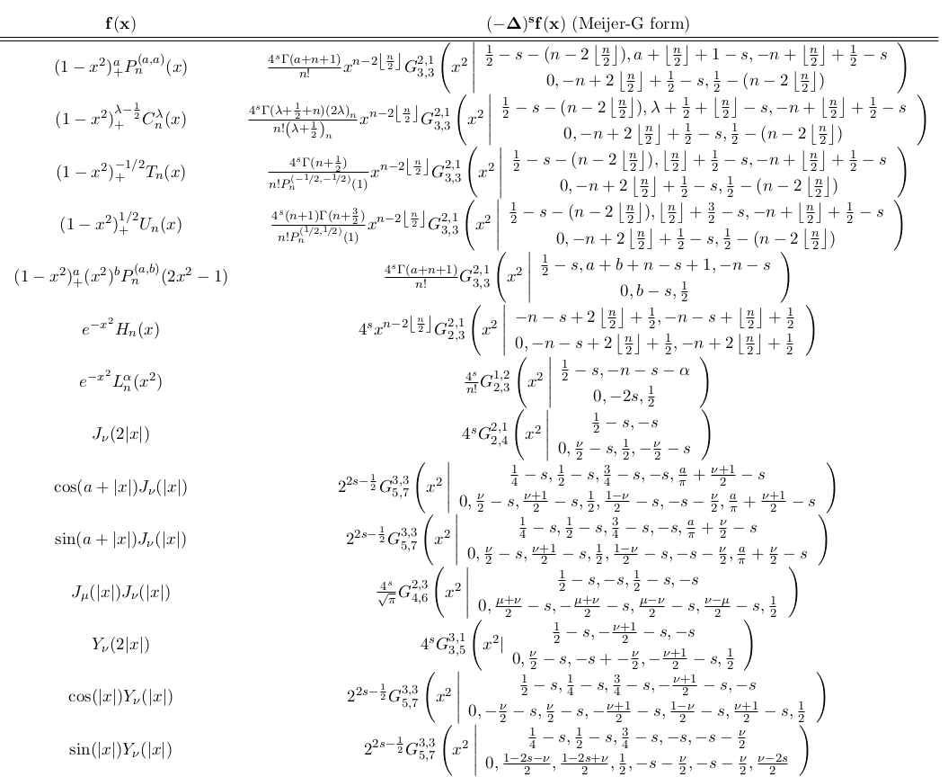

Slide 18
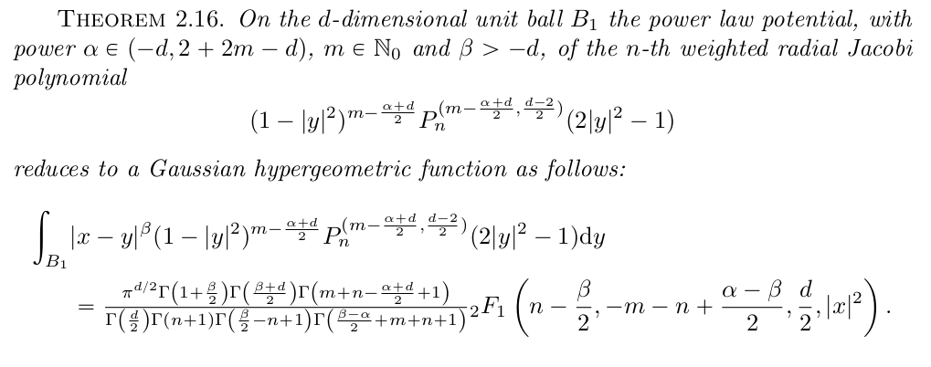
Riesz potentials and Jacobi polynomials (I)
2. Computing power law equilibrium measures

Slide 19
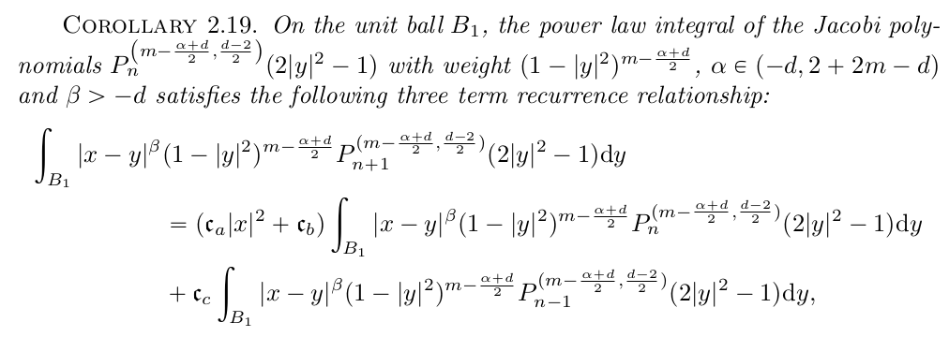
Riesz potentials and Jacobi polynomials (II)
2. Computing power law equilibrium measures

Slide 20
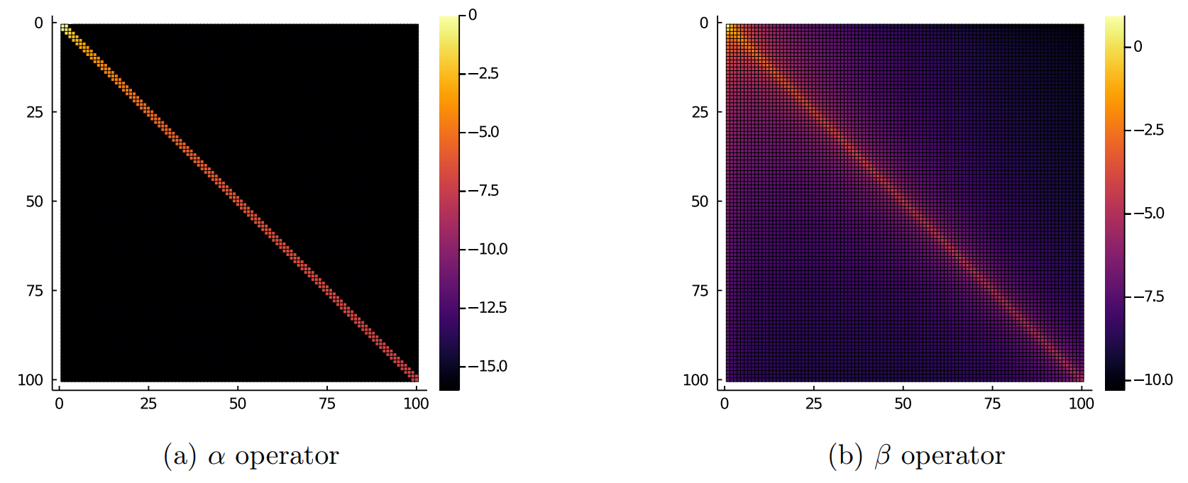
Banded and approximately banded Riesz potentials
2. Computing power law equilibrium measures

Slide 21
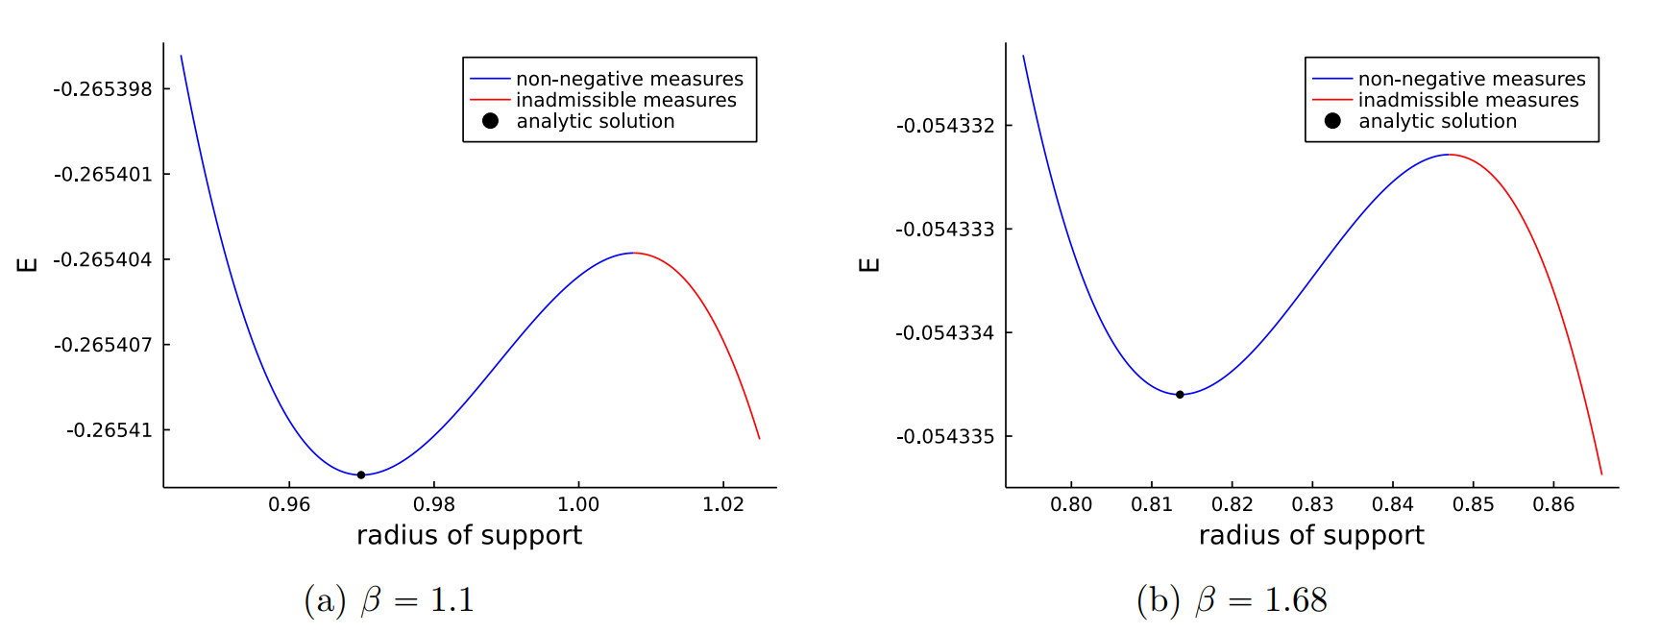
Numerical experiments (I): Verification
3. Numerical Experiments

Slide 22
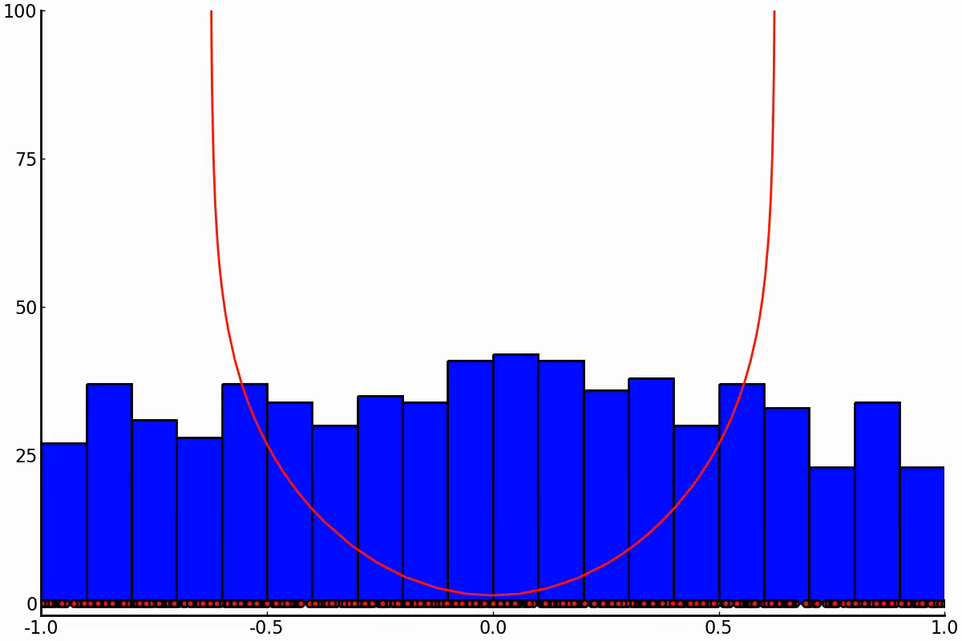
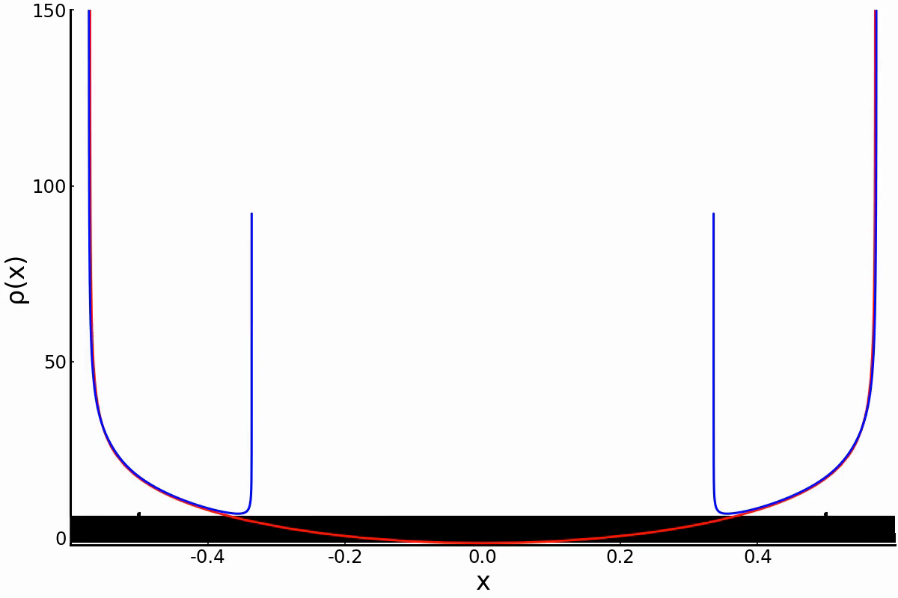
Numerical experiments (I): Verification
3. Numerical Experiments

Slide 23
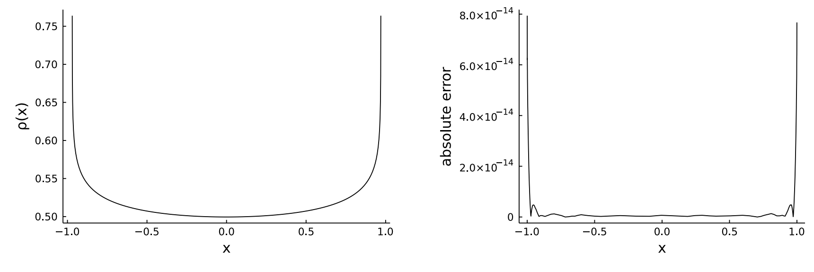
Numerical experiments (I): Verification
3. Numerical Experiments

Slide 24
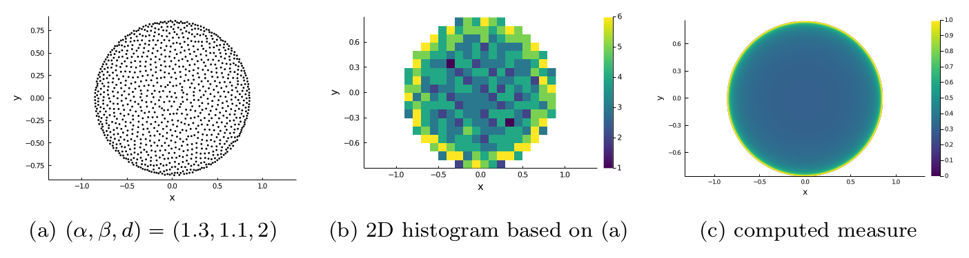
Numerical experiments (I): Verification
3. Numerical Experiments

Slide 25
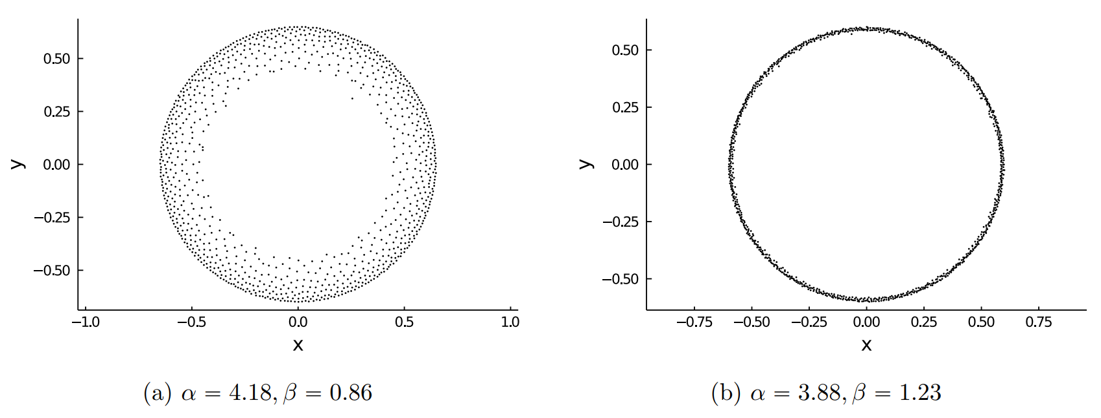
Numerical experiments (III): Gap formation boundary
3. Numerical Experiments

Slide 26
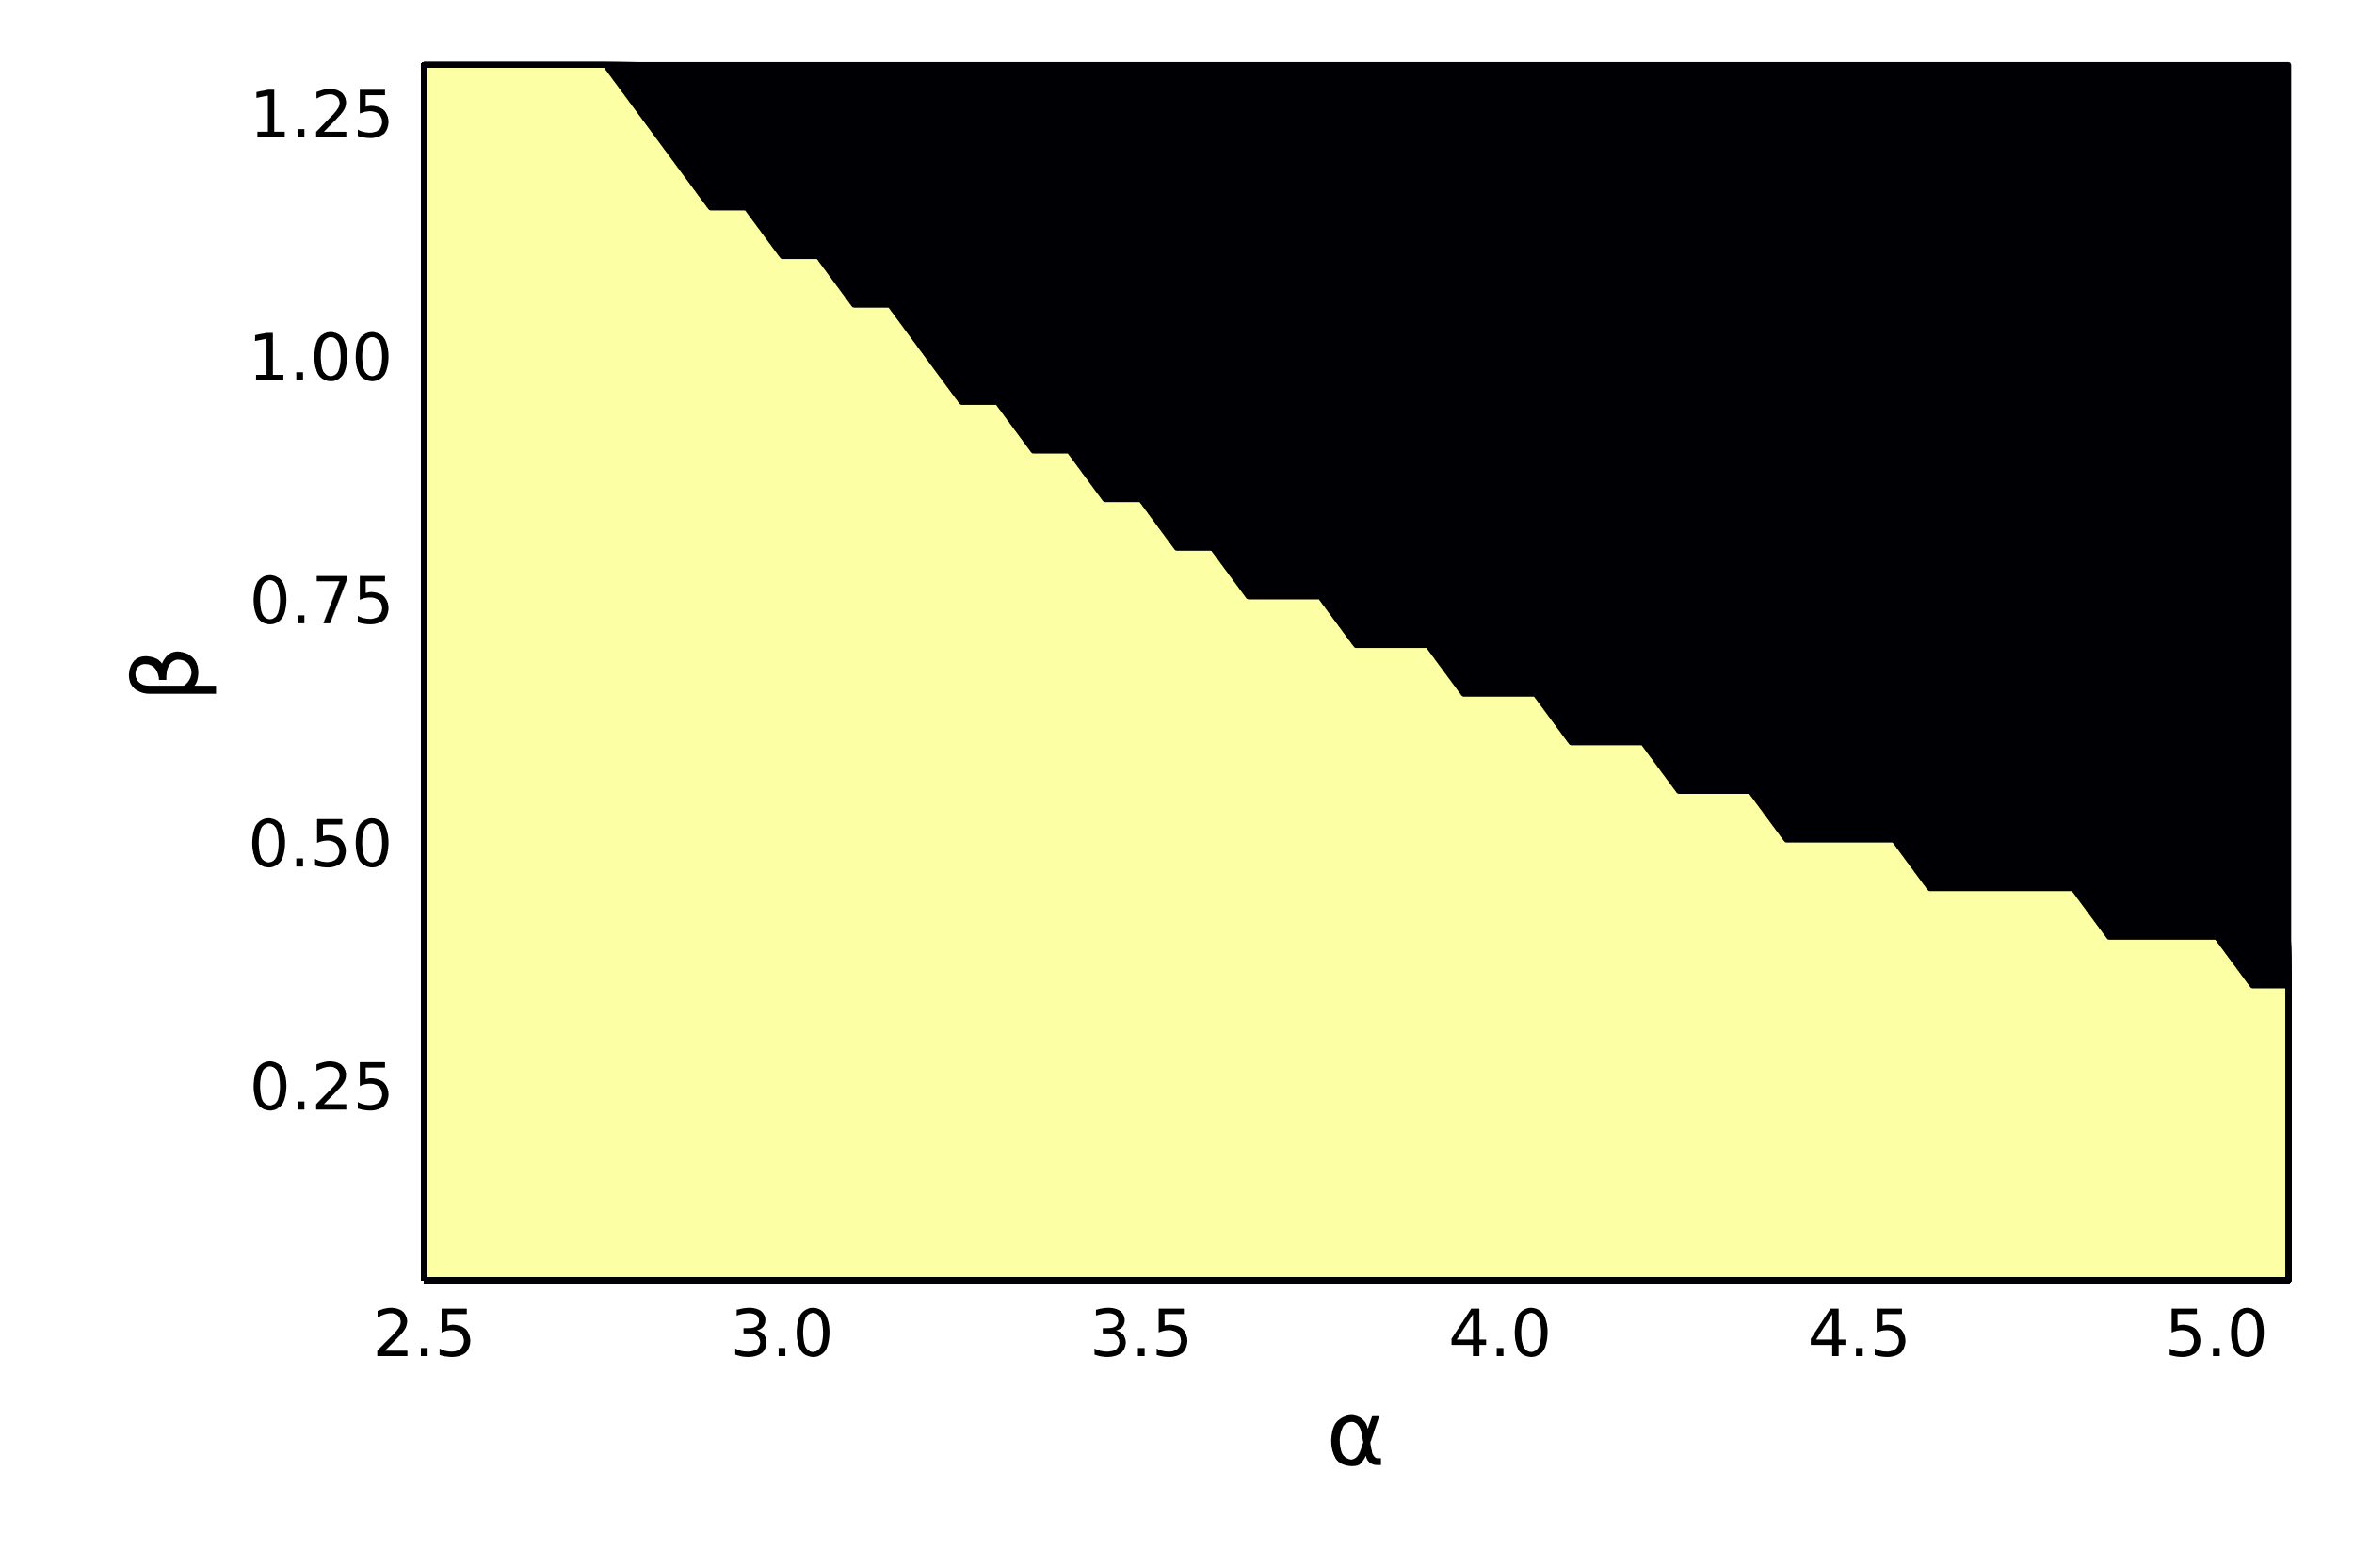
Numerical experiments (III): Gap formation boundary
3. Numerical Experiments

Slide 27
Sparse spectral methods for equilibrium measures
Supported by EPSRC grant EP/T022132/1
SIAM CSE23
Amsterdam, 2023
Timon Salar Gutleb
Oxford Centre for Nonlinear PDE
Mathematical Institute, University of Oxford
In collaboration with:
José A. Carrillo
Sheehan Olver

Slide 28
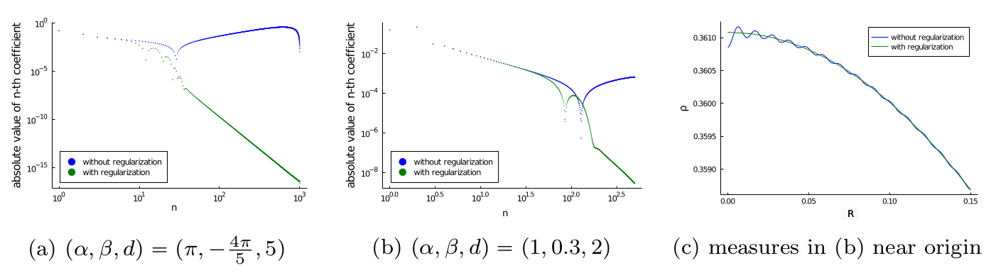
Numerical experiments (IV): Regularization
Extra Slide

