Slide 1
MOKONO TSHIDILO
CSC3A MINI PROJECT
219070464

Slide 2
WEBSITE CREDENTIAL INTRUDER TRACK
Notifies the user if there are some intruders

Slide 3
Presentation views
Problem Statement
Solution
Program screenshots

Slide 4
Problem Statement
Some websites tend to allow any user access to other person's information, while they are not part of the user's network. Problems regarding information access could be completely controlled by user but illegal access could still happen especially for those are just starting to use social networks or those who are not familiar with them.

Slide 5
Solution
So this will help a user to see who is accessing their information without their permission, by informing the user with a notification and tell them who is accessing their information and on which website their intruding. And also users can be able to communicate to alert each other about the intruders.

Slide 6
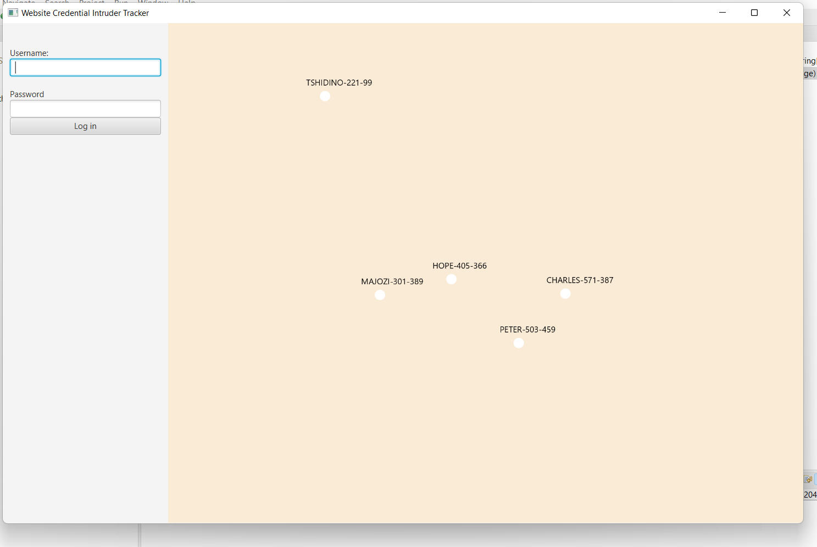
Program screenshoots

