Slide 1
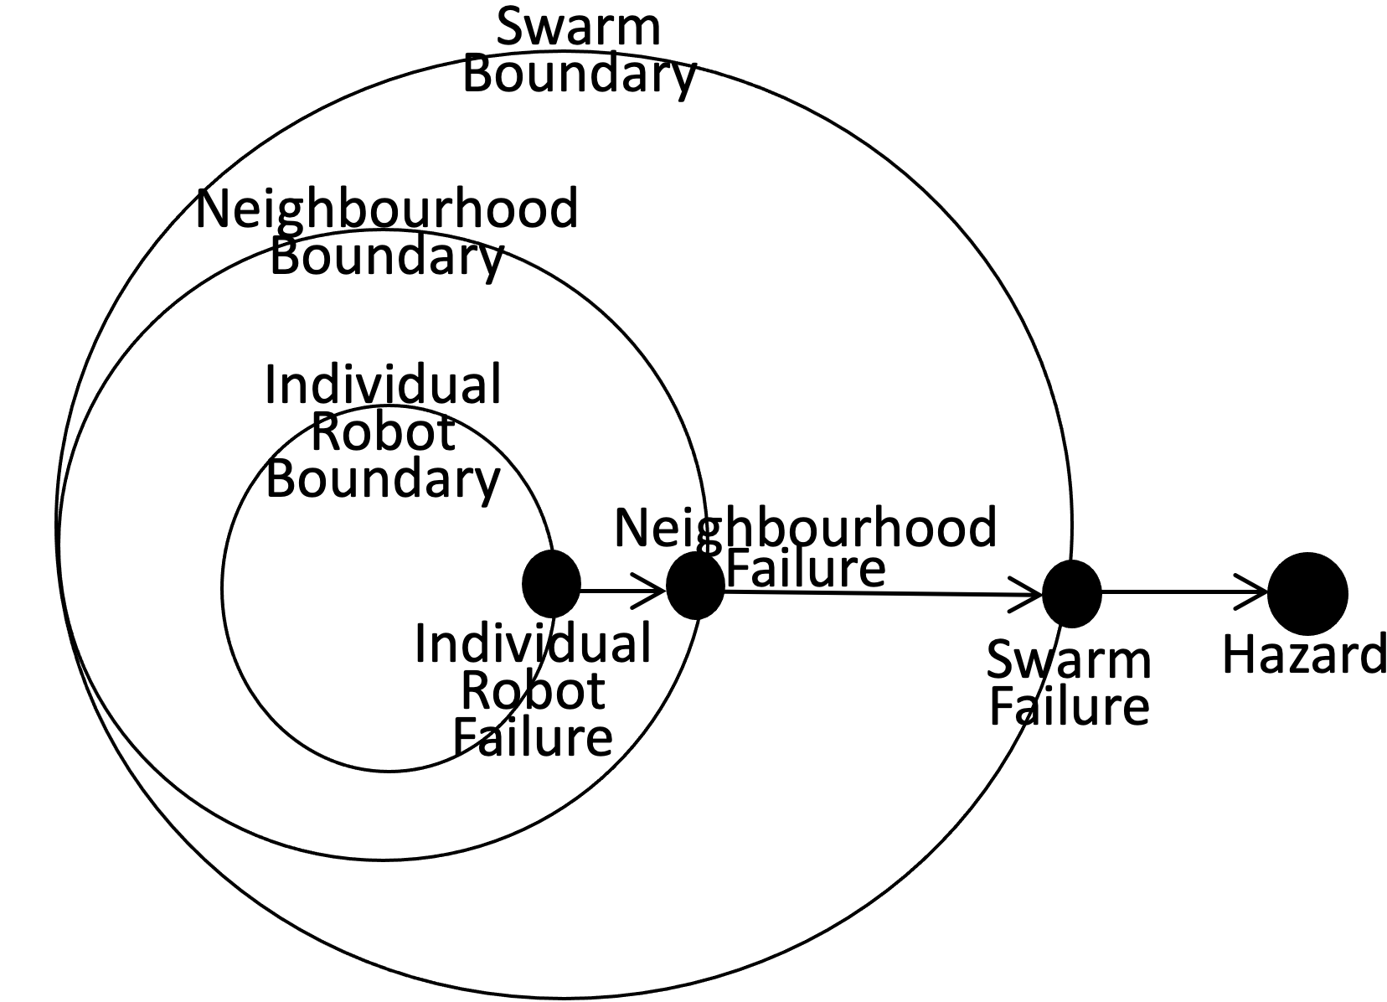
Swarm Boundary
Neighbourhood Boundary
Individual Robot Boundary
Neighbourhood
Failure
Individual
Robot
Failure
Swarm Failure
Hazard

Slide 2
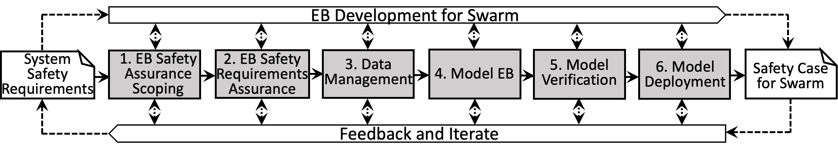
EB Development for Swarm
System Safety Requirements
1. EB Safety Assurance Scoping
2. EB Safety Requirements Assurance
3. Data Management
5. Model Verification
6. Model Deployment
Safety Case for Swarm
4. Model EB
Feedback and Iterate
AERoS is iterative by design, and contains six stages where assurance activities are performed in parallel to the development activities.

Slide 3
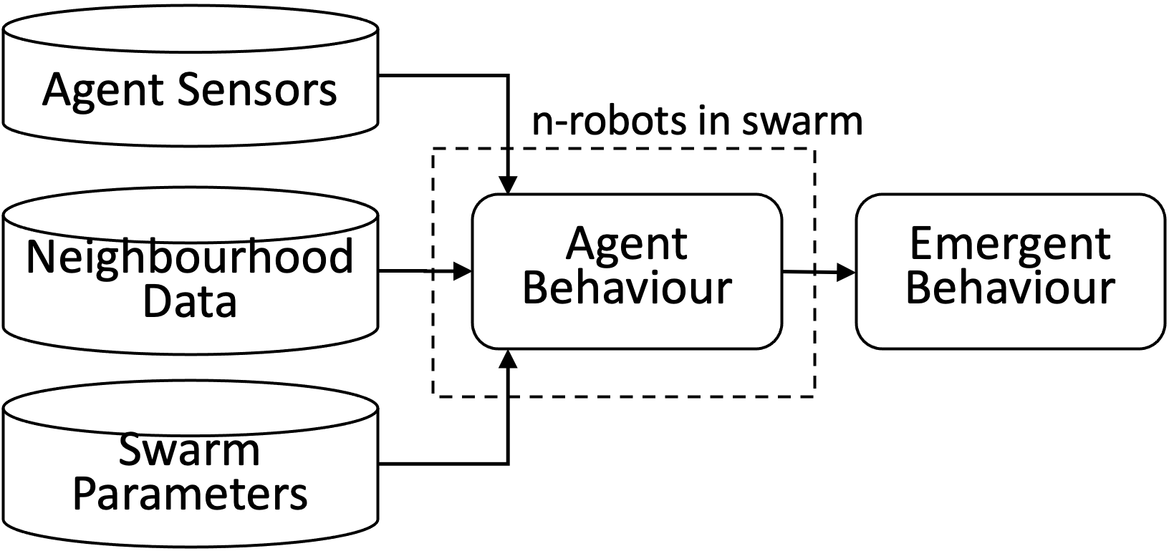
Agent Sensors
n-robots in swarm
Neighbourhood Data
Agent Behaviour
Emergent Behaviour
Swarm Parameters

Slide 4
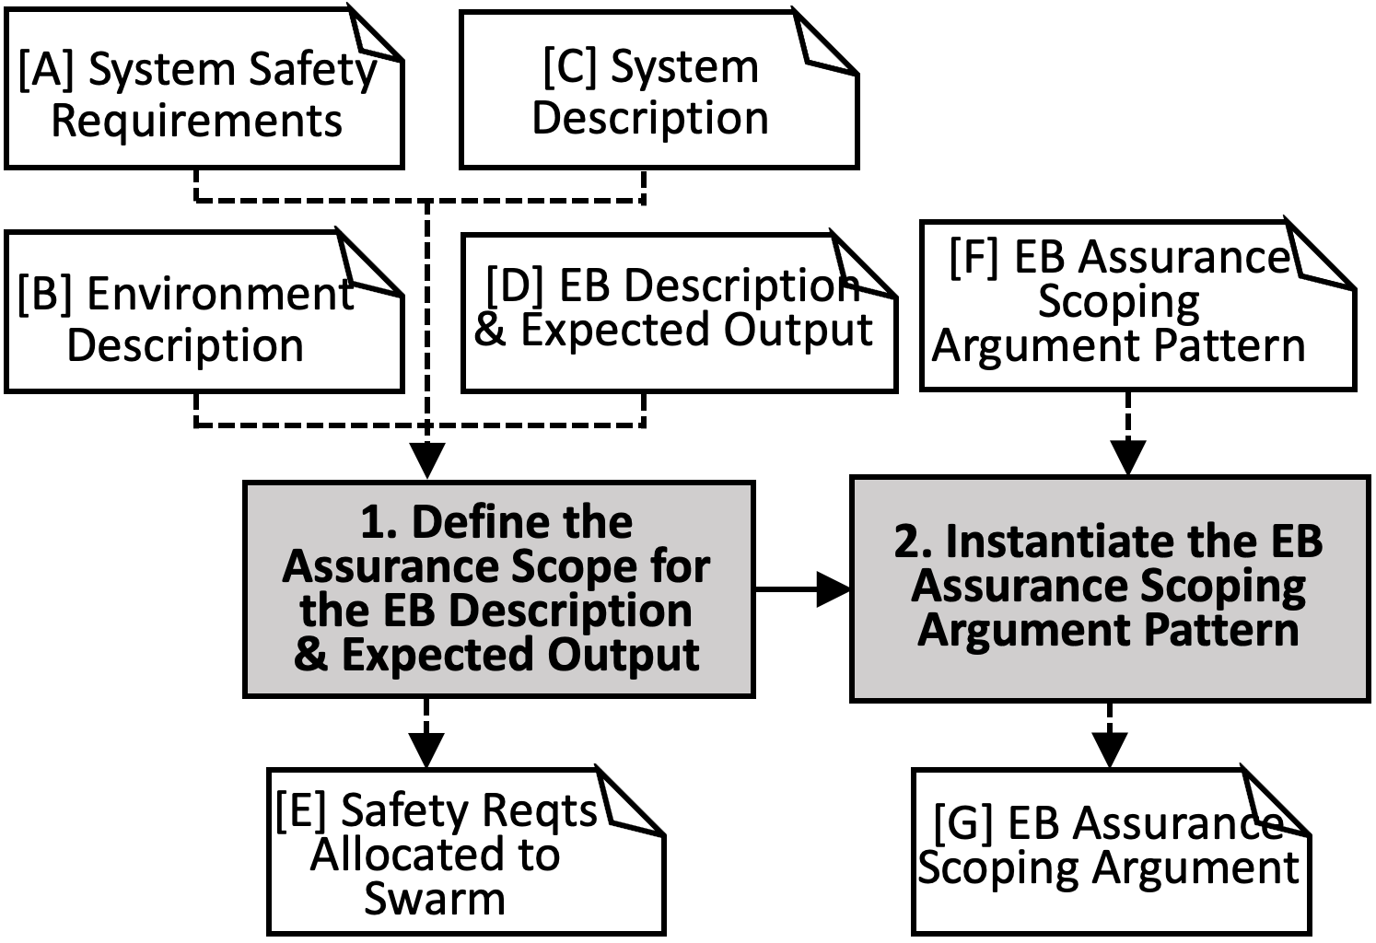
Stage 1
[A] System Safety Requirements
[C] System Description
[B] Environment Description
[D] EB Description & Expected Output
[F] EB Assurance Scoping Argument Pattern
1. Define the Assurance Scope for the EB Description & Expected Output
2. Instantiate the EB Assurance Scoping Argument Pattern
[E] Safety Reqts Allocated to Swarm
[G] EB Assurance Scoping Argument

Slide 5
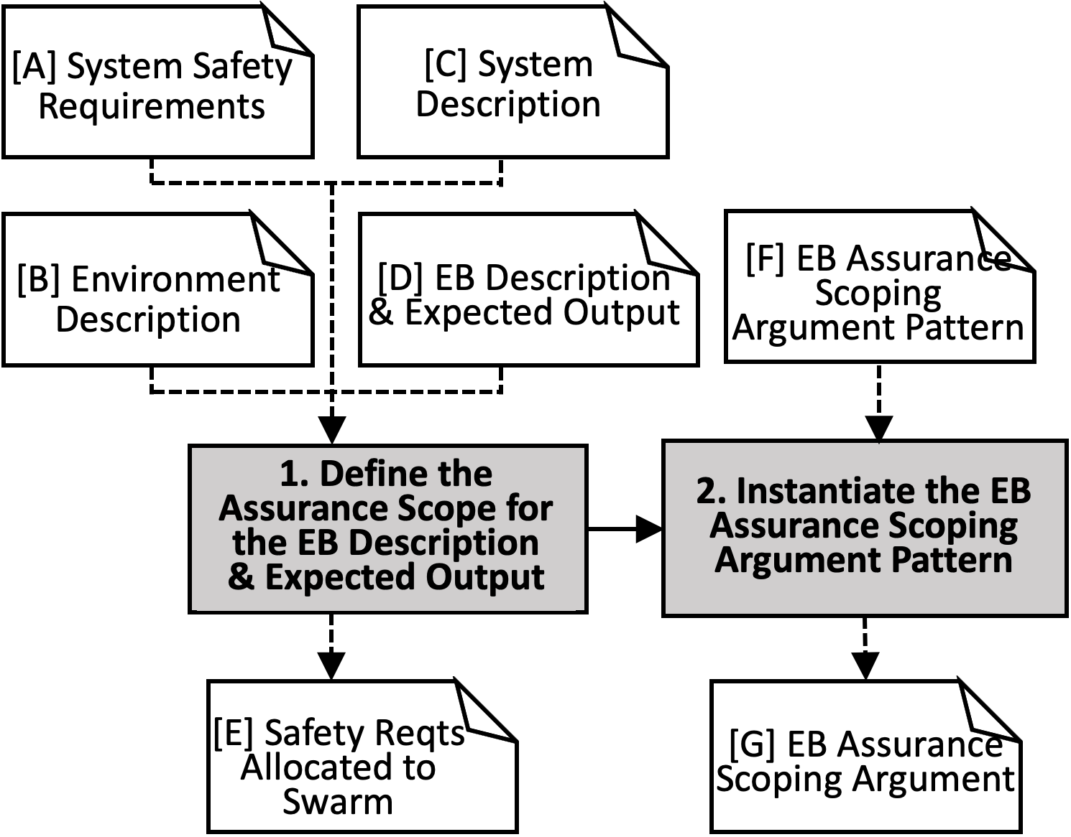
Stage 1
[A] System Safety Requirements
[C] System Description
[B] Environment Description
[D] EB Description & Expected Output
[F] EB Assurance Scoping Argument Pattern
1. Define the Assurance Scope for the EB Description & Expected Output
2. Instantiate the EB Assurance Scoping Argument Pattern
[E] Safety Reqts Allocated to Swarm
[G] EB Assurance Scoping Argument

Slide 6
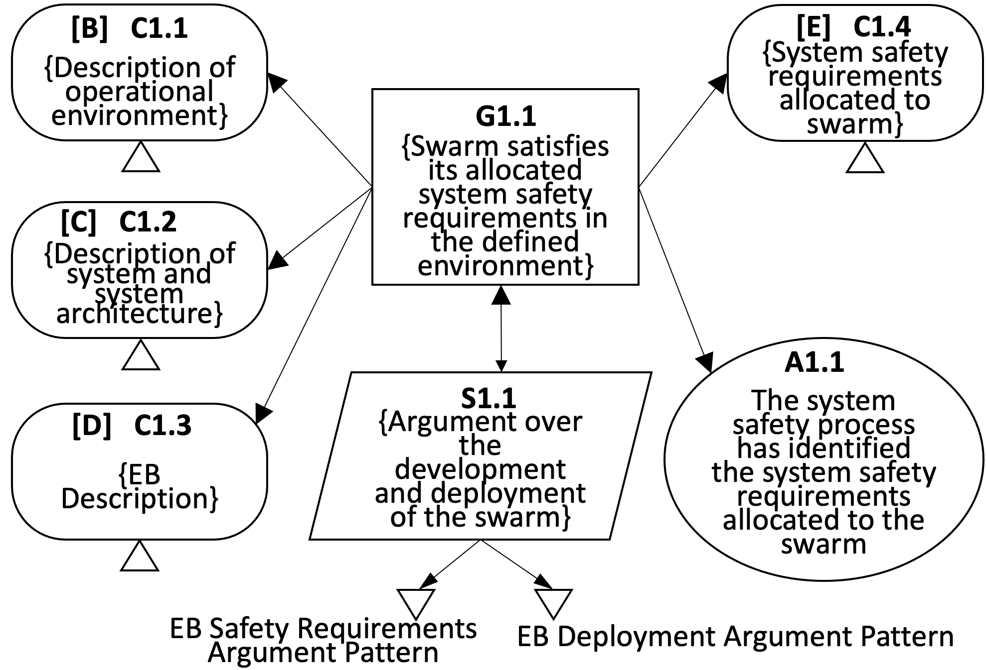
[B] C1.1
[E] C1.4
{Description of operational environment}
{System safety requirements allocated to swarm}
G1.1
{Swarm satisfies its allocated system safety requirements in the defined environment}
[C] C1.2
{Description of system and system architecture}
A1.1
The system safety process has identified the system safety requirements allocated to the swarm
S1.1
[D] C1.3
{Argument over the development and deployment of the swarm}
{EB Description}
EB Safety Requirements Argument Pattern
EB Deployment Argument Pattern
[B] C1.1
[E] C1.4
{Description of operational environment}
{System safety requirements allocated to swarm}
G1.1
{Swarm satisfies its allocated system safety requirements in the defined environment}
[C] C1.2
{Description of system and system architecture}
A1.1
The system safety process has identified the system safety requirements allocated to the swarm
S1.1
{Argument over the development and deployment of the swarm}
[D] C1.3
{EB Description}
EB Safety Requirements Argument Pattern
EB Deployment Argument Pattern

Slide 7
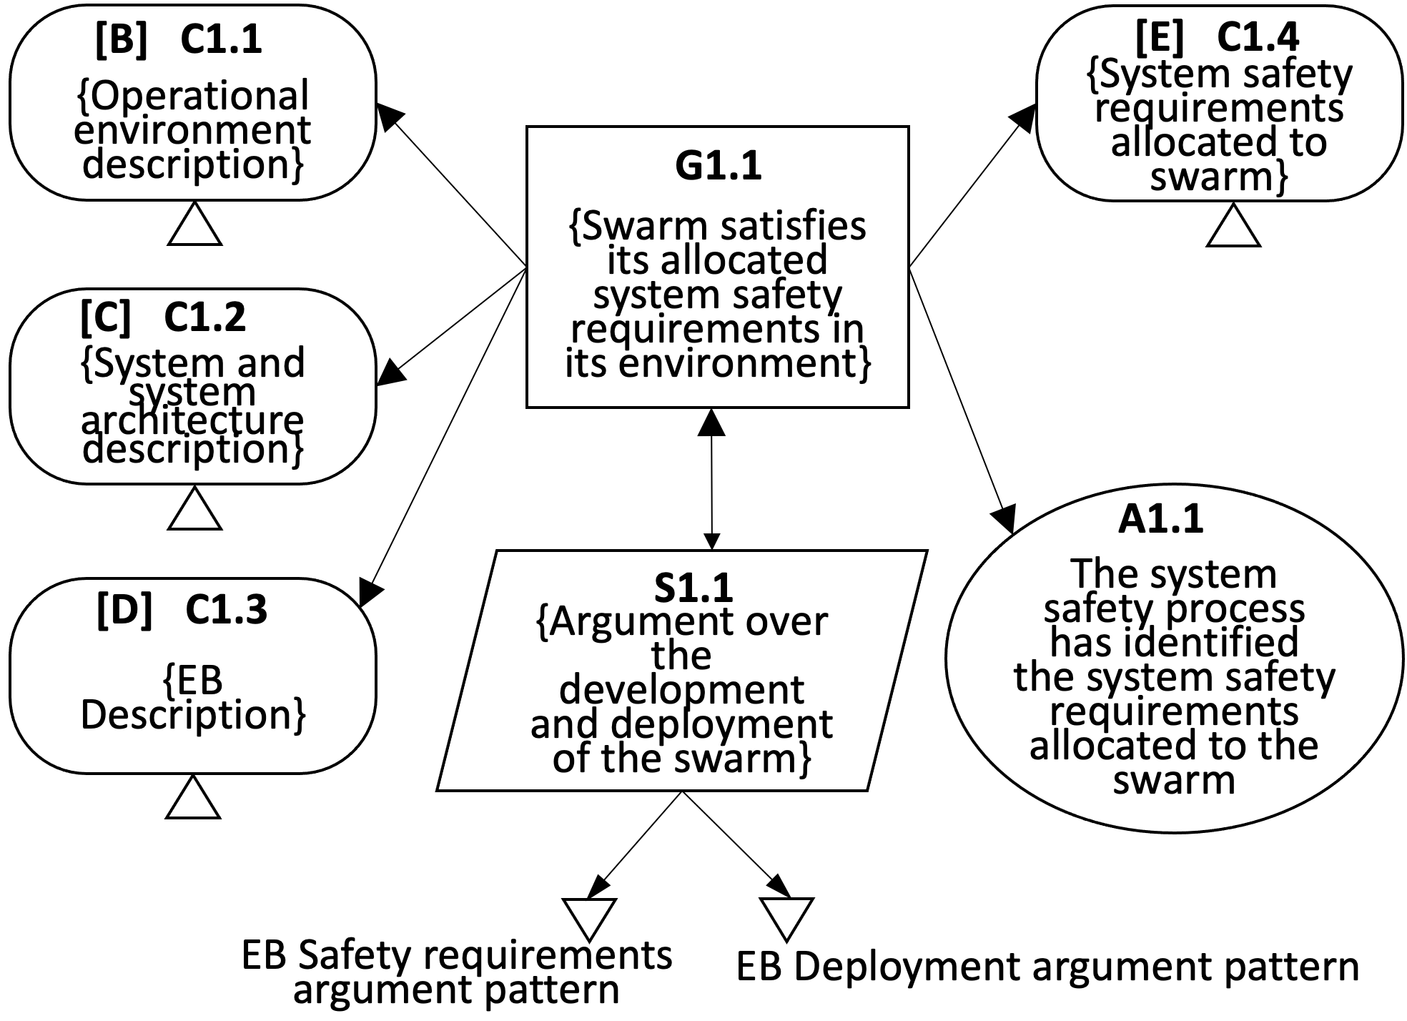
[B] C1.1
[E] C1.4
{Operational environment description}
{System safety requirements allocated to swarm}
G1.1
{Swarm satisfies its allocated system safety requirements in its environment}
[C] C1.2
{System and system architecture description}
A1.1
The system safety process has identified the system safety requirements allocated to the swarm
S1.1
[D] C1.3
{Argument over the development and deployment of the swarm}
{EB Description}
EB Safety requirements argument pattern
EB Deployment argument pattern

Slide 8
Stage 2
[E] Safety Rqts Allocated to Swarm
[I] EB Safety Rqts Argument Pattern
3. Develop EB Safety Requirements
4. Validate EB Safety Requirements
5. Instantiate EB Safety Requirements Argument Pattern
[H] EB Safety Requirements
[J] EB Safety Rqts Validation Results
[K] EB Safety Rqts Argument

Slide 9
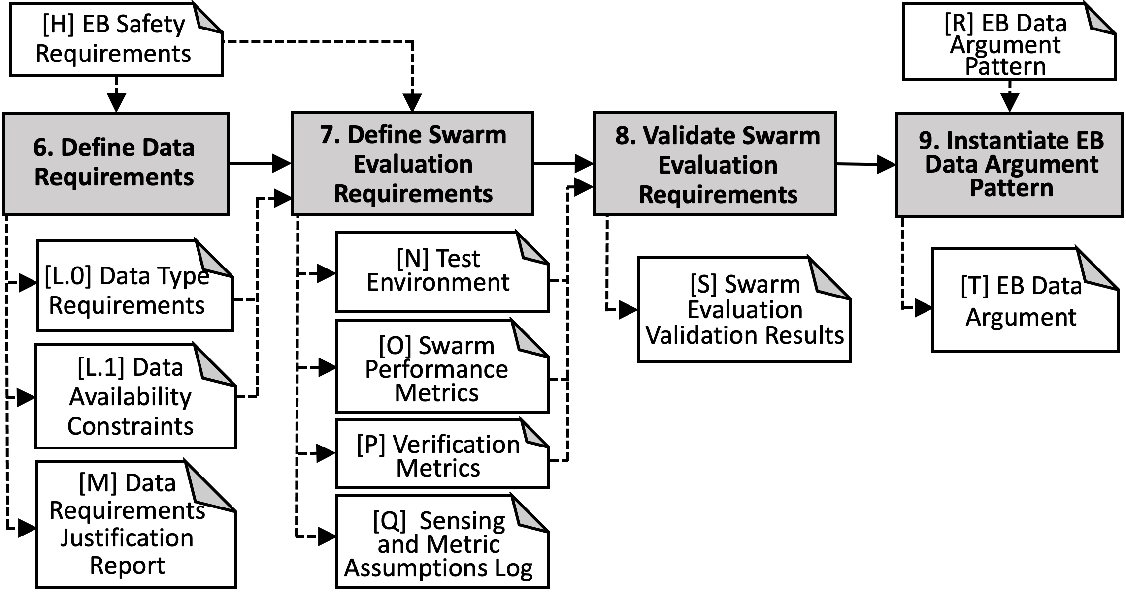
Stage 3: Data Management
[H] EB Safety Requirements
[R] EB Data Argument Pattern
6. Define Data Requirements
7. Define Swarm Evaluation Requirements
8. Validate Swarm Evaluation Requirements
9. Instantiate EB Data Argument Pattern
[L.0] Data Type Requirements
[N] Test Environment
[S] Swarm Evaluation Validation Results
[T] EB Data Argument
[L.1] Data Availability Constraints
[O] Swarm Performance Metrics
[P] Verification Metrics
[M] Data Requirements Justification Report
[Q] Sensing and Metric Assumptions Log
Notes:
Generate ML Data -> Generate Swarm Sim Data
Validate ML Data -> Validate Swarm Sim Data
Objectives:
1. Develop data requirements which are sufficient to allow for the ML safety requirements to be encoded as features against which the data sets to be produced in this stage may be assessed.
2. Generate data sets in accordance with the data requirements for use in the development and verification stages, providing a rationale for those activities undertaken with respect to the ML safety requirements.
3. Analyse the data sets obtained by objective 2 to determine their sufficiency in meeting the data requirements.
4. Create an assurance argument, based on the evidence generated by meeting the first three objectives, that provides a clear justification of the ML Data requirements. This should explicitly state the assumptions and tradeoffs made and any uncertainties concerning the data requirements and the processes by which they were developed and validated.
Pg. 19.
Activities:
6. Activity 6: Activity 6: Define Data Requirements. Data plays a particularly important role in machine learning with data encoding the requirements which will be embodied in the resulting ML model. ML data requirements shall therefore be defined to ensure it is possible to develop a machine learnt model that satisfies the ML Safety Requirements. This activity requires as input the ML safety requirements ([H]) as described in Stage 2 and, from these requirements, data requirements ([L]) shall be generated. Of particular interest in the development of data requirements are those safety requirements which pertain to the description of the system environment. Pg. 19
7. Activity 7: Generate ML Data [N], [O], [P]. Data shall be generated that meets the ML data requirements established in Activity 4. This shall include three separate datasets: Development data [N], Internal test data [O] and Verification data [P]2. The
first two of these sets are for use in the development process (Stage 3) whilst verification set is used in model verification (Stage 4). The generation of ML data will typically consider three sub‐process: collection, preprocessing and augmentation.
Pg. 22
8. Activity 8: Validate ML Data [S]. The ML data validation activity shall check that the three generated data sets are sufficient to meet the ML data requirements. The results of the data validation activity shall be explicitly documented ([S]).
Data validation shall consider the relevance, completeness, and balance of the data sets. Discrepancies identified between the data generated and the ML data requirement shall be justified. These justifications shall be captured as part of the data validation results ([S]). Pg. 25
9. Activity 9: Instantiate ML Data Argument Pattern [T]. This activity requires as input the ML data argument pattern ([R]), as well as the artefacts from the previous activities of this stage ([L], [M], [N], [O], [P], [Q]and [S]). The activity uses the activities and outputs from the previous stages to create an instantiated ML data argument ([T]). Pg. 28
Inputs:
[H]: Activity 3: Develop ML Safety Requirements [H] This activity requires as input the system safety requirements allocated to the ML component ([E]). Pg. 12
[R]: Artefact [R]: ML Data argument pattern. The argument pattern relating to this stage of the AMLAS process is shown in Figure 9. Pg. 28, 29.
Outputs:
[L]: Artefact [L]: Data Requirements. The ML data requirements shall specify the characteristics that the data collected must have in order to ensure that a model meeting the ML safety requirements may be created. ML data requirements shall include consideration of the relevance, completeness, accuracy and balance of the data [5]. These requirements shall explicitly state the assumptions made with respect to the operating environment and the data features required to encode the domain. Pg. 20
[M]: Artefact [M]: Data Requirements Justification Report. A justification shall be provided that the specified ML data requirements are sufficient to ensure it is possible to develop a machine learnt model that satisfies the ML Safety Requirements. This justification shall be documented in a data requirements justification report ([M]). This will typically require an analysis of the data requirements to ensure that the intent of the ML safety requirements are maintained by the data to be collected. This may involve Expert review and statistical analysis techniques.
[N] [O] [P]
Activity 7: Generate ML Data [N], [O], [P]. Data shall be generated that meets the ML data requirements established in Activity 4. This shall include three separate datasets: Development data [N], Internal test data [O] and Verification data [P]2. The
first two of these sets are for use in the development process (Stage 3) whilst verification set is used in model verification (Stage 4). The generation of ML data will typically consider three sub‐process: collection, preprocessing and augmentation.
Pg. 22
[Q]:
Artefact [Q]:Data Generation Log. It is possible for many data sets to be generated which meet the data requirements. Decisions made when collecting, processing and augmenting the data should therefore be recorded in order to explain how the data sets meet the data requirements. A data generation log ([Q]) shall be kept which details the decisions made in each sub‐process to obtain data with the desired features. Pg. 25
[S]: Activity 8: Validate ML Data [S]. The ML data validation activity shall check that the three generated data sets are sufficient to meet the ML data requirements. The results of the data validation activity shall be explicitly documented ([S]).
Data validation shall consider the relevance, completeness, and balance of the data sets. Discrepancies identified between the data generated and the ML data requirement shall be justified. These justifications shall be captured as part of the data validation results ([S]). Pg. 25
[T]: Activity 9: Instantiate ML Data Argument Pattern [T]. This activity requires as input the ML data argument pattern ([R]), as well as the artefacts from the previous activities of this stage ([L], [M], [N], [O], [P], [Q]and [S]). The activity uses the activities and outputs from the previous stages to create an instantiated ML data argument ([T]). Pg. 28

Slide 10
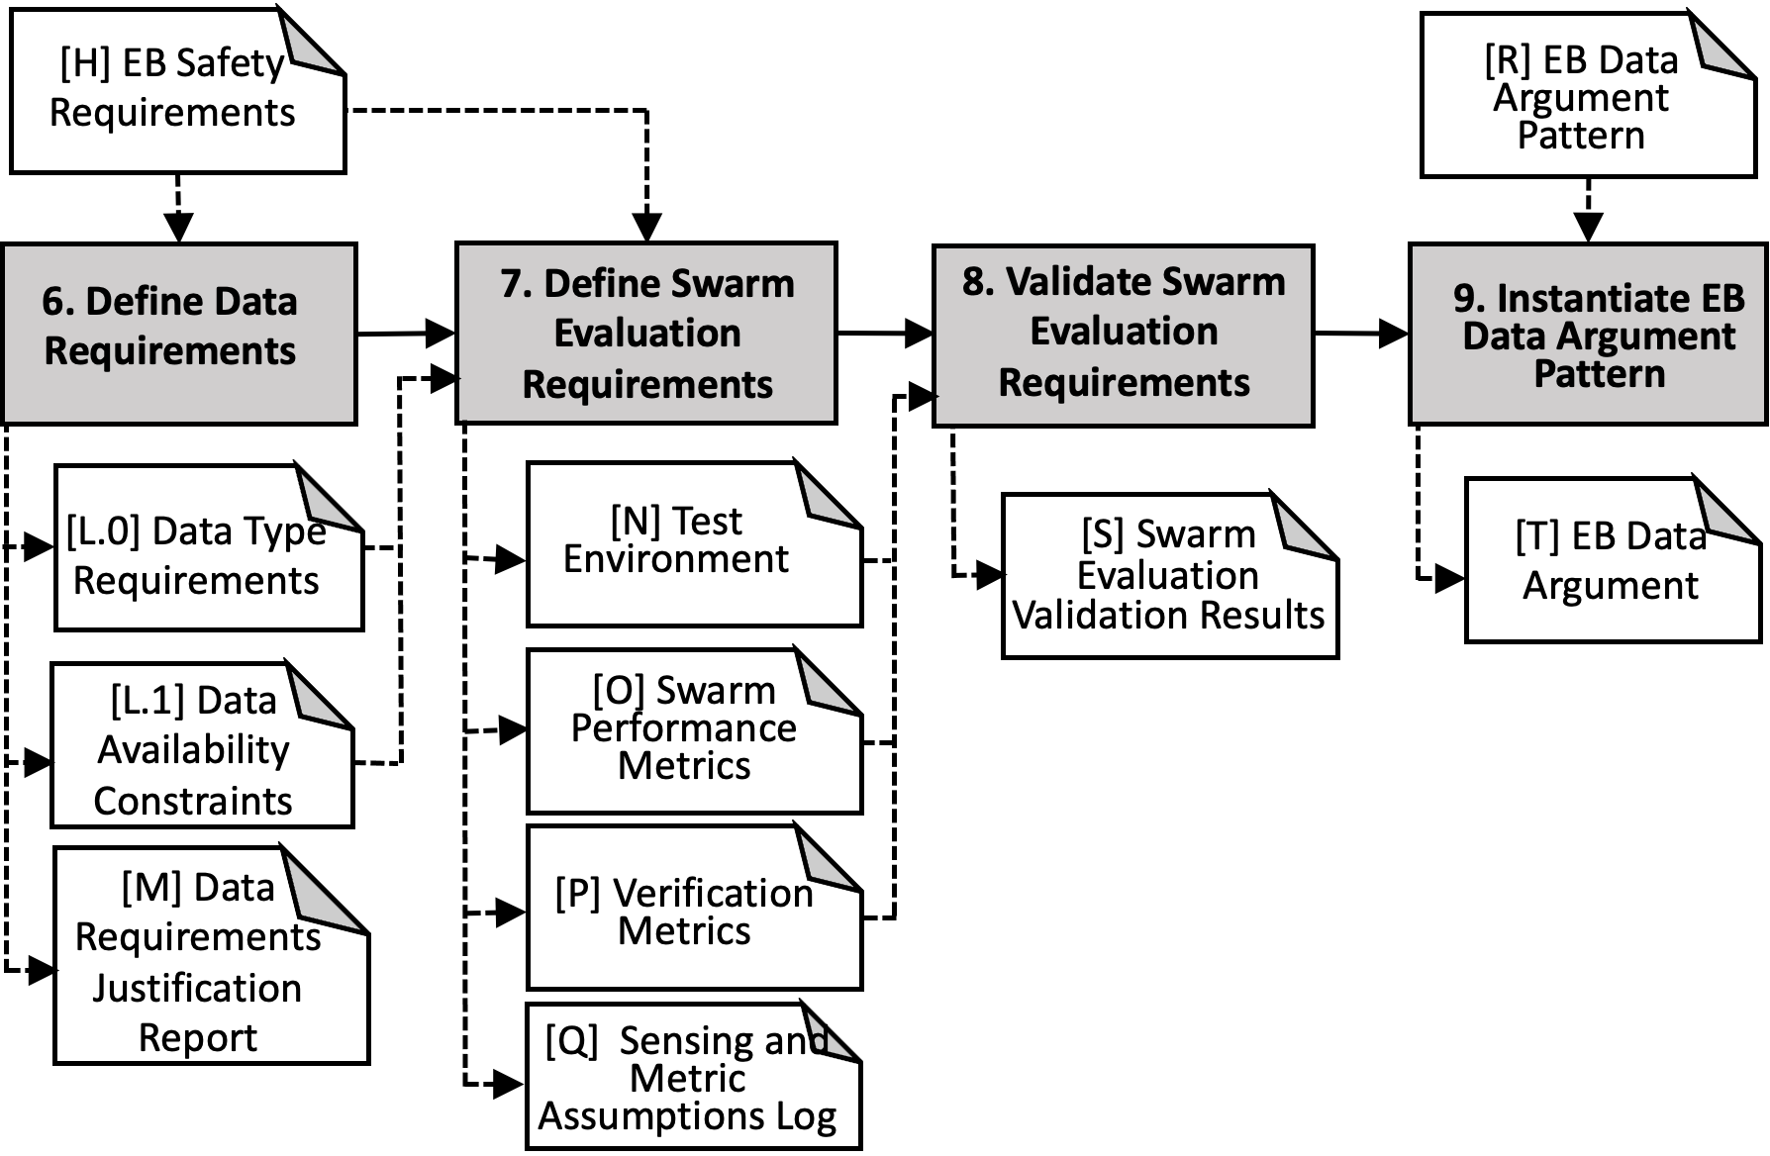

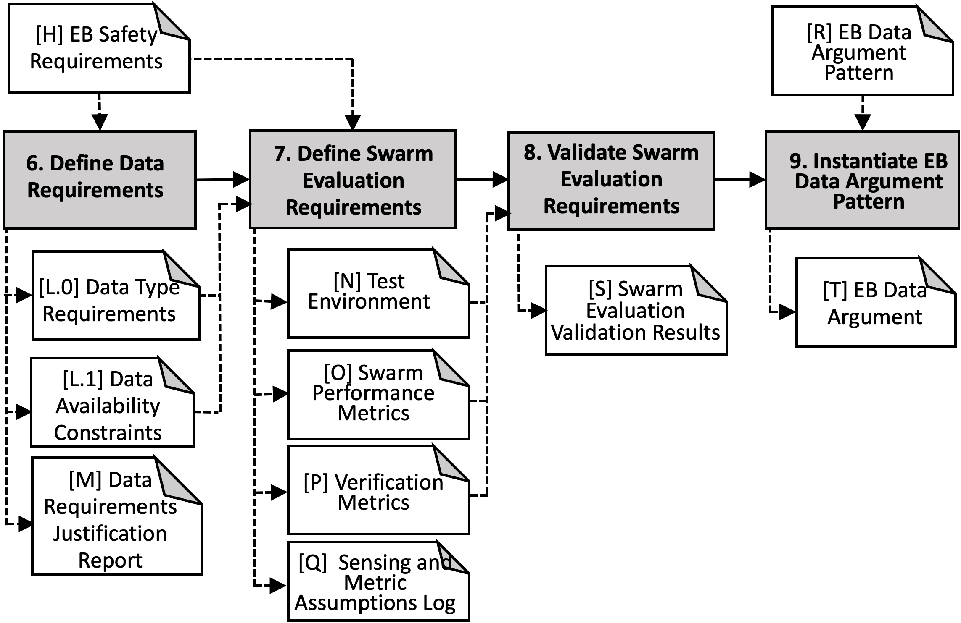
Stage 3: Data Management
[H] EB Safety Requirements
[R] EB Data Argument Pattern
6. Define Data Requirements
7. Define Swarm Evaluation Requirements
8. Validate Swarm Evaluation Requirements
9. Instantiate EB Data Argument Pattern
[L.0] Data Type Requirements
[N] Test Environment
[S] Swarm Evaluation Validation Results
[T] EB Data Argument
[L.1] Data Availability Constraints
[O] Swarm Performance Metrics
[M] Data Requirements Justification Report
[P] Verification Metrics
[Q] Sensing and Metric Assumptions Log
Notes:
Generate ML Data -> Generate Swarm Sim Data
Validate ML Data -> Validate Swarm Sim Data
Objectives:
1. Develop data requirements which are sufficient to allow for the ML safety requirements to be encoded as features against which the data sets to be produced in this stage may be assessed.
2. Generate data sets in accordance with the data requirements for use in the development and verification stages, providing a rationale for those activities undertaken with respect to the ML safety requirements.
3. Analyse the data sets obtained by objective 2 to determine their sufficiency in meeting the data requirements.
4. Create an assurance argument, based on the evidence generated by meeting the first three objectives, that provides a clear justification of the ML Data requirements. This should explicitly state the assumptions and tradeoffs made and any uncertainties concerning the data requirements and the processes by which they were developed and validated.
Pg. 19.
Activities:
6. Activity 6: Activity 6: Define Data Requirements. Data plays a particularly important role in machine learning with data encoding the requirements which will be embodied in the resulting ML model. ML data requirements shall therefore be defined to ensure it is possible to develop a machine learnt model that satisfies the ML Safety Requirements. This activity requires as input the ML safety requirements ([H]) as described in Stage 2 and, from these requirements, data requirements ([L]) shall be generated. Of particular interest in the development of data requirements are those safety requirements which pertain to the description of the system environment. Pg. 19
7. Activity 7: Generate ML Data [N], [O], [P]. Data shall be generated that meets the ML data requirements established in Activity 4. This shall include three separate datasets: Development data [N], Internal test data [O] and Verification data [P]2. The
first two of these sets are for use in the development process (Stage 3) whilst verification set is used in model verification (Stage 4). The generation of ML data will typically consider three sub‐process: collection, preprocessing and augmentation.
Pg. 22
8. Activity 8: Validate ML Data [S]. The ML data validation activity shall check that the three generated data sets are sufficient to meet the ML data requirements. The results of the data validation activity shall be explicitly documented ([S]).
Data validation shall consider the relevance, completeness, and balance of the data sets. Discrepancies identified between the data generated and the ML data requirement shall be justified. These justifications shall be captured as part of the data validation results ([S]). Pg. 25
9. Activity 9: Instantiate ML Data Argument Pattern [T]. This activity requires as input the ML data argument pattern ([R]), as well as the artefacts from the previous activities of this stage ([L], [M], [N], [O], [P], [Q]and [S]). The activity uses the activities and outputs from the previous stages to create an instantiated ML data argument ([T]). Pg. 28
Inputs:
[H]: Activity 3: Develop ML Safety Requirements [H] This activity requires as input the system safety requirements allocated to the ML component ([E]). Pg. 12
[R]: Artefact [R]: ML Data argument pattern. The argument pattern relating to this stage of the AMLAS process is shown in Figure 9. Pg. 28, 29.
Outputs:
[L]: Artefact [L]: Data Requirements. The ML data requirements shall specify the characteristics that the data collected must have in order to ensure that a model meeting the ML safety requirements may be created. ML data requirements shall include consideration of the relevance, completeness, accuracy and balance of the data [5]. These requirements shall explicitly state the assumptions made with respect to the operating environment and the data features required to encode the domain. Pg. 20
[M]: Artefact [M]: Data Requirements Justification Report. A justification shall be provided that the specified ML data requirements are sufficient to ensure it is possible to develop a machine learnt model that satisfies the ML Safety Requirements. This justification shall be documented in a data requirements justification report ([M]). This will typically require an analysis of the data requirements to ensure that the intent of the ML safety requirements are maintained by the data to be collected. This may involve Expert review and statistical analysis techniques.
[N] [O] [P]
Activity 7: Generate ML Data [N], [O], [P]. Data shall be generated that meets the ML data requirements established in Activity 4. This shall include three separate datasets: Development data [N], Internal test data [O] and Verification data [P]2. The
first two of these sets are for use in the development process (Stage 3) whilst verification set is used in model verification (Stage 4). The generation of ML data will typically consider three sub‐process: collection, preprocessing and augmentation.
Pg. 22
[Q]:
Artefact [Q]:Data Generation Log. It is possible for many data sets to be generated which meet the data requirements. Decisions made when collecting, processing and augmenting the data should therefore be recorded in order to explain how the data sets meet the data requirements. A data generation log ([Q]) shall be kept which details the decisions made in each sub‐process to obtain data with the desired features. Pg. 25
[S]: Activity 8: Validate ML Data [S]. The ML data validation activity shall check that the three generated data sets are sufficient to meet the ML data requirements. The results of the data validation activity shall be explicitly documented ([S]).
Data validation shall consider the relevance, completeness, and balance of the data sets. Discrepancies identified between the data generated and the ML data requirement shall be justified. These justifications shall be captured as part of the data validation results ([S]). Pg. 25
[T]: Activity 9: Instantiate ML Data Argument Pattern [T]. This activity requires as input the ML data argument pattern ([R]), as well as the artefacts from the previous activities of this stage ([L], [M], [N], [O], [P], [Q]and [S]). The activity uses the activities and outputs from the previous stages to create an instantiated ML data argument ([T]). Pg. 28

Slide 11
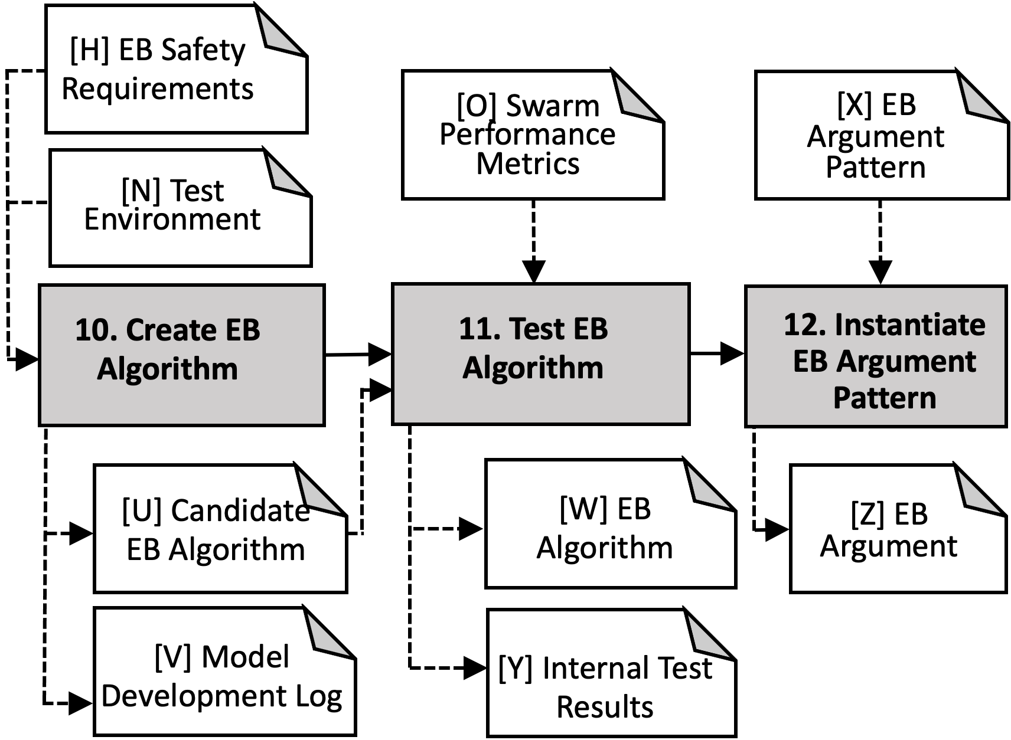
[H] EB Safety Requirements
[O] Swarm Performance Metrics
[X] EB Argument Pattern
[N] Test Environment
10. Create EB Algorithm
11. Test EB Algorithm
12. Instantiate EB Argument Pattern
[U] Candidate EB Algorithm
[W] EB Algorithm
[Z] EB Argument
[V] Model Development Log
[Y] Internal Test Results
Stage 4: Model ML/EB
[H] EB Safety Requirements
[O] Swarm Performance Metrics
[X] EB Argument Pattern
[N] Test Environment
10. Create EB Algorithm
11. Test EB Algorithm
12. Instantiate EB Argument Pattern
[U] Candidate EB Algorithm
[W] EB Algorithm
[Z] EB Argument
[V] Model Development Log
[Y] Internal Test Results
Notes:
Model Learning in AMLAS -> Model EB in our approach
Objectives:
1. Develop the machine learnt model using the development data obtained in the previous stage such that the allocated ML safety requirements are satisfied.
2. Use internal test data to assess the extent to which the machine learnt model is able to meet the ML safety requirements when presented with data not used for development.
3. Create an assurance argument, based on the evidence generated by meeting the first two objectives, which provides a clear justification that the ML model meets the ML safety requirements.
This should explicitly explain the tradeoffs, assumptions and uncertainties concerning both the ML model and the process by which it is developed and validated.
Pg. 31
Activities:
10. Activity 10: Create ML Model [V]. An ML model meeting the ML Safety Requirements ([H]) shall be developed using the development data ([N]). The creation of an ML model starts with a decision as to the form of model that is most appropriate for the problem at hand and shall be most effective at satisfying the ML safety requirements. This decision may be based on expert knowledge and previous experience of best practice. The rationale shall be recorded in the model development log ([U]).
Pg. 31
11. Activity 11: Test ML Model [V]. Each candidate model created in Activity 5 shall be evaluated using the internal test data ([H]) to check that it is able to satisfy the ML safety requirements. The internal test data shall not have been used during Activity 5 in creating the candidate model5. Pg. 34
12. Activity 12: Instantiate ML Learning Argument Pattern [Y]. This activity requires as input the ML learning argument pattern ([W]), as well as the artefacts from the previous activities of this stage ([O], [U], [V] and [X]). The activity uses these activities and outputs from the previous stages to create an instantiated ML learning argument ([Y]). Pg. 35.
Inputs to the Stage:
[H]: Activity 3: Develop ML Safety Requirements [H] This activity requires as input the system safety requirements allocated to the ML component ([E]). Pg. 12.
[N] [O]: … Generate ML Data [N], [O], [P]. Data shall be generated that meets the ML data requirements established in Activity 4. This shall include three separate datasets: Development data [N], Internal test data [O] and Verification data [P]2. The
first two of these sets are for use in the development process (Stage 3) whilst verification set is used in model verification (Stage 4). The generation of ML data will typically consider three sub‐process: collection, preprocessing and augmentation.
Pg. 22.
[W]: Artefact [W]: Model Learning argument pattern. The argument pattern relating to this stage of the AMLAS process is shown in Figure 12. The key elements of the argument pattern are described below. Pg. 35.
Outputs of the Stage:
[] Candidate EB Model: Typically numerous different candidate models of the selected type will be created from the development data by tuning the model hyperparameters in order to create models that may satisfy the ML safety requirements. Pg. 32.
[U] Model Development Log: Artefact [U]: Model Development Log. The process used in creating the model shall be documented in a model development log ([U]). The development log shall document and justify all key decisions made during the learning process (including the choice of development tool chain e.g. Tensorflow3 or pyTorch4 machine learning platforms), and how those choices impact the performance or robustness of the model. Pg. 33.
[V] ML Model: Activity 11: Test ML Model [V]. Each candidate model created in Activity 5 shall be evaluated using the internal test data ([H]) to check that it is able to satisfy the ML safety requirements. The internal test data shall not have been used during Activity 5 in creating the candidate model. Pg. 34.
[X] Internal Test Results: Artefact [X]: Internal Test Results. A document shall be created that records the results of executing the ML model ([V]) using the internal test data ([O]). The sufficiency of these results with respect to the defined ML safety requirements ([H]) shall also be documented. Pg. 34.
[Y]: ML Argument: Activity 12: Instantiate ML Learning Argument Pattern [Y]. This activity requires as input the ML learning argument pattern ([W]), as well as the artefacts from the previous activities of this stage ([O], [U], [V] and [X]). The activity uses these activities and outputs from the previous stages to create an instantiated ML learning argument ([Y]). Pg. 35.

Slide 12
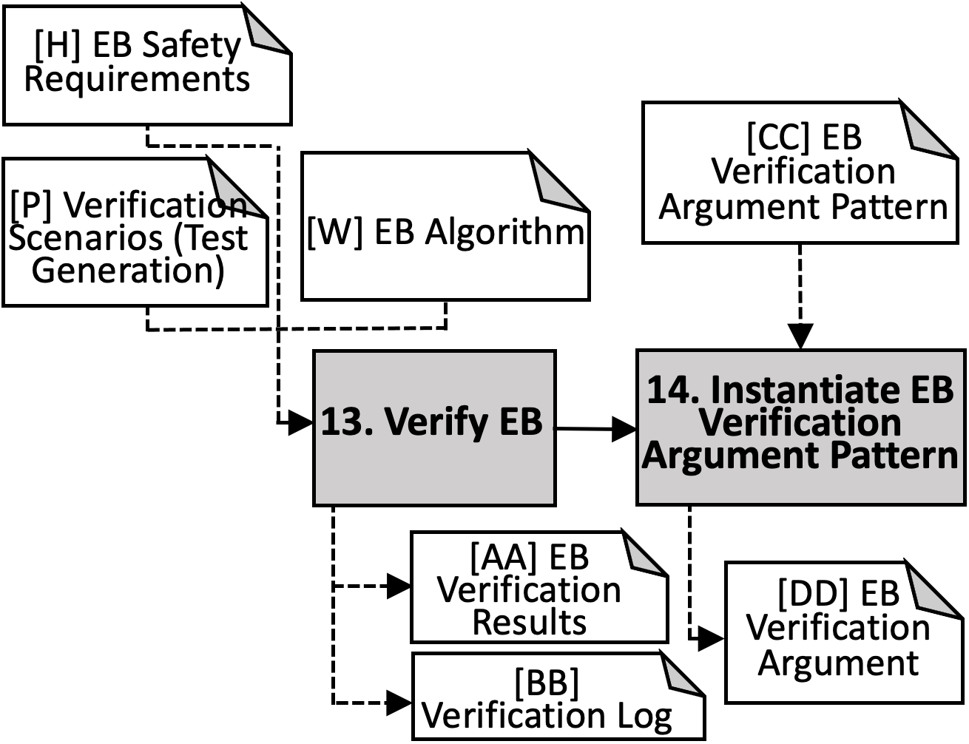
Stage 5: Model Verification
[H] EB Safety Requirements
[H] EB Safety Requirements
[CC] EB Verification Argument Pattern
[P] Verification Scenarios (Test Generation)
[W] EB Algorithm
[CC] EB Verification Argument Pattern
[P] Verification Scenarios (Test Generation)
[W] EB Algorithm
13. Verify EB
14. Instantiate EB Verification Argument Pattern
13. Verify EB
14. Instantiate EB Verification Argument Pattern
[AA] EB Verification Results
[DD] EB Verification Argument
[AA] EB Verification Results
[BB] Verification Log
[DD] EB Verification Argument
[BB] Verification Log
Notes:
Objectives:
1. Demonstrate that the model will meet the ML safety requirements when exposed to inputs not present during the development of the model.
2. Create an assurance argument, based on the evidence generated by the first objective. The argument should clearly demonstrate the relationship between the verification evidence and the ML safety requirements. It should explicitly explain the tradeoffs, assumptions and uncertainties concerning the verification results and the process by which they were generated.
Pg. 39.
Activities:
13. Activity 13: Verify ML Model. This activity requires as input the ML safety requirements ([H]), the verification data ([P]) and the machine learnt model ([V]). Model verification may consist of two sub‐activities: test‐based verification
and formal verification. For every ML safety requirement at least one verification activity shall be undertaken. The results of verification for each requirement shall be recorded in the ML verification results ([Z]).
14. Activity 14: Instantiate ML Verification Argument Pattern [CC]. This activity requires as input the ML verification argument pattern ([BB]), as well as the artefacts from the previous activities of this stage ([AA], [Z]and [P]). The activity uses these activities and outputs from the previous stages to create an instantiated ML verification argument ([CC]). Pg. 43.
Inputs to the Stage:
[H] ML Safety Requirements.
Activity 3: Develop ML Safety Requirements [H]. This activity requires as input the system safety requirements allocated to the ML component ([E]). See Stage 2, Pg. 12.
[P]: Verification Data
Activity 7: Generate ML Data [N], [O], [P]. Data shall be generated that meets the ML data requirements established in Activity 4. This shall include three separate datasets: Development data [N], Internal test data [O] and Verification data [P]2. The first two of these sets are for use in the development process (Stage 3) whilst verification set is used in model verification (Stage 4). Pg. 22.
[V] ML Model. Activity 10: Create ML Model [V]
An ML model meeting the ML Safety Requirements ([H]) shall be developed using the development data ([N]). (see Stage 4, Pg. 31)
[BB]: Artefact [BB]: ML Verification Argument Pattern. The argument pattern relating to this stage of the AMLAS process is shown in Figure 14. The key elements of the argument pattern are described below. Pg. 44.
Outputs of the Stage:
[Z]: Artefact [Z]: ML verification evidence
Having undertaken verification activities, ML verification evidence should be collated and reported in terms which are meaningful to the safety engineer with respect to the ML safety requirements and the operating environment. The verification evidence shall be comprehensive and shall clearly demonstrate coverage with respect to the dimensions of variability, and combinations thereof, relevant to the ML safety requirements. Pg. 42.
[AA] Artefact [AA]: Verification Log
This log should explicitly document the verification strategy. For testing this should include the range of tests undertaken and the rationale for performing each test with bounds and test parameters where appropriate. In addition the approaches taken to manage verification data in such a way as to ensure that data leakage did not occur should be documented. For formal verification the techniques employed should be listed and the rationale for using such approaches to verify properties of the model with respect to real‐world features included. Pg. 43.
[CC] Activity 14: Instantiate ML Verification Argument Pattern [CC]
This activity requires as input the ML verification argument pattern ([BB]), as well as the artefacts from the previous activities of this stage ([AA], [Z]and [P]). The activity uses these activities and outputs from the previous stages to create an instantiated ML verification argument ([CC]). Pg. 43.

Slide 13
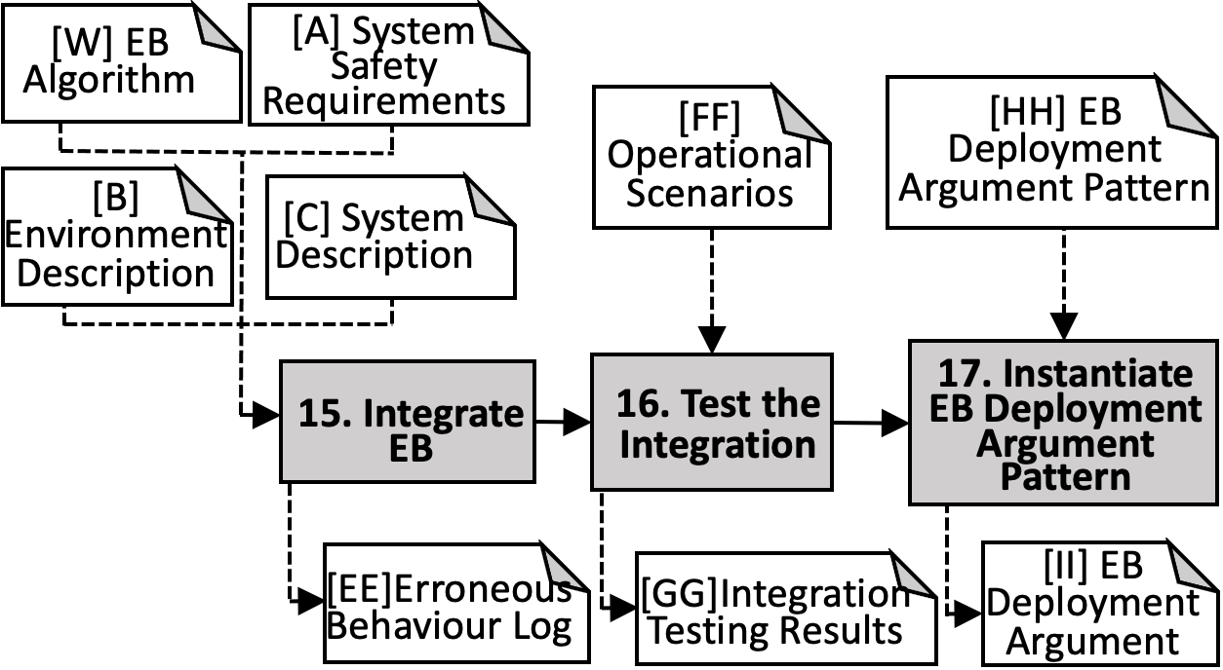
[W] EB Algorithm
[A] System Safety Requirements
[FF] Operational Scenarios
[HH] EB Deployment Argument Pattern
[B] Environment Description
[C] System Description
Stage 6: Model Deployment
16. Test the Integration
17. Instantiate EB Deployment Argument Pattern
15. Integrate EB
[EE]Erroneous Behaviour Log
[GG]Integration Testing Results
[II] EB Deployment Argument
[W] EB Algorithm
[A] System Safety Requirements
[FF] Operational Scenarios
[HH] EB Deployment Argument Pattern
[B] Environment Description
[C] System Description
16. Test the Integration
17. Instantiate EB Deployment Argument Pattern
15. Integrate EB
[EE]Erroneous Behaviour Log
[GG]Integration Testing Results
[II] EB Deployment Argument
[W] EB Algorithm
[A] System Safety Requirements
[FF] Operational Scenarios
[HH] EB Deployment Argument Pattern
[B] Environment Description
[C] System Description
15. Integrate EB
16. Test the Integration
17. Instantiate EB Deployment Argument Pattern
[EE]Erroneous Behaviour Log
[GG]Integration Testing Results
[II] EB Deployment Argument
Notes:
Objectives:
1. Integrate the machine learnt component into the target system in such a manner that the system satisfies the allocated system safety requirements. The component should be integrated in the pipeline linking its inputs and outputs to other system components.
2. Demonstrate that the allocated system safety requirements are still satisfied during operation of the target system and environment.
3. Create an assurance argument to demonstrate that the ML model will continue to meet the ML safety requirements once integrated into the target system.
Pg. 46.
Activities:
15. Activity 15: Activity 15: Integrate ML Model
The ML Model needs to be deployed onto the intended hardware platform and integrated into the broader system of which it is a part. Deploying the component may be a multi‐stage process in which the component is first deployed to computational hardware which is then integrated at a subsystem level before being integrating with the final hardware platform. The deployment process will include, connecting the component’s inputs to sensing devices (or equivalent components) and providing its output to the wider system. This activity takes as inputs the system safety requirements ([A]), the environment description ([B]), the system description ([C]) and the ML model ([V]) defined in the previous stages and integrates the model into the overall system .
Pg. 46.
16. Activity 16: Activity 16: Test the Integration [FF]
Once the ML model has been integrated into the wider system, the integration needs to be tested to check that the system safety requirements ([A]) are satisfied. This activity requires a defined set of operational scenarios ([EE]) against which the behaviour of the system, as implemented in ML, can be tested.
Pg. 49.
17. Activity 17: Activity 17: Instantiate ML Deployment Argument Pattern [HH]
This activity requires as input the ML verification argument pattern ([BB]), as well as the artefacts from the previous activities of this stage ([AA], [Z]and [P]). The activity uses these activities and outputs from the previous stages to create an instantiated ML verification argument ([CC]).
Pg. 51.
Inputs:
[V] ML Model. Activity 10: Create ML Model [V]
An ML model meeting the ML Safety Requirements ([H]) shall be developed using the development data ([N]). (see Stage 4, Pg. 31)
[A]: The safety requirements are generated from the system safety assessment process. Such a process covers hazard identification and risk analysis. Importantly, it shall determine the contribution, i.e. in the form of concrete failure conditions, that the output of the machine learning component makes to potential system hazards. Pg. 6.
[B]: In determining the allocation of system safety requirements to the ML component it is crucial that the system environment is considered. The system environment considered during system safety requirement allocation shall be explicitly defined in Artefact [B] to ensure consistency when determining ML safety requirements. Pg. 7.
[C]: The allocation of system safety requirements to the ML component shall also consider the system architecture. The system to which the ML component shall be deployed and the system architecture shall be explicitly defined in Artefact [C]. This helps to ensure it is correctly accounted for when determining ML safety requirements. Pg. 8.
[EE] Operational Scenarios: Artefact [EE]: Operational Scenarios.
An operational scenario is defined as “Description of an imagined sequence of events that includes the interaction of the product or service with its environment and users, as well as interaction among its product or service components” [32]. The set of operational scenarios shall therefore represent real scenarios that may be encountered when the system is in operation. This set shall comprise a number of defined scenarios, meaningful with respect to the safety requirements of the system, that may occur during the system life.
Pg. 49.
[GG] ML Deployment Argument Pattern.
Artefact [GG]: ML Deployment Argument Pattern
The argument pattern relating to this stage of the AMLAS process is shown in Figure 16. The key elements of the argument pattern are described below.
Pg. 51.
Outputs:
[DD] Artefact [DD]: Erroneous Behaviour Log
The nature and characteristics of the erroneous outputs shall be predicted and documented in the erroneous behaviour log ([DD]) such that an appropriate system response can be determined. These predictions shall be informed by the findings of internal testing and of verification activities. This understanding can be enhanced through integration testing performed at Activity 16.
Pg. 49.
[FF] Activity 16: Test the Integration [FF]
Once the ML model has been integrated into the wider system, the integration needs to be tested to check that the system safety requirements ([A]) are satisfied. This activity requires a defined set of operational scenarios ([EE]) against which the behaviour of the system, as implemented in ML, can be tested.
Pg. 49
[HH] ML Deployment Argument:
Activity 17: Instantiate ML Deployment Argument Pattern [HH]
This activity requires as input the ML verification argument pattern ([BB]), as well as the artefacts from the previous activities of this stage ([AA], [Z]and [P]). The activity uses these activities and outputs from the previous stages to create an instantiated ML verification argument ([CC]).
Pg. 51.

Slide 14
Notes:
Model Learning in AMLAS -> Model EB in our approach
Objectives:
1. Develop the machine learnt model using the development data obtained in the previous stage such that the allocated ML safety requirements are satisfied.
2. Use internal test data to assess the extent to which the machine learnt model is able to meet the ML safety requirements when presented with data not used for development.
3. Create an assurance argument, based on the evidence generated by meeting the first two objectives, which provides a clear justification that the ML model meets the ML safety requirements.
This should explicitly explain the tradeoffs, assumptions and uncertainties concerning both the ML model and the process by which it is developed and validated.
Pg. 31
Activities:
10. Activity 10: Create ML Model [V]. An ML model meeting the ML Safety Requirements ([H]) shall be developed using the development data ([N]). The creation of an ML model starts with a decision as to the form of model that is most appropriate for the problem at hand and shall be most effective at satisfying the ML safety requirements. This decision may be based on expert knowledge and previous experience of best practice. The rationale shall be recorded in the model development log ([U]).
Pg. 31
11. Activity 11: Test ML Model [V]. Each candidate model created in Activity 5 shall be evaluated using the internal test data ([H]) to check that it is able to satisfy the ML safety requirements. The internal test data shall not have been used during Activity 5 in creating the candidate model5. Pg. 34
12. Activity 12: Instantiate ML Learning Argument Pattern [Y]. This activity requires as input the ML learning argument pattern ([W]), as well as the artefacts from the previous activities of this stage ([O], [U], [V] and [X]). The activity uses these activities and outputs from the previous stages to create an instantiated ML learning argument ([Y]). Pg. 35.
Inputs to the Stage:
[H]: Activity 3: Develop ML Safety Requirements [H] This activity requires as input the system safety requirements allocated to the ML component ([E]). Pg. 12.
[N] [O]: … Generate ML Data [N], [O], [P]. Data shall be generated that meets the ML data requirements established in Activity 4. This shall include three separate datasets: Development data [N], Internal test data [O] and Verification data [P]2. The
first two of these sets are for use in the development process (Stage 3) whilst verification set is used in model verification (Stage 4). The generation of ML data will typically consider three sub‐process: collection, preprocessing and augmentation.
Pg. 22.
[W]: Artefact [W]: Model Learning argument pattern. The argument pattern relating to this stage of the AMLAS process is shown in Figure 12. The key elements of the argument pattern are described below. Pg. 35.
Outputs of the Stage:
[] Candidate EB Model: Typically numerous different candidate models of the selected type will be created from the development data by tuning the model hyperparameters in order to create models that may satisfy the ML safety requirements. Pg. 32.
[U] Model Development Log: Artefact [U]: Model Development Log. The process used in creating the model shall be documented in a model development log ([U]). The development log shall document and justify all key decisions made during the learning process (including the choice of development tool chain e.g. Tensorflow3 or pyTorch4 machine learning platforms), and how those choices impact the performance or robustness of the model. Pg. 33.
[V] ML Model: Activity 11: Test ML Model [V]. Each candidate model created in Activity 5 shall be evaluated using the internal test data ([H]) to check that it is able to satisfy the ML safety requirements. The internal test data shall not have been used during Activity 5 in creating the candidate model. Pg. 34.
[X] Internal Test Results: Artefact [X]: Internal Test Results. A document shall be created that records the results of executing the ML model ([V]) using the internal test data ([O]). The sufficiency of these results with respect to the defined ML safety requirements ([H]) shall also be documented. Pg. 34.
[Y]: ML Argument: Activity 12: Instantiate ML Learning Argument Pattern [Y]. This activity requires as input the ML learning argument pattern ([W]), as well as the artefacts from the previous activities of this stage ([O], [U], [V] and [X]). The activity uses these activities and outputs from the previous stages to create an instantiated ML learning argument ([Y]). Pg. 35.

Slide 15
Notes:
Model Learning in AMLAS -> Model EB in our approach
Objectives:
1. Develop the machine learnt model using the development data obtained in the previous stage such that the allocated ML safety requirements are satisfied.
2. Use internal test data to assess the extent to which the machine learnt model is able to meet the ML safety requirements when presented with data not used for development.
3. Create an assurance argument, based on the evidence generated by meeting the first two objectives, which provides a clear justification that the ML model meets the ML safety requirements.
This should explicitly explain the tradeoffs, assumptions and uncertainties concerning both the ML model and the process by which it is developed and validated.
Pg. 31
Activities:
10. Activity 10: Create ML Model [V]. An ML model meeting the ML Safety Requirements ([H]) shall be developed using the development data ([N]). The creation of an ML model starts with a decision as to the form of model that is most appropriate for the problem at hand and shall be most effective at satisfying the ML safety requirements. This decision may be based on expert knowledge and previous experience of best practice. The rationale shall be recorded in the model development log ([U]).
Pg. 31
11. Activity 11: Test ML Model [V]. Each candidate model created in Activity 5 shall be evaluated using the internal test data ([H]) to check that it is able to satisfy the ML safety requirements. The internal test data shall not have been used during Activity 5 in creating the candidate model5. Pg. 34
12. Activity 12: Instantiate ML Learning Argument Pattern [Y]. This activity requires as input the ML learning argument pattern ([W]), as well as the artefacts from the previous activities of this stage ([O], [U], [V] and [X]). The activity uses these activities and outputs from the previous stages to create an instantiated ML learning argument ([Y]). Pg. 35.
Inputs to the Stage:
[H]: Activity 3: Develop ML Safety Requirements [H] This activity requires as input the system safety requirements allocated to the ML component ([E]). Pg. 12.
[N] [O]: … Generate ML Data [N], [O], [P]. Data shall be generated that meets the ML data requirements established in Activity 4. This shall include three separate datasets: Development data [N], Internal test data [O] and Verification data [P]2. The
first two of these sets are for use in the development process (Stage 3) whilst verification set is used in model verification (Stage 4). The generation of ML data will typically consider three sub‐process: collection, preprocessing and augmentation.
Pg. 22.
[W]: Artefact [W]: Model Learning argument pattern. The argument pattern relating to this stage of the AMLAS process is shown in Figure 12. The key elements of the argument pattern are described below. Pg. 35.
Outputs of the Stage:
[] Candidate EB Model: Typically numerous different candidate models of the selected type will be created from the development data by tuning the model hyperparameters in order to create models that may satisfy the ML safety requirements. Pg. 32.
[U] Model Development Log: Artefact [U]: Model Development Log. The process used in creating the model shall be documented in a model development log ([U]). The development log shall document and justify all key decisions made during the learning process (including the choice of development tool chain e.g. Tensorflow3 or pyTorch4 machine learning platforms), and how those choices impact the performance or robustness of the model. Pg. 33.
[V] ML Model: Activity 11: Test ML Model [V]. Each candidate model created in Activity 5 shall be evaluated using the internal test data ([H]) to check that it is able to satisfy the ML safety requirements. The internal test data shall not have been used during Activity 5 in creating the candidate model. Pg. 34.
[X] Internal Test Results: Artefact [X]: Internal Test Results. A document shall be created that records the results of executing the ML model ([V]) using the internal test data ([O]). The sufficiency of these results with respect to the defined ML safety requirements ([H]) shall also be documented. Pg. 34.
[Y]: ML Argument: Activity 12: Instantiate ML Learning Argument Pattern [Y]. This activity requires as input the ML learning argument pattern ([W]), as well as the artefacts from the previous activities of this stage ([O], [U], [V] and [X]). The activity uses these activities and outputs from the previous stages to create an instantiated ML learning argument ([Y]). Pg. 35.

Slide 16
Stage 4: Model ML/EB
[H] EB Safety Requirements
[O] Swarm Performance Metrics
[W] EB Argument Pattern
[N] Test Environment
10. Create EB Algorithm
11. Test EB Algorithm
12. Instantiate EB Argument Pattern
Candidate EB Algorithm
[V] EB Algorithm
[Y] EB Argument
[U] Model Development Log
[X] Internal Test Results
Notes:
Model Learning in AMLAS -> Model EB in our approach
Objectives:
1. Develop the machine learnt model using the development data obtained in the previous stage such that the allocated ML safety requirements are satisfied.
2. Use internal test data to assess the extent to which the machine learnt model is able to meet the ML safety requirements when presented with data not used for development.
3. Create an assurance argument, based on the evidence generated by meeting the first two objectives, which provides a clear justification that the ML model meets the ML safety requirements.
This should explicitly explain the tradeoffs, assumptions and uncertainties concerning both the ML model and the process by which it is developed and validated.
Pg. 31
Activities:
10. Activity 10: Create ML Model [V]. An ML model meeting the ML Safety Requirements ([H]) shall be developed using the development data ([N]). The creation of an ML model starts with a decision as to the form of model that is most appropriate for the problem at hand and shall be most effective at satisfying the ML safety requirements. This decision may be based on expert knowledge and previous experience of best practice. The rationale shall be recorded in the model development log ([U]).
Pg. 31
11. Activity 11: Test ML Model [V]. Each candidate model created in Activity 5 shall be evaluated using the internal test data ([H]) to check that it is able to satisfy the ML safety requirements. The internal test data shall not have been used during Activity 5 in creating the candidate model5. Pg. 34
12. Activity 12: Instantiate ML Learning Argument Pattern [Y]. This activity requires as input the ML learning argument pattern ([W]), as well as the artefacts from the previous activities of this stage ([O], [U], [V] and [X]). The activity uses these activities and outputs from the previous stages to create an instantiated ML learning argument ([Y]). Pg. 35.
Inputs to the Stage:
[H]: Activity 3: Develop ML Safety Requirements [H] This activity requires as input the system safety requirements allocated to the ML component ([E]). Pg. 12.
[N] [O]: … Generate ML Data [N], [O], [P]. Data shall be generated that meets the ML data requirements established in Activity 4. This shall include three separate datasets: Development data [N], Internal test data [O] and Verification data [P]2. The
first two of these sets are for use in the development process (Stage 3) whilst verification set is used in model verification (Stage 4). The generation of ML data will typically consider three sub‐process: collection, preprocessing and augmentation.
Pg. 22.
[W]: Artefact [W]: Model Learning argument pattern. The argument pattern relating to this stage of the AMLAS process is shown in Figure 12. The key elements of the argument pattern are described below. Pg. 35.
Outputs of the Stage:
[] Candidate EB Model: Typically numerous different candidate models of the selected type will be created from the development data by tuning the model hyperparameters in order to create models that may satisfy the ML safety requirements. Pg. 32.
[U] Model Development Log: Artefact [U]: Model Development Log. The process used in creating the model shall be documented in a model development log ([U]). The development log shall document and justify all key decisions made during the learning process (including the choice of development tool chain e.g. Tensorflow3 or pyTorch4 machine learning platforms), and how those choices impact the performance or robustness of the model. Pg. 33.
[V] ML Model: Activity 11: Test ML Model [V]. Each candidate model created in Activity 5 shall be evaluated using the internal test data ([H]) to check that it is able to satisfy the ML safety requirements. The internal test data shall not have been used during Activity 5 in creating the candidate model. Pg. 34.
[X] Internal Test Results: Artefact [X]: Internal Test Results. A document shall be created that records the results of executing the ML model ([V]) using the internal test data ([O]). The sufficiency of these results with respect to the defined ML safety requirements ([H]) shall also be documented. Pg. 34.
[Y]: ML Argument: Activity 12: Instantiate ML Learning Argument Pattern [Y]. This activity requires as input the ML learning argument pattern ([W]), as well as the artefacts from the previous activities of this stage ([O], [U], [V] and [X]). The activity uses these activities and outputs from the previous stages to create an instantiated ML learning argument ([Y]). Pg. 35.

Slide 17
Stage 5: Model Verification
[H] EB Safety Requirements
[BB] EB Verification Argument Pattern
[P] Verification Scenarios (Test Generation)
[V] EB Algorithm
13. Verify EB
14. Instantiate EB Verification Argument Pattern
[Z] EB Verification Results
[CC] EB Verification Argument
[AA] Verification Log
Notes:
Objectives:
1. Demonstrate that the model will meet the ML safety requirements when exposed to inputs not present during the development of the model.
2. Create an assurance argument, based on the evidence generated by the first objective. The argument should clearly demonstrate the relationship between the verification evidence and the ML safety requirements. It should explicitly explain the tradeoffs, assumptions and uncertainties concerning the verification results and the process by which they were generated.
Pg. 39.
Activities:
13. Activity 13: Verify ML Model. This activity requires as input the ML safety requirements ([H]), the verification data ([P]) and the machine learnt model ([V]). Model verification may consist of two sub‐activities: test‐based verification
and formal verification. For every ML safety requirement at least one verification activity shall be undertaken. The results of verification for each requirement shall be recorded in the ML verification results ([Z]).
14. Activity 14: Instantiate ML Verification Argument Pattern [CC]. This activity requires as input the ML verification argument pattern ([BB]), as well as the artefacts from the previous activities of this stage ([AA], [Z]and [P]). The activity uses these activities and outputs from the previous stages to create an instantiated ML verification argument ([CC]). Pg. 43.
Inputs to the Stage:
[H] ML Safety Requirements.
Activity 3: Develop ML Safety Requirements [H]. This activity requires as input the system safety requirements allocated to the ML component ([E]). See Stage 2, Pg. 12.
[P]: Verification Data
Activity 7: Generate ML Data [N], [O], [P]. Data shall be generated that meets the ML data requirements established in Activity 4. This shall include three separate datasets: Development data [N], Internal test data [O] and Verification data [P]2. The first two of these sets are for use in the development process (Stage 3) whilst verification set is used in model verification (Stage 4). Pg. 22.
[V] ML Model. Activity 10: Create ML Model [V]
An ML model meeting the ML Safety Requirements ([H]) shall be developed using the development data ([N]). (see Stage 4, Pg. 31)
[BB]: Artefact [BB]: ML Verification Argument Pattern. The argument pattern relating to this stage of the AMLAS process is shown in Figure 14. The key elements of the argument pattern are described below. Pg. 44.
Outputs of the Stage:
[Z]: Artefact [Z]: ML verification evidence
Having undertaken verification activities, ML verification evidence should be collated and reported in terms which are meaningful to the safety engineer with respect to the ML safety requirements and the operating environment. The verification evidence shall be comprehensive and shall clearly demonstrate coverage with respect to the dimensions of variability, and combinations thereof, relevant to the ML safety requirements. Pg. 42.
[AA] Artefact [AA]: Verification Log
This log should explicitly document the verification strategy. For testing this should include the range of tests undertaken and the rationale for performing each test with bounds and test parameters where appropriate. In addition the approaches taken to manage verification data in such a way as to ensure that data leakage did not occur should be documented. For formal verification the techniques employed should be listed and the rationale for using such approaches to verify properties of the model with respect to real‐world features included. Pg. 43.
[CC] Activity 14: Instantiate ML Verification Argument Pattern [CC]
This activity requires as input the ML verification argument pattern ([BB]), as well as the artefacts from the previous activities of this stage ([AA], [Z]and [P]). The activity uses these activities and outputs from the previous stages to create an instantiated ML verification argument ([CC]). Pg. 43.

Slide 18
Stage 6: Model Deployment
[V] EB Algorithm
[A] System Safety Requirements
[EE] Operational Scenarios
[GG] EB Deployment Argument Pattern
[B] Environment Description
[C] System Description
16. Test the Integration
17. Instantiate EB Deployment Argument Pattern
15. Integrate EB
[DD]Erroneous Behaviour Log
[FF]Integration Testing Results
[HH] EB Deployment Argument
Notes:
Objectives:
1. Integrate the machine learnt component into the target system in such a manner that the system satisfies the allocated system safety requirements. The component should be integrated in the pipeline linking its inputs and outputs to other system components.
2. Demonstrate that the allocated system safety requirements are still satisfied during operation of the target system and environment.
3. Create an assurance argument to demonstrate that the ML model will continue to meet the ML safety requirements once integrated into the target system.
Pg. 46.
Activities:
15. Activity 15: Activity 15: Integrate ML Model
The ML Model needs to be deployed onto the intended hardware platform and integrated into the broader system of which it is a part. Deploying the component may be a multi‐stage process in which the component is first deployed to computational hardware which is then integrated at a subsystem level before being integrating with the final hardware platform. The deployment process will include, connecting the component’s inputs to sensing devices (or equivalent components) and providing its output to the wider system. This activity takes as inputs the system safety requirements ([A]), the environment description ([B]), the system description ([C]) and the ML model ([V]) defined in the previous stages and integrates the model into the overall system .
Pg. 46.
16. Activity 16: Activity 16: Test the Integration [FF]
Once the ML model has been integrated into the wider system, the integration needs to be tested to check that the system safety requirements ([A]) are satisfied. This activity requires a defined set of operational scenarios ([EE]) against which the behaviour of the system, as implemented in ML, can be tested.
Pg. 49.
17. Activity 17: Activity 17: Instantiate ML Deployment Argument Pattern [HH]
This activity requires as input the ML verification argument pattern ([BB]), as well as the artefacts from the previous activities of this stage ([AA], [Z]and [P]). The activity uses these activities and outputs from the previous stages to create an instantiated ML verification argument ([CC]).
Pg. 51.
Inputs:
[V] ML Model. Activity 10: Create ML Model [V]
An ML model meeting the ML Safety Requirements ([H]) shall be developed using the development data ([N]). (see Stage 4, Pg. 31)
[A]: The safety requirements are generated from the system safety assessment process. Such a process covers hazard identification and risk analysis. Importantly, it shall determine the contribution, i.e. in the form of concrete failure conditions, that the output of the machine learning component makes to potential system hazards. Pg. 6.
[B]: In determining the allocation of system safety requirements to the ML component it is crucial that the system environment is considered. The system environment considered during system safety requirement allocation shall be explicitly defined in Artefact [B] to ensure consistency when determining ML safety requirements. Pg. 7.
[C]: The allocation of system safety requirements to the ML component shall also consider the system architecture. The system to which the ML component shall be deployed and the system architecture shall be explicitly defined in Artefact [C]. This helps to ensure it is correctly accounted for when determining ML safety requirements. Pg. 8.
[EE] Operational Scenarios: Artefact [EE]: Operational Scenarios.
An operational scenario is defined as “Description of an imagined sequence of events that includes the interaction of the product or service with its environment and users, as well as interaction among its product or service components” [32]. The set of operational scenarios shall therefore represent real scenarios that may be encountered when the system is in operation. This set shall comprise a number of defined scenarios, meaningful with respect to the safety requirements of the system, that may occur during the system life.
Pg. 49.
[GG] ML Deployment Argument Pattern.
Artefact [GG]: ML Deployment Argument Pattern
The argument pattern relating to this stage of the AMLAS process is shown in Figure 16. The key elements of the argument pattern are described below.
Pg. 51.
Outputs:
[DD] Artefact [DD]: Erroneous Behaviour Log
The nature and characteristics of the erroneous outputs shall be predicted and documented in the erroneous behaviour log ([DD]) such that an appropriate system response can be determined. These predictions shall be informed by the findings of internal testing and of verification activities. This understanding can be enhanced through integration testing performed at Activity 16.
Pg. 49.
[FF] Activity 16: Test the Integration [FF]
Once the ML model has been integrated into the wider system, the integration needs to be tested to check that the system safety requirements ([A]) are satisfied. This activity requires a defined set of operational scenarios ([EE]) against which the behaviour of the system, as implemented in ML, can be tested.
Pg. 49
[HH] ML Deployment Argument:
Activity 17: Instantiate ML Deployment Argument Pattern [HH]
This activity requires as input the ML verification argument pattern ([BB]), as well as the artefacts from the previous activities of this stage ([AA], [Z]and [P]). The activity uses these activities and outputs from the previous stages to create an instantiated ML verification argument ([CC]).
Pg. 51.

