Slide 1
P.A.R.T.Y App
Project for CSCI352
Vincent Manoli, Brett Bivens, Thomas Logan.

Slide 2
Background Information
What is this project?
PARTY also known as Pixel Art Rendering Tool for You.
Why this project?
Interesting concept
Had a component that each group member wanted to work on
What do you need to know about this project?
Resolution of your monitor may complicate the advance mode

Slide 3
Approach
How did we do it?
Waterfall and Agile Methodologies
Visual Studio
Photoshop
GitHub
Design patterns used.
Observer
Factory

Slide 4
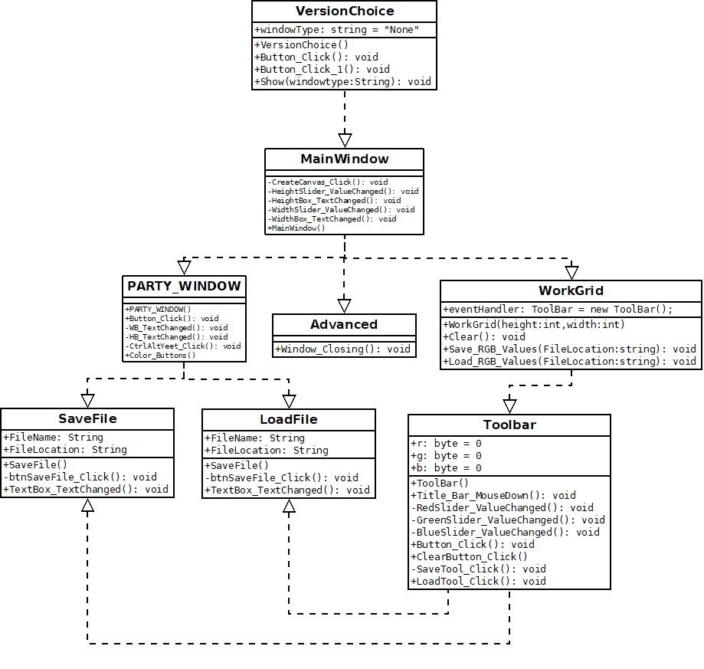
Class Diagrams

Slide 5
Future Plans for PARTY
Better Save & Load Feature
Advance Tools working Functionally
Somewhat better Color control in Advance Mode.

Slide 6
Questions and Where to find us
GitHub: https://github.com/TSLogan-UTM/PARTYapp
Thomas: thosloga@ut.utm.edu
Vincent: vinomano@ut.utm.edu
Brett: jerbbive@ut.utm.edu

