Slide 1
new member Orientation
By WB4 Team

Slide 2
Revision History
Name | Creation Date | Description
Hnin Wutt Yee | 2024/08/12 | Newly creation
Thinzar Aung | 2024/10/10 | Updated

Slide 3
Agenda
Brief introductions of all team members
Team’s Projects Overview
Regular Tasks and Responsibilities
Resources and Useful Links

Slide 4
Team and Member Introduction
[Project Manager]
Thinzar Aung
Offshore Development Department 2
WB4 Team
[Senior Project Leader]
Naw Aye Myat Thuzar
[Senior Software Engineer]
Thant Sin Oo
[Senior Programmer]
Nyein Chan Maung
[Senior Programmer]
Ingyinn Kay Khaing
[Junior Programmer]
[Junior Programmer]
[Junior Programmer]
[Junior Programmer]
Khant Bhone Naing
Saw Myo Zayar Kyaw
Suan Yee Aung
Min Htet Soe

Slide 5
Team's Projects (WB4 System Maintenance)
WB4 Teikei Projects ***
WB4 PR Project
WB4 AP Project
WB4 Batch Project
Build Work Project ***
PLATE Project ***
PLATEAuto Project ***
EPM Project ***
Tool Developments ***

Slide 6
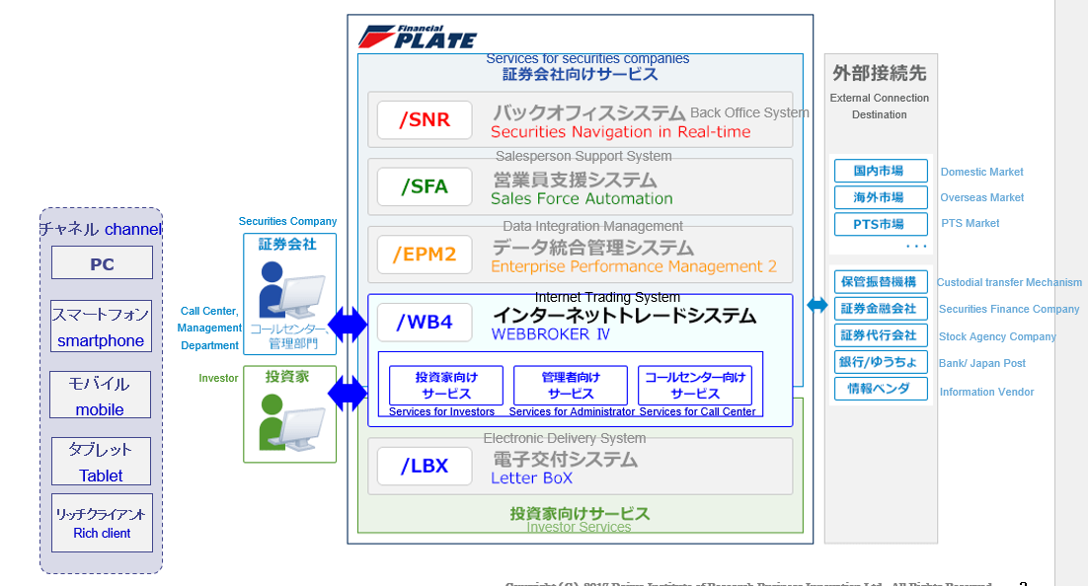
WB4 System
/Plate
Reference Link : \\10.1.8.4\FileServer\23 WB4\04 PJT\2 ENG\Team Introduction\WB4システム紹介_translated.pptx

Slide 7
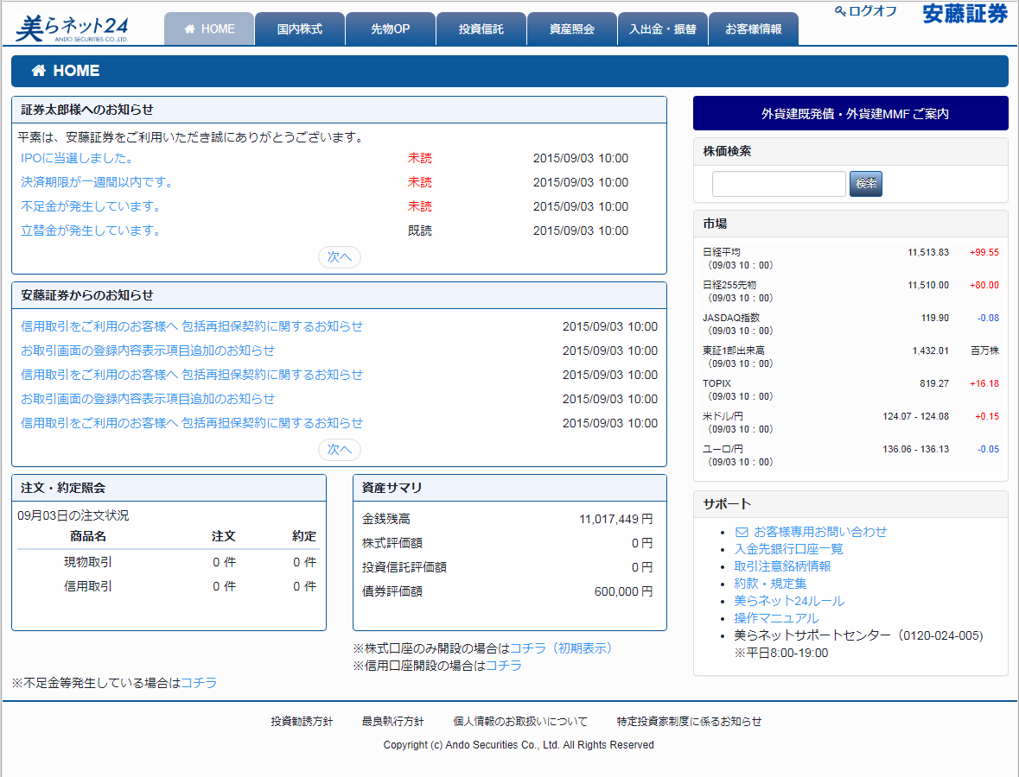
System appearance
トップ画面（例：安藤証券様）Top screen (example: Ando Securities)
Reference Link : \\10.1.8.4\FileServer\23 WB4\04 PJT\2 ENG\Team Introduction\WB4システム紹介_translated.pptx

Slide 8
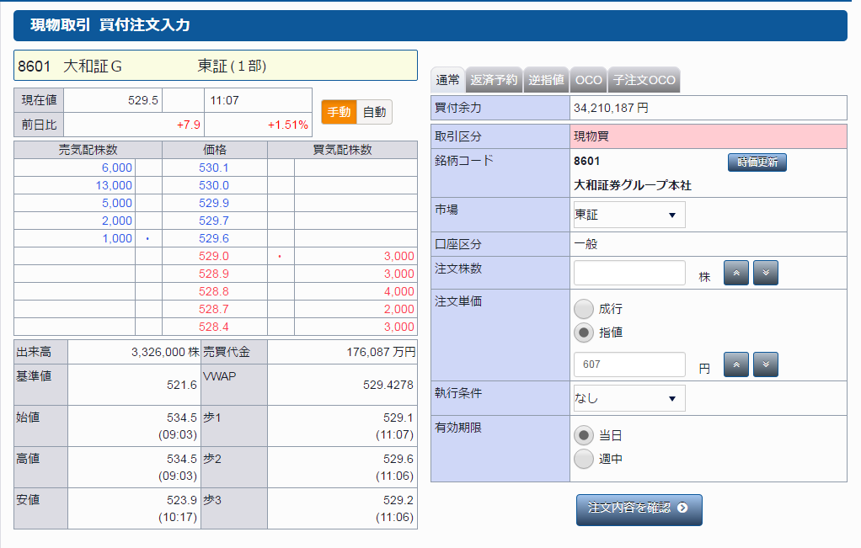
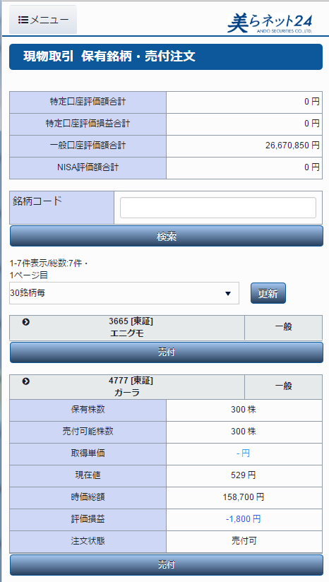
System appearance
取引画面（例：安藤証券様） Transaction screen (example: Ando Securities)
PC用取引画面
PC transaction screen
スマホ用取引画面
Trading screen for smartphone
Reference Link : \\10.1.8.4\FileServer\23 WB4\04 PJT\2 ENG\Team Introduction\WB4システム紹介_translated.pptx

Slide 9
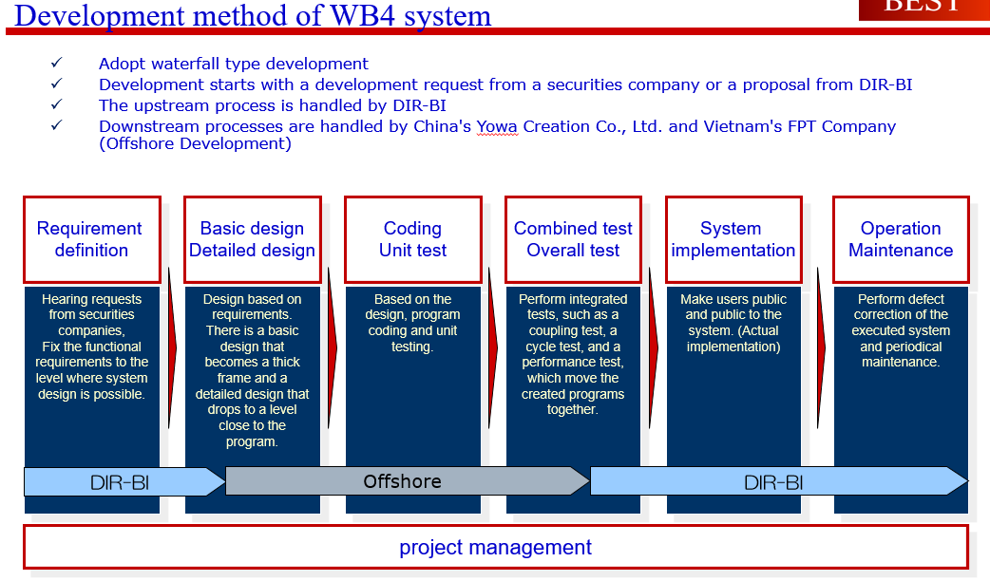
Development Methods
Reference Link : \\10.1.8.4\FileServer\23 WB4\04 PJT\2 ENG\Team Introduction\WB4システム紹介_translated.pptx

Slide 10
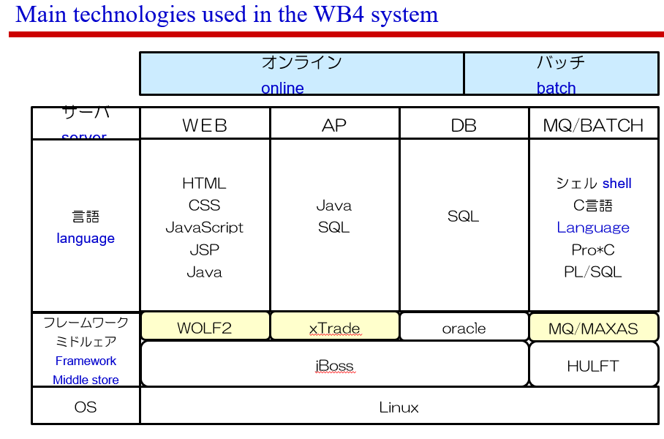
Development Languages
Reference Link : \\10.1.8.4\FileServer\23 WB4\04 PJT\2 ENG\Team Introduction\WB4システム紹介_translated.pptx

Slide 11
Weekly and Monthly Regular Tasks
Weekly regular tasks
Fill daily report at WHM system every Wednesday and Friday. (also last day of the month)
Fill Thinc report every Wednesday.
Tele meeting will be held every Thursday (11:30 ~ 12:00 MMT).
Monthly tasks
Create Work from home form every 25th.

Slide 12
Daily report rule
Project Code for 2024
Actual project code - DAT2024-02-11-001-01
Internal training - DAT2022-08-25-001-01
OTC - DAT2024-02-11-003-01 (For Offshore Technical Certificate Training)
QC - DAT2021-08-16-005-01
Rule
If you fill Actual project code, WBS no. and function should not be empty.
Fill "会議「定例会」" at "Description" for all meeting except team meeting.
Fill "会議「チーム」" for team meeting.
For full leave, select “Full Leave” at Attendance.
For half leave, fill “-” at Project ID, select “Half Leave” at Category and actual hours is 3.5.
Please refer to the following file for detail information
\\10.1.8.4\FileServer\23 WB4\02 MGT\99 MIS\99 General Documents\WHM_Report_Rule_Ver1.2.xlsx

Slide 13
Resources and Useful Link
Thinc - http://www.tchsf.dir.co.jp/
https://azure.thinc.dir.co.jp/
WB4 system introduction - \\10.1.8.4\FileServer\23 WB4\04 PJT\2 ENG\Team Introduction
Training videos -
\\10.1.8.4\FileServer\23 WB4\04 PJT\2 ENG\99 Training\99 MIS\00 Training Video
\\10.1.8.4\FileServer\23 WB4\04 PJT\2 ENG\99 Training\100 Jinwa Training
Sample WFH form - \\10.1.8.4\FileServer\23 WB4\99 MIS\WFH

Slide 14
Resources and Useful Link
DAT Staff Website - 10.1.8.9/Staff/StaffList
Meeting Room - http://10.1.8.51:90/booked/Web/
(username is “wb4” and default password is “wb42018”)
Catering service - http://10.1.9.207:8080/CateringService/CSMIS/showMyLoginPage
(username is staff Id and default password is “gogodat”)
**User name and password of the following links are same as pc’s login user name and password.
DAT ELearning - http://10.1.8.29/moodle/login/index.php
WHM - http://10.1.8.222:8080/whm/faces/login.xhtml
WB4 SVN - http://10.1.8.14:18080/svn/WB4

Slide 15
Welcome From Our Team!
Let's build our dream together, united as one team.

