Slide 1

Project title:Applying Mixture of Recursions (MoR) to Vision Transformers (ViT)
Introduction:
Vision Transformers achieve state-of-the-art results but suffer from massive parameter counts and computational costs due to uniform processing.
1.1 Problem Statement
Standard ViTs inefficiently apply the same deep computation to trivial background patches as they do to complex objects. This fixed-depth causes a lot of unnecessary computation, making it difficult to run on edge devices.
1.2 Objective
To implement MoR-ViT, a recursive architecture that uses an Expert-Choice router to dynamically allocate compute. This system physically removes unimportant tokens at early stages to drastically reduce parameters and FLOPs while maintaining high classification accuracy.
Motivation:
In real-world images, information is not evenly distributed. Processing every pixel with the same cost is inefficient. We need "Adaptive Computation."
Normal Vision Transformers are very large so they run too slow on phones or small devices. We need a method where the model can go deeper without becoming too big
Recent works like Mixture-of-Recursions (MoR) proved that recursive (shared weight) models work well on Transformers. I aim to translate this method into a practical vision architecture.
Name: T. Satya Pranav
Roll No: 2201213
Supervisor: Dr. Kaustuv Nag

Slide 2
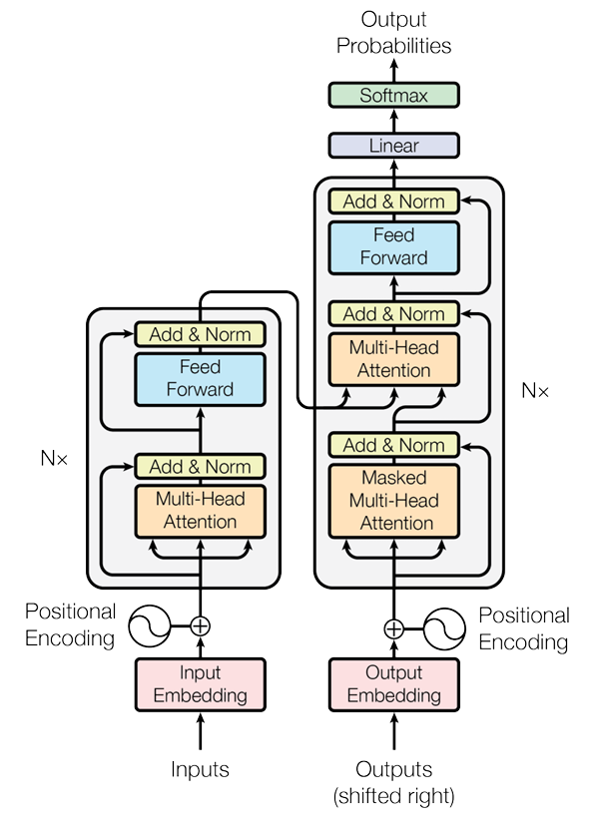
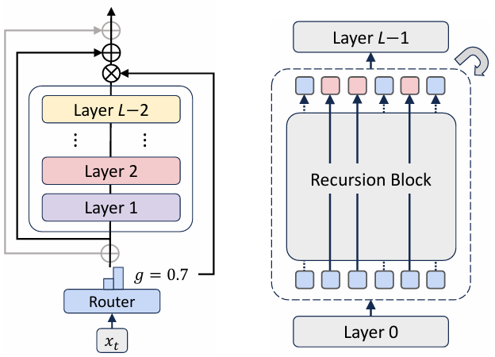
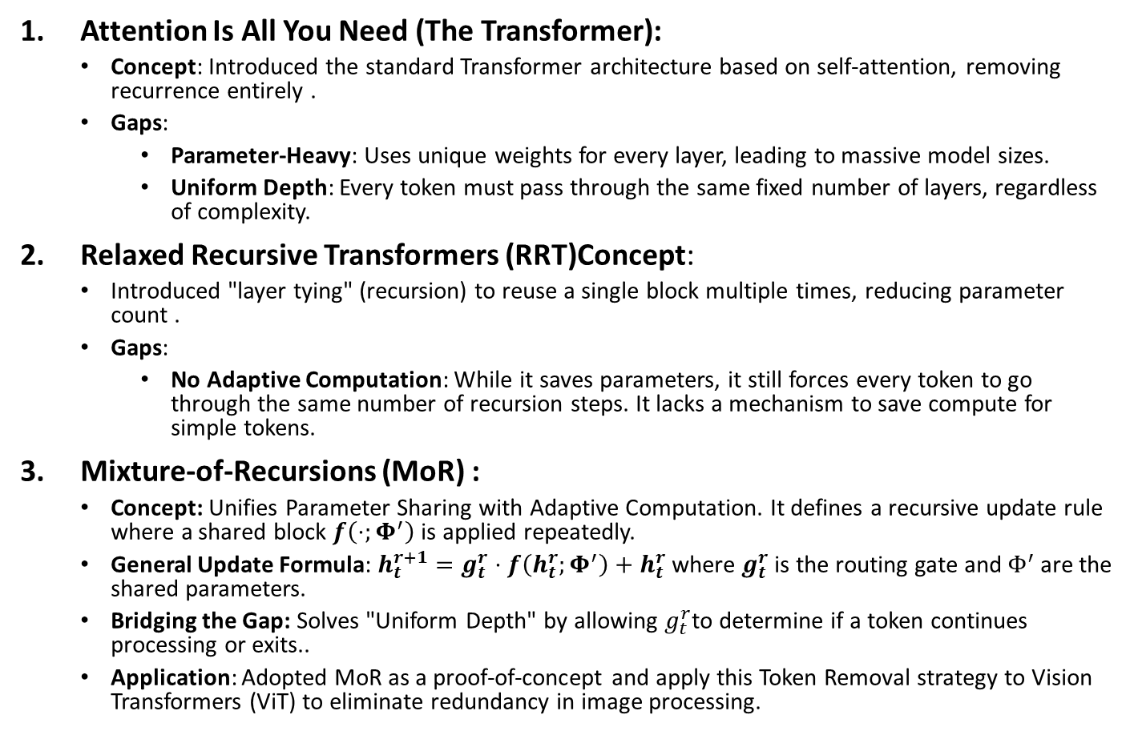
Literature review:
Attention Is All You Need (The Transformer):
Concept: Introduced the standard Transformer architecture based on self-attention, removing recurrence entirely .
Gaps:
Parameter-Heavy: Uses unique weights for every layer, leading to massive model sizes.
Uniform Depth: Every token must pass through the same fixed number of layers, regardless of complexity.
Relaxed Recursive Transformers (RRT)Concept:
Introduced "layer tying" (recursion) to reuse a single block multiple times, reducing parameter count .
Gaps:
No Adaptive Computation: While it saves parameters, it still forces every token to go through the same number of recursion steps. It lacks a mechanism to save compute for simple tokens.
Mixture-of-Recursions (MoR) :
Concept: Unifies Parameter Sharing with Adaptive Computation. It defines a recursive update rule where a shared block $f\left(⋅;Φ^{′}\right)$ is applied repeatedly.
General Update Formula: $h_{t}^{r+1}=g_{t}^{r}⋅f\left(h_{t}^{r};Φ^{′}\right)+h_{t}^{r}$ where $g_{t}^{r}$is the routing gate and $Φ^{′}$are the shared parameters.
Bridging the Gap: Solves "Uniform Depth" by allowing $g_{t}^{r}$to determine if a token continues processing or exits..
Application: Adopted MoR as a proof-of-concept and apply this Token Removal strategy to Vision Transformers (ViT) to eliminate redundancy in image processing.
Name: T. Satya Pranav
Roll No: 2201213
Project Title:: Applying Mixture of Recursions (MoR) to Vision Transformers (ViT)

Slide 3
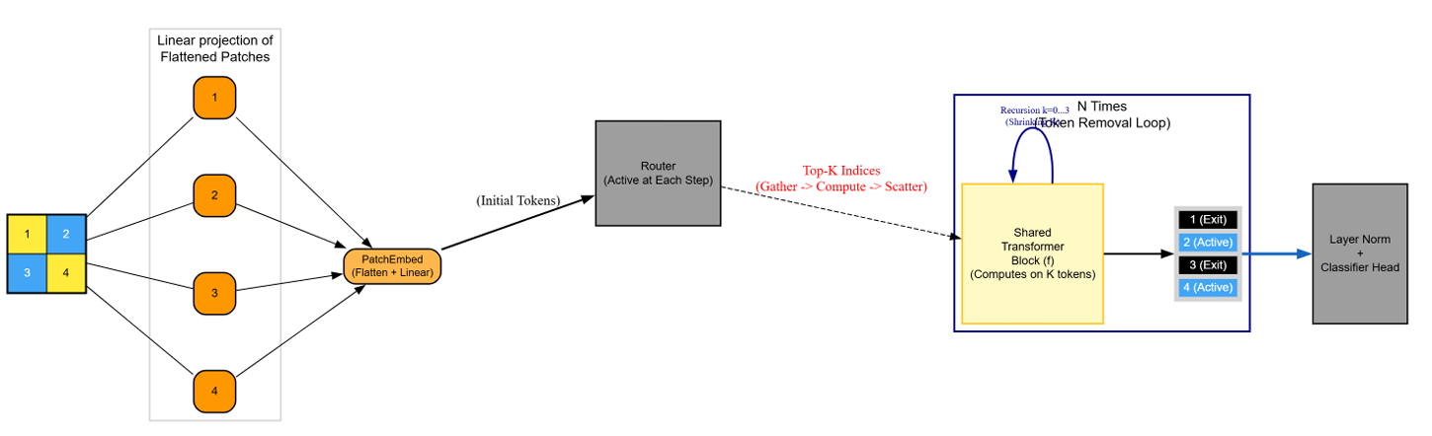
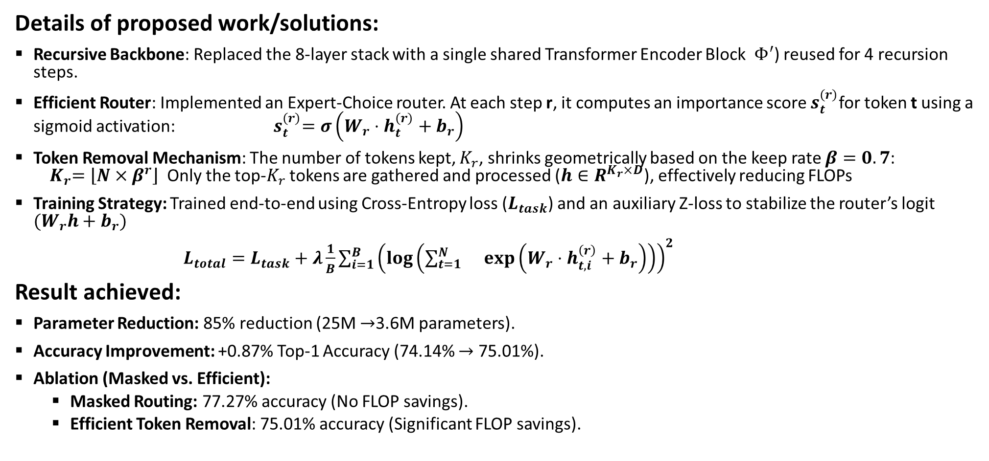
Work Done till date:
Details of proposed work/solutions:
Recursive Backbone: Replaced the 8-layer stack with a single shared Transformer Encoder Block $Φ^{′}$) reused for 4 recursion steps.
Efficient Router: Implemented an Expert-Choice router. At each step r, it computes an importance score $s_{t}^{\left(r\right)}$for token t using a sigmoid activation:${ s}_{t}^{\left(r\right)}=σ\left(W_{r}⋅h_{t}^{\left(r\right)}+b_{r}\right)$
Token Removal Mechanism: The number of tokens kept, $K_{r}$, shrinks geometrically based on the keep rate $β=0.7$: ${ K}_{r}=\left\lfloor N×β^{r}\right\rfloor$Only the top-$K_{r}$ tokens are gathered and processed ($h∈R^{K_{r}×D}$), effectively reducing FLOPs
Training Strategy: Trained end-to-end using Cross-Entropy loss ($L_{task}$) and an auxiliary Z-loss to stabilize the router’s logit $(W_{r}h+b_{r})$
$L_{total}=L_{task}+λ\frac{1}{B}\sum_{i=1}^{B}{{\left(\log\left(\sum_{t=1}^{N}{}\exp\left(W_{r}⋅h_{t,i}^{\left(r\right)}+b_{r}\right)\right)\right)}^{2}}$
Result achieved:
Parameter Reduction: 85% reduction (25M $→$3.6M parameters).
Accuracy Improvement: +0.87% Top-1 Accuracy (74.14% $→$ 75.01%).
Ablation (Masked vs. Efficient):
Masked Routing: 77.27% accuracy (No FLOP savings).
Efficient Token Removal: 75.01% accuracy (Significant FLOP savings).
Name: T. Satya Pranav
Roll No: 2201213
Project Title: Applying Mixture of Recursions (MoR) to Vision Transformers (ViT)

