Slide 1
Super cattle
By the lone Alpaca
Notes:
Hello,
My name is Tom and I am the sole member of the team ‘The lone Alpaca’. My project is called SuperCattle and it is competing in ‘IoT insights for better regional agribusiness at scale’ and ‘The digital future of agriculture’.

Slide 2
The problem
Australian cattle stations are huge (The biggest is roughly the same size as Israel)
The cattle must be constantly moved as feedable grass in scarce in rural Australia
The farms are to big for farmers to move around and check the grass themselves
Notes:
The problem that this hack is attempting to resolve is that managers of the vast cattle stations that populate inland Australia do not know where to move there cattle. As they must be moved so that they have constant feeding or else the farmers are forced to purchase expensive feed.

Slide 3
The Solution
Harness the power of Australia’s strong mobile network to deploy a number of small devices across the farm
The devices could measure the grass growth through computer vision
A network of these devices could be combined to efficiently move cattle around a station
Device would be made up of camera, IoT Board (Arduino) and a solar panel
Would be mounted on fence, water tank, etc. For good view point
Notes:
The solution is to setup an array of devices connect via the 3G/4G network. The devices would use computer vision to evaluate the quality of the grass and share it back to the farmer so they can work out where to move their cattle. The device would be mounted on a fence or tree so it can see a large area. The device itself would be an Arduino, a camera and a solar panel as well as additional sensors such as temperature to further help the farmers.

Slide 4
The Computer Vision
For this prototype Teachable Machines was used
Three categories where created: Good, Halfway and Dry
It was trained on images gathered from a variety of sources
Notes:
A prototype of the computer vision was made using teachable machines, there are three categories for this model, good, for quality feedable grass, halfway, for grass that is likely feedable but for only a short period and dry, for un-feedable grass.

Slide 5
Video on Teachable Machines
[This slide is not to be include]

Slide 6
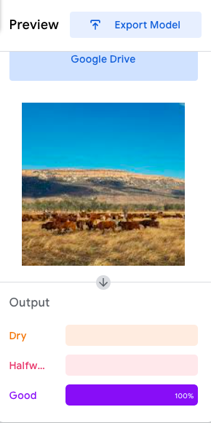
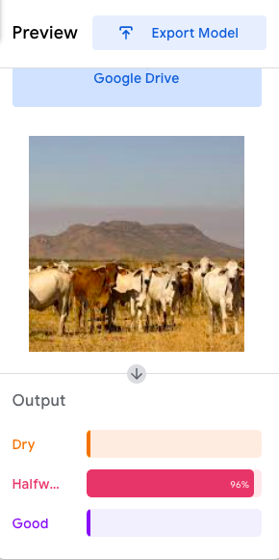
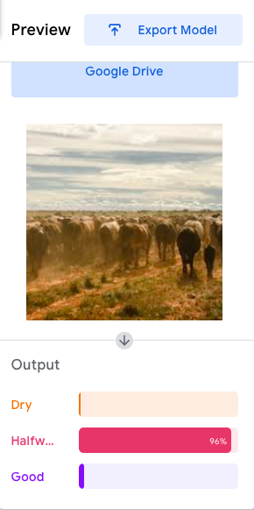
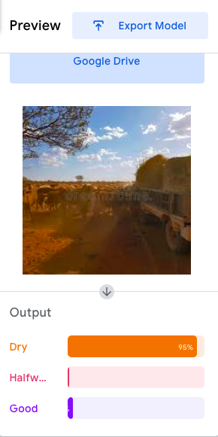
How did it go
Notes:
This is how the computer vision went, it managed to completely recognize, as indicated by the bars at the bottom, that the grass on the left was feedable, the two in the middle are average and the one on the right is pretty poor. This seems pretty inline with how this grass looks.

Slide 7
Image of Map
[This slide is not to be include]

Slide 8
Thanks
Notes:
Thankyou for considering this submission

