Slide 1
Sql第四章

Slide 2
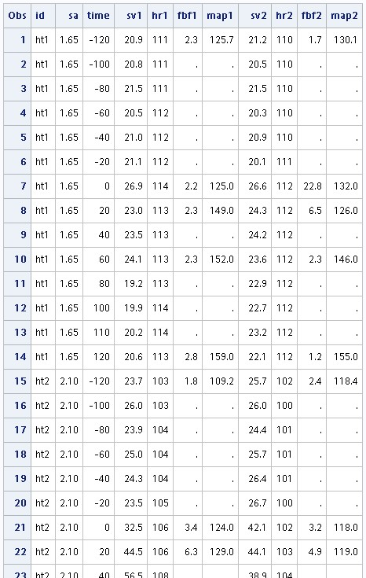
data xxx; infile "C:\Users\MATH\Desktop\ 新增資料夾\heart.dat" firstobs=2; input id $ sa time sv1 hr1 fbf1 map1 sv2 hr2 fbf2 map2; run; proc print data=xxx; run;

Slide 3
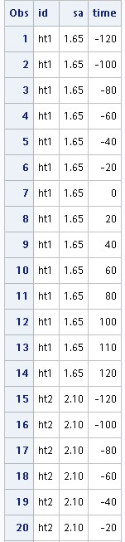
proc sql; create table sq1 as select id ,sa ,time from xxx; proc print data=sq1; run;

Slide 4
data data1; set xxx(keep= id sa time) ; run; proc print data=data1; run;

Slide 5
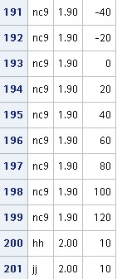
proc sql; insert into sq1 set id="hh" ,sa=2 ,time=10; proc sql; insert into sq1 values ("jj", 2 , 10); proc print data=sq1; run;

Slide 6
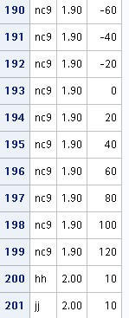
data ccc; input id$ sa time; cards; hh 2 10 jj 2 10 ; run; proc print data=ccc; run; data data1; set data1 ccc; proc print data=data1; run;

Slide 7
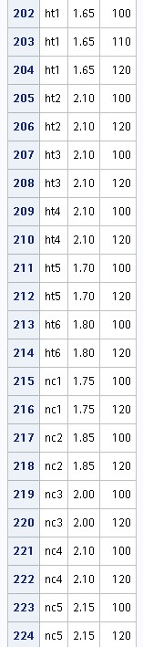
proc sql; insert into sq1 select id, sa, time from xxx where time>=100; proc print data=sq1; run;

Slide 8
data ccc; set xxx(keep=id sa time); where time>=100; run; data data1; set data1 ccc; run; proc print data=data1; run;

Slide 9
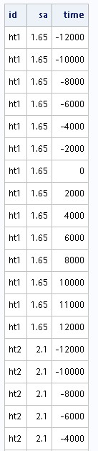
proc sql; update sq1 set time=time*100; select * from sq1; run;

Slide 10
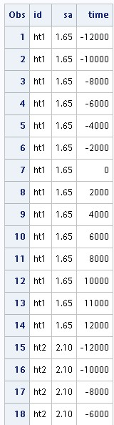
data data1; set xxx(keep=id sa time); time=time*100; proc print data=data1; run;

Slide 11
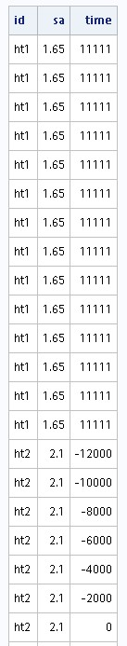
proc sql; update sq1 set time=11111 where id="ht1"; select * from sq1;

Slide 12
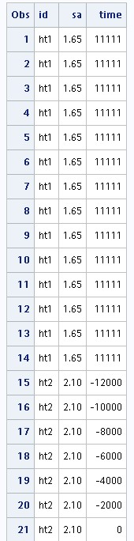
data data1; set data1; if id="ht1" then time=11111; run; proc print data=data1; run;

Slide 13
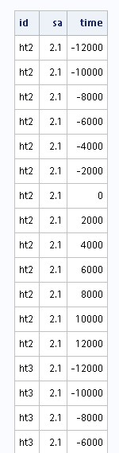
proc sql; delete from sq1 where id="ht1"; select * from sq1;

Slide 14
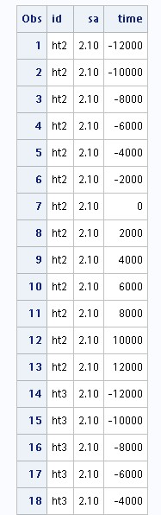
data data1; set data1; if id="ht1" then delete; proc print data=data1; run;

Slide 15
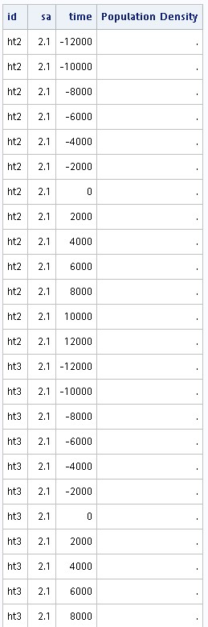
proc sql; alter table sq1 add density num label= "Population Density"; proc sql; select * from sq1;

Slide 16
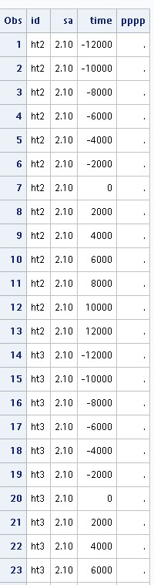
data ccc; input pppp; cards; ; run; data data1; merge data1 ccc; proc print data=data1; run;

Slide 17
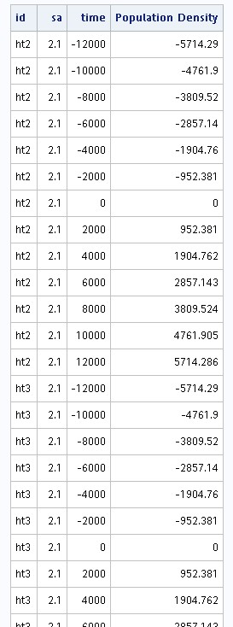
proc sql; update sq1 set density=time/sa; select * from sq1;

Slide 18
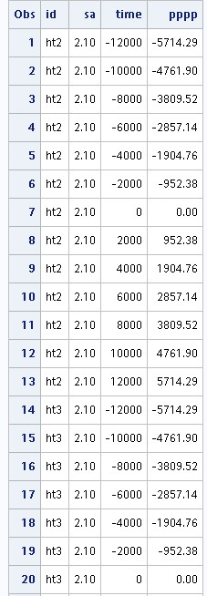
data rrr; set data1; pppp=time/sa; run; proc print data=rrr; run;

Slide 19
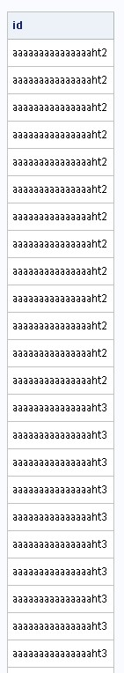
proc sql; alter table sq1 modify id char(60) format=$60.; update sq1 set id='aaaaaaaaaaaaaaa'||id; select id from sq1;

Slide 20
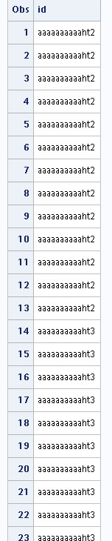
data rrr; length id $15.; set data1; id='aaaaaaaaaa'||id; proc print data=rrr; var id; run;

Slide 21
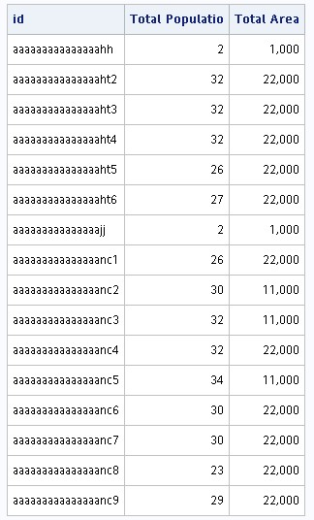
proc sql; create view sq2 as select id, sum(sa) as totpop format=comma15. label='Total Populatio', sum(time) as totarea format=comma15. label='Total Area' from sq1 group by id; select *from sq2; proc sort data=rrr; by id; run;

Slide 22
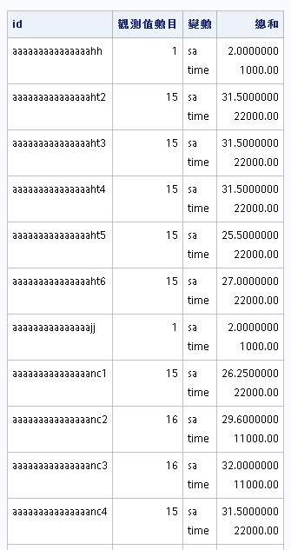
proc print data=sq1; run; proc means data=sq1 sum; class id; var sa time; run;

