Slide 1
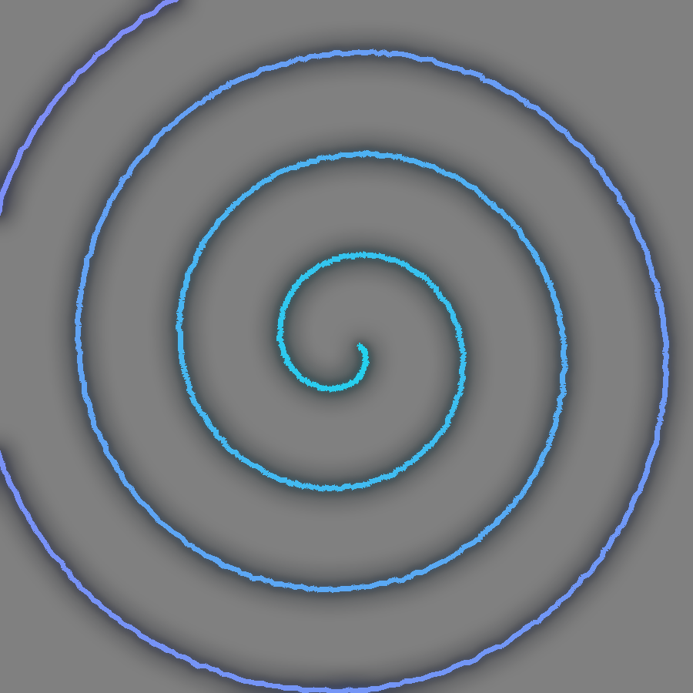
HACKATHON PROJECT • AI FOR HEALTHCARE
Parkinson’s Disease Detection
Dual-Stream EfficientNetB0 Model
Spiral + Wave hand-drawing analysis with deep transfer learning
TECH STACK
Python
TensorFlow / Keras
EfficientNetB0
scikit-learn
NumPy
Matplotlib
Google Colab

Slide 2



Why Early Detection Matters
A progressive neurological disorder
Tremor and rigidity change how a person controls a pen.
Handwriting reveals the signal
Spiral and wave drawings capture tremor and motor instability.
Non-invasive and low-cost
Spiral test
Just paper and a camera. No expensive scanners or labs needed.
Wave test → tremor amplitude & rhythm

Slide 3




Our Approach: End-to-End Pipeline
01
02
03
04
05
06
Drawing
Augment
EfficientNetB0
Pooling + Dense
Sigmoid
Prediction
224×224 image
Rotate, zoom, shift
ImageNet weights
GAP, Dropout, L2
Probability
Healthy / Parkinson
Two specialised models. One trained on spiral drawings, one on wave drawings, each evaluated on its own and then combined as an ensemble by averaging probabilities.

Slide 4
Dataset Overview
73
72
Spiral training images
Wave training images
2
80/20
Classes: Healthy / Parkinson
Train / validation split

Slide 5
Model Architecture
Input 224×224×3
Why EfficientNetB0?
Compound scaling gives high accuracy with a small footprint, ideal for limited data.
Data Augmentation (rotation, zoom, shift, contrast)
EfficientNetB0 (ImageNet, include_top = False)
Fighting overfitting
Augmentation, two dropout layers and L2 regularisation guard against a tiny dataset.
GlobalAveragePooling2D + Dropout 0.4
Dense 64 (ReLU, L2 1e-3) + Dropout 0.3
Transfer learning
Pretrained ImageNet features adapt to tremor patterns in drawings.
Dense 1 (Sigmoid) → Healthy / Parkinson

Slide 6
Two-Phase Training Strategy
PHASE 1
PHASE 2
Frozen Base
Fine-Tuning
EfficientNetB0 frozen, train the head
Adam, learning rate 1e-3
Up to 40 epochs
EarlyStopping (patience 8)
ReduceLROnPlateau (×0.5)
Unfreeze last 30 layers
BatchNorm layers kept frozen
Adam, learning rate 1e-5
EarlyStopping (patience 10)
Best weights restored
Class weights
Batch size 16
Seed 42
Binary cross-entropy
Balances both classes
224×224 inputs
Reproducible runs
Adam optimiser

Slide 7
Results: Spiral Model
Confusion matrix
Predicted
Healthy
Parkinson
76.7%
Actual
14
1
Healthy
6
9
Parkinson
Test accuracy (30 images)
Insight: High precision for Parkinson (0.90), but recall is 0.60, so some cases are missed. Spiral shapes are harder to separate.

Slide 8
Results: Wave Model
Confusion matrix
Predicted
Healthy
Parkinson
90%
Actual
14
1
Healthy
2
13
Parkinson
Test accuracy (30 images)
Insight: Balanced and strong: 0.90 F1 on both classes, with only 3 of 30 drawings misclassified.

Slide 9
Model Comparison
Wave model leads
90.0% accuracy with balanced precision and recall.
Ensemble: 86.7%
Averaging both models lifts the weaker spiral stream (76.7%).
Takeaway
Wave drawings carry the strongest signal for this dataset.

Slide 10


Key Takeaways & Future Scope
FUTURE SCOPE
Larger, more diverse datasets
WHAT WE ACHIEVED
Two EfficientNetB0 classifiers built with two-phase transfer learning
90% test accuracy on wave drawings, 76.7% on spiral
86.7% with a simple probability-averaging ensemble
Trained on only ~70 images per task, with augmentation and regularisation
Grad-CAM explainability for clinicians
Web and mobile screening app
Improve spiral recall with tuning

Slide 11
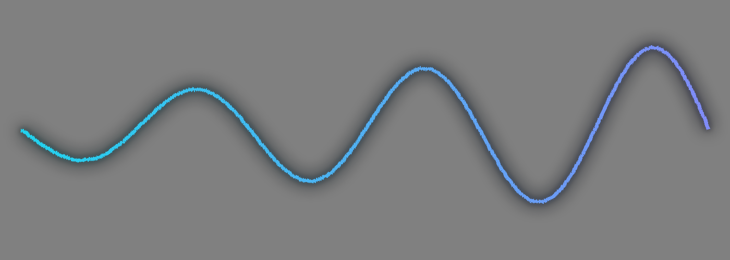
THANK YOU
Questions and feedback are welcome
With regards, presented by
TEAM: MAX EFFORT
TS SHARAN • 25BCA7670
SJ VISWAK • 25BCE7873

