Slide 1
Sampling, Reconstruction, and
FFT Analysis of a Swept Sinusoidal Signal
Kaveesha Induwara (EIT S17229) · Lab Partners: Kenura, Teshan
Notes:
Good morning. Today I'll be presenting my lab experiment on sampling, reconstruction, and FFT analysis of a swept sinusoidal signal, carried out for the Data Acquisition Laboratory module.

Slide 2

Objective
Verify Nyquist–Shannon sampling theorem
Confirm no aliasing occurs
Sweep signal 10 Hz to 1 kHz
Sample at constant 20 kHz
Notes:
The main objective was to experimentally verify the Nyquist–Shannon sampling theorem — to prove that sampling at a sufficiently high, constant rate lets us reconstruct a signal without losing information, and without aliasing distorting the result.

Slide 3

Theoretical Background
Nyquist rate: fs ≥ 2 × fmax
Aliasing = irreversible fold-back
FFT reveals frequency content
Jitter-free sampling essential
Notes:
Quickly, the theory: the Nyquist rate says we must sample at least twice the highest frequency present. Sample below that and you get aliasing — higher frequencies get mistaken for lower ones, and that error can't be undone afterward. The FFT is how we check, after the fact, whether this held true.

Slide 4

Hardware Setup
Seeed XIAO nRF52840 Sense
12-bit onboard ADC (SAADC)
Keysight EDU33212A generator
SCPI control over USB
Notes:
The hardware side: a Seeed XIAO nRF52840 Sense board handled sampling using its built-in 12-bit ADC, and a Keysight EDU33212A waveform generator supplied the swept sine signal, controlled remotely over SCPI commands.

Slide 5

Circuit Protection
No snubber circuit used
Vpp = 3.0 V
Voff = 1.5 V
Swing kept 0.0–3.0 V
Notes:
Instead of a snubber circuit, we protected the ADC input directly at the source — setting the generator's peak-to-peak voltage to 3.0 volts on a 1.5 volt offset, so the signal never left the safe 0 to 3 volt range.

Slide 6

Methodology: Hardware Timer
NRF_TIMER3 drives sampling
Fixed rate: 20 kHz
Absolute timing, zero drift
No software delay() used
Notes:
Timing precision came from a dedicated hardware timer, NRF_TIMER3, firing every 50 microseconds for a strict 20 kilohertz sample rate. Critically, the compare register was advanced by a fixed amount each time, so there's no drift — unlike using delay() in software, which would introduce jitter.

Slide 7

Methodology: RAM Buffering
Capture-then-transfer design
Buffer up to 50,000 samples
No USB during capture
Eliminates transfer jitter
Notes:
All samples are first collected fully into RAM — up to 50,000 of them — and only sent over USB after the capture is complete. This keeps the slow, unpredictable USB transfer completely separate from the time-critical sampling loop.

Slide 8

Methodology: Python Automation
PyVISA controls generator
SCPI sweeps 10 Hz–1 kHz
Auto-triggers each capture
Logs data to CSV
Notes:
On the host side, a Python script automated the whole sweep — stepping the generator from 10 hertz to 1 kilohertz using SCPI commands, triggering a capture at each step, and logging both the measured and ideal reference voltage to a CSV file.

Slide 9
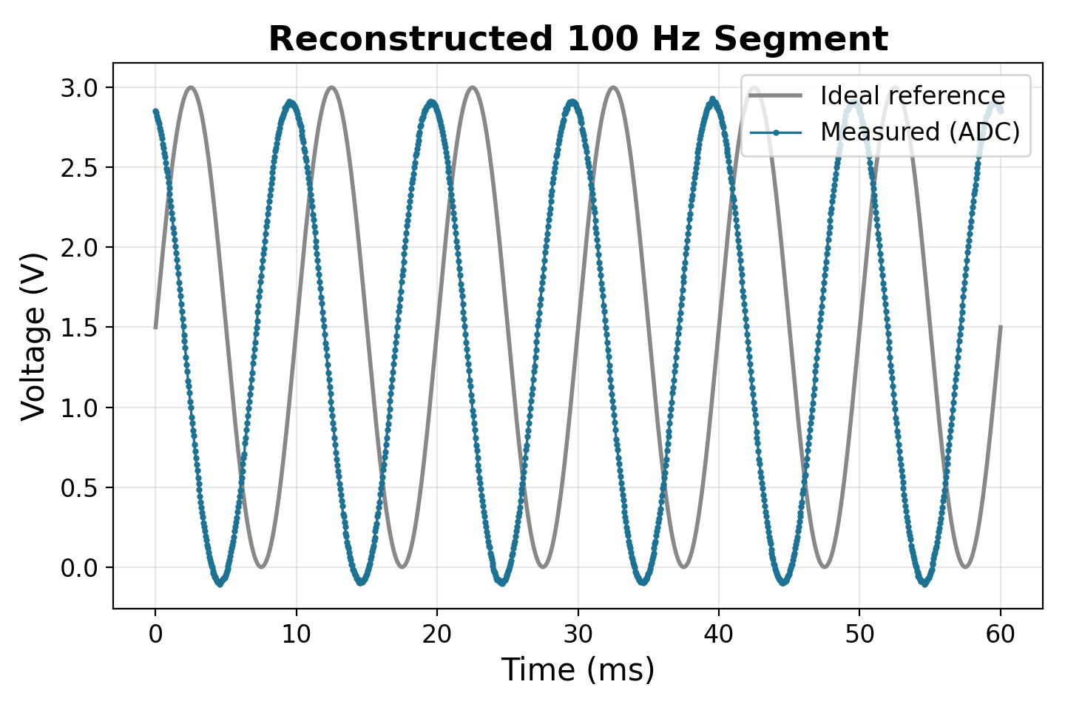
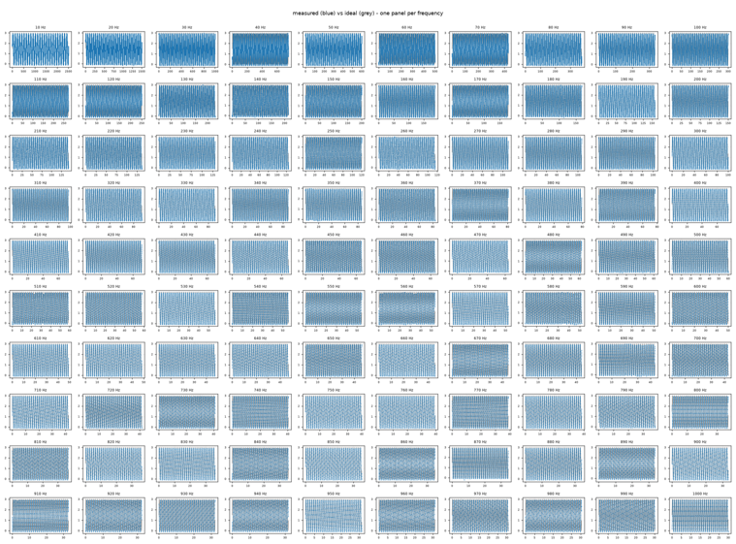
Results: Time-Domain Reconstruction
Measured vs ideal overlay
Close match across full sweep
Full 10 Hz–1 kHz sweep overview — measured (blue) vs ideal (grey)
Notes:
Here's the reconstructed waveform for the 100 hertz segment — note the graph carries a title, labelled axes, and units throughout. Measured voltage in blue closely tracks the ideal reference in grey. On the right, the full-sweep overview grid shows this same close agreement held across all 100 frequencies from 10 hertz to 1 kilohertz.

Slide 10
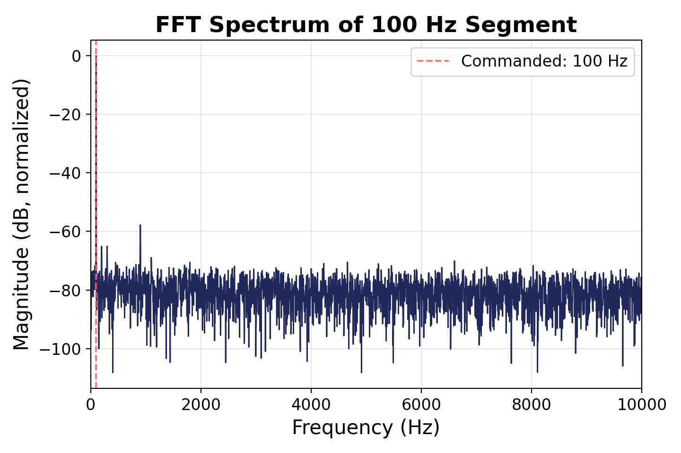
Results: FFT Verification
Single peak per frequency
No energy near Nyquist — no aliasing
Notes:
Taking the FFT of each segment, we see a single sharp peak exactly at the commanded frequency — here, 100 hertz — with nothing showing up near the 10 kilohertz Nyquist frequency. The graph is fully labelled with frequency in hertz and magnitude in decibels. This held true at every point in the sweep, confirming no aliasing occurred.

Slide 11

Conclusion
Nyquist theorem confirmed
20 kHz sufficient for 1 kHz
Hardware timing removed jitter
C++ and Python integration successful
Notes:
To conclude, this experiment confirmed the Nyquist–Shannon theorem in practice. A 20 kilohertz sampling rate was more than sufficient for our 10 hertz to 1 kilohertz sweep, and combining hardware-timed firmware with Python-based automation gave us a jitter-free, reliable acquisition pipeline.

Slide 12
Thank You
Questions welcome
Notes:
Thank you for your attention — I'm happy to take any questions.

