Slide 1





Cover
Our team
The idea
Behind the game
How to play
Game features
POINTERBREAK
POINTERBREAK
POINTERBREAK
pointerbreak.team-4.com

Slide 2



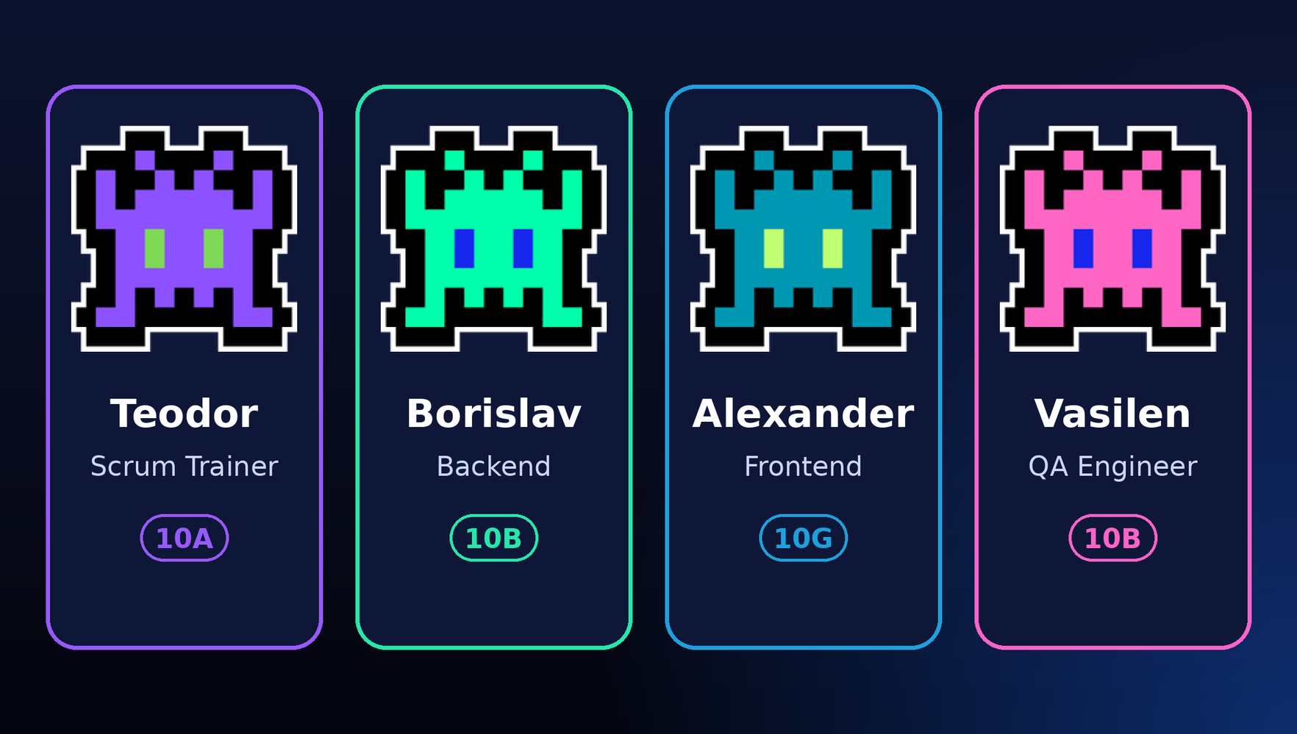
Cover
Our team
The idea
Behind the game
How to play
Game features
OUR TEAM

Slide 3
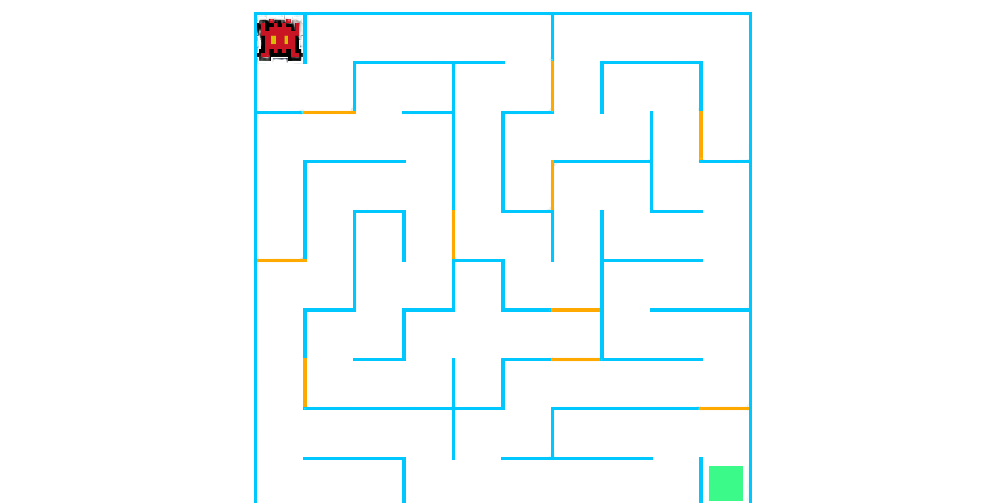
Cover
Our team
The idea
Behind the game
How to play
Game features
The idea
A MAZE. A PLAYER. ONE EXIT.
    Randomly generated mazes
    Different sizes
    Three difficulty levels
    Retro arcade experience

Slide 4
Cover
Our team
The idea
Behind the game
How to play
Game features
WHAT'S INSIDE?
    10x10 to 50x50 mazes
    6 playable characters
    Special shortcut doors
    Timer & scoring system
    High score leaderboard

Slide 5
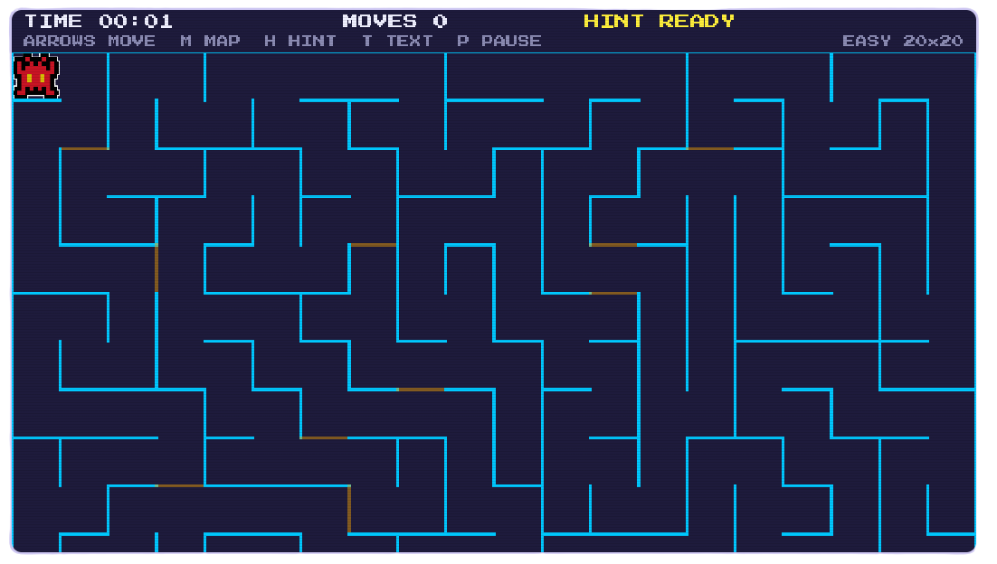
Cover
Our team
The idea
Behind the game
How to play
Game features
FIND YOUR WAY OUT
    Start: Top-left corner
    Exit: Bottom-right corner
    Arrow keys: Movement
    H: Hint
    M: Full maze view
    P / ESC: Pause

Slide 6
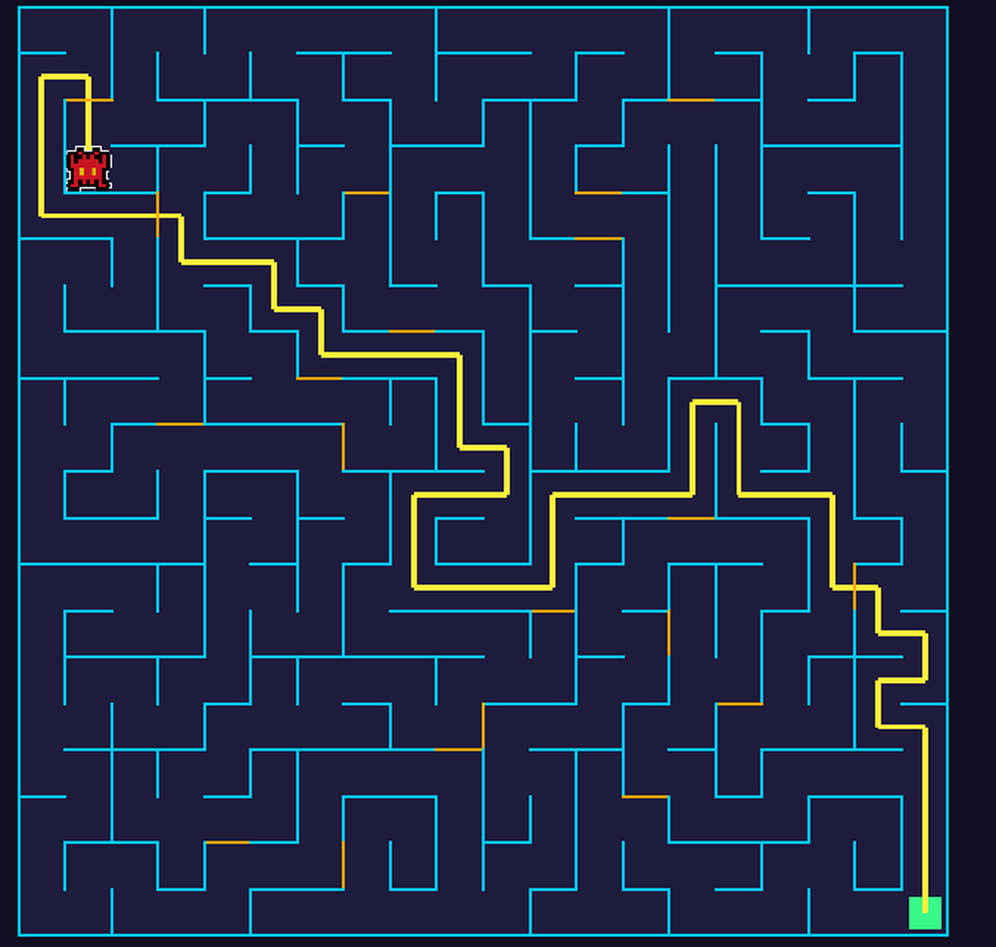
Cover
Our team
The idea
Behind the game
How to play
Game features
Three levels,
one hint
EASY. MEDIUM. HARD.
    Easy: no time limit
    Hard: tight time limit
    H: one hint per game
    Hint costs 20% of score

Slide 7
POINTERBREAK
POINTERBREAK
POINTERBREAK
pointerbreak.team-4.com

