Slide 1

Amazon E-Commerce Performance Analysis
Business Insights & Recommendations using Power BI
Karthikeya Turlapati

Slide 2
Problem Statement
Explosive growth in e-commerce has led to massive customer and sales data.
Amazon needs to identify top-performing products, categories, and customers for better strategy.
Rising competition requires data-driven insights to improve profitability.
Business decisions are hindered by unstructured data and hidden patterns.
Lack of consolidated reporting makes it difficult to track revenue trends and customer behavior.

Slide 3


Data Overview
Dataset: Amazon E-Commerce (Orders & Customers)
Size: ~1,000+ records across multiple tables
Tables & Key Fields:
Orders → OrderID, Date, Status, Sale Price
Customers → CustomerID, Location, Purchase History
Preprocessing: Cleaned duplicates, fixed missing values, standardized dates & prices

Slide 4
Tools & Analysis Focus
Tools Used
SQL – Data extraction, transformation, table joins.
Excel – Quick exploration & validation checks.
Power BI – Dashboards, DAX calculations, visuals.
Analysis Focus
Cleaned and prepared data
Analyzed patterns (sales, returns, customer behavior)
Built interactive dashboard to derive insights

Slide 5
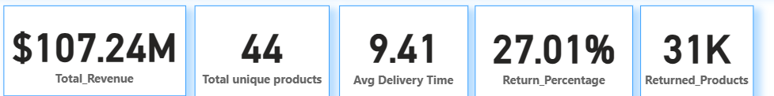
Key Performance Indicators (KPIs)
Total Revenue: $107.24M → Strong revenue base across 44 products.
Unique Products: 44 → A moderately diverse product portfolio.
Avg Delivery Time: 9.41 days → Delivery times are slightly long, scope for logistics improvement.
Return Percentage: 27.01% → A significant concern, over 1 in 4 products returned.
Returned Products: 31K → Indicates high customer dissatisfaction or product mismatch.

Slide 6
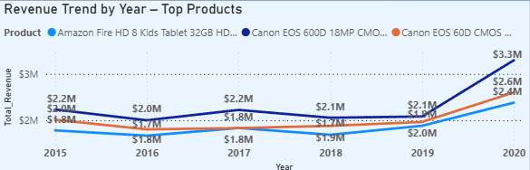
Overall Sales Performance
Revenue remained stable around ~$2M annually from 2015–2019.
2020 saw a sharp surge, with top products reaching $3.3M, driven by demand for Amazon Fire Tablets & Canon Cameras.
The Amazon Fire HD 8 Kids Tablet consistently outperformed, becoming the top revenue driver in 2020.
Indicates the role of flagship products in scaling revenue and the importance of timely product promotion.

Slide 7
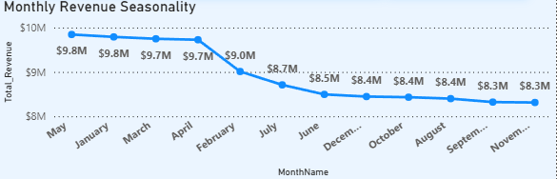
Monthly Revenue Seasonality
Revenue peaks in January–March (~$9.8M), indicating strong demand post-holiday season.
Gradual decline begins from April (~$9.7M) to July (~$8.7M), suggesting a slowdown in customer spending.
From August to November, revenue remains flat at $8.3M–$8.4M, marking the lowest demand period.
Highlights the importance of early-year promotions and targeted campaigns during low-demand months to stabilize revenue.

Slide 8
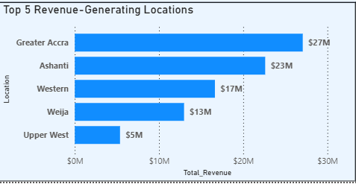
Top Revenue-Generating Locations
Greater Accra and Ashanti dominate revenue with $27M and $23M.
Western and Weija follow, but significantly lower.
Upper West generates the least ($5M).
Revenue is highly concentrated in a few key regions → scope to expand presence in underperforming areas.

Slide 9
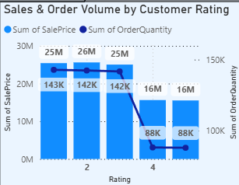
Sales & Order Volume by Customer Rating
Ratings 1–3 show high sales volume ($25M each), but drop sharply at ratings 4–5 ($16M).
Order quantity also falls at higher ratings.
Customers leaving higher ratings buy fewer items — need to explore loyalty or premium product strategies.

Slide 10
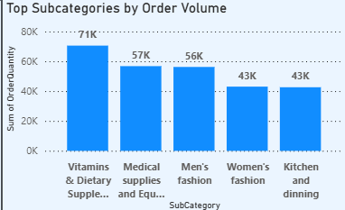
Top Subcategories by Order Volume
Vitamins & Dietary Supplements lead with 71K orders.
Medical Supplies, Men’s & Women’s Fashion follow closely.
Kitchen & Dining also contributes strongly (~43K).
Health products are the strongest category → marketing & bundling strategies can further drive growth.

Slide 11
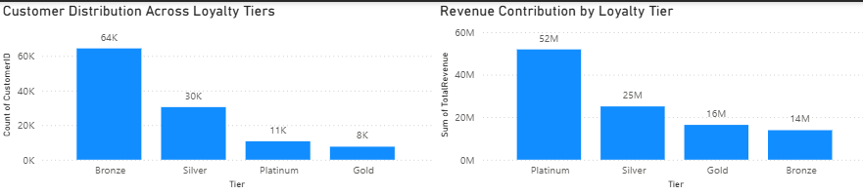
Loyalty Tiers: Customer Base vs. Revenue Impact
Majority of customers are in Bronze and Silver tiers, indicating high acquisition but low upgrade rate
Platinum customers contribute the highest revenue ($52M) despite being only ~11K in count — showing strong value per customer

Slide 12
Conclusion
A small proportion of customers and select categories drive the majority of sales.
May and June consistently show higher revenue, making them ideal for targeted campaigns.
Platinum and Silver tiers generate the largest revenue share, even with fewer transactions.
Top-performing regions and categories highlight untapped potential for scaling growth.

Slide 13
Recommendations
Introduce tier-based rewards and personalized offers to retain Platinum and Silver customers.
Align stock and discounts with seasonal peaks (May–June) and top-selling categories.
Scale marketing and operations in top revenue regions, while addressing gaps in underperforming ones.
Provide agent/product training to lift lower-rated transactions, boosting both satisfaction and revenue.
Invest in fast-growing subcategories like Baby Products & Supplements to diversify and expand sales growth.

Slide 14
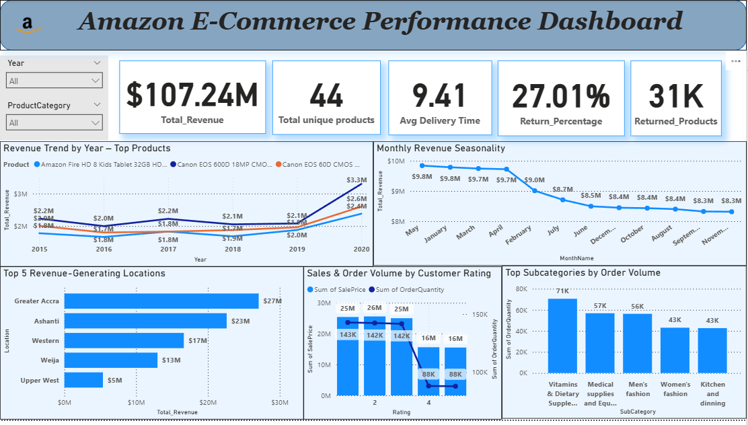
Dashboard Overview
Interactive dashboard tracking revenue trends, seasonal patterns, regional performance, product categories, and return rates

Slide 15


