Slide 1

Customer Behavior and Sales Analysis Using SQL – Chinook Music Database
Presented by :
Karthikeya Turlapati

Slide 2
Contents
Project Overview and Objective
Database Structure & Key Tables
Data Cleaning & Preparation
Customer Purchase Behavior Insights
Genre & Track-Level Sales Analysis
Churn Rate & Retention Metrics
Customer Segmentation & CLTV
Geographical Performance Overview
Strategic Business Recommendations
Conclusion & Key Takeaways

Slide 3
Project Overview
In this project, I explored the Chinook Music Store database to understand how customers interact with the platform like what they buy, how often they purchase, and which tracks or genres drive the most revenue. Using SQL, I analyzed patterns in customer behavior, sales performance, and regional trends.

Slide 4
Project Objective
Dive deep into customer purchasing behavior
Identify which tracks, genres, and artists perform the best
Analyze churn patterns and customer retention
Estimate lifetime value (CLTV) for different customer segments
Turn insights into actionable business recommendations

Slide 5
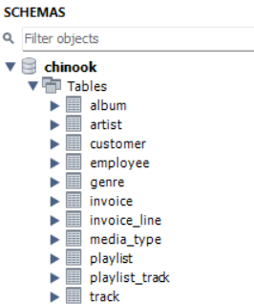
Database Structure & Key Tables
The Chinook database is a standard music store schema that represents practical business operations such as customer orders, product inventory, billing, and track metadata.
For this project, I primarily worked with the following key tables:
Customer – stores customer details including location and support rep
Invoice – contains order-level information including date, amount, and billing address
Invoice_Line – provides item-level details (track, quantity, unit price)
Track – includes all music track data like name, album, genre, price
Album – links tracks to albums
Artist – connects albums to artists
Genre – helps categorize tracks into music types

Slide 6
Data Cleaning & Preparation
Before going into analysis, I performed a brief review of the dataset to look for missing values, duplicates, and inconsistencies.
The primary fields, including invoice_date, total, track_id, and customer_id, were completed and clean. However, a few optional entries in the customer database, such as state, fax, and company had missing values, which were left alone because they had no impact on the research project.
I also searched for duplicate records using groups. Minor repeats such as purchasing the same music numerous times on the same invoice were expected and acceptable. Overall, the data was well-structured and needed just minor cleanup before querying.

Slide 7
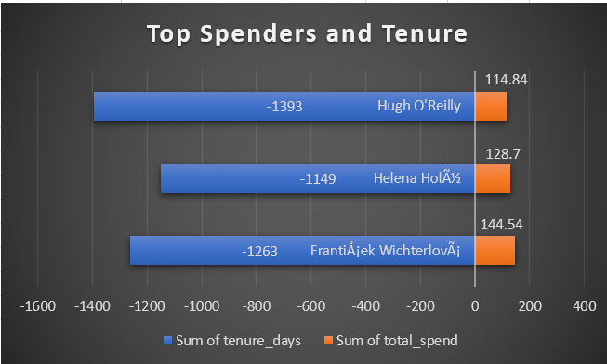
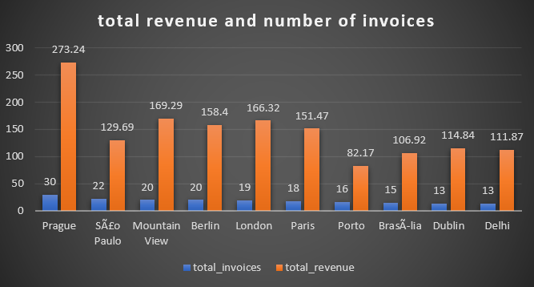
Customer Purchase Behaviour Insights
To understand how customers interact with the Chinook platform, I analyzed their purchase frequency, total spending, and average order value. Using the invoice and invoice_line tables, I grouped the data by customer to track how often they buy and how much they typically spend
Most customers made 5 to 13 purchases, with a few high-frequency buyers crossing 15+ orders
Average order value across active customers ranged from 7 to 11
Top spenders like František Wichterlová and Helena Holý showed consistent engagement over 1000+ days
Customers from cities like Prague, Mountain View, and São Paulo were more active than others
A few users purchased the same track multiple times, indicating strong content preference or playlist habits

Slide 8
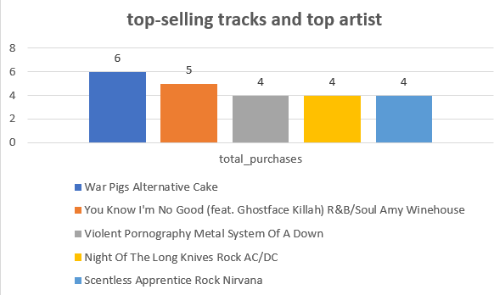
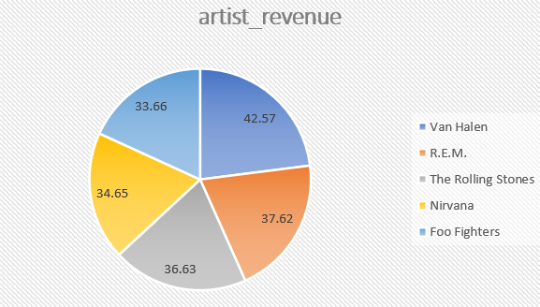
Genre & Track-Level Sales Analysis
To better evaluate product performance, I analyzed track purchases, genre popularity, and artist-level sales. I linked the invoice_line, track, genre, and artist columns to see which music categories and artists received the greatest revenue, particularly in the United States.
Rock was the top-performing genre, contributing over 50% of total U.S. revenue
Other strong genres included Alternative & Punk, Metal, and R&B/Soul
Top-selling track: War Pigs by Cake
Best-selling artists: Van Halen, Nirvana, The Rolling Stones, and R.E.M.
Customers showed clear preference for high-energy, band-driven genres, especially in English-speaking countries

Slide 9
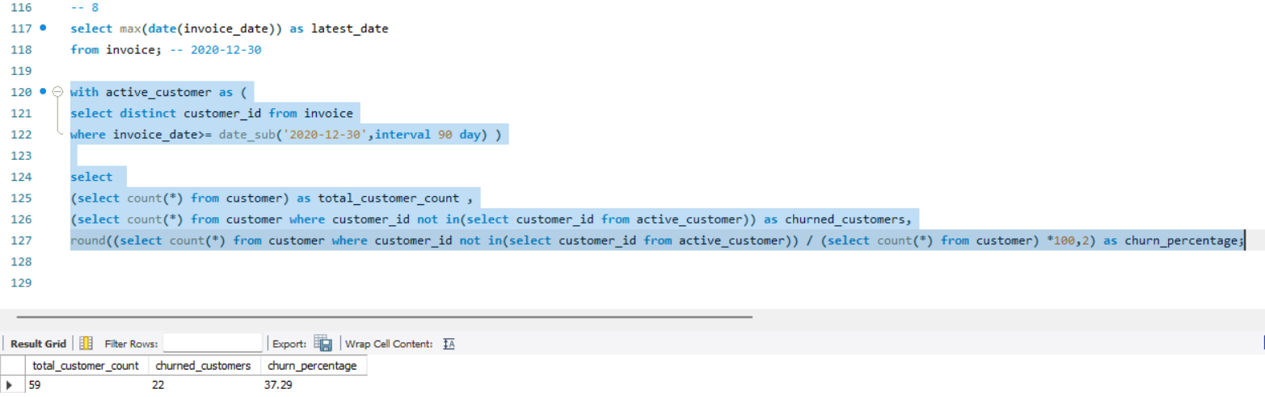
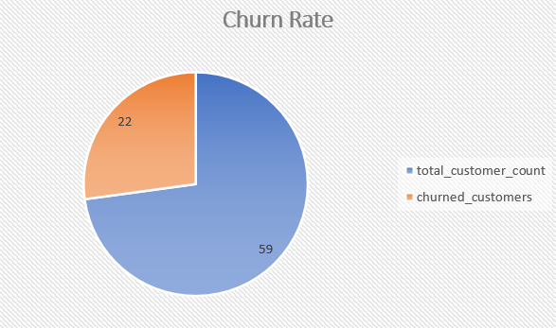
Churn Rate & Retention Metrics
To analyze customer retention, I defined churned customers as those who had not made a purchase within 90 days of the most recent invoice date (2020-12-30). Using SQL date filters, I distinguished between active and inactive customers and determined the churn rate.
Out of 59 total customers, 22 were churned, giving a churn rate of 37.29%
Churned users typically made less than 10 purchases, with shorter engagement spans
High-value customers like Manoj Pareek and François Tremblay churned despite good spending history shows a missed retention opportunity
Most churned customers dropped off after mid-2020, possibly due to product fatigue or lack of engagement

Slide 10
Customer Segmentation & CLTV
High-Customer Lifetime Value customers like František Wichterlová and Helena Holý stayed active for over 1000+ days with 12–18 purchases
Mid-value customers had shorter tenure and fewer orders, but still consistent spending
Low-CLTV customers had fewer than 6 purchases, low engagement, and dropped early
Some churned customers had high CLTV — strong targets for win-back strategies

Slide 11
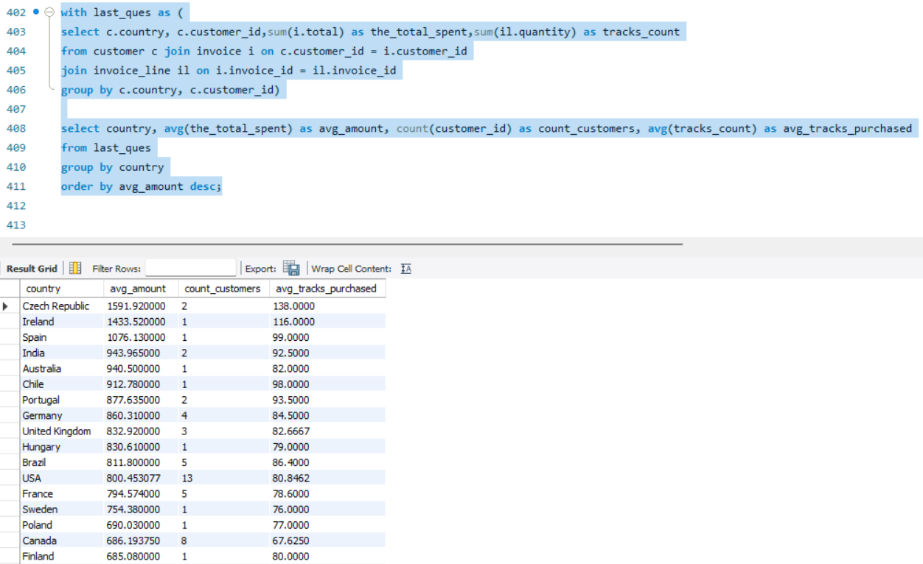
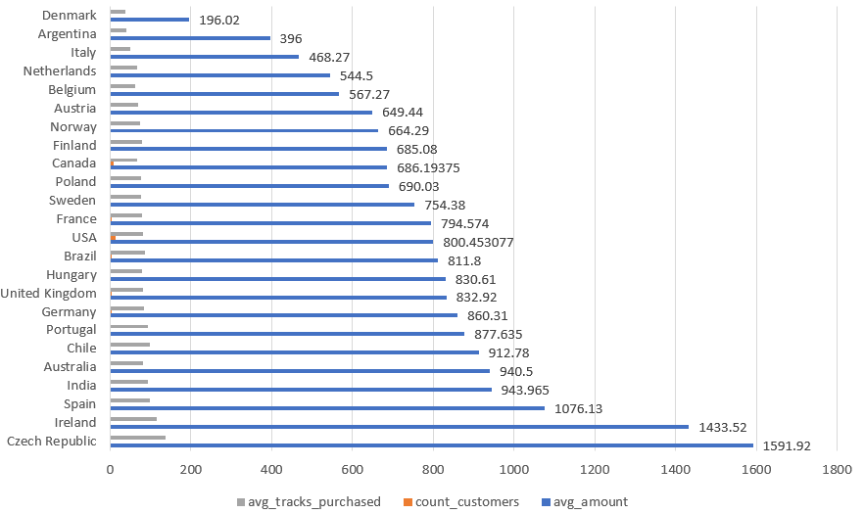
Geographical Performance Overview
Czech Republic, Ireland, and Spain had the highest avg spend per customer (1000+)
USA had the largest customer base (13), but slightly lower per-customer spend
India, Germany, and Brazil showed balanced performance mid-to-high spend and solid track purchases
Low-engagement countries like Denmark and Argentina had < 500 avg spend

Slide 12
Strategic Business Recommendations
Focus loyalty programs on high-CLTV customers to increase their lifetime value and retention.
Re-engage with customers of high value such as Manoj Pareek through customized email offers or playlists.
Bundle popular genres Rock, Alt, Metal into subscriptions to boost the average revenue per user
Increase focus on top-performing countries Czech Republic, Ireland with specialized offers.
Run win-back campaigns for mid-value churned consumers, promoting curated content or one-time deals.
Avoid large spending on low-engagement locations; instead, explore smaller-scale outreach.

Slide 13
Conclusion & Key Takeaways
The Chinook data indicated different variations in customer behavior, regional trends, and product preferences.
High CLTV customers shown significant engagement – ideal prospects for loyalty programs.
Churned users included numerous valuable customers, suggesting a retention imbalance.
Rock and alternative genres dominated sales, particularly in high-performing countries.
Strategic segmentation and region-specific targeting can help Chinook boost revenue, minimize churn, and achieve long-term success.

Slide 14


