Slide 1

CVR COLLEGE OF ENGINEERING DEPARTMENT OF INFORMATION TECHNOLOGY
A Project seminar
on
CERTIFICATE GENERATOR
by
T Sai Charan -18B81A1288
P Sai Charan -18B81A1289
P Yashwanth Reddy -18B81A12B9
Under guidance of
D. Bhanu Mahesh -Associate Professor

Slide 2
CONTENTS
Abstract
Literature review
Proposed approach of the work
Architecture of the model
System Design
Data Set Description
List of functions/procedures.
Code Snippets
Implementation Screenshots
Result Analysis
Conclusion and Future Scope
References

Slide 3
Abstract
Online contest has taken a huge peak in recent covid days. Most of the organizations are preferring to conduct their competitions and exams online. Also conducting online contest have been difficult these days if one wants to distribute certificates to participants.
This portal ensures to conduct contest to each and every student along with generating certificates. These certificates can be generated directly by student when ever they complete their contest successfully. Not only students can generate certificates but also after concluding of contest faculty can also directly send certificates to the students registered emails at one go.

Slide 4
Literature review
HackerRank:
https://www.hackerrank.com/administration/contests/create
Hackerrank is a most popular website we all come across. Hackerrank allows us to host our contents online
Google Docs AutoCrat add-on:
After successful completion of contests using hackerrank, Hackerrank generates an excel sheet with the participant details and their results.
Using this excel sheets, we can generate certificate with our certificate template and send certificates to participants to their mail id’s and also store these certificates in our local storage.

Slide 5
Limitations of the existing Applications/ Models
All the mentioned applications can either help us in conducting exams or either generate certificates, but not both.
There is no single application that conducts exams and automatically generates cetificates to the participants.

Slide 6
Proposed approach of the work
We have created two different views of this website
First is for the person who creates contest and hosts them
Second is the person who attempts the contest and gets a certificate after completion of contest

Slide 7
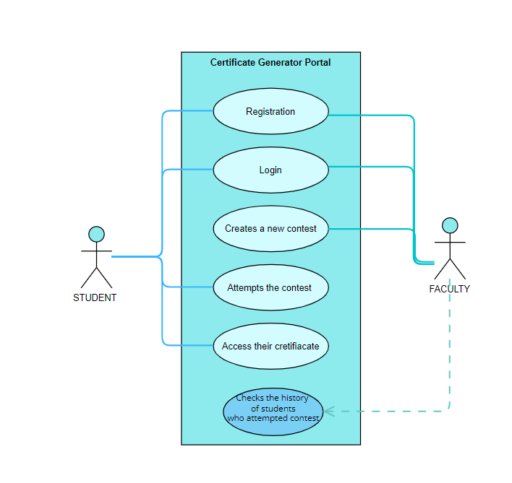
Use Case Diagram

Slide 8
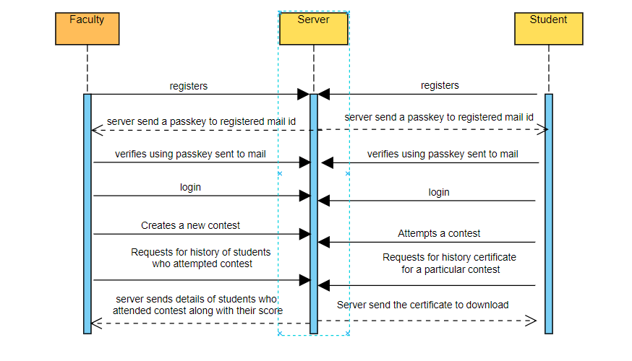
Sequence Diagram

Slide 9
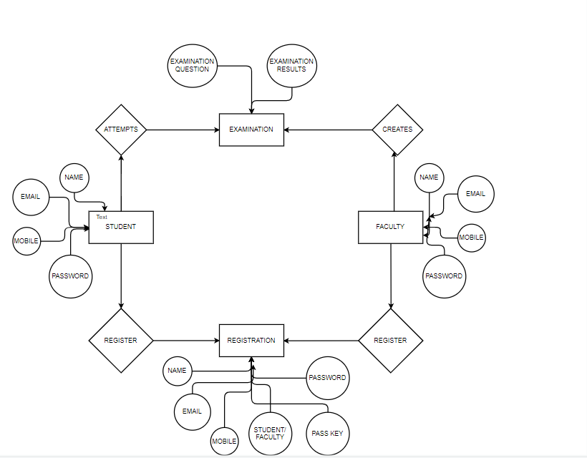
ER Diagram

Slide 10
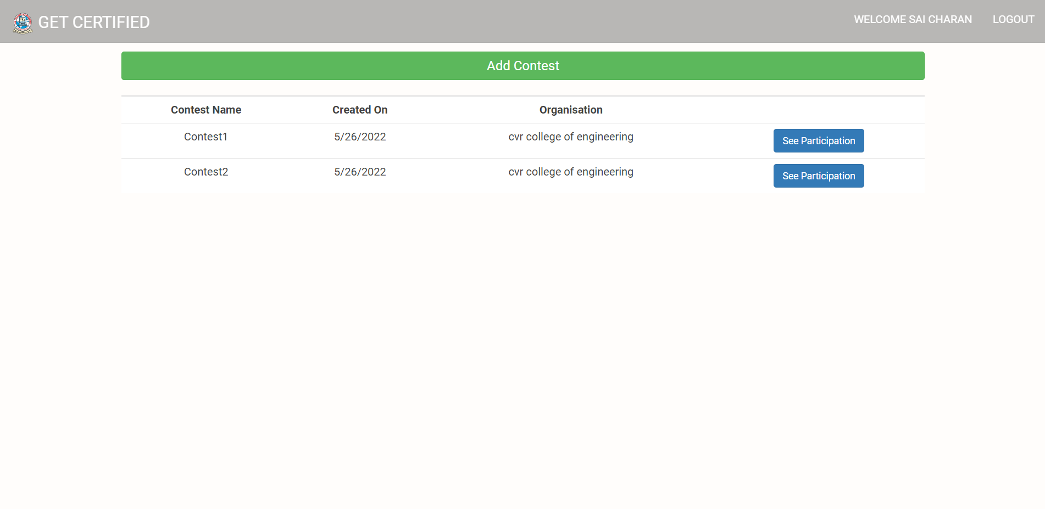
Faculty Dashboard

Slide 11


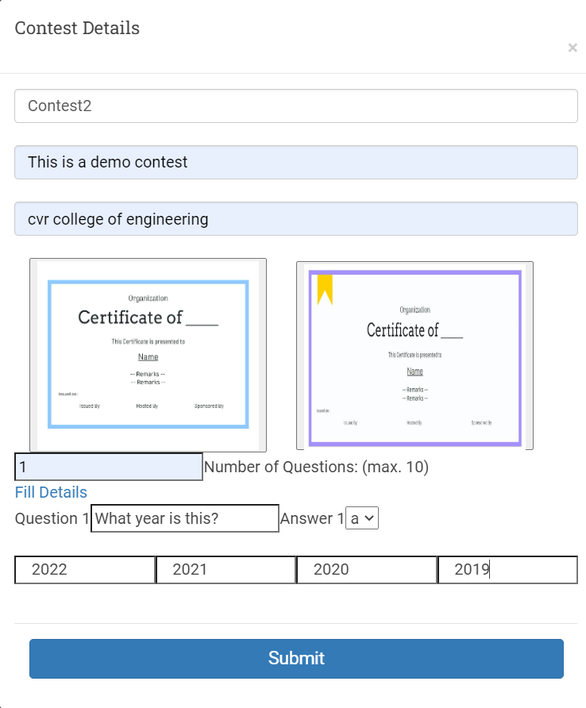
Faculty Creating Contest

Slide 12
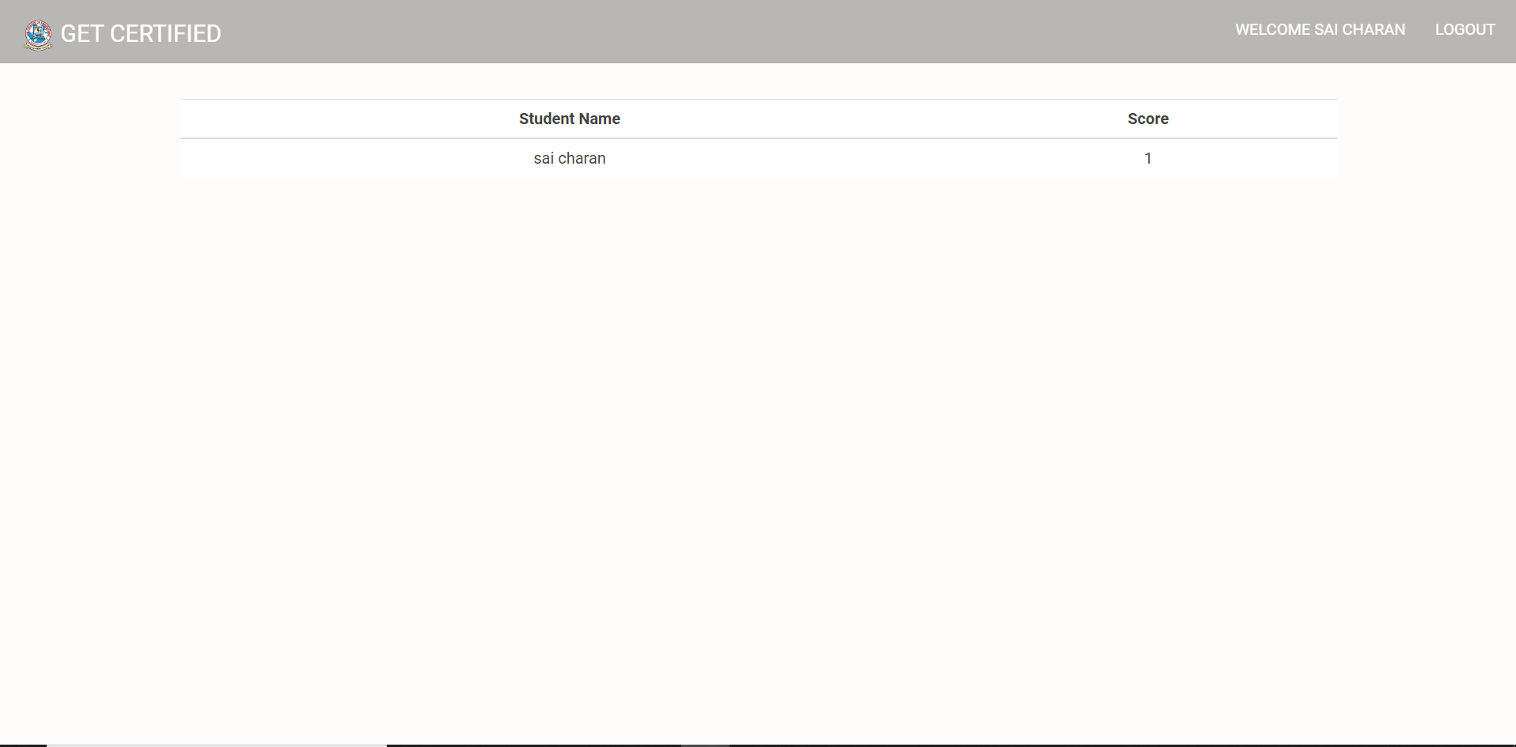
Contest History

Slide 13
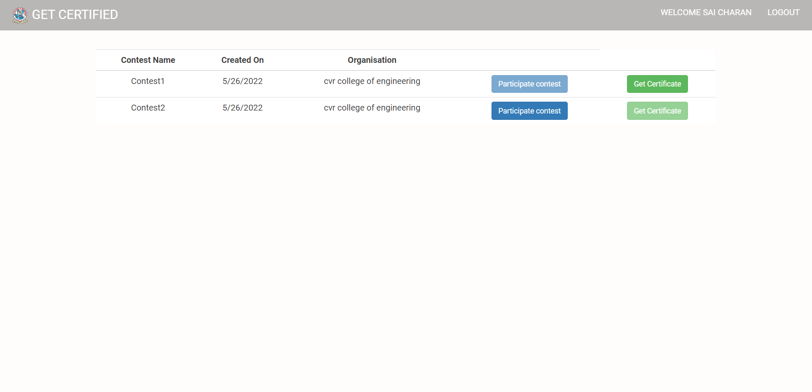
Student Dashboard

Slide 14
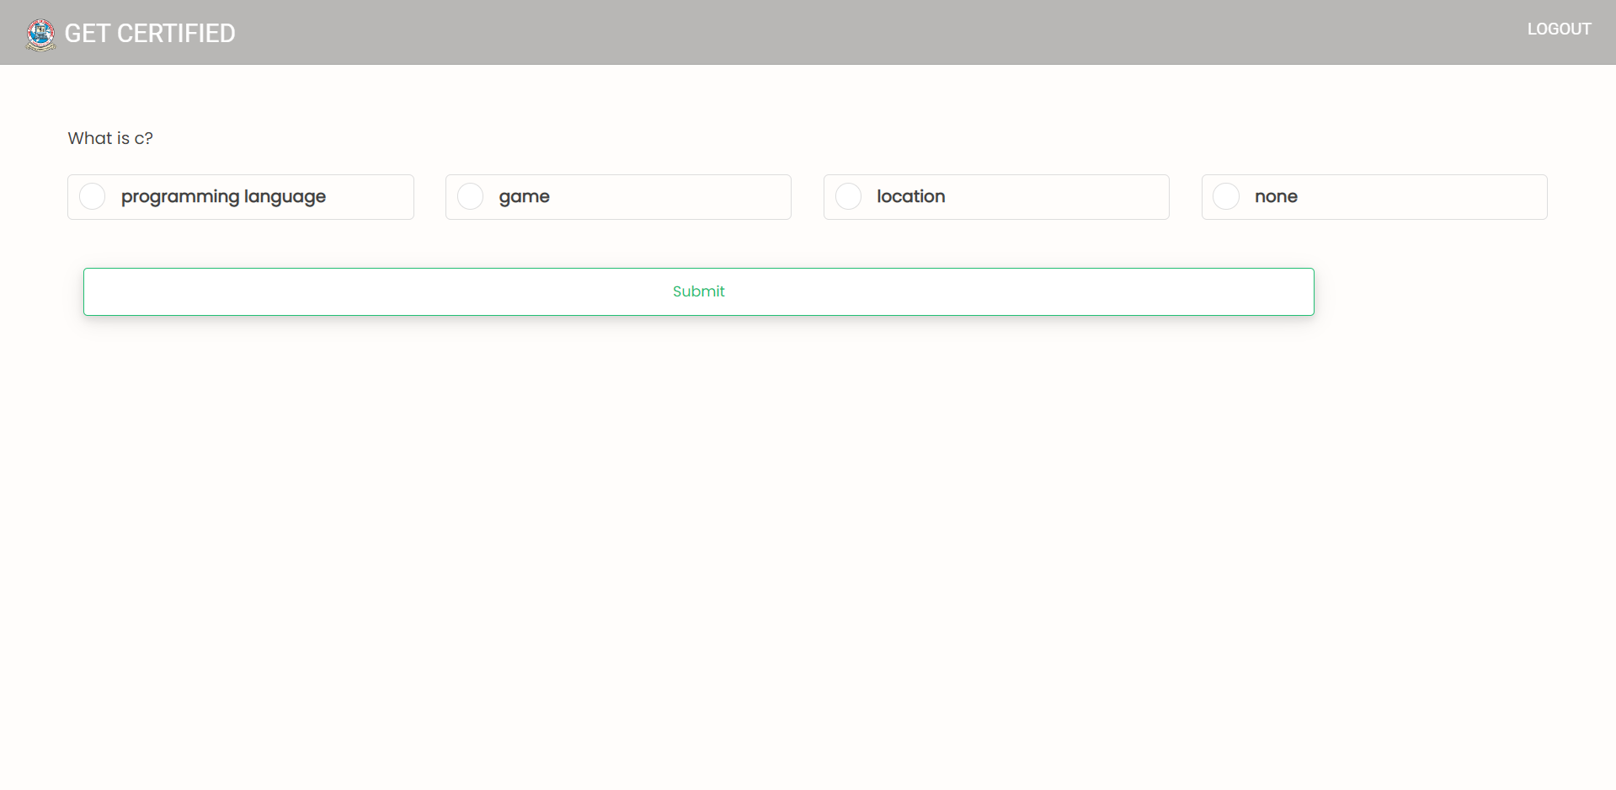
Student Contest Page

Slide 15
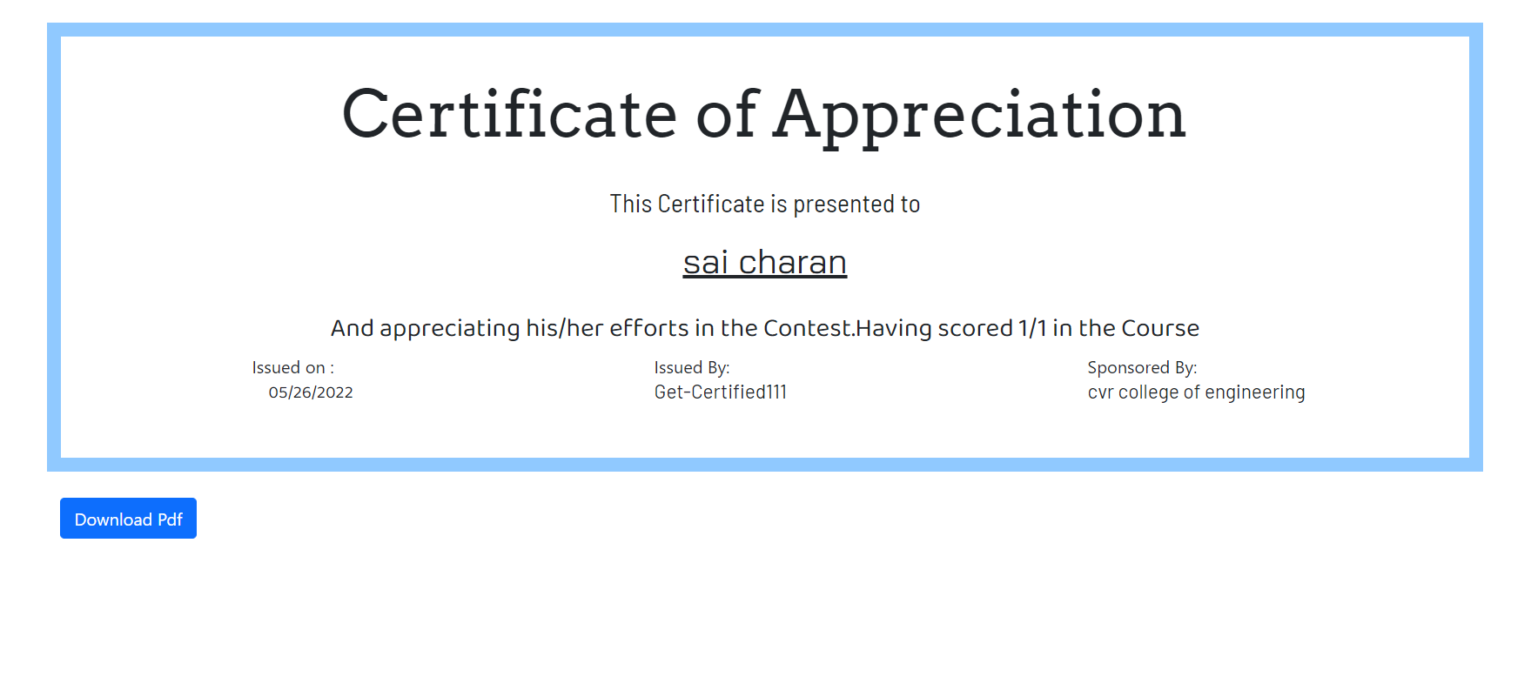
Certificate Generated

Slide 16
CONCLUSION AND FUTURE SCOPE
Using this solution, we can reduce the work that need to do by organizers who are conducting exams by simply generating certificates to all the participants. This website can also be used for all the internal examinations that are being conducting inside an educational institution.

Slide 17
Thank You

