Slide 1
TOPIC : SMART PHONE TEARDOWN
Contents
Why I chose this Project
Specifications of smart phone
Out Look of internal components
CC board components
Mother board components
Hierarchy charts
PRESENTED BY :
TADIPARTHI SAI HARSHITHA
21116094

Slide 2
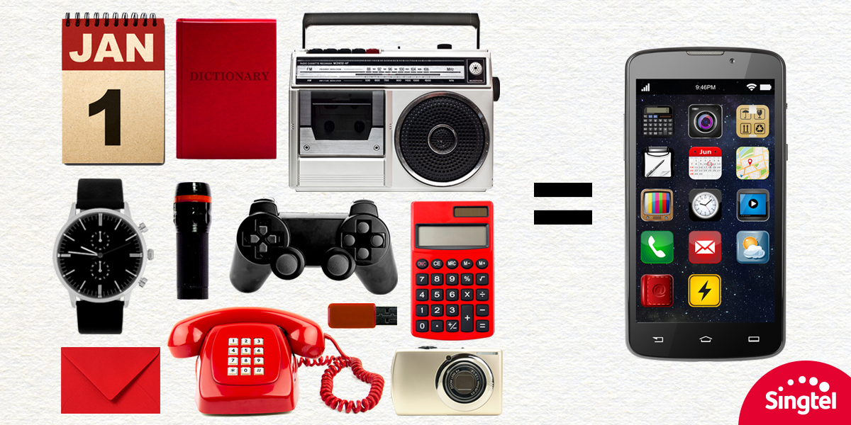
WHY I CHOSE THIS PROJECT
The smartphone has changed the way we live, and it’s hard to imagine a time when we had different devices for all the functions our phones can now fulfil.
I was always curious about how a single touch does all these things
I hoped this project would help me understand these things and learn something new.

Slide 3
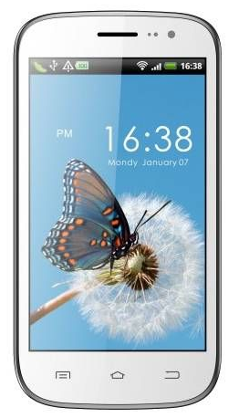
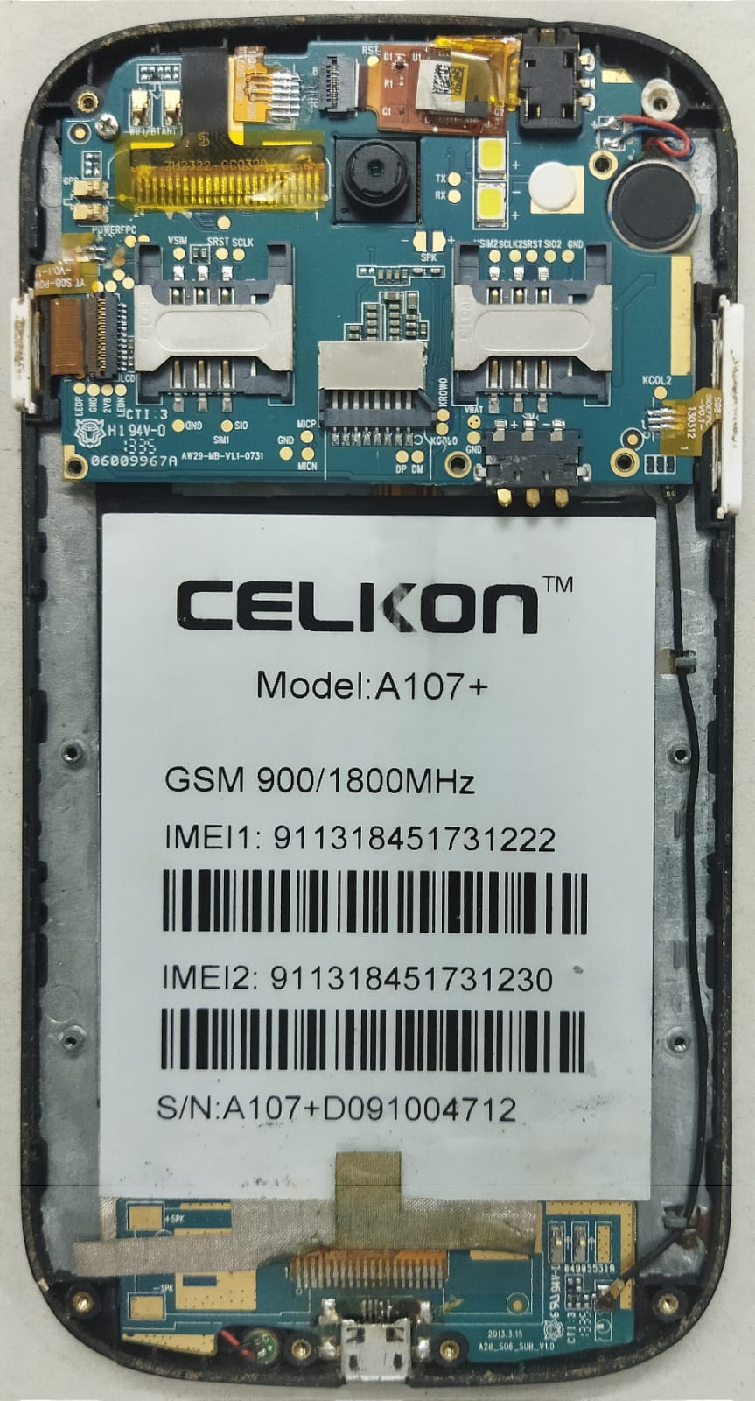
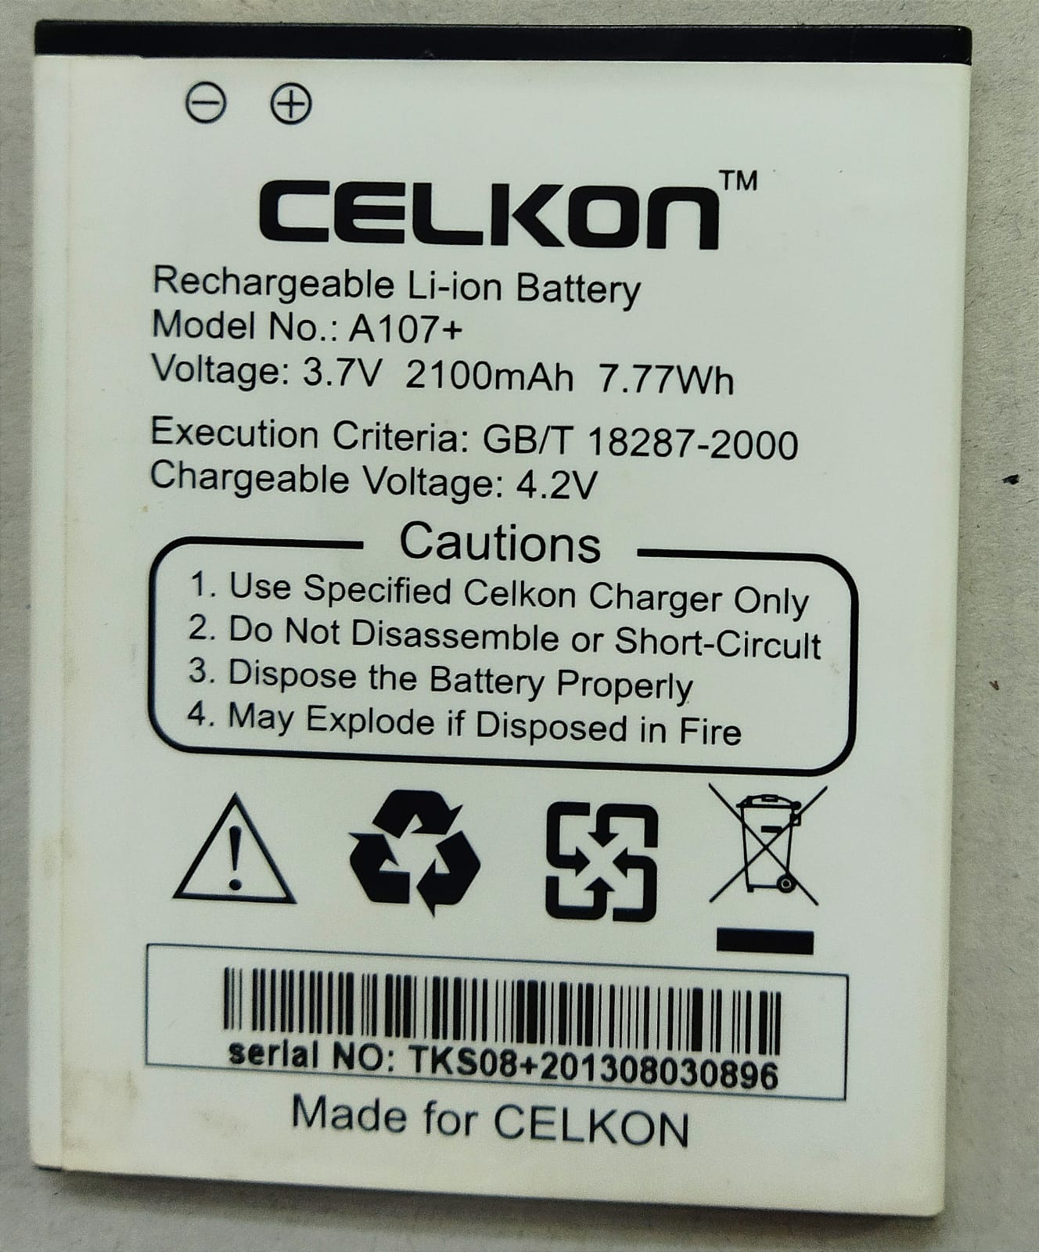
OUT LOOK OF INTERNAL COMPONENTS
SPECIFICATIONS
MODEL : CELKON A107+
DIMENSIONS : 148 mm * 77 mm * 9.6 mm
RAM : 512MB
ROM : 4GB
CAMERA : 8MP + 1.3 MP
PROCESSOR : Dual Core,1GHz
OPERATING : Android V4:2.2(Jelly Bean)
SYSTEM
BATTERY : 2100mAH,removable
DISPLAY TYPE : TFT LCD
3.5 mm JACK
BACK CAMERA
FLASH
VIBRATOR
SIM CARD ADAPTER
SIM CARD ADAPTER
MEMORY CARD ADAPTER
CELKON A107+
1
BATTERY: Batteries of phones normally use lithium-ion technology that is either removable or non-removable in mobile devices
Battery
CHARGING PORT

Slide 4
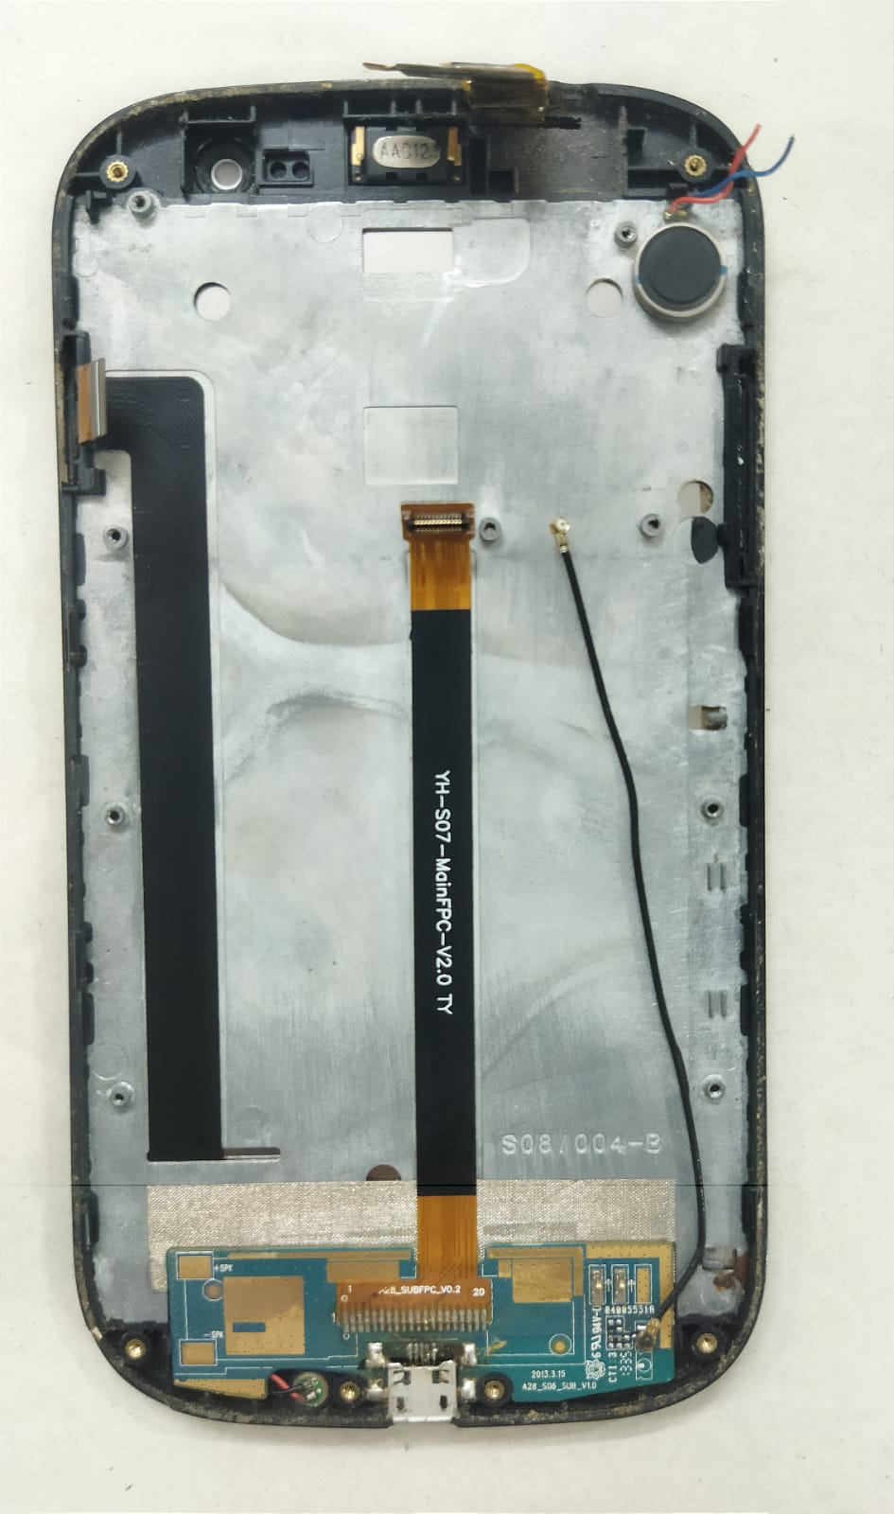
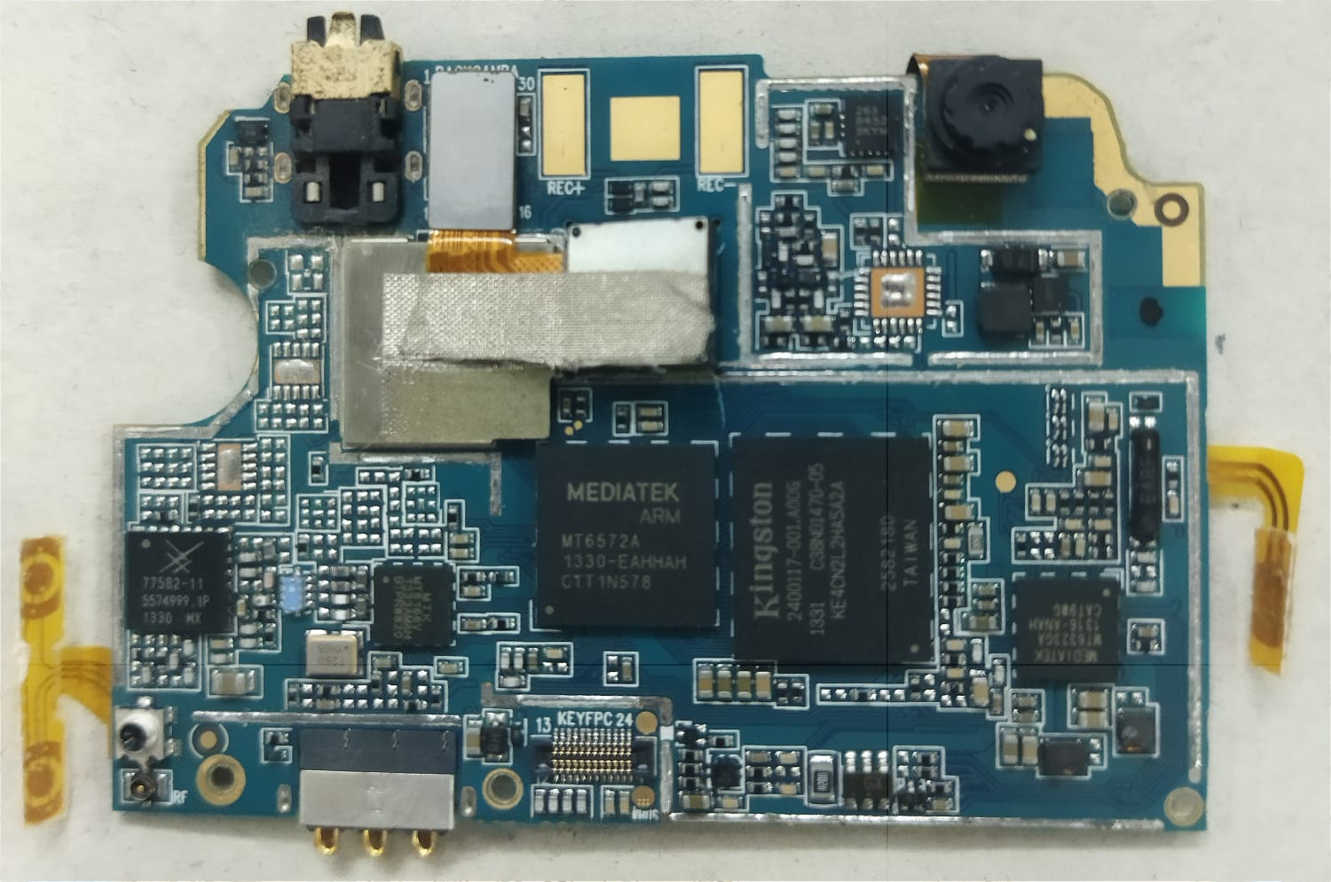
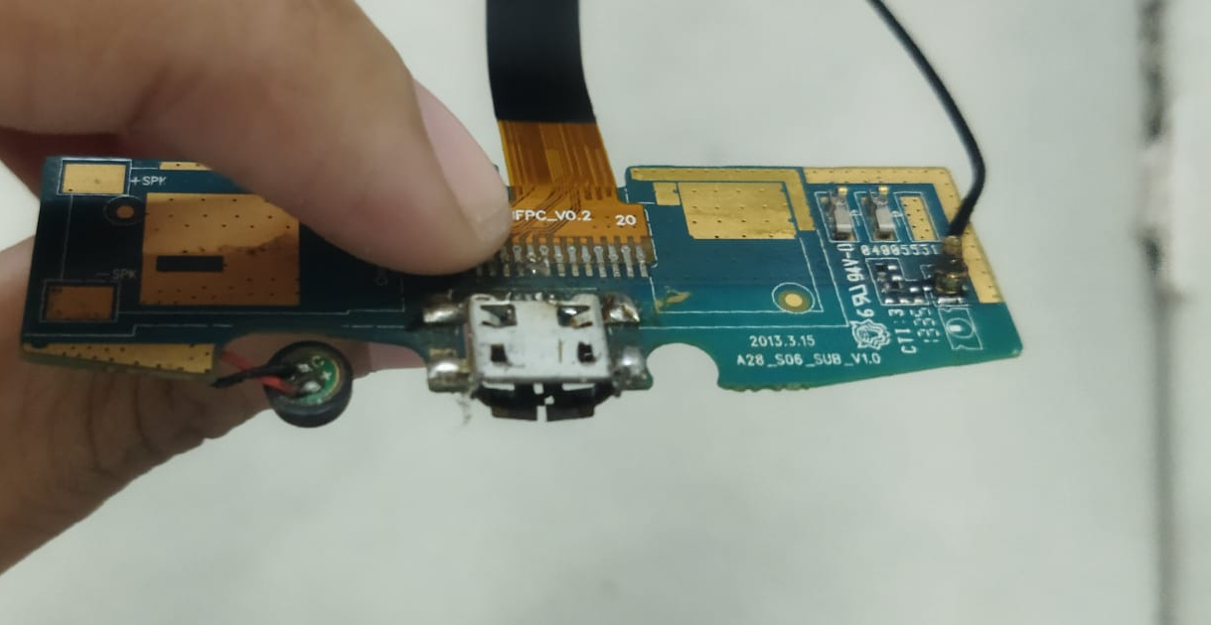
EAR SPEAKER
FRONT CAMERA
POWER CHIP
FRONT CAMERA
COMBO STRIP
MIDDLE STRIP
ANTENNA CABLE
Proximity sensor
SUB BOARD
CHARGING PORT
ROM
SoC
MIKE
RAM
MOTHER BOARD / MAIN BOARD
CC BOARD / SUB BOARD

Slide 5
Main board
SoC-System on a chip
ROM-Read only memory
Sub board
Charging connector
Signal receiver pins
RAM – Random Access Memory
Wifi
NFC
Baseband
GPRS
Antenna
Mike
SoC
CPU-Central Processing Unit
GPU-Graphical Processor Unit-GPU-Improve performance in the rendering of videos, games, and other graphics
Sensors
ACCELEROMETER-to detect the orientation of mobile, as well as allow features like shaking the phone to change music
GYROSCOPE-Works with accelerometer to detect rotation of mobile, for features like tilting phone to play racing games .
LTE modem – adds cellular connectivity to other devices
Display processor
Video processor
DIGITAL COMPASS-Helps to find north direction
AMBIENT LIGHT SENSOR-Sets the screen brightness based on the surrounding light
PROXIMITY SENSOR-During a call, if the device is brought near ears, it automatically locks the screen to prevent touch commands

