Slide 1
Imperialism
Stronger nation seeks to dominate a weaker nation politically, economically, and socially
Broken down into 2 periods
  The Old Imperialism
  The New Imperialism

Slide 2
The Old Imperialism
1500-1800
Europeans establish colonies in Americas, India, Southeast Asia, Africa, & China
European power was limited

Slide 3
The New Imperialism
1870-1914
Japan, U.S. & industrialized nations of Europe became more aggressive in expanding into other lands
Focused mainly in Asia & Africa
  Declining empires & wars left them vulnerable

Slide 4
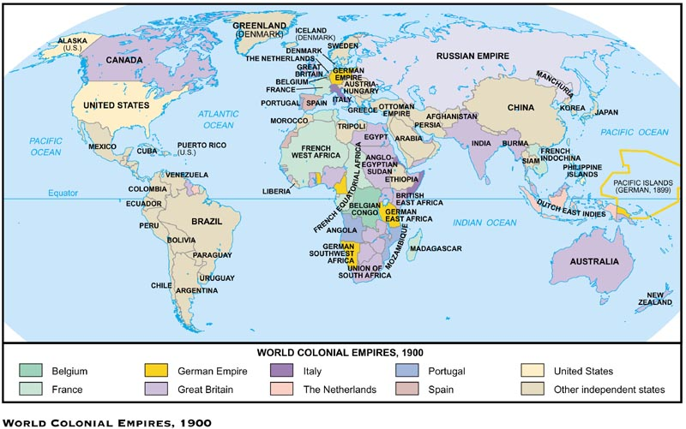
Colonial Empires

Slide 5


Causes of the New Imperialism
Economic
Need for natural resources & new Markets (Industrial Revolution)
Place for growing populations to settle
Place to invest profits

Slide 6

Political
Bases for trade & military ships
Power & security of global empire
Spirit of nationalism

Slide 7

Social
Missionaries Spread Christianity
Share western civilization
Belief than western ways are best
  Racism
Social Darwinism

Slide 8
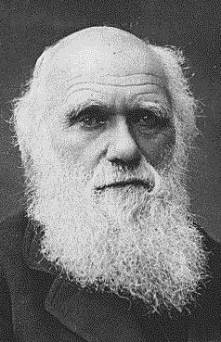

Social Darwinism
Applied Darwin’s theory of Survival of the fittest to competition between nations
Natural for stronger nations to dominate weaker ones

Slide 9
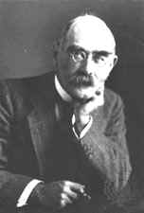
White Man's Burden
Poem by Rudyard Kipling
Offered justification for imperialism
White imperialist had a moral duty to educate less developed people
  Spread western ideas, customs & religions to people in Africa & Asia

Slide 10
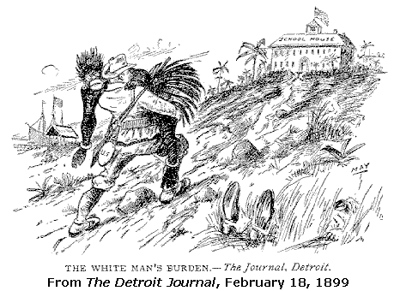

Slide 11
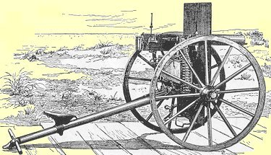
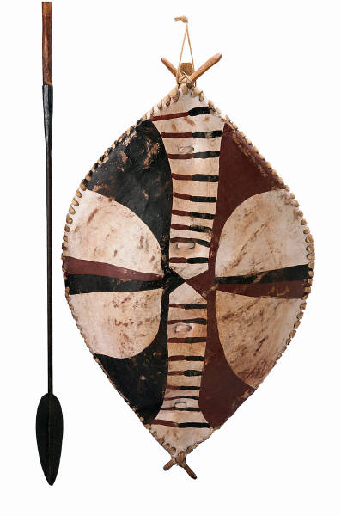
Western Advantages
Strong economies/governments
Powerful Armies & navies
Superior technology
  Maxim Gun
  Steam driven warships/railroads
  Medical advances
VS.

Slide 12
Forms of Imperial Control
Colony
  Governed internally by a foreign power
Protectorate
  Own internal government but under control of an outside power
Sphere of Influence
  Outside power claims exclusive investment or trading rights

Slide 13
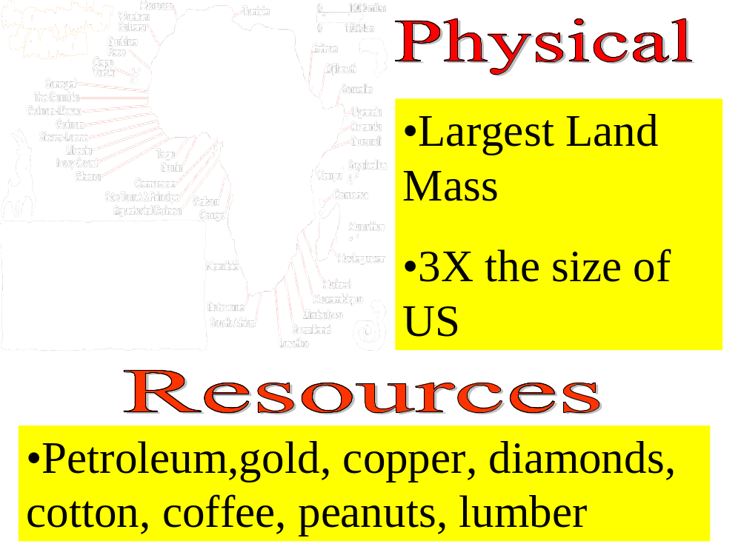

Slide 14
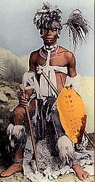
Africa Before Imperialism
Divided into 100’s of ethnic & linguistic groups
Mixture of large empires & small independent villages
Most practiced traditional beliefs
  Others practiced Islam & Christianity

Slide 15
Early European contact
Established contact in early 1450’s
Early contact limited to coastal territory
  Travel to interior was limited due to navigability of rivers & disease
Large networks of Africans controlled trade (gold & ivory)
  European interest based on slave Trade (Triangular trade)

Slide 16
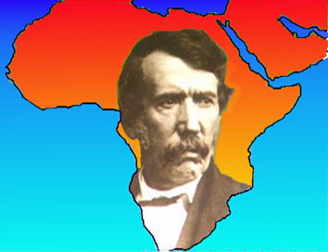
Exploration of the Interior
Known as the Dark Continent
1860’s Scottish missionary David Livingstone- first European to explore Sub- Saharan Africa
Reported lush forests, waterfalls, & grasslands
  Discovers Victoria Falls

Slide 17
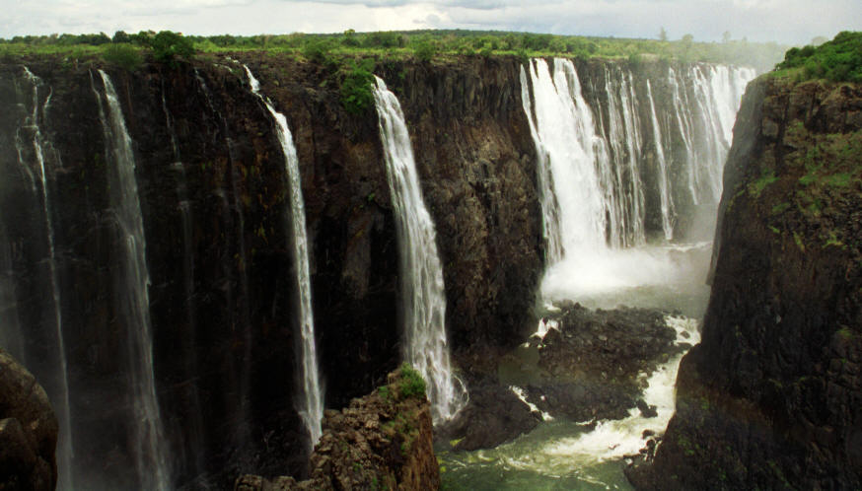
Victoria Falls

Slide 18
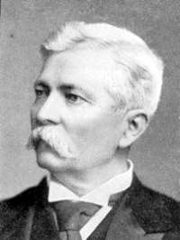
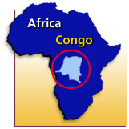
1871 American Henry Stanley searches for & finds Livingstone
Stanley finds mouth of Congo opening up interior to trade
Helps establish Congo Free State for King Leopold II of Belgium
  Sets off Scramble for Africa

Slide 19
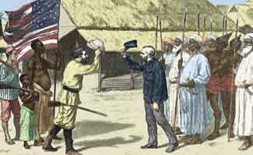
"Dr. Livingstone, I assume?"

Slide 20
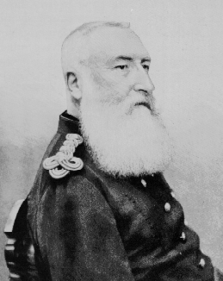
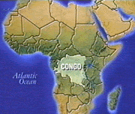
The Scramble For Africa
Belgian presence in the Congo setoff European race for colonies
  No European power wanted to be left behind
Discoveries of Gold & Diamonds in South America also increased interest

Slide 21
The Berlin Conference 1884-1885
Conference of European powers set up rules for colonizing Africa
  Any country could claim land
  Divided Africa w/ no regard for ethnic or linguistic groups
  No African rulers attended
  By 1914 only 2 countries remained independent

Slide 22
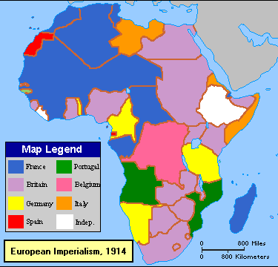

Slide 23
Internal Factors enabling European Imperialism
Variety of Cultures & Languages
Low Level of Technology
Ethnic Strife

Slide 24

British Imperialism in Africa
Scattered throughout Africa
Controlled heavily populated regions heavy in resources
Parts of West & East Africa, Egypt, & most of Southern Africa

Slide 25
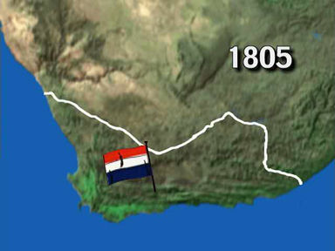
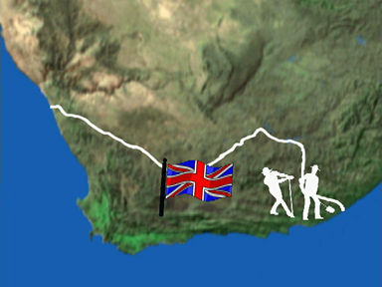
Southern Africa
Dutch Farmers(Boers) settle Cape town in 1652
English acquired Cape colony from Dutch in 1806
Boers resented English rule & Migrated north (The Great Trek)

Slide 26
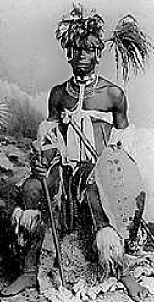
The Zulu Nation
1816 African leader Shaka unites the Zulu Nation
Zulu warriors fight against European slave traders & Ivory hunters

Slide 27
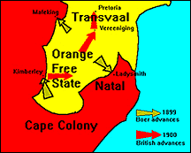
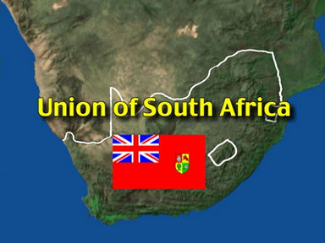
The Boer War
Results

Slide 28
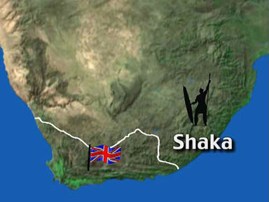
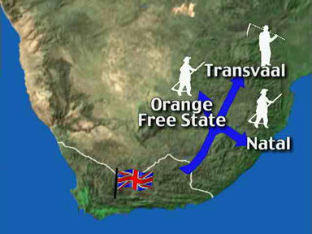
Conflict between Boers & Zulus
The Great Trek causes conflict between Boers & Zulus
Boers aided by British defeat Zulus
Boers establish independent Republics of Transvaal & Orange Free State

Slide 29
The Boer War
1867 diamond & gold deposits discovered in Boer territory
1890 Cecil Rhodes expands control of South Africa
  Annexes the Boar Republics
Boers resist & fighting lasts from 1899-1902
1910 British form Union of South Africa( *Racial segregation until1993)

Slide 30
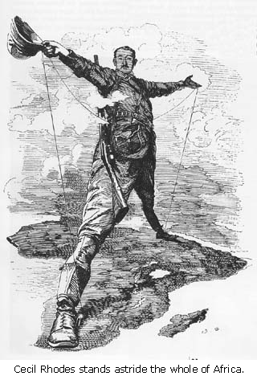
Cecil Rhodes promoter
of British imperialism
in Africa

Slide 31
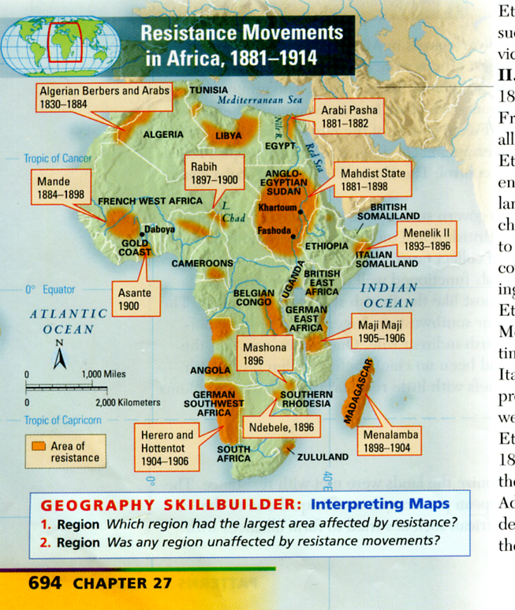

Slide 32
African Resistance Movements
Most Resistance was unsuccessful
  Superior European technology
  Alliances failed
Maji- Maji Rebellion 1905
  Germans in East Africa squash spiritual uprising (26,000 killed)

Slide 33
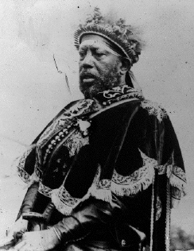
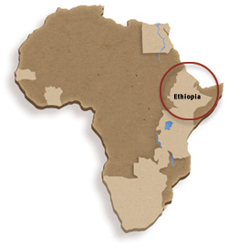
Ethiopia- A successful Resistance
Menelik II Emperor of Ethiopia
  Purchases weapons from France & Russia
  Defeated Italian forces in 1896
Only African nation to resist Europeans

Slide 34
Positive Impacts of Colonial Rule
Reduced local warfare
Improved sanitation, hospitals & education
African products popular in European Market
Improved infrastructure
  Railroads,dams, telephones & telegraph lines

Slide 35
Negative impacts of Colonial Rule
Lost land & independence
Death caused by new disease & resistance
Change to cash crops resulted in famine
Breakdown of traditional culture
European establishment of boundaries (Problem today)

Slide 36
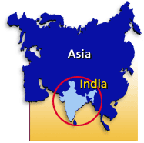
Indian Subcontinent
Location: Southern Asia
Mountains: Himalayas
Rivers:Brahmaputra, Ganges, & Indus
Religions- Hinduism (Caste System), Islam, Buddhism, Christian, Sikh
Early Civilizations- Mohenjo Daro, Harappa, Mauryas, Mughals
*Monsoons

Slide 37
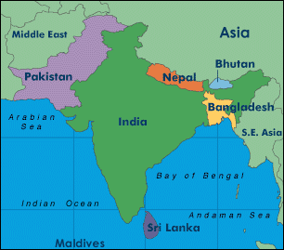
Nations:
India, Pakistan, Bangladesh, Bhutan, Nepal, & Sri Lanka

Slide 38
British East India Company (1600) govt. chartered trading monopoly
  1613 received permission to trade from Mughal Empire
  Company had its own army(Sepoys)
  W/ decline of Mughals & defeat of French, Company controlled 3/5’s of India
  Exercised power usually associated with a government

Slide 39
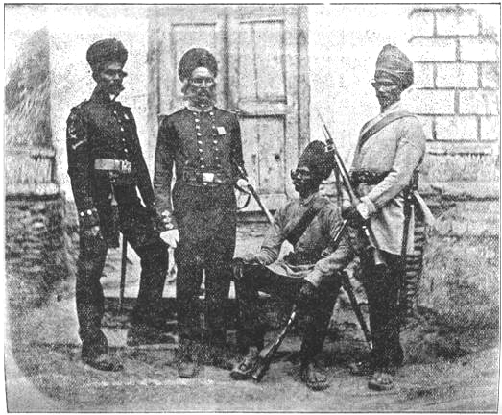
Sepoy Mutiny
Sepoys- Indian soldiers
  Felt British military rules were against religious beliefs
  1857 Hindus & Muslims to unite against British
  British crush revolt & Parliament ends company’s rule of India
  British government takes control of India

Slide 40
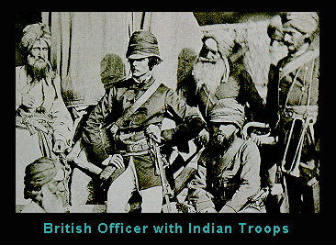

Slide 41
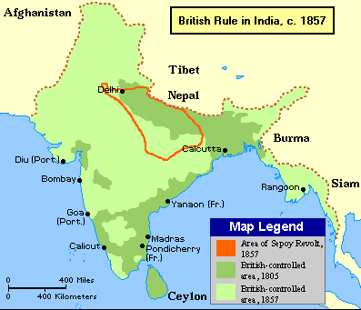
.

Slide 42
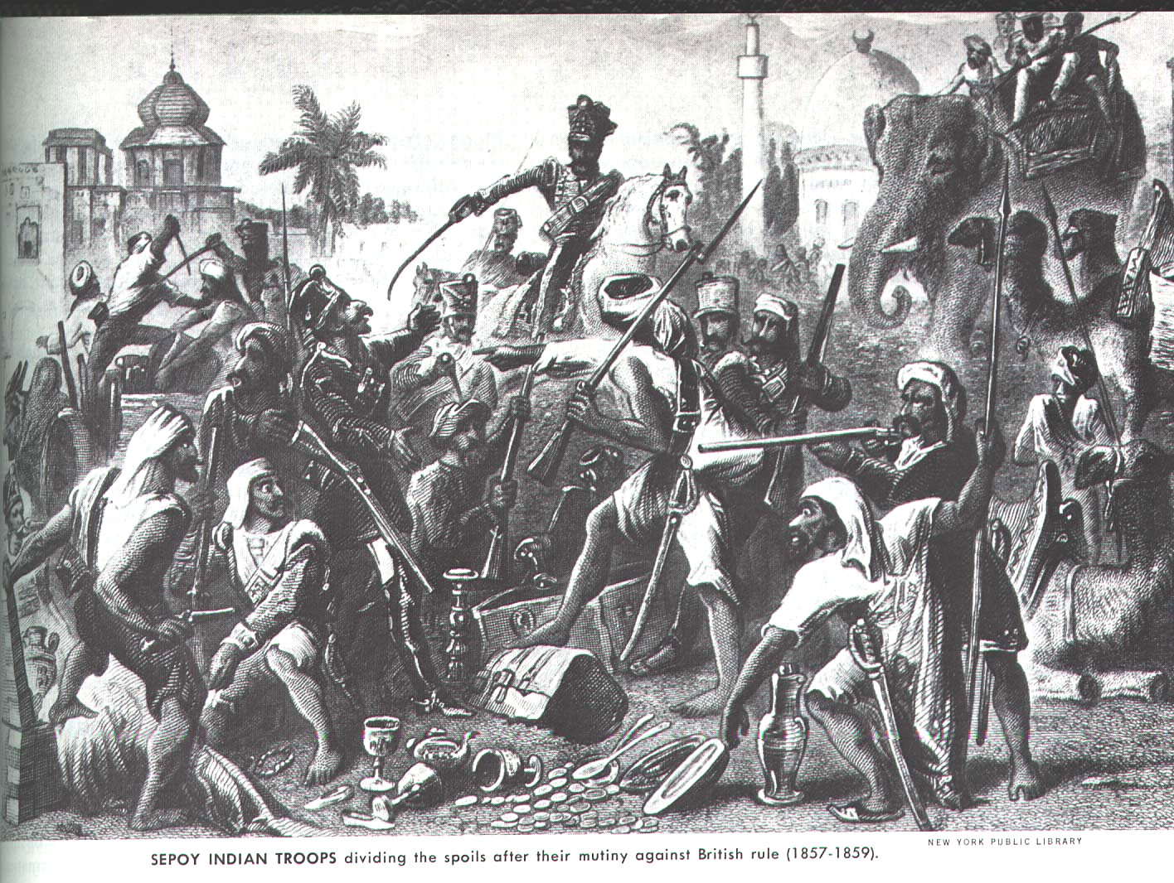

Slide 43

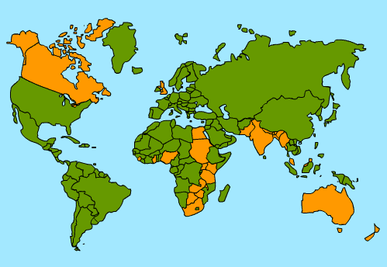
India was Jewel in the Crown of English Colonies
  300 million people= a huge potential market
    Indian business competition was prohibited
  Major supplier of Raw materials (Cotton, opium)

Slide 44
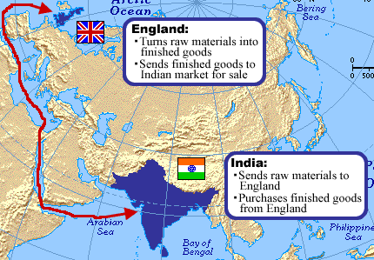

Slide 45
The Raj- British Rule in India 1757-1947
Cabinet minister in England directed policy
British Governor General (Viceroy) carried out government orders in India
British established a single law for everybody( All castes were equal)
Established English as the official language

Slide 46
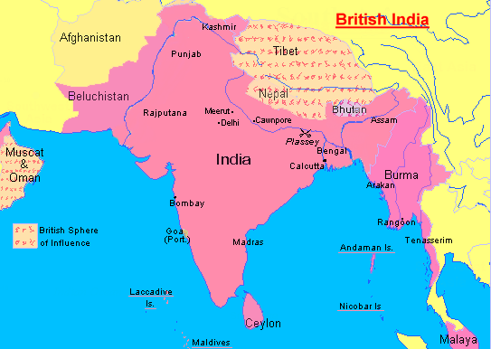

Slide 47

Positives of Imperialism
  Improved infrastructure, built schools,improved sanitation & public health, ended local warfare
  Indians allowed to study abroad

Slide 48

Negatives of Imperialim
  British held all political & economic power
  Indians treated as second class citizens
  Conversion to cash crops caused famine
  Indian cultural values, beliefs & practices were threatened

Slide 49
Indian Nationalist movements
Ram Mohun Roy- Father of Modern India
  Moved India away from traditional ways (Ex. Wanted to end child marriages, widow suicide (suttee) etc.)
1885- Indian National Congress
1906- Muslim League formed
1947- Independence & Partition

Slide 50
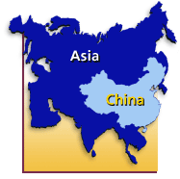
China
Geography- Huang He (Yellow) & Yangtze Rivers; Kunlun & Himalayan Mts.; Great Wall
Geographic Isolation=Ethnocentrism (Middle Kingdom) Viewed others as inferior or barbarians
Dynastic Cycles/Mandate of Heaven

Slide 51
Early European Contact
Europeans interested in tea,silk, & porcelain
  Also hoped to tap into huge market &source of cheap labor
Manchu's looked down on foreigners
  Interest in foreign goods was non-existent
Chinese Ethnocentrism led to its downfall
  Could not repel European advances

Slide 52
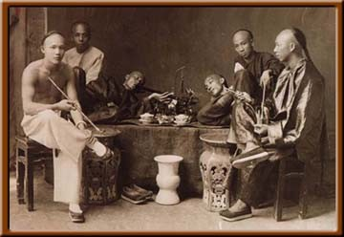
Opium War
Late 1700’s British trade opium in China (leads to addiction)
  Chinese try to halt opium trade
  1839 War breaks out – British easily defeat Chinese
1842 British force Chinese to sign harsh Treaty of Nanjing

Slide 53
Treaty of Nanjing
First in a series of uneven treaties signed with foreigners
China had to open more ports, pay for cost of war
Gave Britain Hong Kong
Granted foreigners extraterritoriality
  Right to be tried by their own courts & laws rather than those of China

Slide 54
Spheres of Influence
1898 China was divided into Spheres of Influence by foreign powers
1899 U.S. Proposes that China’s “doors” be open to merchants of all nations
  Protected the trade rights of all nations & made sure no one country colonized China

Slide 55
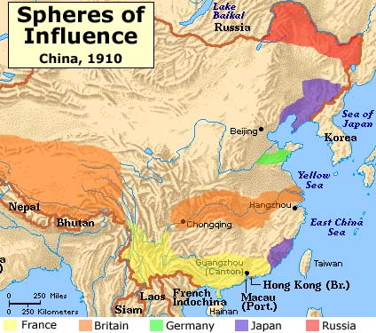

Slide 56
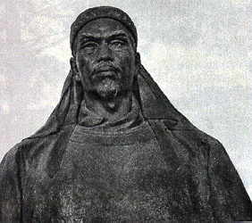
Chinese Reaction to Imperialism
Taiping Rebellion-(1850-1864) Chinese peasants inspired by Hong Xiuquan try to overthrow Manchu Dynasty
  Takes 14 years to crush & costs millions of lives

Slide 57
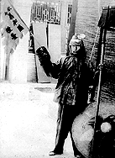
The Boxer Rebellion- (1900)
  Secret society of Boxers rises up against foreign powers
  Combined force of European,American , & Japanese forces crush revolt
  Resulted in Chinese govt.conceding more to foreign powers

Slide 58
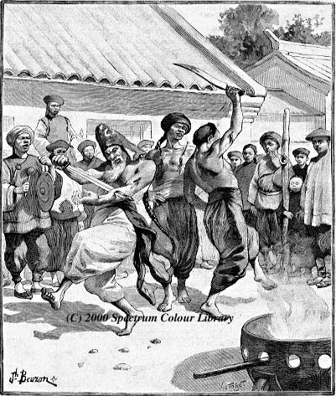
The Fists of Richeous Harmony

Slide 59


Slide 60
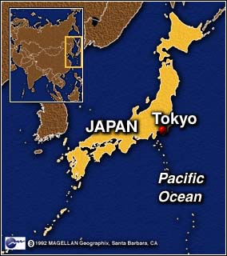
Japan
Located in East Asia
Geographic conditions favored isolation
Culture heavily influenced by China & Korea
Industrialized nation but lacks vital resources

Slide 61
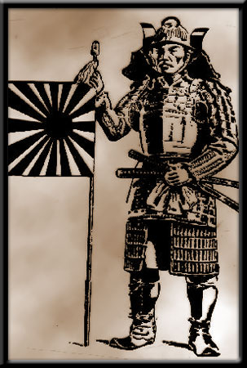
Tokugawa Shogunate(1603-1868)
Feudal system led by warrior class (Samurai)
Brought stability to Japan,
Banned all contact with outside world (isolationism)
  Outlawed European products & Christian Missionaries

Slide 62
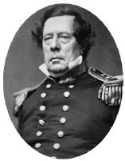
The Opening of Japan
1858 U.S. Commodore Matthew Perry sails into Tokyo Harbor
  Requests opening of Japanese ports to trade
  Tokugawa Shoguns facing enormous military might unwillingly agree
  Treaty of Kanagawa- 1854 Ends Japanese isolation

Slide 63


Slide 64
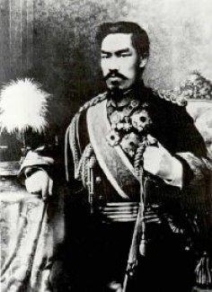
The Meiji Restoration (1868)
Tokugawa Shogunate overthrown; restoring power of the Emperor
Strong centralized government w/ a constitution
Industrialized Japan
Built up military power
Built up infrastructure & Economy
Modernizes Japan & makes it competitive with the west

Slide 65
Japan as Imperialistic Power
Lack of Raw materials & revamped military Steers Japan towards imperialism
Sino- Japanese War (1894)- Japan easily defeats China
  Gains Taiwan &increased influence in Korea

Slide 66
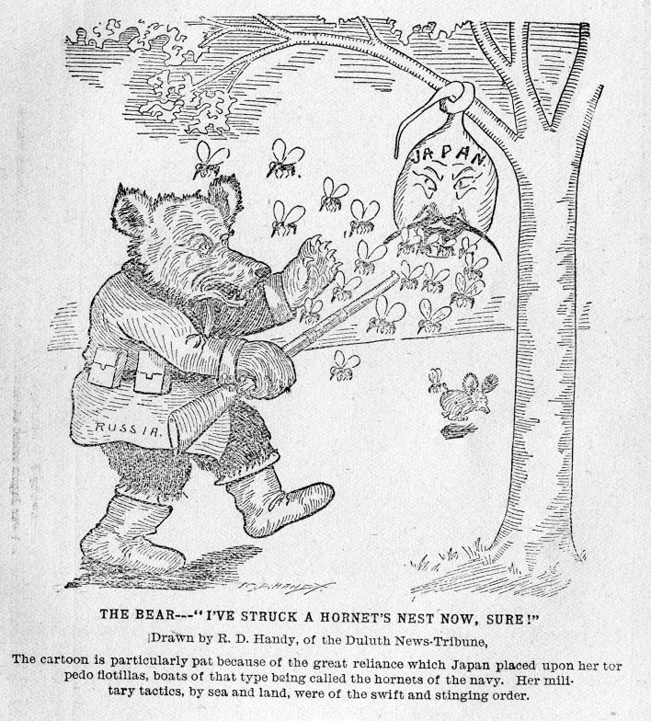
Russo- Japanese War (1904)
  Japan defeats Russia in a conflict over control of Korea
  Treaty of Portsmouth ends war
    Japan gains territory in Manchuria
  Japan annexes Korea in 1910

Slide 67
Japan Dominates Korea
Prime example of imperialism at its worst
  Closed newspapers & controlled schools
  Replaced study of Korean language & history w/ that of Japan/
  Gave Korean land to Japanese
  Replaced Korean businesses w/ Japanese businesses

Slide 68
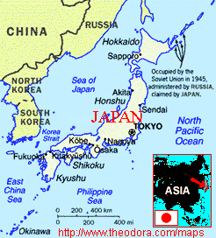

Slide 69
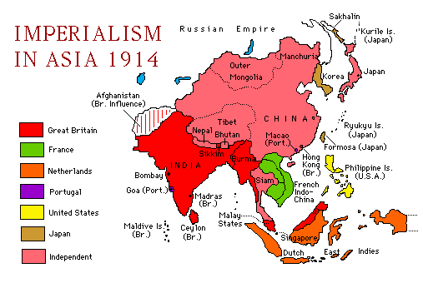

Slide 70
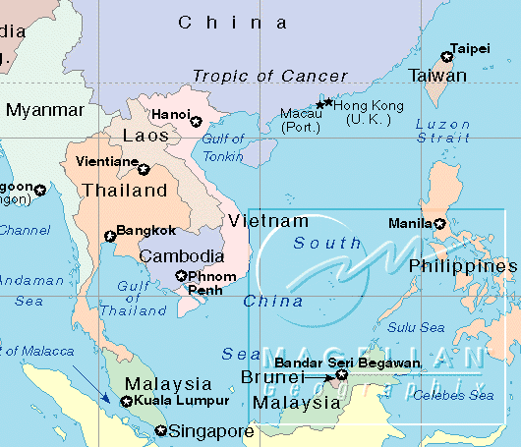
Southeast Asia

Slide 71
The Pacific Rim
Source of tropical agriculture,minerals & oil
Hindus, Muslims, Christians & Buddhists
Dutch, British, French, US all raced to gain colonies
*Dutch East India Co. ruled Indonesia
****French ruled over Indochina (Vietnam)

Slide 72






Slide 73


Slide 74



