Slide 1

CAPSTONE PROJECT-1 EDA On Hotel Booking Analysis By SAI NARASIMHA CHARAN THULASI

Slide 2
Problem Statement
This Project will be anaylizing Hotel Booking data.
This data set contains booking information for a city hotel and a resort hotel, and includes information such as when the booking was made, length of stay, the number of adults, children, and/or babies, and the number of available parking spaces. Hotel industry is a very volatile industry and the bookings depends on above factors.
The main objective behind this project is to explore and analyze data to discover important factors that govern the bookings and give insights to hotel management which can perform various campaigns to boost the business and performance.

Slide 3
Data Description
The columns and the data it represents are listed below:
hotel : Name of the hotel (Resort Hotel or City Hotel)
is_canceled : If the booking was canceled (1) or not (0)
lead_time: Number of days before the actual arrival of the guests
arrival_date_year : Year of arrival date
arrival_date_month : Month of month arrival date
arrival_date_week_number : Week number of year for arrival date
arrival_date_day_of_month : Day of arrival date
stays_in_weekend_nights : Number of weekend nights (Saturday or Sunday) spent at the hotel by the guests.
stays_in_week_nights : Number of weeknights (Monday to Friday) spent at the hotel by the guests.
adults : Number of adults among guests
children : Number of children among guests
babies : Number of babies among guests
meal : Type of meal booked

Slide 4
14.Country : Country of origin.
15.booking_changes : Number of changes/amendments made to the booking from the moment the booking was entered on the PMS until the moment of check-in or cancellation 16.deposit_type : Indication on if the customer made a deposit to guarantee the booking. 17.agent : ID of the travel agency that made the booking 18.company : ID of the company/entity that made the booking or responsible for paying the booking. 19.days_in_waiting_list : Number of days the booking was in the waiting list before it was confirmed to the
customer 20.customer_type : Type of booking, assuming one of four categories
21.adr : Average Daily Rate as defined by dividing the sum of all lodging transactions by
the total number of staying nights 22.required_car_parking_spaces : Number of car parking spaces required by the customer 23.previous_bookings_not_canceled : Number of previous bookings not cancelled by the customer prior to the current booking 24.reserved_room_type : Code of room type reserved. Code is presented istead of designation for anonymity
reasons. 25.assigned_room_type : Code for the type of room assigned to the booking. 26.required_car_parking_spaces : Number of car parking spaces required by the customer 27.total_of_special_requests : Number of special requests made by the customer

Slide 5
Work Flow:
Data Collection and Understanding
Data Cleaning and Manipulation
Exploratory Data Analysis(EDA)
EDA will be divided into following 3 analysis.
Univariate analysis: Univariate analysis is the simplest of the three analyses where the data you are analyzing is only one variable.
2) Bivariate analysis: Bivariate analysis is where you are comparing two variables to study their relationships
3) Multivariate anlysis: Multivariate analysis is similar to Bivariate analysis but you are comparing more than two variables

Slide 6
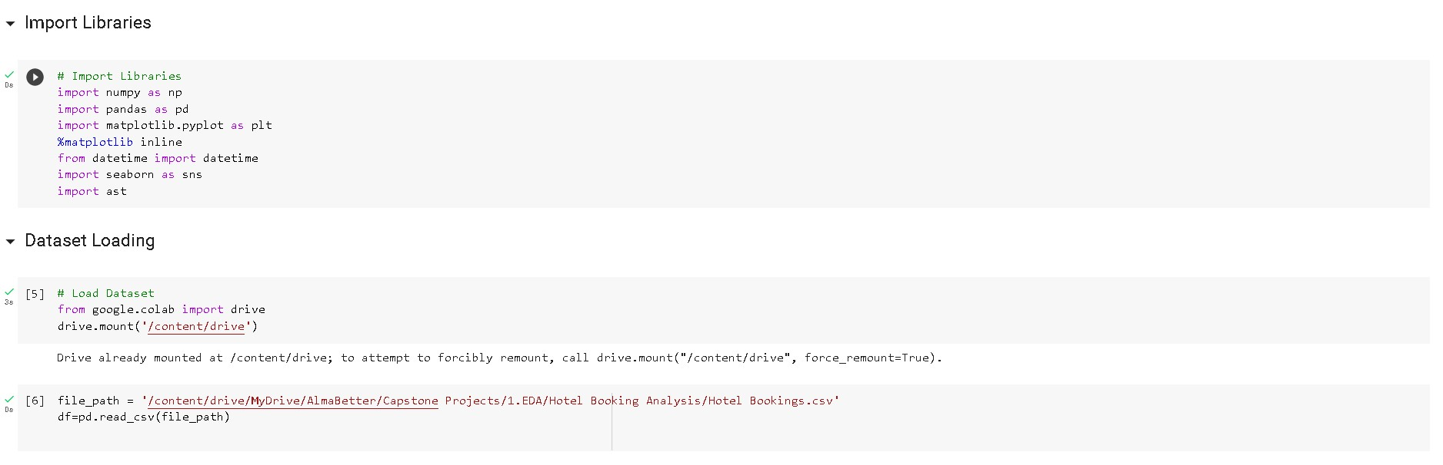
Import Libraries And Dataset Loading(Data Collection)
Here we import libraries what we need for the analysis and load the data from the drive.

Slide 7
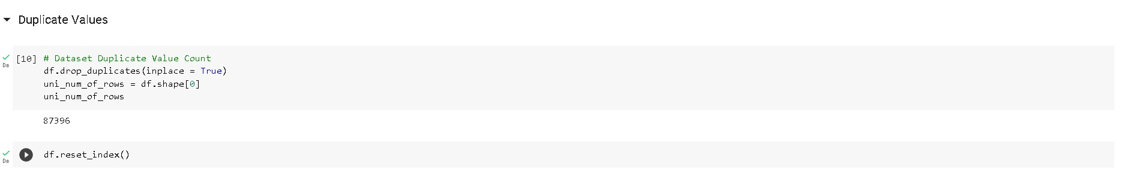
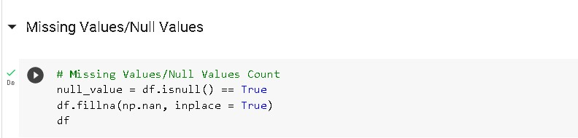
Data Cleaning and Manipulations
Here we check the duplicate values
Here we check the null values

Slide 8
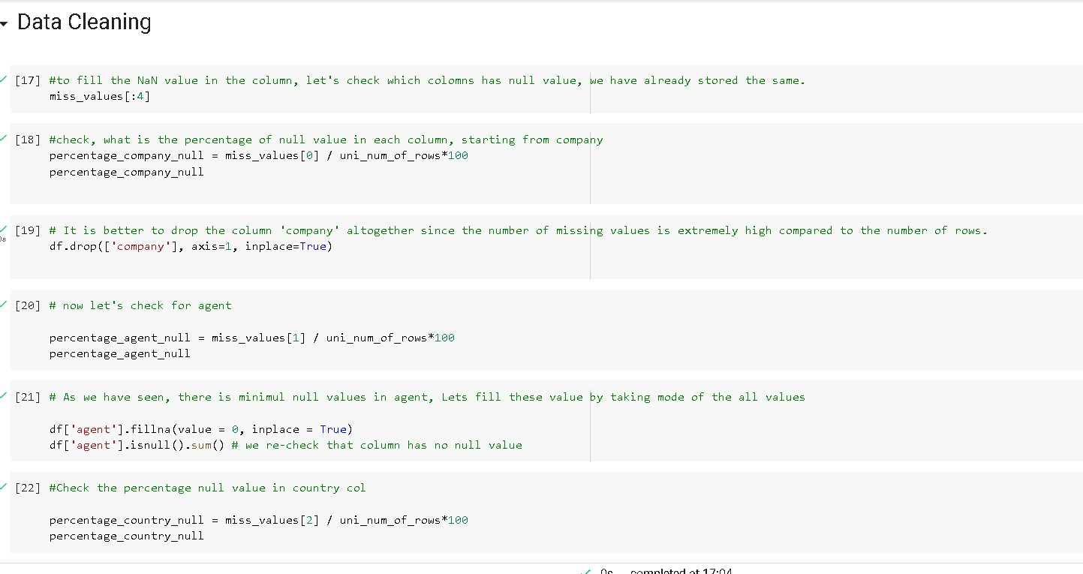
Data Wrangling Data Cleaning and Manipulations
Here we done a lot of operations on hotel booking analysis, Like what percentage of the null values and for the specific columns

Slide 9
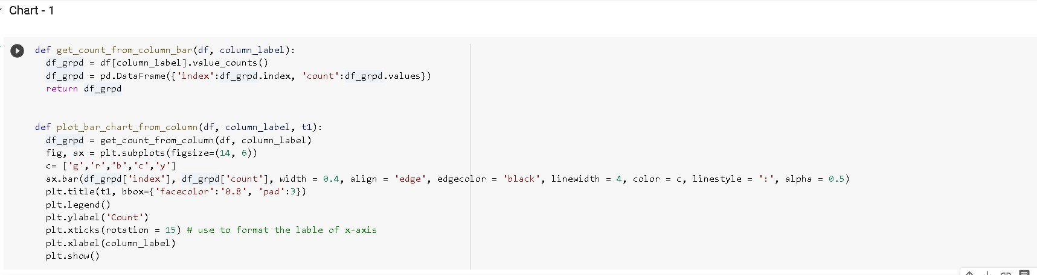
Data Vizualization, Storytelling & Experimenting with charts
CHART-1:
Here we write the code for the 1st chart and plot the graph as well as we want

Slide 10
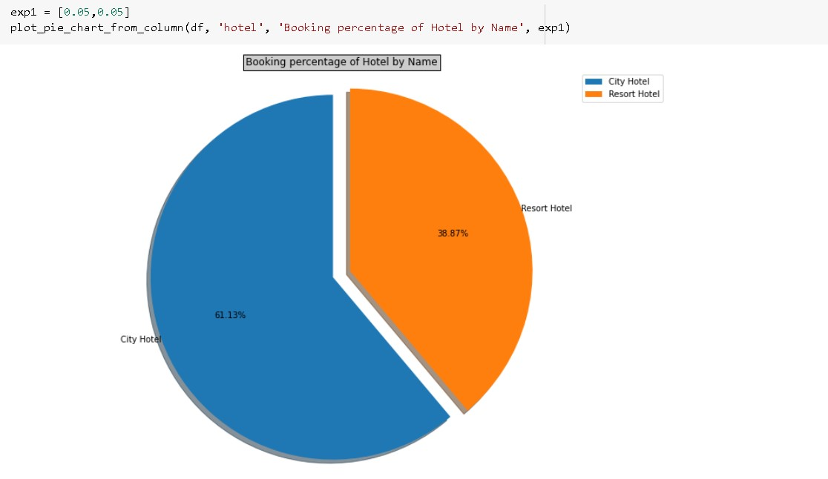
Data Vizualization, Storytelling & Experimenting with charts
Chart-1: Booking Percentage of Hotel by Name
Here, we found that the booking number is Higher in City Hotel which is 61.12% than Resort Hotel which is 38.87%. Hence we can say that City hotel has more consumption.
To present the data that in which hotel more booking have been done.
Yes, for both Hotels, this data making some positive business impact : -
City Hotel :- Provided more services to attract more guest to increase more revenue.
Resort Hotel :- Find solution to attract guest and find what city hotel did to attract guest

Slide 11
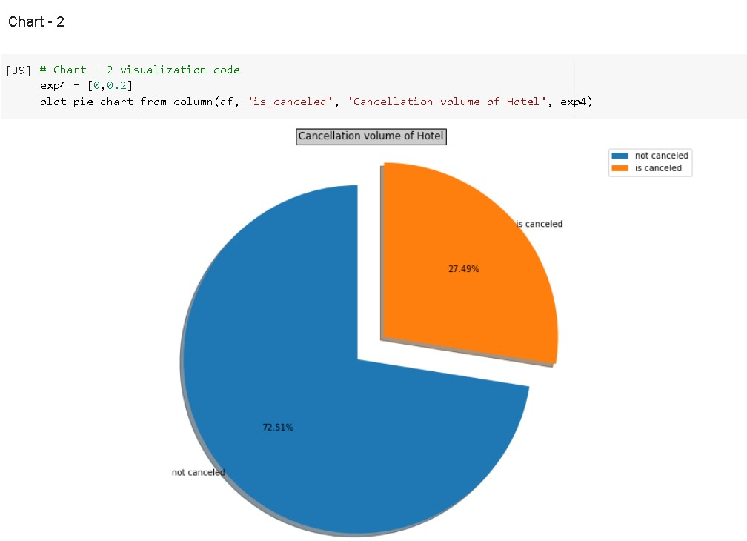
Data Vizualization, Storytelling & Experimenting with charts
Chart-2: Cancellation Volume of Hotel
In this chart, we presented the cancellation rate of the hotels booking
Here, we found that overall more than 25% of booking got cancelled
Here, we can see, that more than 27% booking getting cancelled.
Solution: We can check the reason of cancellation of a booking & need to get this sort on business level

Slide 12
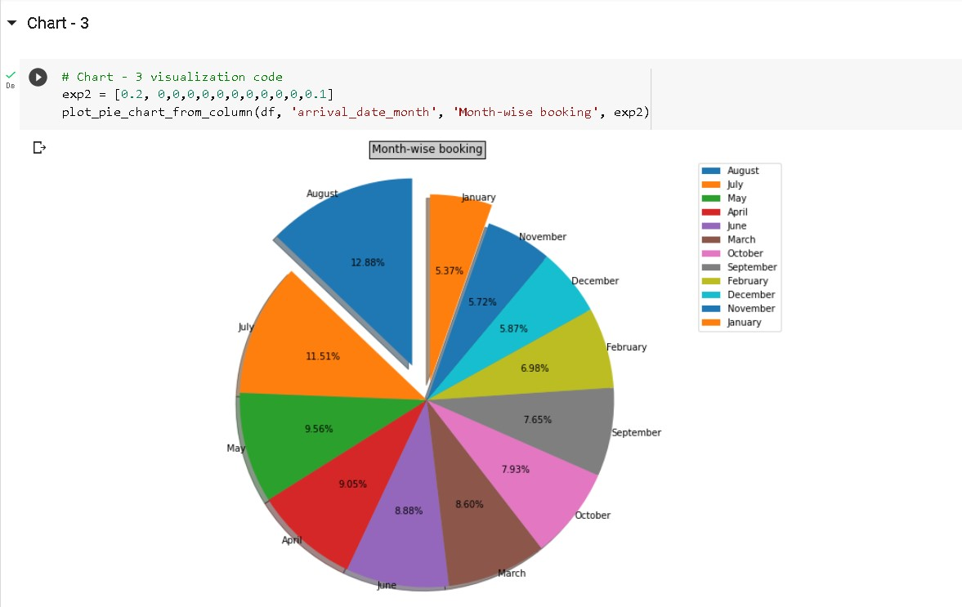
Data Vizualization, Storytelling & Experimenting with charts
Chart-3: Month-wise Booking
To show the percentage share of booking in each month,on overall level
The above percentage shows month May, July and Aug are the highest booking months due to holiday season. Recommending aggressive advertisement to lure more and more customers.
The increased volume of visitors will help hotel to manage revenue in down time, will also help employee satisfaction and retention.

Slide 13
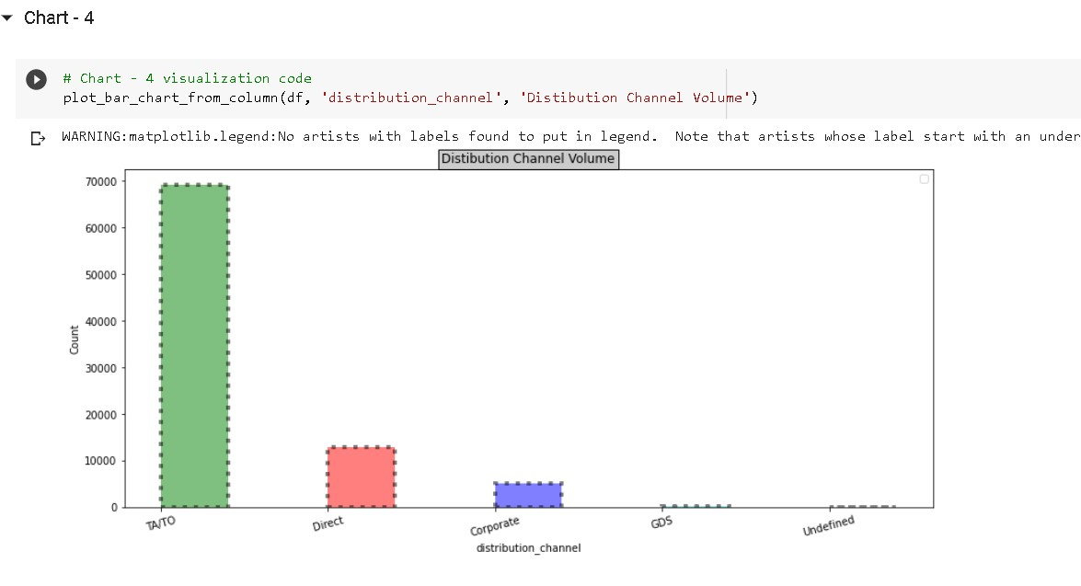
Data Vizualization, Storytelling & Experimenting with charts
Chart-4: Distribution channel Volume
The following chart represent maximum volume of booking done through which channel to represnt the numbers in descending order we chose bar graph.
As clearly seen TA/TO(Tour of Agent & Tour of operator) is highest, recommending to continue booking through TA/TO.
this shows positive business impact.
Higher the number of TA/TO will help to
increase the revenue generation of Hotel.

Slide 14
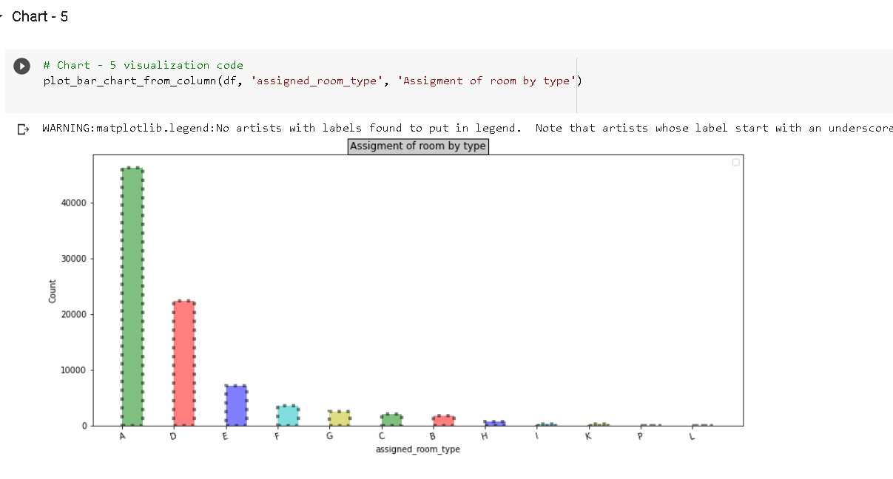
Data Vizualization, Storytelling & Experimenting with charts
Chart-5: Assigment of room by type
To show distribution by volume, which room is alotted.
This chart shows room type 'A' is most prefered by guest.
In thisPositive impact because 'A','D','E' is more prefered by guest due to better services offered in room type.

Slide 15
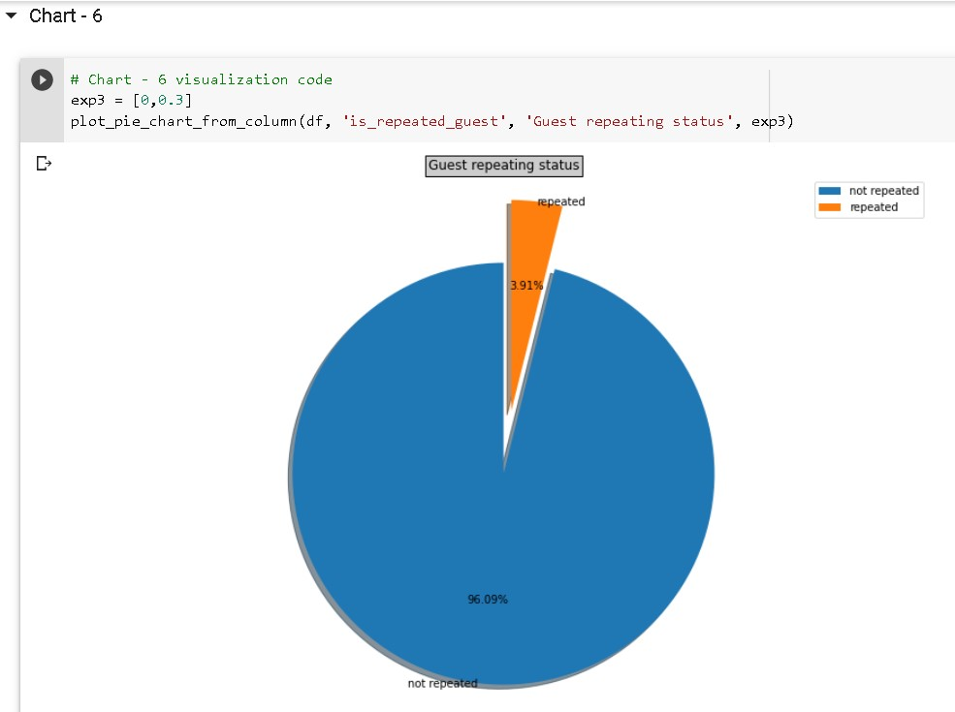
Data Vizualization, Storytelling & Experimenting with charts
Chart-6:
To show the percentage share of repeated & non-repeated guests.
Here, we can see that the number of repeated guests is very less as compared to overall guests.
We can give alluring offers to non-repetitive customers during Off seasons to enhance revenue

Slide 16
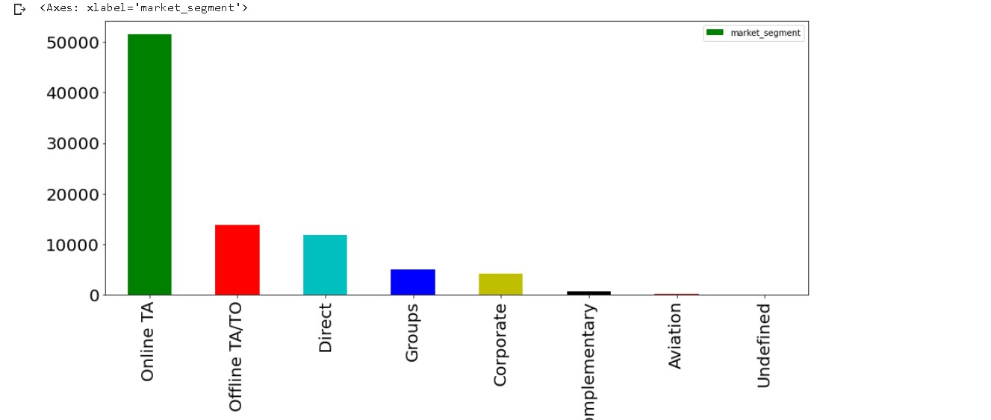
Data Vizualization, Storytelling & Experimenting with charts
Chart-7:
In this chart, we have seen market segment by which hotel has booked.
Online TA has been used most frequently to book hotel by the guest.
Yes, it is creating positive business impact that guests are using Online TA market segment as most prefered to book hotels.

Slide 17
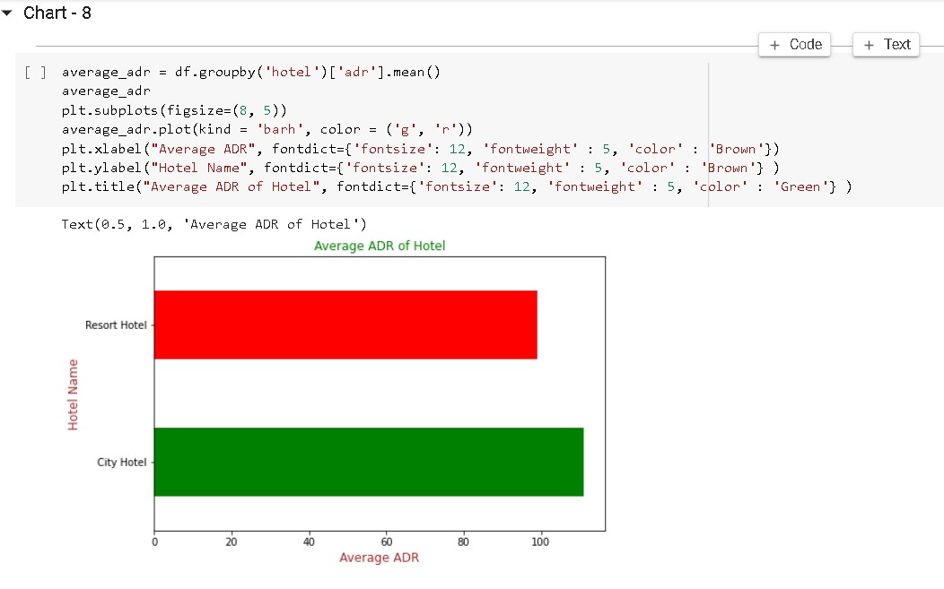
Data Vizualization, Storytelling & Experimenting with charts
Chart-8:
To specify the average ADR for both hotels.
As we can see the average ADR of City hotel is higher than Resort hotel, so the profit and revenue will be higher for city hotel.
Here, we can do more advertising for City hotel to get more customer, which result higher profit

Slide 18
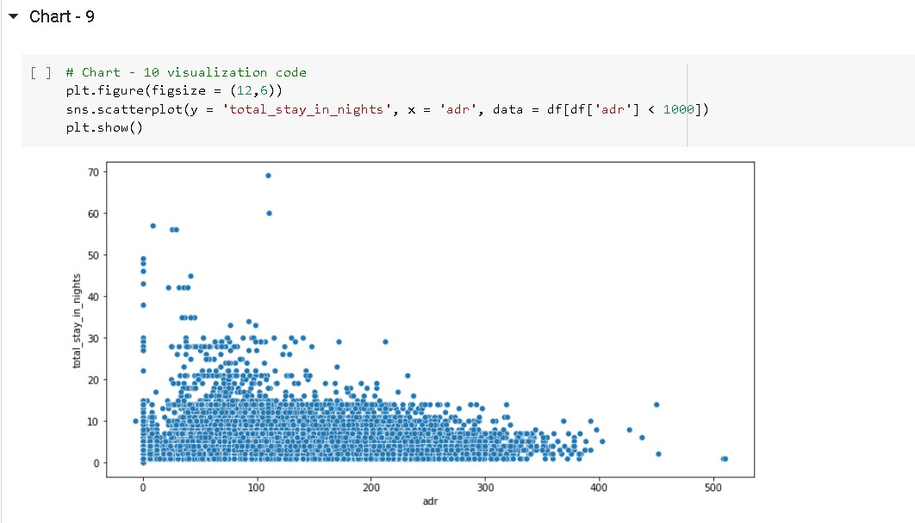
Data Vizualization, Storytelling & Experimenting with charts
Chart-9:
To show comparision & affect of total stay days vs ADR.
Here, we found that if guest's stay days is getting decreased, ADR is getting high.

Slide 19
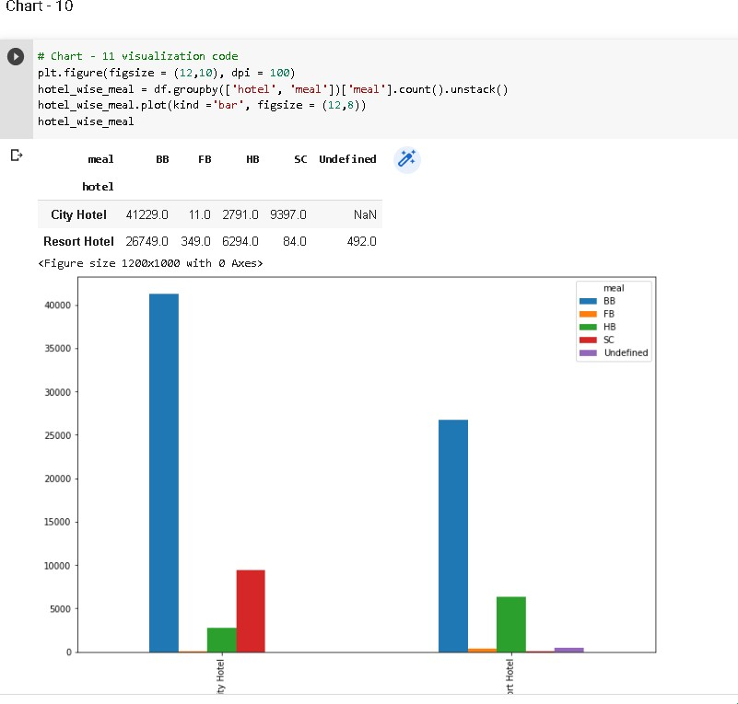
Data Vizualization, Storytelling & Experimenting with charts
Chart-10:

Slide 20
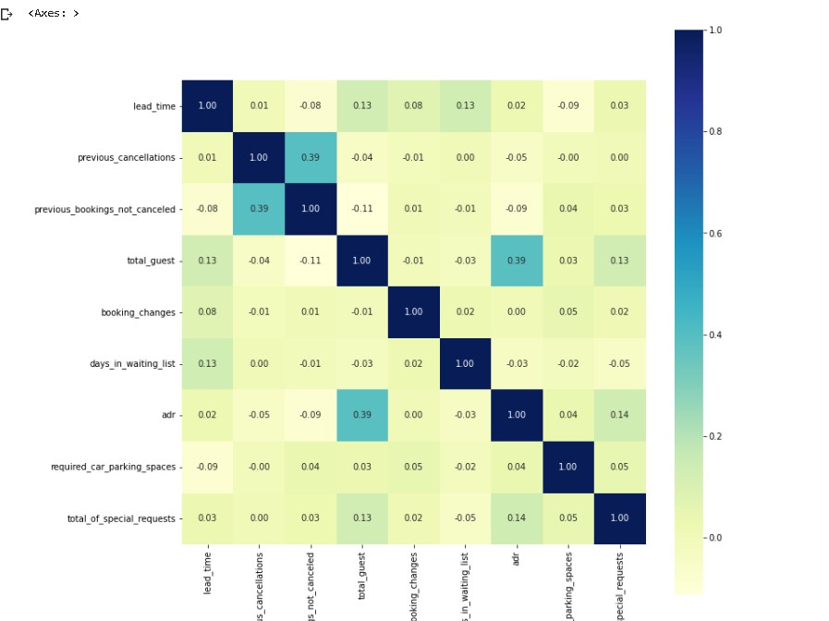
Data Vizualization, Storytelling & Experimenting with charts
Chart-11:
To understand the relationsip between different numerical values.
Highest corelation value between axis is 39% positive & lowest corelation value between the axis is -9% negative.

Slide 21
Solution to Business Objective
1. For hotel business to flourish few things which we need to consider is high revenue generation, customers satisfaction and employeee retention.
2. We where also able to co relate the values showing the max and min percentage between them so that the percenytage lying those numbers can be enhanced by various medium
3. We are able to show the trend of arrivals of visitor at client locations through which client engaged visitos well advance for there entaertainment and leisure activities
4. Outliers like higher the visitor then adr has reduced drastically was shown in scattered plot so in off season client can engage with offices for bulk booking this will aslo help extra revenue generation
5. We are able achieve the same by showing the client which are the months which are high in revenue generation by pie chart distribution
6. Increasing the revenue achieved by bar chart distribution of which typre room are most reserved and what are the months likely for visitors
7. So for these the client can be well prepare in advance so that minimum grievances would be faced by clients in long run and would help in further enhancement of their hospitality.

Slide 22
Conclusion
1. City Hotel seems to be more preferred among travellers and it also generates more revenue & profit.
2. Most number of bookings are made in July and August as compared rest of the months.
3. Room Type A is the most preferred room type among travellers.
4. Most number of bookings are made from Portugal & Great Britain.
5. Most of the guest stays for 1-4 days in the hotels.
6. City Hotel retains more number of guests.
7. Around one-fourth of the total bookings gets cancelled. More cancellations are from City Hotel.
8. New guest tends to cancel bookings more than repeated customers.
9. Lead time, number of days in waiting list or assignation of reserved room to customer does not affect cancellation of bookings.
10. Corporate has the most percentage of repeated guests while TA/TO has the least whereas in the case of cancelled
bookings TA/TO has the most percentage while Corporate has the least.
11. The length of the stay decreases as ADR increases probably to reduce the cost.

Slide 23


