Slide 1
Amazon Product Graph Study
Wilfried, Tobias
18. Juni, 2019

Slide 2

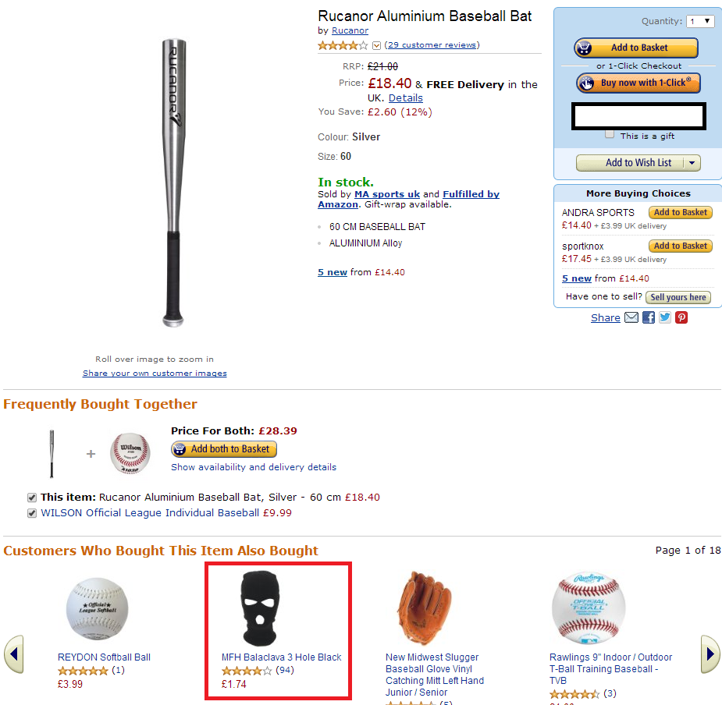
Amazon product co-purchasing network metadata
Dataset information
Dataset from SNAP (Stanford Network Analysis Project) https://snap.stanford.edu/data/amazon-meta.html
Data collected by crawling Amazon website, status summer 2006
Contains information about co-purchases «similar products»
Interlinked product network
Columns include
Title
Group
Salesrank
List of similar products
Detailed product categorisation
Product reviews: time, customer, rating, …
Most pressing question: How many steps from a banana slicer to an e-bike?
https://www.reddit.com/r/funny/comments/22f33p/customers_also_bought/

Slide 3
Data pre-processing
Original data set
548’552 products
1’788’725 edges (pointer to similar products)
Size: ~1GB txt file
Product groups:
Not so easy to handle, so we reduced it to 10611 products and 52158 edges
Book
Music
DVD
Software
Video (VHS!)
Toy
Sports
Baby Products
Video Games
What!? No kitchen utensils? Nevermind, let’s stick with it anyway…
…
Id: 1
ASIN: 0827229534
title: Patterns of Preaching: A Sermon Sampler
group: Book
salesrank: 396585
similar: 5 0804215715 156101074X 0687023955 0687074231 082721619X
categories: 2
|Books[283155]|Subjects[1000]|Religion & Spirituality[22]|Christianity[12290]|Clergy[12360]|Preaching[12368]
|Books[283155]|Subjects[1000]|Religion & Spirituality[22]|Christianity[12290]|Clergy[12360]|Sermons[12370]
reviews: total: 2 downloaded: 2 avg rating: 5
2000-7-28 cutomer: A2JW67OY8U6HHK rating: 5 votes: 10 helpful: 9
2003-12-14 cutomer: A2VE83MZF98ITY rating: 5 votes: 6 helpful: 5
…
…

Slide 4
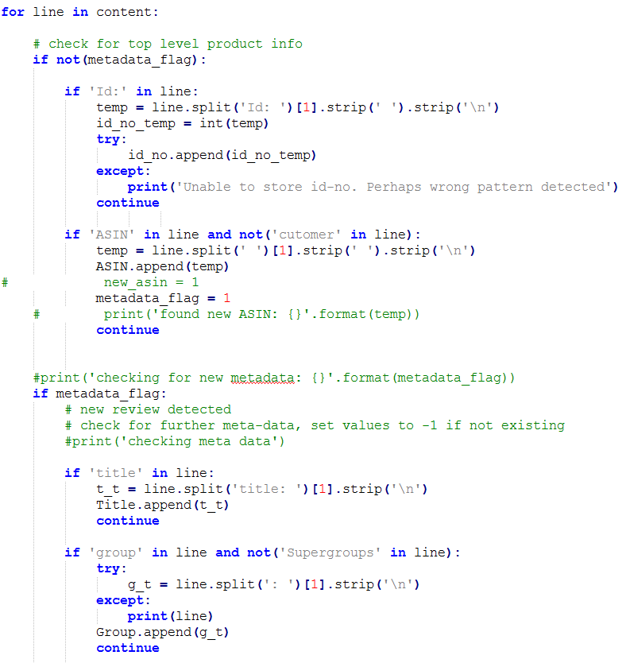
Data pre-processing
Data preparation by Python script
Parse file line by line and identify keywords (“ASIN”, “group”, “salesrank”, “similar”…)
Extract numbers or strings, fill Pands DataFrame, export to csv fil
Filter data by salesrank < 5000
Results in 10611 products!
Salesrank is not unique [1,2,6,7,…,17,17,17,19,20,21,21,21,…]
From
To: product data
…
Id: 1
ASIN: 0827229534
title: Patterns of Preaching: A Sermon Sampler
group: Book
salesrank: 396585
similar: 5 0804215715 156101074X 0687023955 0687074231 082721619X
categories: 2
|Books[283155]|Subjects[1000]|Religion & Spirituality[22]|Christianity[12290]|Clergy[12360]
|Books[283155]|Subjects[1000]|Religion & Spirituality[22]|Christianity[12290]|Clergy[12360]
reviews: total: 2 downloaded: 2 avg rating: 5
2000-7-28 cutomer: A2JW67OY8U6HHK rating: 5 votes: 10 helpful: 9
2003-12-14 cutomer: A2VE83MZF98ITY rating: 5 votes: 6 helpful: 5
…
…
Id; ASIN; Group; Salesrank; Reviews; avg rating; Title
21; 0790747324; DVD; 795; 140; 4.5; The Time Machine
84; B000063W82; Video; 780; 14; 4.5; The Best of Schoolhouse Rock!
252; B0000262WI; Music; 581; 82; 4.5; The Köln Concert
254; 6301967917; Video; 4828; 20; 4.0; Electra Glide in Blue
296; 0385504209; Book; 19; 3049; 3.5; The Da Vinci Code
And: links
src dest
0790747324 B00007JMD8
0790747324 6305350221
0790747324 B00004RF9B
0790747324 B00005JKFR
0790747324 B00005NG6A

Slide 5
Amazon product graph analysis
Questions we want to answer
Get general understanding of dataset
Correlation between inDegrees and salesrank, number of reviews, avg rating,…
Does reference to similar products influence salesrank?
Products with balanced similarity, i.e. product-pairs references
Analysis of strongly connected components

Slide 6
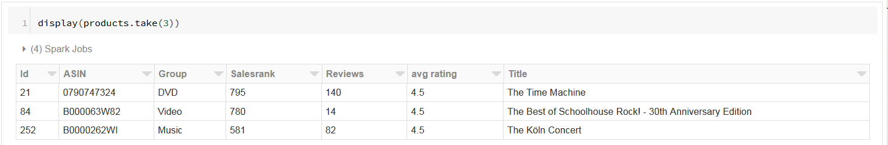
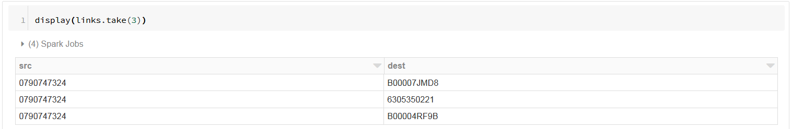
Amazon product graph analysis
General steps to set-up the graph
Create tables, read data, rename columns, cast strings to int, …
Quick check whether data are imported correctly
Build graph based on “products” and “links”

Slide 7
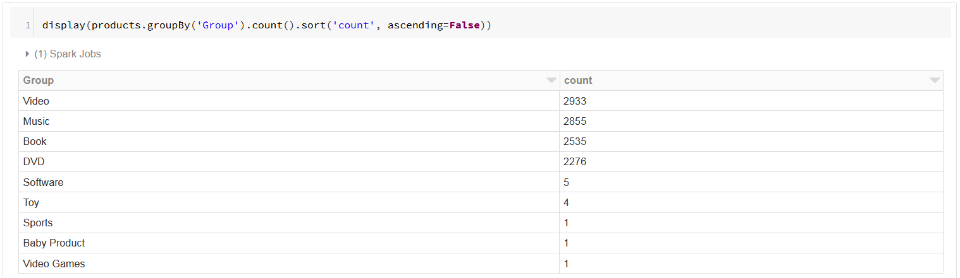
Amazon product graph analysis
Explorative data analysis

Slide 8
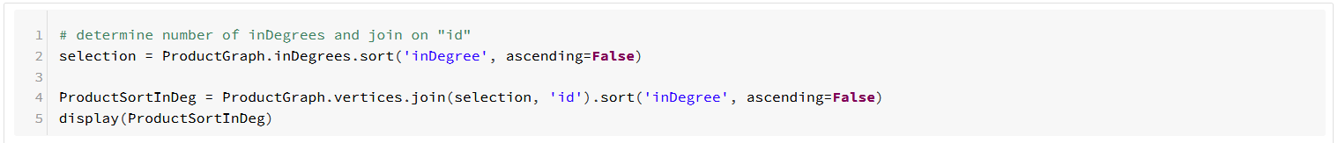
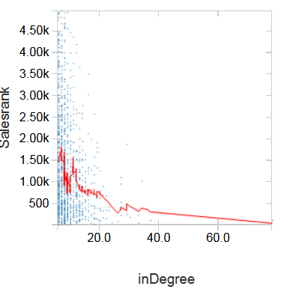
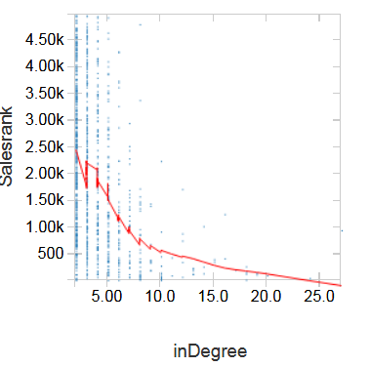
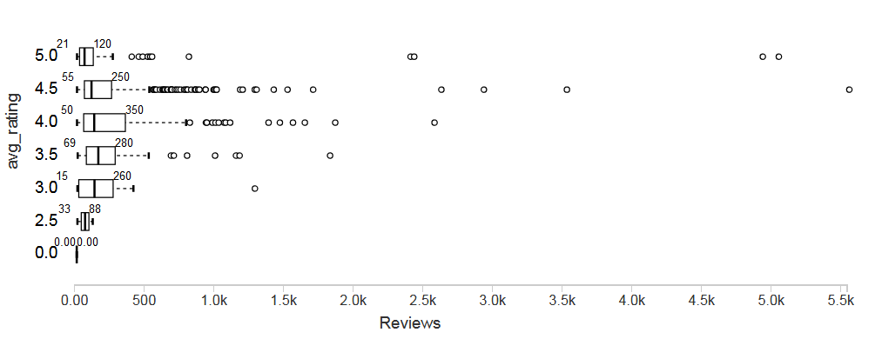
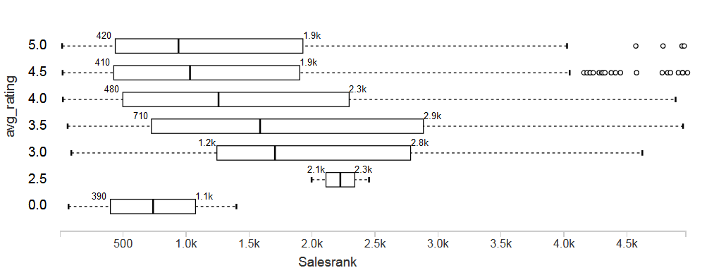
Amazon product graph analysis
Correlation between inDegrees and other features
only books
There seems to be a weak correlation between number of inDegrees and the salesrank --> recommender systems

Slide 9
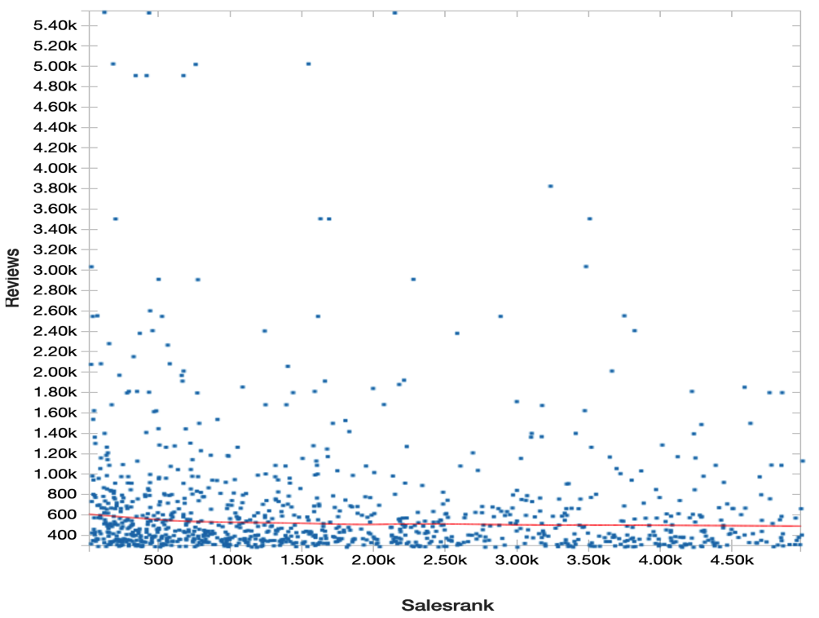
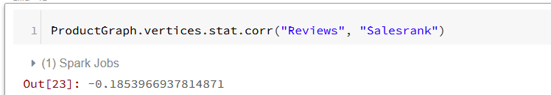
Further statistics about the data:
reminder: 10611 products
97.5% of the products have 5 outDegrees, the rest have 1 – 4 outDegrees
Almost no correlation between # reviews and salesrank (Pearson: - 0.19)
Number of products that reference each other is 5601, 5400 belong to the same product group

Slide 10

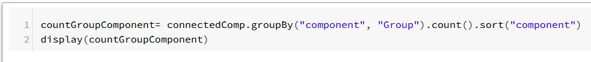
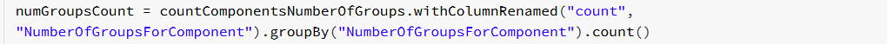
Number of components with n groups within them:
6751 strongly connected components all in all
“peculiar” size distribution:
Only 352 components have more than 4 members
Number of groups within one component | Number of such components
4 | 1
3 | 6
2 | 77
1 | 6667
Component identifier | # Members of component
A | 988
B | 29
C | 25
D | 21
… | …

