Slide 1


Augmentation eines kognitiven Trainings mit transkranieller Gleichstromstimulation (tDCS)
Tobias Schwippel
DGPPN 2024

Slide 2
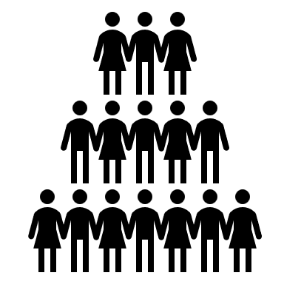





Cognition in Schizophrenia
500.000 individuals &
98% have lower cognitive performance than expected¹
Performance impairment of ~1.5 STD²
~ 80% unemployment rate and early retirement rates³
Yearly societal cost of ~ 11-20k per individual⁴
No effective pharmacological treatment⁵
Reduced quality of life
Tobias Schwippel
1. Keefe et al. 2005; 2. Keefe et al. 2011; 3. Marwaha et al. 2018; 4. Frey 2014; 5. McCutcheon et al. 2023
DGPPN 2024

Slide 3
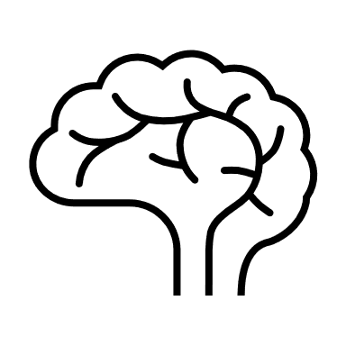
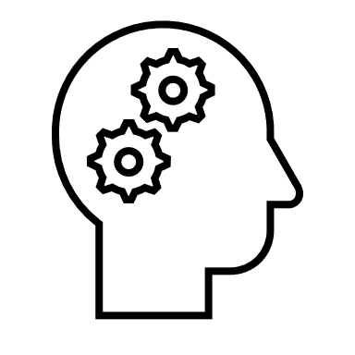



Schizophrenia – A Multiscale Disorder
Brain
Cognition
Behavior
Prefrontal Dysfunction
Grey matter volume ↓
Glutamate / Dopamine ↓
Excitability / Neuroplasticity / Connectivity ↓
Global Cognitive Impairment
Non-social cognition ↓ (WM, PS, Attention, EF, Memory)
Social cognition↓
Vertical Transfer
Daily Life
Working in a job↓
Maintain social relationships↓
Follow your dreams ↓
Horizontal Transfer
Tobias Schwippel
DGPPN 2024

Slide 4



Cognitive Training
Brain
Cognition
Behavior
Network Reorganization
Cognitive Training
Guercio et al. 2019
Vertical Transfer
Relevant Reintegration
Horizontal transfer between cognitive domains (near transfer)
Vita et al. 2021 (n = 8851): CRT: cognition d = 0.29 and functioning d =0.22
Kambeitz-Ilankovic et al. 2019 (n = 4067), computerized CRT: cognition g = 0.28, functioning g = 0.16, → better with “human guidance”
Tobias Schwippel
DGPPN 2024

Slide 5
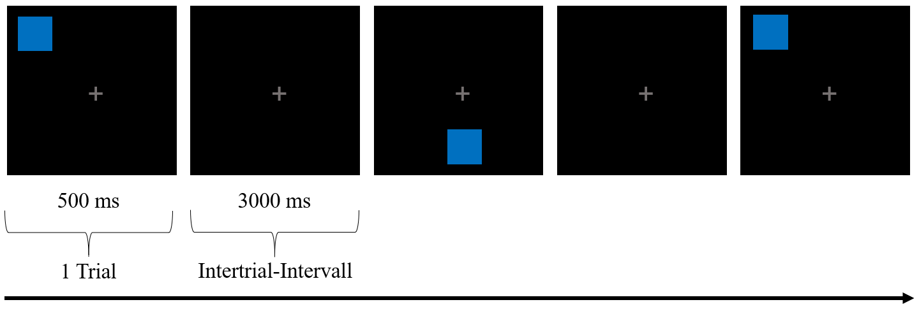

Adaptive Spatial n-back Training
Brain
Cognition
Behavior
2-back
Primary Outcome Parameters
Response Time
Mean n-back level (difficulty/capacity)
Adaptive n-back: Individualization of Task
Ensure best learning and avoid ceiling effects
Ensure cortical activation of target network
Tobias Schwippel
DGPPN 2024

Slide 6
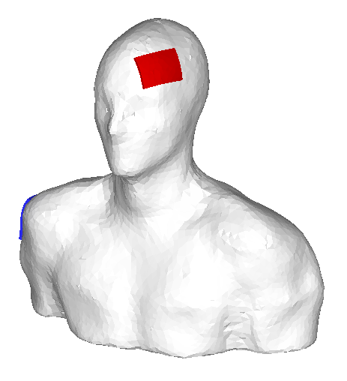
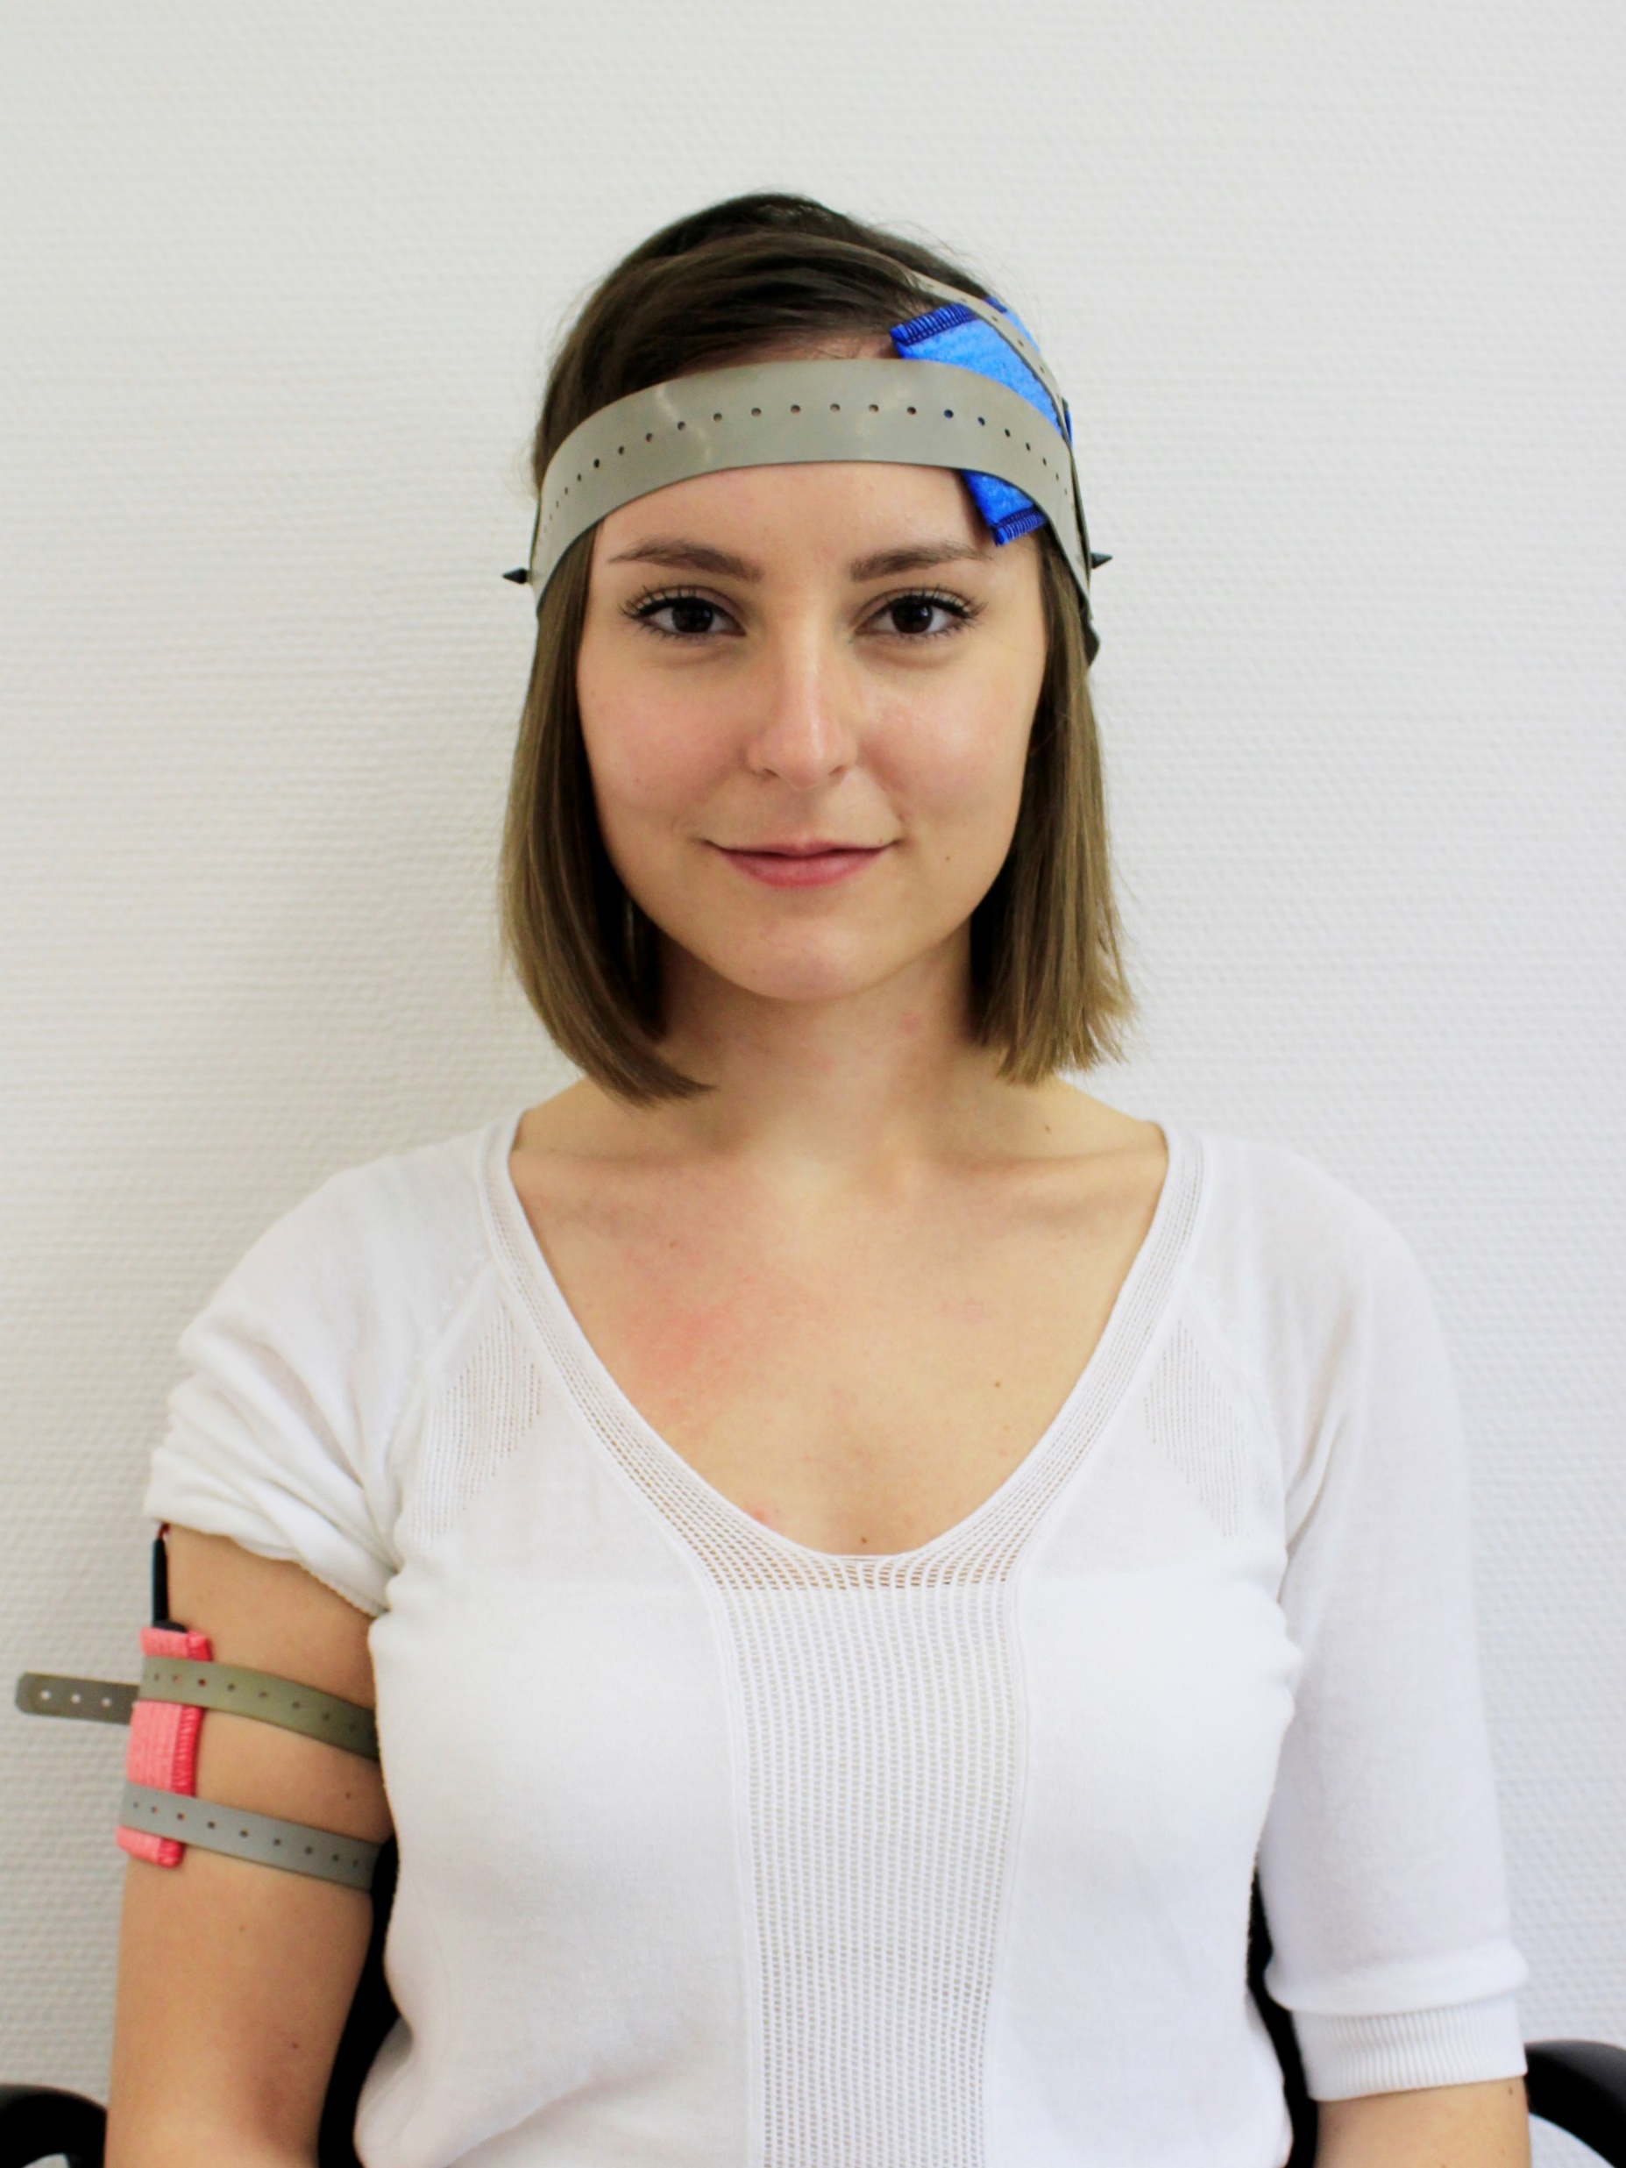
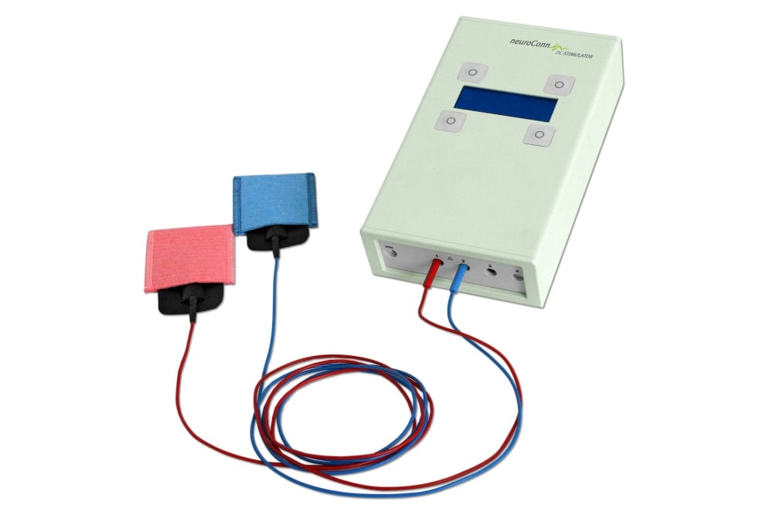
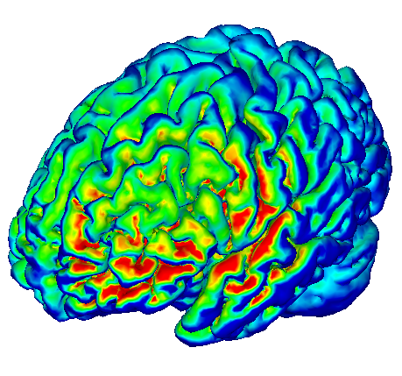
Transcranial Direct Current Stimulation (tDCS)
Brain
Cognition
Behavior
E (V/m)
0 0.15
Pros
Cost & Accessibility
Safety
Combination
Cons
Low spatial & temporal targeting
Weak current
It is current
Tobias Schwippel
DGPPN 2024

Slide 7
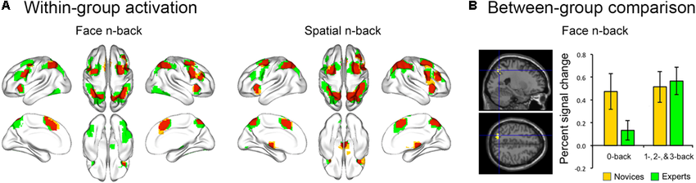
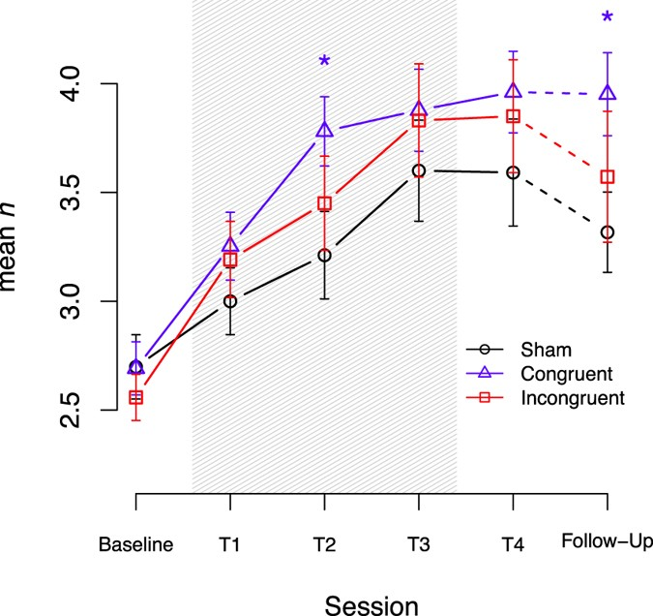
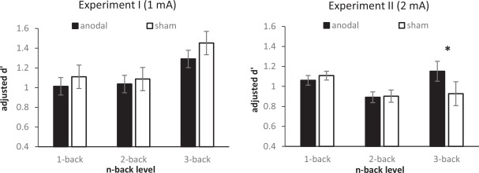


Combination
Brain
Cognition
Behavior
Synergy through
state-dependent stimulation
Determine the right target in HC (Laterality Test)
Stimulation Intensity in SZ (Spatial WM + right DLPFC tDCS)
Jung et al. 2018
Schwippel et al. 2018
Ruf et al. 2017
Left DLPFC | Right DLPFC
Verbal WM | Spatial WM
Tobias Schwippel
DGPPN 2024

Slide 8
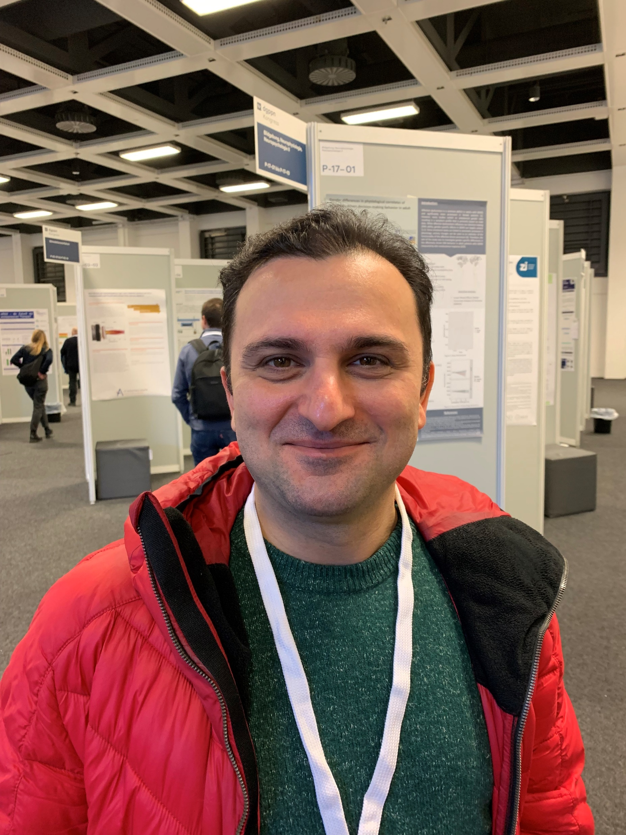
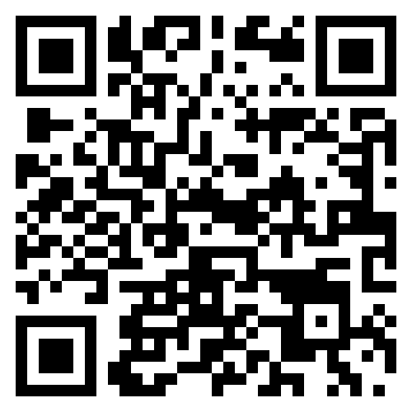
Study Design
Ibrahim Hajiyev
Online Effects / Learning
Offline & Transfer Effects
Trial registration
Tobias Schwippel
Schwippel et al. under review
DGPPN 2024

Slide 9
Results

Slide 10
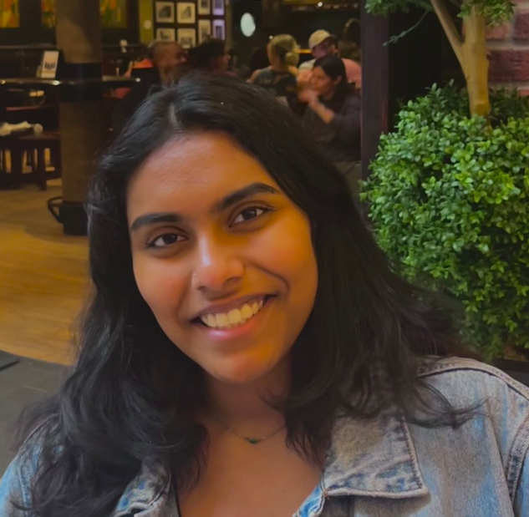
Online Effects
Sanvi Korsapathy
Both groups improve
tDCS reaches plateau faster
Individuals max out at mean n = 2.5 - 3
tDCS constantly faster
No improvement over time (learning)
Tobias Schwippel
* p < .05, # p ≤ .07
DGPPN 2024

Slide 11
Offline Effects
Tobias Schwippel
* p < .05, # p ≤ .07
DGPPN 2024

Slide 12
Cognitive Transfer
BACS Composite Score – Post Session:
tDCS group: + 7 points [t-score] → 10.5 IQ points
Sham group: + 3.2 points [t-score] → 4.7 IQ points
F(1, 24) = 3.997, p = .057, η²_{p} = 0.143
Tobias Schwippel
* p < .05, # p ≤ .07
DGPPN 2024

Slide 13
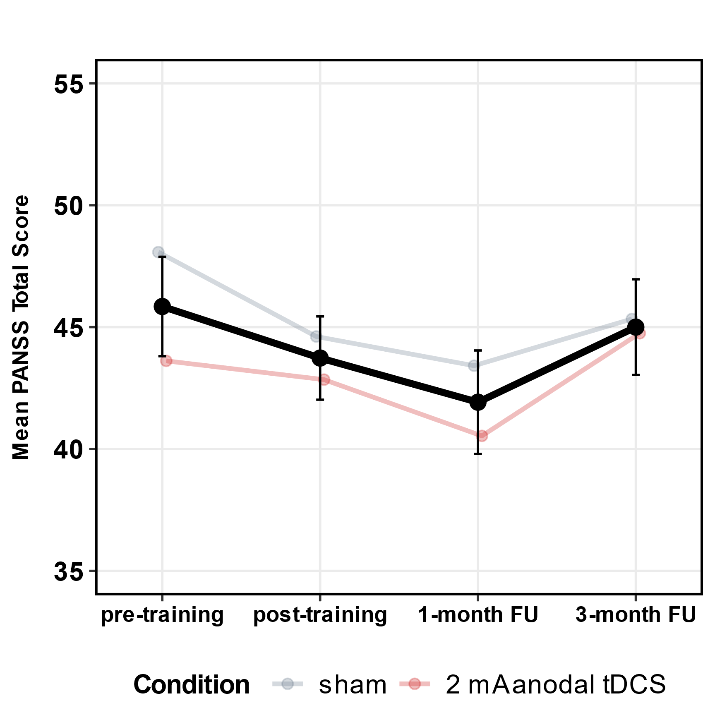
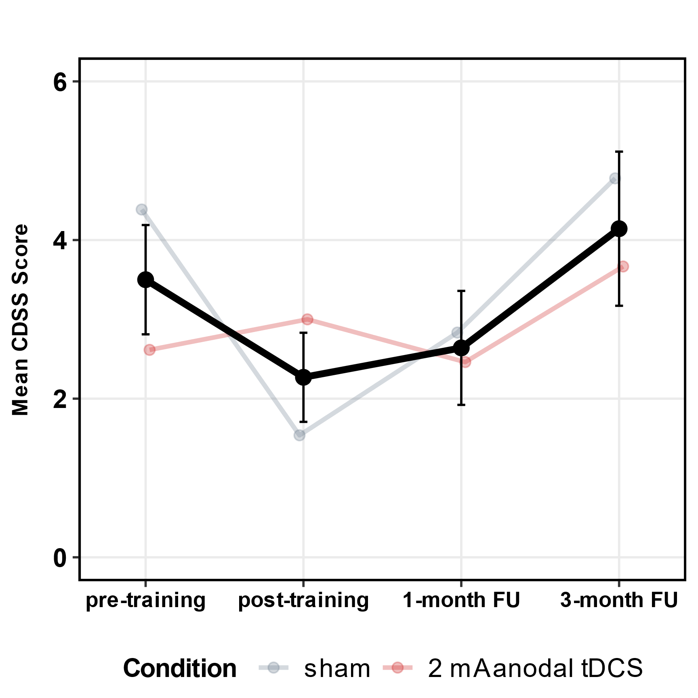
Clinical Transfer

Slide 14
Discussion

Slide 15
Summary Limitations
Blinding Effective
Feasible
Tolerable
Online Effects
Offline Effects
Near Transfer (Network)
Low sample size
More room for stim individualization
Real-life transfer not assessed
Brain network effects not reported
Conclusions
Enhancement: Yes, we can increase effect sizes for the trained task, potentially for (near) transfer!
Multi-Scale Effects: Strengthening the trained network through tDCS + cognitive training explains transfers.
Limits of Transfer: Specific cognitive improvements might not transfer to clinical symptoms, daily life or quality of life.
Tobias Schwippel
DGPPN 2024

Slide 16
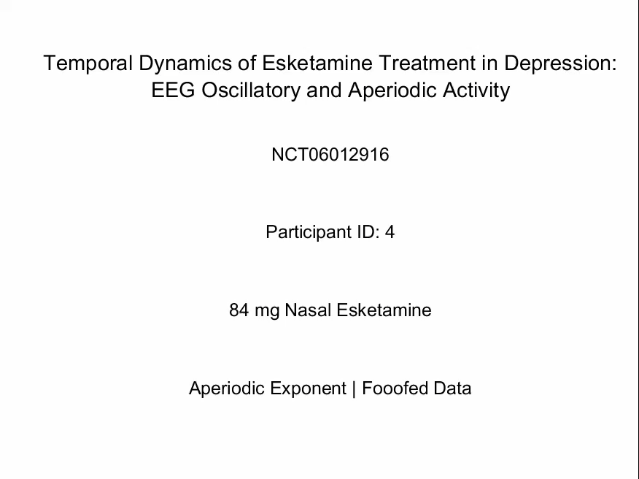
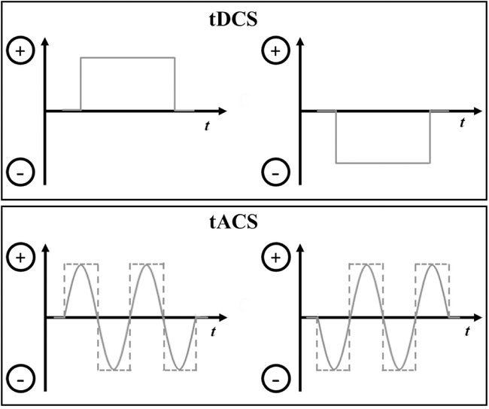
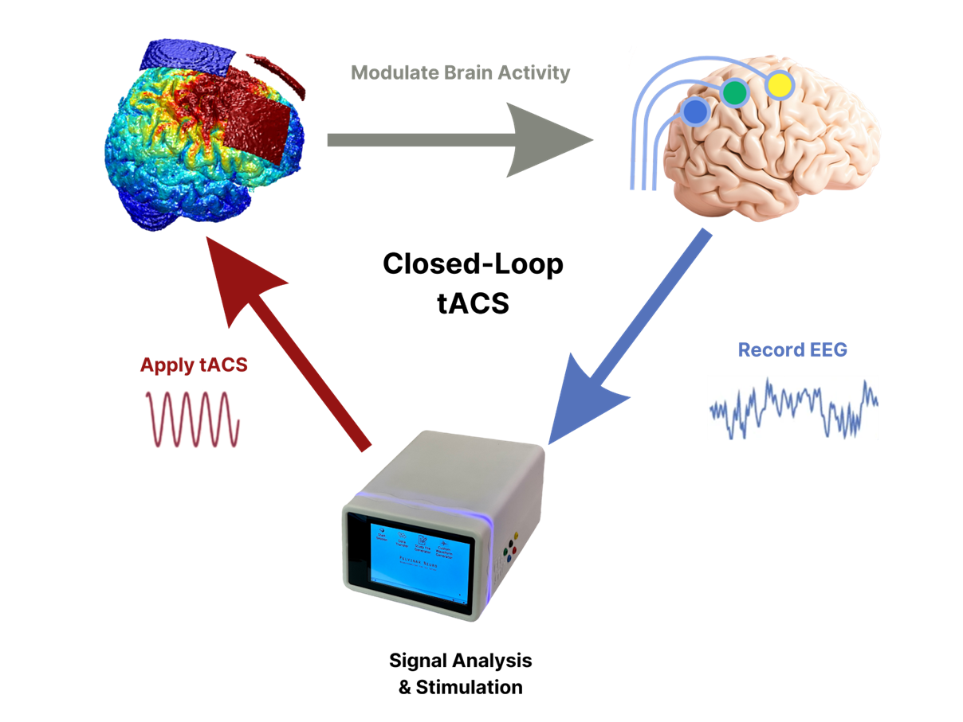
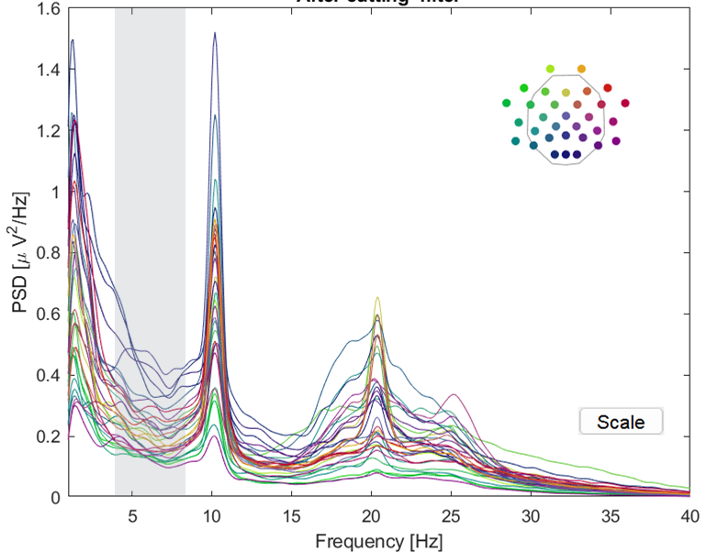
Improving Stimulation
State-dependent (closed-loop)
Modality
Individualization
Excitability
Connectivity
Cellini et al. 2018
Tobias Schwippel
DGPPN 2024

Slide 17
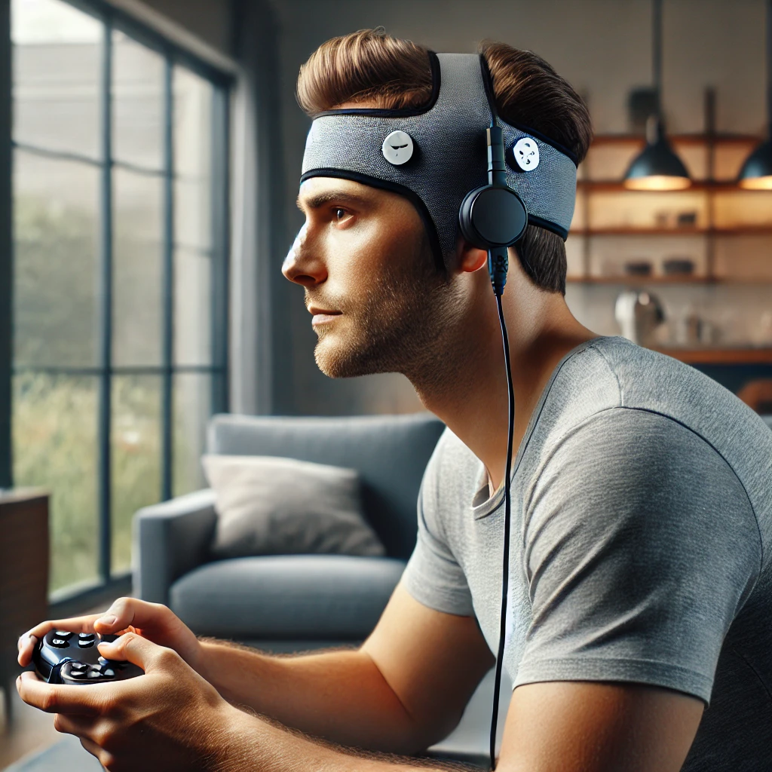
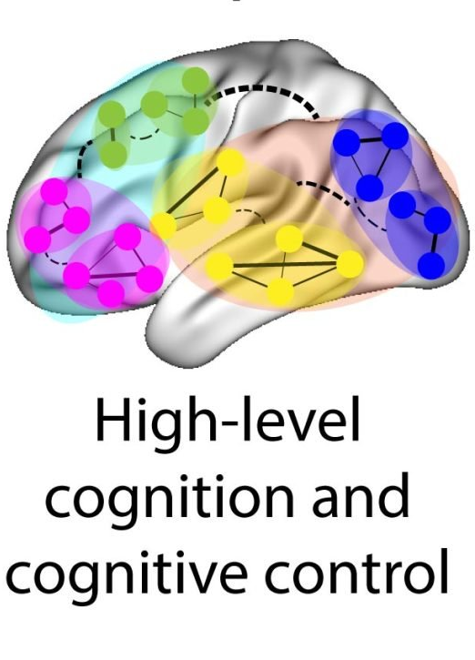
Improving Cognitive Training
Home-treatment
Gamification
Mix of Tasks
A perfect intervention will target all scales with a diverse set of individualized treatments.
Tobias Schwippel
ChatGPT; Tenor; Dribbble.com; Owen et al. 2021
DGPPN 2024

Slide 18

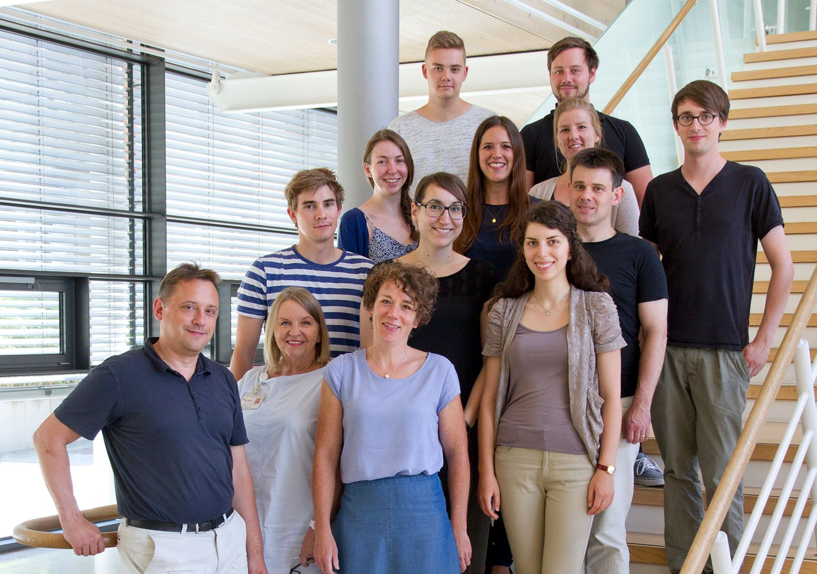


Teamwork makes the dream work
Tübingen
Christian Plewnia (PI)
Ibrahim Hajiyev
Simone Weller
Katharina Koppe
Düsseldorf
Daniel Kamp (PI)
Aylin Utlu
Chapel Hill
Flavio Frohlich (PI)
Sanvi Korsapathy
Jimin Park
Funding
This work was supported by the German Federal Ministry of Education and Research (ESPRIT/FKZ 01EE1407H).
Contact
Tobias Schwippel schwippel@gmail.com
Tobias Schwippel
DGPPN 2024

