Slide 1
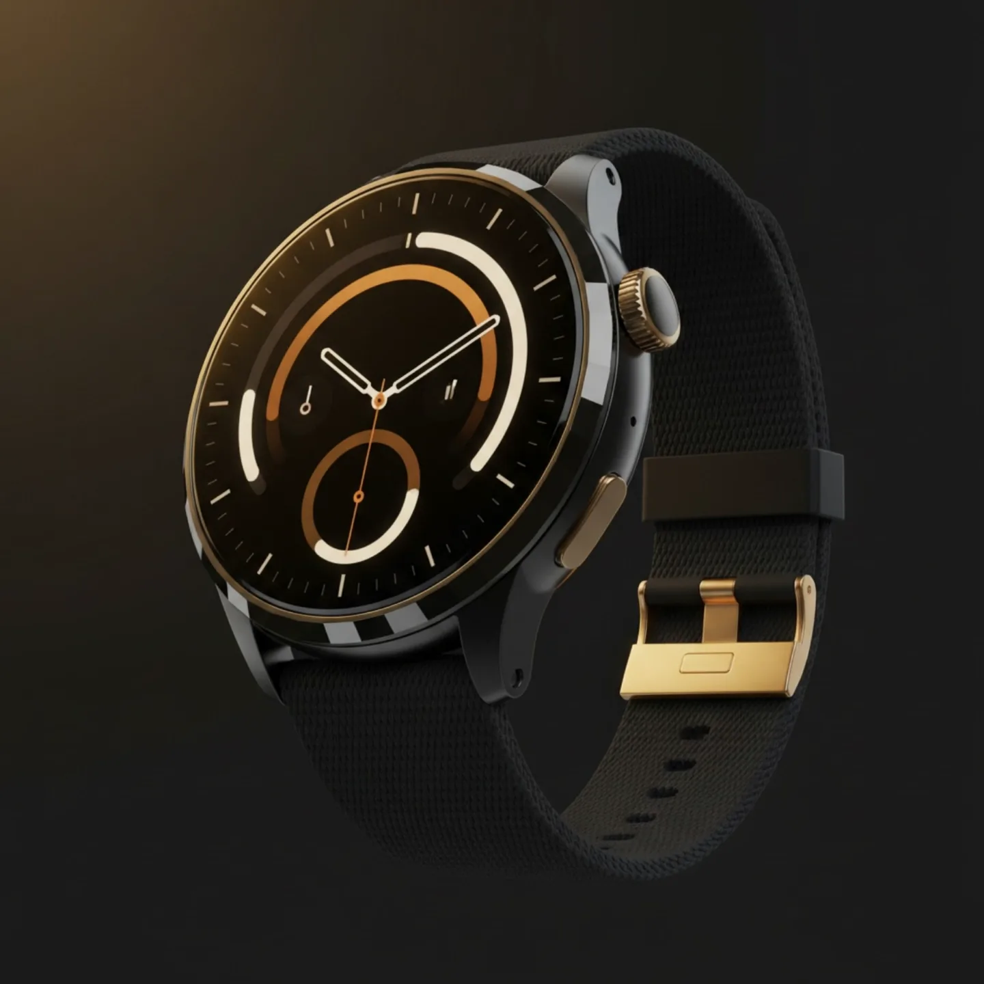
✓
TESTER.IO
PORTFOLIO — 2026
[ CASE STUDY ] PRODUCT MARKETING SITE
Tester Smart Watch Pro
A product site that wears like an instrument.
Tricia
wk1-day2.vercel.app ↗
WEB DEVELOPER
Notes:
Open here. This is a portfolio piece — a single-product marketing site for a fictional field-grade smartwatch. The story is the work, not the watch.

Slide 2
[ 01 ] THE BRIEF
TESTER SMART WATCH PRO
THE CHALLENGE
Make a single-product site feel like a premium hardware artifact — not a spec sheet.
A self-directed build. One product, one page, one idea — taken end to end: visual direction, narrative, hand-written front-end, motion, and a working contact pipeline behind it.
ROLE
BUILD
DEPLOY
Web Developer — sole build
Hand-written HTML / CSS / JS
Vercel — live in production
Notes:
The challenge: make a single-product site feel like a premium hardware artifact, not a spec sheet. Self-directed — one product, one page, one idea, executed end to end.

Slide 3
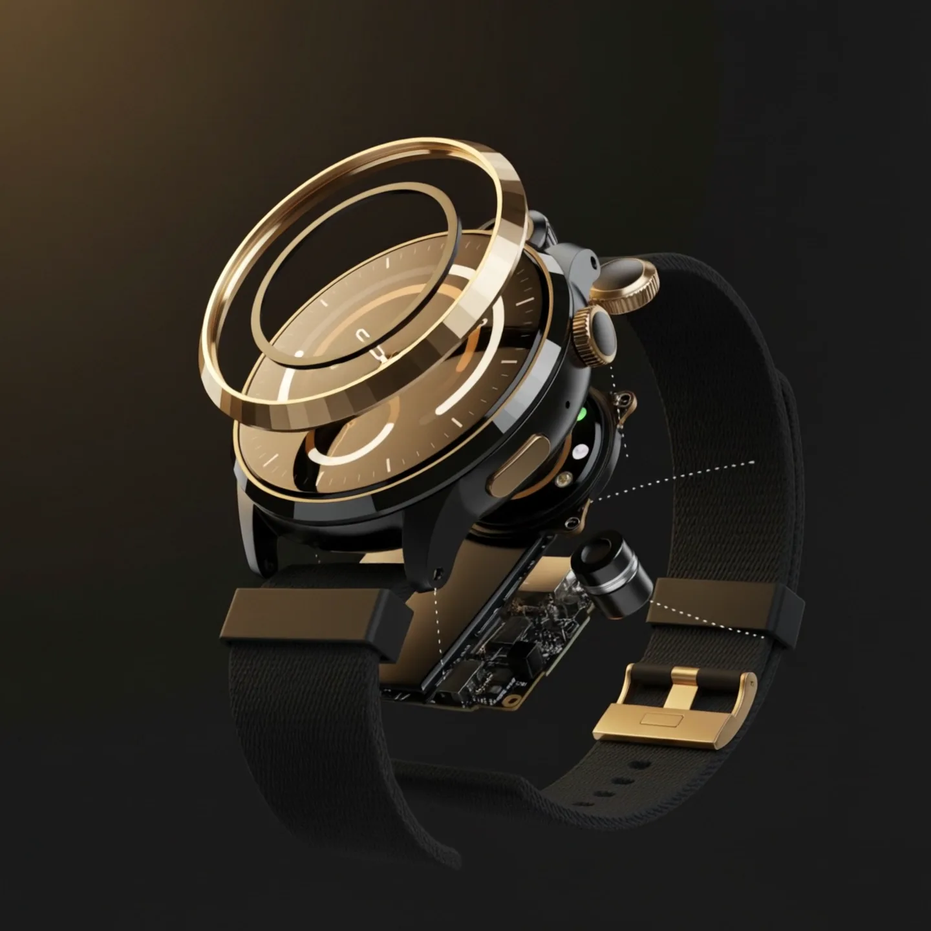
[ 02 ] THE CONCEPT
TESTER SMART WATCH PRO
THE CORE IDEA
Wear the instrument.
Not a gadget — a field-grade tool you wear. A single billet of brushed titanium, a sapphire sensor stack, fourteen days between charges. The site had to feel machined and tactile , the way the object would.
Notes:
The core idea — 'Wear the instrument.' A field-grade tool you wear: machined, tactile, engineering-led. That one line drove every design decision.

Slide 4
[ 03 ] THE VISUAL SYSTEM
TESTER SMART WATCH PRO
A system built to feel machined.
TYPE — THREE ROLES
PALETTE
GRID & NUMBERING
Aa
Titanium #0B0D10
Fraunces · display
Cream #EEF1F4
Aa
EDITION 01
Montserrat · UI / body
Sapphire #3D7EE0
SECTION 01 — HERO
01
Gold · detail #E6B979
Bracketed indices anchor every section — a quiet editorial spine.
JetBrains Mono · labels
Notes:
The system: titanium canvas, sapphire accent, gold reserved for tiny details. Three typefaces with strict roles, and the editorial Edition / Section numbering motif that runs through the whole site.

Slide 5
[ 04 ] THE OPENING
HERO & NARRATIVE
The first screen sets the tone.
Full-bleed video, the headline in serif, and a running spec ticker — the page opens like a product reveal, not a landing page.
Caliber T-12 / Apex
14-day endurance
200m / 20 ATM
Grade-5 titanium
Notes:
The hero. Video behind, the 'Wear the instrument' headline, and a spec ticker that establishes the watch as a real instrument: Caliber T-12, 14-day endurance, 200m, Grade-5 titanium. Drop the real hero screenshot here.

Slide 6
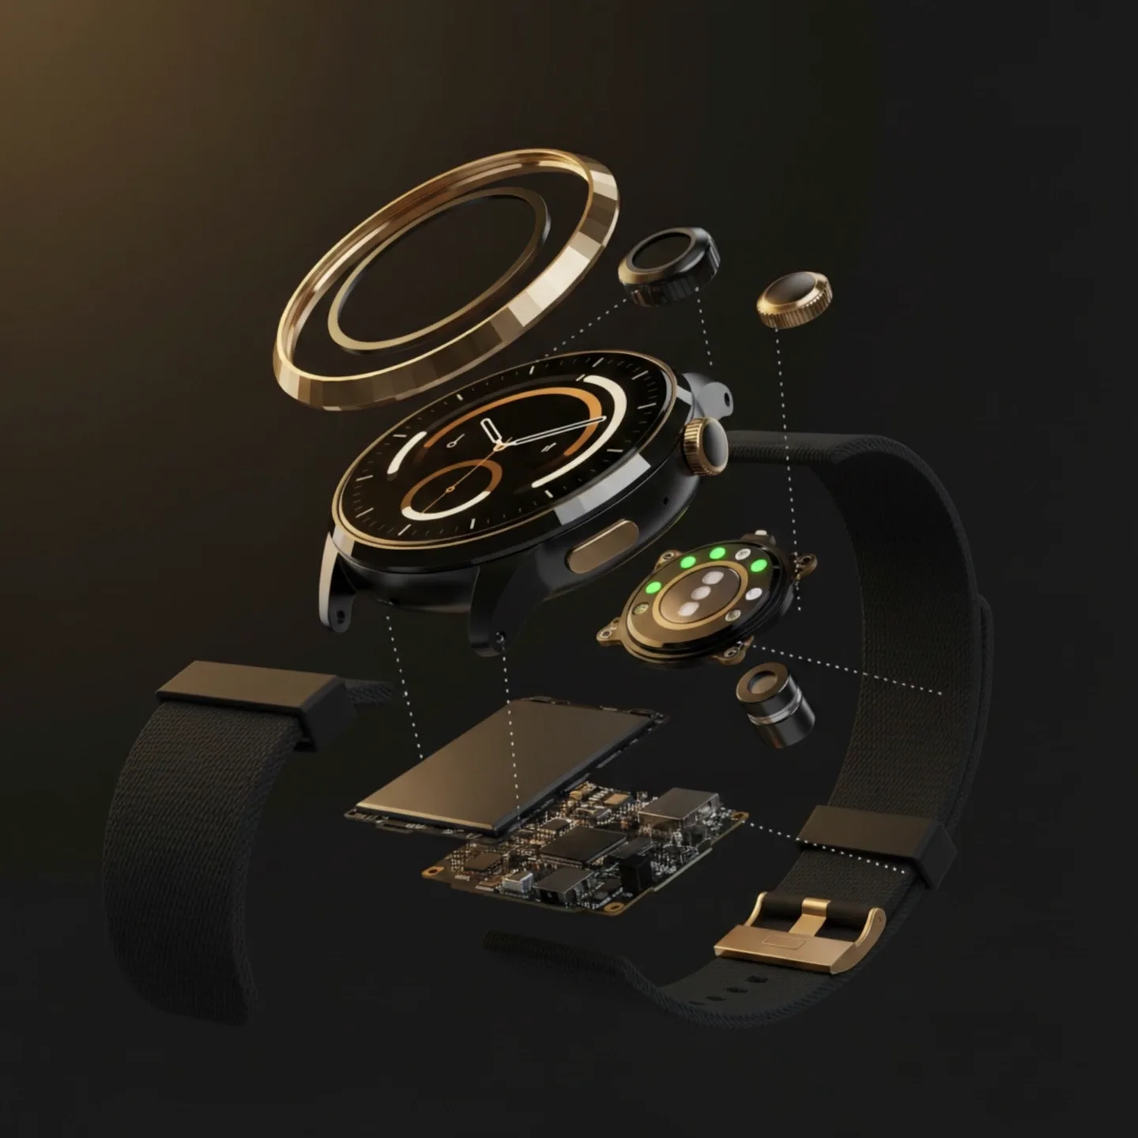
[ 05 ] THE TEARDOWN
THE CENTERPIECE
84
components
IN A 12MM CASE
The signature scroll section — an exploded view with five tappable callouts that reveal the watch from bezel to movement.
A
Bezel
Machined Grade-5 titanium
B
Crystal
Sapphire, AR-coated
C
Sensor block
Optical + electrical
D
Cell
14-day endurance pack
E
Caliber T-12
The movement
Notes:
The signature section and the centerpiece of the build. An exploded view of the watch with tappable A–E callouts. 84 components in a 12mm case — this is where the 'instrument' idea pays off.

Slide 7
[ 06 ] INTERACTION & MOTION
HOW THE PAGE MOVES
01 — SCROLL
02 — MARQUEE
Scroll choreography
The spec ticker
IntersectionObserver + requestAnimationFrame reveal each section in sequence.
A looping marquee of caliber specs runs beneath the hero.
03 — REEL
04 — ECOSYSTEM
Cinematic reel
The device mesh
A motion film built in Remotion (React), embedded as the centerpiece video.
“One signal, every device” — a 12-product family wired into one canvas.
One signal. Every device.
Notes:
How the page moves. Scroll choreography with IntersectionObserver and rAF, a looping spec marquee, a Remotion-built cinematic reel, and the ecosystem mesh — one signal, every device, across a 12-product family.

Slide 8
[ 07 ] CRAFT DETAILS
SIX FEATURES, ONE VOICE
Six features, each given a moment.
01
02
03
Sapphire optic stack
Six-axis IMU
Dual-band GNSS
SENSOR GLASS
MOTION SENSING
POSITIONING
04
05
06
14-day endurance
200m water resistance
AMOLED 1.4″ LTPO
BATTERY
DEPTH RATED
DISPLAY
LANGUAGE
VOICE
ORIGIN
Sapphire / titanium vocabulary, used consistently.
Quiet, non-marketing copy — let specs speak.
“Built in Berlin, 2026” framing throughout.
Notes:
The small decisions. Six features each given their own moment, the consistent sapphire/titanium language, the quiet non-marketing copy voice, and the 'Built in Berlin, 2026' framing.

Slide 9
[ 08 ] THE RESULT
LIVE IN PRODUCTION
LIVE
Shipped.
Single-page and fully responsive, built in hand-written vanilla front-end — no framework. Behind it, a working contact pipeline on Express + Supabase, Playwright-tested, deployed on Vercel.
wk1-day2.vercel.app ↗
Notes:
The outcome: live, shipped, fully responsive on Vercel, with a working contact pipeline behind it. Point to the live link and the hero screenshots. Drop the desktop and mobile captures here.

Slide 10
[ RECAP ] WHAT THIS PROJECT DEMONSTRATES
One page. Four disciplines.
Visual design
Narrative
Front-end engineering
Motion
Tricia
wk1-day2.vercel.app ↗
WEB DEVELOPER
✓
Wear the instrument.
Notes:
Close. Recap the four disciplines this single project shows: visual design, narrative, front-end engineering, motion. Hand off the live link and contact. End on the line.

