Slide 1
Rat in a Maze Project
(Rescue Remy)
A maze is a rectangular area with an entrance and an exit.
The interior of a maze contains walls or obstacles that one cannot walk through.
We shall place these obstacles along rows and columns parallel to the rectangular boundary of the maze.
We view the maze as broken up into equal size squares, some of which are part of the walls and the others are part of the hallways. Thus they are “open”.

Slide 2
Rat in a Maze Project, Version 1
An example of a maze is shown on the next slide.
The dark squares are parts of walls that one cannot walk through.
One of the open squares is designated as the Start position and another as the Exit position.
For our particular example, we will use the upper left corner square as the Start; the Exit is the lower right corner square.
If m is the number of rows and n the number of columns, we could represent a maze by an mxn rectangular array of zeros and ones.
In this representaion, a zero representing an open square and a one representing a wall square.
In our particular example, m = n = 10.

Slide 3
0 1 1 1 1 1 0 0 0 0
0 0 0 0 0 1 0 1 0 0
0 0 0 1 0 1 0 0 0 0
0 1 0 1 0 1 0 1 1 0
0 1 0 1 0 1 0 1 0 0
0 1 1 1 0 1 0 1 0 1
0 1 0 0 0 1 0 1 0 1
0 1 0 1 1 1 0 1 0 0
1 0 0 0 0 0 0 1 0 0
0 0 0 0 1 1 1 1 0 0
S
E
Array Representation
Of M
Maze M

Slide 4
It will be convenient to add a border wall all around the maze, as shown below.
1 1 1 1 1 1 1 1 1 1 1 1
1 0 1 1 1 1 1 0 0 0 0 1
1 0 0 0 0 0 1 0 1 0 0 1
1 0 0 0 1 0 1 0 0 0 0 1
1 0 1 0 1 0 1 0 1 1 0 1
1 0 1 0 1 0 1 0 1 0 0 1
1 0 1 1 1 0 1 0 1 0 1 1
1 0 1 0 0 0 1 0 1 0 1 1
1 0 1 0 1 1 1 0 1 0 0 1
1 1 0 0 0 0 0 0 1 0 0 1
1 0 0 0 0 1 1 1 1 0 0 1
1 1 1 1 1 1 1 1 1 1 1 1
S
E
Maze M with border
Array Representation of
Maze M with border

Slide 5
Now, having said that we could represent the maze by an array of 0s and 1s,
we reflect that this does not promote readability.
So we will instead introduce an enumerated type which will include constants
OPEN and WALL and use these named constants instead of zero and one.
To reflect our search method for finding an exit path, we will also have a
third state: VISITED.
In traversing the maze, we can only move forward into an OPEN position
and can only pass from one OPEN position to another if they have a
common edge.
Thus a given position has 4 possible neighboring positions in the directions
down, left, up and right.
You cannot make a jump across a diagonal.
For example, you cannot move from position (8,1) to position (9,2).

Slide 6
Search Method : DFS
First we mark the Start position as VISITED and make it the current position.
When exploring from a current position P, we look for an open neighbor in a fixed pattern: down, left, up, right.
When an OPEN neighbor Q is found, we mark it as visited.
In this case we say that Q was entered from P and that P is “pending”: we have not finished exploring from P.
We first check to see if Q is the Exit position.
If so, the search concludes successfully. In this case, we print out the path from the Start to the Exit for the (literate) rat.
If not, we continue exploring from position Q.

Slide 7
Search Method
If all four neighbors of Q are either WALL or VISITED, we return to the position P from which Q was first visited and continue exploring from P.
That is, we “back out” from Q to P. This is the only way we can move to a previously visited position.
Once we back out from Q, we will never return. Also, Q will not be on the escape path.
If we return to the Start position and find no OPEN neighbors, the search concludes unsuccessfully: there is no path from the Start to the Exit.
Poor Remy!
We next illustrate the execution of the algorithm on our previous example.

Slide 8
Searching the Example Maze
S
E
Visited and pending
(on current path)
Visited and Done
(not on current path)
Current position

Slide 9
Searching the Example Maze
S
↓
Arrows indicate the
current path
E
Visited and pending
(on current path)
Visited and Done
(not on current path)
Current position

Slide 10
Searching the Example Maze
S
↓
↓
Arrows indicate the
current path
E
Visited and pending
(on current path)
Visited and Done
(not on current path)
Current position

Slide 11
Searching the Example Maze
S
↓
↓
Arrows indicate the
current path
↓
E
Visited and pending
(on current path)
Visited and Done
(not on current path)
Current position

Slide 12
Searching the Example Maze
S
↓
↓
Arrows indicate the
current path
↓
↓
E
Visited and pending
(on current path)
Visited and Done
(not on current path)
Current position

Slide 13
Searching the Example Maze
S
↓
↓
Arrows indicate the
current path
↓
↓
↓
E
Visited and pending
(on current path)
Visited and Done
(not on current path)
Current position

Slide 14
Searching the Example Maze
S
↓
↓
Arrows indicate the
current path
↓
↓
E
Visited and pending
(on current path)
Visited and Done
(not on current path)
Current position

Slide 15
Searching the Example Maze
S
↓
↓
Arrows indicate the
current path
↓
E
Visited and pending
(on current path)
Visited and Done
(not on current path)
Current position

Slide 16
Searching the Example Maze
S
↓
↓
Arrows indicate the
current path
E
Visited and pending
(on current path)
Visited and Done
(not on current path)
Current position

Slide 17
Searching the Example Maze
S
↓
Arrows indicate the
current path
E
Visited and pending
(on current path)
Visited and Done
(not on current path)
Current position

Slide 18
Searching the Example Maze
S
Arrows indicate the
current path
E
Visited and pending
(on current path)
Visited and Done
(not on current path)
Current position

Slide 19
Searching the Example Maze
↑
S
Arrows indicate the
current path
E
Visited and pending
(on current path)
Visited and Done
(not on current path)
Current position

Slide 20
Searching the Example Maze
↑
↑
S
Arrows indicate the
current path
E
Visited and pending
(on current path)
Visited and Done
(not on current path)
Current position

Slide 21
Searching the Example Maze
↑
S
Arrows indicate the
current path
E
Visited and pending
(on current path)
Visited and Done
(not on current path)
Current position

Slide 22
Searching the Example Maze
→
↑
S
Arrows indicate the
current path
E
Visited and pending
(on current path)
Visited and Done
(not on current path)
Current position

Slide 23
Searching the Example Maze
→
↑
↓
S
Arrows indicate the
current path
E
Visited and pending
(on current path)
Visited and Done
(not on current path)
Current position

Slide 24
Searching the Example Maze
→
↑
↓
S
→
Arrows indicate the
current path
E
Visited and pending
(on current path)
Visited and Done
(not on current path)
Current position

Slide 25
Searching the Example Maze
→
↑
↓
S
→
↓
Arrows indicate the
current path
E
Visited and pending
(on current path)
Visited and Done
(not on current path)
Current position

Slide 26
Searching the Example Maze
→
↑
↓
S
→
↓
↓
Arrows indicate the
current path
E
Visited and pending
(on current path)
Visited and Done
(not on current path)
Current position

Slide 27
Searching the Example Maze
→
Three steps combined
↑
↓
↑
S
→
Arrows indicate the
current path
E
Visited and pending
(on current path)
Visited and Done
(not on current path)
Current position

Slide 28
Searching the Example Maze
→
→
→
Several steps combined
↑
↓
↑
↓
S
→
↓
↓
Arrows indicate the
current path
↓
↓
←
←
↓
↓
E
Visited and pending
(on current path)
Visited and Done
(not on current path)
Current position

Slide 29
Searching the Example Maze
→
→
→
Several steps combined
↑
↓
↑
↓
S
→
↓
↓
Arrows indicate the
current path
↓
↓
←
←
↓
↓
↓
E
Visited and pending
(on current path)
Visited and Done
(not on current path)
Current position

Slide 30
Searching the Example Maze
→
→
↑
↓
→
→
→
Several steps combined
↑
↓
↑
↓
↑
↓
S
→
↓
↑
↓
↑
Arrows indicate the
current path
↓
↑
↓
↑
←
←
↓
↑
↓
↑
→
→
→
↓
↑
→
E
Visited and pending
(on current path)
Visited and Done
(not on current path)
Current position

Slide 31
Searching the Example Maze
→
→
↑
↓
→
→
→
Several steps combined
↑
↓
↑
↓
↑
↓
S
→
→
↓
↑
↓
↑
↓
Arrows indicate the
current path
←
↓
↑
↓
↓
↑
↓
←
←
↓
↑
↓
↓
↑
↓
→
→
→
↓
↑
↓
→
→
E
Visited and pending
(on current path)
Visited and Done
(not on current path)
Current position

Slide 32
Using a Stack to Hold the Current Path
We now consider how to carry out the algorithm described previously.
In particular, how do we keep track of the position from which the current position was entered?
Consider this: Suppose we go from S to P, then P to Q, then Q to R and R to T, then at position T find no OPEN neighbors.
Then we back out to R. Suppose R has no OPEN neighbors. Then we should back out to Q.
If Q has no OPEN neighbors, we back out to P and then to S.
So the Path progresses like this:
S
S→P
S →P →Q
S →P→Q →R
S →P→Q →R →T
S →P→Q →R
S →P→Q
S →P
S
Looks like a stack to me!
So we will maintain a stack of Positions.
When we first visit a Position, we push it on the stack.
To back out from a Position, we pop the top of the stack
and continue exploring from there.

Slide 33
Searching the Example Maze
0 1 2 3 4 5 6 7 8 9 10 11
0
1
2
3
4
5
6
7
8
9
10
11
→
(2,3)
(3,3)
(3,2)
(2,2)
(2,1)
(3,1)
↑
↓
↑
S
→
E
Stack
Visited and pending
(on current path)
Visited and Done
(not on current path)
Current position

Slide 34
Now enter the start position by entering two positive integers: 1 1
Now enter the exit position by entering two positive integers: 10 10
Here is the maze you input where *=Wall, - = open area:
************
*-*****----*
*-----*-*--*
*---*-*----*
*-*-*-*-**-*
*-*-*-*-*--*
*-***-*-*-**
*-*---*-*-**
*-*-***-*--*
**------*--*
*----****--*
************

Slide 35
The way out of the maze is as follows:
(1,1) (2,1) (3,1) (3,2) (2,2) (2,3) (2,4) (2,5) (3,5) (4,5) (5,5) (6,5) (7,5) (7,4) (7,3) (8,3)
(9,3) (10,3) (10,4) (9,4) (9,5) (9,6) (9,7) (8,7) (7,7) (6,7) (5,7) (4,7) (3,7) (2,7) (1,7) (1,8)
(1,9) (2,9) (3,9) (3,10) (4,10) (5,10) (5,9) (6,9) (7,9) (8,9) (9,9) (10,9) (10,10)
Note: the above is not exactly the output. In the real output, each ordered pair would be
on a separate line.

Slide 36
Homework: Show the contents of the stack after each
push or pop during the execution of the maze 1 algorithm
(3,3)
(3,3)
(3,3)
(3,3)
S
E
(3,3)
(3,3)
(3,3)
(3,3)
(3,3)
(3,3)
(3,3)
(3,3)
(3,3)
(3,3)
(3,3)

Slide 37
Rat in a Maze: BFS Search
The method we used to find an exit from a maze in the previous
slides works but will usually not find a shortest path to the exit.
An extreme case is a maze with no internal walls (just the hedge).
If the start is the upper left corner and the exit the lower right
corner, the path found by our previous method will traverse every
position in the maze!
In this project we implement a method that finds a shortest path
to the Exit. In fact, it finds a shortest path to every position visited
during the search

Slide 38
The approach we used in the first project is called a
depth-first search, because we probe as deep as we can until
blocked, then back out until we can continue in another
probe direction.
The new approach is called breadth-first search: we will visit each
of the OPEN neighbors of the current position one after another,
then move to the first of the neighbors visited.

Slide 39
In general, as we visit the OPEN neighbors of the current position,
we place them in a queue in the order they were visited.
Then we remove the position at the front of the queue and make
it our current position, and visit each of its OPEN neighbors,
appending them to the queue as we visit them.
We continue like this until we find the exit or have visited all the
reachable positions without finding the exit. This will be the case
when we empty the queue.

Slide 40
The problem now is how do we reconstruct the path when we
find the exit.
The answer is that we will use another 2-dimensional array pred
of Positions; the i,jth entry in the array will be the position from
which Position(i,j) was visited.
This position will be the predecessor of P(i,j) in a shortest path
from Start to P(i,j).
Thus, if the current position is P and Q is an open neighbor of
P, then at the time we visit Q and append it to the queue, we
set pred[Q.row][Q.col] to the Position P.

Slide 41
Initially, we mark start as VISITED and append it to the queue.
We then we do the following while the queue is not empty:
• Serve an element from the queue into the Position variable current.
Examine each neighbor of current in the down,left,up,right order.
If a neighbor is OPEN, we
mark it as VISITED
make current the predecessor of the neighbor
check to see if the neighbor is the Exit.
If so, we set *found to TRUE and return;
otherwise we append the neighbor to the queue.
If we break out of the loop because the queue has been emptied,
we set *found to FALSE and return.

Slide 42
We illustrate the algorithm with the same maze we used in the
notes on the first maze project.
As before the start is at the upper left corner and the exit at the
lower right corner.
We start by marking start as VISITED and inserting it in the
queue of pending positions.

Slide 43
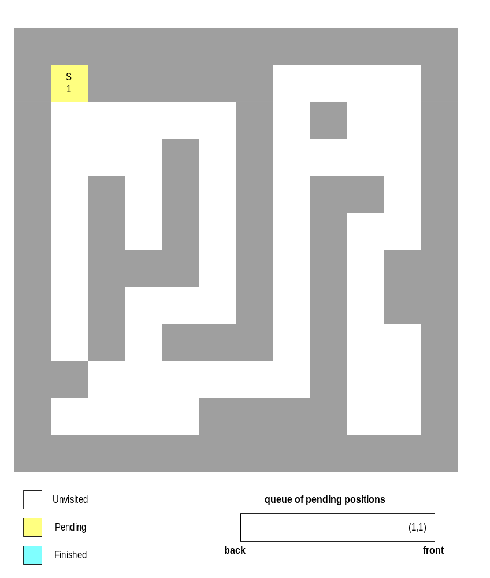

Slide 44
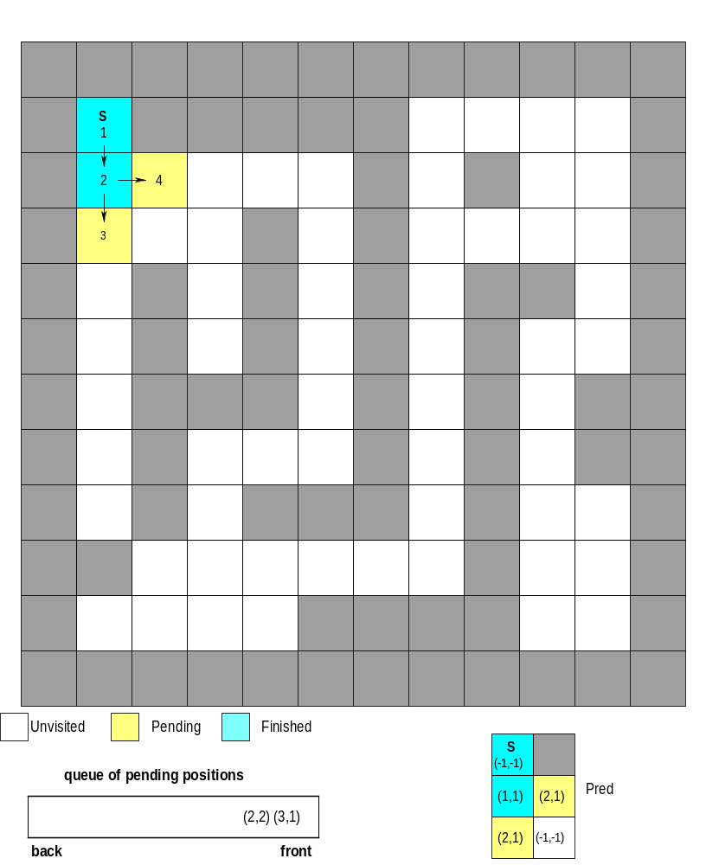

Slide 45
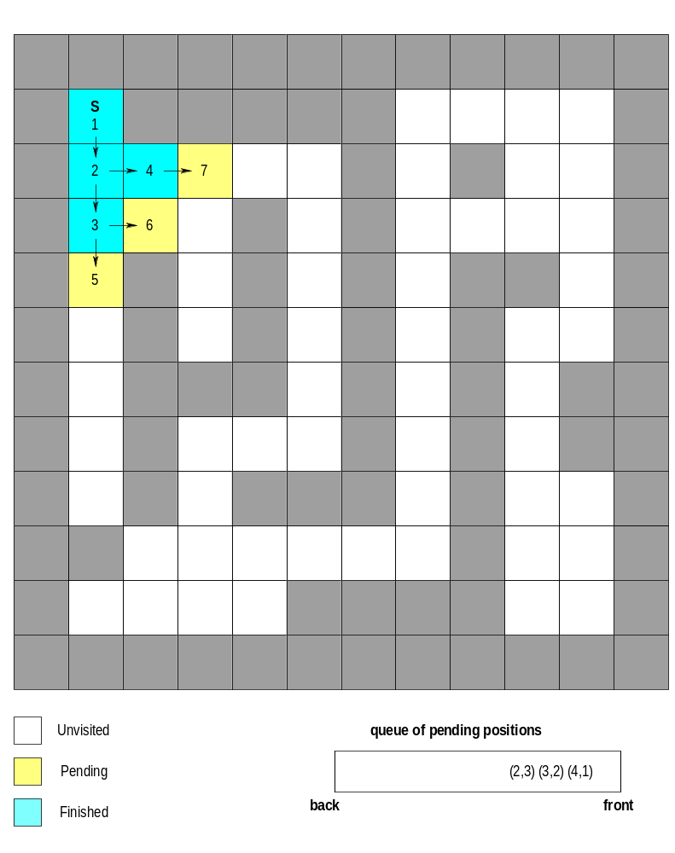

Slide 46
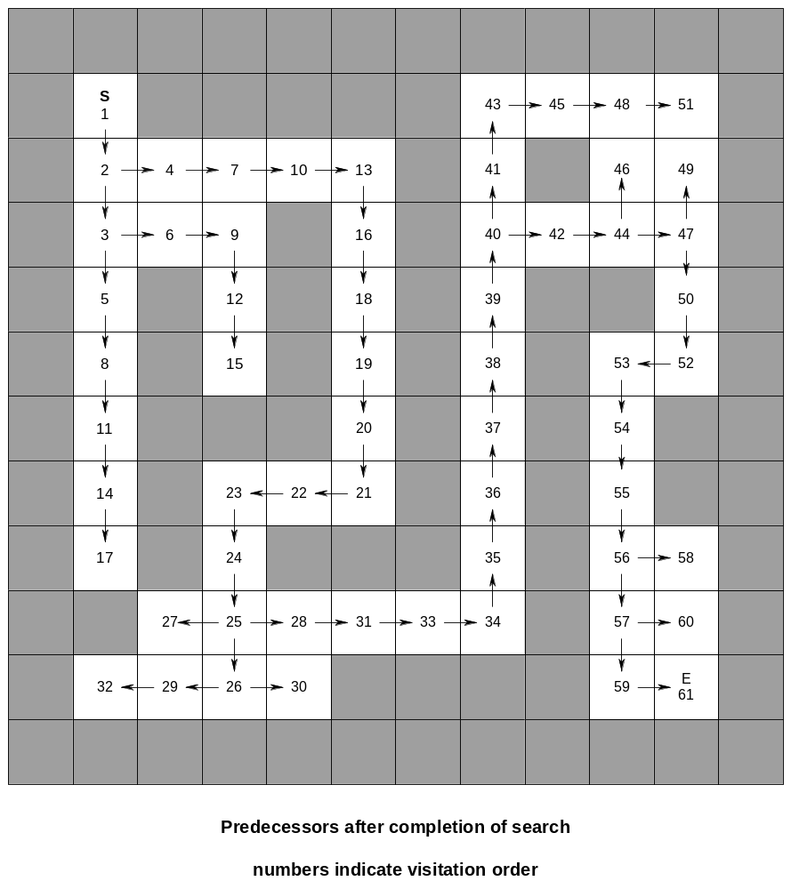

Slide 47
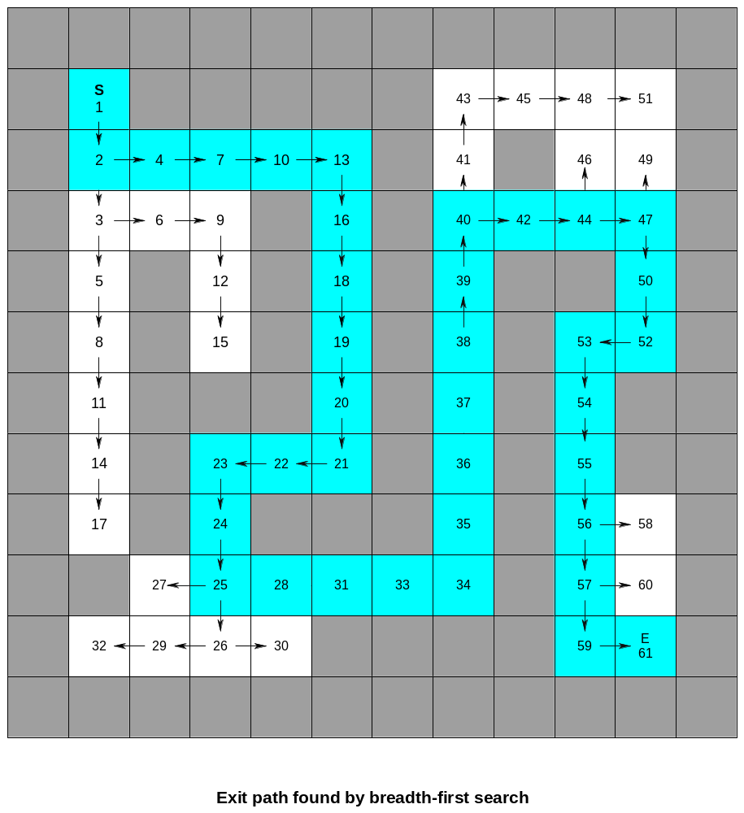

Slide 48
Printing the path
Given the completed pred array, how do we output the path from
start to a given position P?
One approach is to
push P onto a stack, then
push the predecessor of P onto the stack, then
push the predecessor of the predecessor of P onto the stack, etc.
When we have pushed start on the stack, we stop and start
popping and printing the positions.
This would be done in the function ShowPath, which now has
arguments the predecessor array and a target Position
(like P in the preceding discussion).

Slide 49
An alternate approach is to make the function
void ShowPath(PosArray pred, Position P)
a recursive function
The code for the recursive version is quite simple and avoids
having to include the stack files in your program.

