Slide 1
Reproducibility
Thomas Sol Dourdin

Slide 2
Introduction
REPLICABILITY
The capacity to “obtain consistent results across studies aimed at answering the same scientific question, each of which has obtained its own data”*
Universality of science
Rigorous sharing of methods
QUALITATIVE
*National Academies of Sciences, Engineering and Medecine, 2019 in Hicks, 2023

Slide 3
Introduction
REPLICABILITY
REPRODUCIBILITY
The capacity to “obtain consistent results across studies aimed at answering the same scientific question, each of which has obtained its own data”*
The capacity to “obtain the same results from the same data by using the same computational steps, the same code, and the same analytical conditions”*
Universality of science
Rigorous sharing of methods
Emerged with analytical, computer sciences
QUALITATIVE
QUANTITATIVE
*National Academies of Sciences, Engineering and Medecine, 2019 in Hicks, 2023

Slide 4
Introduction
REPLICABILITY
REPRODUCIBILITY
The capacity to “obtain consistent results across studies aimed at answering the same scientific question, each of which has obtained its own data”*
The capacity to “obtain the same results from the same data by using the same computational steps, the same code, and the same analytical conditions”*
Good practices
Universality of science
Rigorous sharing of methods
Emerged with analytical, computer sciences
QUALITATIVE
QUANTITATIVE
*National Academies of Sciences, Engineering and Medecine, 2019 in Hicks, 2023

Slide 5
Introduction
« Why is that so important? »

Slide 6

Introduction
« Why is that so important? »
From « Publish or Perish » to « Reproduce or Reject »

Slide 7

Introduction
« Why is that so important? »
From « Publish or Perish » to « Reproduce or Reject »
For students: think about your supervisor…

Slide 8
Introduction
PROJECT ARCHITECTURE
PROJECT IMPLEMENTATION
The 4 pillars of reproducibility
PROJECT TRACKING
PROJECT SHARING

Slide 9
Introduction
renv
PROJECT ARCHITECTURE
PROJECT IMPLEMENTATION
targets
The 4 pillars of reproducibility
PROJECT TRACKING
PROJECT SHARING
Git
Rmd
GitHub
GitLab
Quarto

Slide 10
PROJECT
SHARING
PROJECT TRACKING
PROJECT IMPLEMENTATION
PROJECT ARCHITECTURE

Slide 11


PROJECT
SHARING
PROJECT TRACKING
Research Compendium
Data
PROJECT IMPLEMENTATION
PROJECT ARCHITECTURE
R
Reproducibility
Results
.Rproj

Slide 12
PROJECT
SHARING
PROJECT TRACKING
Research Compendium
Data
PROJECT IMPLEMENTATION
PROJECT ARCHITECTURE
R
Reproducibility
Results
.Rproj
Docs
ConfigFiles
README.txt

Slide 13

PROJECT
SHARING
PROJECT TRACKING
Research Compendium
Data
PROJECT IMPLEMENTATION
PROJECT ARCHITECTURE
R
Reproducibility
Results
.Rproj
Data
Docs
RAW
TIDY
ConfigFiles
README.txt

Slide 14
PROJECT
SHARING
PROJECT TRACKING
Research Compendium
Data
PROJECT IMPLEMENTATION
PROJECT ARCHITECTURE
R
Reproducibility
Results
.Rproj
R
01-ImportAndTidy.R
02-DataVizualisation.R
03-StatisticalTest.R
…
Docs
ConfigFiles
README.txt

Slide 15
PROJECT
SHARING
PROJECT TRACKING
Research Compendium
Data
PROJECT IMPLEMENTATION
PROJECT ARCHITECTURE
R
Reproducibility
Results
.Rproj
Results
TidyData
Plots
TestResults
…
Docs
Plot1
Plot2
Plot3
ConfigFiles
README.txt

Slide 16
PROJECT
IMPLEMENTATION
PROJECT SHARING
Versioning tools: Git and GitHub
Dedicated to collaborative work (i.e. scientific labs)
Increasingly used as a showcase
Supports reproducibility
Needs time to be familiar…
PROJECT ARCHITECTURE
PROJECT TRACKING
Git (local)
master
PROJECT

Slide 17
PROJECT
IMPLEMENTATION
PROJECT SHARING
Versioning tools: Git and GitHub
Dedicated to collaborative work (i.e. scientific labs)
Increasingly used as a showcase
Supports reproducibility
Needs time to be familiar…
PROJECT ARCHITECTURE
PROJECT TRACKING
Git (local)
working
master
PROJECT
BRANCH
PROJECT

Slide 18
PROJECT
IMPLEMENTATION
PROJECT SHARING
Versioning tools: Git and GitHub
Dedicated to collaborative work (i.e. scientific labs)
Increasingly used as a showcase
Supports reproducibility
Needs time to be familiar…
PROJECT ARCHITECTURE
PROJECT TRACKING
Git (local)
working
master
PROJECT
BRANCH
PROJECT
COMMIT
Work in progress
COMMIT

Slide 19
PROJECT
IMPLEMENTATION
PROJECT SHARING
Versioning tools: Git and GitHub
Dedicated to collaborative work (i.e. scientific labs)
Increasingly used as a showcase
Supports reproducibility
Needs time to be familiar…
PROJECT ARCHITECTURE
PROJECT TRACKING
Git (local)
working
master
PROJECT
BRANCH
PROJECT
COMMIT
Work in progress
COMMIT
PROJECT
COMMIT

Slide 20
PROJECT
IMPLEMENTATION
PROJECT SHARING
Versioning tools: Git and GitHub
Dedicated to collaborative work (i.e. scientific labs)
Increasingly used as a showcase
Supports reproducibility
Needs time to be familiar…
PROJECT ARCHITECTURE
PROJECT TRACKING
Git (local)
working
master
PROJECT
BRANCH
PROJECT
COMMIT
Work in progress
COMMIT
PROJECT
MERGE
PROJECT
COMMIT

Slide 21
PROJECT
IMPLEMENTATION
PROJECT SHARING
Versioning tools: Git and GitHub
Dedicated to collaborative work (i.e. scientific labs)
Increasingly used as a showcase
Supports reproducibility
Needs time to be familiar…
PROJECT ARCHITECTURE
PROJECT TRACKING
Git (local)
GitHub (remote)
working
master
PROJECT
BRANCH
PROJECT
PROJECT
PULL
COMMIT
Work in progress
COMMIT
PROJECT
MERGE
PROJECT
PROJECT
COMMIT
PUSH

Slide 22
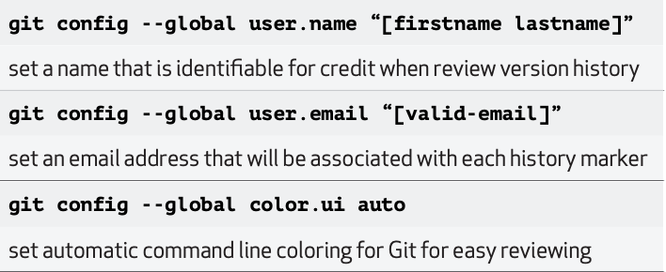
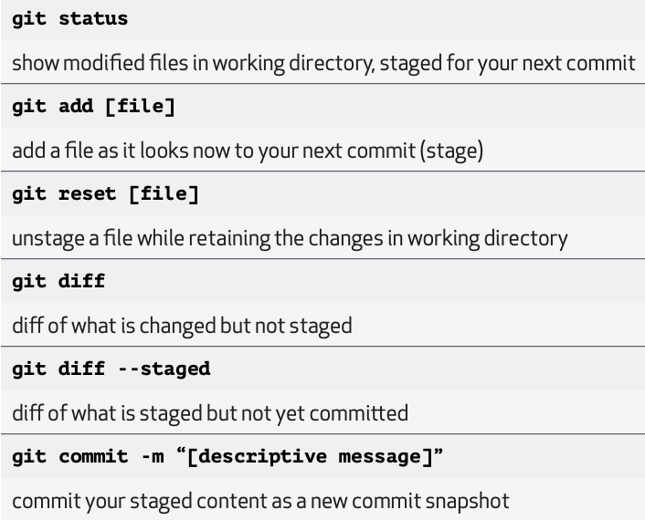
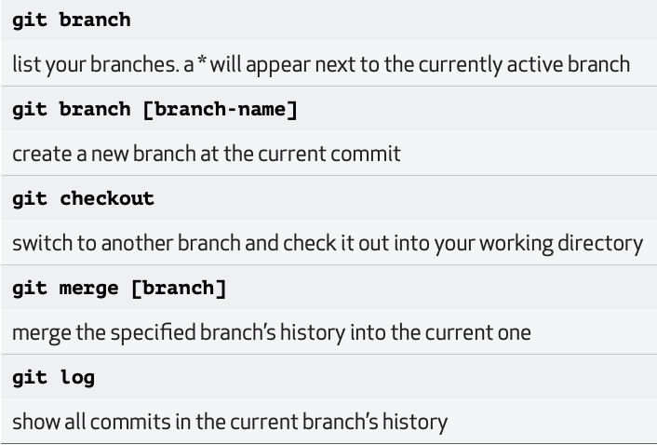
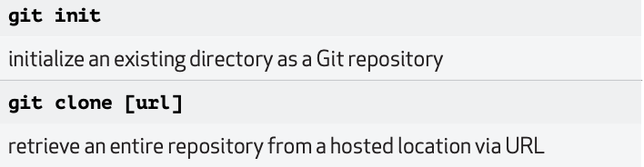
PROJECT
IMPLEMENTATION
PROJECT SHARING
Versioning tools: Git and GitHub
Dedicated to collaborative work (i.e. scientific labs)
Increasingly used as a showcase
Supports reproducibility
Needs time to be familiar…
PROJECT ARCHITECTURE
PROJECT TRACKING
A whole world of functions to manipulate Git !

Slide 23
PROJECT
TRACKING
PROJECT ARCHITECTURE
PROJECT
SHARING
PROJECT IMPLEMENTATION

Slide 24
PROJECT ARCHITECTURE
PROJECT IMPLEMENTATION
PROJECT TRACKING
PROJECT SHARING

Slide 25
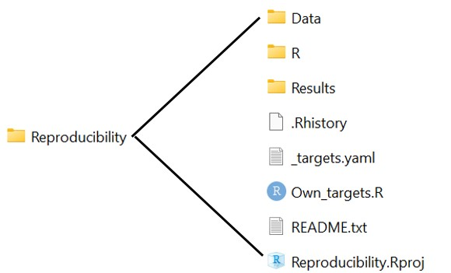
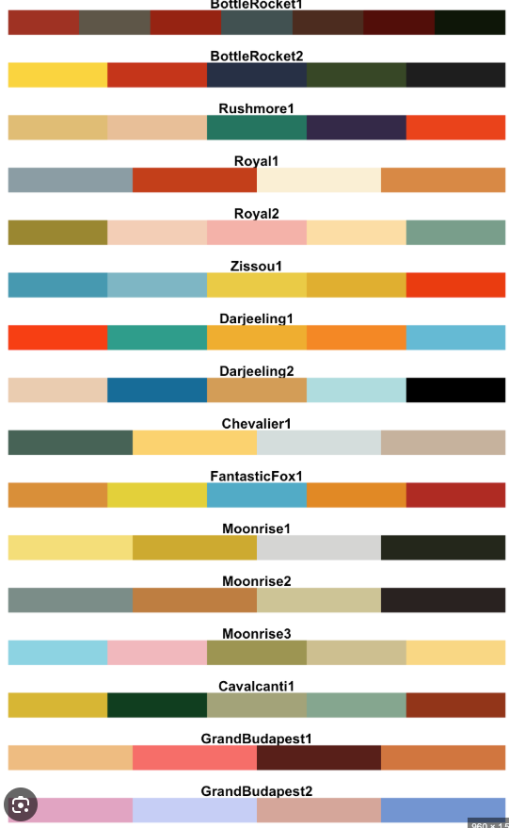
Introduction

