Slide 1
Reproducibility
Thomas Sol Dourdin

Slide 2
Introduction
1992

Slide 3

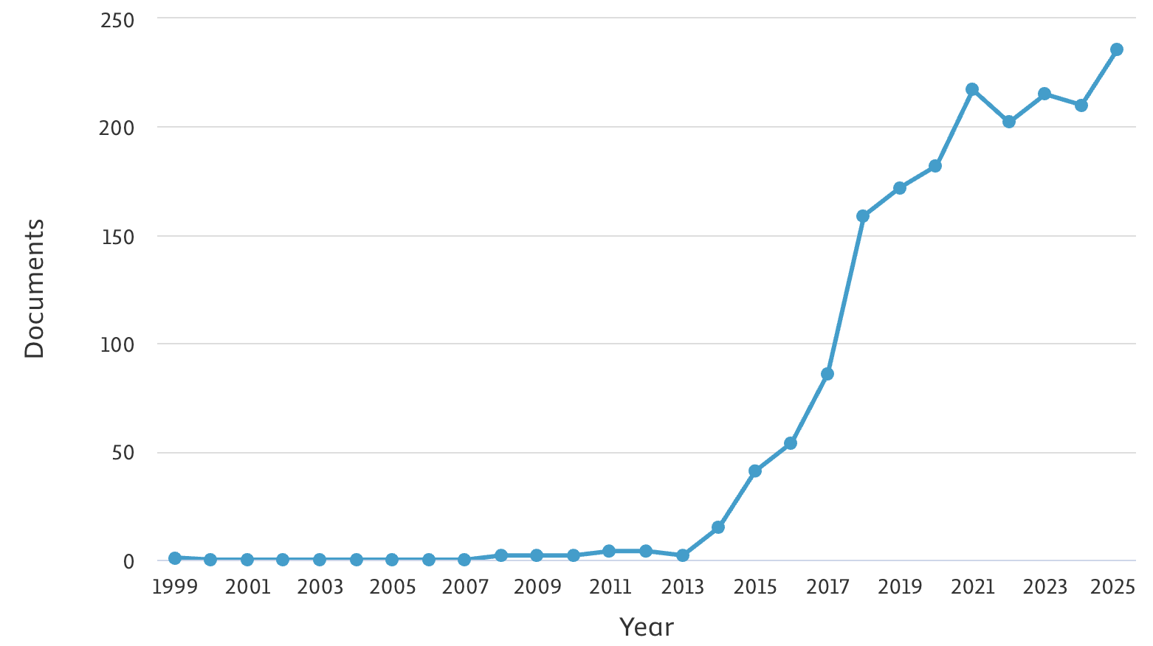

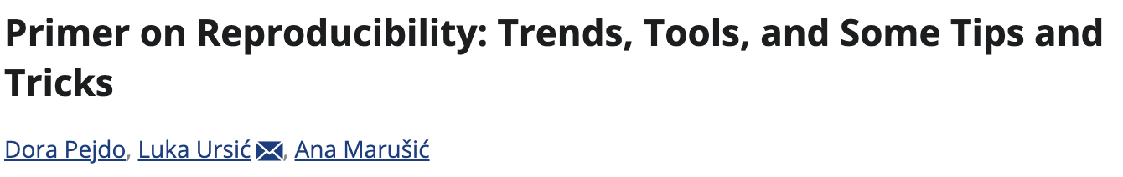
Introduction
1992
2014
TITLE-ABS-KEY ( "reproducibility crisis" OR "replication crisis" OR "scientific reproducibility" OR "research reproducibility" ) - SCOPUS
2018
2026

Slide 4
Introduction
REPLICABILITY
The capacity to “obtain consistent results across studies aimed at answering the same scientific question, each of which has obtained its own data”*
Universality of science
Rigorous sharing of methods
QUALITATIVE
*National Academies of Sciences, Engineering and Medecine, 2019 in Hicks, 2023

Slide 5
Introduction
REPLICABILITY
REPRODUCIBILITY
The capacity to “obtain consistent results across studies aimed at answering the same scientific question, each of which has obtained its own data”*
The capacity to “obtain the same results from the same data by using the same computational steps, the same code, and the same analytical conditions”*
Universality of science
Rigorous sharing of methods
Emerged with analytical, computer sciences
QUALITATIVE
QUANTITATIVE
*National Academies of Sciences, Engineering and Medecine, 2019 in Hicks, 2023

Slide 6
Introduction
REPLICABILITY
REPRODUCIBILITY
The capacity to “obtain consistent results across studies aimed at answering the same scientific question, each of which has obtained its own data”*
The capacity to “obtain the same results from the same data by using the same computational steps, the same code, and the same analytical conditions”*
Good practices
Universality of science
Rigorous sharing of methods
Emerged with analytical, computer sciences
QUALITATIVE
QUANTITATIVE
*National Academies of Sciences, Engineering and Medecine, 2019 in Hicks, 2023

Slide 7
Introduction
« Why is that so important? »

Slide 8

Introduction
« Why is that so important? »

Slide 9
Introduction
« Why is that so important? »
From « Publish or Perish » to « Reproduce or Reject »

Slide 10

Introduction
« Why is that so important? »
From « Publish or Perish » to « Reproduce or Reject »
For students: think about your supervisor…

Slide 11
Introduction
Reproducibility is not an end in itself; it is a means to promote acceptance and dissemination of your work, as well as overall transparency in science.
« Why is that so important? »
From « Publish or Perish » to « Reproduce or Reject »
For students: think about your supervisor…

Slide 12
Introduction
REPRODUCIBILITY
Reproducible research projects
Find help
Produce and share stand-alone scripts
Ensure your whole work can be exactly reproduced by anyone, at anytime.
readable
understandable
executable
data example
packages

Slide 13
Introduction
REPRODUCIBILITY
Reproducible research projects
Find help
Produce and share stand-alone scripts
Ensure your whole work can be exactly reproduced by anyone, at anytime.
readable
understandable
executable
data example
packages

Slide 14
Introduction
PROJECT ARCHITECTURE
PROJECT IMPLEMENTATION
The 4 pillars of reproducibility
PROJECT TRACKING
PROJECT SHARING

Slide 15
Introduction
renv
PROJECT ARCHITECTURE
PROJECT IMPLEMENTATION
targets
The 4 pillars of reproducibility
PROJECT TRACKING
PROJECT SHARING
Git
Rmd
GitHub
GitLab
Quarto

Slide 16
PROJECT
SHARING
PROJECT TRACKING
Research Compendium
« A convention for how you organise your research artefacts into directories. » (https://github.com/ropensci/rrrpkg)
PROJECT IMPLEMENTATION
PROJECT ARCHITECTURE

Slide 17


PROJECT
SHARING
PROJECT TRACKING
Research Compendium
« A convention for how you organise your research artefacts into directories. » (https://github.com/ropensci/rrrpkg)
PROJECT IMPLEMENTATION
PROJECT ARCHITECTURE
Data
R
Reproducibility
Results
.Rproj

Slide 18
PROJECT
SHARING
PROJECT TRACKING
Research Compendium
« A convention for how you organise your research artefacts into directories. » (https://github.com/ropensci/rrrpkg)
PROJECT IMPLEMENTATION
PROJECT ARCHITECTURE
Data
R
Reproducibility
Results
.Rproj
Docs
ConfigFiles
Report
README.txt

Slide 19

PROJECT
SHARING
PROJECT TRACKING
Research Compendium
« A convention for how you organise your research artefacts into directories. » (https://github.com/ropensci/rrrpkg)
PROJECT IMPLEMENTATION
PROJECT ARCHITECTURE
Data
R
Reproducibility
Results
Data
.Rproj
RAW
TIDY
Docs
ConfigFiles
Report
README.txt

Slide 20
PROJECT
SHARING
PROJECT TRACKING
Research Compendium
« A convention for how you organise your research artefacts into directories. » (https://github.com/ropensci/rrrpkg)
PROJECT IMPLEMENTATION
PROJECT ARCHITECTURE
Data
R
Reproducibility
Results
R
.Rproj
01-ImportAndTidy.R
02-DataVizualisation.R
03-StatisticalTest.R
…
Docs
ConfigFiles
Report
README.txt

Slide 21
PROJECT
SHARING
PROJECT TRACKING
Research Compendium
« A convention for how you organise your research artefacts into directories. » (https://github.com/ropensci/rrrpkg)
PROJECT IMPLEMENTATION
PROJECT ARCHITECTURE
Data
R
Reproducibility
Results
Results
.Rproj
TidyData
Plots
TestResults
…
Plot1
Plot2
Plot3
Docs
ConfigFiles
Report
README.txt

Slide 22
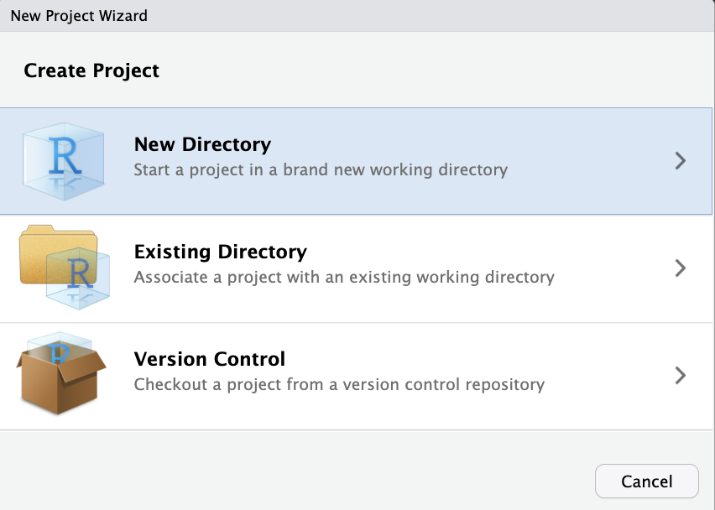
PROJECT
SHARING
PROJECT TRACKING
Research Compendium
« A convention for how you organise your research artefacts into directories. » (https://github.com/ropensci/rrrpkg)
PROJECT IMPLEMENTATION
PROJECT ARCHITECTURE
Data
R
Reproducibility
Results
.Rproj
Docs
ConfigFiles
Report
setwd()
README.txt

Slide 23
PROJECT
SHARING
PROJECT TRACKING
Research Compendium
« A convention for how you organise your research artefacts into directories. » (https://github.com/ropensci/rrrpkg)
PROJECT IMPLEMENTATION
PROJECT ARCHITECTURE
Data
R
Reproducibility
Results
.Rproj
Docs
ConfigFiles
Report
setwd()
README.txt
read_csv(« Data/Allo.csv ») → read_csv(here::here(« Data », « Allo.csv »))

Slide 24
Introduction
PROJECT ARCHITECTURE
PROJECT IMPLEMENTATION
The 4 pillars of reproducibility
PROJECT TRACKING
PROJECT SHARING

Slide 25
PROJECT
TRACKING
PROJECT ARCHITECTURE
PROJECT
SHARING
PROJECT IMPLEMENTATION

Slide 26
PROJECT
TRACKING
PROJECT ARCHITECTURE
PROJECT
SHARING
PROJECT IMPLEMENTATION
The layers of reproducibility
Code
Packages
System libraries
OS
MATERIAL
targets
renv
Whole environment
Conda / Docker
Docker

Slide 27
PROJECT
TRACKING
PROJECT ARCHITECTURE
PROJECT
SHARING
PROJECT IMPLEMENTATION
The layers of reproducibility
Our concern
Code
Packages
System libraries
OS
MATERIAL
targets
renv
Whole environment
Conda / Docker
Docker
Geek’s concern

Slide 28
PROJECT
TRACKING
PROJECT ARCHITECTURE
Reproducible R environment - renv
All necessary to execute the code and obtain the same results.
PROJECT
SHARING
PROJECT IMPLEMENTATION
The layers of reproducibility
Our concern
Code
Packages
System libraries
OS
MATERIAL
targets
renv
Whole environment
Conda / Docker
Docker
Geek’s concern

Slide 29
PROJECT
TRACKING
PROJECT ARCHITECTURE
Reproducible R environment - renv
All necessary to execute the code and obtain the same results.
PROJECT
SHARING
PROJECT IMPLEMENTATION
R packages
→ Name
Version
Dependencies
Sources (CRAN, Bioconductor, GitHub, etc.)
R version
The layers of reproducibility
Our concern
Code
Packages
System libraries
OS
MATERIAL
targets
renv
Whole environment
Conda / Docker
Docker
Geek’s concern

Slide 30
PROJECT
TRACKING
PROJECT ARCHITECTURE
Reproducible R environment - renv
All necessary to execute the code and obtain the same results.
PROJECT
SHARING
PROJECT IMPLEMENTATION
R packages
→ Name
Version
Dependencies
Sources (CRAN, Bioconductor, GitHub, etc.)
R version
The layers of reproducibility
Our concern
Code
Packages
System libraries
OS
MATERIAL
targets
renv
renv::init()
renv::snapshot()
renv::status()
renv::restore()
Initiate the renv environment
Whole environment
Conda / Docker
Save the current status
Docker
Compare the current status with renv.lock
Restore the environment described in renv.lock
Geek’s concern

Slide 31
PROJECT ARCHITECTURE
PROJECT IMPLEMENTATION
The 4 pillars of reproducibility
PROJECT TRACKING
PROJECT SHARING

Slide 32
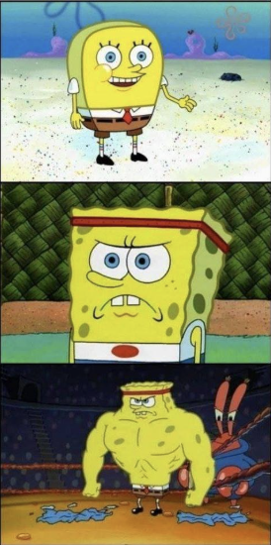
PROJECT ARCHITECTURE
PROJECT IMPLEMENTATION
Rendering tools: R markdown
PROJECT TRACKING
PROJECT SHARING
Using Base R for your analysis and copy pasting the results into word
Using dplyr, ggplot2, specific packages and reporting analyses in rmarkdown/quarto docs.
Coupling rmarkdown/quarto with automation tools like renv and targets

Slide 33

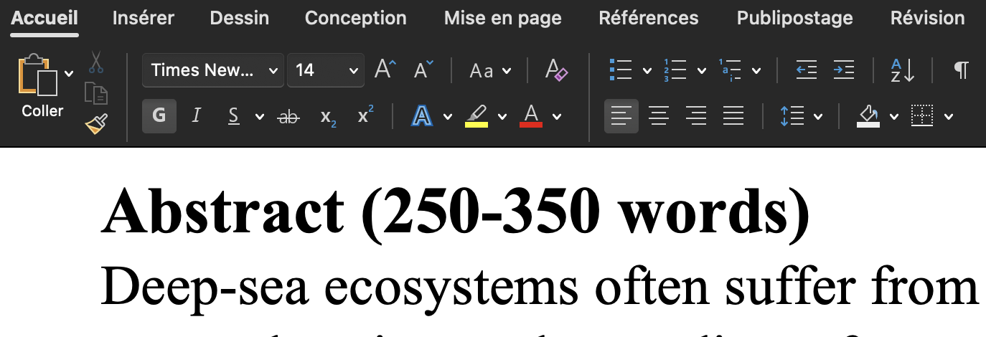
PROJECT ARCHITECTURE
PROJECT IMPLEMENTATION
Rendering tools: R markdown
PROJECT TRACKING
PROJECT SHARING
WYSIWYG
Using Base R for your analysis and copy pasting the results into word
Using dplyr, ggplot2, specific packages and reporting analyses in rmarkdown/quarto docs.
Coupling rmarkdown/quarto with automation tools like renv and targets

Slide 34


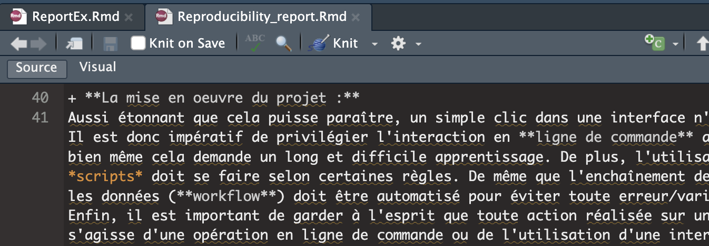
PROJECT ARCHITECTURE
PROJECT IMPLEMENTATION
Rendering tools: R markdown
PROJECT TRACKING
PROJECT SHARING
WYSIWYG
WYSIWYM
Using Base R for your analysis and copy pasting the results into word
mark-up language enabling to separate content and form.
Using dplyr, ggplot2, specific packages and reporting analyses in rmarkdown/quarto docs.
Integrate active code in the document
Directly linked to your R scripts
Coupling rmarkdown/quarto with automation tools like renv and targets

Slide 35
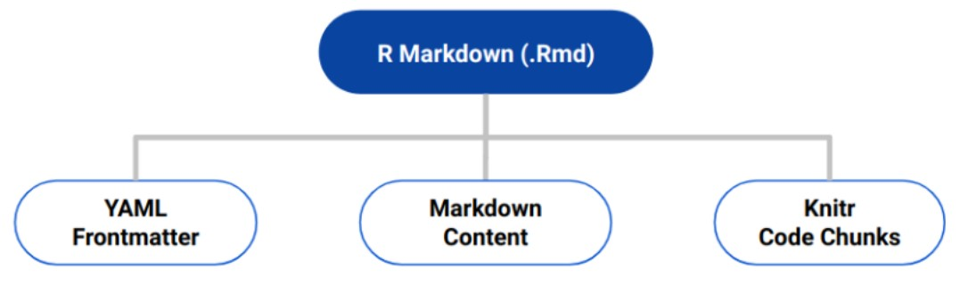
PROJECT ARCHITECTURE
PROJECT IMPLEMENTATION
Rendering tools: R markdown
PROJECT TRACKING
PROJECT SHARING

Slide 36
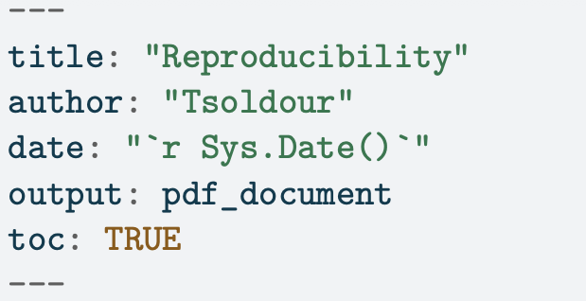
PROJECT ARCHITECTURE
PROJECT IMPLEMENTATION
Rendering tools: R markdown
PROJECT TRACKING
PROJECT SHARING

Slide 37
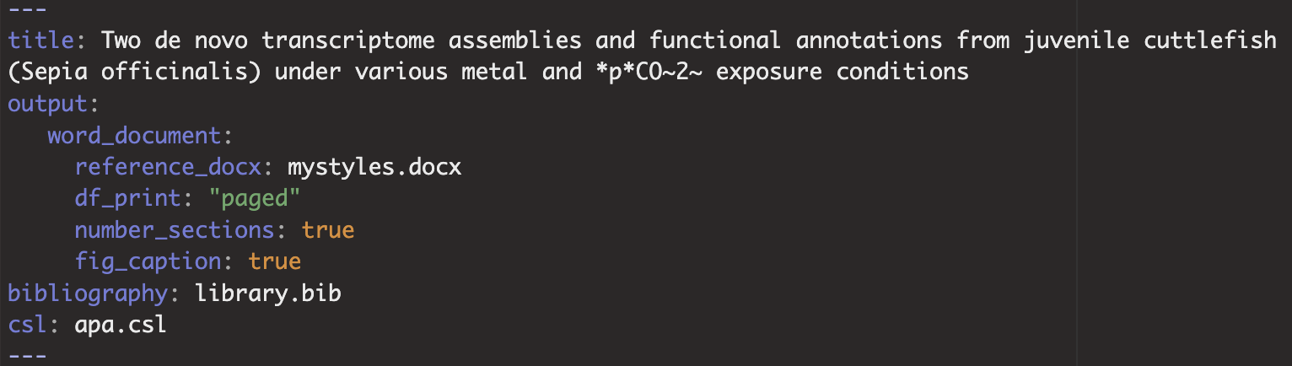
PROJECT ARCHITECTURE
PROJECT IMPLEMENTATION
Rendering tools: R markdown
PROJECT TRACKING
PROJECT SHARING

Slide 38
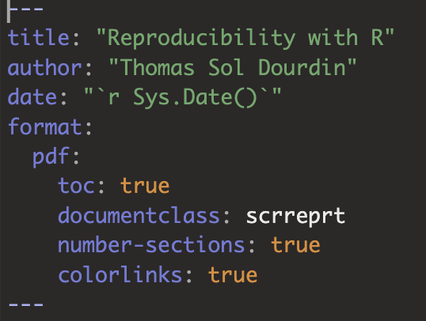
PROJECT ARCHITECTURE
PROJECT IMPLEMENTATION
Rendering tools: R markdown
PROJECT TRACKING
PROJECT SHARING
R markdown
Quarto

Slide 39
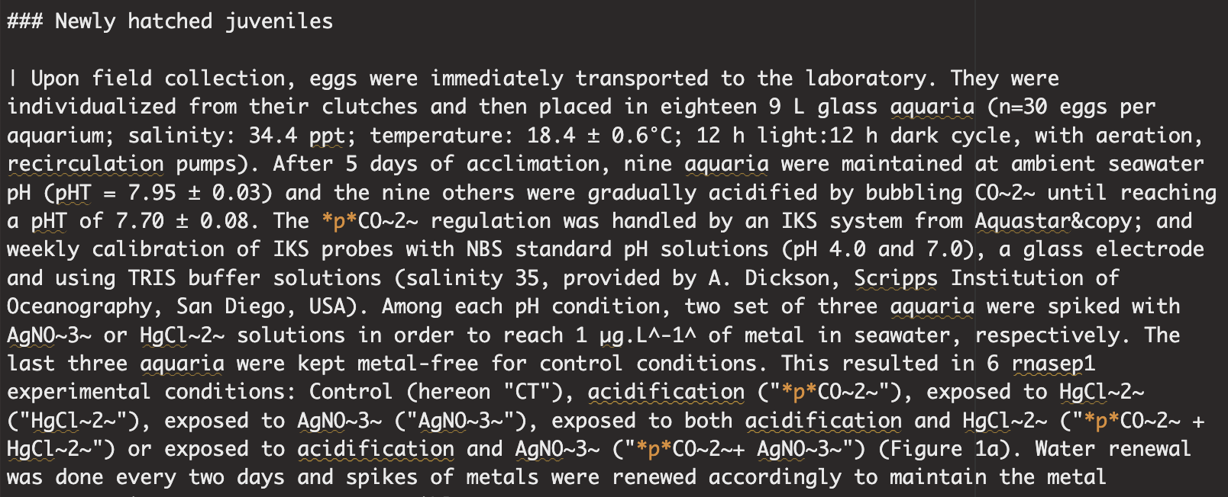
PROJECT ARCHITECTURE
PROJECT IMPLEMENTATION
Rendering tools: R markdown
PROJECT TRACKING
PROJECT SHARING

Slide 40
PROJECT ARCHITECTURE
PROJECT IMPLEMENTATION
Rendering tools: R markdown
PROJECT TRACKING
PROJECT SHARING
Main marks-up
*italic*
**bold**
~subscript~
^superscript^
+ dash
[link](URL)
![image](path){size}
<br> - blank line
# First title
## Second title

Slide 41
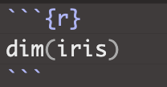
PROJECT ARCHITECTURE
PROJECT IMPLEMENTATION
Rendering tools: R markdown
PROJECT TRACKING
PROJECT SHARING
R markdown
basic

Slide 42
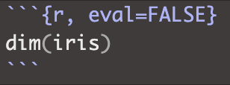
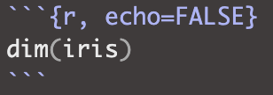


PROJECT ARCHITECTURE
PROJECT IMPLEMENTATION
Rendering tools: R markdown
PROJECT TRACKING
PROJECT SHARING
R markdown
$$🟰$$
$$🟰$$
basic
code only
result only

Slide 43
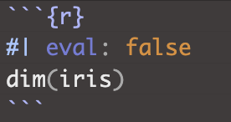
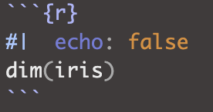


PROJECT ARCHITECTURE
PROJECT IMPLEMENTATION
Rendering tools: R markdown
PROJECT TRACKING
PROJECT SHARING
R markdown
$$🟰$$
$$🟰$$
basic
code only
result only
Quarto
$$🟰$$
$$🟰$$
basic
code only
result only

Slide 44
PROJECT ARCHITECTURE
PROJECT IMPLEMENTATION
Rendering tools: R markdown
PROJECT TRACKING
PROJECT SHARING
Main chunk options
eval
echo
warning
error
Include
renderings
label
fig-cap/tbl-cap
Fig-width/height/align
…
R markdown
$$🟰$$
$$🟰$$
basic
code only
result only
Quarto
$$🟰$$
$$🟰$$
basic
code only
result only

Slide 45
PROJECT ARCHITECTURE
PROJECT IMPLEMENTATION
Rendering tools: R markdown
PROJECT TRACKING
PROJECT SHARING
Main chunk options
eval
echo
warning
error
Include
renderings
label
fig-cap/tbl-cap
Fig-width/height/align
…
R markdown
$$🟰$$
$$🟰$$
basic
code only
result only
Quarto
$$🟰$$
$$🟰$$
basic
code only
result only
Including inline code is also possible: `r write your code`

Slide 46
Introduction
PROJECT ARCHITECTURE
PROJECT IMPLEMENTATION
The 4 pillars of reproducibility
PROJECT TRACKING
PROJECT SHARING

Slide 47
PROJECT
IMPLEMENTATION
PROJECT SHARING
Versioning tools: Git and GitHub
PROJECT ARCHITECTURE
PROJECT TRACKING

Slide 48
PROJECT
IMPLEMENTATION
PROJECT SHARING
Versioning tools: Git and GitHub
Dedicated to collaborative work (i.e. scientific labs)
Increasingly used as a showcase
Supports reproducibility
Needs time to be familiar…
PROJECT ARCHITECTURE
PROJECT TRACKING

Slide 49
PROJECT
IMPLEMENTATION
PROJECT SHARING
Versioning tools: Git and GitHub
Dedicated to collaborative work (i.e. scientific labs)
Increasingly used as a showcase
Supports reproducibility
Needs time to be familiar…
PROJECT ARCHITECTURE
PROJECT TRACKING
Git (local)
master
PROJECT

Slide 50
PROJECT
IMPLEMENTATION
PROJECT SHARING
Versioning tools: Git and GitHub
Dedicated to collaborative work (i.e. scientific labs)
Increasingly used as a showcase
Supports reproducibility
Needs time to be familiar…
PROJECT ARCHITECTURE
PROJECT TRACKING
Git (local)
working
master
PROJECT
BRANCH
PROJECT

Slide 51
PROJECT
IMPLEMENTATION
PROJECT SHARING
Versioning tools: Git and GitHub
Dedicated to collaborative work (i.e. scientific labs)
Increasingly used as a showcase
Supports reproducibility
Needs time to be familiar…
PROJECT ARCHITECTURE
PROJECT TRACKING
Git (local)
working
master
PROJECT
BRANCH
PROJECT
COMMIT
Work in progress
COMMIT

Slide 52
PROJECT
IMPLEMENTATION
PROJECT SHARING
Versioning tools: Git and GitHub
Dedicated to collaborative work (i.e. scientific labs)
Increasingly used as a showcase
Supports reproducibility
Needs time to be familiar…
PROJECT ARCHITECTURE
PROJECT TRACKING
Git (local)
working
master
PROJECT
BRANCH
PROJECT
COMMIT
Work in progress
COMMIT
PROJECT
COMMIT

Slide 53
PROJECT
IMPLEMENTATION
PROJECT SHARING
Versioning tools: Git and GitHub
Dedicated to collaborative work (i.e. scientific labs)
Increasingly used as a showcase
Supports reproducibility
Needs time to be familiar…
PROJECT ARCHITECTURE
PROJECT TRACKING
Git (local)
working
master
PROJECT
BRANCH
PROJECT
COMMIT
Work in progress
COMMIT
PROJECT
MERGE
PROJECT
COMMIT

Slide 54
PROJECT
IMPLEMENTATION
PROJECT SHARING
Versioning tools: Git and GitHub
Dedicated to collaborative work (i.e. scientific labs)
Increasingly used as a showcase
Supports reproducibility
Needs time to be familiar…
PROJECT ARCHITECTURE
PROJECT TRACKING
Git (local)
GitHub (remote)
working
master
PROJECT
BRANCH
PROJECT
PROJECT
PULL
COMMIT
Work in progress
COMMIT
PROJECT
MERGE
PROJECT
PROJECT
COMMIT
PUSH

Slide 55
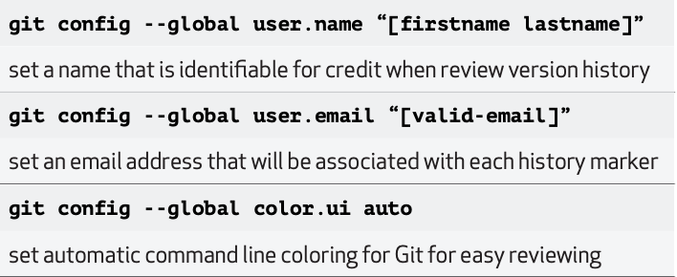
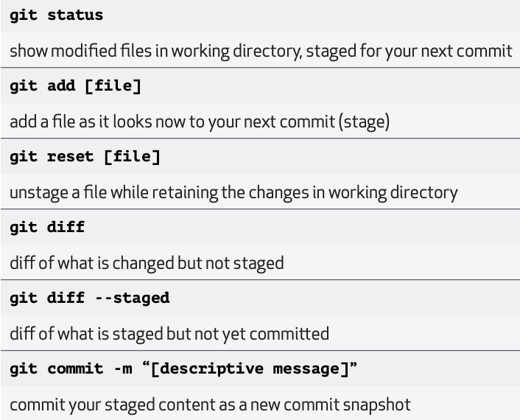
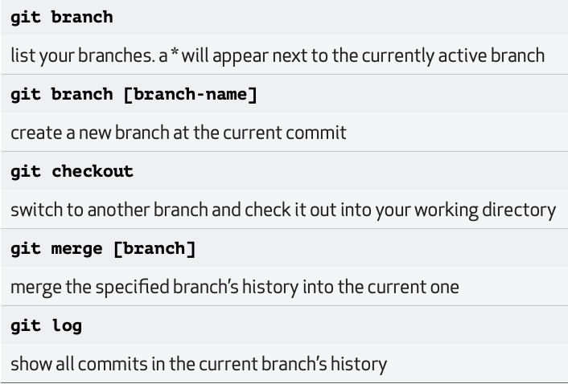
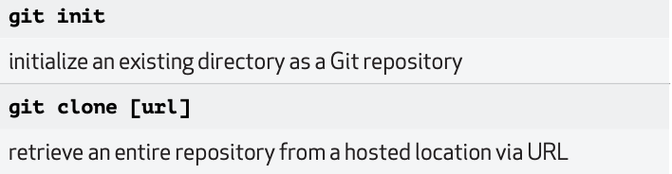
PROJECT
IMPLEMENTATION
PROJECT SHARING
Versioning tools: Git and GitHub
Dedicated to collaborative work (i.e. scientific labs)
Increasingly used as a showcase
Supports reproducibility
Needs time to be familiar…
PROJECT ARCHITECTURE
PROJECT TRACKING
A whole world of functions to manipulate Git !

Slide 56
PROJECT
IMPLEMENTATION
PROJECT SHARING
Versioning tools: Git and GitHub
Installation
Windows: https://gitforwindows.org/
macOS: git --version
git config
PROJECT ARCHITECTURE
PROJECT TRACKING
Let’s do it together – and take notes !

Slide 57
PROJECT
IMPLEMENTATION
PROJECT SHARING
Versioning tools: Git and GitHub
Configuration
git COMMAND --ARGUMENT
PROJECT ARCHITECTURE
PROJECT TRACKING
git config --global user.name “your name”
git config --global user.email “your email”
git config --global core.editor “emacs” #or any other preferred editor
git config --global init.defaultBranch “master” #main branch of your projects
Let’s do it together – and take notes !

Slide 58
PROJECT
IMPLEMENTATION
PROJECT SHARING
Versioning tools: Git and GitHub
Configuration
git COMMAND --ARGUMENT
PROJECT ARCHITECTURE
PROJECT TRACKING
git config --global user.name “your name”
git config --global user.email “your email”
git config --global core.editor “emacs” #or any other preferred editor
git config --global init.defaultBranch “master” #main branch of your projects
Now, create a Personal Access Token to link your Git to GitHub
Via R
Via GitHub
Let’s do it together – and take notes !

Slide 59
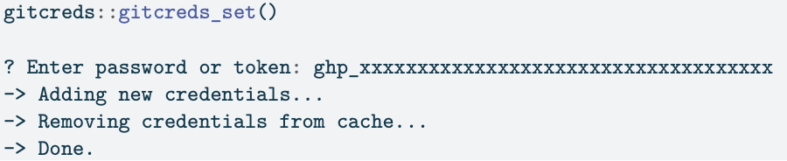
PROJECT
IMPLEMENTATION
PROJECT SHARING
Versioning tools: Git and GitHub
Configuration
git COMMAND --ARGUMENT
PROJECT ARCHITECTURE
PROJECT TRACKING
git config --global user.name “your name”
git config --global user.email “your email”
git config --global core.editor “emacs” #or any other preferred editor
git config --global init.defaultBranch “master” #main branch of your projects
Now, create a Personal Access Token to link your Git to GitHub
Via R
usethis::create_github_token()
gitcreds::gitcreds_set()
Let’s do it together – and take notes !

Slide 60
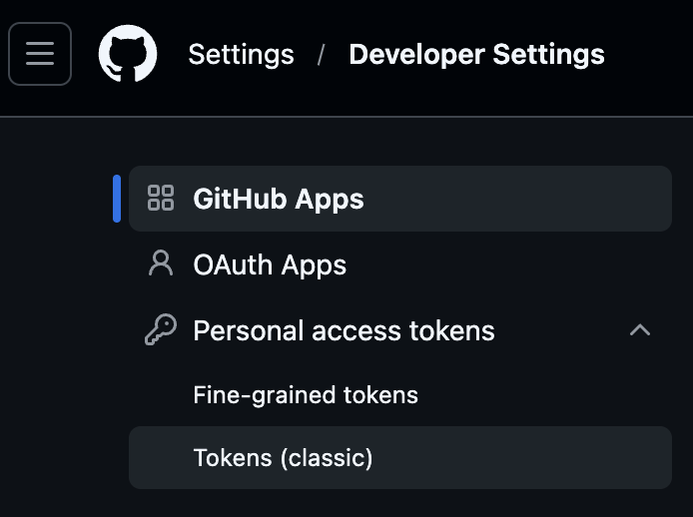
PROJECT
IMPLEMENTATION
PROJECT SHARING
Versioning tools: Git and GitHub
Configuration
git COMMAND --ARGUMENT
PROJECT ARCHITECTURE
PROJECT TRACKING
git config --global user.name “your name”
git config --global user.email “your email”
git config --global core.editor “emacs” #or any other preferred editor
git config --global init.defaultBranch “master” #main branch of your projects
Now, create a Personal Access Token to link your Git to GitHub
Via GitHub
→settings > Developer settings > Personal access
tokens > Generate new token
Let’s do it together – and take notes !

Slide 61
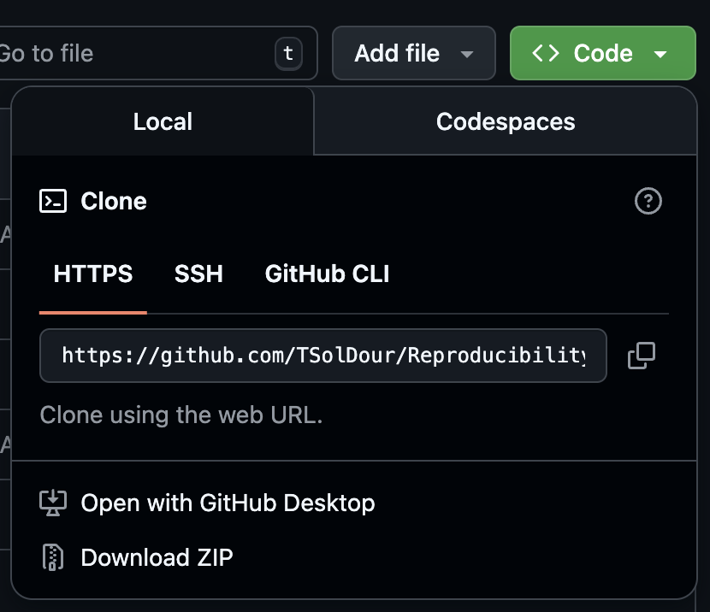
PROJECT
IMPLEMENTATION
PROJECT SHARING
Versioning tools: Git and GitHub
Connecting Git & GitHub
git init #start to track versions
git add <file name> #specify which file to track (individually)
git add --all #to track all the files in the folder
git rm --cached #to remove files from tracking
git commit --m <describe the commit> #make your first commit
git remote add origin <HTTPS URL> #https of the corresponding GitHub rep
git push –set-upstream origin <master branch> #push to the remote
PROJECT ARCHITECTURE
PROJECT TRACKING
git clone <HTTPS URL> #import existing GitHub rep
Let’s do it together – and take notes !

Slide 62
PROJECT
IMPLEMENTATION
PROJECT SHARING
Versioning tools: Git and GitHub
PROJECT ARCHITECTURE
PROJECT TRACKING
Git (local)
GitHub (remote)
working
master
PROJECT
BRANCH
PROJECT
PROJECT
PULL
COMMIT
Work in progress
COMMIT
PROJECT
MERGE
PROJECT
PROJECT
COMMIT
PUSH

Slide 63
Introduction
PROJECT ARCHITECTURE
PROJECT IMPLEMENTATION
The 4 pillars of reproducibility
PROJECT TRACKING
PROJECT SHARING

Slide 64
PROJECT
TRACKING
PROJECT ARCHITECTURE
Automate the workflow – targets
PROJECT
SHARING
PROJECT IMPLEMENTATION

Slide 65
PROJECT
TRACKING
PROJECT ARCHITECTURE
Automate the workflow – targets
Need to know what is a function and how to create it.
Input function output
PROJECT
SHARING
PROJECT IMPLEMENTATION

Slide 66
PROJECT
TRACKING
PROJECT ARCHITECTURE
Automate the workflow – targets
Need to know what is a function and how to create it.
Input function output
PROJECT
SHARING
PROJECT IMPLEMENTATION
output
function(argument)
m <- mean(v)
s <- sd(v)
n <- length(v)
c(mean = m, sd = s, n = n)

Slide 67
PROJECT
TRACKING
PROJECT ARCHITECTURE
Automate the workflow – targets
Need to know what is a function and how to create it.
Input function output
PROJECT
SHARING
PROJECT IMPLEMENTATION
output
function(argument)
library()
mean()
aov()
ggplot()
deseq()
m <- mean(v)
s <- sd(v)
n <- length(v)
c(mean = m, sd = s, n = n)

Slide 68
PROJECT
TRACKING
PROJECT ARCHITECTURE
Automate the workflow – targets
Need to know what is a function and how to create it.
Input function output
PROJECT
SHARING
PROJECT IMPLEMENTATION
output
function(argument)
library()
mean()
aov()
ggplot()
deseq()
m <- mean(v)
s <- sd(v)
n <- length(v)
c(mean = m, sd = s, n = n)
Use it with targets !

Slide 69
PROJECT
TRACKING
PROJECT ARCHITECTURE
PROJECT
SHARING
PROJECT IMPLEMENTATION

Slide 70
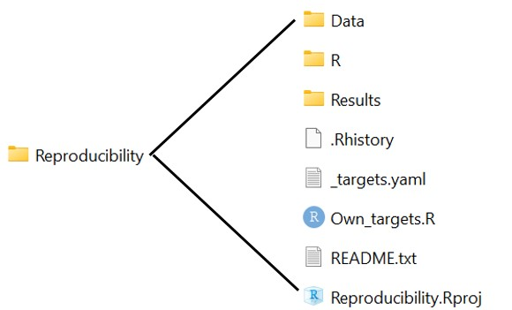
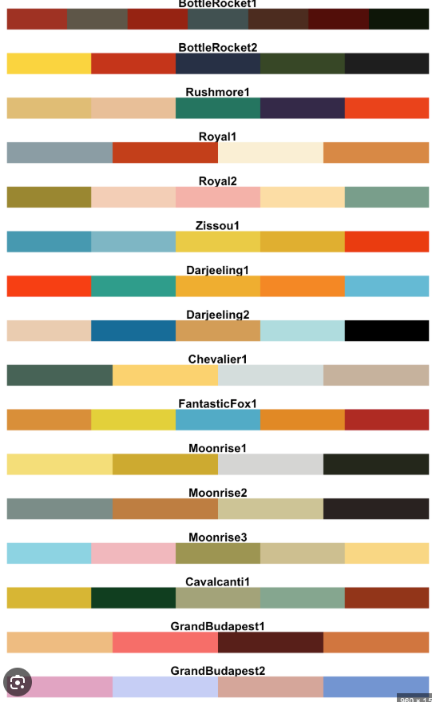
Introduction

