Slide 1
GIPHER - GIF FOR ALL

Slide 2
AGENDA
OBJECTIVES
TECHNOLOGIES
FUNCTIONALITIES IMPLEMENTED
MICRO SERVICES
WORKFLOW

Slide 3
OBJECTIVES
The objective of this project is to create a Rest API to fetch the giphers.
The view should be static where user can search the gipher by name, thing, place. It should fetch the data from third party API(giphy.com)

Slide 4
TECHNOLOGIES
FRONT-END TECHNOLOGIES--HTML, CSS, ANGULAR
BACK-END TECHNOLOGIES---SPRING BOOT
DATABASES— MYSQL, MONGODB

Slide 5
FUNCTIONALITIES IMPLEMENTED
REGISTER
LOGIN
SEARCH
FAVORITES
RECOMMENDATIONS
LOGOUT

Slide 6
MICRO SERVICES
User Authentication:In user authentication we can do login,register,validation,token generation.
Recommendation:Fetching,adding,deleting recommendations.
Favorites:Fetching,adding,deleting,favorites

Slide 7
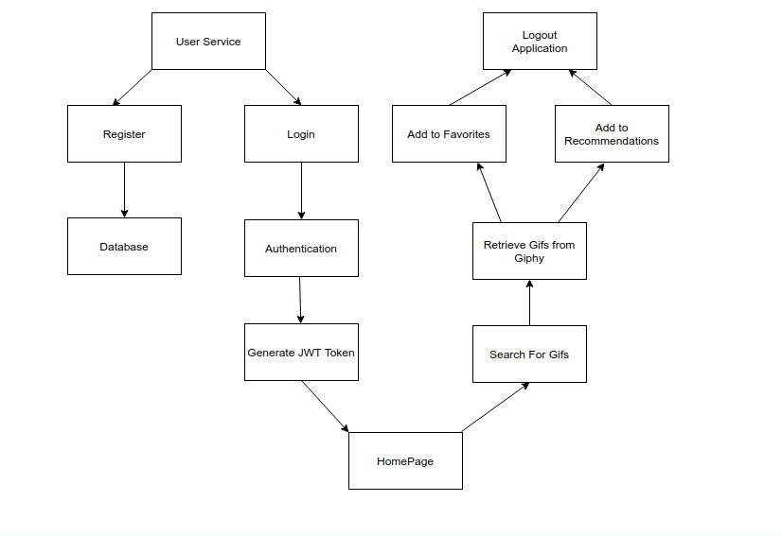
WORKFLOW

Slide 8
THANK YOU

