Slide 1
Effective Approaches to Attention-based Neural Machine Translation Dminh-Thang Luong, Hieu Pham, Chris D. Manning
Tarun Sunkaraneni
CS 6596

Slide 2
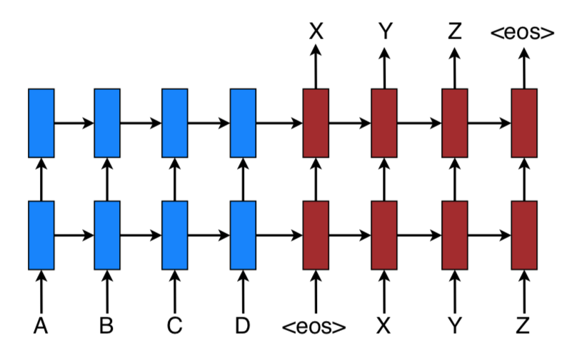
Introduction: NMT
State-of-the-art performance in large scale translation tasks such as from English to French.
Minimal domain knowledge, conceptually simple, and requires a small memory footprint.
Easier decoder implementation.
A stacking recurrent architecture for translating a source
A B C D → X Y Z
Notes:
As all of you know, NMT stands for Neural Machine Translation.
As most of you already know, Neural Machine Translation does really well at its job.
Neural translation is often a large neural network that is trained in an end-end fashion and has the ability to generalize well to very long word sequences.
Why? Neural Machine translation is appealing because it requires very little precursor knowledge such as gigantic phrase tables and language models, as standard Machine Translation does.
Implementing NMT decoders is easy unlike the highly intricate decoders in standard MT.
The process indicated by this picture summarizes how the sequence ABCD gets translated into XYZ. The blue cells indicate the encoding part of the NMT, while the maroon indicates the decoding part.
It is interesting to note that <EOS> is the initial input to the the desired translation. (Discussion)

Slide 3
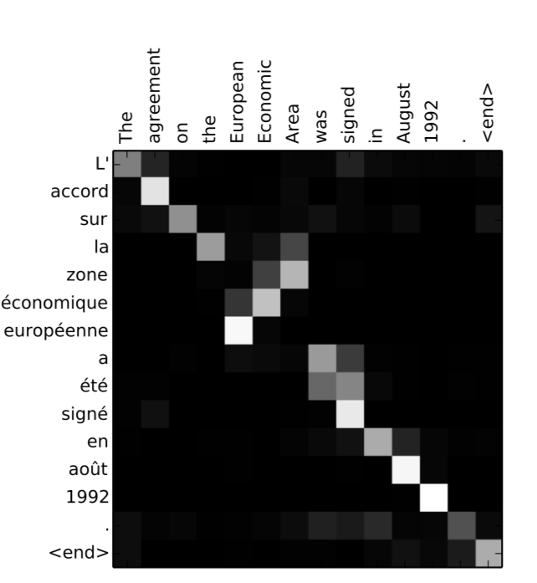
Introduction: Attention
Allows models to learn alignments between different representations.
Capturing relationship between:
image objects and agent actions in a control problem.
Speech frames and text in speech recognition
Visual features of a picture and its text description in a image caption generation task
Precursor work → Bahadanu: content-based neural attention
Claims same principles carry over in Neural Turing Machines and Memory networks
Notes:
As all of you also know, the idea of Attention is also been instrumental in advancing neural network performance in NLP tasks and with image captioning.
Student of Bengio, has a tensorflow class named after him BahadanuAttention.

Slide 4
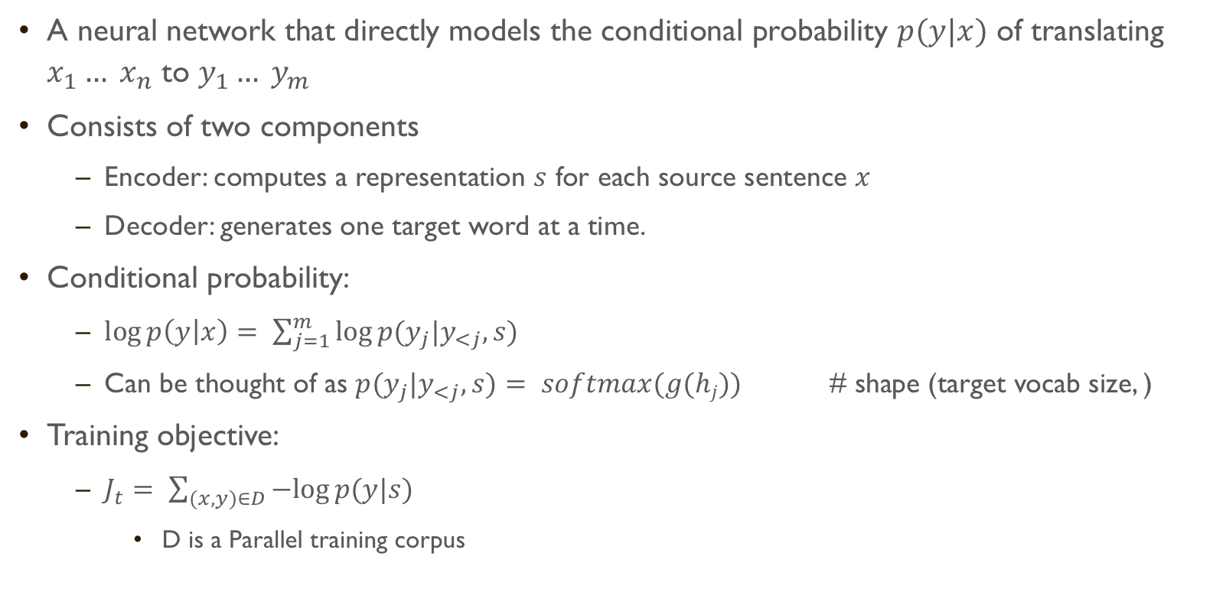
Neural Machine Translation
A neural network that directly models the conditional probability $p(y|x)$ of translating $x_{1}… x_{n}$ to $y_{1}… y_{m}$
Consists of two components
Encoder: computes a representation $s$ for each source sentence $x$
Decoder: generates one target word at a time.
Conditional probability:
$\log{p\left(y | x\right)}= \sum_{j=1}^{m}{log⁡p(y_{j}|y_{<j}, s)}$
Can be thought of as $p(y_{j}|y_{<j}, s)$ $= softmax(g(hj))$ # shape (target vocab size, )
Training objective:
$J_{t}= \sum_{(x,y)∈D}{−log⁡p(y|s)}$
D is a Parallel training corpus
Notes:
S is generated from x.

Slide 5


Attention based models
Global and Local
Whether attention is placed on all source positions or on only a few source positions.
At each time step $t$ in the decoding phase, take hidden state $h_{t}$ at the top layer of a stacking LSTM
Goal: derive a context vector $c_{t}$ that can help predict target $y_{t}$
Attentional hidden state:
$\tilde{h}=tanh⁡(w_{c}[c_{t};h_{t}])$
$p(y_{j}|y_{<j}, s)$ $= softmax(W_{s}\tilde{h})$
Notes:
From the given summation it seems that we start by predicting the probability of the first word given <eos> and so on until we get the probability of generating the last word given the sequence before.
Bahadanu adopted a stacked GRU units for both the encoder and the decoder.

Slide 6
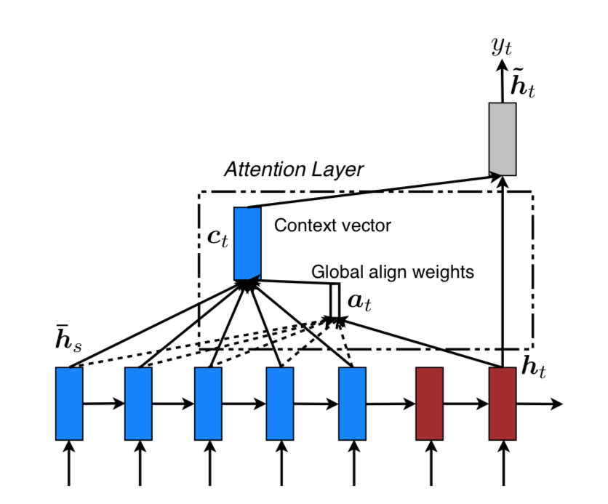
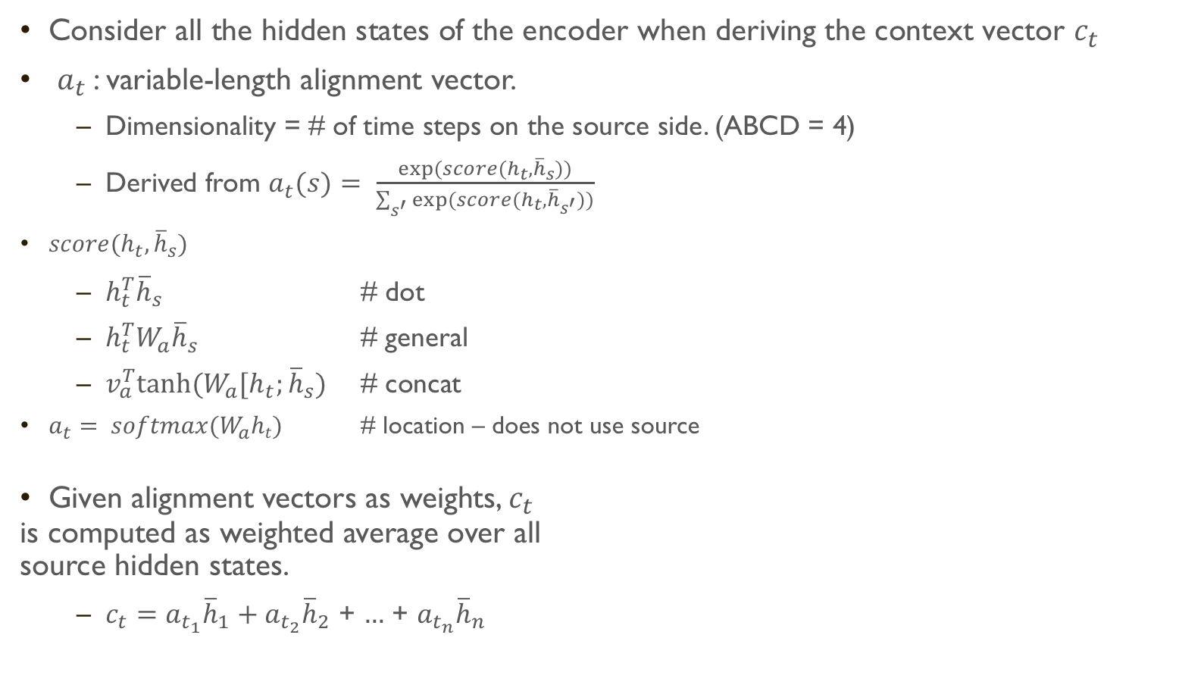

Global Attention model
Consider all the hidden states of the encoder when deriving the context vector $c_{t}$
$a_{t}$: variable-length alignment vector.
Dimensionality = # of time steps on the source side. (ABCD = 4)
Derived from $a_{t}(s)$ $= \frac{exp⁡(score(h_{t},{\overline{h}}_{s}))}{\sum_{s^{′}}{exp⁡(score(h_{t},{\overline{h}}_{s^{′}}))}}$
$score(h_{t},{\overline{h}}_{s})$
$h_{t}^{T}{\overline{h}}_{s}$ # dot
$h_{t}^{T}{W_{a}\overline{h}}_{s}$ # general
$v_{a}^{T}tanh⁡(W_{a}[h_{t};{\overline{h}}_{s})$ # concat
$a_{t}$ $= softmax(W_{a}ht)$ # location – does not use source
Given alignment vectors as weights, $c_{t}$
is computed as weighted average over all
source hidden states.
$c_{t}=a_{t_{1}}{\overline{h}}_{1}+a_{t_{2}}{\overline{h}}_{2}$ + $…$ + $a_{t_{n}}{\overline{h}}_{n}$
$h_{t}$: current target hidden state
${\overline{h}}_{s}$ : source hidden state
Notes:
This method is analogous to the soft attention we’ve discussed in class.
How location works is kind of confusing assuming that it does not rely on the source hidden states. Wa may be sufficient to infer in some cases.

Slide 7
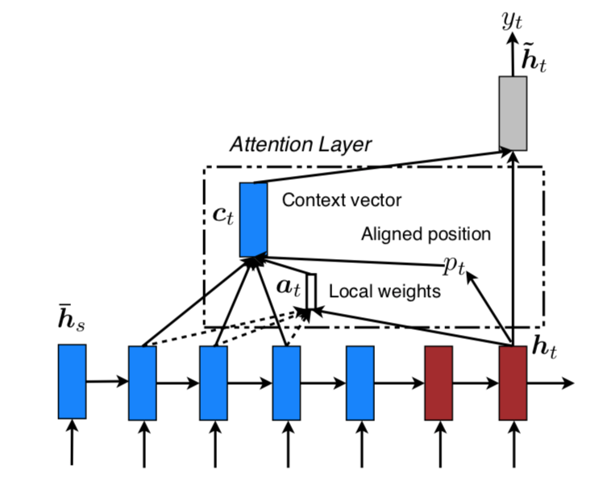
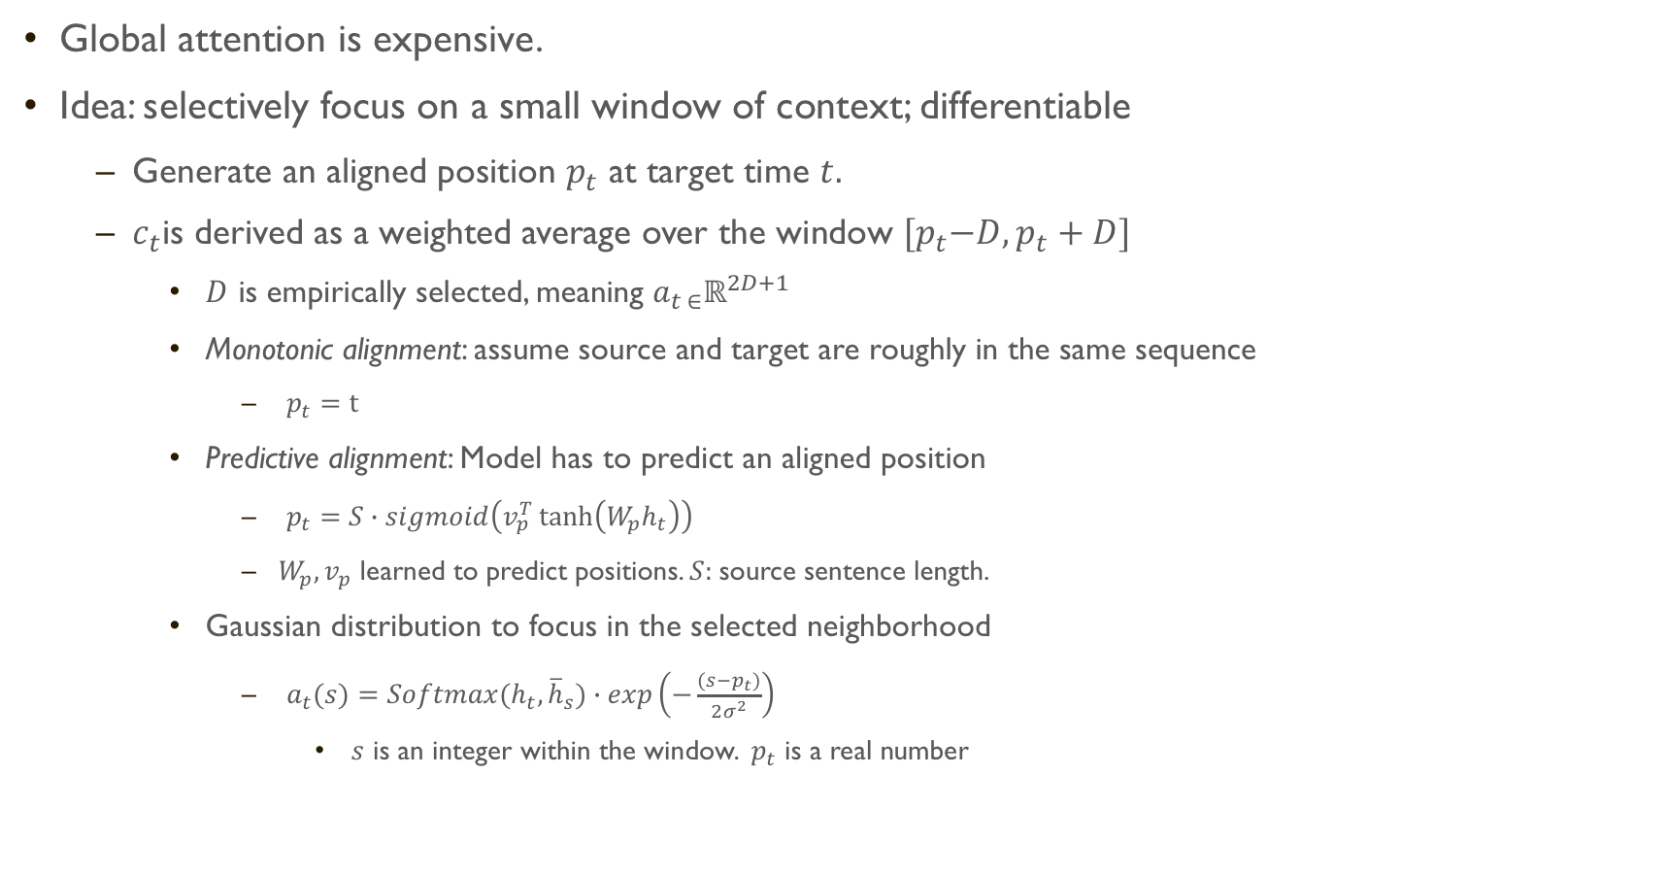
Local Attention model
Global attention is expensive.
Idea: selectively focus on a small window of context; differentiable
Generate an aligned position $p_{t}$ at target time $t.$
$c_{t}$is derived as a weighted average over the window ${[p}_{t}−D,p_{t}+D]$
$D$ is empirically selected, meaning $a_{t ∈}ℝ^{2D+1}$
Monotonic alignment: assume source and target are roughly in the same sequence
$p_{t}=t$
Predictive alignment: Model has to predict an aligned position
$p_{t}$ $=S∙sigmoid\left(v_{p}^{T}\tanh\left(W_{p}h_{t}\right)\right)$
$W_{p}, v_{p}$ learned to predict positions. $S:$source sentence length.
Gaussian distribution to focus in the selected neighborhood
$a_{t}(s)$ $=Softmax(h_{t},{\overline{h}}_{s})∙exp\left(−\frac{(s−p_{t})}{2σ^{2}}\right)$
$s$ is an integer within the window. ${ p}_{t}$ is a real number
Notes:
The problem with Global attention is that it has to attend to all words on the source side of each target word, which can render it impractical to translate longer sequences such as paragraphs or documents.
To address this, the paper also proposes a local attentional mechanism that chooses to focus only on a small subset of the source positions per target word.
In image captioning, soft attention can be thought of weighing over all patches in the source image. hard attention selects one patch of the image to attend to at a time.
While less expensive at inference time, the hard attention model is non-differentiable and requires more complicated techniques such as variance reduction or reinforcement learning to train.

Slide 8
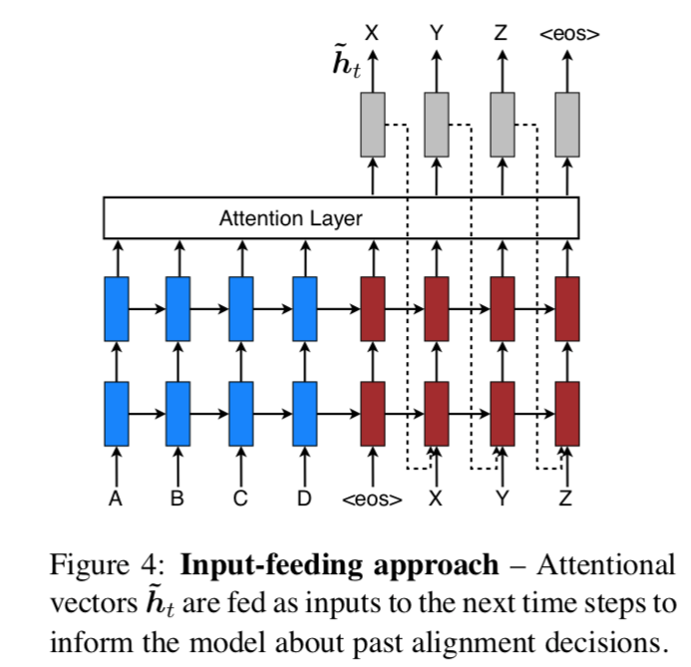
Input-feeding approach
Notes:
S is generated from x.

Slide 9
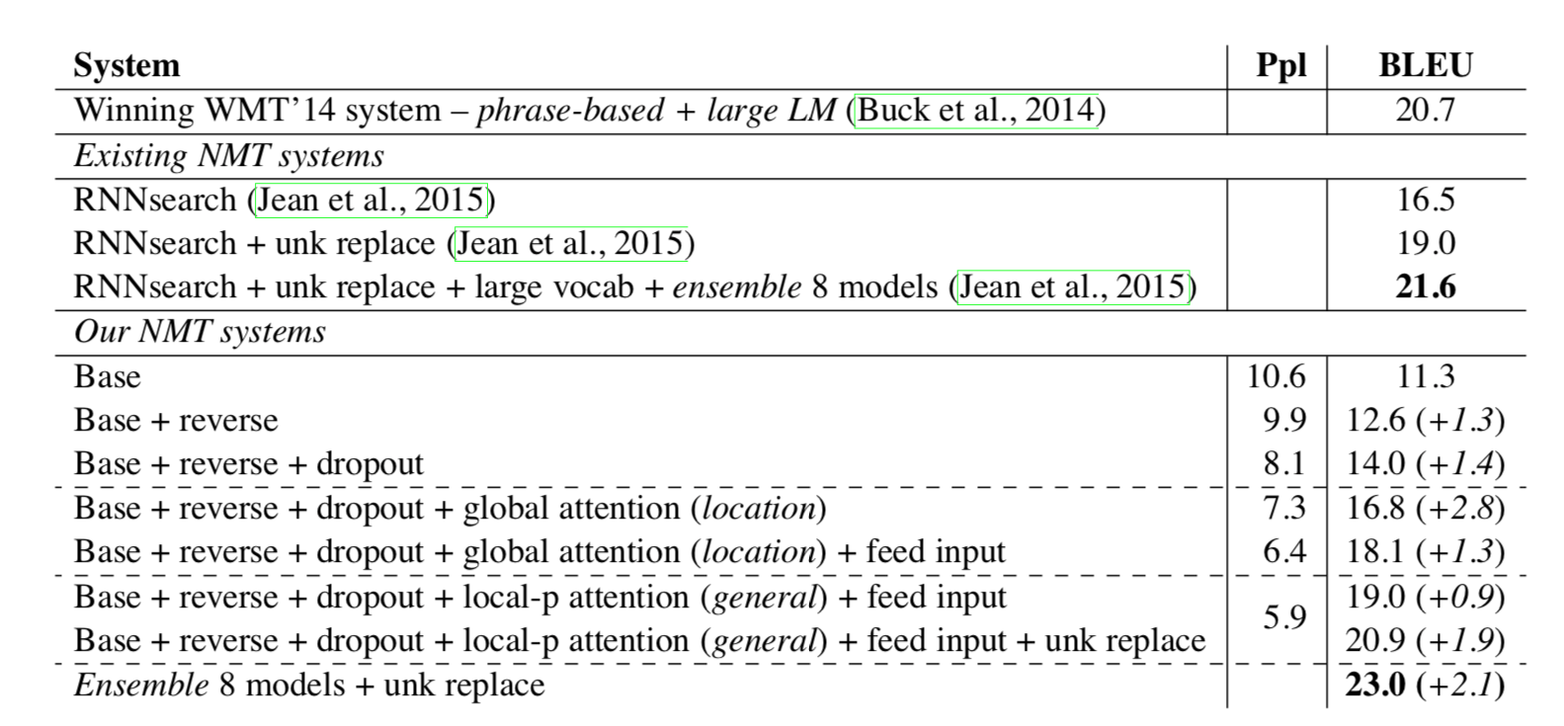
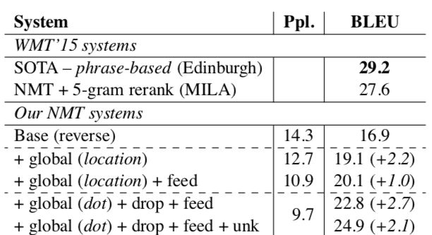
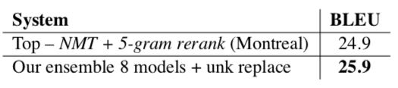
Results
WMT’14 English-German
WMT’15 English-German (using WMT’ 14)
WMT’15 German-German (using WMT’ 14)
Notes:
S is generated from x.

Slide 10

Results
Notes:
S is generated from x.

