Slide 1

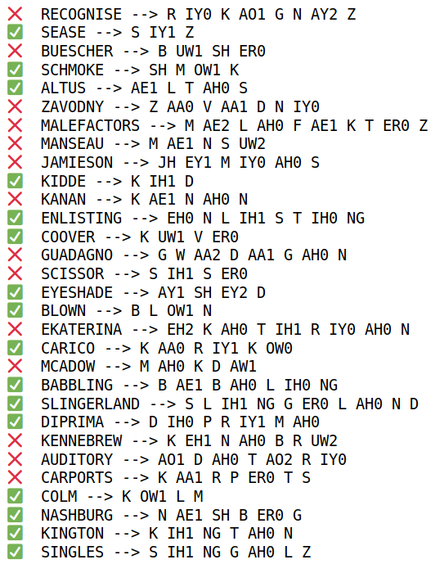
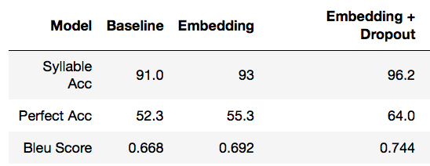
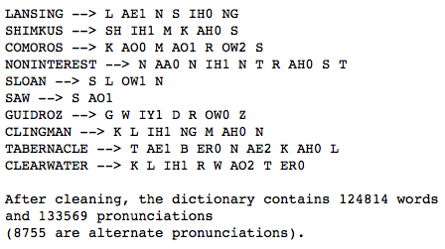
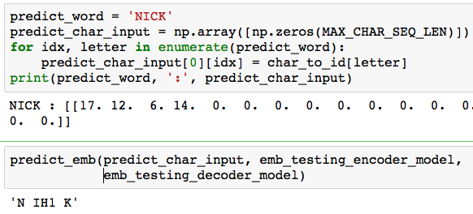
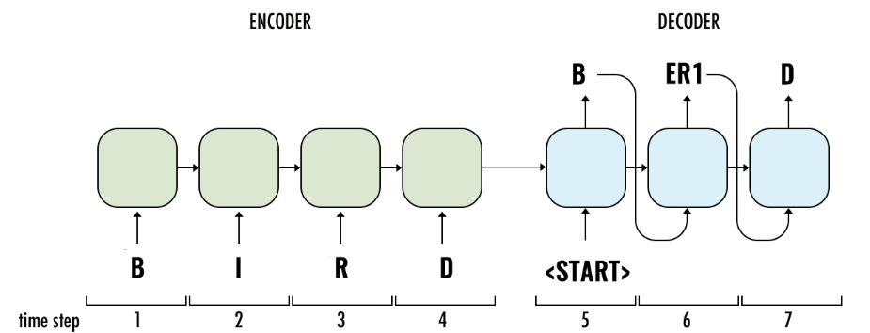
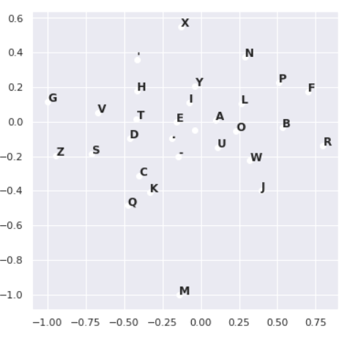
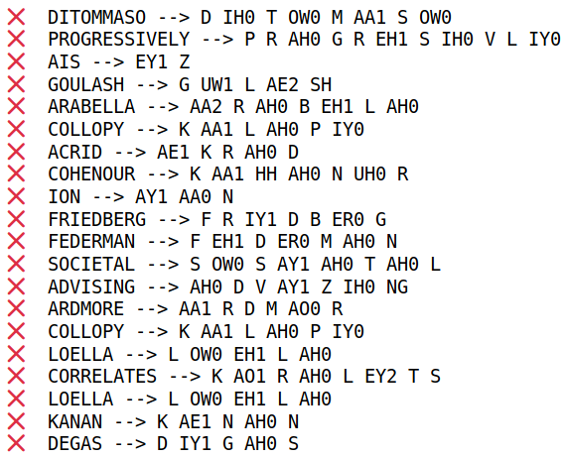
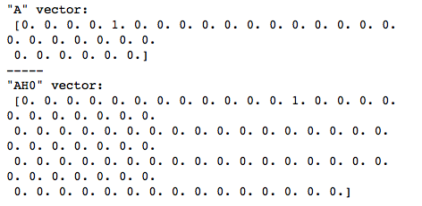
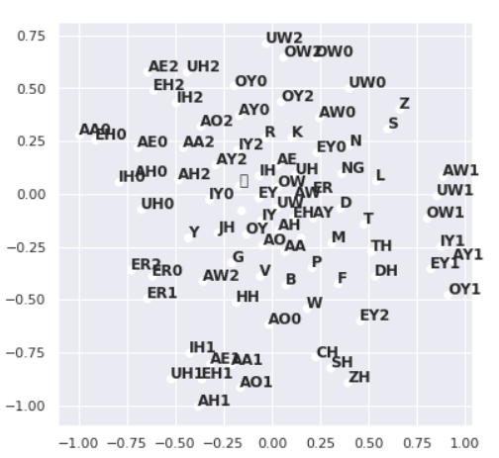
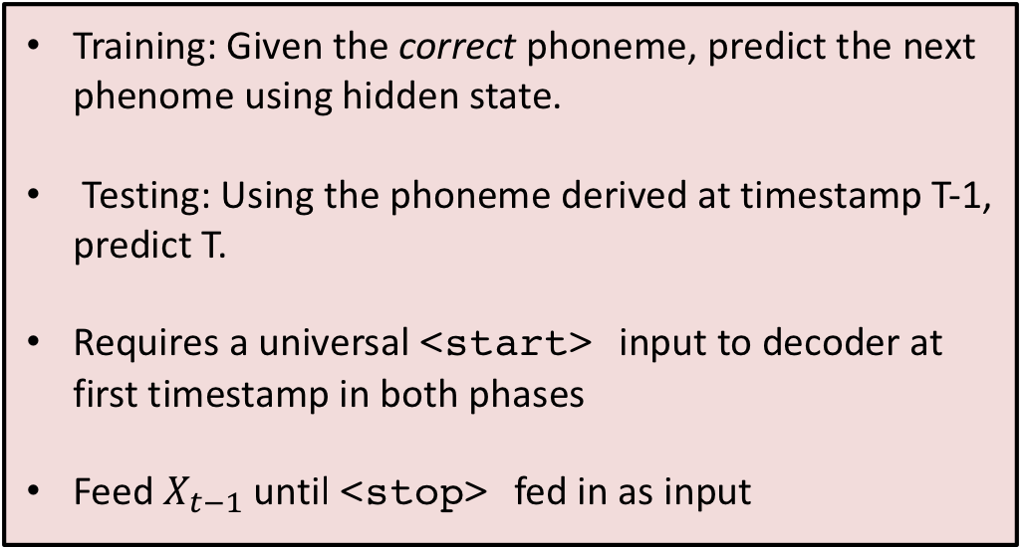
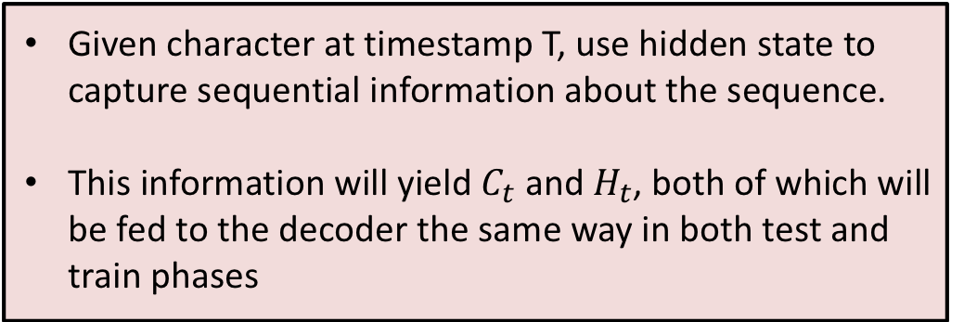
Pronounce this!
Tarun Sunkaraneni
Introduction
Predictions
Evaluation
CMU pronunciation dictionary maps over 134,000 words to their pronunciations.
There are 39 phenomes, not accounting for lexical stress variations.
84 total symbols with vowel stress variations.
Stress markers: 0(None), 1(primary), 2(secondary)
Embedding layer gives model flexibility to perform better, but can result in overfitting.
After adding Dropout, the perfect accuracy score increases
Embedding lowered memory constraints significantly, although adding many more trainable parameters
1) Baseline
One hot encoded input characters and output phenomes.
No form of regularization
1) Syllable accuracy: done by counting number of phenomes with stress markers.
2) Perfect accuracy: count examples with correct output phonemes and stress markers.
3) Bleau Score: Used in NMT, same principle applies in phenome translation
2) Character Embeddings
Learnable character and phoneme embeddings provides model more flexibility to learn, and makes training less memory intensive
Encoder input shape: (# Examples, Max word length)
Decoder input shape: (# Examples, Max phenomes length)
Char embedding shape: (# Examples, Embedding dim)
Phenome embedding shape: (# Examples, Embedding dim)
Fix overfitting by adding dropout
Unaddressed problems
Our information flow only goes in one direction. Word pronunciation is very much dependent on the next character as it is on the previous character.
Use Bi-Directional RNN connections
Only connection between Encoder and Decoder is through the state ”handoff.” These states alone might not be sufficient for long words.
Use Attention mechanism.
Predication is not robust and versatile, chooses only most likely sequence.
Use BeamSearch
Architecture
Encoder input shape: (# Examples, Max word length, # of characters)
Decoder output shape: (# Examples, Max phonemes length, # of phonemes)
TSNE-visualizations of characters and phonemes
Encoder Procedure
Given character at timestamp T, use hidden state to capture sequential information about the sequence.
This information will yield $C_{t}$ and $H_{t}$, both of which will be fed to the decoder the same way in both test and train phases
Improvements
Very little hyperparameter training was done due to compute requirements.
Separate Stress marker model to predict intensity of vowels
Decoder Procedure
Training: Given the correct phoneme, predict the next phenome using hidden state.
Testing: Using the phoneme derived at timestamp T-1, predict T.
Requires a universal <start> input to decoder at first timestamp in both phases
Feed $X_{t−1}$ until <stop> fed in as input
Acknowledgements
Predicting Pronunciations with Syllabification and Stress with Recurrent Neural Networks - Daan Esch
Text-to-Phoneme mapping using neural Networks – Eniko Bilicu
English Phoneme predictions using RNN – Ryan Epp
Joint-Sequence Models for Grapheme-to-Phoneme Conversion- Max Bisani

