Slide 1
COUNCILOR MEJIA X CITY SERVICES PROJECT
Team 3
Derek Dumouchel - Team Lead
Zihao Shen
Tian Tan
Lu Yao

Slide 2
COUNCILOR MEJIA X CITY SERVICES Client Partner: Sandra Saavedra and Councilor Mejia Project Manager: Sophia Marian Sena Technical Engineer: Aidan Gomez
Team 3
Derek Dumouchel
Zihao Shen
Tian Tan
Lu Yao
Motivation
To ensure that the city of Boston equitably distributed relief funds across demographics (race, ethnicity, income, etc.) during Covid-19 Pandemic
Goal
Analyze business relief datasets along with available census data to determine the outreach and adequacy of the aid.
Background
Covid-19 had devastating effects on the economy, severely hindering business revenue and growth. It is believed that it disproportionately affected lower income residents and businesses.

Slide 3
MID-SEMESTER STATUS
Accomplishments
Evaluation of race composition and population density.
Dispersity of funds across neighborhoods
Division of Labor
Weekly meetings on Mondays to review goals and assessments.
Status updates via Slack and Google Drive on Thursdays, prior to the weekly meetings with the project lead.
Different datasets and features are reviewed and assessed by team members.
E.g., Business Funds/Licenses dataset, Census block data, Geocode Analysis
Team lead chosen with collaboration on deliverables via Google Docs.
Dataset Utilization
‘Boston Neighborhood’
‘Business Assistance Funds’
‘Boston Zoning Subdistricts’
‘Boston Census Data’
‘Active Food Establishment License’
‘Liquor License’

Slide 4
EARLY OBSERVATIONS
Early Results
Slides 5-8
Early Visualizations (put plots)
Slides 5-8
Challenges with Data
Dataset not up to date
Total funding allocation per business not provided

Slide 5
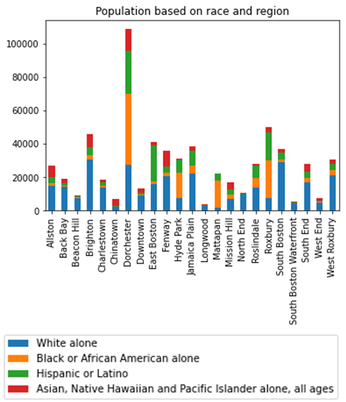
Census Analysis
Surrounding downtown(Chinatown, South End, North End, West End, Bay Village, Beacon Hill and Back Bay): Chinese and other Asian populations, African American, white.
North and east of downtown(East Boston and Charlestown): a majority of Hispanics, Brazilians.
West of downtown(Fenway Kenmore, Allston, Brighton, Longwood and Mission Hill): populated heavily by students from nearby universities. Mission Hill is an ethnically diverse neighborhood.
South of downtown(Roxbury, Jamaica Plain, Dorchester and South Boston): Dorchester is considered to be Boston's most diverse.
Roslindale: a majority-minority neighborhood.
Mattapan: mainly African Americans.
Hyde Park: mainly African Americans and Caribbean Americans
West Roxbury: mainly white.

Slide 6
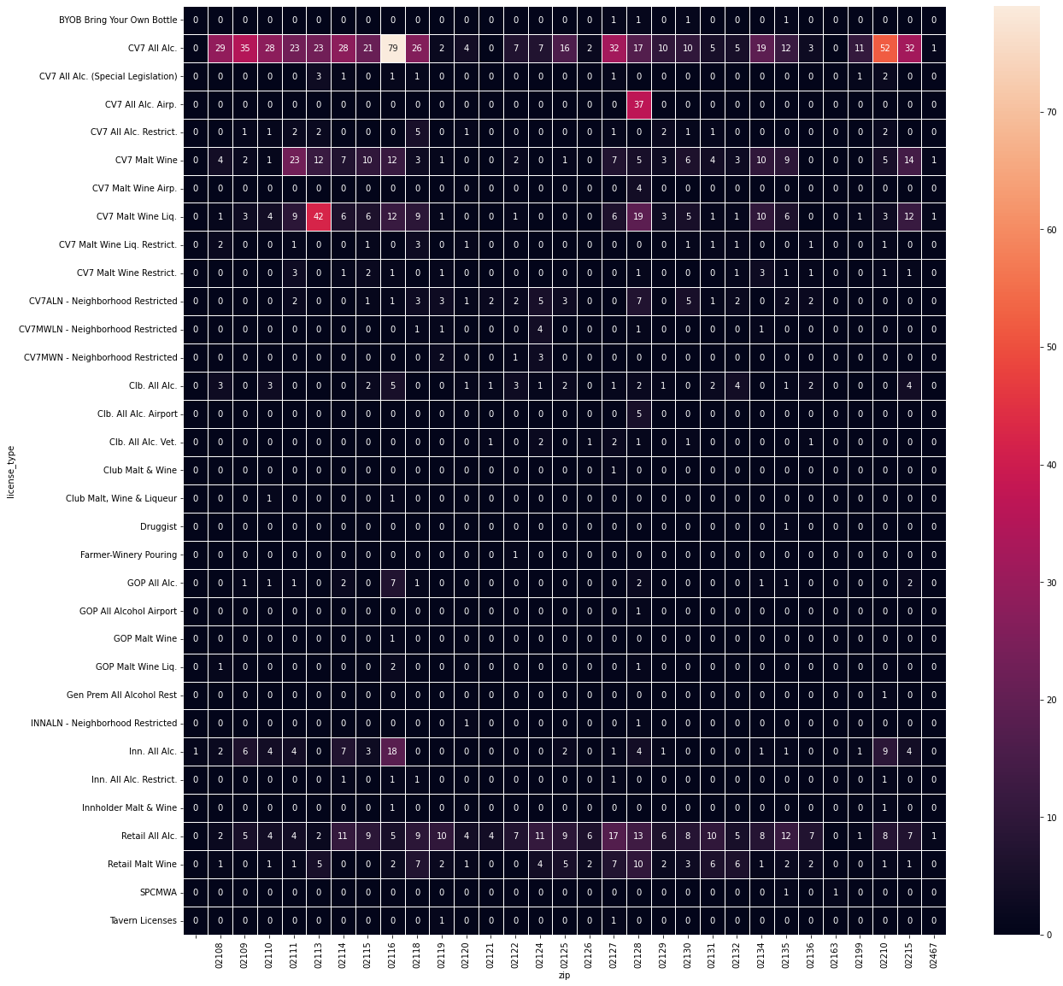
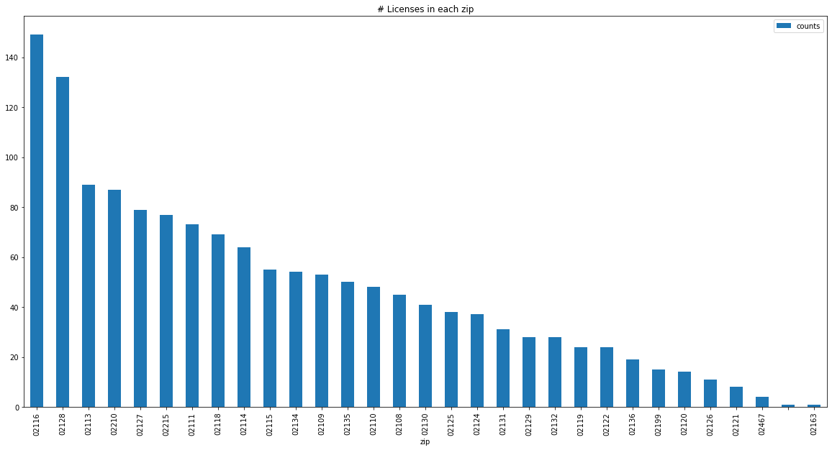
Alcohol Analysis
33 license types among 31 regions
If analyze together, generated the plot left
The license ‘CV7 All Alc.’ is usually used.
If analyze separately, generated the plot below
The zip code 02116 (Back Bay) has most licenses.

Slide 7
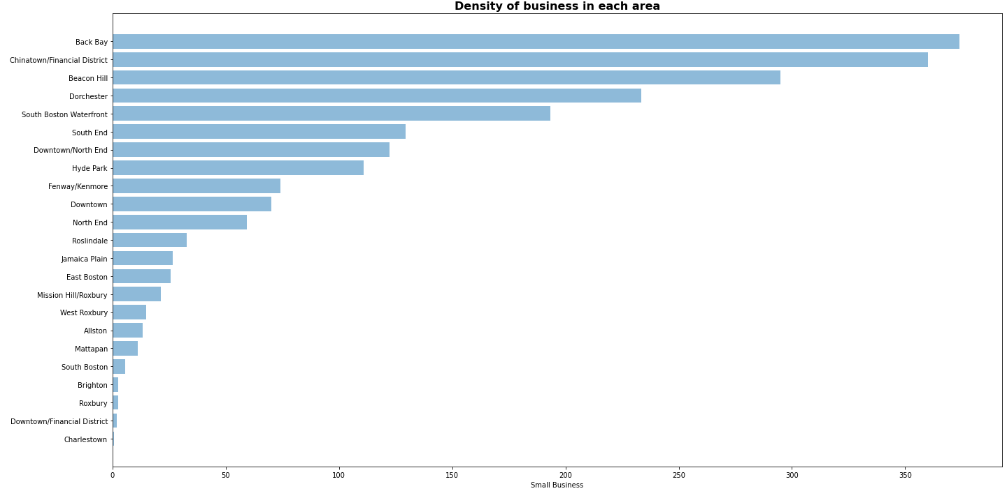
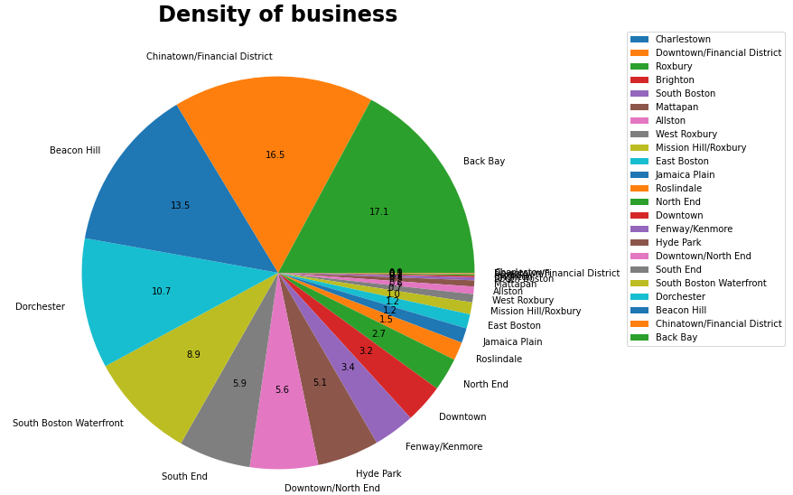
Distribution of small businesses
By combining the amount of small business and the area of each neighborhood, we can find that Back Bay and Chinatown/Financial District area have higher density of small businesses, with over 350 per mi^{^2}

Slide 8
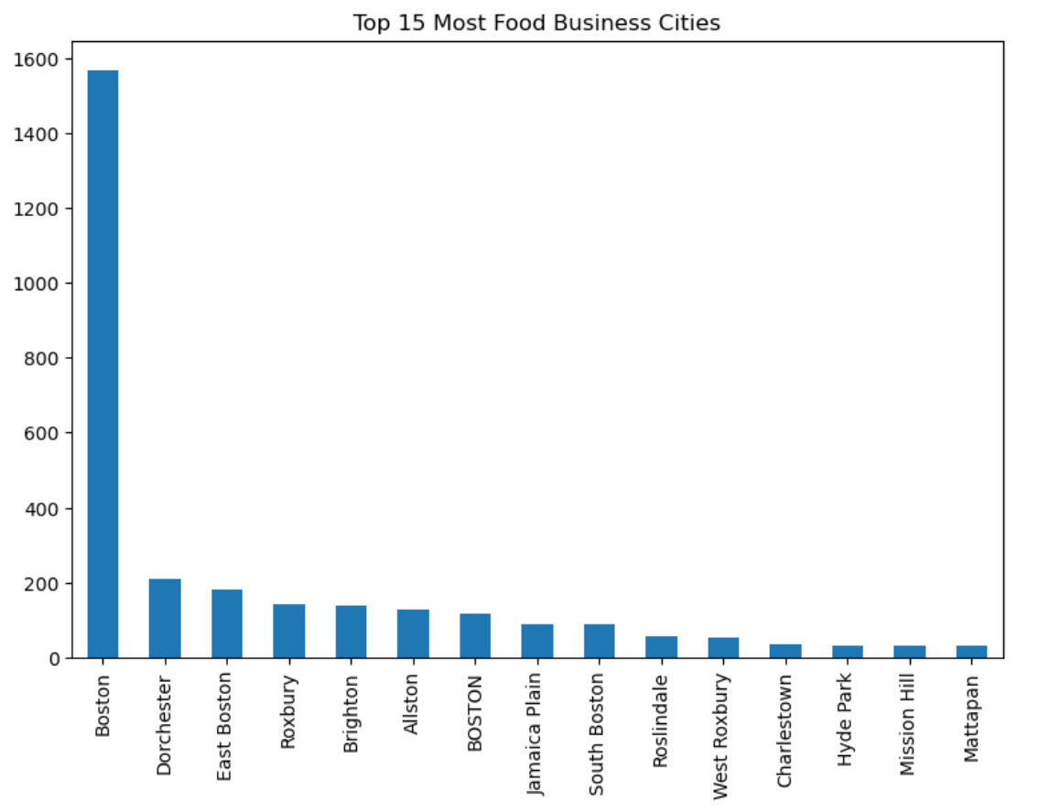
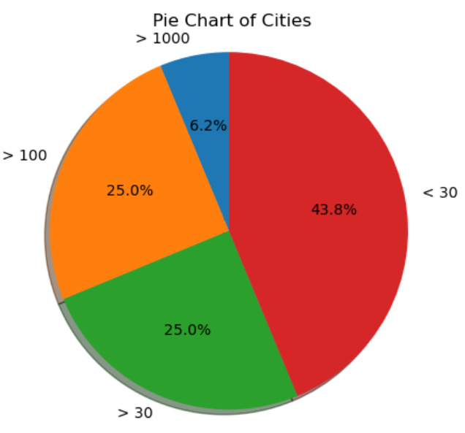
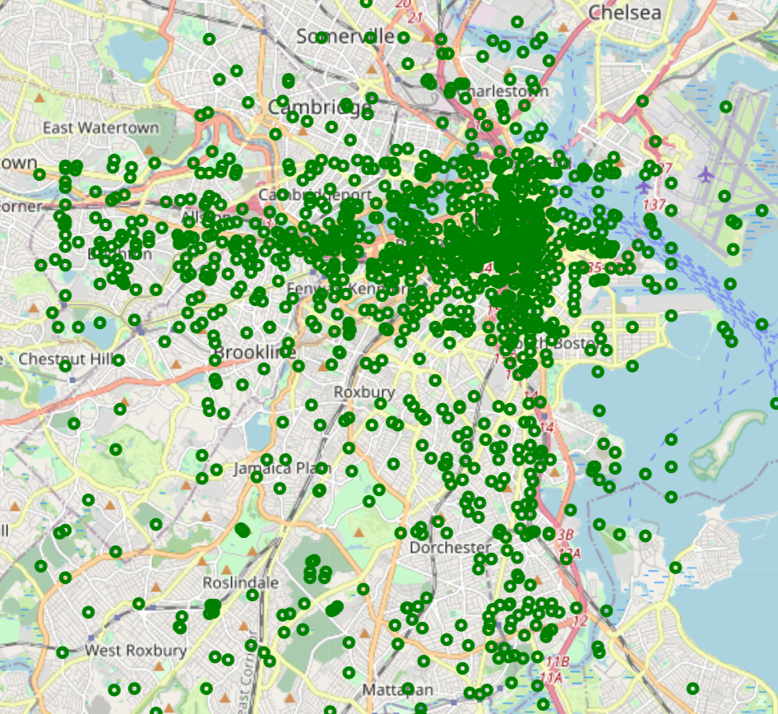
Food Analysis
Bar chart shows the number of food businesses in each city. It is very easy to find that the number of food businesses in Boston far exceeds that of other regions. In other regions, food business is more evenly distributed.
The pie chart displays the proportion of cities based on the number of food businesses. Cities with less than 30 food businesses account for 43.8% of all cities.
By marking all food businesses on the map, it shows that their distribution is scattered around the Boston city.

Slide 9
CHALLENGES AND LIMITATIONS
Challenges
Data’s categories are various, it is hard to combine together
Confused about the criteria for defining equity communities, i.e. communities where funding should be targeted to achieve the city’s equity goals.
Next Steps (early results, next steps, plans to complete project)
Do further research and data visualization
Compile fundings and answer questions
Extension Project
Assessment of housing assistance funds has begun.

