Slide 1


Tin sinh học ứng dụng (Applied Bioinformatics)
Phuc Loi Luu, PhD
Luu.p.loi@googlemail.com
Nov 02 2024

Slide 2
Content
Class member introduction
Curriculum of Applied Bioinformatics 2024
Projects and important dates
Evalutation for the course
How my lecture work?
Linux OS, Google Colab and Linux Command Lines

Slide 3

Class member introduction
Bạn phẻ không?
Phẻ! Cảm ơn bạn. Còn bạn?

Slide 4
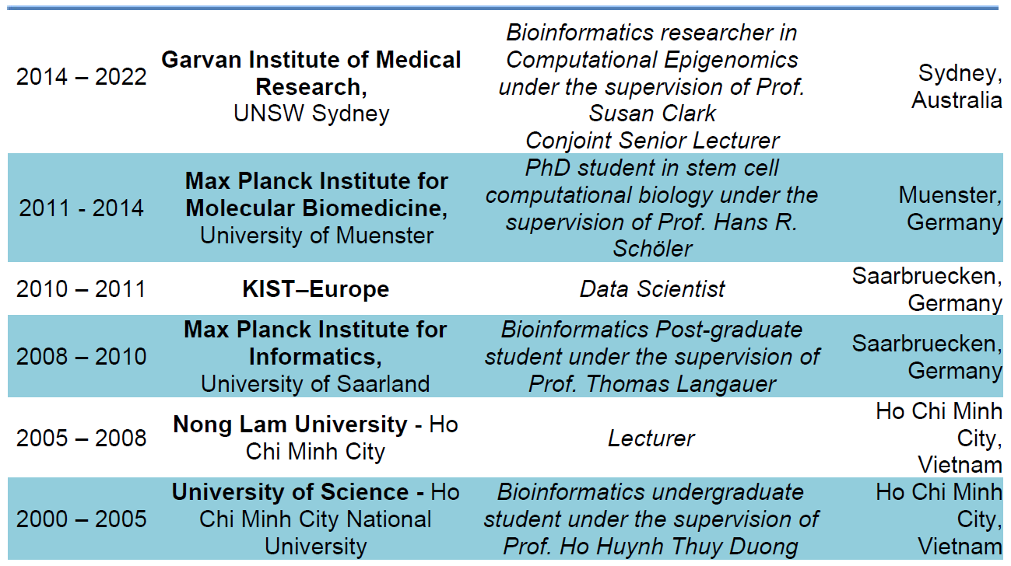
EDUCATION AND PROFESSION

Slide 5
Curriculum of Applied Bioinformatics 2024
Linux OS, Google Colab and Linux Command Lines (02 Nov)
Basic Bash script and Awk (09 Nov)
Basic R (16 Nov)
Statistics with R (23 Nov)
Data visualization with R (30 Nov)
Review basic molecular biology and the human genome (09 Nov)
Introduction to Next Generation Sequencing (NGS), Gene annotation and the related databases (23 Nov)
Next Generation Sequencing (NGS) and its applications in clinic and agriculture (30 Nov)
Short read sequencing and upstream analysis for DNA-seq (7 Dec)
Short read sequencing and downstream analysis (variant calling and variant annotation) for DNA-seq (14 Dec)
A brief introduction to clinical genomics and precision medicine (21 Dec)
Long read sequencing introduction and upstream analysis for DNA-seq (28 Dec)
Long read sequencing and downstream analysis (denovo assembly and genome annotation) for DNA-seq (4 Jan 2025)
Presenting group projects (11 Jan 2025)

Slide 6
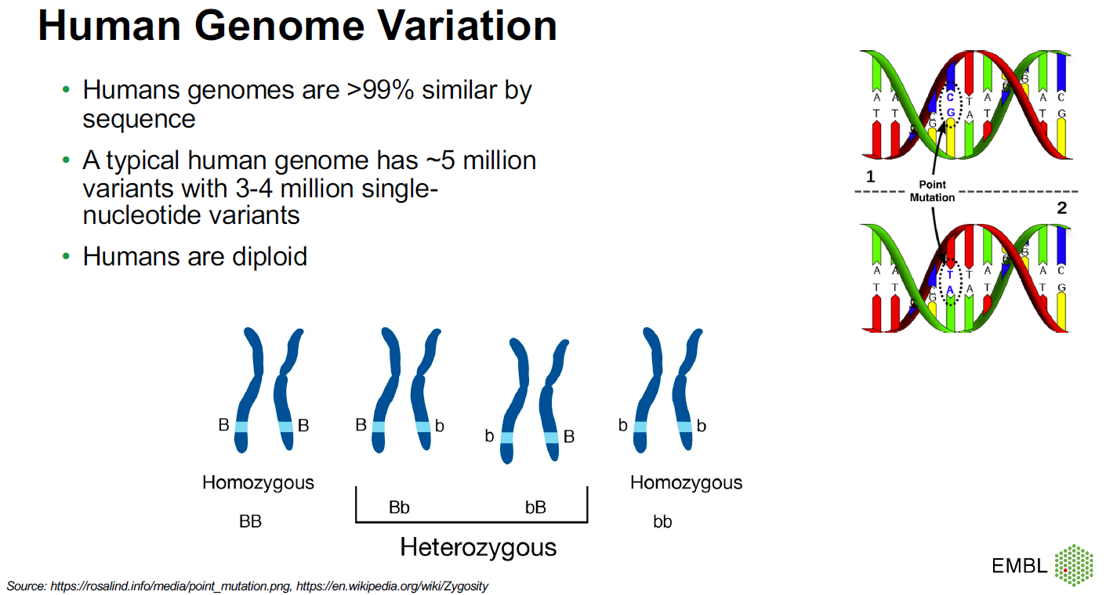

Slide 7
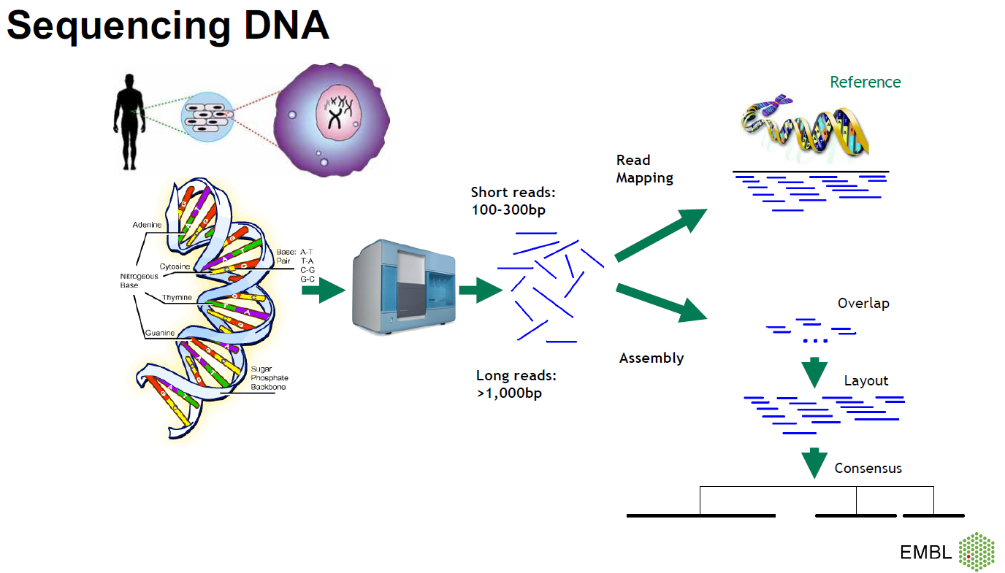

Slide 8
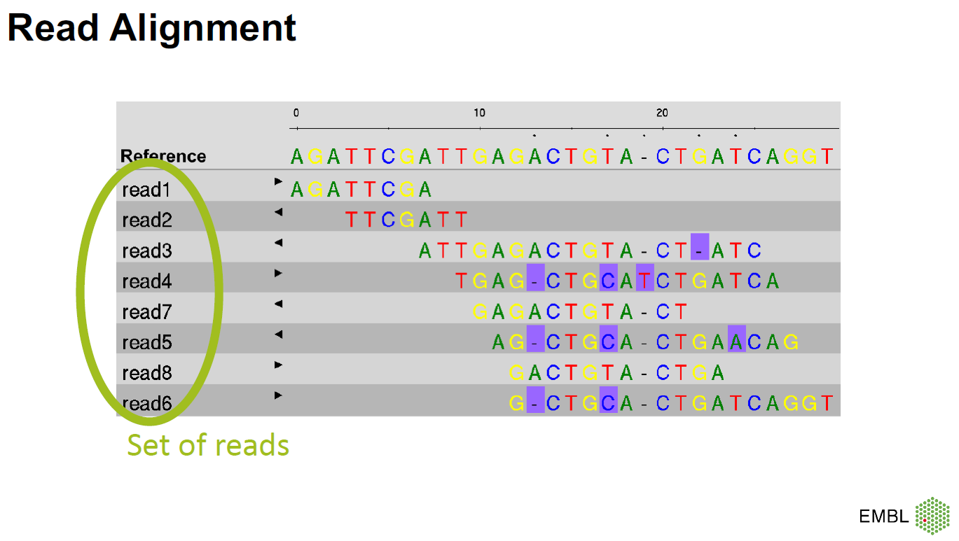

Slide 9
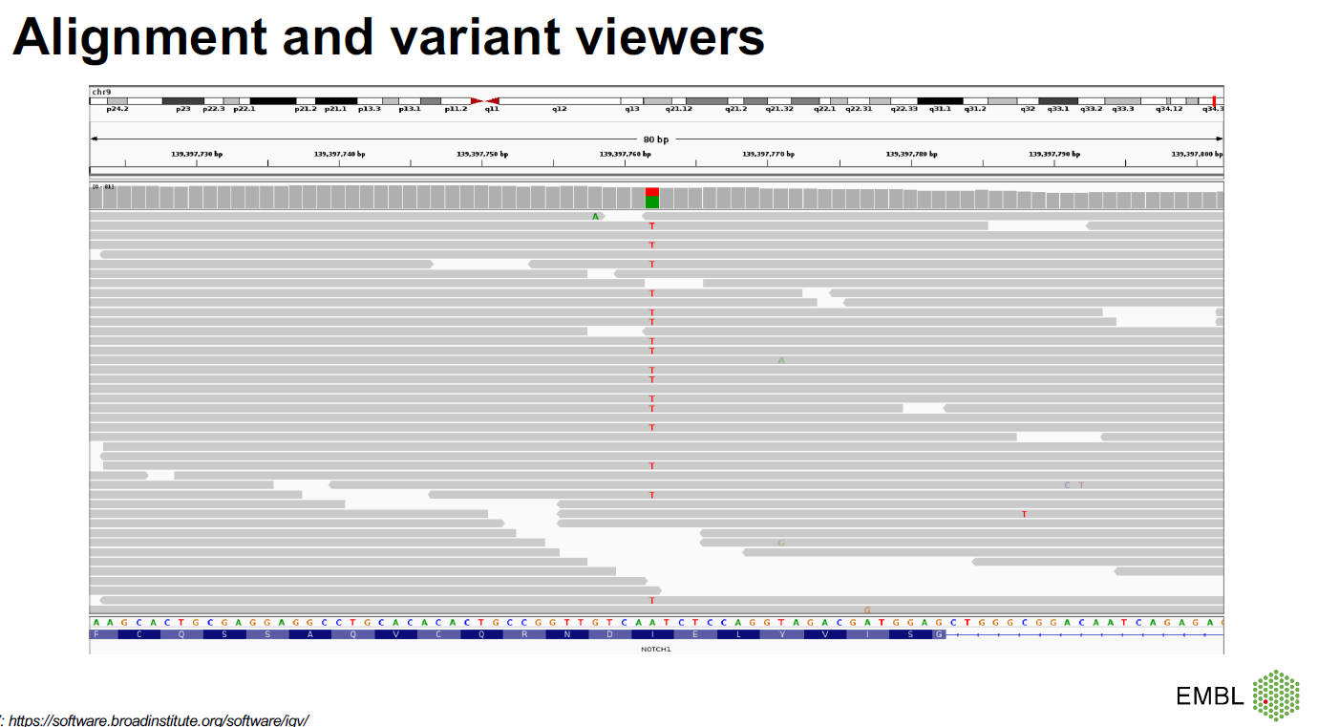

Slide 10
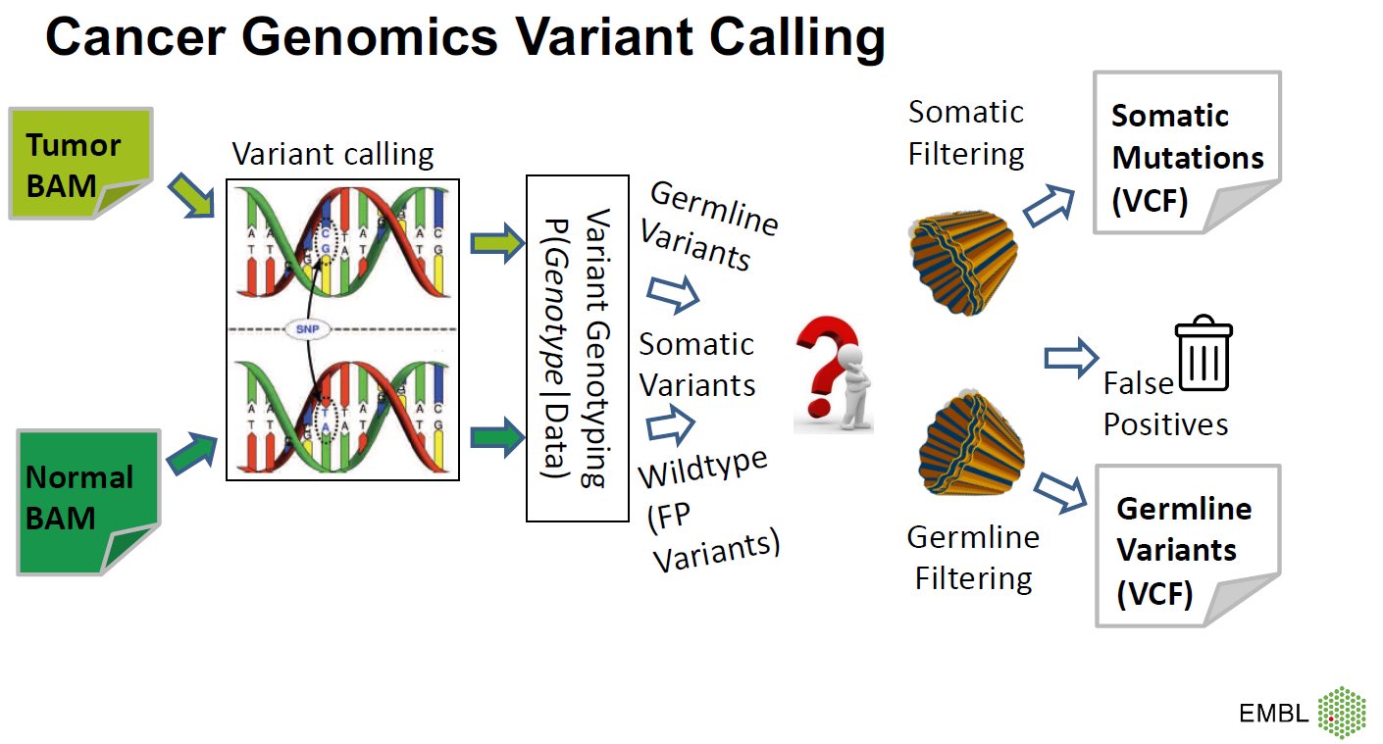

Slide 11
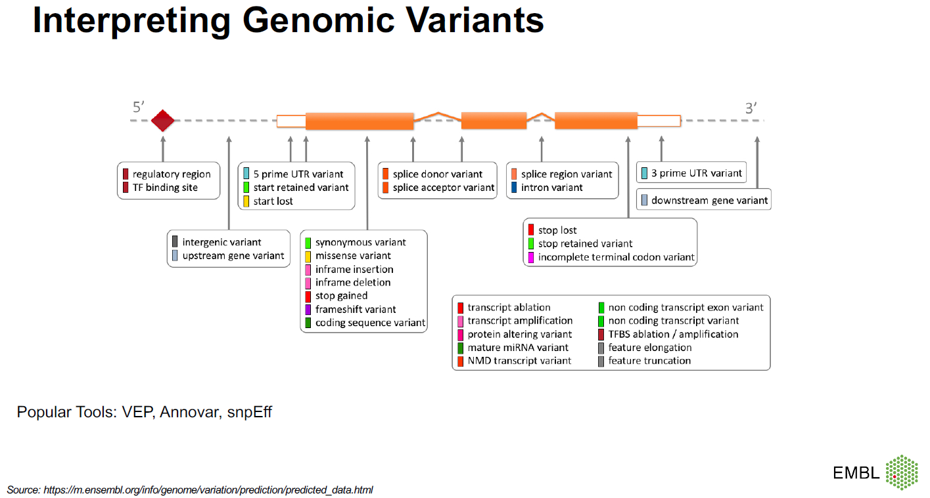

Slide 12
Projects and important dates
No | Project | Aim | Requirement | Group
1 | A breast cancer gene panel (BRCA1 and BRCA2) | Processing a dataset of 10 samples | - Programming bash - Human Moclecular biology - Clinical background
2 | A gene panel sequencing dataset of a cancer | Processing a dataset of 2 samples | - Programming bash - Human Moclecular biology - Clinical background
3 | Whole Exome sequencing (WES) dataset of a cancer | Processing WES and interpretation of the result | - Programming bash - Human Moclecular biology - Clinical background
4 | Whole Exome sequencing (WES) dataset of a genetic disease | Processing WES and interpretation of the result | - Programming bash - Human Moclecular biology - Clinical background
5 | Denovo assembly of a viral genome ONT/PacBio | Understanding processing and interpretation of the result | - Programming bash - Moclecular microbiology - Clinical background
6 | Variant calling and subtyping of bacteria Whole Genome Sequencing | Understanding the artical and interpretation of the result | - Programming bash - Moclecular microbiology - Clinical background

Slide 13
Do we need to install and learn Ubuntu and programing?
Không học Ubuntu và lập trình được không?
Được nhe!

Slide 14
Do we need to install and learn Ubuntu and programing?
Không học Ubuntu và lập trình được không?
Được, nhưng như có chân mà ngồi xe lăn!

Slide 15
Evalutation for the course
Presentation date (final exam): 11 Jan 2025
Max 30 min each group
5-10 questions each student
Report (20) +
Presentation (20) +
Slide (10) +
Questions for the presentation (25) +
Questions for the all of lectures (25)

Slide 16
How does my lecture work?
Start at 1:30 PM every Saturday from 02 Nov 2024 to 12 Jan 2025 (14 weeks)
15 min oral test at the begin of the lecture
Time breaks in a lecture (2:45-3:00 PM and 4:00-4:15 PM)
Lecture end at 5 PM
No attendance checking

Slide 17
No attendance checking
Nghỉ học được không bạn?
Được nhe!

Slide 18
No attendance checking
Nghỉ học được không bạn?
Nhưng khó đậu nhe!

Slide 19
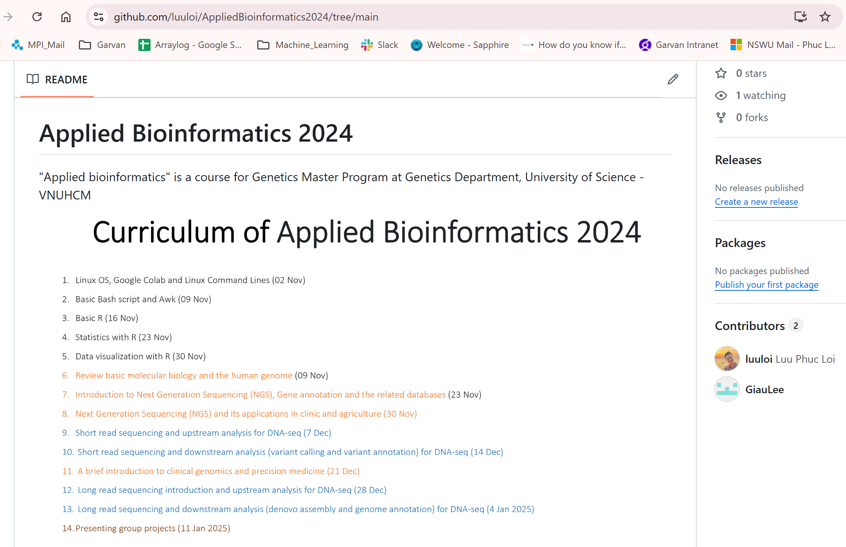
https://github.com/luuloi/AppliedBioinformatics2024/tree/main

Slide 20
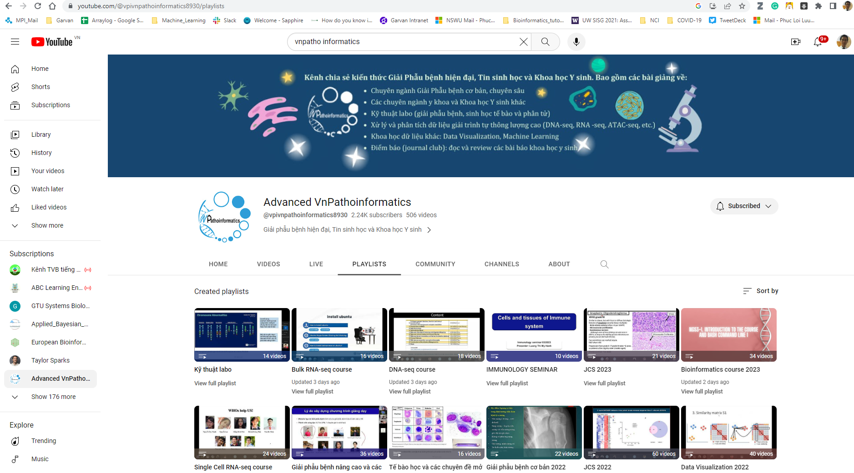
https://www.youtube.com/@vpivnpathoinformatics8930/playlists

Slide 21
