Slide 1
CST3492 · GROUP B · TEAM 4
Folio
A course assistant inside IntelliJ.
It answers from the lectures, and it shows the page.
罗臻 Luo Zhen
2451989
李灿文 Li Canwen
2452270
范羽 Fan Yu
2452750
孟圣雨 Meng Shengyu
2452272
Folio · CST3492 Group B · Team 4
1 / 9
Notes:
Open here. Read the name, then the four people once. Say this is Group B, Team 4. About forty seconds. Do not open the IDE yet.

Slide 2
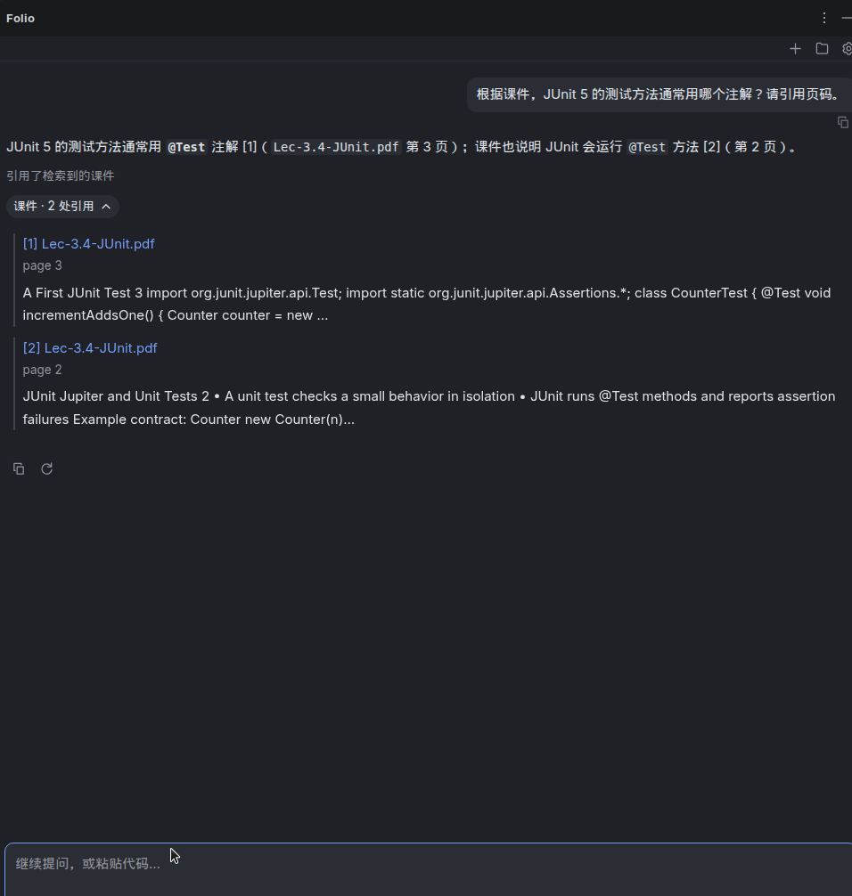
02 PROJECT
What it is
A tool window on the right of IntelliJ. It answers from the lectures on this machine, and it names the page.
The picture is that answer: @Test, from Lec-3.4, pages 3 and 2.
F0
Course retrieval. Chunk, index, retrieve, cite the file and the page.
F1
Three actions. A drill. A JUnit preview written only when asked. Commit text from the staged diff.
Not ours
Group C rewrites the student’s code and drives the diff viewer.
Folio · CST3492 Group B · Team 4
2 / 9
Notes:
One page for the product and the brief. Point at the screenshot, then read F0, F1, and the Group C line. About one minute.

Slide 3
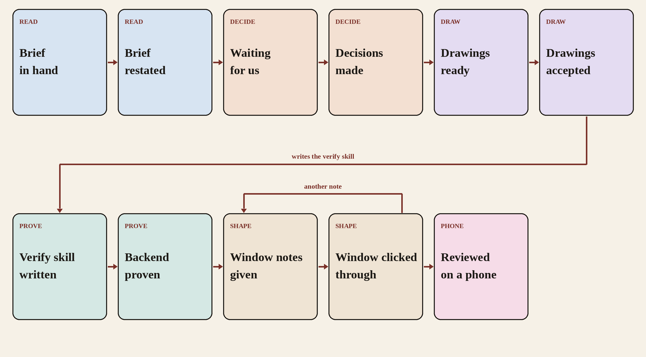
How it was made
03 MAKING
Folio · CST3492 Group B · Team 4
3 / 9
Notes:
Walk the chart from Brief in hand down to Reviewed on a phone. The only loop is a later window note, which returns to Window notes given. Accepting on the phone is the end. TLC checked 11 states. No drawing before the restatement, no proof before our edits, no window change before the skill passes. About two minutes.

Slide 4
03 MAKING
Decisions that stayed with us
After the restatement, Cursor named the choices it would not make alone.
Retrieval
A local word index, not an embedding service. The citation has to survive a dead network.
The third action
A course drill. Rewriting code would repeat Group C. Answering again would repeat F0.
Tests
Show a preview. Write the file only after an explicit click.
Commits
Show the message. Do not run git commit.
The model
The address stays in settings. This demonstration uses DeepSeek.
Folio · CST3492 Group B · Team 4
4 / 9
Notes:
These are the answers we gave. One minute. If asked why not vectors: a Chinese question still has to hit an English slide by its words, and the page has to appear before the network returns.

Slide 5
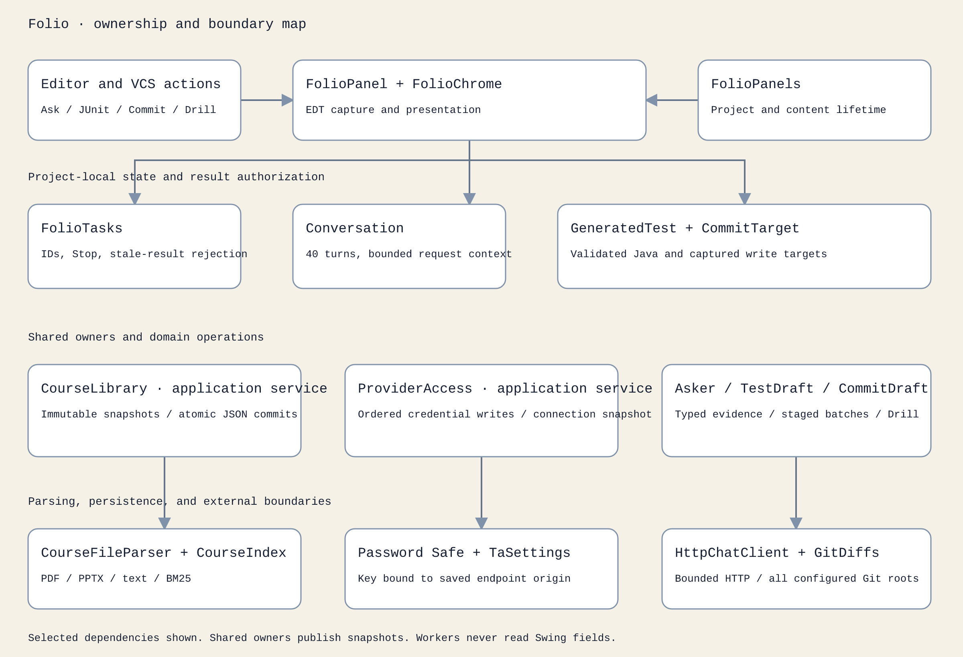
03 MAKING
Ownership, from the repository
docs/images/components.svg. Who owns the library, the key, and a write.
Folio · CST3492 Group B · Team 4
5 / 9
Notes:
This is the architecture drawing already in the repository. Top row is the IDE. Middle row is a project’s tasks and conversation. Bottom row is the shared library, the key, and the model or Git boundary. Workers do not read Swing fields. Forty-five seconds.

Slide 6
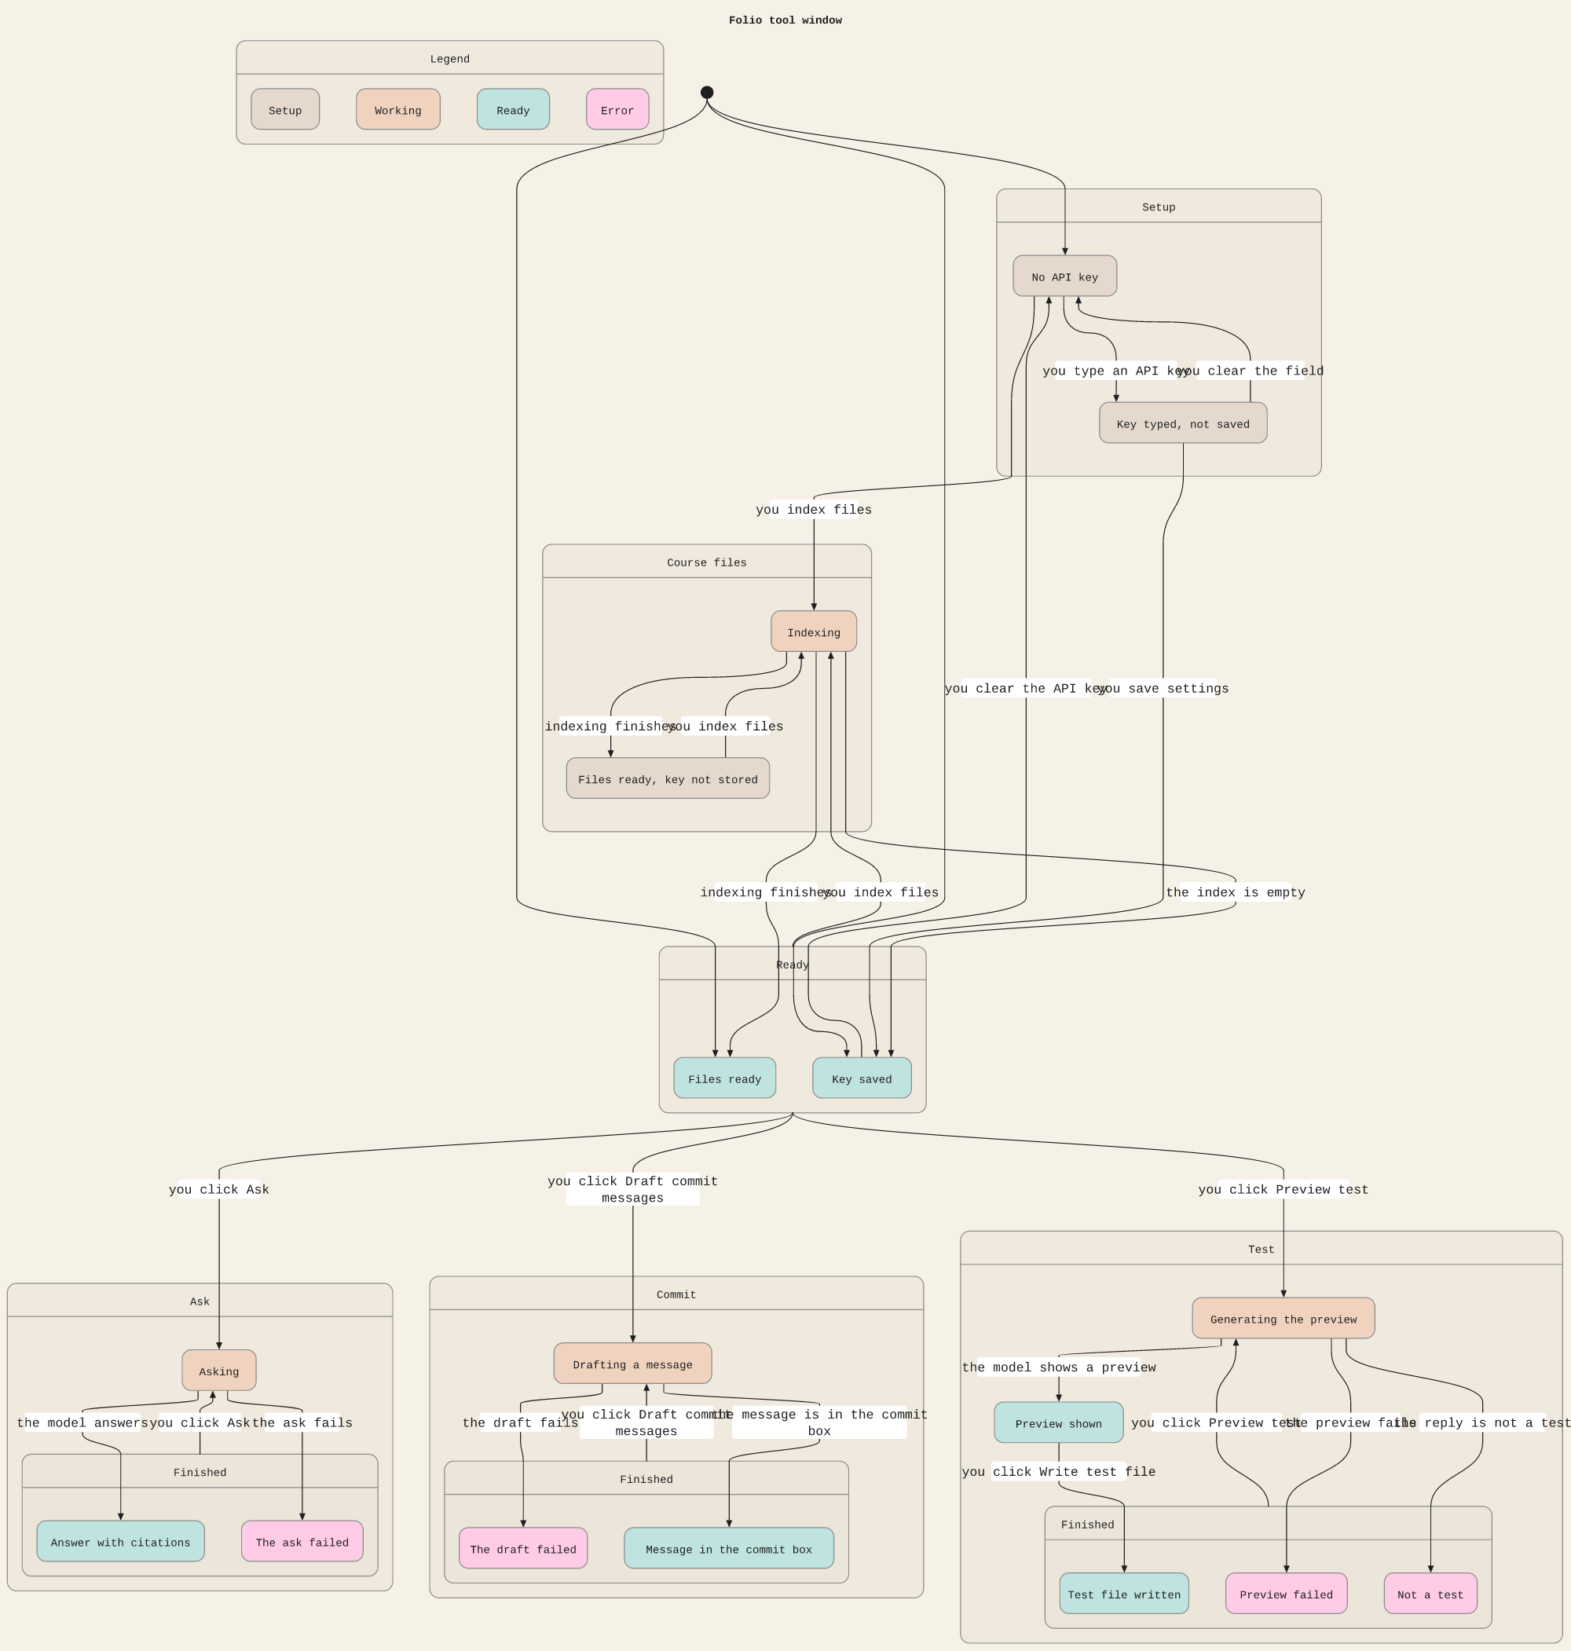
03 MAKING
Tool window, checked with TLC
docs/statechart. One activity at a time. A key is required before Ask, Preview, or Draft.
Folio · CST3492 Group B · Team 4
6 / 9
Notes:
This is the statechart already in the repository. Setup, indexing, then Ask, Test, and Commit. Write is only from a preview that parsed as a test. Say the overlapping labels are the real chart, not a simplification. One minute.

Slide 7
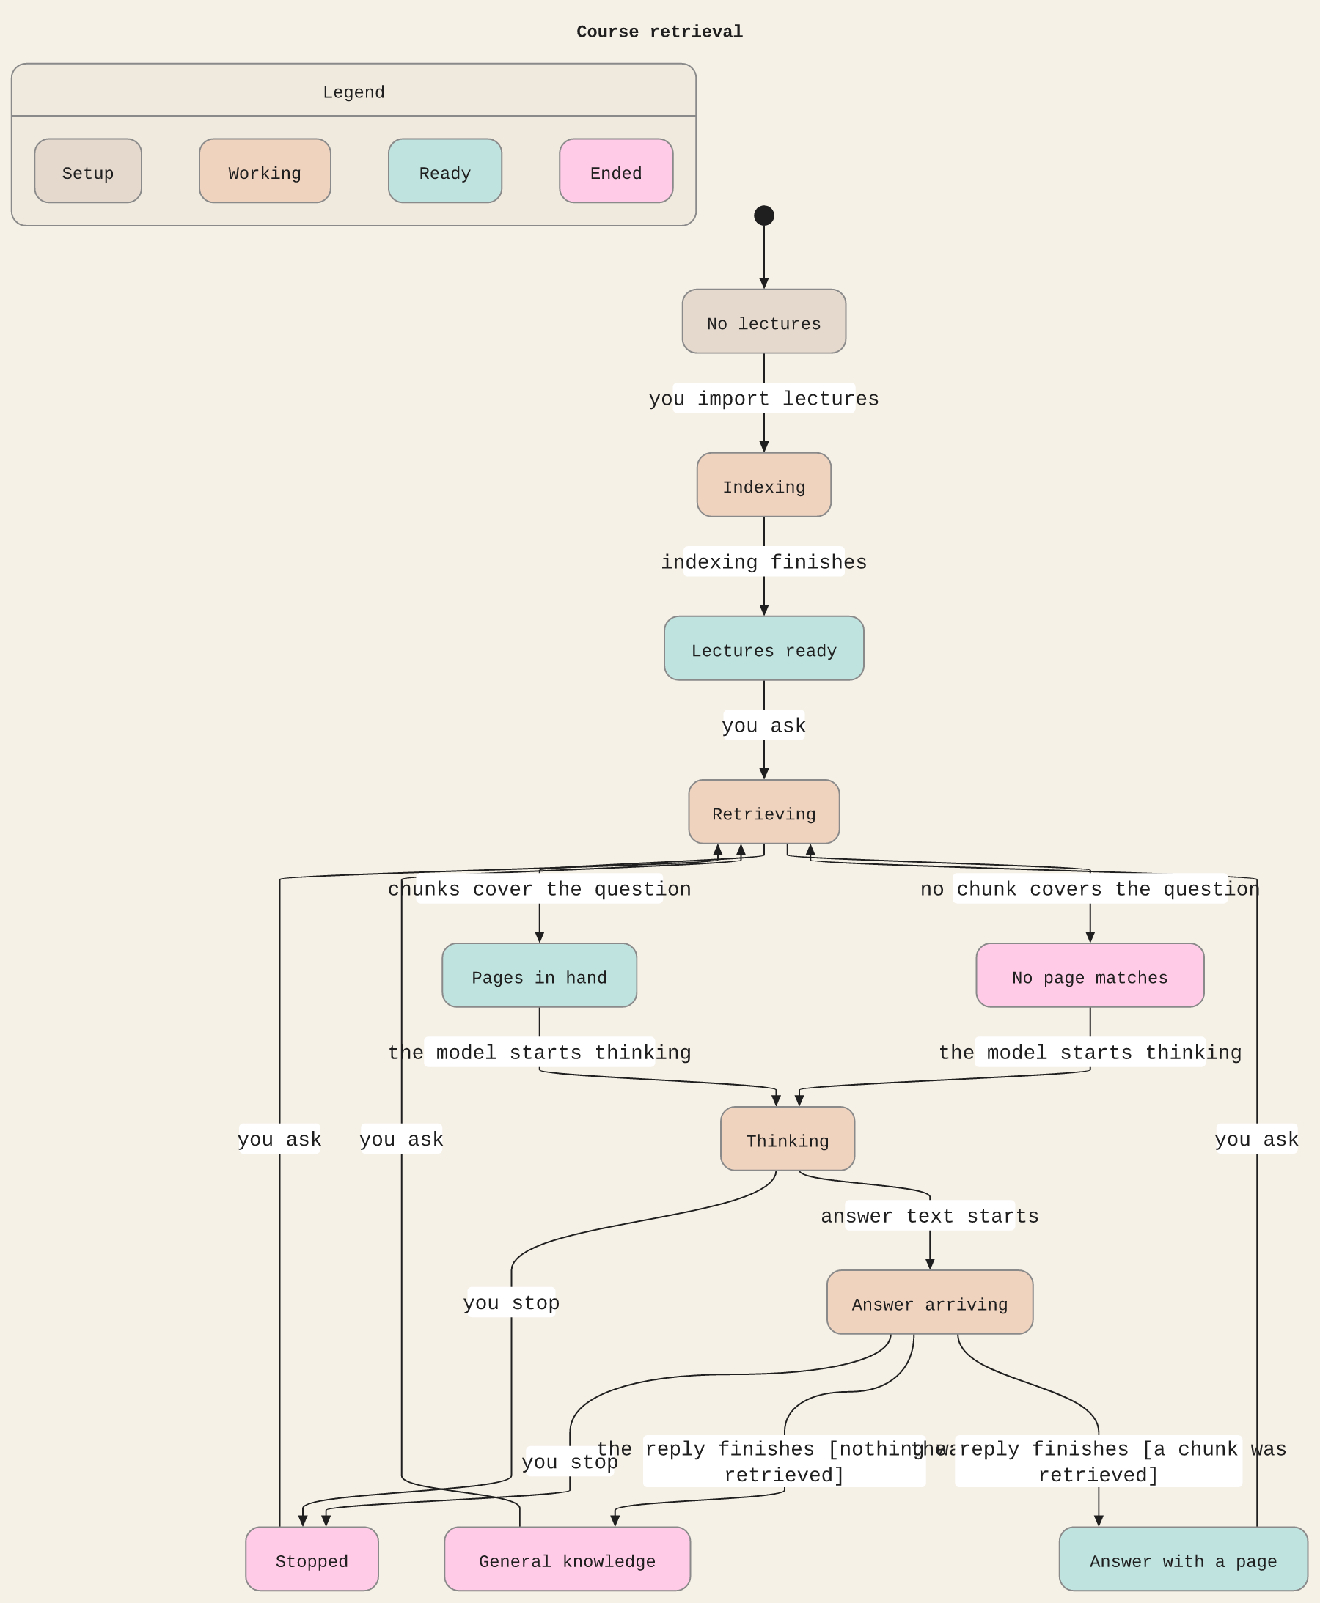
03 MAKING
Retrieval, checked with TLC
A page citation exists only after a hit. A miss ends as general knowledge. Stop does not invent a page.
Folio · CST3492 Group B · Team 4
7 / 9
Notes:
This submodule was drawn with /statechart. TLC found 14 states. CiteOnlyWhenHit, MissNeverCited, and StoppedHasNoCitation all hold. Point at the two finishes: nothing retrieved, or a chunk was retrieved. One minute.

Slide 8
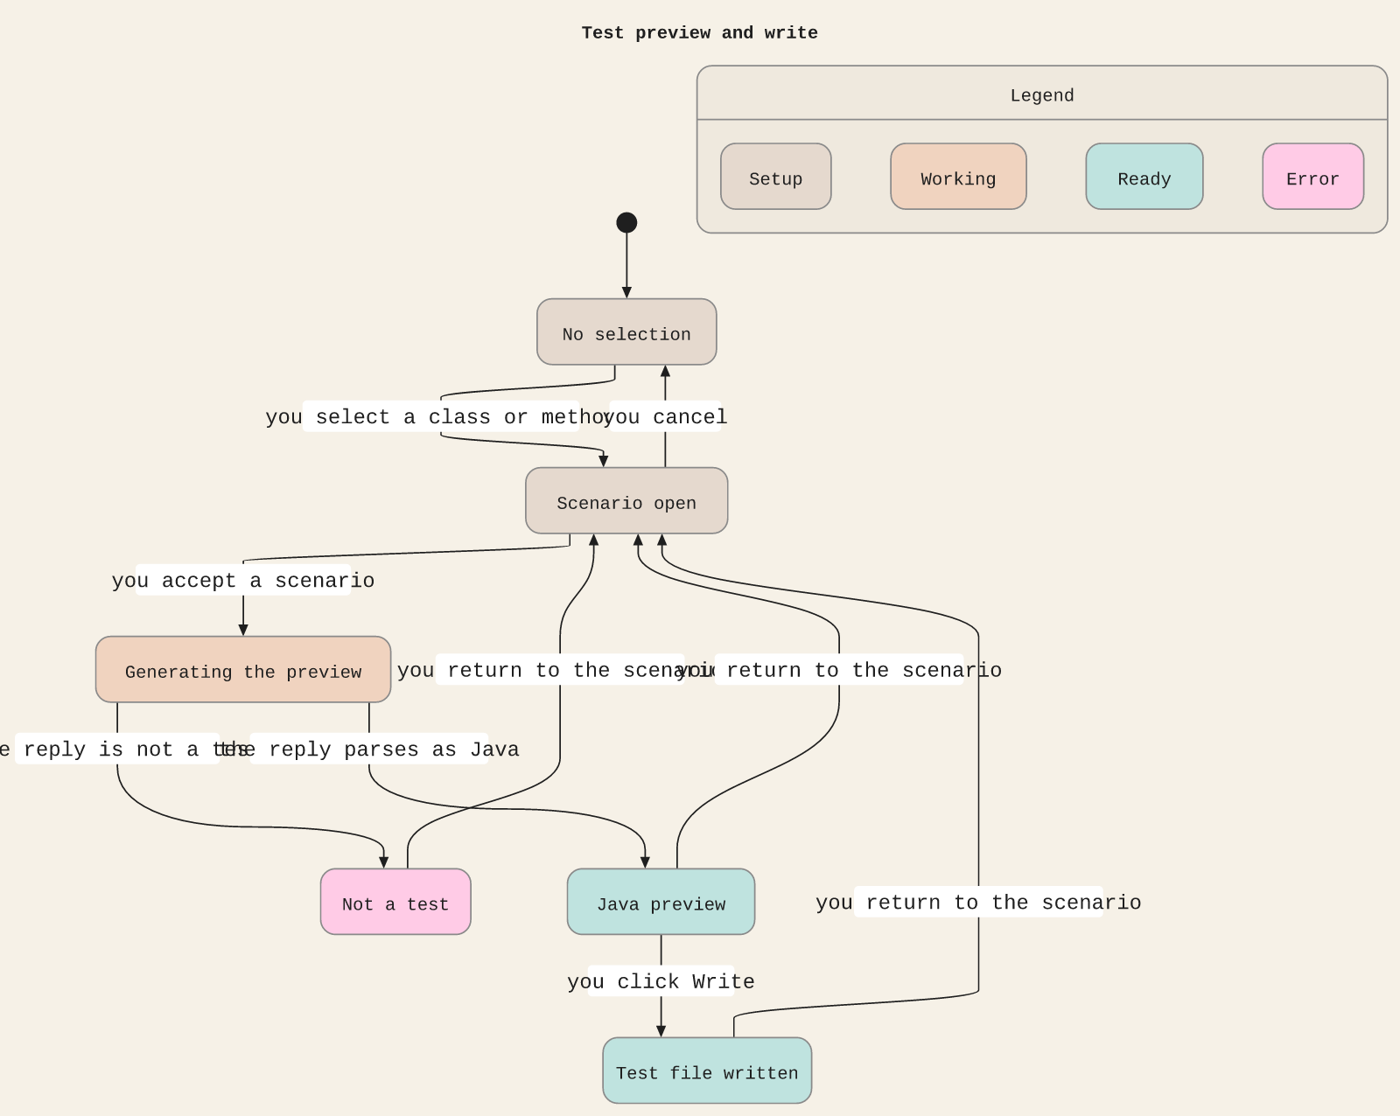
03 MAKING
Test write, checked with TLC
An empty cancel writes nothing. Write is reachable only from a Java preview.
Folio · CST3492 Group B · Team 4
8 / 9
Notes:
Second submodule from /statechart. Six states. The file is a copy of a preview that parsed. Not a test has no arrow to Test file written. Twenty seconds.

Slide 9
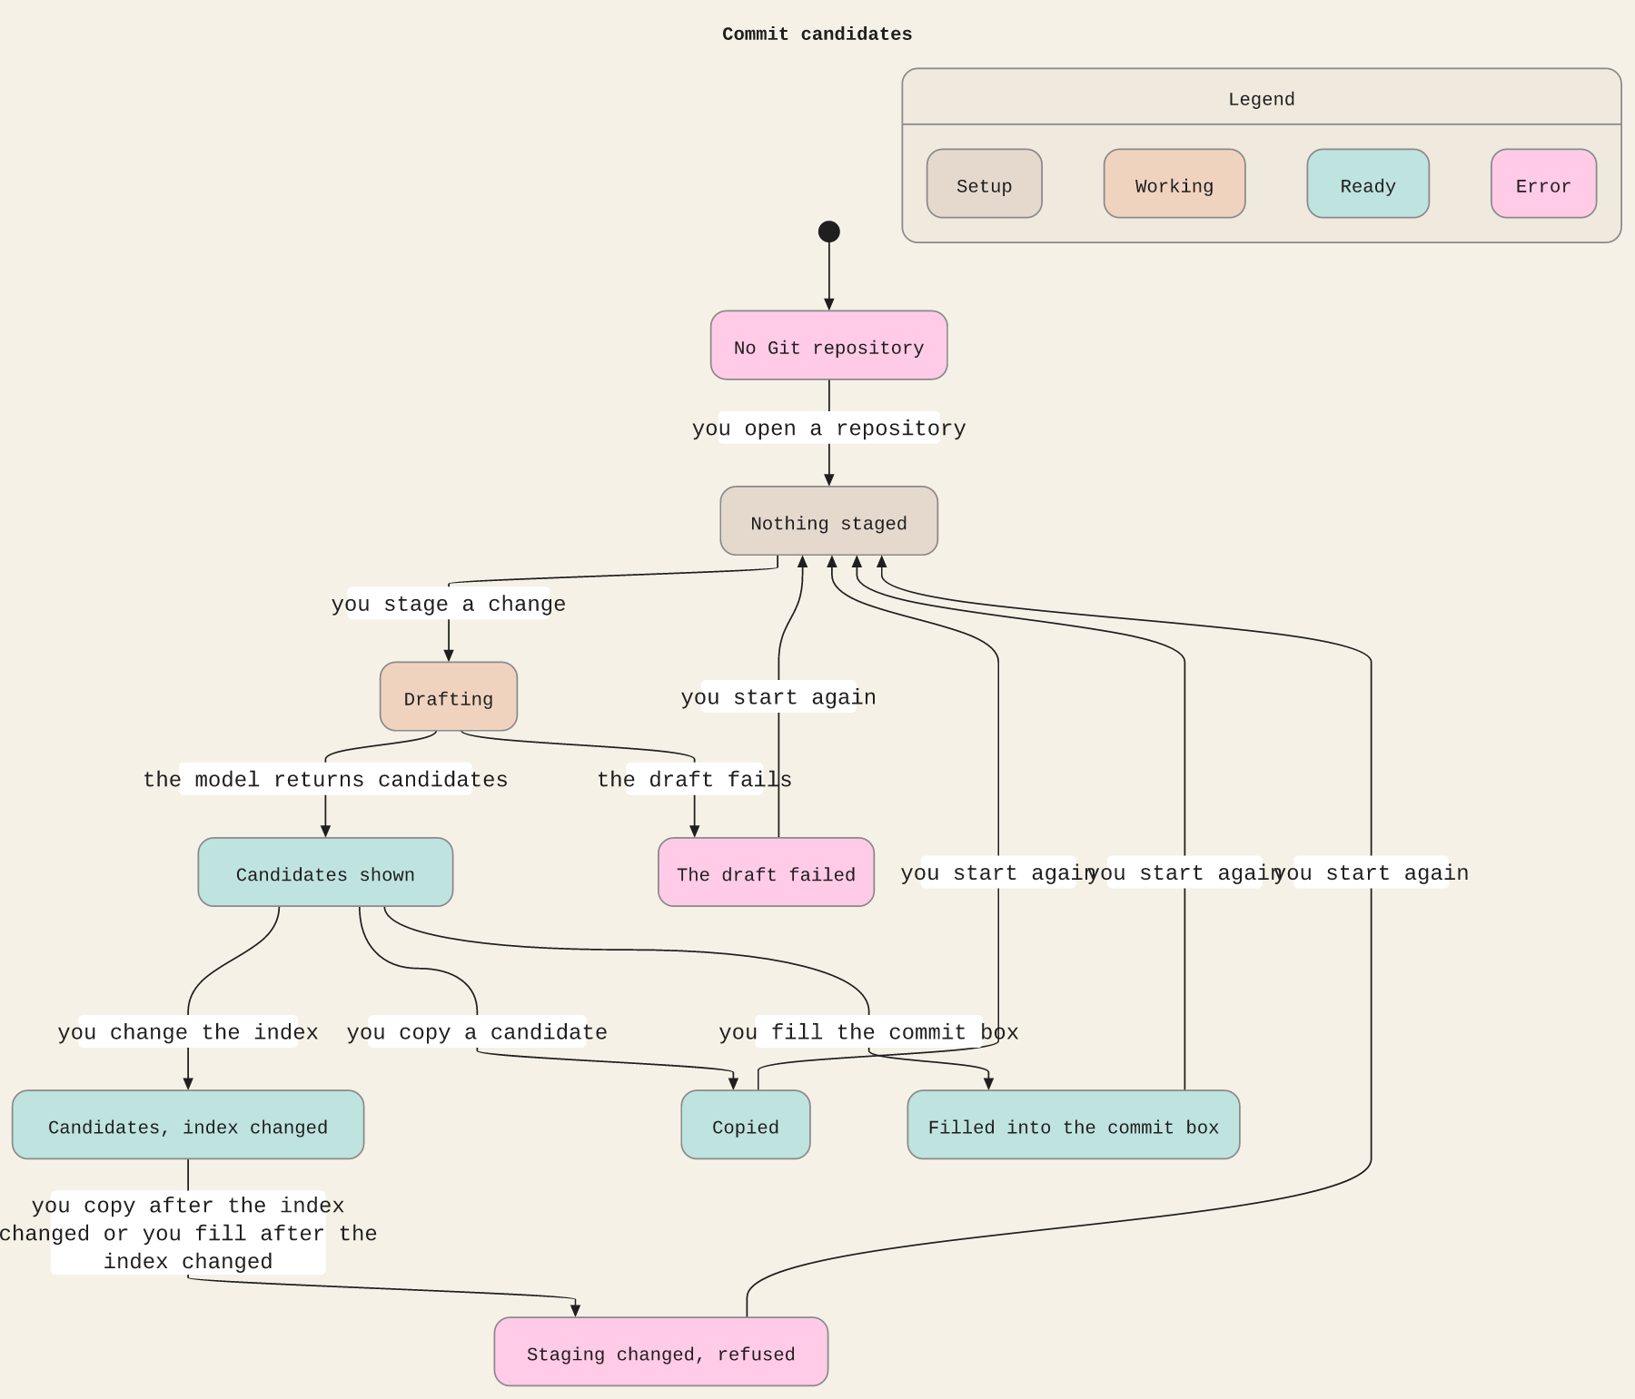
03 MAKING
Commit delivery, checked with TLC
Copy and fill require the captured staging. Nothing in the model creates a commit.
Folio · CST3492 Group B · Team 4
9 / 9
Notes:
Third submodule from /statechart. Nine states. NeverCommits holds because no action sets a commit. After the index changes, copy and fill are refused. Twenty seconds.

