Slide 1


CLASSIFYING THE SLEEP HEALTHY AND LIFESTYLE
CAN THO UNIVERSITY SOFTWARE CENTER
MEKONG DELTA - APTECH
PROJECT – ANALYZING DATA WITH R
INSTRUCTOR
LAM CHI NGUYEN
STUDENTS
VO NGUYEN KHOA
NGUYEN THI KIM CUONG
TRAN THI CAM LAI

Slide 2
1. INTRODUCTION
The Health indicators that affect sleep
Some of sleep diseases
There is a lack of research on sleep disorders
1.1 PROBLEM

Slide 3
1.2 PURPOSE
The goal of the study is to understand and evaluate the impact of health indicators and stress levels on sleep disorders.
The results of this study may provide important information to better understand sleep disorders and suggest effective treatment and management methods.
Built a classification model to classify classes according to sleep disorders (None, insomnia, sleep apnea) of hospital patients.

Slide 4
1.3 SPECIFIC REQUIREMENTS
(1) How does the relationship between gender and age affect insomnia and sleep apnea?
(2) How does the relationship between occupation and sleep duration affect sleep quality?
(3) How does the relationship between heart rate and stress levels affect sleep quality?
(4) How does the relationship between heart rate and stress levels affect sleep quality?
(5) How does the relationship between BMI categories impact sleep quality?
(6) How does the relationship between blood pressure and heart rate affect insomnia and sleep apnea?
(7) How does sleep quality affect sleep disorders?
(8) How to build analytical models to determine the occurrence of sleep disorders such as insomnia and sleep apnea?

Slide 5
2. EXPLORATORY DATA ANALYSIS (EDA)
2.1 DATA SOURCE
Sleep Health and Lifestyle Dataset” is a data set on lifestyle and sleep health taken from K Hospital. Specifically, the data set emphasizes 4 aspects: Comprehensive data on sleep (i), factors Lifestyle factors (ii), cardiovascular health (iii), sleep disorder analysis (iv).
Contributors: Laksika Tharmalingam
Source: https://www.kaggle.com/datasets/uom190346a/sleep-health-and-lifestyle-dataset

Slide 6
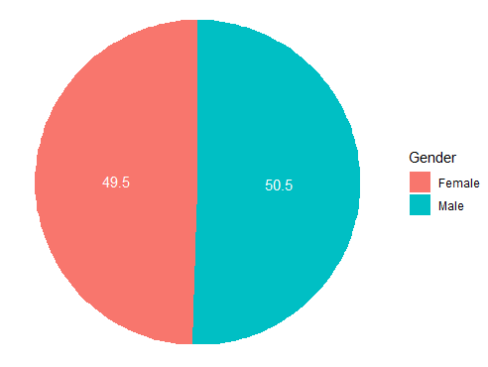
2.2 DATA DESCRIPTION
2.2.1 Gender
The gender of person. In this dataset have 185 Female(49,5%) and 189 Male(50,5%)

Slide 7
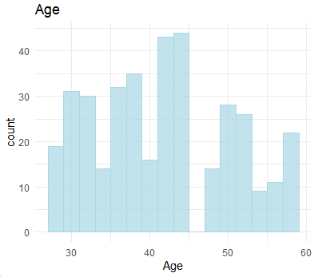
2.2.2 Age
Figure 2. Age Distribution
The age of the person. In this dataset, ages are distributed between 27 – 59 year old

Slide 8
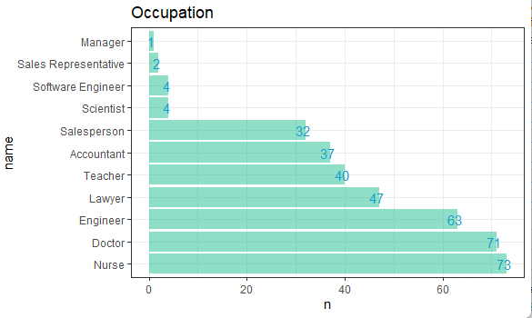
2.2.3 Occupation

Slide 9
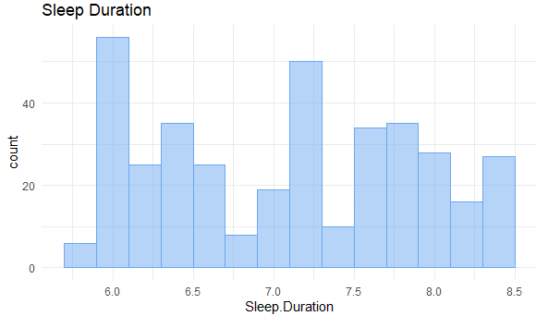
2.2.4 Sleep duration
This dataset's distribution of sleep duration falls between 5.8 and 8.5

Slide 10
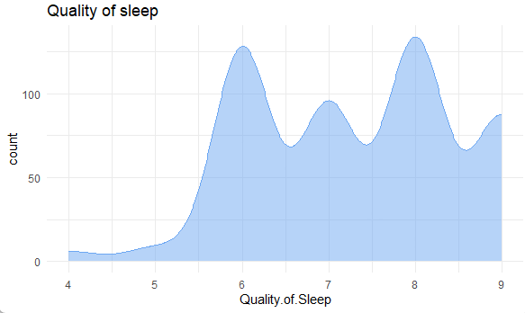
2.2.5 Quality of Sleep
In this dataset, Sleep quality is mainly distributed at levels 6 to 8.

Slide 11
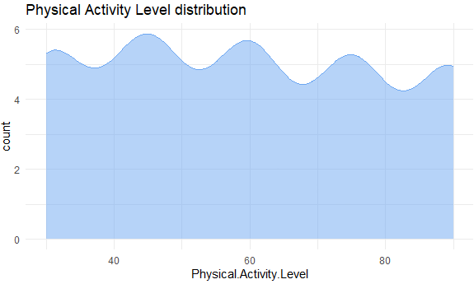
2.2.6 Physical activity level
The range of Physical Activity Levels is 30 to 90.

Slide 12
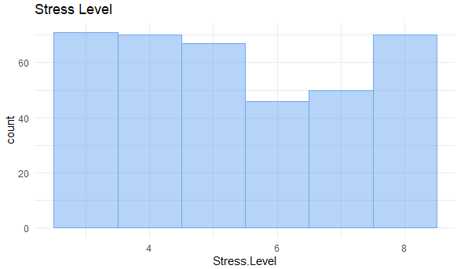
2.2.7 Stress level
It ranges from level 3 to 8 in this dataset.

Slide 13
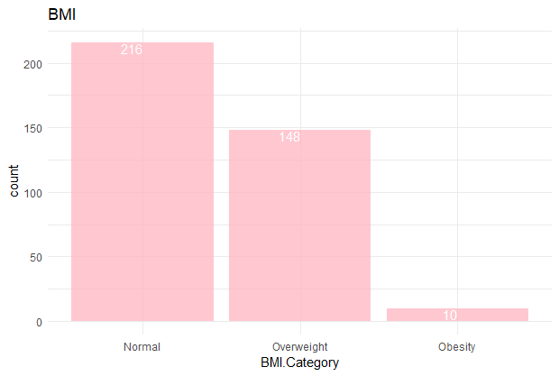
2.2.8 BMI Category
In this dataset, the BMI category of the person is divided into three groups: Normal, Overweight, Obesity.

Slide 14
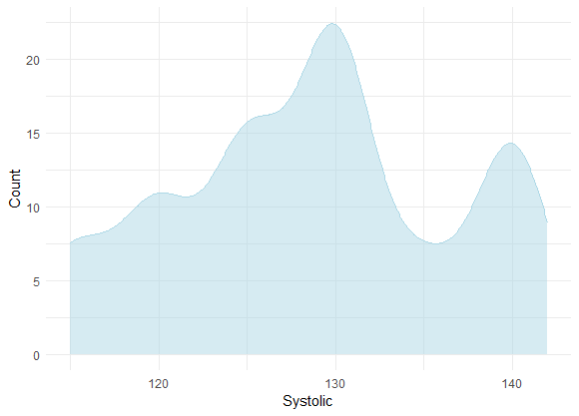
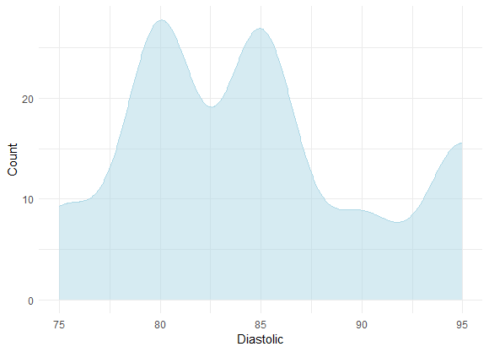
2.2.9 Blood pressue
The blood pressue is given as 2 figures: Systolic pressue and Diastolic pressue.

Slide 15
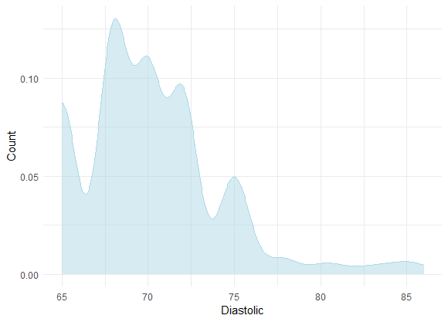
2.2.10 Heart rate
It ranges from approx 68-86.

Slide 16
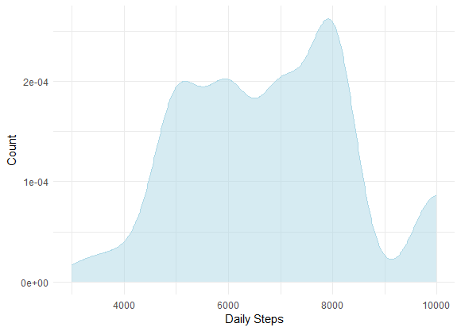
2.2.11 Daily steps
It ranges from approx 3000 to 10000.

Slide 17
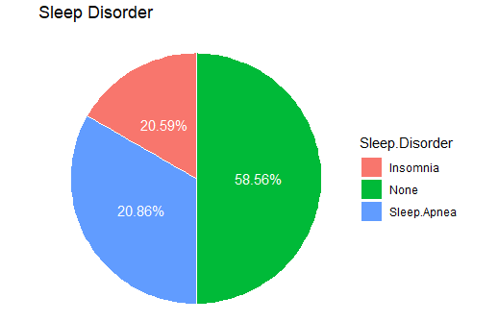
2.2.12 Sleep disorder
In this dataset, they are divided into three groups: None, Insomnia, and Sleep Apnea. In which:
None has 219 people.
Insomnia has 77 people.
Sleep Apnea has 78 people.

Slide 18
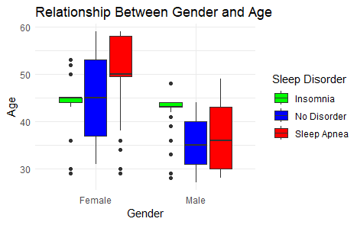
2.3 VISUALIZATION AND BASICS EVALUATION
2.3.1 The relationship between gender and age affect insomnia and sleep apnea

Slide 19
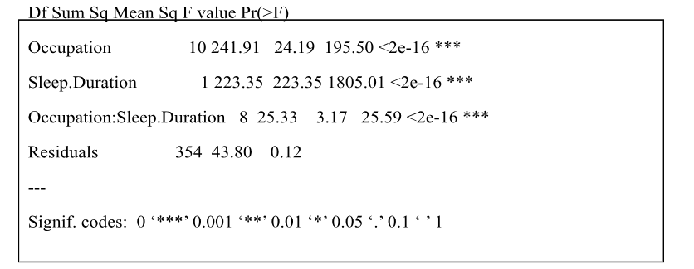
2.3.2
The relationship between occupation and sleep duration affect sleep quality

Slide 20
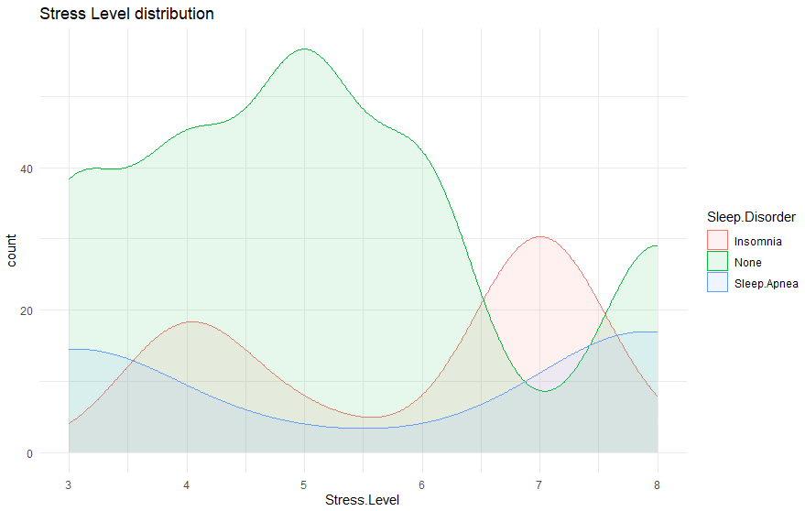
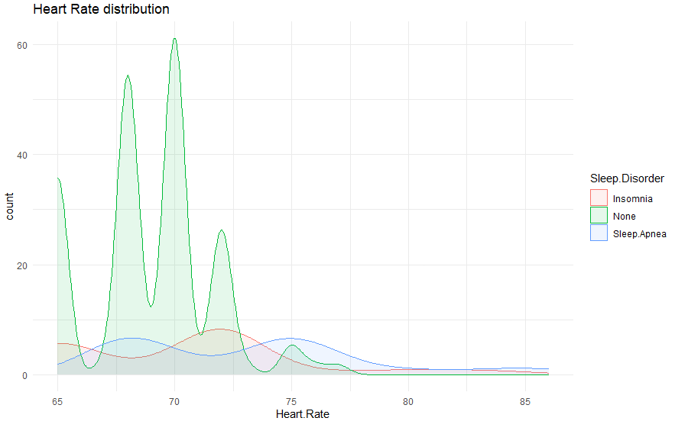
2.3.4 The relationship between Stress levels affect Heart Rate

Slide 21
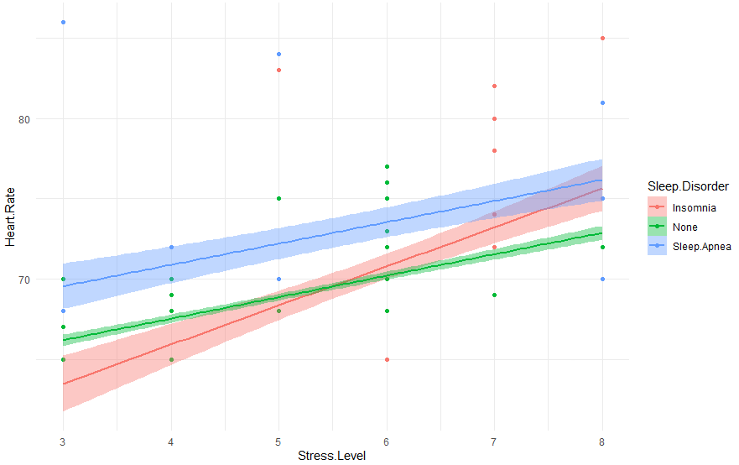
Figure 17. Relationship between Stress Level, Heart Rate and Sleep Disorder

Slide 22
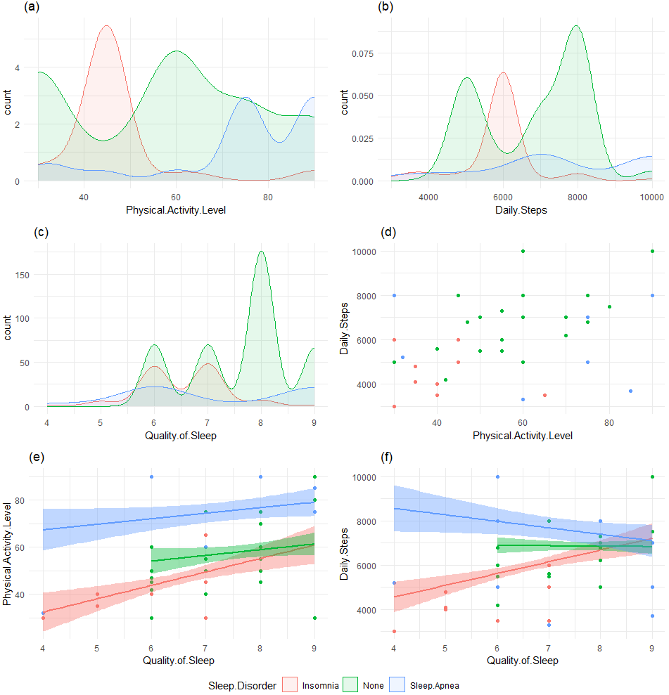
2.3.5 The relationship between physical activity and daily steps impact Quality of Sleep and Sleep Disorder

Slide 23
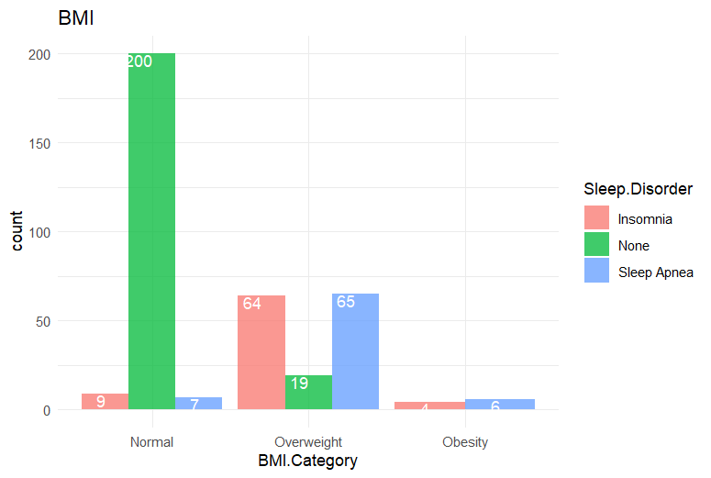
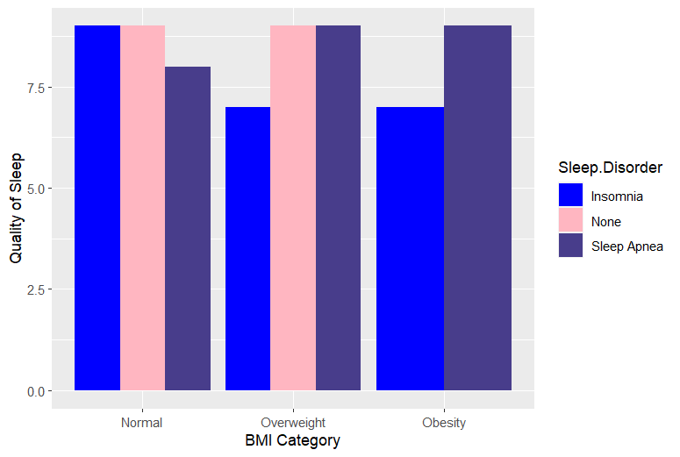
2.3.5 The relationship between BMI categories affecting sleep quality
Figure 19. . Count BMI Categories
Figure 20. Relationship between BMI Category, Quality of Sleep and Sleep Disorder

Slide 24
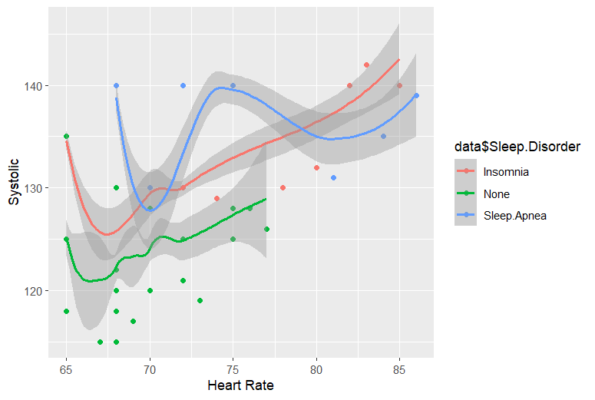
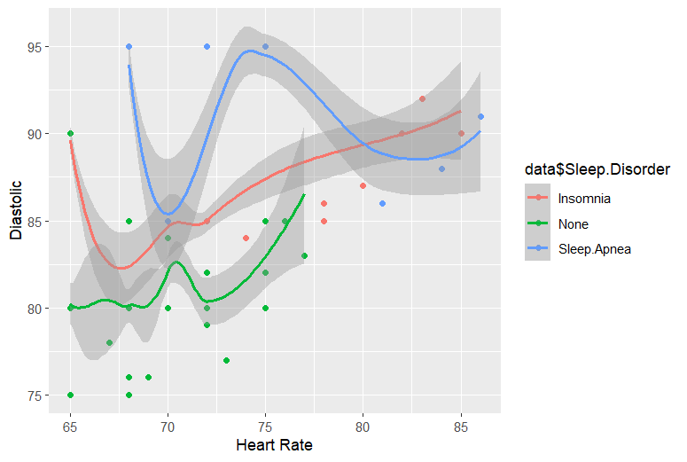
2.3.6 The relationship between blood pressure and heart rate affect insomnia and sleep apnea
Figure 21. Relationship between Heart Rate, Systolic(Blood Pressure) and Sleep Disorder
Figure 22. Relationship between Heart Rate, Diastolic(Blood Pressure) and Sleep Disorder

Slide 25
3. AI/ML MODEL
INPUT
(i) Comprehensive data on sleep;
(ii) Factors Lifestyle factors;
(iii) Cardiovascular health;
(iv) Sleep disorder analysis
OUTPUT
Classification of Sleep Disorder (None, Sleep Apnea, Insomnia)
APPROACH
Decision Tree and Random Forest Classification

Slide 26
Decision Tree
Classification tree: rpart(formula = Sleep.Disorder ~ ., data = train_data, method = "class", xval = 10) Variables actually used in tree construction: [1] Age BMI.Category Physical.Activity.Level [4] Systolic Root node error: 125/297 = 0.42088 n= 297 CP nsplit rel error xerror xstd 1 0.376 0 1.000 1.000 0.068066 2 0.344 1 0.624 0.800 0.065155 3 0.040 2 0.280 0.288 0.044997 4 0.010 4 0.200 0.320 0.047066
set.seed(111) ind <- sample(2, nrow(data), replace = TRUE, prob = c(0.8, 0.2)) train_data <- data[ind==1,] test_data <- data[ind==2,]
addmargins(prop.table(table(ind)))
decision_tree<- rpart(Sleep.Disorder ~ ., data = train_data, method = 'class', xval = 10, # k-fold với k = 10 )
printcp(decision_tree)

Slide 27
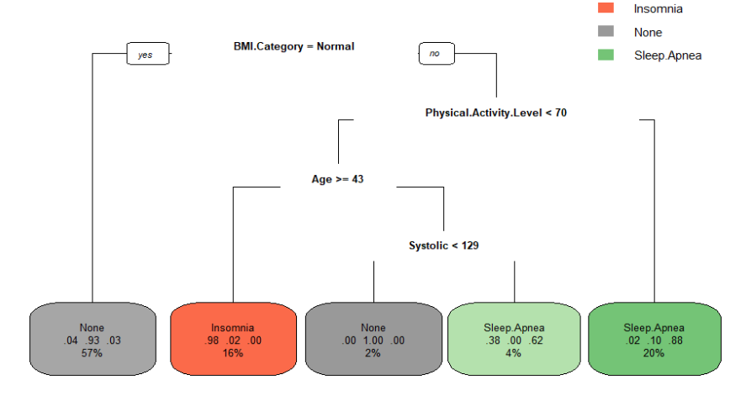
Figure 23. Decision tree

Slide 28
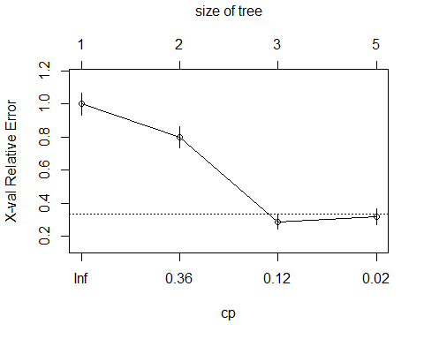

Slide 29
Prune the tree to optimal size
Classification tree: rpart(formula = Sleep.Disorder ~ ., data = train_data, method = "class", xval = 10) Variables actually used in tree construction: [1] BMI.Category Physical.Activity.Level Root node error: 125/297 = 0.42088 n= 297 CP nsplit rel error xerror xstd 1 0.376 0 1.000 1.000 0.068066 2 0.344 1 0.624 0.800 0.065155 3 0.040 2 0.280 0.288 0.044997
library(caret) decision_tree_prune <- prune(decision_tree, cp = decision_tree$cptable[which.min(decision_tree$cptable[, "xerror"]), "CP"]) printcp(decision_tree_prune)

Slide 30
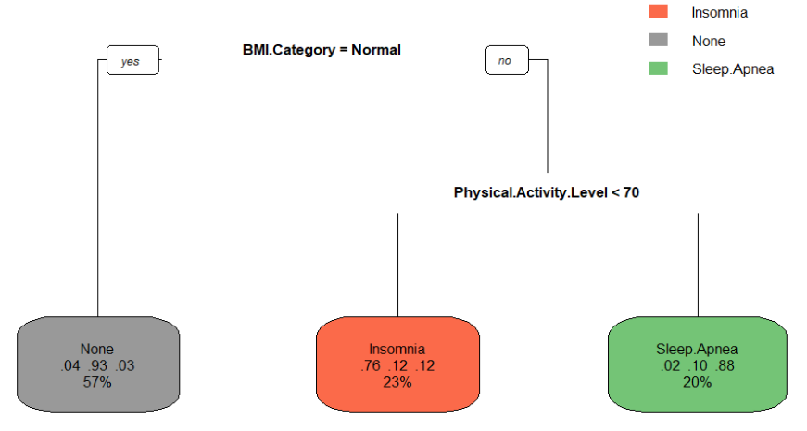
Figure 25. Decision tree after prune

Slide 31
Random Forest Classification
Call: randomForest(formula = Sleep.Disorder ~ ., data = train_data, ntree = 1000, important = TRUE) Type of random forest: classification Number of trees: 1000 No. of variables tried at each split: 3 OOB estimate of error rate: 8.75% Confusion matrix: Insomnia None Sleep.Apnea class.error Insomnia 47 5 7 0.20338983 None 1 166 5 0.03488372 Sleep.Apnea 5 3 58 0.12121212
set.seed(111) ind <- sample(2, nrow(data), replace = TRUE, prob = c(0.8, 0.2)) train_data <- data[ind==1,] test_data <- data[ind==2,]
addmargins(prop.table(table(ind)))
rf_model <- randomForest(Sleep.Disorder~., data = train_data, ntree = 1000, important = TRUE) rf_model

Slide 32
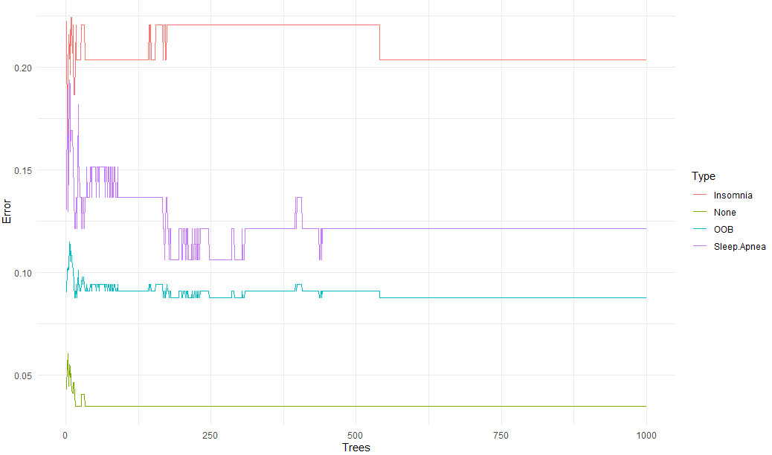
Figure 26. Random forerst Error

Slide 33
Find the optimal mtry value
297 samples 11 predictor 3 classes: 'Insomnia', 'None', 'Sleep.Apnea' No pre-processing Resampling: Cross-Validated (10 fold) Summary of sample sizes: 268, 266, 268, 267, 266, 268, ... Resampling results across tuning parameters: mtry splitrule Accuracy Kappa 2 gini 0.9090434 0.8413850 2 extratrees 0.9156025 0.8528083 3 gini 0.9057100 0.8356049 3 extratrees 0.9123767 0.8471099 4 gini 0.9022618 0.8296133 4 extratrees 0.9057100 0.8356049 5 gini 0.9057100 0.8356049 5 extratrees 0.9089359 0.8413033 Tuning parameter 'min.node.size' was held constant at a value of 1 Accuracy was used to select the optimal model using the largest value. The final values used for the model were mtry = 2, splitrule = extratrees and min.node.size = 1.
rf_fit <- train(Sleep.Disorder~., data = train_data, method = "ranger", tuneLength = 12, metric = "ROC", trControl = trainControl( method = "cv", # k-fold cross validation number = 10, # 10 folds savePredictions = "final", classProbs = TRUE, summaryFunction = defaultSummary ) ) rf_fit

Slide 34
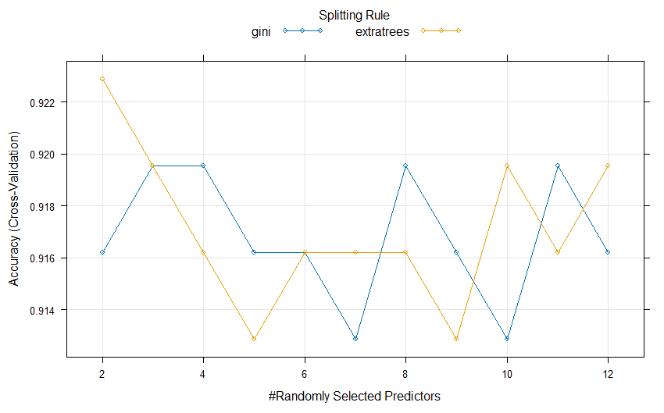

Slide 35
Call: randomForest(formula = Sleep.Disorder ~ ., data = train_data, mtry = rf_fit$bestTune$mtry, splitrule =
# Build the model with the best mtry
set.seed(111) rf_model_2 <- randomForest(Sleep.Disorder~., data = train_data, mtry = rf_fit$bestTune$mtry, splitrule = rf_fit$bestTune$splitrule, importance = TRUE, ntree = 1000) rf_model_2
rf_fit$bestTune$splitrule, importance = TRUE, ntree = 1000) Type of random forest: classification Number of trees: 1000 No. of variables tried at each split: 2 OOB estimate of error rate: 8.42% Confusion matrix: Insomnia None Sleep.Apnea class.error Insomnia 48 5 6 0.18644068 None 1 166 5 0.03488372 Sleep.Apnea 5 3 58 0.12121212

Slide 36
Validation
predict_decision_tree <- predict(decision_tree, newdata = test_data, type="class") confusionMatrix(test_data$Sleep.Disorder, predict_decision_tree)
Confusion Matrix and Statistics Reference Prediction Insomnia None Sleep.Apnea Insomnia 16 2 0 None 4 43 0 Sleep.Apnea 1 2 9
Overall Statistics Accuracy : 0.8831 95% CI : (0.7897, 0.9451) No Information Rate : 0.6104 P-Value [Acc > NIR] : 1.098e-07
Kappa : 0.7857 Mcnemar's Test P-Value : 0.2998

Slide 37
Validation
predict_rf <- predict(rf_model_2, newdata = test_data, type = "class") confusionMatrix(test_data$Sleep.Disorder,predict_rf)
Confusion Matrix and Statistics Reference Prediction Insomnia None Sleep.Apnea Insomnia 16 2 0 None 3 44 0
Sleep.Apnea 1 2 9
Overall Statistics Accuracy : 0.8961 95% CI : (0.8055, 0.9541) No Information Rate : 0.6234 P-Value [Acc > NIR] : 7.181e-08 Kappa : 0.8078 Mcnemar's Test P-Value : 0.3618

Slide 38
4. CONCLUSION
Research shows that sleep disorders greatly affect the lives of people of different ages, genders, and health conditions.
For people with sleep apnea syndrome, most women are more likely to have it than men. People with high stress levels and high blood pressure are also a factor leading to sleep apnea syndrome. And another factor that causes sleep apnea is BMI.
For people with insomnia, the average is higher in women than in men. Lack of physical activity also has an impact on insomnia. Compared to people with a high number of steps of physical activity, people with a lower number of steps of physical activity have a higher risk of insomnia. And people with high stress levels and those in the overweight and obese BMI group had high rates of insomnia. Finally, people with high blood pressure are also more likely to suffer from insomnia.
Classification helps doctors know which sleep disorder class the patient belongs to in order to give warnings and appropriate treatment regimens

Slide 39
THANK YOU

