Slide 1
Unsupervised Learning helps Supervised Neural Word Segmentation
Xiaobin Wang¹, Deng Cai², Linlin Li¹, Guangwei Xu¹, Hai Zhao³, Luo Si¹
Alibaba Group, ²The Chinese University of Hong Kong, ³Shanghai Jiao Tong University

Slide 2
Chinese word segmentation
Word segmentation is a fundamental task for Chinese language processing.
Chinese texts have no explicit word boundary marker.
E.g., 来到夏威夷我很高兴。（I’m very glad to come to Hawaii.）
来到/夏威夷/我/很/高兴/。（come to / Hawaii / I / very / glad）
Words are the smallest ideographic units.
E.g., Same characters, different means:
美国（America） Vs. 美（Beautiful）国（Country）
Appropriate segmentation is important.
E.g., 佟大为/妻子/生下/一/儿子（Tong Dawei’s wife gave birth to a son.）
佟大/为/妻子/生下/一/儿子（Tongda born a son for his wife.）

Slide 3
Methodology Review
 | Supervised | Unsupervised
Models | Sequence labeling Shift-reduce Full path searching(the baseline) | Goodness measure based methods. Language model based methods.
Pros | HIGHER performance （F₁ > 95%） | LOWER performance （F1 ≈ 80%）
Cons | Rely on manually labeled data OOV problem | Learn from unlabeled data. detect new words from growing big data.

Slide 4
Motivation
Take advantage from both supervised and unsupervised models.
Fitting labeled training data well
Leveraging abundant unlabeled data
Make use of global information
Detecting emerging words continuously

Slide 5
Contributions
Proposes to incorporate unsupervised segmentation information into neural models.
Our methods indeed boosts the OOV recall and F₁.
Achieve state-of-the-art performance of closed test.
Our methods can improve the baseline continuously along with the growth of unlabeled data size.

Slide 6
Methodology
Neural word segmentation model as backbone
Model proposed by Cai et. al (2017) is used as backbone
Unsupervised segmentation information as auxiliary
goodness measure based method
language model bosed method

Slide 7
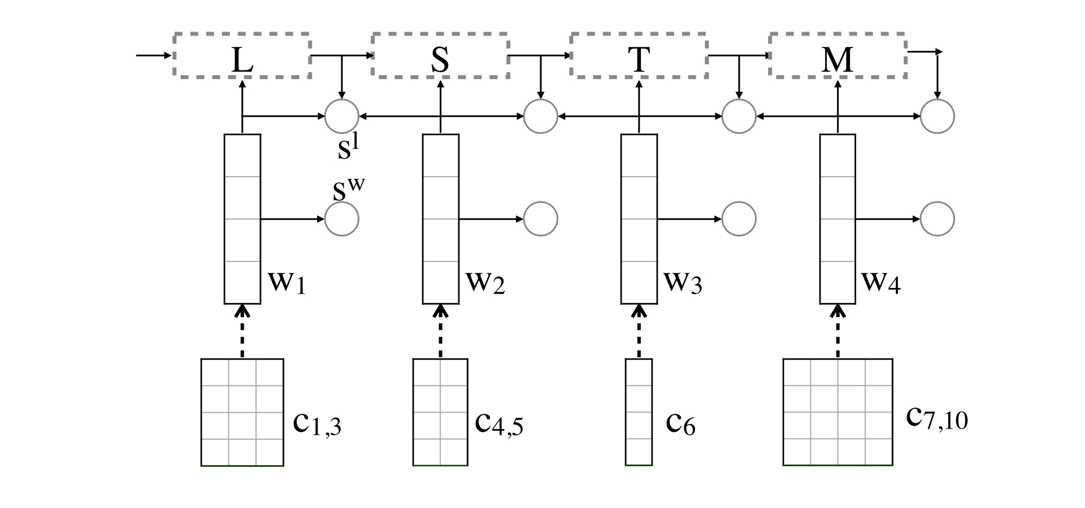
Methodology (backbone model)
3
Linking score
2
Word score
1
Input word vector
Calculate the‘word’representation from character representation
Calculate the word score based on word representation
Calculate the linking score based on word representation and history state
Calculate segmentation score by summing up all word scores and linking score

Slide 8
Methodology (unsupervised segmentation)
Goodness measure based model
STEP ONE: Assign each character n-gram a goodness measure (likelihood to be a word).
E.g., Accessor Variety (AV) : counts the distinct neighbours of a character sequence
来到夏威夷很高兴。
我曾今到过夏威夷。
我很想到夏威夷玩。
STEP TWO: Find the best segmentation by maximizing the sum of goodness measure.
AV(‘夏威夷’) = min(Left_AV, Right_AV) = min(2, 3) = 2
z
来到 | 夏威夷 | 我 | 很 | 高兴 | 。
S₁ | S₂ | S₃ | S₄ | S₅ | S₆
来到 | 夏威夷 | 我很 | 高兴 | 。
S’₁ | S’₂ | S’₃ | S’₄ | S’₅
Sum₁ > Sum₂

Slide 9
Methodology (unsupervised segmentation)
Language model based model (NPYLM as a example)
Nested Pit-Yor Language Model: evaluate a segmentation on two levels
CHARACTER LEVEL:
WORD LEVEL:
Segmentation score:
The is estimated by Pit-Yor Process (lots of mathematics)

Slide 10
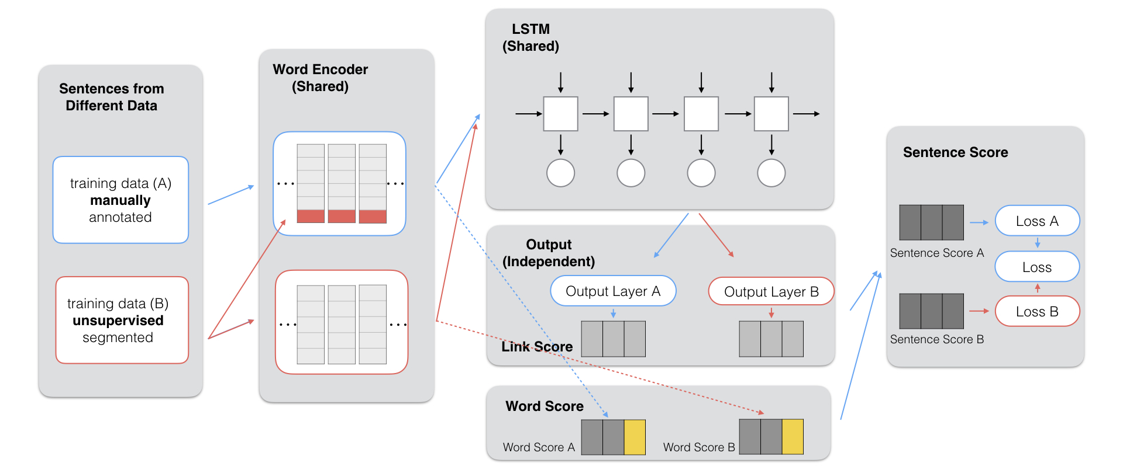
Proposed methods (Overview)
Add label embedding
Apply multitask learning
Augment word score

Slide 11
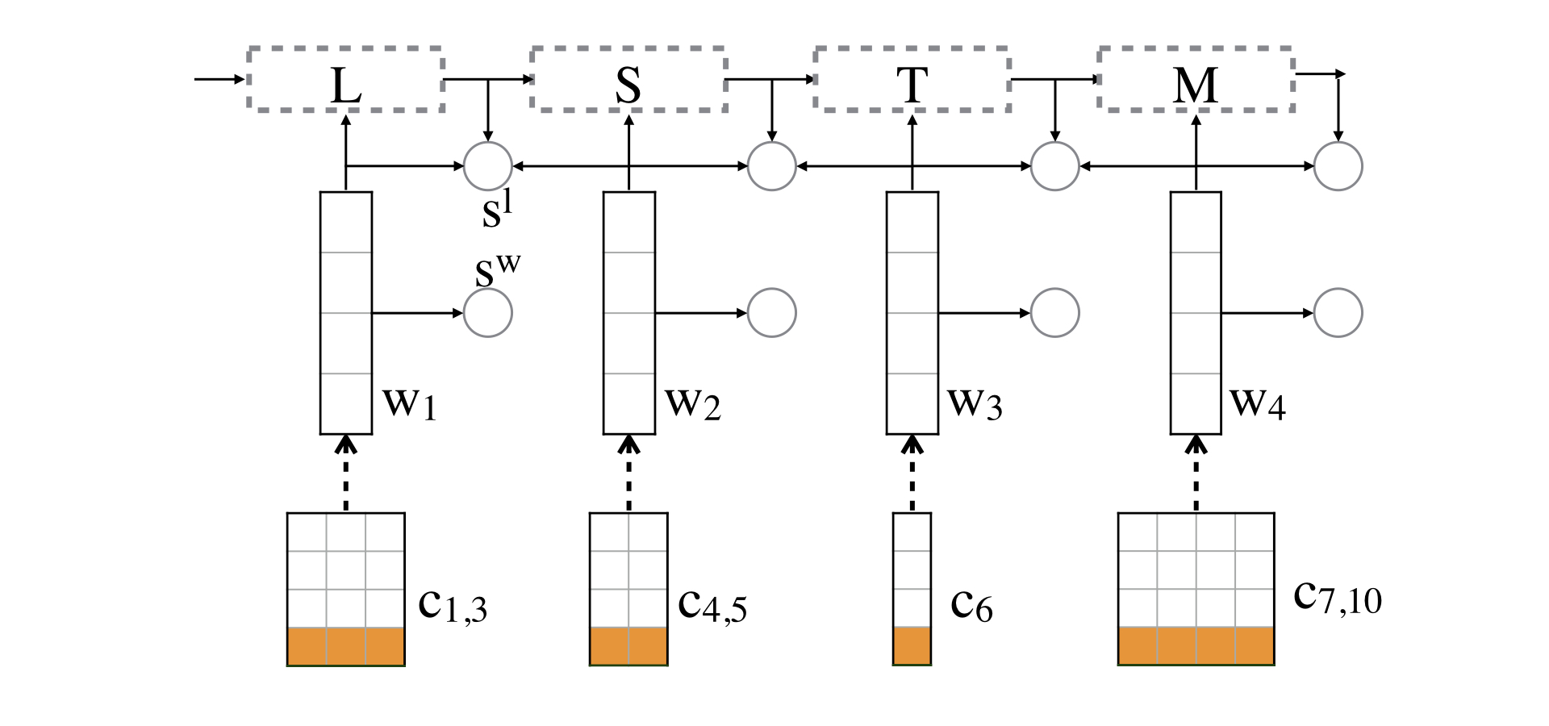
Add label embedding
Interpret unsupervised segmentation results into label sequence
E.g., 来到/夏威夷/我/很/高兴/。（come to / Hawaii / I / very / glad）
B E B I E S S B E S
Feed the label information into model as prior segmentation knowledge

Slide 12
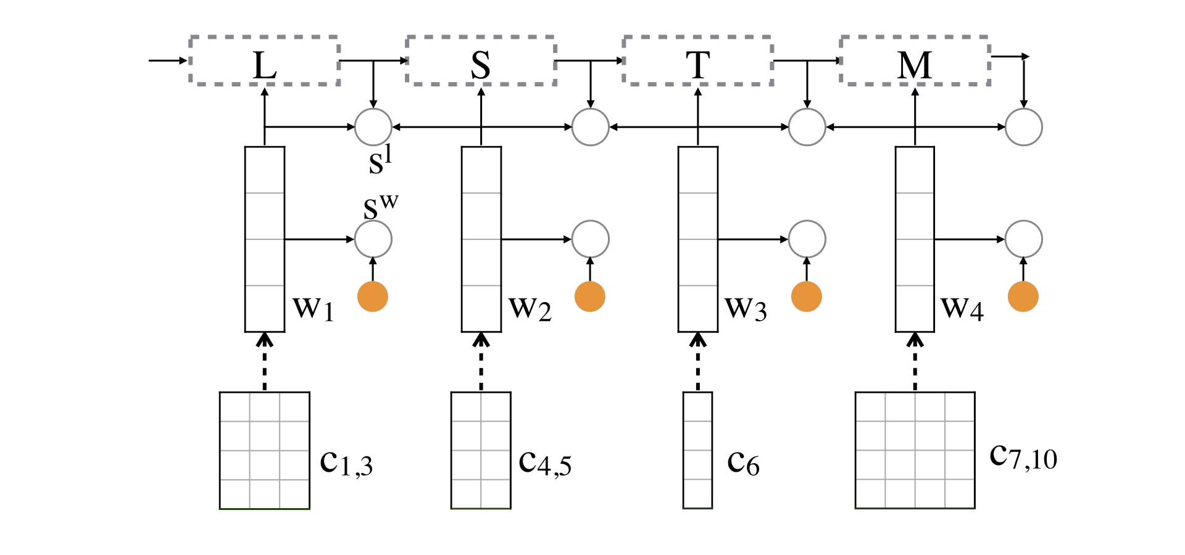
Augment word score
Word score and goodness measure play the similar role -> estimating the soundness of a word
Goodness measure can be estimated from a huge unlabeled corpus

Slide 13
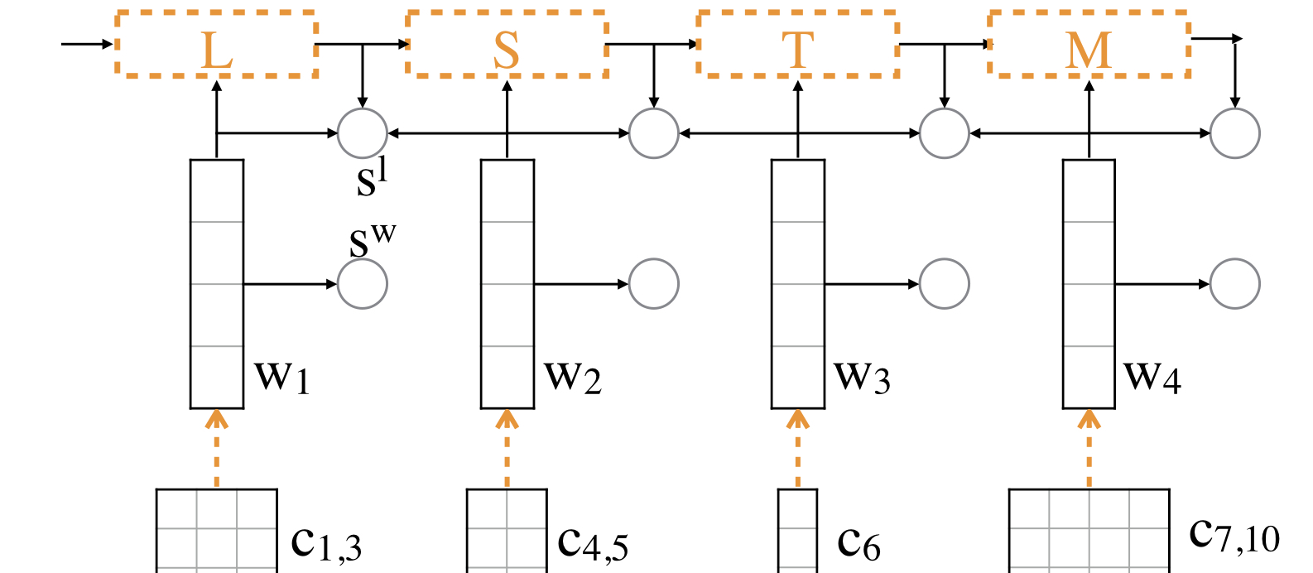
Apply multitask learning
learning from labeled and unlabeled data simultaneously
Shared parameters
Joint cost function:

Slide 14
Strategy Collaboration
Goodness measure:
better estimation of word score
Language based:
better segmentation results
+
Take advantage of different unsupervised methods.
+ label embedding / + goodness measure:
feed unsupervised infos during training and testing.
Multitask learning:
Utilize unsupervised infos only in training.
+
Make use of unsupervised infos both in training and testing.

Slide 15
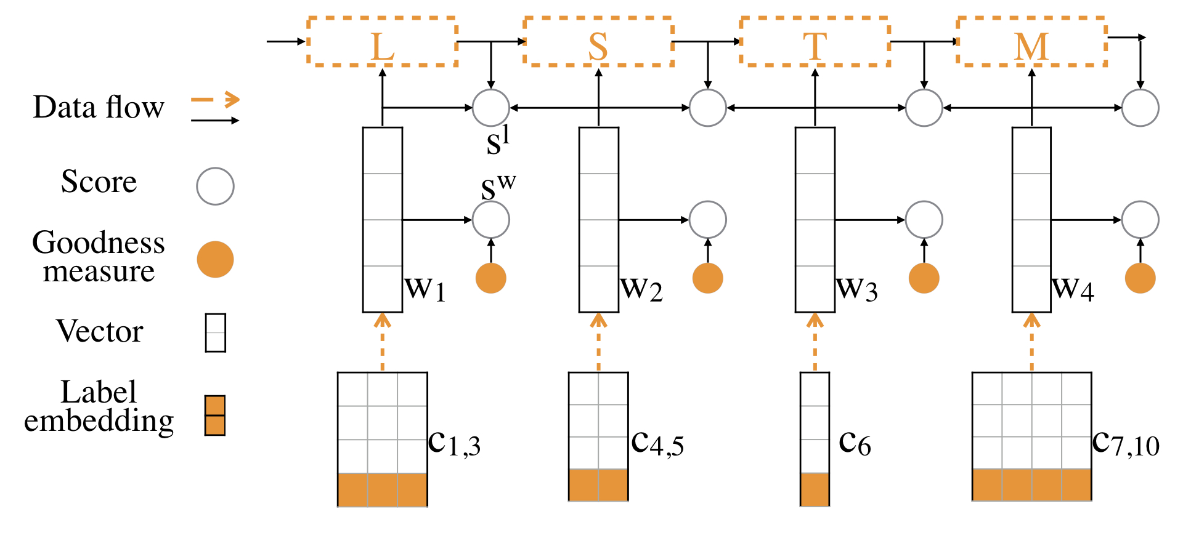
Strategy Collaboration
For label embedding and multitask learning, we utilize NPYLM to generate segmented text.
For goodness score we use Accessor Variety

Slide 16
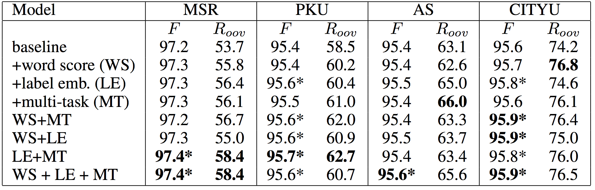
Experiments
Closed test
The proposed methods boost the baseline significantly.
Our proposed
* means the improvement are significant (at 95% confidence level.)

Slide 17
Experiments
Open test
The performance is continuously improving while the size of unlabeled data increases.

Slide 18
Conclusions
We Incorporate the results of unsupervised segmentation with neural word segmentation models.
Extend the character embedding with the embedding of segmentation
Augment the word score with goodness measure
Use multitask learning to learn from unsupervised segmentation
Our proposed methods boost the OOV recall rate significantly and outperform the baseline.
The performance is continuously improving while the size of unlabeled data increases.

