Slide 1
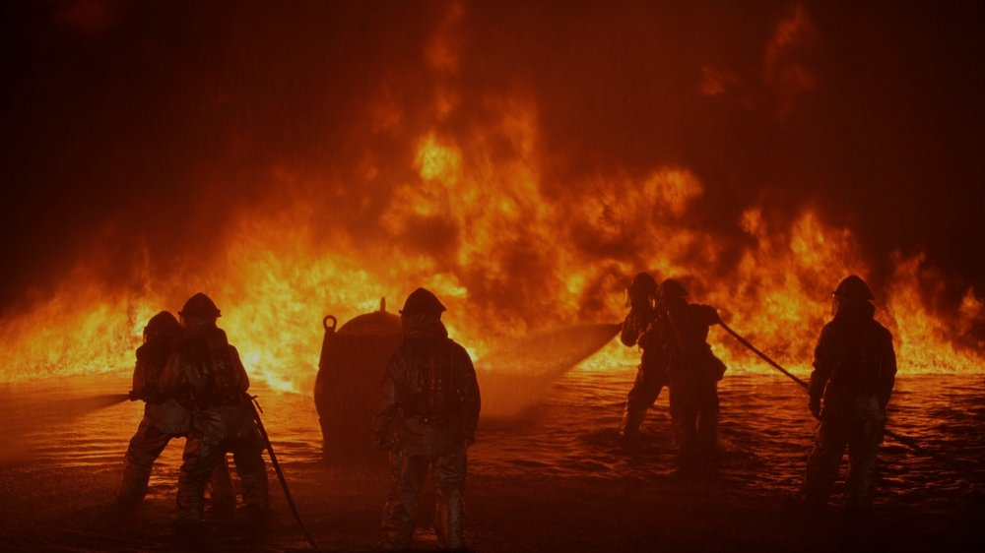

Twitter Disaster Detection
Design and implement a tool using social media activity to develop a rapid alert response system from a disastrous event.
Jann Erik Dietert, Petra Woßeng, Oliver C. Faber - 08.10.2020

Slide 2
Twitter Disaster Detection Topic fields
Data exploration:
Data analysis/statistic and structuring
Methodical approach
Modelling and evaluation
Numeric feature list from text at MNB, LogReg
Vectorized word count at TFiDF, MNB
Vectorized NER (LOC, GPE) at TFIDF, MNB
Trial of model
Summing up Q&A

Slide 3
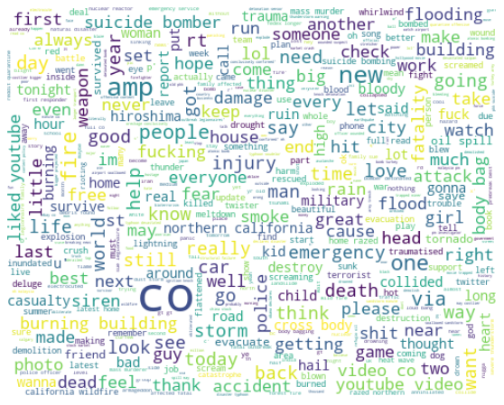
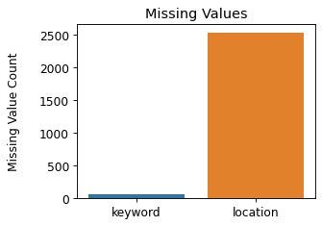
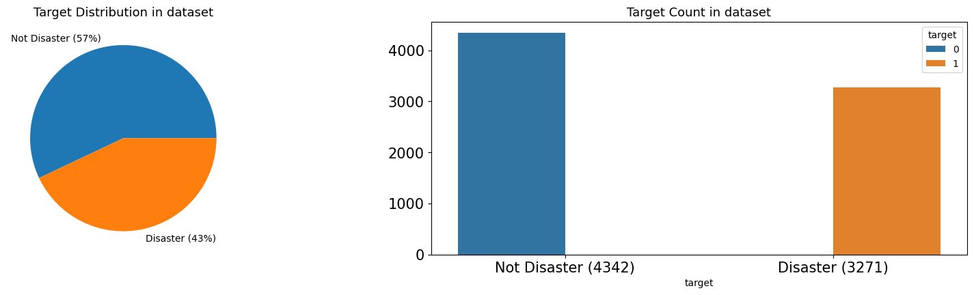
Data exploration and findings
Missing values
Target distribution
Word cloud of all tweets (cleaned)
in Target count in dataset

Slide 4


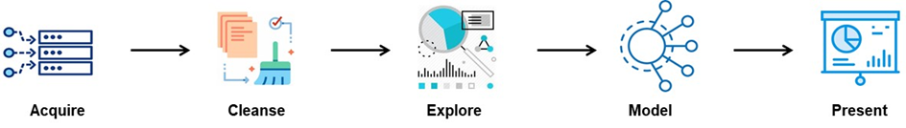
Methodical approach to model and evaluate Twitter data for disaster detection
Vectorized word count at TFiDF, MNB
standatized calculated features
Validation
Modelling
Vectorized NER (LOC, GPE) at TFIDF, MNB
Clean & Prep
Explore
manually calculated features
Modelling
Validation
Numeric feature list from text at MNB, LogReg
Clean & Prep
word_count - unique_word_count - stop_word_count - url_count - mean_word_length - char_count -
punctuation_count - hashtag_count - mention_count
Validation
Modelling
Notes:
Note
Data Cleaning & feature extention
Bag of Word
Tfidf, Multinominal NB
Linear Regession
Sklearn pipeline Models
…
cross_val_score
accuracy_score, r2_score, plot_confusion_matrix, roc_auc_score, roc_curve
…
LogisticRegression
metrics
CategoricalNB
MultinomialNB, BernoulliNB
feature_extraction.text
CountVectorizer, TfidfVectorizer
…
Note
Data Cleaning & feature extention
Bag of Word
Tfidf, Multinominal NB
Linear Regession

Slide 5
Data Cleaning and extending features
Data cleaning
Extending features
TEXT of tweets:
Removed hyper-links
Removed punctuation
Removed all non-letters and extra spaces
Set all text to lowercase
Stopwords (en)
WordNetLemmatizer()
PorterStemmer()
KEYWORD extracted of text:
Cleaning as in text
LOCATION tweet was sent from:
NER with Spacy LOC & GPE
Evolution of e.g.:
word_count - number of words in text
unique_word_count - number of unique words in text
stop_word_count - number of stop words in text
url_count - number of urls in text
mean_word_length - average character count in words
char_count - number of characters in text
punctuation_count - number of punctuations in text
hashtag_count - number of hashtags (#) in text
mention_count - number of mentions (@) in text

Slide 6
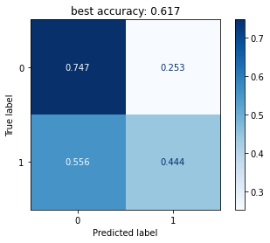

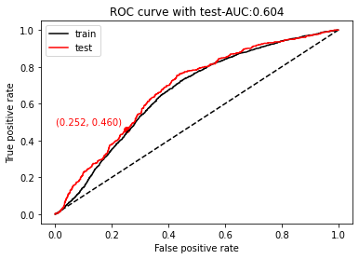
Modelling and evaluation Pipe: Vectorized numeric feature list from text
Train
Test
Validate
Exemplary evaluated features
word_count - unique_word_count - stop_word_count
url_count - mean_word_length - char_count
punctuation_count - hashtag_count - mention_count

Slide 7
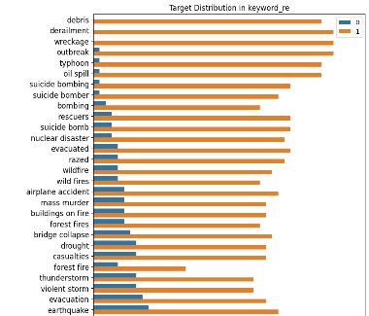
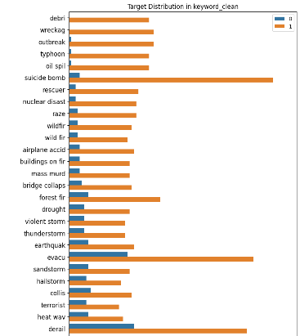


Data cleaning: Keyword-Target Distributions
1st step: cleaned with regex
2nd step: plus stemming
accuracy
with regex:
0.724
Accuracy
with regex & porter stemmer: 0,725
Absolute keyword count
Absolute keyword count

Slide 8
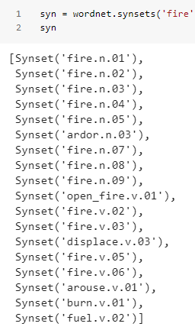
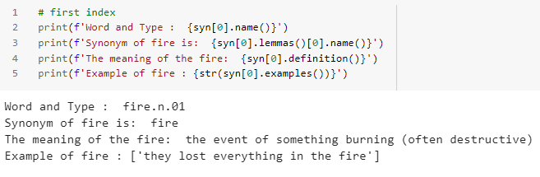
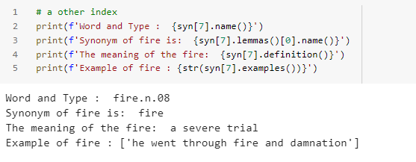
Wordnet – synsets

Slide 9
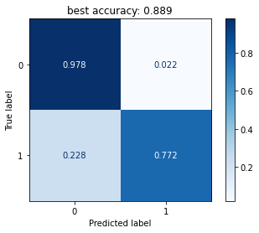
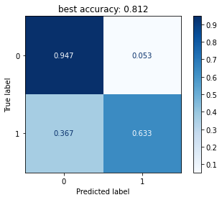
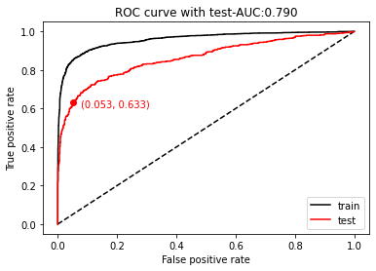
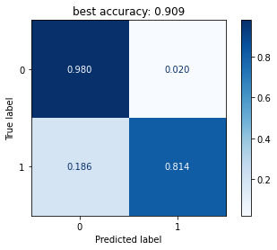
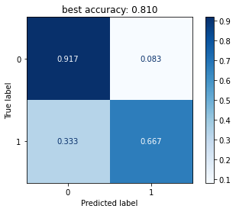
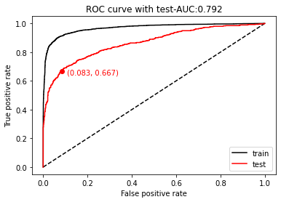
Evaluation of basis models Pipe: Vectorized word counting (TFiDF, MNaiveBayes)
Cleaned and lemmatized
data set
Original data set without pre-processing
Train
Test
Validate
Notes:
################# NEW #################
df = disaster_tweets.copy() # original data set, no postprocessin
pipeMNB = make_pipeline(TfidfVectorizer(ngram_range=(1, 1)), MultinomialNB()) #### naive bayes
%time fpr_0, tpr_0 = my_fit_cm(df, pipeMNB, "text", "target")

Slide 10
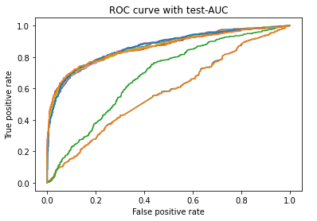
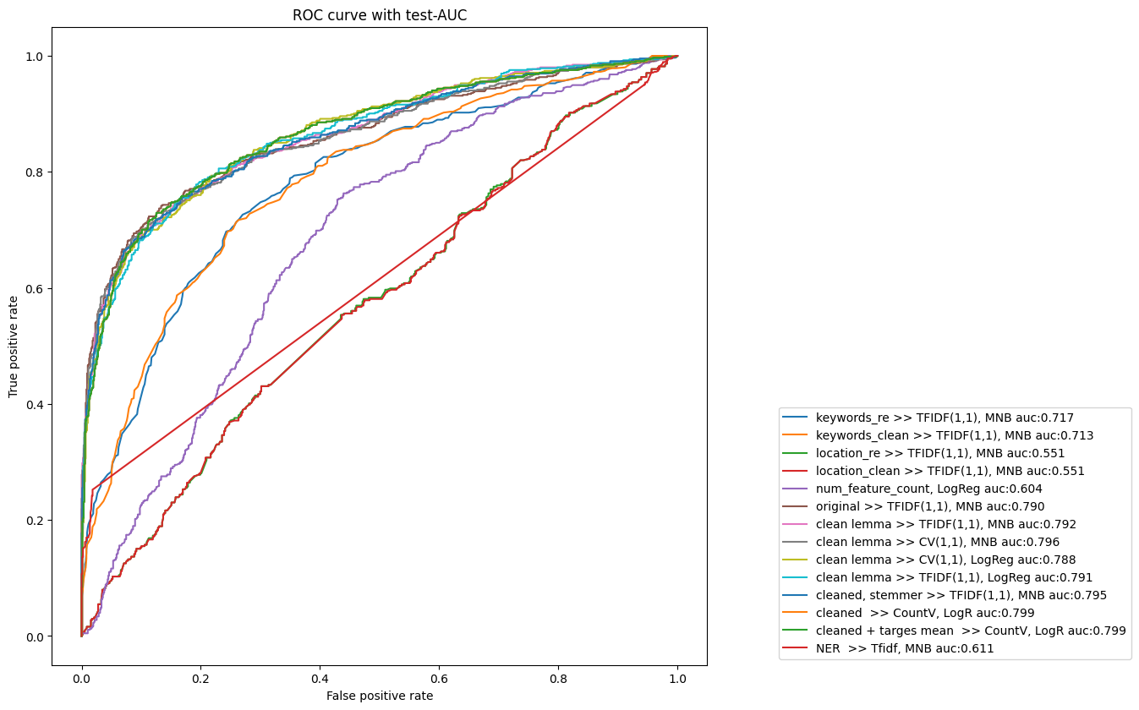
Modelling and evaluation: Final results
Vectorized word counts produced best results
Final result: ROC curves with test-AUC (3 groups)
Vectorized word count at TFiDF, MNB
Vectorized NER (LOC, GPE) at TFIDF, MNB
Numeric feature list from text at MNB, LogReg
Notes:
Locoation_re

Slide 11
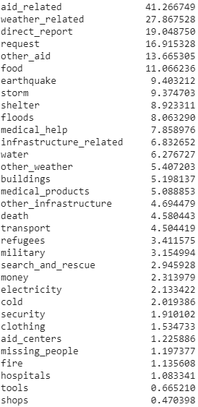
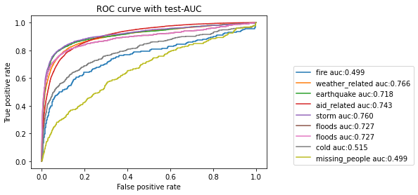
Testing of our pipe and model (CountVectorizer & MNB)
with a different data set (source: Kaggle).
Final result: ROC curves with test-AUC
Notes:
################# NEW #################
df = disaster_tweets.copy() # original data set, no postprocessin
pipeMNB = make_pipeline(TfidfVectorizer(ngram_range=(1, 1)), MultinomialNB()) #### naive bayes
%time fpr_0, tpr_0 = my_fit_cm(df, pipeMNB, "text", "target")
loc='upper right', bbox_to_anchor=(0.5, 0.5)

Slide 12
Thank you !
Q&A ?!

