Slide 1
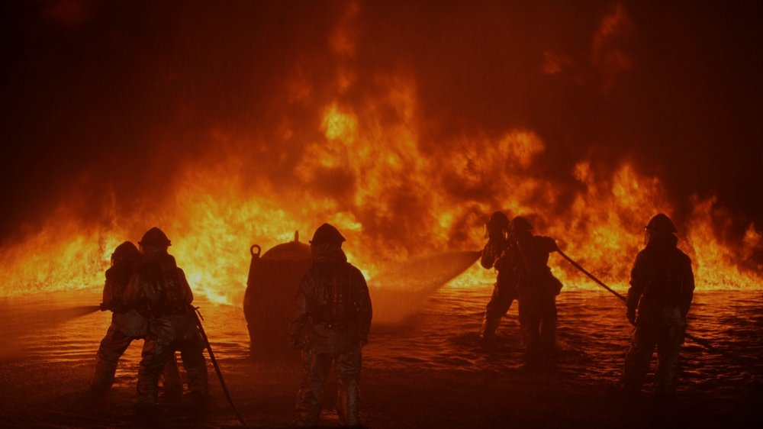

Twitter Disaster Detection
Design and implement a tool using social media activity to develop a rapid alert response system from a disastrous event.
Jann Erik Dietert, Petra Woßeng, Oliver C. Faber - 08.10.2020

Slide 2
Twitter Disaster Detection Topic fields
Data exploration:
Data analysis/statistic and structuring
Methodical approach
Modelling and evaluation
Vectorized word counting (TFiDF, MNB, Bernoulli)
TFIDF & NER with Loc & Gpe data
Extended feature list deduced of detailing textural analysis
Trial of model
Exemplary …
Summing up Q&A

Slide 3
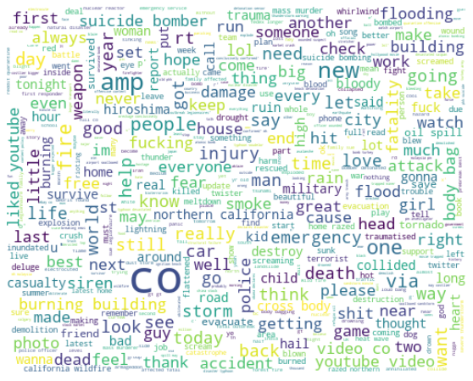
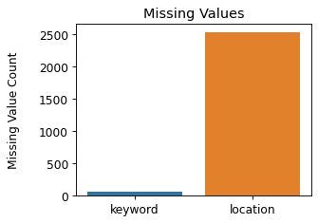
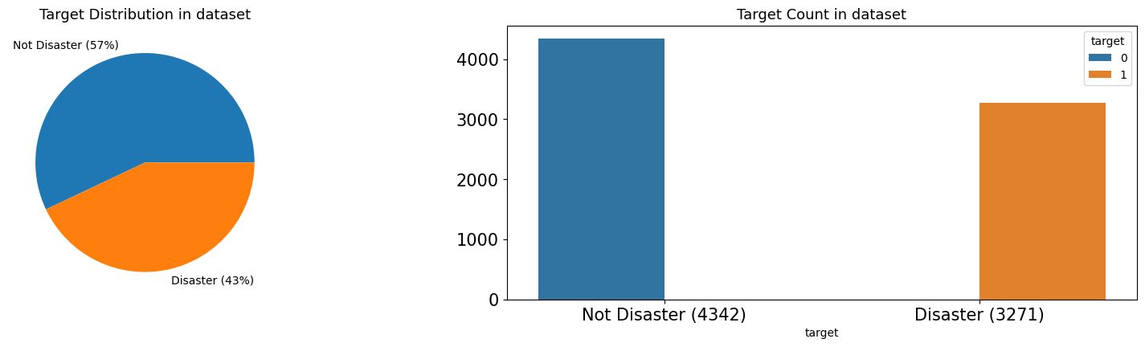
Data exploration and findings
Missing values
Target distribution
Word cloud of all tweets (cleaned)
in Target cout in dataset

Slide 4
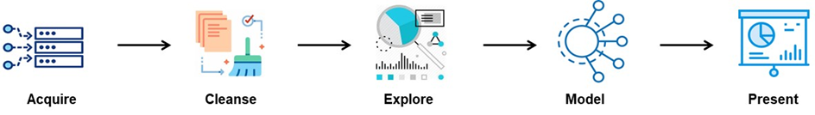


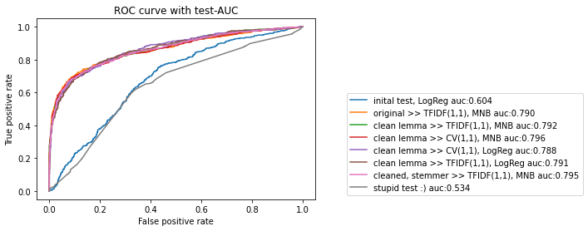
Wrangel & Clean
Explore & Prep
Modelling
Validation
Data Cleaning
Data Cleaning
Sklearn pipeline Models
…
cross_val_score
accuracy_score, r2_score, plot_confusion_matrix, roc_auc_score, roc_curve
…
LogisticRegression
metrics
CategoricalNB
MultinomialNB, BernoulliNB
feature_extraction.text
CountVectorizer, TfidfVectorizer
…
Note
Data Cleaning & feature extention
Bag of Word
Tfidf, Multinominal NB
Linear Regession

Slide 5
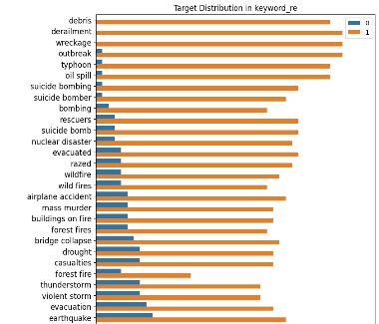
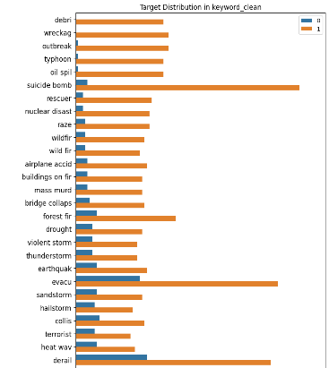


Data cleaning: Keyword-Target Distributions
1st step: cleaned with regex
2nd step: plus stemming
Absolute keyword count
Absolute keyword count

Slide 6
Data Cleaning and extending features
Data Cleaning
Extending features
TEXT of tweets:
Removed hyper-links
Removed punctuation
Removed all non-letters and extra spaces
Set all text to lowercase
Stopwords (en)
WordNetLemmatizer()
PorterStemmer()
KEYWORD extracted of text:
Cleaning as in text
LOCATION tweet was sent from:
My Spacy LOC & GPE
Evolution of e.g.:
word_count - number of words in text
unique_word_count - number of unique words in text
stop_word_count - number of stop words in text
url_count - number of urls in text
mean_word_length - average character count in words
char_count - number of characters in text
punctuation_count - number of punctuations in text
hashtag_count - number of hashtags (#) in text
mention_count - number of mentions (@) in text

Slide 7
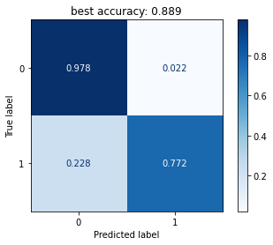
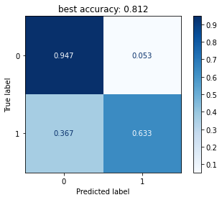
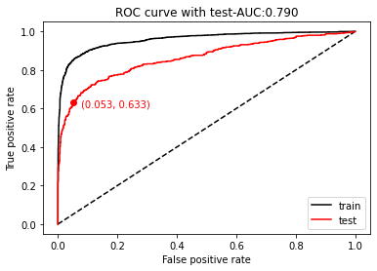
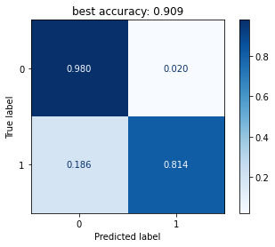
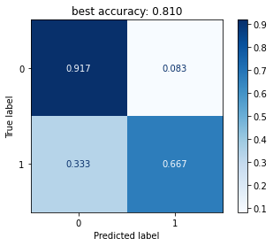
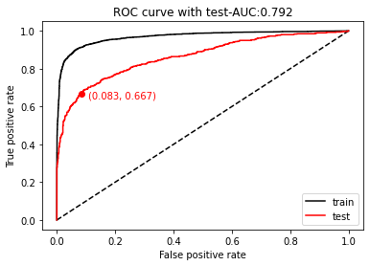
Evaluation of basis models Pipe: Vectorized word counting (TFiDF, MNaiveBayes)
CountVectorizer(), MultinomialNB()) #### naive bayes
Train
Test
Validate
Notes:
################# NEW #################
df = disaster_tweets.copy() # original data set, no postprocessin
pipeMNB = make_pipeline(TfidfVectorizer(ngram_range=(1, 1)), MultinomialNB()) #### naive bayes
%time fpr_0, tpr_0 = my_fit_cm(df, pipeMNB, "text", "target")

Slide 8
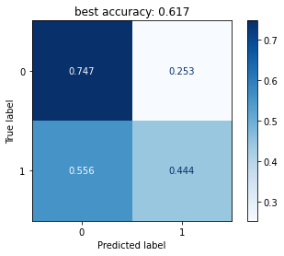

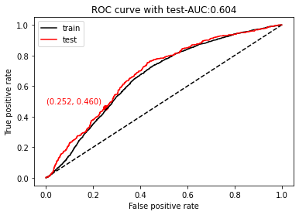
Modelling and evaluation Pipe: Vectorized numeric feature list from text
Train
Test
Validate
Exemplary evaluated features
word_count - unique_word_count - stop_word_count
url_count - mean_word_length - char_count
punctuation_count - hashtag_count - mention_count

Slide 9
Modelling and evaluation: Final result
Final result: ROC curves with test-AUC
Notes:
################# NEW #################
df = disaster_tweets.copy() # original data set, no postprocessin
pipeMNB = make_pipeline(TfidfVectorizer(ngram_range=(1, 1)), MultinomialNB()) #### naive bayes
%time fpr_0, tpr_0 = my_fit_cm(df, pipeMNB, "text", "target")
loc='upper right', bbox_to_anchor=(0.5, 0.5)

Slide 10
Thank you !
Q&A ?!
Wrangel & Clean
Explore & Prep
Modelling
Validation

