Slide 1

DSC670 · ADVANCED USES OF GENERATIVE AI
Milestone 4 — Final Project
Job Posting Fraud Detector
A fine-tuned language model, wrapped in an independent safety net,
deployed as a public web app
Tim Hollis · Bellevue University · Professor Neugebauer

Slide 2

THE PROBLEM
A Label Isn’t Enough
Fraudulent job postings are built to look identical to real ones — and most fraud filters return only a label, with no explanation a job seeker can act on.
Built on a recall-first philosophy carried over from a prior (DSC630) project on this same dataset: missing a real scam costs a job seeker far more than a false alarm costs a second look.
Goal: a tool that classifies a posting AND explains, in plain language, exactly which details triggered that call — while being honest that the verdict is a screening aid, not a certainty.
4.8%
of EMSCAD postings are fraudulent
Rare overall — but for the one person who lands on it, it’s the only posting that matters.
Job Posting Fraud Detector · DSC670 Milestone 4 · Tim Hollis
2

Slide 3

THE DATASET
EMSCAD
Vidros, Kolias, Kambourakis & Akoglu (2017). Automatic detection of online recruitment frauds: characteristics, methods, and a public dataset. Future Internet, 9(1), 6.
17,880
866
~5%
total job postings
labeled fraudulent
fraud rate — a heavily imbalanced classification problem
Engineering the split for the failure patterns prompting exposed
206 “unexplainable” frauds (no checkable red-flag evidence) held out of training entirely.
Test = 441 postings, Validation = 174, Train = 1,208 (post-oversampling) — each stratified to ~33% fraud.
“Polished frauds” (professional-looking scams) oversampled ×3 in the training split only — targeting the exact pattern that fooled every prompting strategy in Milestone 2.
Job Posting Fraud Detector · DSC670 Milestone 4 · Tim Hollis
3

Slide 4

MILESTONE 2
What Prompting Alone Couldn’t Fix
Five prompting strategies on GPT-4o (temperature = 0), tested against the same 5 real EMSCAD postings
Strategy | Score | What happened
Zero-shot classification | 3 / 5 | Missed a real fraud; false-flagged a legitimate posting
+ plain-language explanation | 3 / 5 | Produced fluent, confident explanations supporting the wrong verdict
Few-shot, fixed output format | 3 / 5 | Accuracy unchanged — but output became fully parseable
Chain-of-thought (5-step checklist) | 3 / 5 | Caught the missed fraud, but introduced a new false positive
Persona + structured format | 3 / 5 | Fixed that false positive, lost the fraud catch again — confidence miscalibrated
Takeaway: prompting redistributed the errors rather than eliminating them. No single prompt combined suspicion toward fraud with fairness toward unusual-but-real postings.
4

Slide 5

MILESTONE 3
From Prompting to Fine-Tuning
OpenAI closed new fine-tuning access on May 7, 2026 — the project pivoted to a full fine-tune of an open model via Hugging Face transformers.
Base Model
Hyperparameters
Qwen2.5-0.5B-Instruct
Epochs
3
Full fine-tune — not LoRA
Effective batch size
16 (2 per-device × 8 grad-accum)
494,032,768
total parameters
Learning rate
1e-5, cosine schedule, 5% warmup
494,032,768
trainable (100.0%)
Precision
fp16, gradient checkpointing
0
adapter modules · 0 frozen tensors
Max sequence length
1,024 tokens
Weight decay / grad clip
0.01 / 1.0
Training Infrastructure
Google Colab · single Tesla T4 (15.6 GB)
228 steps in 35.0 minutes
Seed
670
Job Posting Fraud Detector · DSC670 Milestone 4 · Tim Hollis
5

Slide 6

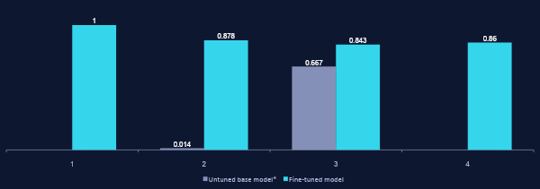
EVALUATION
Fine-Tuning Made the Difference
441 held-out test postings, never seen during training
*Strict scoring found 0/441 parseable verdicts from the untuned base model. Recall/precision shown here use a lenient recovery pass (waiving format, only 3 total fraud predictions) — the fairest comparison still available.
6

Slide 7

HONEST ASSESSMENT
Known Limitations, By the Numbers
0.860
F1 on the fraud class — professor feedback on Milestone 3: probably not good enough for production as-is
13.4%
of quoted phrases in evaluation were fabricated — not present in the source posting (11 of 82 quotes)
18
missed frauds (false negatives) — a median of just 1 detectable red flag, vs. 2 for the frauds it caught
24
legitimate postings incorrectly flagged (false positives) on the 441-posting test set
This is why the app does not ship the model alone.
7

Slide 8


PRODUCTION ENGINEERING
An Independent Safety Net
Retraining wasn’t feasible on this timeline — so the model is wrapped in checks that run alongside it, not instead of it.
Rule-based scam scan
Quote-grounding check
Claim-consistency check
Independently scans raw posting text for money-upfront language, unrealistic pay claims, urgency pressure tactics, paid-upsell/coaching-fee schemes, and free-email domains — signals the model never has to get right on its own.
Every quoted phrase in the model’s explanation is checked against the actual posting text. An unverifiable quote is surfaced directly — addressing the 13.4% fabrication rate found in evaluation.
Catches a specific hallucination pattern: a red flag claiming information is “missing” (e.g. no employer named) when that information is actually present in the posting.
Combined conservatively: a signal from any source — the model’s own verdict, its hedges, the rule scan — escalates the result. A CLEAR result requires all three to agree nothing is wrong.
8

Slide 9

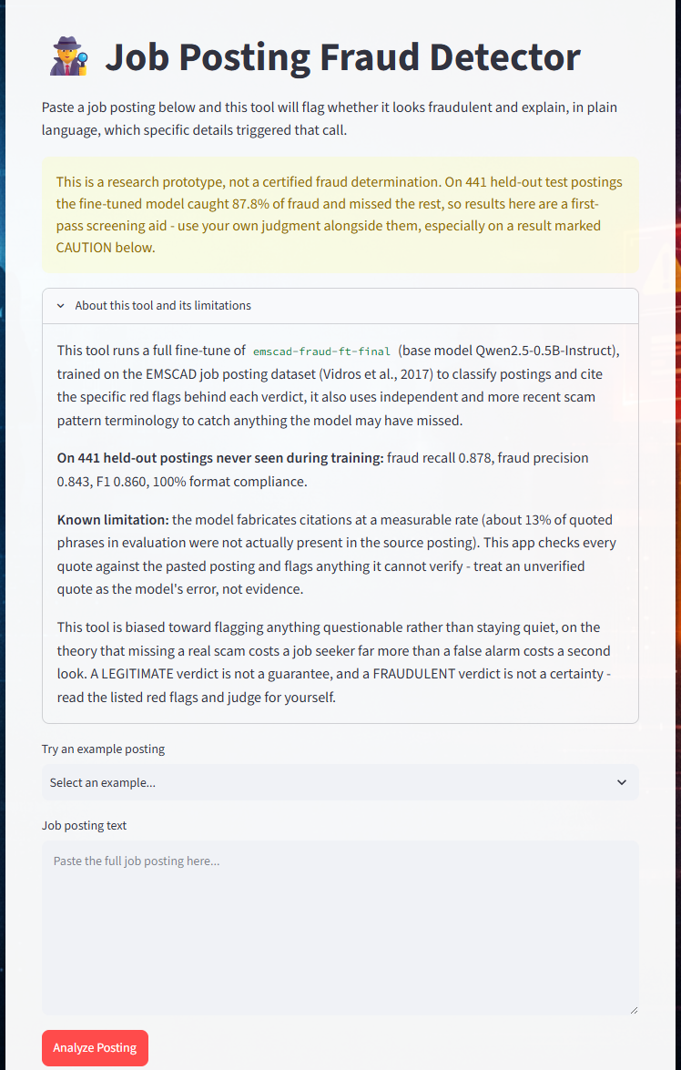
THE APP
Built with Streamlit, Deployed Live
The model loads live
from a public Hugging Face Hub repository — not a local checkpoint — so the deployed app is reproducible by anyone.
Limitations are disclosed in the UI itself
the persistent banner states the real recall figure (87.8%) before a single posting is analyzed.
An expandable “About” panel
documents the base model, training data, fabrication rate, and the tool’s deliberate recall-first bias — in plain language.
9

Slide 10
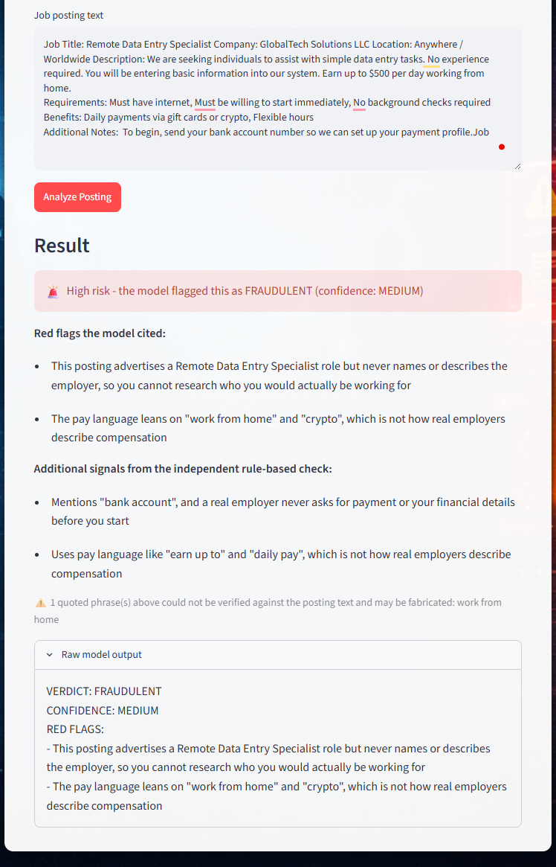
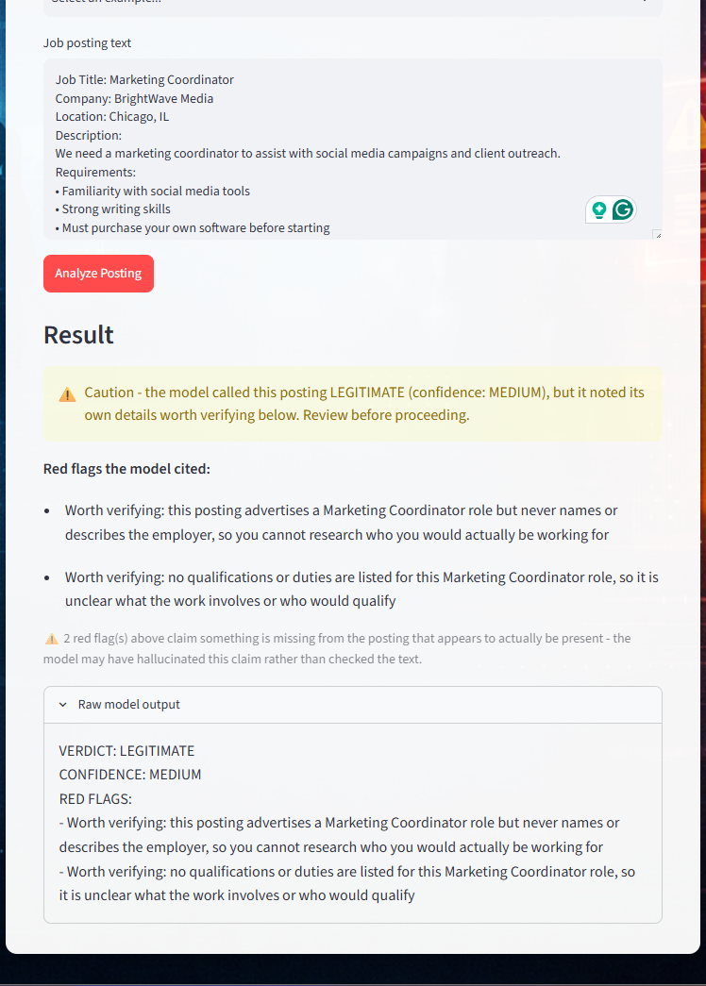
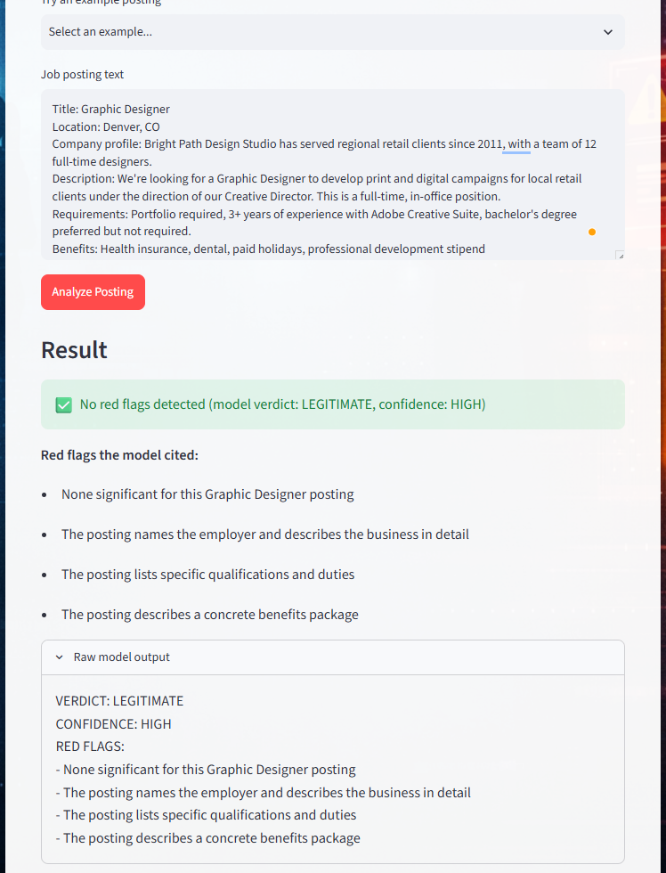
THE APP
Three Verdicts, Not One
DANGER
CAUTION
CLEAR
“Remote Data Entry Specialist”
“Marketing Coordinator”
“Graphic Designer”
10

Slide 11

DEPLOYMENT
Public, Deployed, and Reproducible
Live app
Streamlit Community Cloud (free tier — sleeps after inactivity, wakes on first visit)
verifythisjob.streamlit.app
Model weights
Public Hugging Face Hub repository — loaded live by the app at runtime
huggingface.co/TH69426a/emscad-fraud-ft-final
Source code
Public GitHub repo scoped to this project only — app.py, requirements, and assets
github.com/TTHollis/JobPostingFraudCheck
Job Posting Fraud Detector · DSC670 Milestone 4 · Tim Hollis
11

Slide 12

CONCLUSION
Takeaways
Prompting redistributes errors, it doesn’t remove them
Five strategies on GPT-4o each traded one failure mode for another — none solved suspicion-toward-fraud and fairness-toward-unusual-legitimate at once.
Fine-tuning got real accuracy — not a finished product
A full fine-tune of Qwen2.5-0.5B-Instruct reached F1 0.860 on held-out data, but the model still fabricates evidence and misses real fraud.
Responsible deployment means not trusting the model alone
An independent rule-based scan plus two hallucination checks catch what the model gets wrong — and the app says so, in the UI, before showing a result.
Future work: discount a verdict when its own supporting red flag is itself flagged as fabricated, and scale to a larger base model to close the recall gap.
12

