Slide 1

Predicting Fraudulent
Job Postings
Using Machine Learning and Natural Language Processing
Timothy Hollis
Bellevue University | DSC630 – Predictive Analytics
Professor Andrew Hua | May 2026

Slide 2
The Problem
17,880
4.8%
$2B+
Job postings analyzed
Were fraudulent
Lost to job scams annually
Fraudulent job postings harm real people.
Victims face identity theft, financial loss, and emotional harm — often during an already vulnerable job search.
Existing manual review processes cannot scale. An automated detection system is essential.

Slide 3
Research Question & Approach
"Can the characteristics of a job posting predict whether it is fraudulent?"
Structured
Features
NLP Text
Features
Asymmetric
Cost Focus
Boolean flags, categorical metadata, engineered signals
TF-IDF on cleaned job posting text across 5 fields
Missing fraud (false negative) is worse than a false alarm

Slide 4
Dataset Overview
Employment Scam Aegean Dataset
Feature Types
(EMSCAD) — Shivamb, 2020 / Vidros et al., 2017
Free-Text Fields
17,880
total job postings
Title, company profile, description, requirements, benefits
Structured Metadata
866
fraudulent (4.8%)
Location, employment type, experience, education, industry
18
features per record
Boolean Indicators
Company logo, screening questions, telecommuting
2000–2014
collection period
Engineered Features
has_salary, has_profile, description length

Slide 5
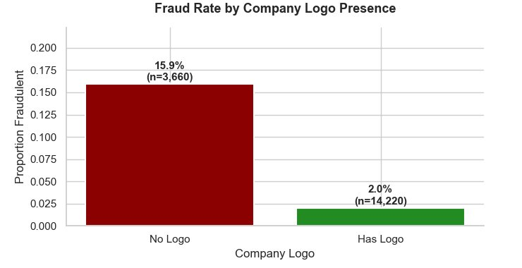
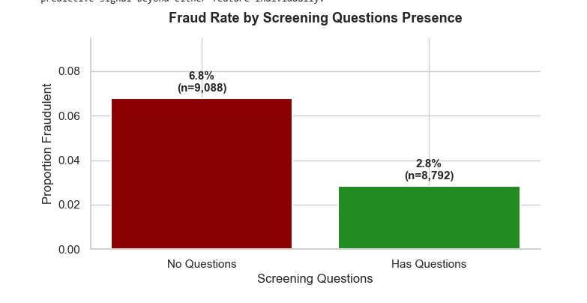
Exploratory Analysis: Structural Fraud Signals
Company logo absence = 8× higher fraud rate
Screening questions absent = 2× higher fraud rate
Key insight: Structural effort — adding a logo, creating questions — strongly predicts legitimacy.

Slide 6
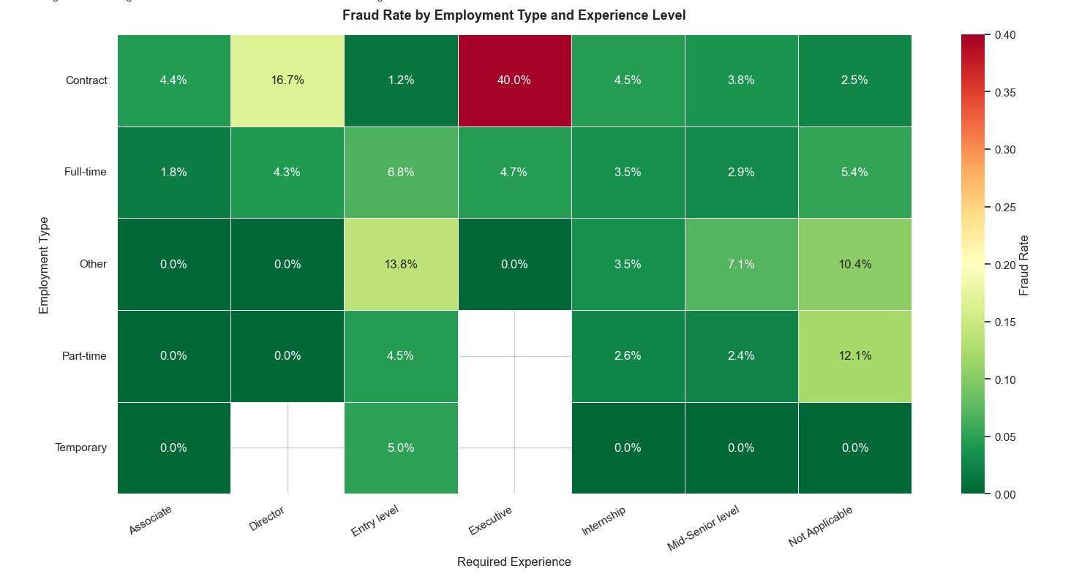
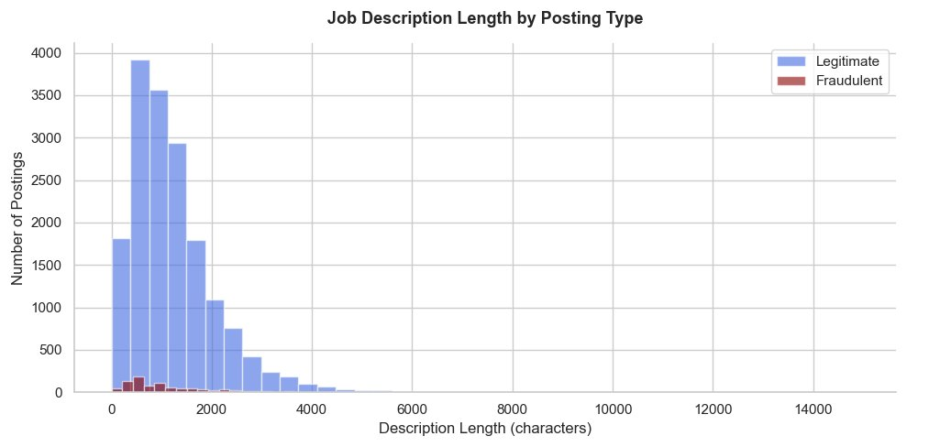
Exploratory Analysis: Interaction Effects
Key
Insights
Contract/Executive postings show 40% fraud rate (n=10, interpret with caution)
Temporary roles show near-zero fraud across all experience levels
Fraud concentrates in specific role/employment intersections — not uniformly distributed
Fraudulent postings average 66 fewer characters in description
Interaction between type and experience adds signal beyond either alone
Description length is a modest but useful signal — retained as a numeric feature

Slide 7
Methods: Pipeline Overview
1
2
3
4
5
Text Cleaning
Feature Engineering
SMOTE Oversampling
Model Training
Threshold Tuning
Lowercase → strip punctuation → remove stopwords → drop tokens < 3 chars → concatenate 5 fields
TF-IDF (5,000 features) + OHE categoricals (2,948) + Boolean/numeric (6) = 7,954 total features
Applied to training data only. Minority class: 693 → 4,491. Total training: 14,304 → 18,102 rows
Logistic Regression (baseline) vs Random Forest (ensemble). Stratified 80/20 split. Balanced class weights.
Sweep 0.10–0.90. Select threshold with recall ≥ 0.90 on fraud class and maximum precision at that floor.

Slide 8
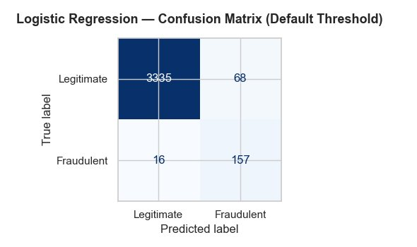
Results: Logistic Regression — Default Threshold
0.789
0.989
0.916
F1 Score
AUC-ROC
AUC-PR
157 of 173 fraudulent postings caught (recall = 91%)
68 legitimate postings incorrectly flagged
Strong recall at default threshold — but 68 false positives motivated threshold tuning.

Slide 9
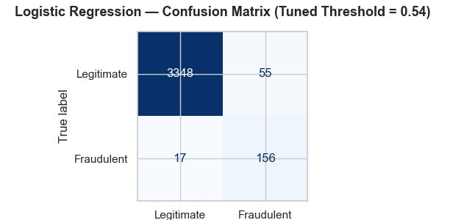
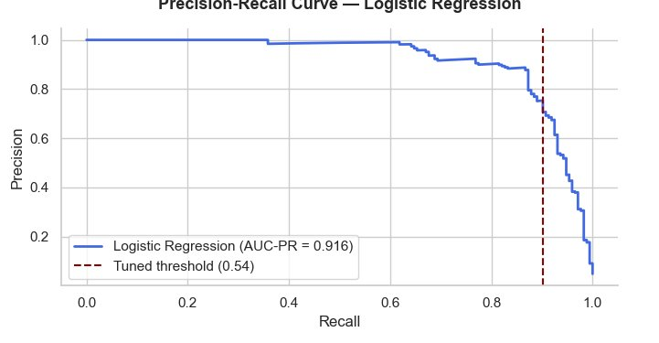
Results: Logistic Regression — Tuned Threshold (0.54)
Threshold 0.54 — Selected Result
F1 Score:
0.812 ▲
Recall:
90.2%
Precision:
73.9%
False Positives:
55 (↓ from 68)
The trade-off at 0.54:
−1 fraudulent posting caught
−13 legitimate postings incorrectly flagged
→ Best F1 of any configuration tested

Slide 10
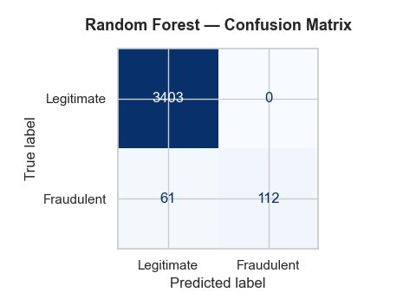
Results: Random Forest — A Different Operating Profile
AUC-ROC: 0.993 | AUC-PR: 0.928 | F1: 0.786
Highest AUC scores — but the confusion matrix tells a different story
0
61
False Positives
Fraud Missed (FN)
The random forest is a high-precision, lower-recall model. It never flags a legitimate posting incorrectly — but it misses more than 1 in 3 fraudulent postings. In a context where missing fraud means real people get deceived, that miss rate is the operative concern.

Slide 11
Model Comparison
Metric
LR Default
LR Tuned (0.54)
Random Forest
F1 Score
0.789
0.812 ★
0.786
AUC-ROC
0.989
—
0.993 ★
AUC-PR
0.916
—
0.928 ★
Fraud Caught (TP)
157
156
112
Fraud Missed (FN)
16
17
61
Legit Flagged (FP)
68
55
0 ★
★ Recommendation: Logistic Regression at threshold 0.54 — best F1, strong recall (90.2%), manageable false positives (55)

Slide 12
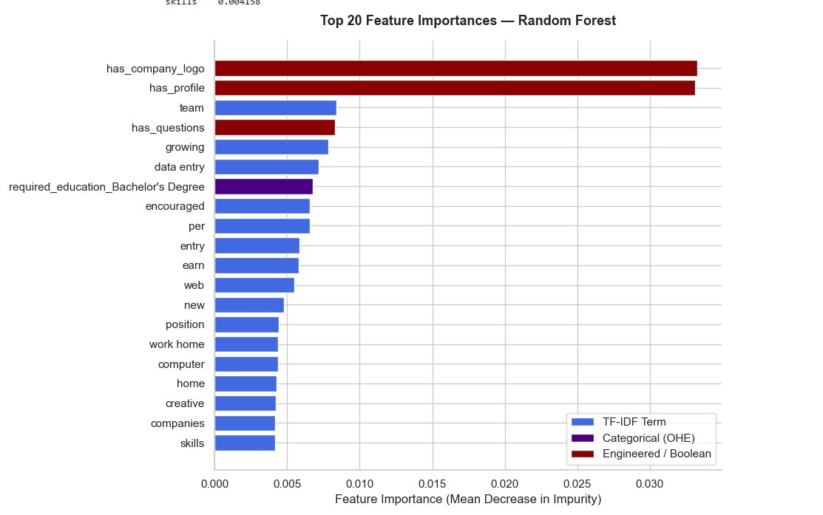
What Drives the Model: Feature Importance
Boolean Features
= 8% of importance
55× more informative
than avg. TF-IDF term
Top Fraud Text Signals
earn
work home
data entry
encouraged
growing
computer
position

Slide 13
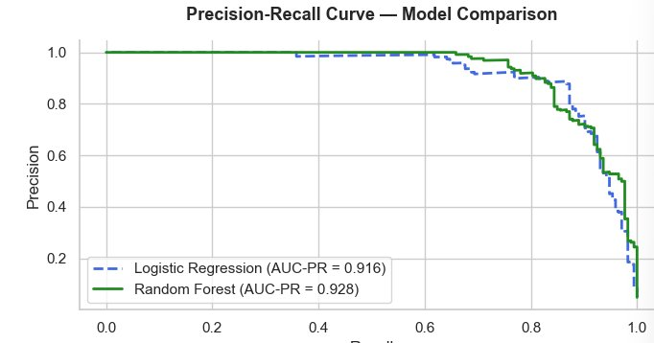
Precision-Recall: Why AUC Alone Is Not Enough
The AUC scores are nearly
identical — 0.916 vs 0.928.
But the confusion matrices
tell completely different stories:
LR Tuned
156 caught / 55 FP
Rand Forest
112 caught / 0 FP
Lesson: always pair aggregate metrics with confusion matrix analysis in imbalanced classification problems.

Slide 14
Conclusion & Deployment Recommendation
Deploy Logistic Regression at threshold 0.54 as a pre-publication screening tool with human oversight.
Post
Submitted
Model
Scores
≥ 0.54?
Review
Queue
Published
or Removed
Limitations
Future Work
Single platform — may not generalize to newer fraud tactics
English-language only — multilingual adaptation needed
~10% of fraud still missed even at tuned threshold
BERT/RoBERTa embeddings for richer semantic signals
Temporal features: posting date, duration, lifecycle
Active learning with human reviewer feedback loop

Slide 15
Thank You
Predicting Fraudulent Job Postings Using
Machine Learning and Natural Language Processing
90.2%
0.812
55
7,954
Recall on Fraud
(LR Tuned)
Best F1 Score
False Positives
(vs 68 default)
Total Features
Engineered
Timothy Hollis | DSC630 Predictive Analytics | Bellevue University | May 2026

