Slide 1

Scam Signatures
Discovering fraud families in online job postings
Timothy Hollis
DSC680 Applied Data Science | Professor Xu Ashton | Bellevue University
Notes:
I'm Tim Hollis, and my topic today is on a tool designed to help job-seekers detect when a job posting matches the signature of known fraud postings. Over the next few minutes I'll cover what I found, including one result that reversed my starting assumption and one that changed my final recommendation.

Slide 2
A verdict is not an explanation
$220M
4.8%
reported lost to job scams in the first half of 2024 alone (FTC, 2024)
of the 17,880 postings in the research dataset are annotated fraudulent
I have built a classifier and a fine-tuned language model on this data before. Both answer one question: is this posting fraudulent?
A verdict with no explanation is hard for a job seeker to act on and hard for a trust and safety team to audit.
So this project drops the label and asks a different question entirely.
Notes:
Job scams are big and getting bigger. The Federal Trade Commission says people reported losing more than 220 million dollars to them in just the first six months of 2024. I've built tools on this data twice before, and both did the same thing. They looked at a posting and said, this one seems fake. The trouble is that a warning with no reason attached is close to useless. A job seeker can't learn anything from it, and the company reviewing the posting can't check whether the tool was right. So this time I asked a different question.

Slide 3
Three questions, with the label withheld
1
2
3
Does fraud concentrate?
How many signatures exist?
Do they still hold?
When postings are grouped by language alone, do fraudulent ones cluster together or scatter among the legitimate?
If they do concentrate, how many distinct shapes are there, and what defines each one?
Do postings written today fall into those same signatures, or has the language moved on?
The fraud label is hidden during all modeling and revealed only afterward, to score what the clustering found.
Notes:
I asked three things. First, do fake postings actually resemble each other, or is every scam its own invention? Second, if they do resemble each other, how many types are there and what makes each one recognizable? Third, do the scams people run into today still look like the ones in my data? The rule I set for myself was that the computer never got to see which postings were fake while it was doing the sorting. I only checked the answers at the very end.

Slide 4
Real postings, prepared in five reproducible steps
17,880
2,008
15,872
real postings collected
2012 to 2014
rows removed
duplicates and empties
postings modeled
at a 4.48% fraud rate
Five text fields joined into one document per posting, with HTML stripped
Field presence recorded before anything was filled in, because a missing company profile is a signal rather than a defect
Duplicates removed, but counted first: fraudulent postings were duplicated at 22.3% against 15.0% for legitimate ones
Notes:
The data is just under eighteen thousand real job postings, collected by a recruiting site and marked legitimate or fraudulent by that site's own investigators. Two cleanup decisions turned out to matter. I noted which parts of a posting were missing before filling in any blanks, because a missing company description is itself a clue. And when I removed duplicate postings I counted them first, because scam postings get reposted far more often than real ones do.

Slide 5
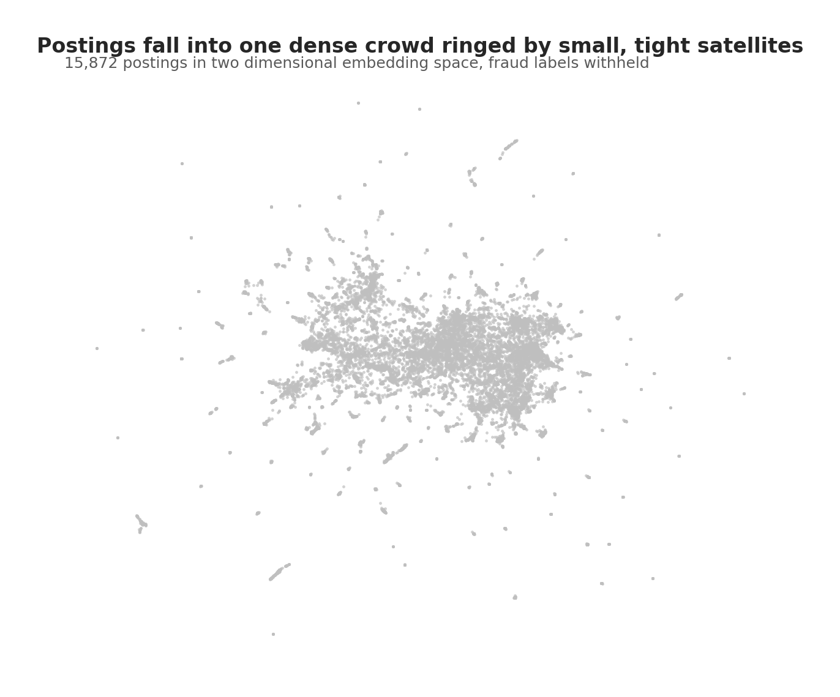
Four steps, no labels
1
Represent
Turn every posting into a vector, so similar wording sits close together
2
Reduce
Compress those vectors while keeping neighbours intact
3
Cluster
Let density find the groups, and leave ambiguous postings unassigned
4
Interpret
Read the dense groups and name what they have in common
Notes:
Here is the whole method in plain terms. First, turn every posting into a kind of fingerprint based on the words it uses. Second, simplify those fingerprints so similar ones sit near each other. Third, look for places where postings pile up, and let anything that doesn't fit stay unsorted rather than forcing it into a group. Fourth, read those piles and describe what they have in common. The picture on the right is the result. One big crowd of ordinary postings, ringed by dozens of small tight clumps. Those clumps are the rest of this talk.

Slide 6
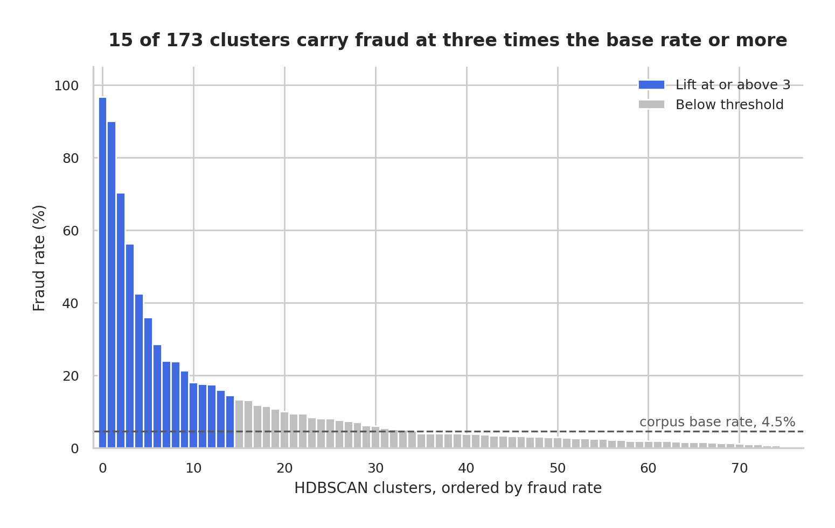
Fraud both concentrates and scatters
Notes:
So do scams resemble each other? Partly. Fifteen of those clumps are packed with fraud, holding about four in every ten fake postings while making up less than six percent of everything. But the number that convinced me isn't on this chart. Remember the postings that didn't fit anywhere. If most scams were one-off improvisations, that leftover pile should have been full of them. It wasn't. It had slightly less fraud than average. Scammers work from templates. The honest caveat is that more than half of the fake postings still didn't land in a clump.

Slide 7
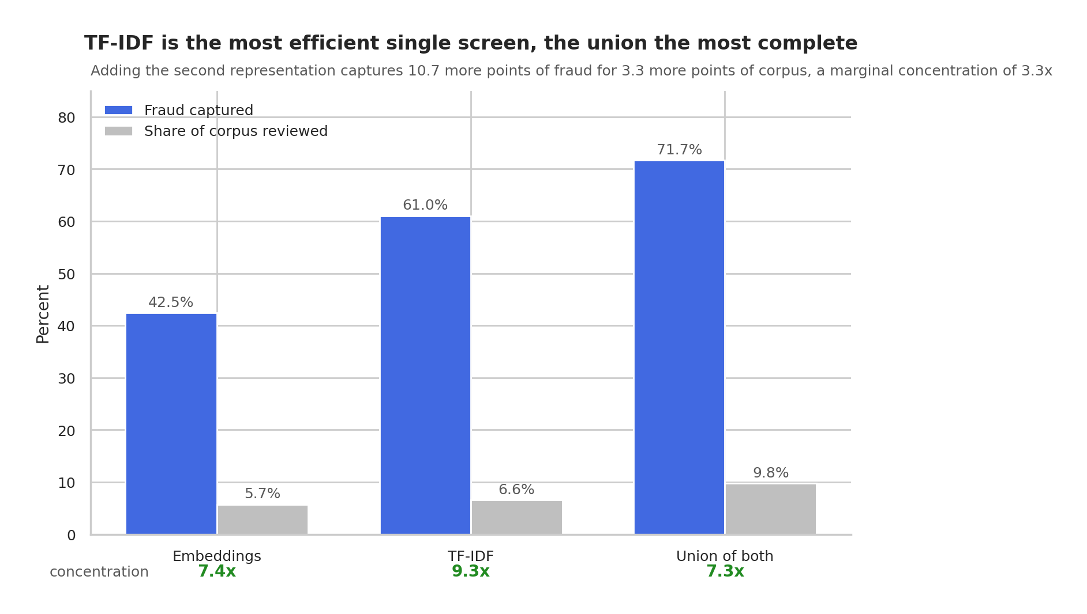
The simpler method won, and I did not expect that
Notes:
This is where the project proved me wrong. I assumed scammers reword the same pitch over and over, so I built the clever method first, the one that matches on meaning rather than exact wording. It lost. They don't reword anything. They copy and paste. The simpler method, the one that just compares the actual words used, found considerably more fraud for the same amount of reading. And the better discovery is that the two methods catch different scams. Run together, they surface about seven in every ten, while a person only has to read about one posting in ten.

Slide 8
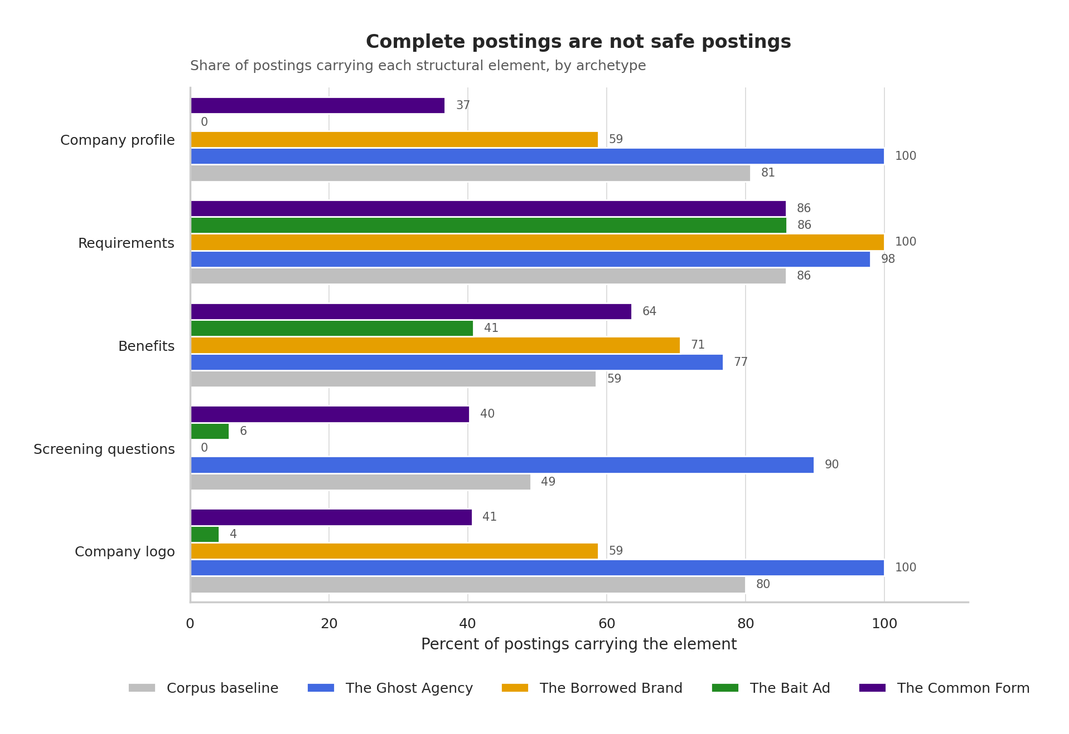
Four shapes, and completeness is not safety
Notes:
Reading those clumps gave me four recognizable types. You spot the Bait Ad by what's missing: no company description, almost no application questions, and around eighty words total, a fifth the length of a normal posting. The Borrowed Brand steals a real company's description word for word and bolts it onto a job that doesn't exist. The Common Form is generic template text that both scammers and real employers use, which is why I won't treat it as proof. And the Ghost Agency, in blue, is the most dangerous. It looks more professional than the average real employer.

Slide 9
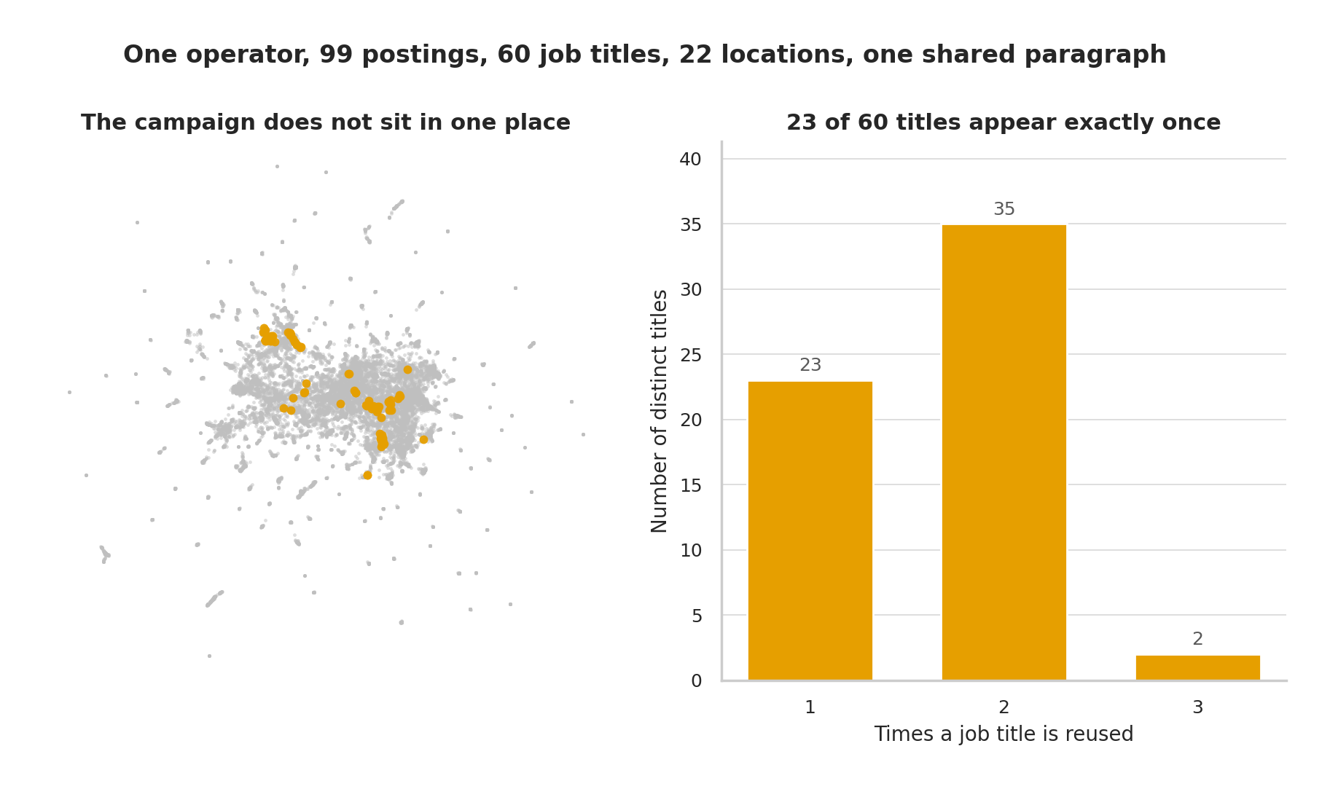
One operator, 99 postings, one reused paragraph
Notes:
This is the most striking thing I found. One scammer posted ninety nine fake jobs, sixty different job titles across twenty two cities, under two company names. That single person accounts for about one in seven of all the fraud in the data. No two postings are identical, because they varied the job description just enough to slip past duplicate detection. But the opening paragraph is the same every time, right down to the same spelling mistakes. Four phrases from that paragraph caught all ninety nine with no false alarms. Finding the pattern is expensive. Catching it afterward is nearly free.

Slide 10
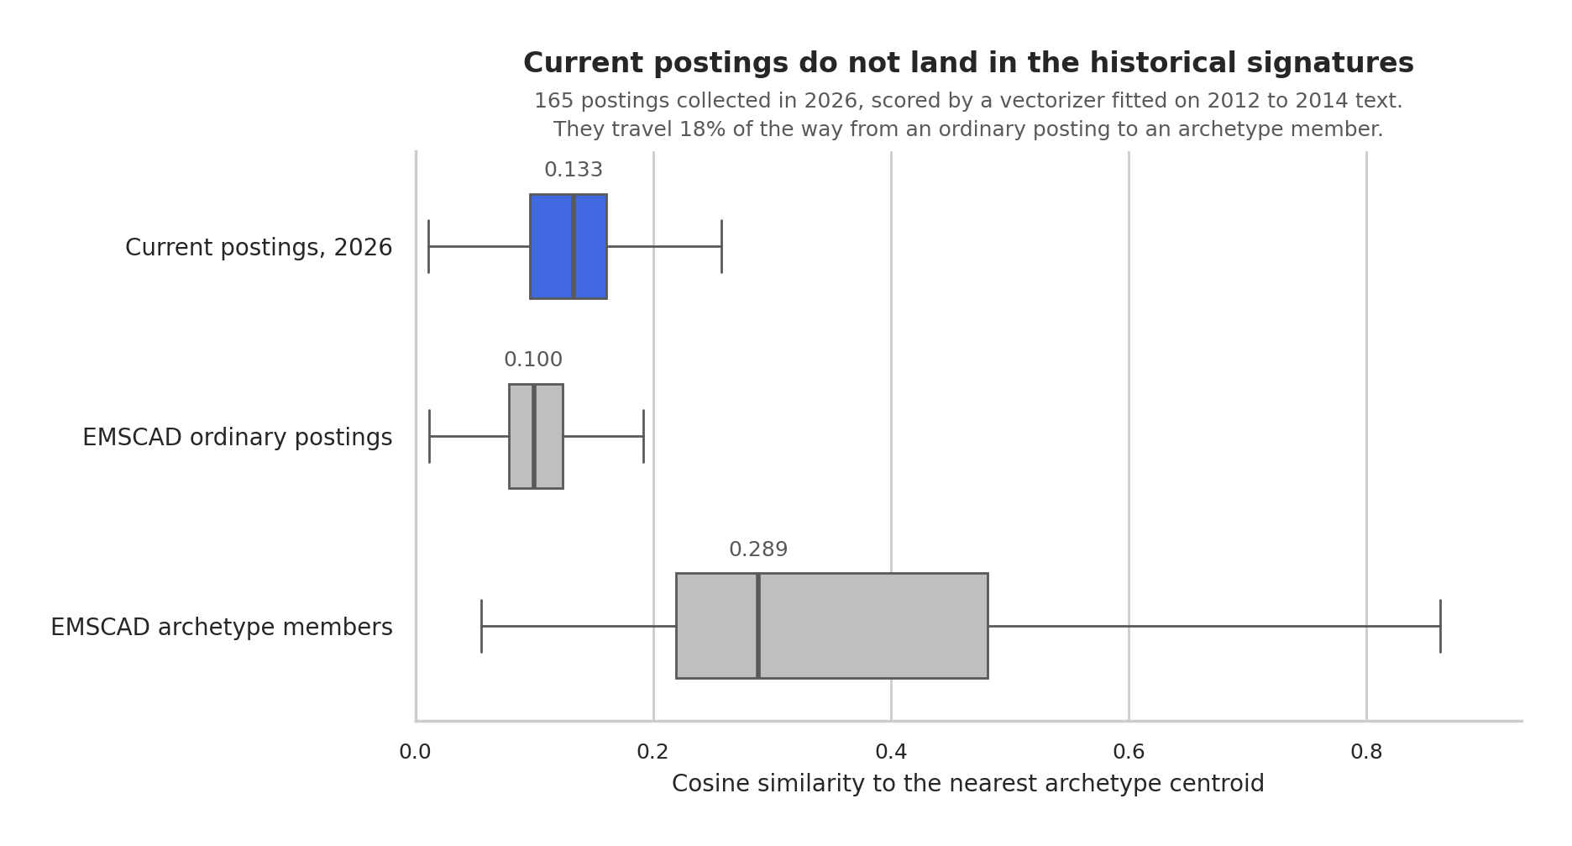
The signatures do not survive to today
Notes:
Last question. Do these four types still describe what's out there now? I collected a hundred and sixty five real job postings this year and checked them against the patterns. They barely resemble them. On a scale where an ordinary old posting sits at the bottom and a known scam type sits at the top, today's postings moved less than a fifth of the way up. And only about half the words in a current posting are words my model had ever seen. Job posting language has moved on.

Slide 11
What a trust and safety team should take from this
Run both representations
Discover, then match
They find different fraud. The union reaches 71.7% of scams within 9.8% of the corpus, which neither achieves alone.
Use clustering to find campaigns, then extract their phrases as exact rules. Four phrases caught 99 postings at 100% precision.
Treat archetype as scrutiny
Refit before deploying
Never as a verdict. One cluster running at 90% fraud has two real gas station job ads as its most representative members.
The 2014 centroids do not transfer to current postings. Verify employer identity rather than trusting posting quality.
Notes:
So what would I tell someone running a job board. Use both matching methods rather than picking one, because together they catch seven scams in ten while a reviewer reads only one posting in ten. Use the pattern-finding to discover a campaign, then turn it into a keyword rule. Treat these four types as a reason to look closer, never as proof. In the group that runs ninety percent fraudulent, the two most typical postings are real gas station job ads, so automating action there punishes a real business for writing a short plain ad.

Slide 12
What shipped, and what I refused to ship
Shipped: campaign phrases
Shipped: the Bait Ad shape
The four Ghost Agency phrases run as literal string matches. In the study they caught 99 postings with no false positives.
Brief, no employer described, no requirements stated. The shape raises a caution and never more, because short honest ads exist.
Refused: the centroids
Live in Verify This Job
The original plan. Research question three killed it: 96.4% of current postings land nearest the one archetype that is not evidence.
The module carries no model, so it answers before the classifier loads and survives a rebuild on any framework.
Notes:
One last thing. I put these findings into the job checking tool I built earlier this year, and what I left out matters more than what I put in. The plan was to ship all four types. But today's postings barely resemble them, so that would have handed people a confident answer that meant nothing. The tool only carries the two things that still hold up: the exact scam wording, and the shape of an ad that tells you nothing about the job. The piece I was originally most confident in is the one I left out, because the tool should answer to what I measured, not to what I assumed going in.

Slide 13
What I would want challenged
The labels have a ceiling. I found byte identical company text where one posting is labelled fraudulent and two are not, so the annotation encodes something outside the text that no text based method can recover.
One operator accounts for 13.9% of all fraud, so the concentration result partly measures a single prolific actor.
The modern sample is 165 postings from curated boards, so it is almost entirely legitimate. It tests whether the shapes persist, not whether they catch current fraud.
The crudest fraud is the easiest to catch. The most professional is the hardest.
Thank you. Questions welcome.
Notes:
I'd rather finish on what I don't trust. The labels have a limit. I found identical company text where one posting is marked fraudulent and two others aren't, which means the original reviewers knew something that isn't in the words at all. One scammer accounts for one in seven of all the fraud, so part of what looks like a pattern is really one busy person. And my present-day sample came from reputable job boards, so it tells me whether these shapes survived, not whether they'd catch today's scams. The clumsiest fraud is the easiest to catch, and the most professional is the hardest. Thank you.

